Slide 1













Contemporary Literary Theory
Prepared by:
Jannatul Tajri
Lecturer, UGV

Slide 2
Course Learning Outcomes: at the end of the course, the student will be able to-
CLO 1 | Explain the key principles and historical development of major contemporary literary theories such as structuralism, post-structuralism, Marxism, feminism, psychoanalysis, postcolonialism, and ecocriticism.
CLO 2 | Analyze literary texts using diverse theoretical frameworks to interpret meaning, ideology, and cultural context.
CLO 3 | Critically compare and contrast different schools of literary theory in terms of their assumptions, goals, and methods.
CLO 4 | Apply selected literary theories to produce scholarly critiques and academic writings
CLO 5 | Demonstrate awareness of how contemporary theories influence identity, representation, power dynamics, and reader-response in literature..

Slide 3
Mapping
Week | Topic | Teaching Learning policy | Assessments policy | CLO
1st | Structuralism: Definition History Type | Lecture with PPT presentation, Discussion | Class attendance Class performance Mid exam | 1
2nd | Cause and effect Literary features | Lecture with PPT presentation, Discussion | Class attendance Class performance, Mid | 1,3
3rd | Deconstruction Definition Derrida theory | Lecture with PPT presentation, Discussion | Class attendance Class performance, Mid Assignment | 4

Slide 4
Week | Topic | Teaching Learning policy | Assessments policy | CLO
4th | Colonialism Definition History Type | Lecture with PPT presentation, Discussion | Class attendance Class performance Mid exam | 1
5th | Cause and effect Literary features Decolonization Neocolonization Important work | Lecture with PPT presentation, Discussion | Class attendance Class performance, Mid | 1,3
6th | Post colonialism Definition Key concept Ambivalence Hybridity | Lecture with PPT presentation, Discussion | Class attendance Class performance, Mid Assignment | 4
Mapping

Slide 5
Week | Topic | Teaching Learning policy | Assessments policy | CLO
7th | Diaspora Hegemony Imperialism Definition Waves Liberal | Lecture with PPT presentation, Discussion | Class attendance Class performance Mid exam | 1
8th | Orientalism Definition Relevance Scope Key terms | Lecture with PPT presentation, Discussion | Class attendance Class performance, Mid | 1,3
9th | Eco criticism Definition Key points writers | Lecture with PPT presentation, Discussion | Class attendance Class performance, MidAssignment | 4
Mapping

Slide 6
Mapping
Week | Topic | Teaching Learning policy | Assessments policy | CLO
^{10th} | Marxism Definition Relevance Scope Key terms | Lecture with PPT presentation, Discussion | Class attendance Class performance Mid exam | 1
^{11th} | Feminism Definition Waves Liberal | Lecture with PPT presentation, Discussion | Class attendance Class performance, Mid | 1,3
^{12th} | Queer Theory | Lecture with PPT presentation, Discussion | Class attendance Class performance, Mid Assignment | 4

Slide 7
Mapping
Week | Topic | Teaching Learning policy | Assessments policy | CLO
^{13th} | Psychoanalytic Criticism Definition Key points writers | Lecture with PPT presentation, Discussion | Class attendance Class performance Mid exam | 1
^{14th} | Revision and Problem solving | Lecture with PPT presentation, Discussion | Class attendance Class performance, Mid | 1,3

Slide 8

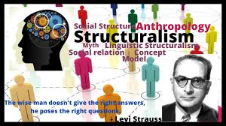
Structuralism
Week: 1st and 2nd

Slide 9


Ferdinand de Saussure
Linguistics
Semiotics
Charles Bally
Albert Sec
Roy Harries
[English Translator]
Roman Jakbson
Claude Levi-Straus
Jacques Lacan
R.Barthes
Mikhail Bakhtin

Slide 10
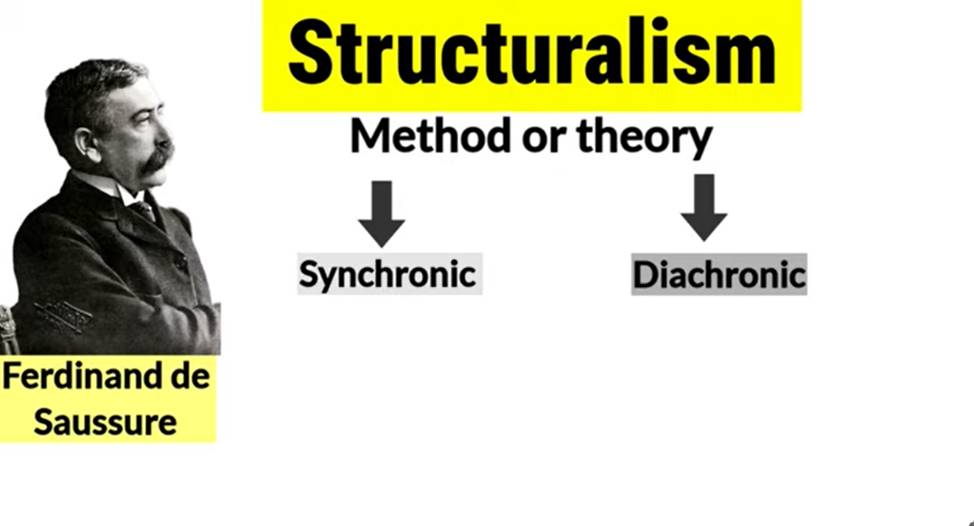

Slide 11
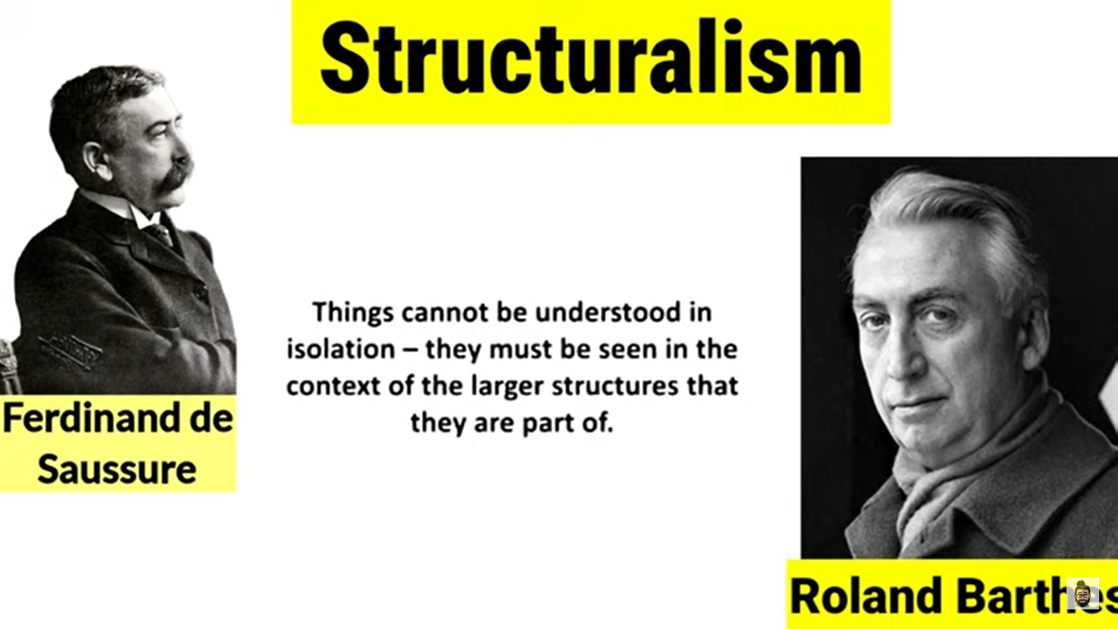

Slide 12
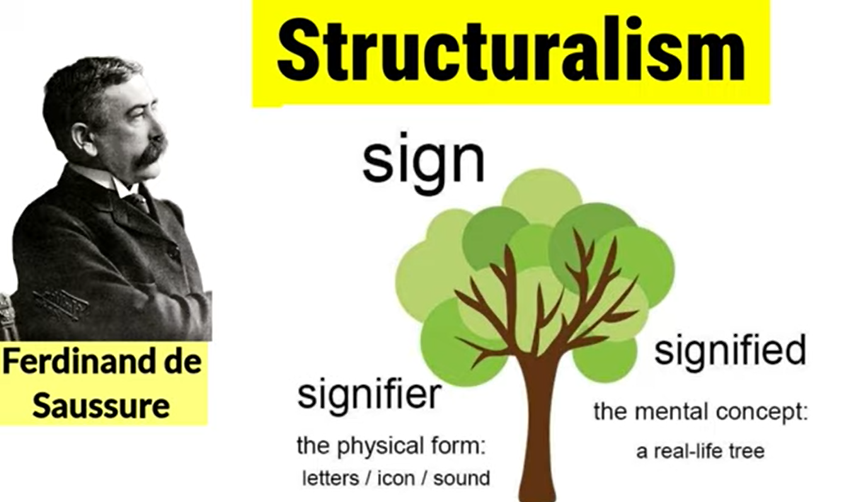

Slide 13
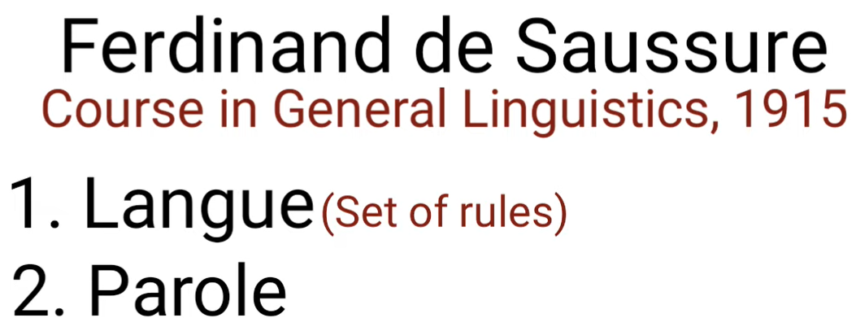
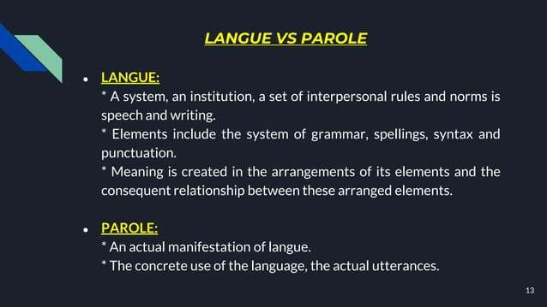

Slide 14

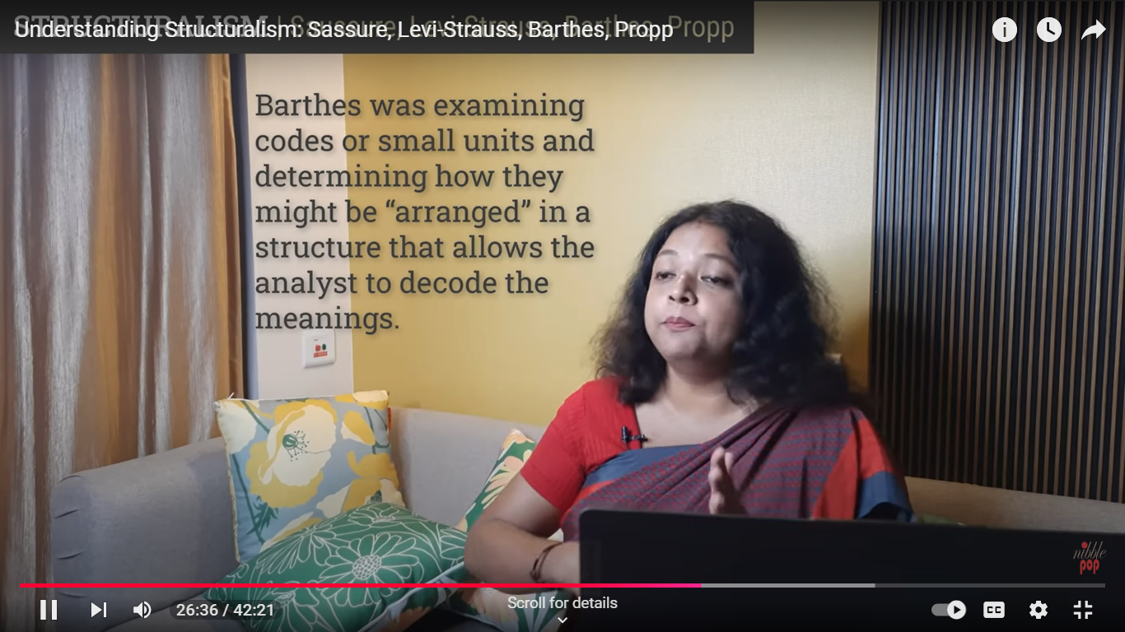



Slide 15
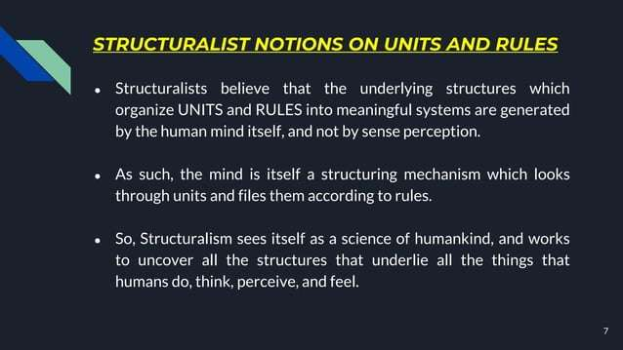

Slide 16
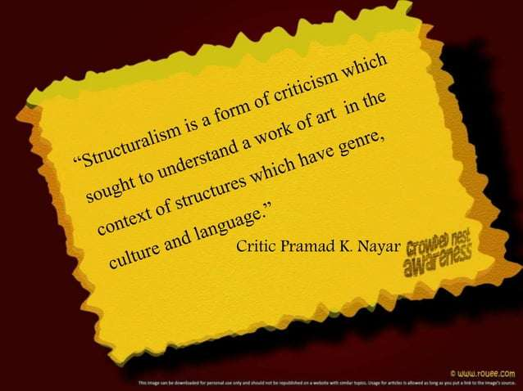
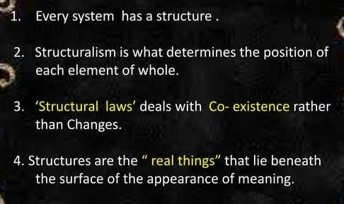

Slide 17
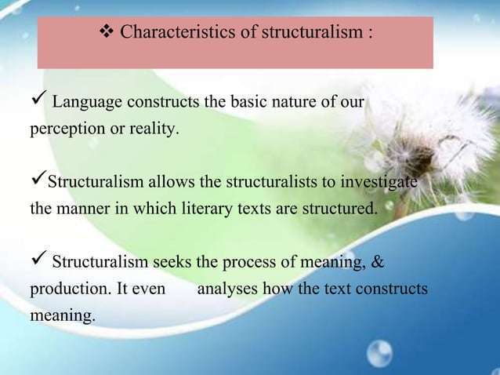

Slide 18
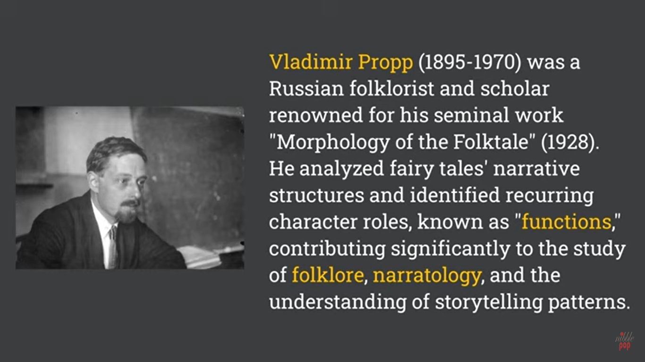

Slide 19


Slide 21
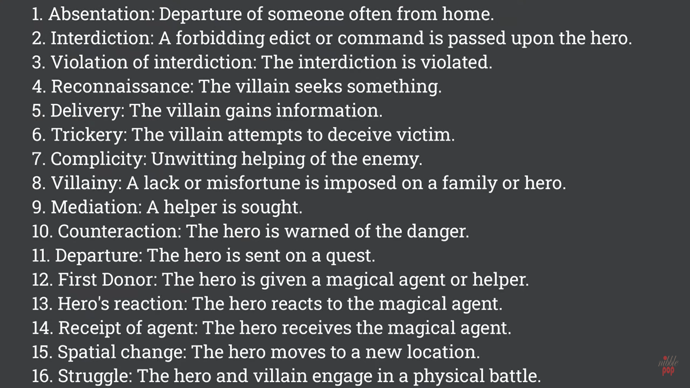

Slide 22
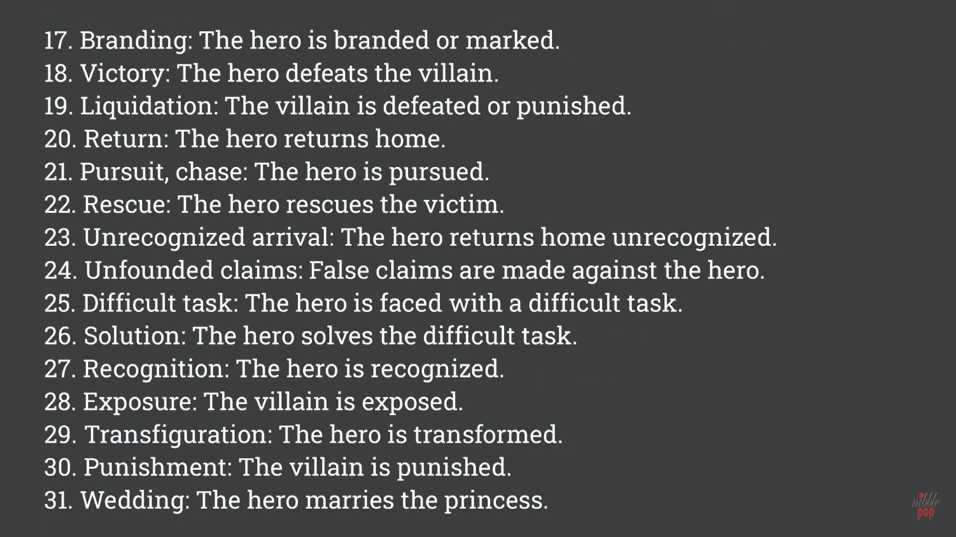

Slide 23

Deconstruction
Week: 3rd

Slide 24
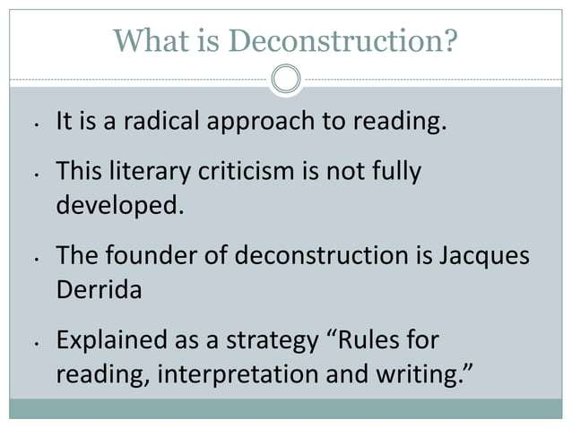
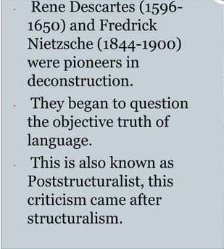

Slide 25
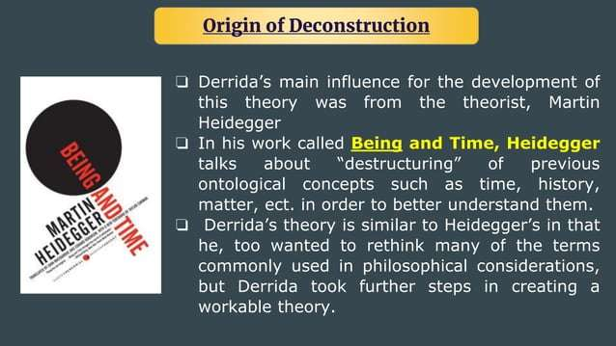

Slide 26


Slide 27
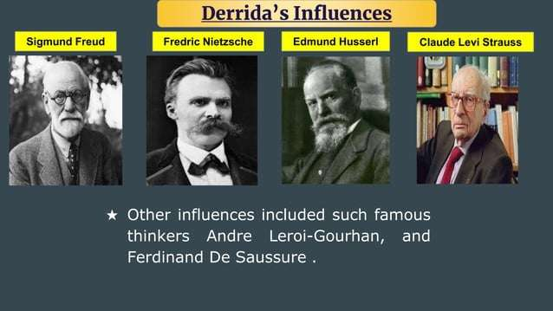

Slide 28
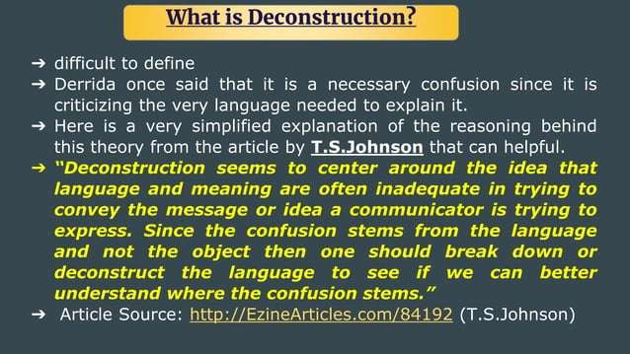

Slide 29
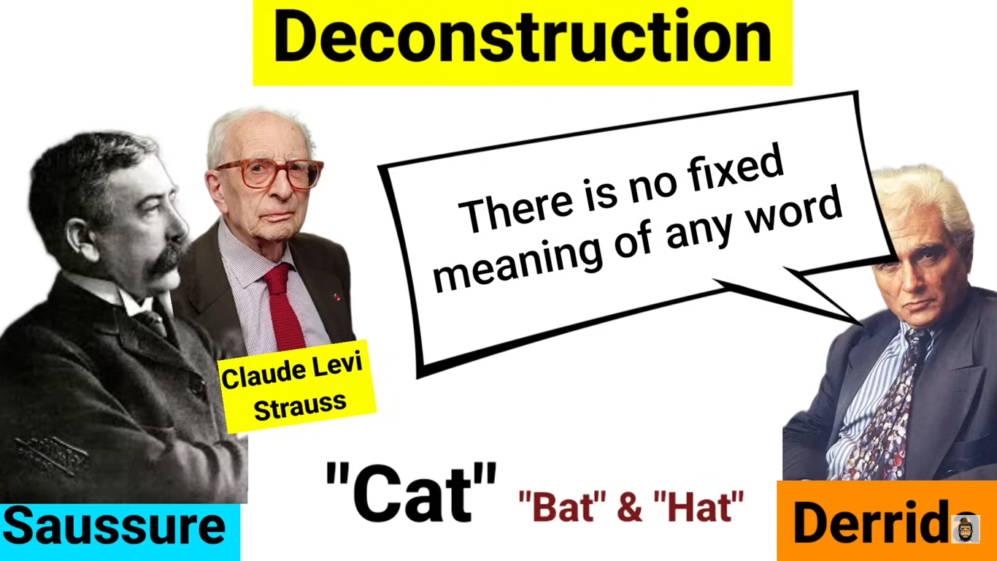
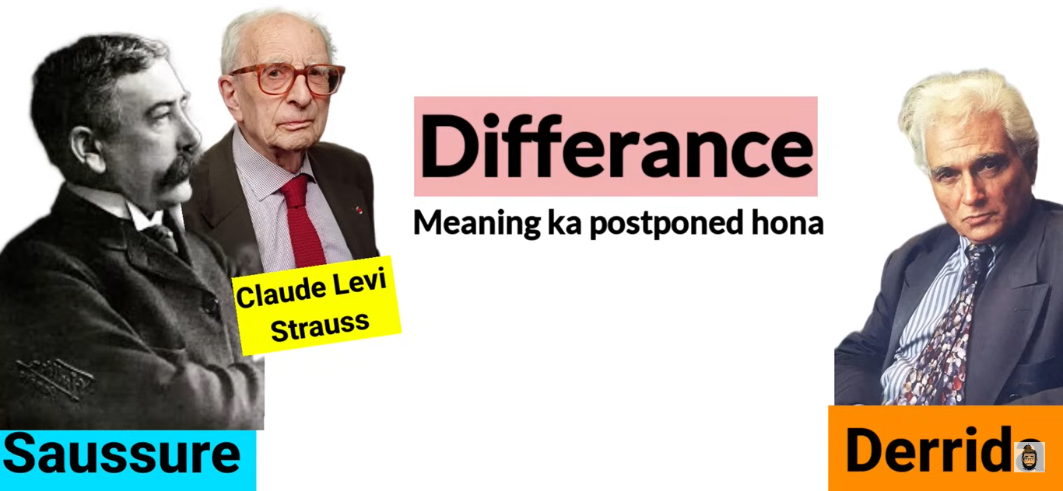
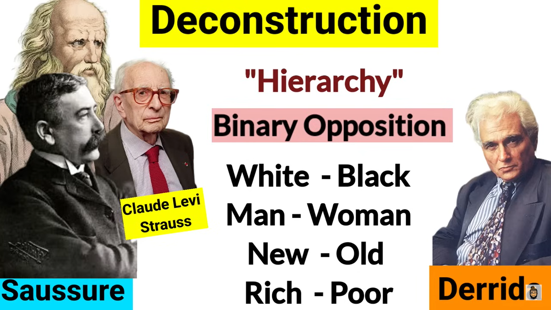

Slide 30
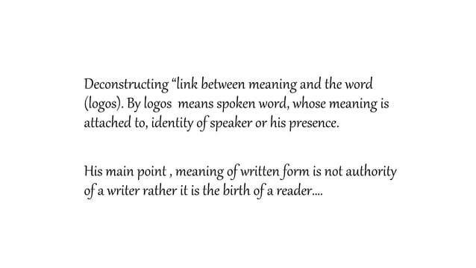




Slide 31
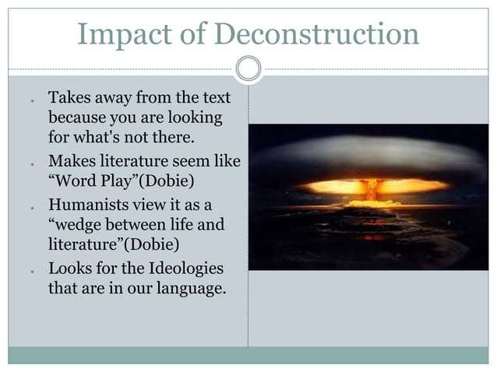
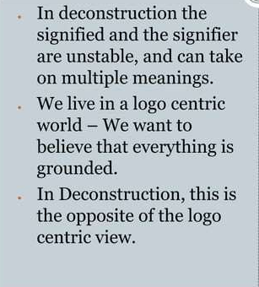
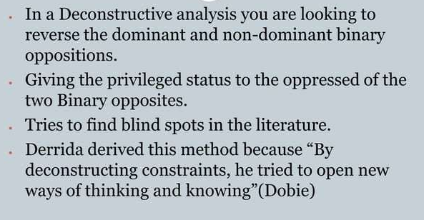

Slide 32
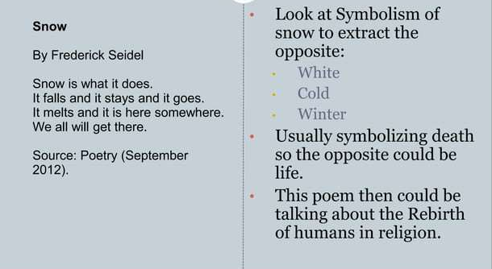

Slide 33


Slide 34


Difference

Slide 35




Slide 36


Slide 37

Colonialism
Week: 4th -6th
By: Jannatul Tajri
Lecturer, University of Global Village

Slide 38

Definition:
Colonialism is the practice by which a powerful country directly controls less powerful countries and uses their resources to increase its own power and wealth.
-Collins Dictionary
Etymologically the word “colony” comes from the Latin word ‘cotonia’ a place for agriculture or cultivator.
Colonialism is the domination or conquering a territory and involving the subjugation of one people to another
So
colonialism refers to the subjugation and control of one country by another

Slide 39
In literature :
Colonialism denotes a literary movement present in the literature of colonized nations, including India, Africa, and America. This body of literature conveys the voices of the colonized in opposition to their colonizers, chiefly addressing the conflicts between them. Emerging in the 20th century, colonial literature served as a powerful instrument of resistance against colonial powers.
Writers: R.K. Narayan, Salman Rushdie, Chinua Achebe, Raja Raw etc.
In other words ,these are writing set in the distant colonized lands and explore the exotic strangeness of these colonized land. Most of the portrayed the colonizer as superior and the colonized as inferior.
Writers: Rudyard Kipling.

Slide 40
History:
First wave
Second wave
16th -18th century
Third wave
19th century
15th century

Slide 41

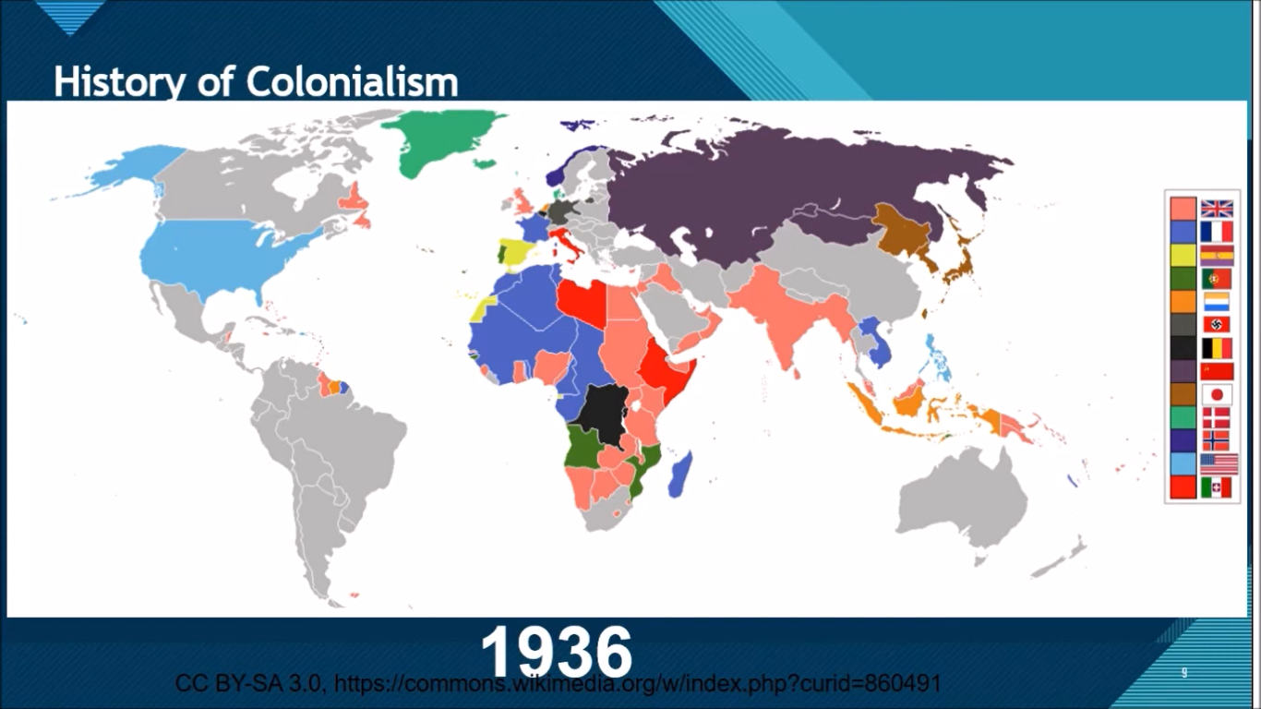
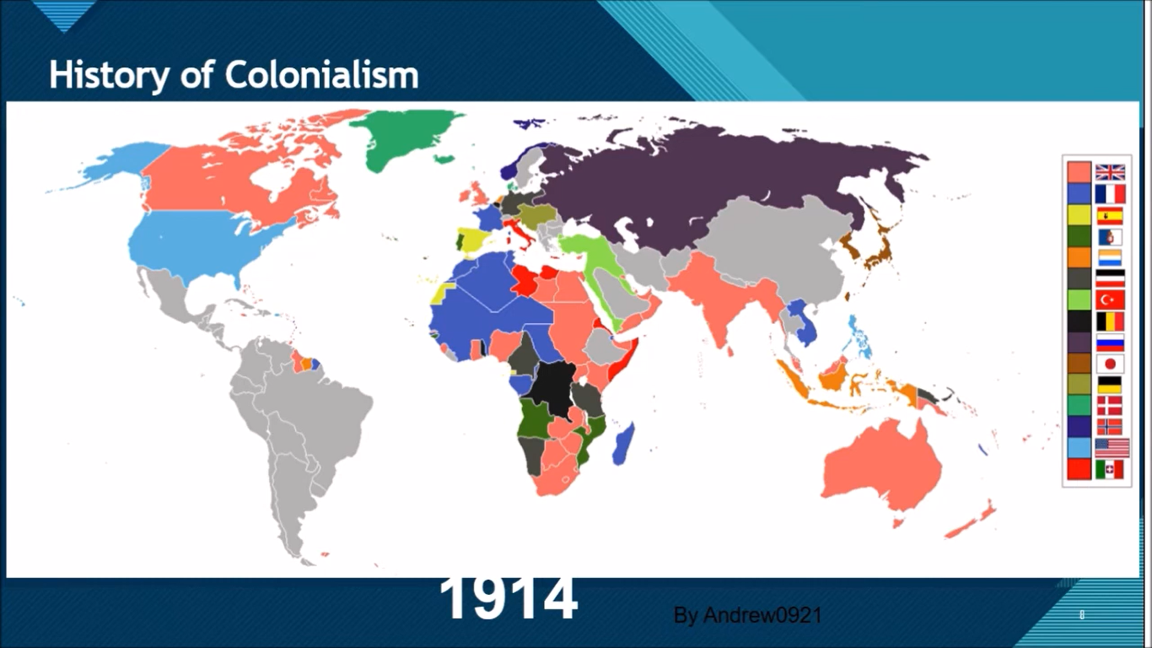
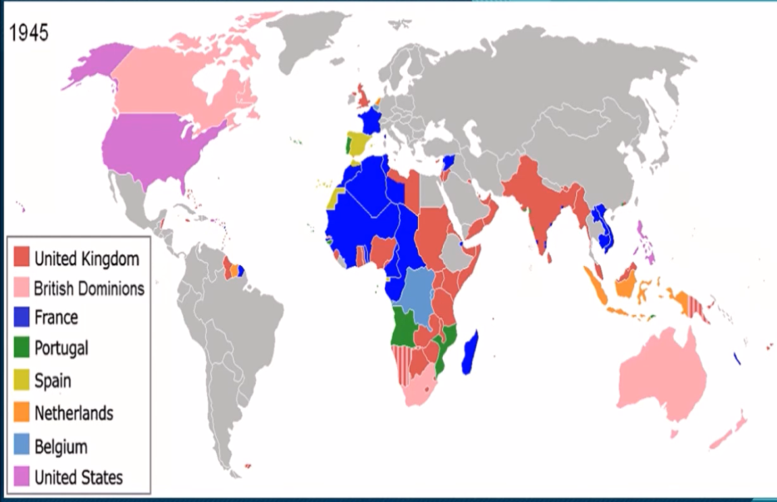

Slide 42
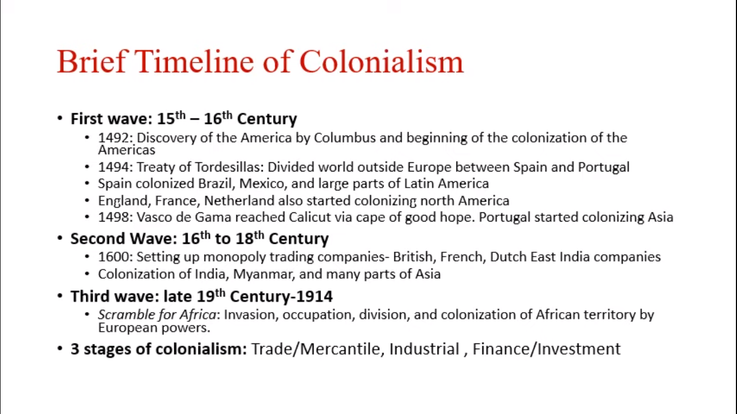

Slide 43

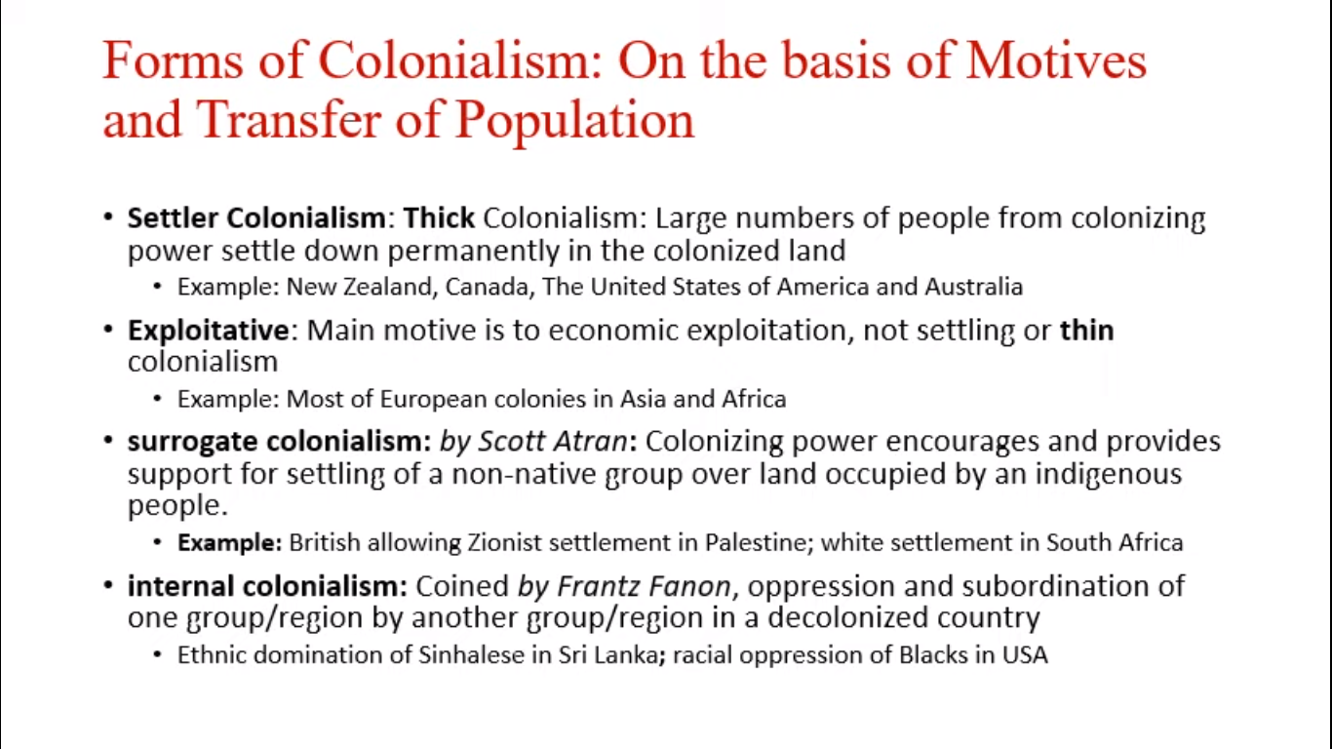

Slide 44

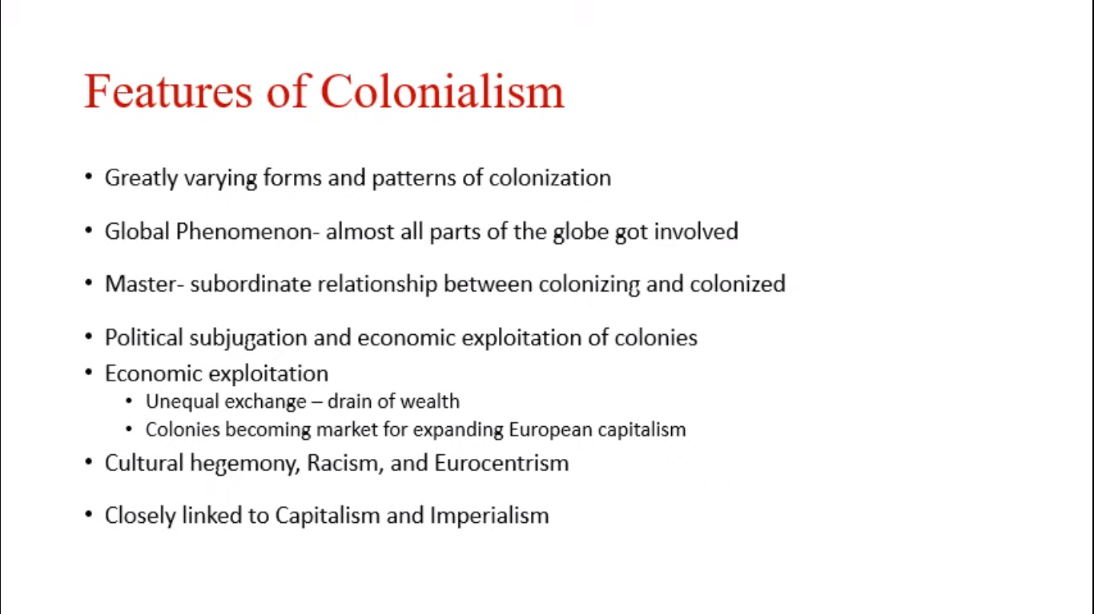

Causes:
GOD
GOLD
GLORY

Slide 45
Effects:
Negative:
Slave trade
Boost to Mercantilism
Ethnic Rivalry
Violation of Human Right
Boundary Disputes
Spread Foreign Diseases
Create Heavy Instability
Treatment of the local environment
Positive:
1. Invest
[Infrastructure or trade]
2. Medical practices
3. Technology
[such as guns, agricultural]
4. Governmental institution

Slide 46
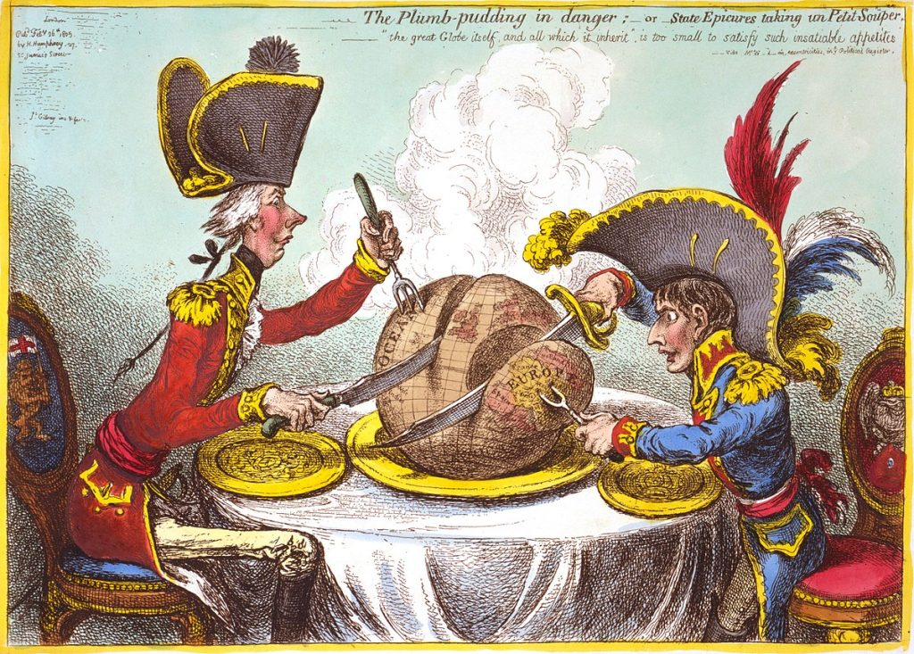
Post-colonialism
Jannatul Tajri
Lecturer
Department of English
University of Global Village

Slide 47
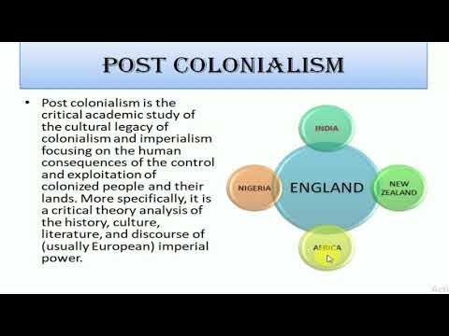

Slide 48



Slide 49
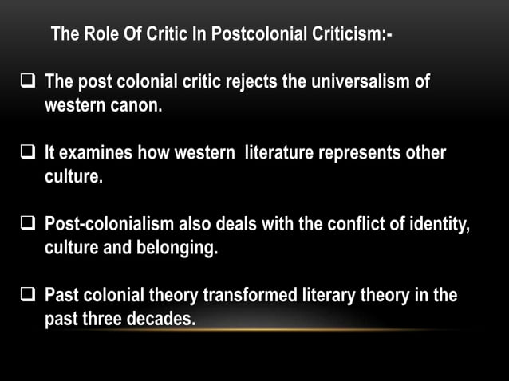
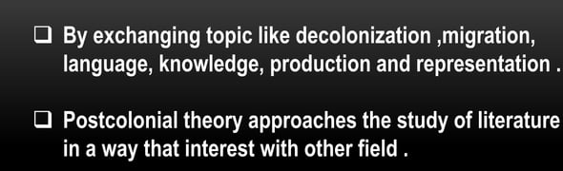

Slide 50
Theories of post colonialism
Hegemony
Ambivalence
Diaspora
Hybridity/Mullato
Cartography
Mimicry
Binarism
Orientalism
1. Mimicry
2. Binarism
3.Ambivalence
4. Hybridity
Orientalism
.....

Slide 51
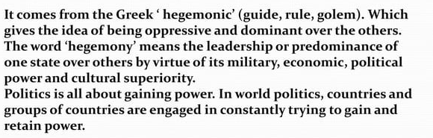
1. Hegemony:
The concept often regarded as the locus of innovation in the Notebooks—and hence their philosophical linchpin—is “hegemony” (egemonia), signifying both leadership and domination.

Slide 52
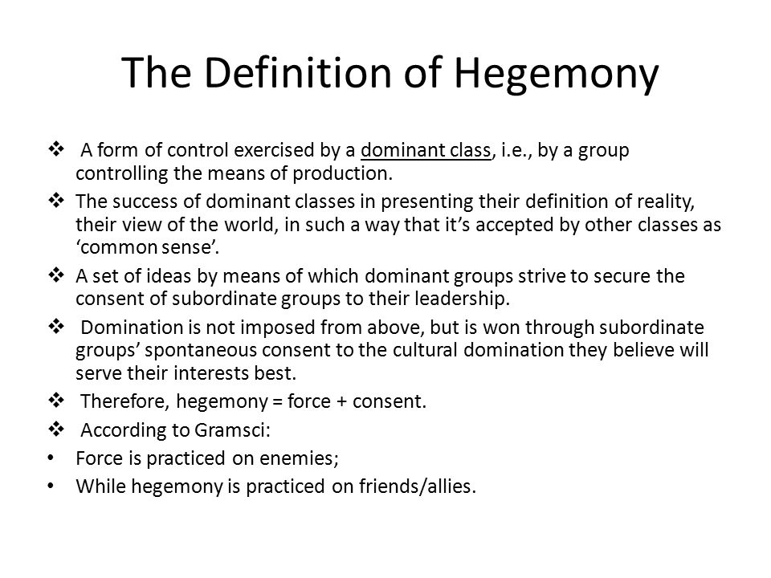
The major themes of Gramsci’s ideas concerning hegemony are explored below, starting with his “sociological” observations on the state, intellectuals, and ideology and then looking at his theoretical reconstruction of Marxist philosophy and his observations concerning the revolutionary party

Slide 53
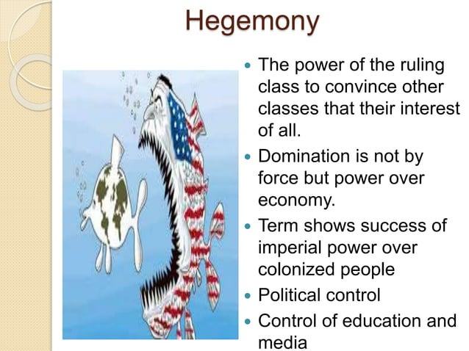

Slide 54
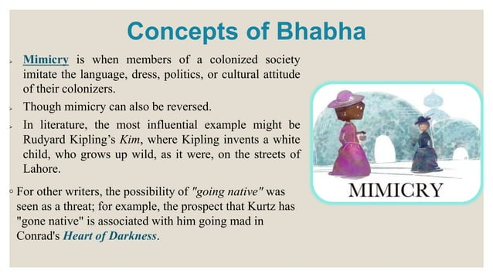
2. Mimicry

Slide 55
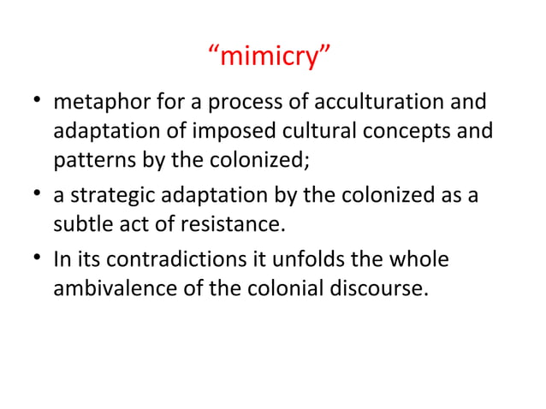
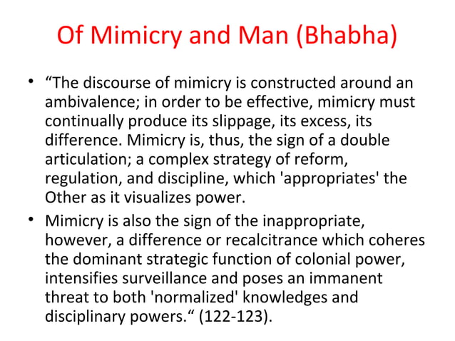

Slide 56
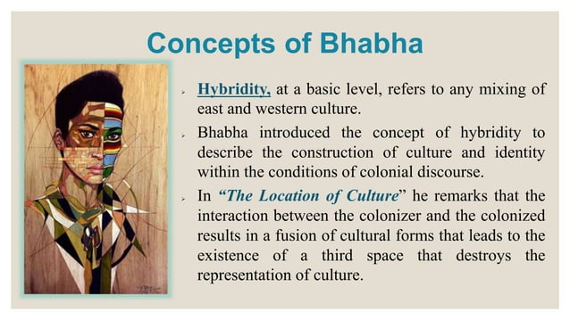
3.Hybridity :

Slide 57
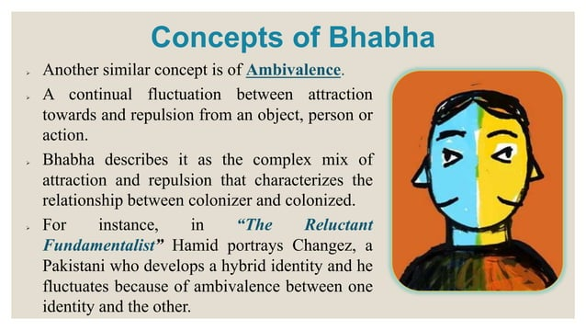
4. Ambivalence:

Slide 58

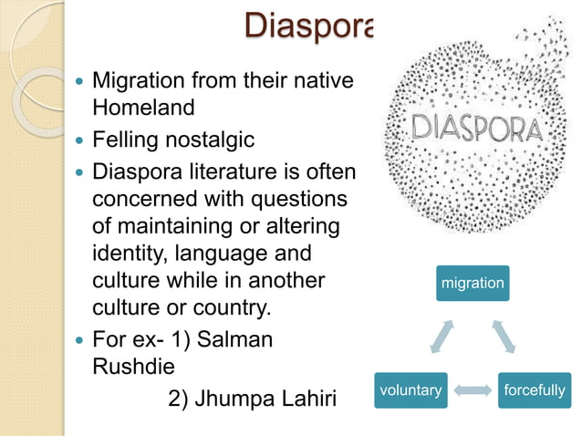
5. Diaspora :

Slide 59
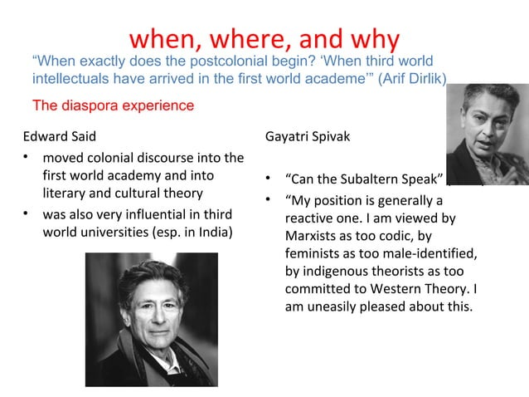

Slide 60
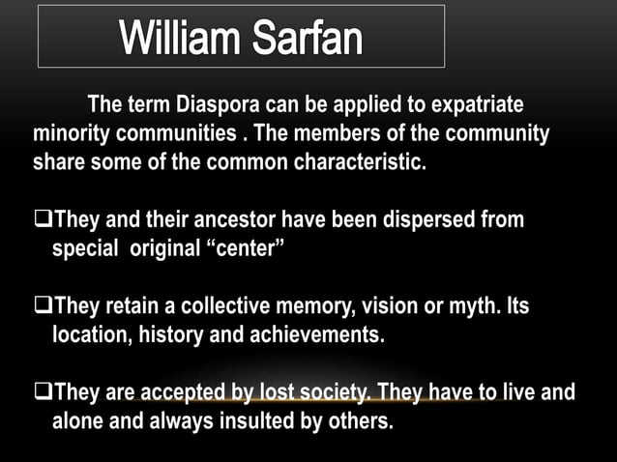

Slide 61


Slide 62
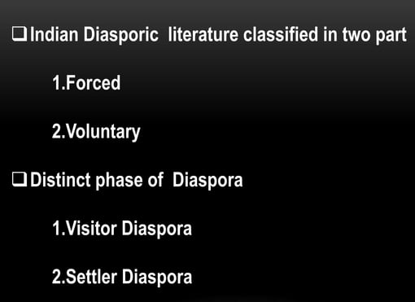

Slide 63
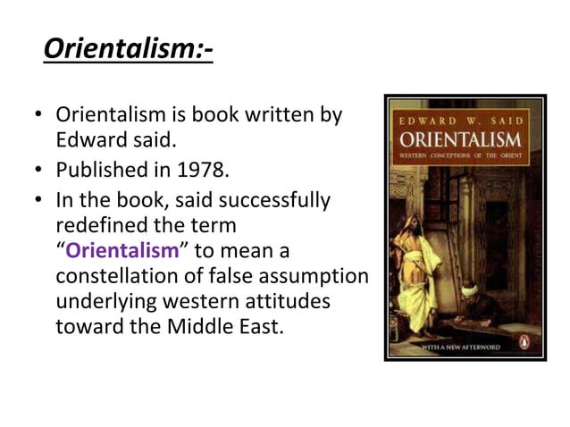
6. Orientalism:

Slide 64


Slide 65


Slide 66
Orientalism
Jannatul Tajri
Lecturer
University of Global Village

Slide 67



Slide 68


Slide 69



Slide 70


Slide 72


Slide 73



Slide 74


Slide 76


Slide 77


Slide 78


Slide 79



Slide 80


Slide 81
ECO-CRITICISM
Jannatul Tajri
Lecturer
Department of English ,UGV

Slide 82


Slide 83


Slide 84


Slide 85



Slide 86


Slide 87


Slide 88


Slide 89


Slide 90


Slide 91


Slide 92


Slide 93


Slide 94


Slide 95


Slide 96


Slide 97


Slide 98


Slide 99


Slide 100


Slide 101


Slide 102


Slide 103


Slide 104


Slide 105


Slide 106


Slide 107


Slide 108


Slide 109


Slide 110


Slide 111


Slide 112


Slide 113


Slide 114


Slide 116

Marxism

Slide 131


Slide 136
Feminism
Jannatul Tajri
Lecturer
University of Global Village

Slide 137



Slide 138



Slide 139


1. First Wave: ( 1792-1949)

Slide 140


Slide 141

Historical Development of Feminist Literary Criticism
First Wave Feminism (Late 19th - Early 20th Century)
Focused on women's suffrage, legal rights, and access to education.
2. Key figures: Mary Wollstonecraft (A Vindication of the Rights of Woman), Virginia Woolf (A Room of One’s Own).
3. Emphasis on women’s presence in literature and the necessity of female authorship.

Slide 142


2. Second Wave: 1949-1980

Slide 143

Liberation [ Gynocriticism]
i. Right to give birth
ii. Household Chores distribution
iii. Equal Workplace Ambience
iv. Marital Rape

Slide 144


Slide 145


Slide 146
Second Wave Feminism (1960s - 1980s)
Addressed workplace discrimination, reproductive rights, and systemic patriarchy.
Key figures: Simone de Beauvoir (The Second Sex), Kate Millett (Sexual Politics), Elaine Showalter (A Literature of Their Own).
Introduced: gynocriticism (study of women’s literature) and gender-based literary analysis.

Slide 147
3. Third wave: 1980-2008
i. Individualism
(Post-Stucturalist)
Expanded discussions to include race, class, sexuality, and intersectionality.
Influenced by postmodernism and deconstruction.
Notable figures: Judith Butler (Gender Trouble), bell hooks (Feminist
Theory: From Margin to Center).

Slide 148
1. Fourth wave:(2008------)
Psychology
Liberal
Radical(sisterhood power)
Marxist

Slide 149






1792
1869
1884
1911
1929
1949

Slide 150





Slide 151


Slide 152

Queer Theory: A Journey Beyond the Binary

Slide 153
Defining Queer Theory: Disrupting Binary Thinking
Deconstructing Norms
Embracing Diversity
Queer theory challenges binary thinking by questioning established categories like "male/female" and "straight/gay".
It celebrates the fluidity and multiplicity of identities, recognizing that lived experiences often defy neat classifications.

Slide 154

Historicizing Queer Theory: From Stonewall to Today
1
Stonewall Uprising
The 1969 Stonewall riots, a pivotal moment in LGBTQ+ history, sparked the modern gay rights movement.
2
Academic Emergence
Queer theory emerged in the 1990s as an academic field, drawing on feminist, post-structuralist, and post-colonial theories.
3
Contemporary Relevance
Queer theory remains a powerful tool for understanding and addressing the ongoing struggles for LGBTQ+ equality.

Slide 155




Queer Intersectionality: Race, Class, and Sexuality
1
Intersectionality
2
Race
Experiences of racism can intersect with and shape LGBTQ+ identities.
3
Class
Economic disparities can create unique challenges for LGBTQ+ individuals.
Sexuality
4
Queer theory acknowledges that sexuality is not a monolithic category, and individuals may experience different forms of oppression based on their sexual identities and practices.

Slide 156

Performativity and the Deconstruction of Gender
Gender as Performance
Deconstructing Norms
Queer theory emphasizes the performative nature of gender, arguing that gender is not a fixed biological category but rather a set of behaviors and actions.
By challenging traditional notions of gender, queer theory opens up possibilities for exploring alternative ways of being in the world.

Slide 157
Queer Temporality: Challenging Linear Narratives
Non-Linear Time
1
Queer theory challenges the traditional concept of linear time by recognizing the cyclical and interconnected nature of history and experience.
Breaking with Tradition
2
It emphasizes the importance of understanding the past in a way that acknowledges the complexities and nuances of LGBTQ+ history.

Slide 158



Queer Futurity: Imagining New Possibilities
Utopian Visions
Social Justice
Queer futurism envisions a future where queerness is not marginalized but celebrated and integrated into all aspects of society.
Queer theory strives for a future where all individuals are treated with respect and dignity, regardless of their gender identity or sexual orientation.

Slide 159

Conclusion: The Transformative Power of Queer Theory
Queer theory has had a profound impact on our understanding of identity, gender, and sexuality. It continues to challenge traditional norms and inspire new ways of thinking about the world.

