Slide 1
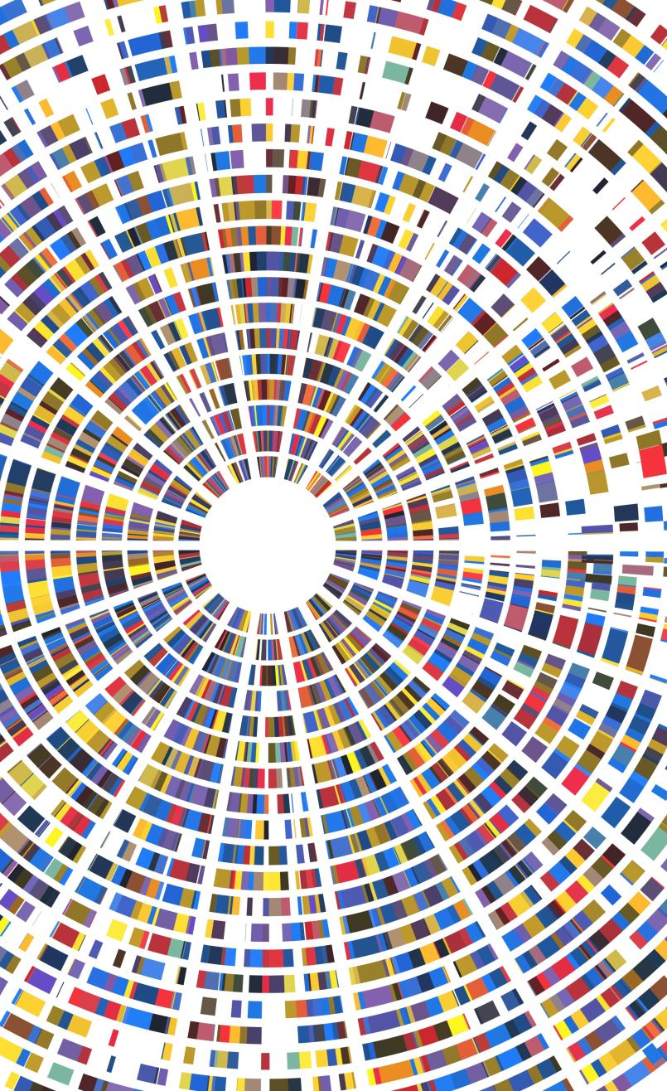


Pattern Recognition CSE 0613-4101
Md. Masudur Rahman Lecturer Dept. of CSE, University of Global Village, Barishal.

Slide 2
Pattern Recognition
Course Code: | CSE 0613-4101 | Credits: | 03
 |  | CIE Marks: | 90
Exam Hours: | 03 | SEE Marks: | 60
Course Learning Outcome (CLOs): After Completing this course successfully, the student will be able to…
CLO | Course Learning Outcome
CLO1 | Define and explain the fundamental concepts of pattern recognition, including patterns, features, and classification principles.
CLO2 | Apply statistical methods such as Bayes' theorem, nearest neighbor techniques, and decision boundaries to classify patterns.
CLO3 | Analyze the effectiveness of different feature selection and extraction techniques for dimensionality reduction in real-world datasets.
CLO4 | Evaluate and compare various clustering methods including hierarchical (single-linkage, complete-linkage, average-linkage, Ward's) and partitional (k-means, ISODATA) algorithms.
CLO5 | Design and implement machine learning-based pattern recognition systems using both supervised and unsupervised learning techniques.

Slide 3
Summary of course content
Sl | Course Content | HRs | Mapped CLO
1 | Introduction to Pattern Recognition: Definitions, examples, and applications | 2 | CLO1
2 | Statistical Decision Theory: Bayes decision rule, error rates, Bayesian risk | 4 | CLO2
3 | Feature Extraction and Selection: Importance, challenges, and methods | 4 | CLO3
4 | Dimensionality Reduction: PCA, LDA, feature selection and transformation | 4 | CLO3
5 | Classifiers: Parametric, non-parametric, nearest neighbor, decision boundaries | 4 | CLO2
6 | Clustering Methods: Hierarchical (single, complete, average linkage, Ward’s) | 4 | CLO4
7 | Partitional Clustering: Forgy’s, k-means, ISODATA algorithms | 4 | CLO4
8 | Modern vs. Traditional Pattern Recognition: ANN, ML, overfitting/underfitting | 3 | CLO5
9 | Applications of Pattern Recognition: Face recognition, OCR, defect detection, etc. | 3 | CLO5
10 | Evaluation Metrics: Precision, recall, ROC, error analysis | 2 | CLO2

Slide 4
Recommended Books
"Pattern Classification" by Richard O. Duda, Peter E. Hart, and David G. Stork
One of the most authoritative texts on statistical pattern recognition.
Covers Bayesian decision theory, neural networks, clustering, and feature selection.
Edition: 2nd Edition
Publisher: Wiley
"Pattern Recognition and Machine Learning" by Christopher M. Bishop
Focuses on probabilistic models, Bayesian networks, and kernel methods.
Great for students with a solid mathematical background.
Publisher: Springer
"Introduction to Statistical Pattern Recognition" by Keinosuke Fukunaga
More theoretical, ideal for understanding statistical methods in depth.
Publisher: Academic Press
"The Elements of Statistical Learning" by Trevor Hastie, Robert Tibshirani, Jerome Friedman
Advanced but widely used in machine learning and pattern recognition.
Available for free from the authors' website.
https://hastie.su.domains/ElemStatLearn/

Slide 5
Recommended Web Resources
MIT OpenCourseWare – Pattern Recognition & Machine Learning
Free course materials, slides, and assignments.
https://ocw.mit.edu
Coursera – Pattern Recognition Courses
Look for courses by institutions like Stanford, University of Washington.
https://www.coursera.org
Scikit-learn Documentation (for practical implementation)
Python library for machine learning and pattern recognition.
https://scikit-learn.org
Google Scholar
For recent research articles, survey papers, and case studies.
https://scholar.google.com
UCI Machine Learning Repository
Source of real-world datasets for pattern recognition practice.
https://archive.ics.uci.edu/ml/index.php

Slide 6
Assessment Pattern
CIE- Continuous Internal Evaluation (90 Marks)
Bloom's Category Marks (out of 60) | Tests (45) | Assignments (15) | Quizzes (15) | Attendance (15)
Remember | 5 |  | 5
Understand | 5 | 5 | 5
Apply | 10 | 5 | 5
Analyze | 10
Evaluate | 5
Create | 10 | 5
SEE- Semester End Examination (60 Marks)
Bloom's Category | Test
Remember | 5
Understand | 10
Apply | 15
Analyze | 10
Evaluate | 10
Create | 10

Slide 7
Course Plan
Week No. | Topic | Teaching-Learning Strategy(s) | Assessment Strategy(s) | Alignment to CLO
1 | Introduction to Pattern Recognition, Pattern Types & Applications | Lecture, Discussion, Visual Examples | Class Participation, Short Quiz | CLO1
2 | What is a Pattern? Deterministic vs Stochastic Processes | Problem Solving, Real-World Examples | Group Discussion, In-class Quiz | CLO1
3 | Bayesian Decision Theory, Prior & Posterior Probabilities | Lecture, Mathematical Derivation, Concept Mapping | Assignment, Problem Set | CLO2
4 | Bayesian Risk, Conditional Risk, Decision Boundaries | Whiteboard Derivation, Analytical Tasks | Short Test, Class Exercise | CLO2
5 | Features: Definition, Extraction, Relevance | Lecture, Case-Based Examples (e.g., Face Recognition) | Worksheet, Class Discussion | CLO3
6 | Feature Selection Methods: Filters, Wrappers, Embedded Methods | Comparison Tables, Tool Demo (e.g., WEKA/sklearn) | Practical Report, Quiz | CLO3
7 | Dimensionality Reduction: PCA, LDA, Kernel PCA | Hands-on Coding Session, Lab Examples | Lab Report, Coding Task | CLO3
8 | Parametric Classification: Gaussian Assumptions, ML Estimation | Lecture with Visual Plots, Conceptual Questions | Short Written Test | CLO2
9 | Non-parametric Classification: Nearest Neighbor, Decision Trees | Python Demo, Hands-on Dataset Work | Coding Assignment, Quiz | CLO2
10 | Clustering Basics: Concept, Similarity Measures | Lecture, Group Activity with Data | Group Task, Presentation | CLO4
11 | Hierarchical Clustering: Single, Complete, Average Linkage | Tree Drawing, Use of Dendrograms | Group Report, Concept Check | CLO4
12 | Ward’s Method and Cluster Evaluation | Case Study, Distance Metric Analysis | Assignment, Class Debate | CLO4
13 | Partitional Clustering: Forgy’s Algorithm, K-means | Interactive Demo, Python Code Practice | Lab Exercise, Short Quiz | CLO4
14 | ISODATA Algorithm, Comparison of Clustering Methods | Comparison Chart, Real Dataset Analysis | Mini Project Assignment | CLO4
15 | Pattern Recognition Applications: OCR, Bioinformatics, Face Recognition | Application Videos, Use-case Discussion | Poster Presentation, Use-case Analysis | CLO5
16 | Overfitting, Underfitting, Generalization in Pattern Recognition | Graphical Explanation, Error Curves Analysis | Coding Exercise, Group Discussion | CLO5
17 | Review of Course Topics & Final Project Presentations | Oral Presentation, Peer Review, Final Review Lecture | Final Project Demo, Viva | CLO1–CLO5

Slide 8
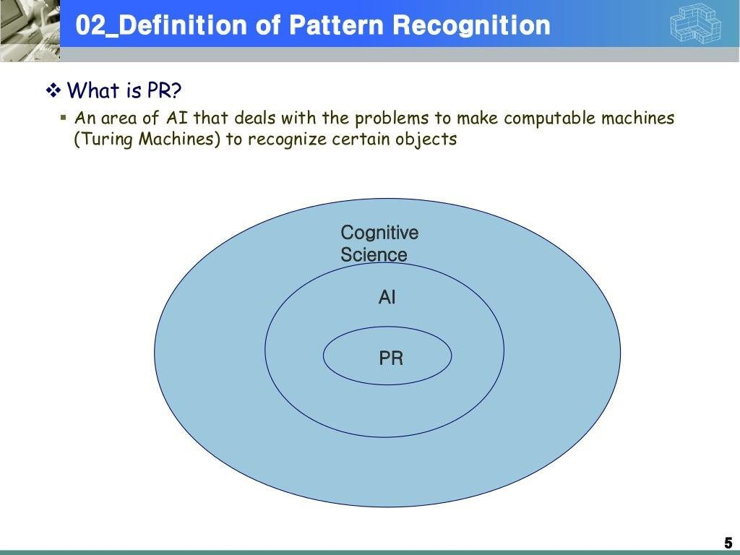

Slide 9
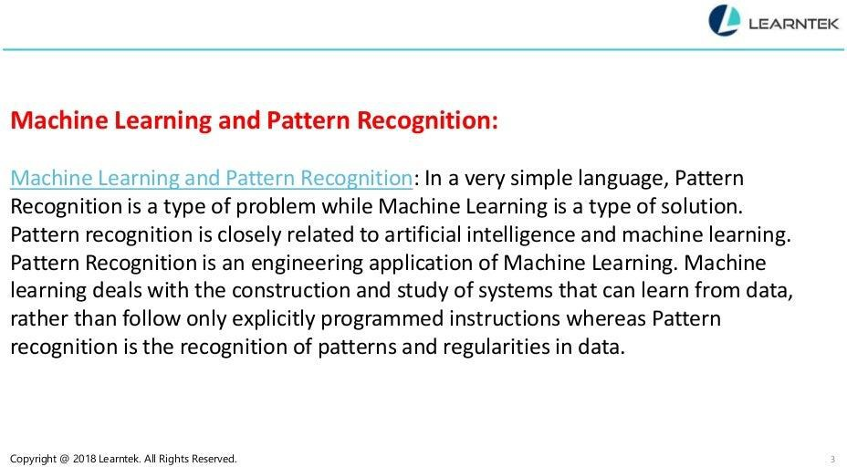

Slide 10
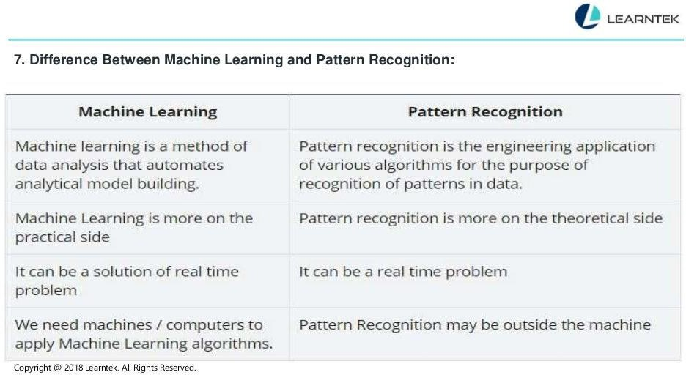

Slide 11
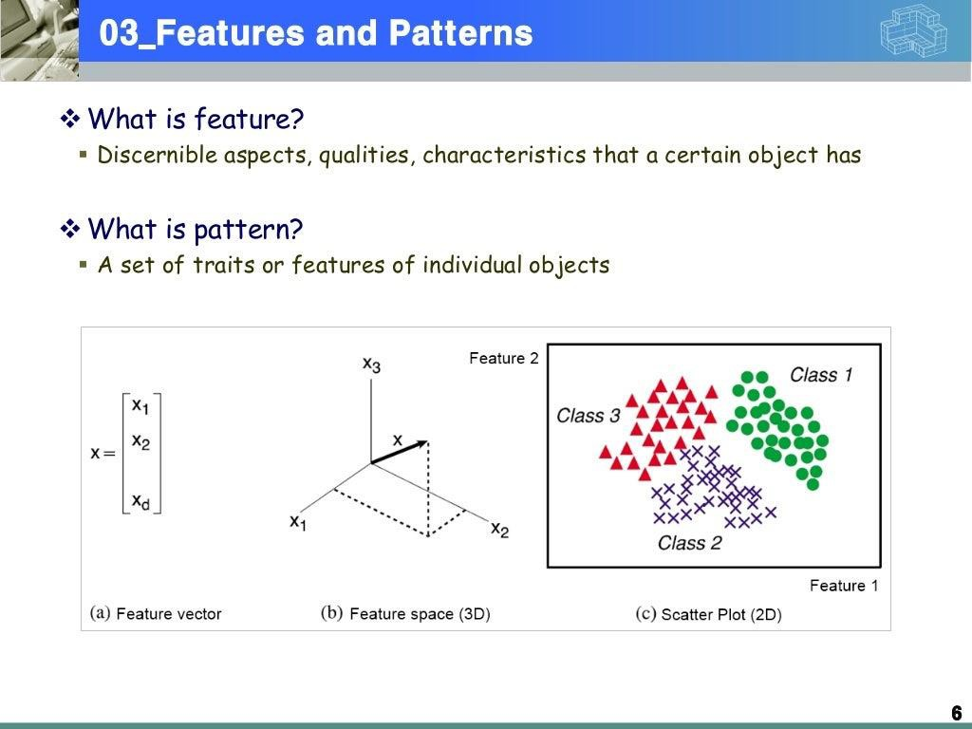

Slide 12
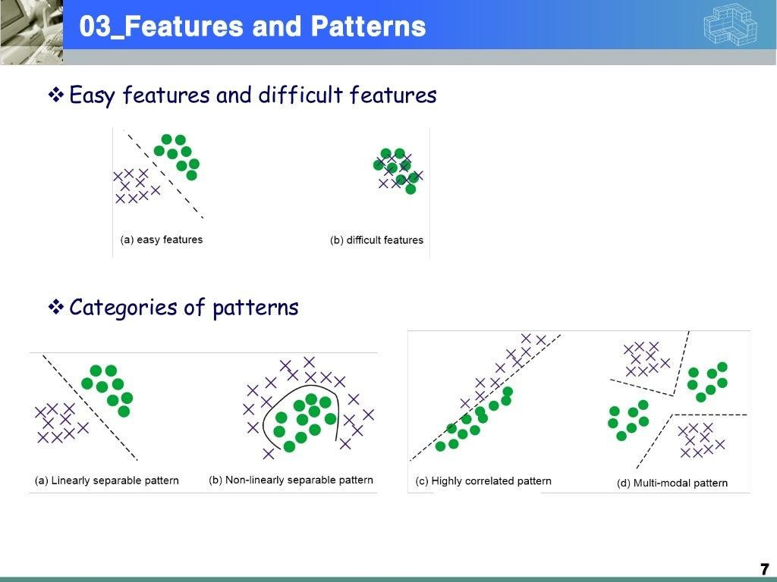

Slide 13
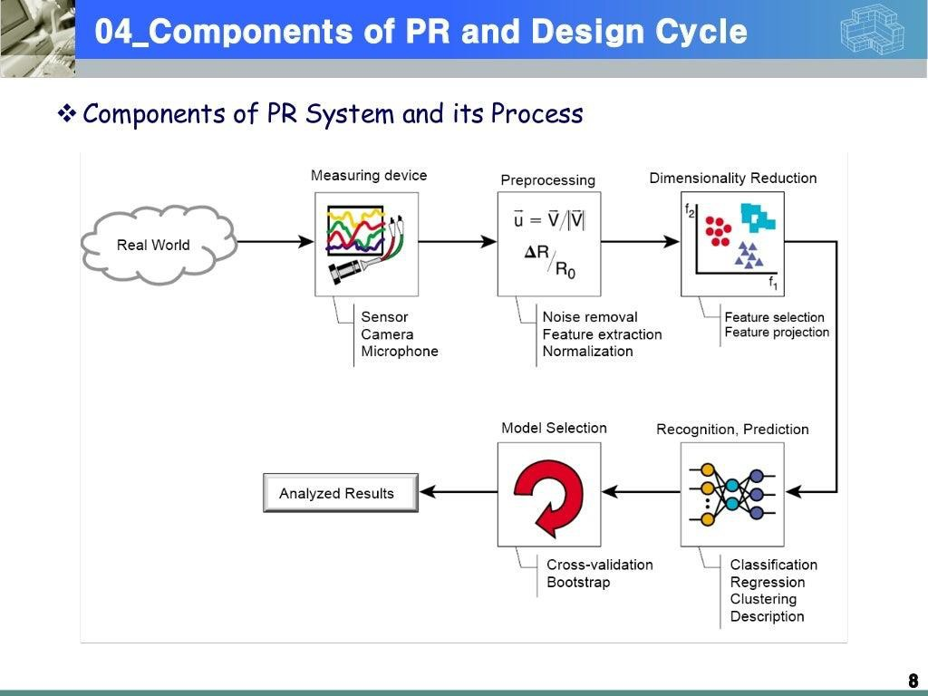

Slide 14
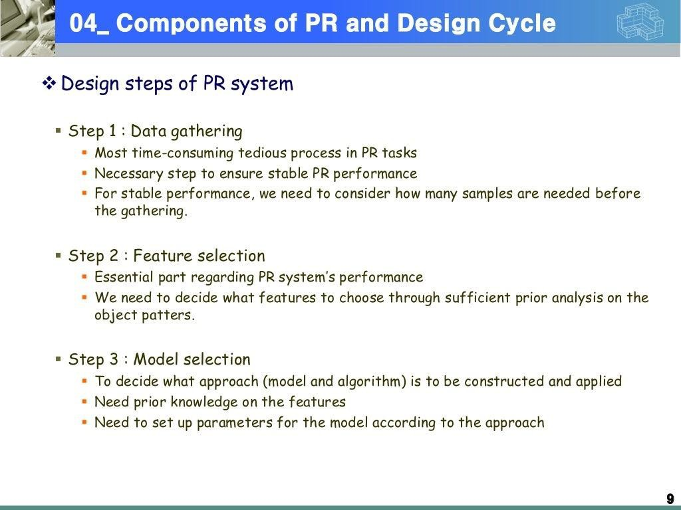

Slide 15
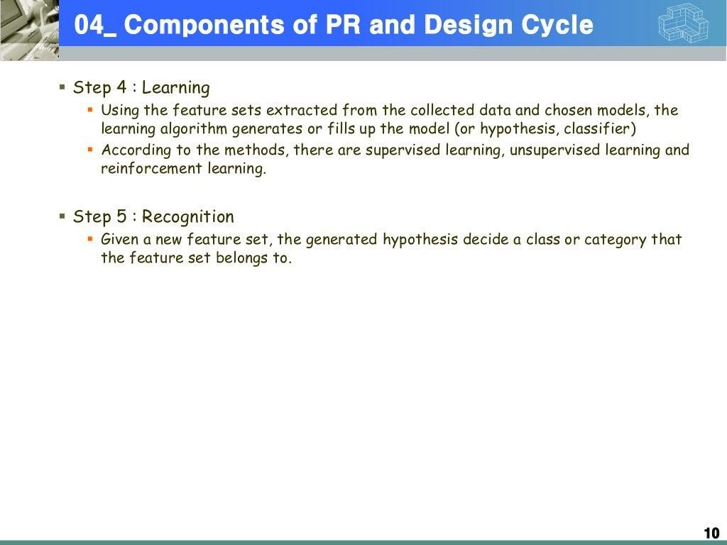

Slide 16
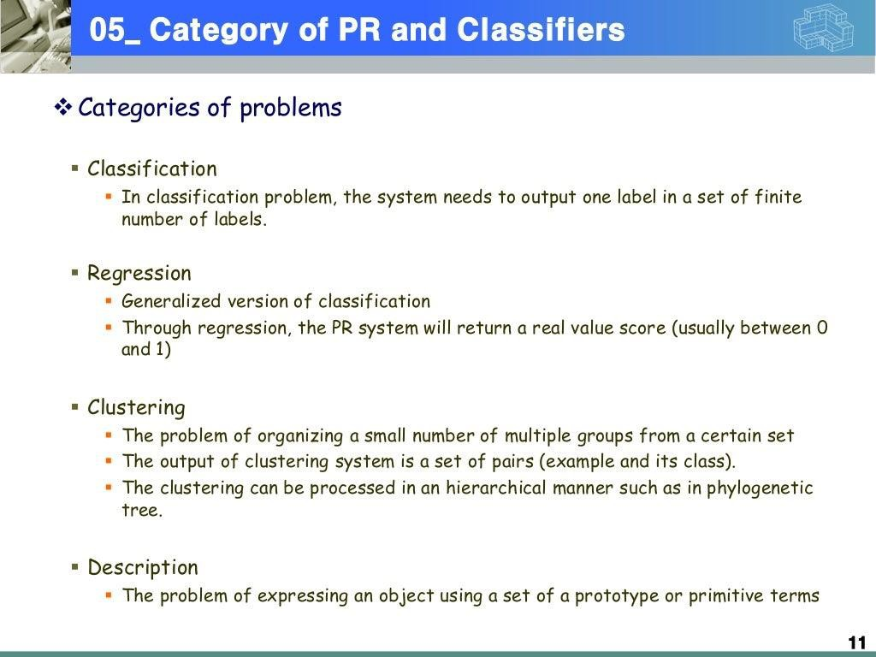

Slide 17
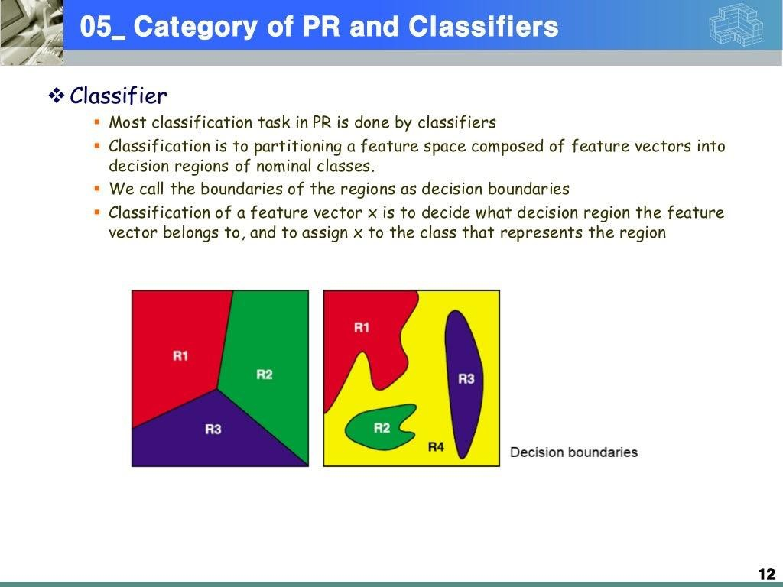

Slide 18
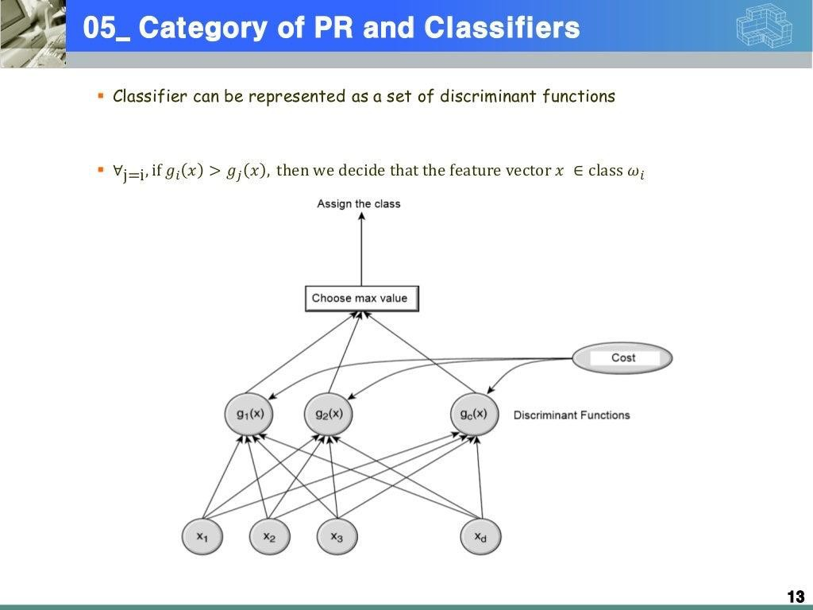

Slide 19
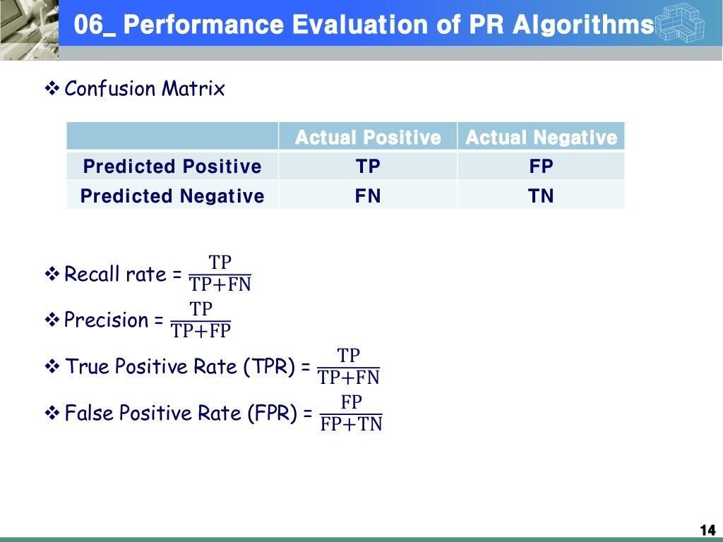

Slide 20
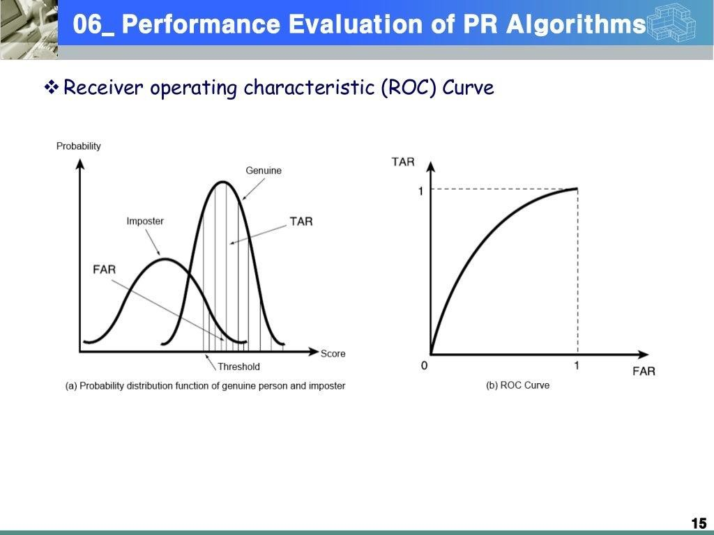

Slide 21
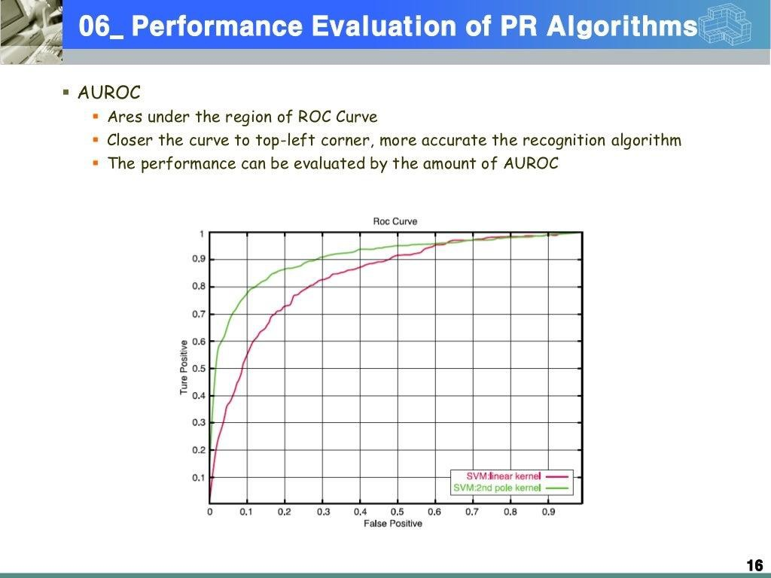

Slide 22
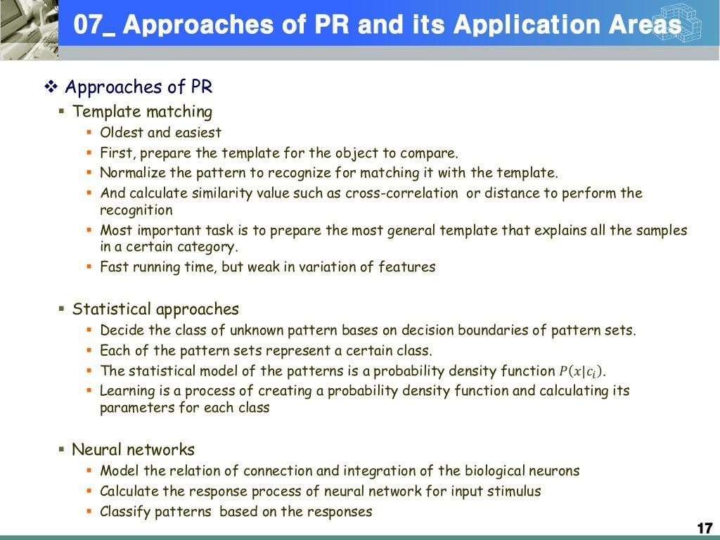

Slide 23
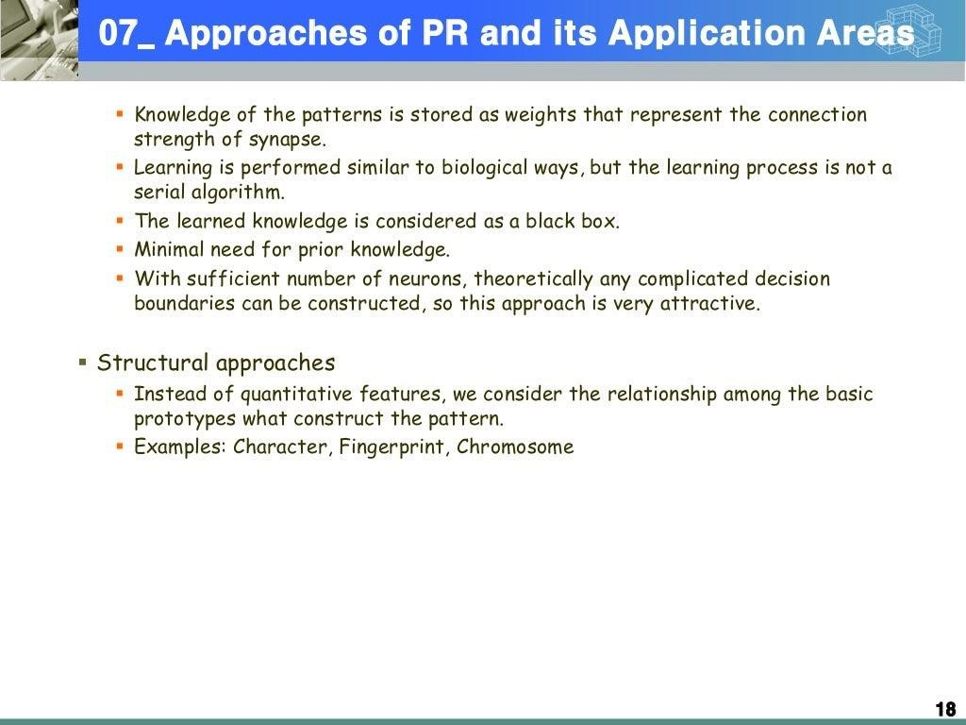

Slide 24
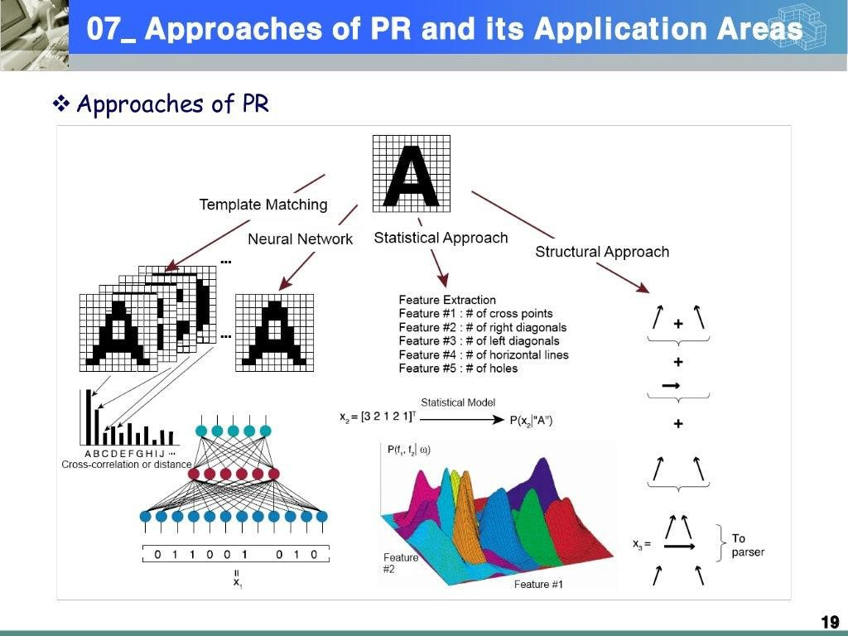

Slide 25
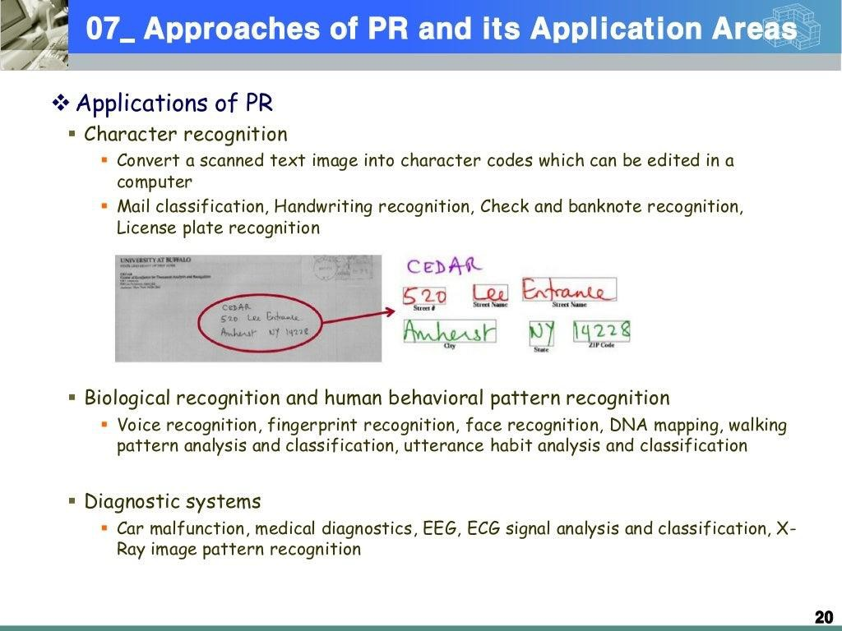

Slide 26
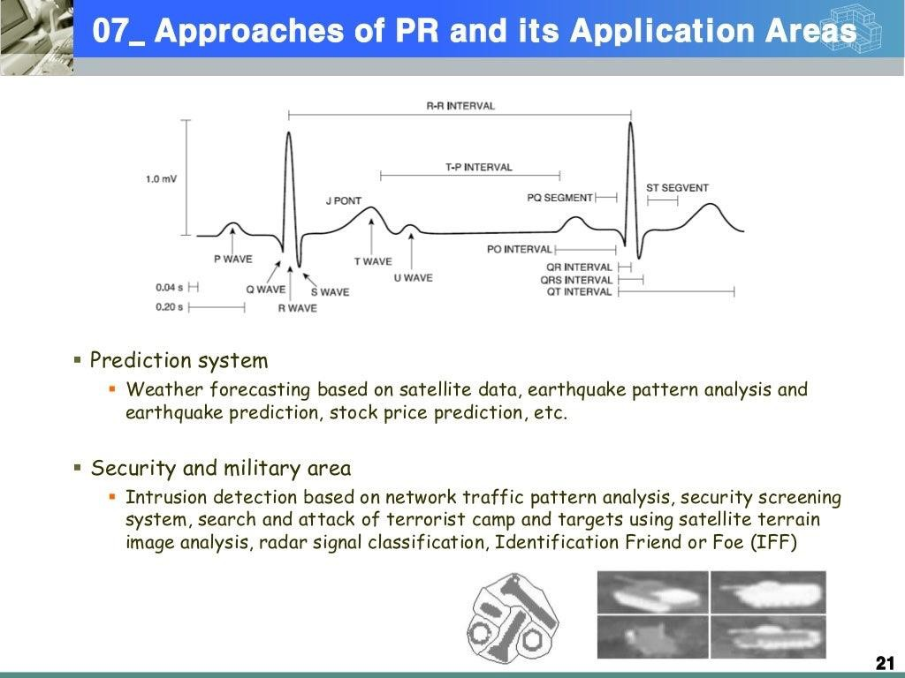

Slide 27
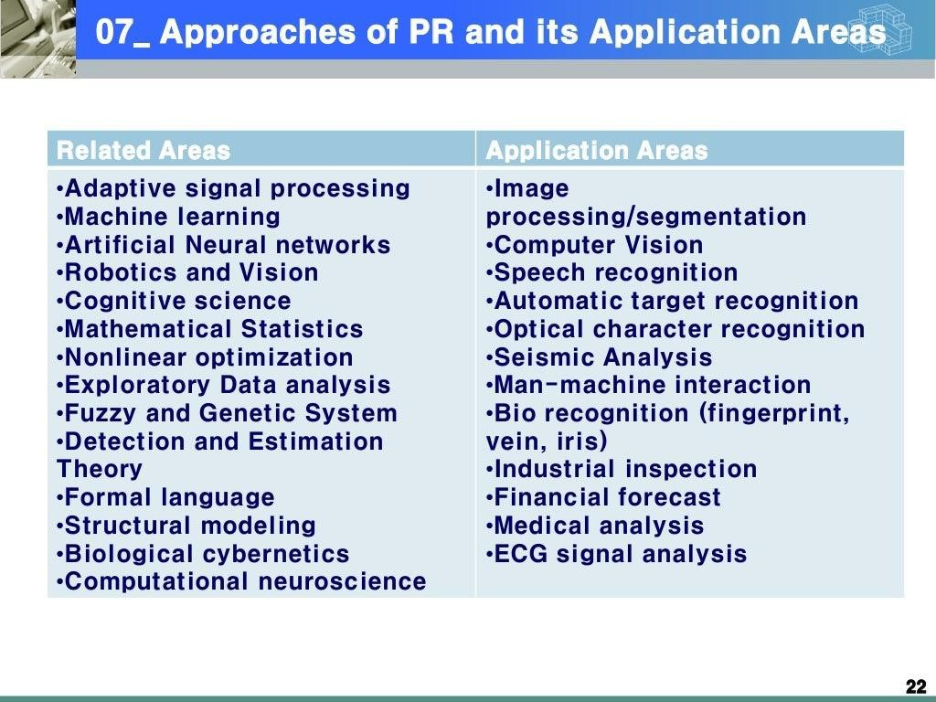

Slide 28
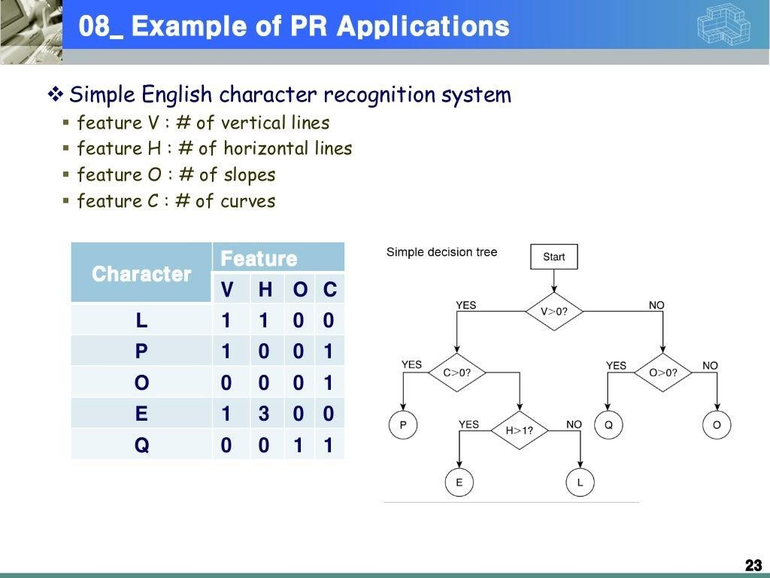

Slide 29


Slide 30
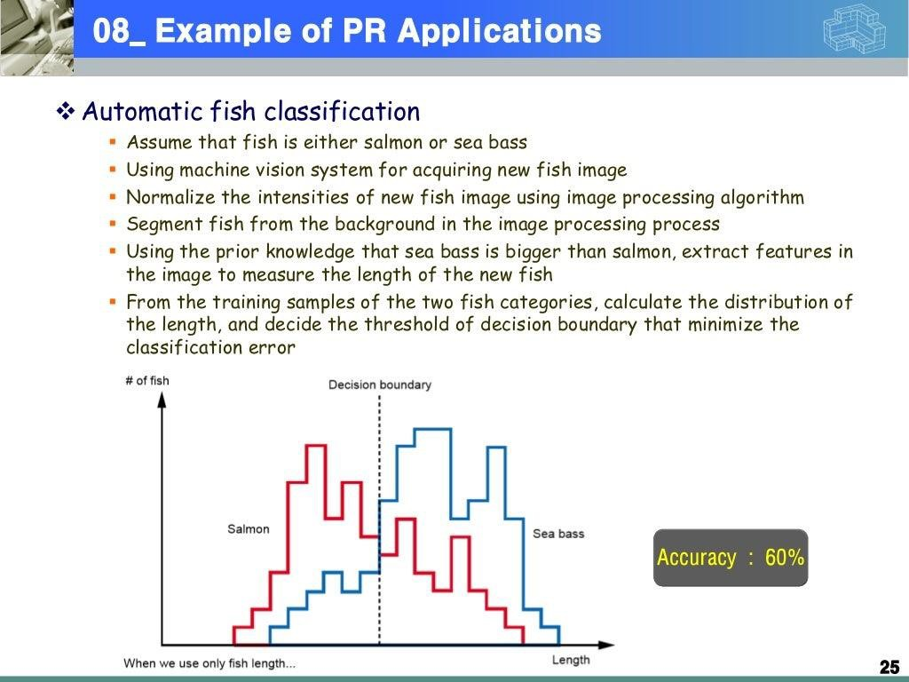

Slide 31
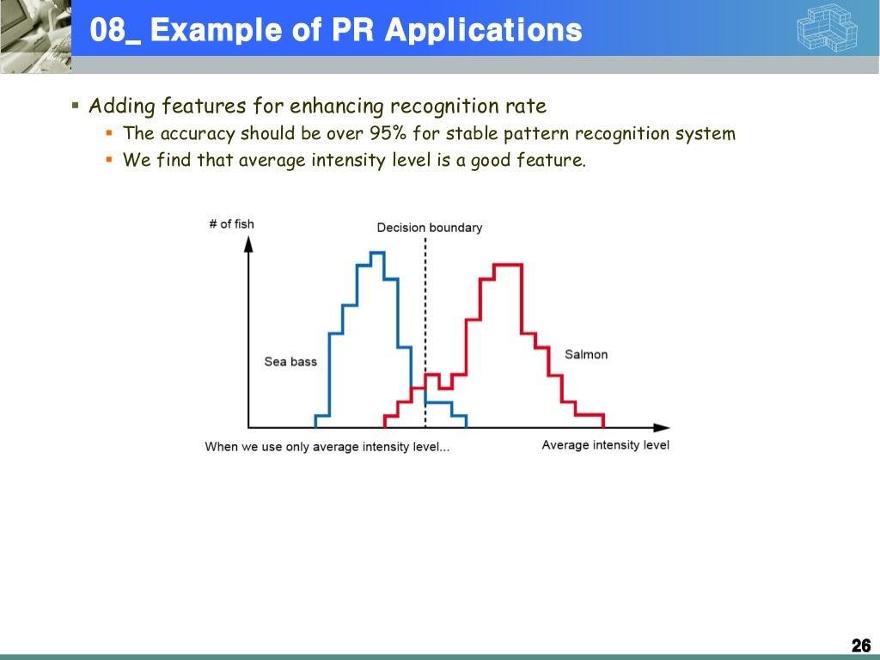

Slide 32
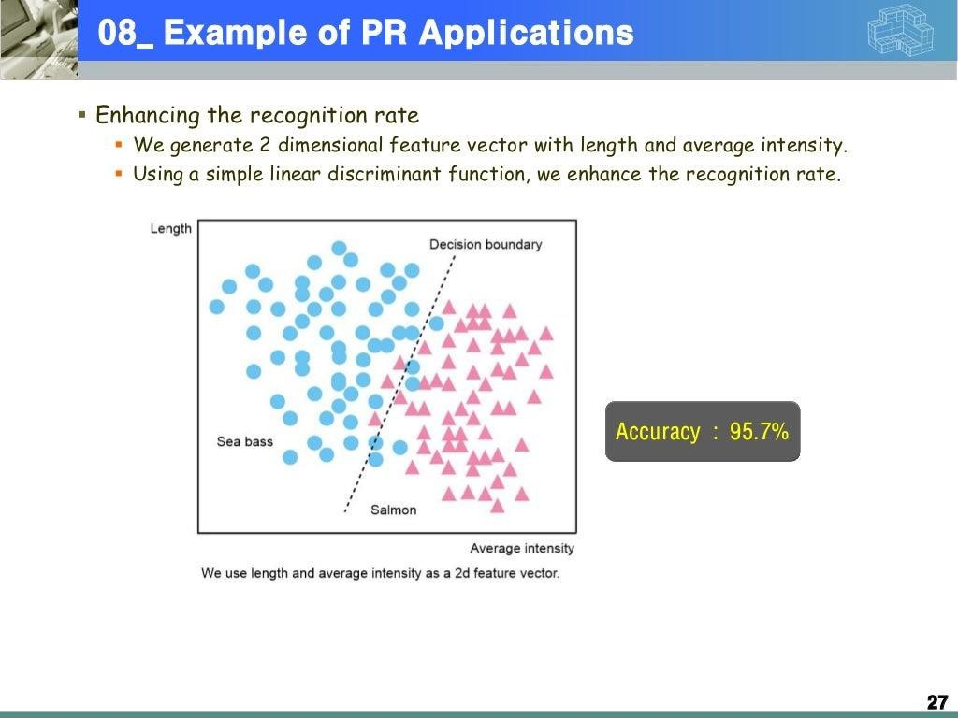

Slide 33
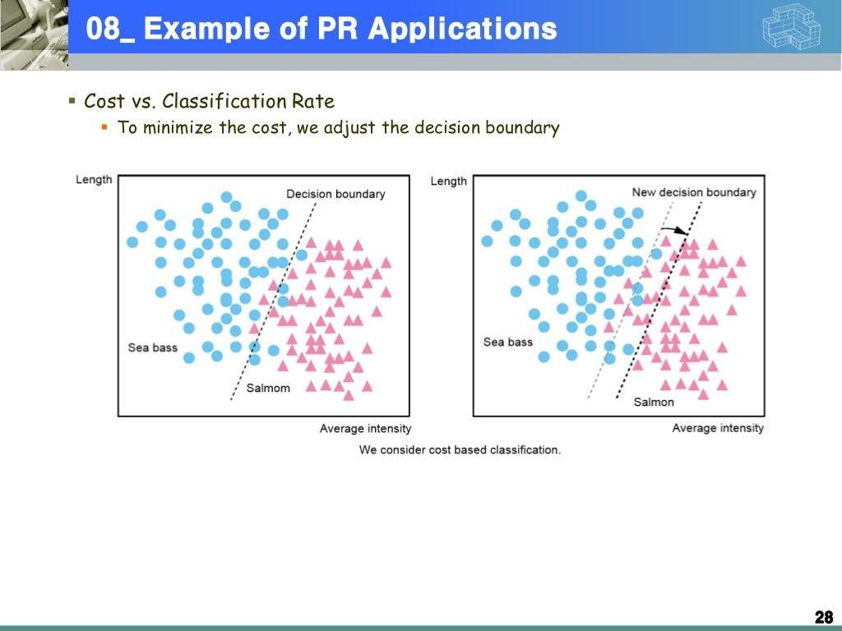

Slide 34
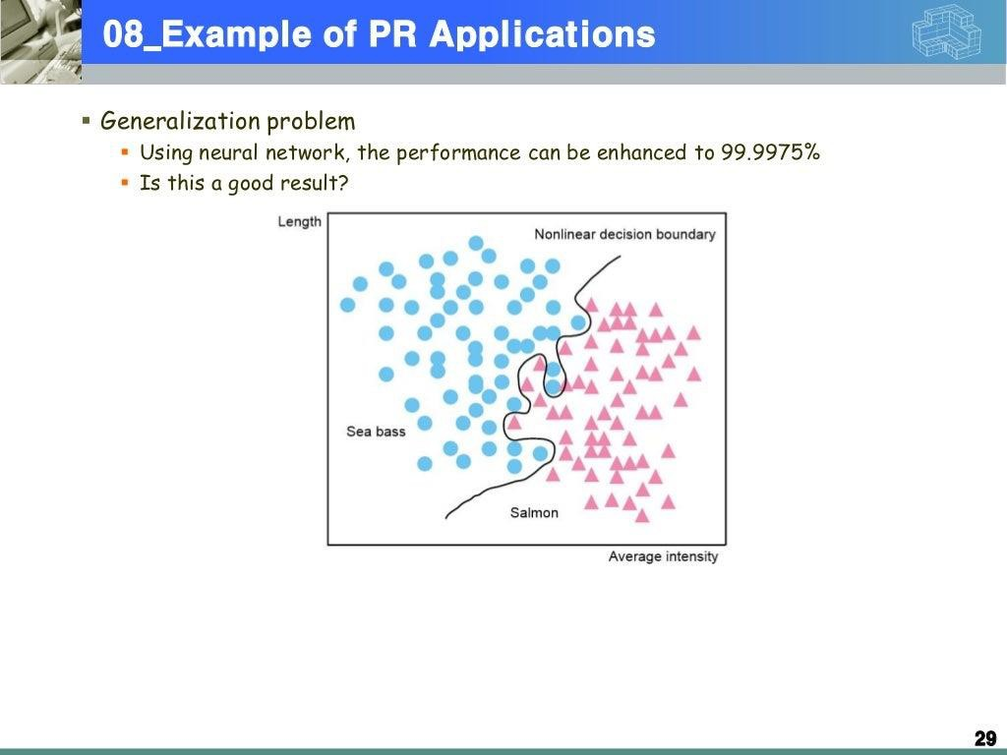

Slide 35
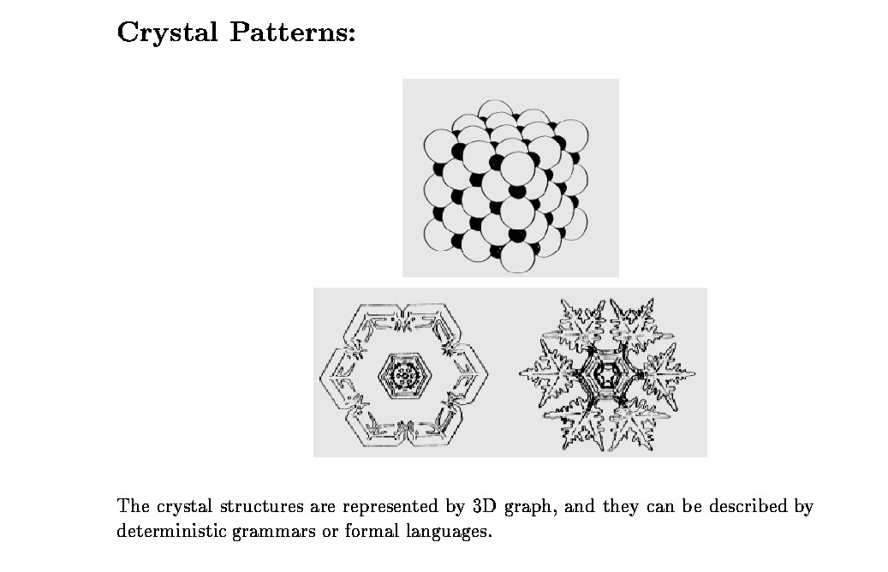
“Pattern Recognition” What is a Pattern?

Slide 36
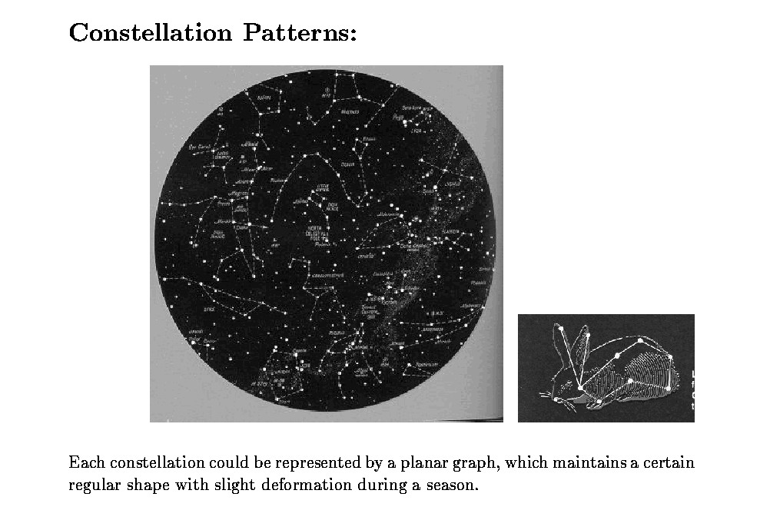

Slide 37
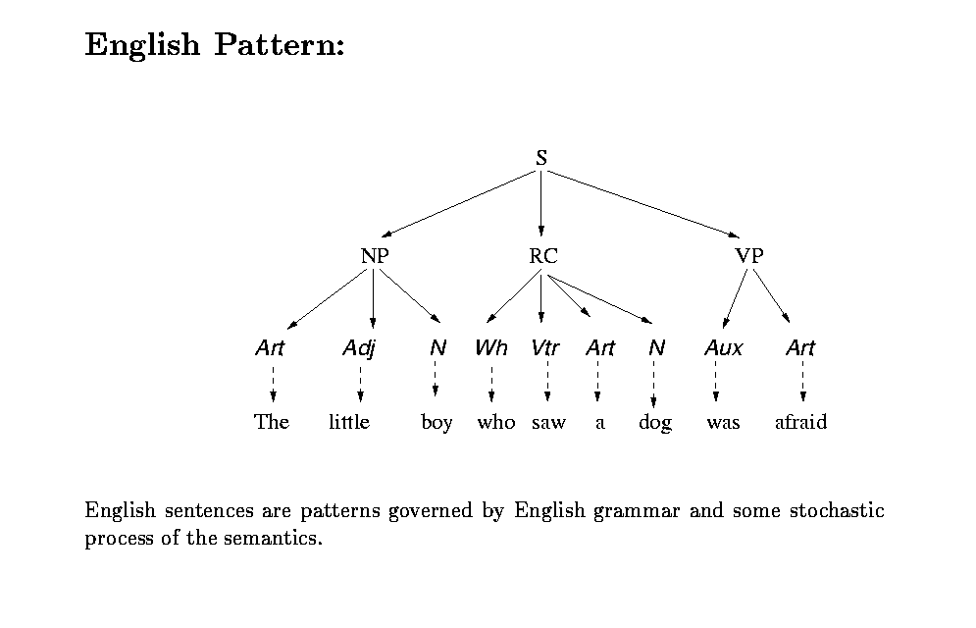

Slide 38
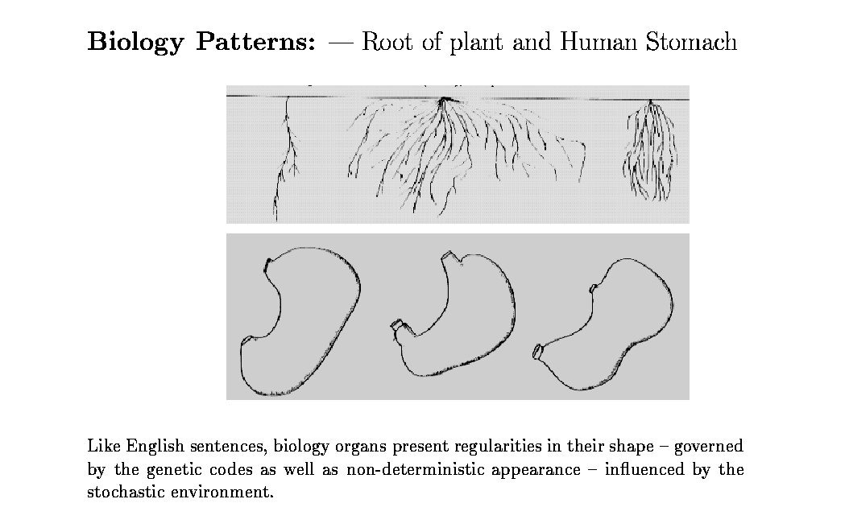

Slide 39
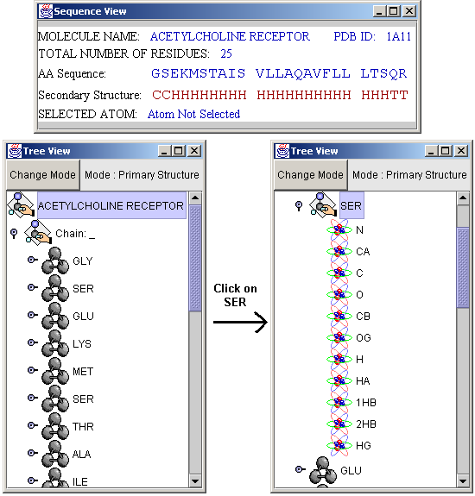
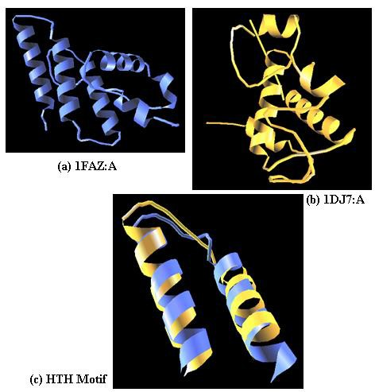
DNA patterns
AGCTCGAT
Protein Patterns
20 amino acids

Slide 40
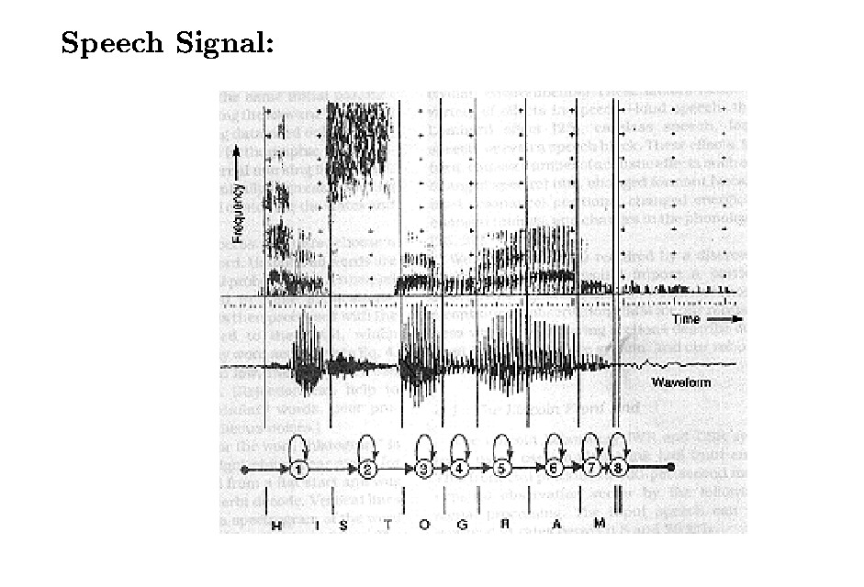

Slide 41
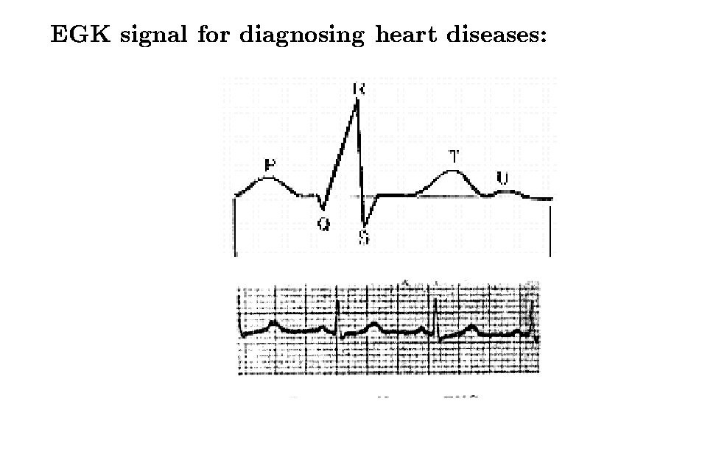

Slide 42
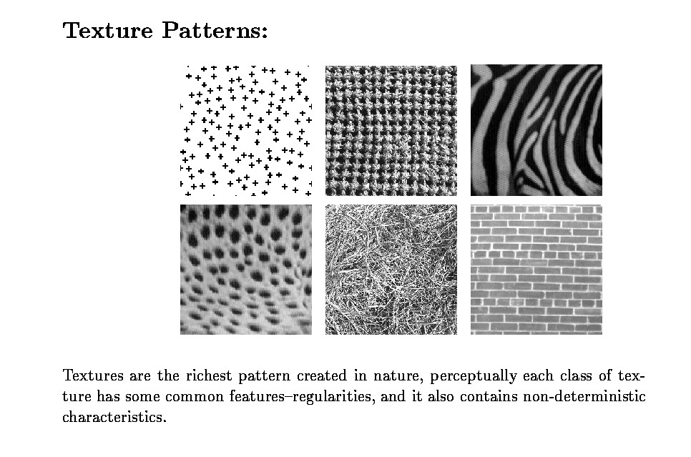

Slide 43

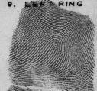


Faces
Finger prints

Slide 44
Other Patterns
Insurance, credit card applications
applicants are characterized by a pattern
# of accidents, make of car, year of model
income, # of dependents, credit worthiness, mortgage amount
Dating services
Age, hobbies, income, etc. establish your “desirability”

Slide 45
Other Patterns
Web documents
Key words based description (e.g., documents containing War, Bagdad, Hussen are different from those containing football, NFL, AFL, draft, quarterbacks)
Intrusion detection
Usage and connection patterns
Cancer detection
Image features for tumors, patient age, treatment option, etc.

Slide 46
Other Patterns
Housing market
Location, size, year, school district
University ranking
Student population, student-faculty ratio, scholarship opportunities, location, faculty research grants, etc.
Too many
E.g.,
http://www.ics.uci.edu/~mlearn/MLSummary.html

Slide 47
What is a pattern?
A pattern is a set of objects, processes or events which consist of both deterministic and stochastic components
A pattern is a record of certain dynamic processes influenced both by deterministic and stochastic factors

Slide 48
What is a Pattern? (cont.)
Constellation patterns, texture patterns, EKG patterns, etc.
Completely regular, deterministic
(e.g., crystal structure)
Completely random
(e.g., white noise)

Slide 49
What is Pattern Recognition?
Classifies “patterns” into “classes”
Patterns (x)
have “measurements”, “traits”, or “features”
Classes ( ϖ_{i})
likelihood (a prior probabilityP(ϖ_{i} ))
class-conditional density
Classifier (f(x) -> ϖ_{i})
An example
p( x|ϖ_{i} )
four coin classes: penny, nickel, dime, and quarter
measurements: weight, color, size, etc.
Assign a coin to a class based on its size, weight, etc.
We use P to denote probability mass function (discrete) and
p to denote probability density function (continuous)

Slide 50
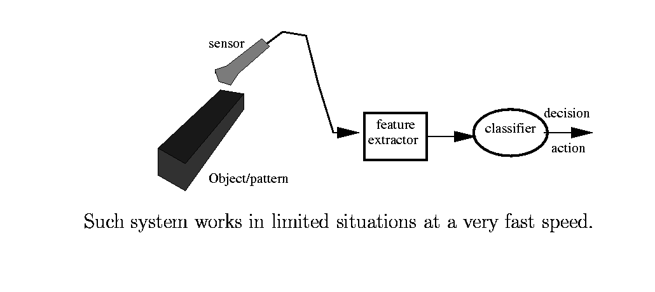
An Example
Many visual inspection systems are like this: Circuit board, fruit, OCR, etc.

Slide 51
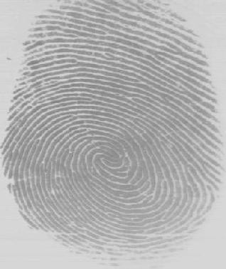
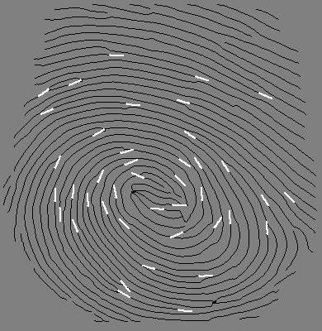
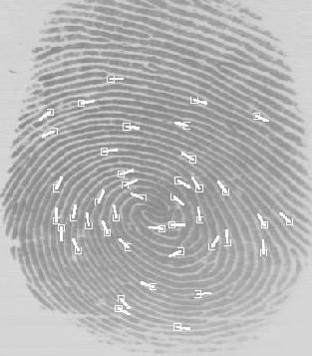
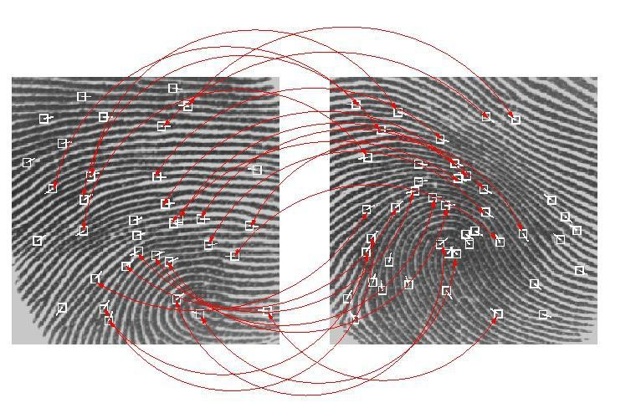
Another Example

Slide 52
Features
The intrinsic traits or characteristics that tell one pattern (object) apart from another
Features extraction and representation allows
Focus on relevant, distinguishing parts of a pattern
Data reduction and abstraction

Slide 53
Detection vs. Description
Detection: something happened
Heard noise
Saw something interesting
Non-flat signals
Description: what has happened?
Gun shot, talking, laughing, crying, etc.
Lines, corners, textures
Mouse, cat, dog, bike, etc.

Slide 54




Feature Selection
More an art than a science
Effectiveness criteria:
population
size
Size alone is not effective

Slide 55



perimeter
compactness
Perimeter is not effective
Discrimination is accomplished by compactness alone
elongatedness
compactness
The two feature values are correlated, only one of them is needed

Slide 56
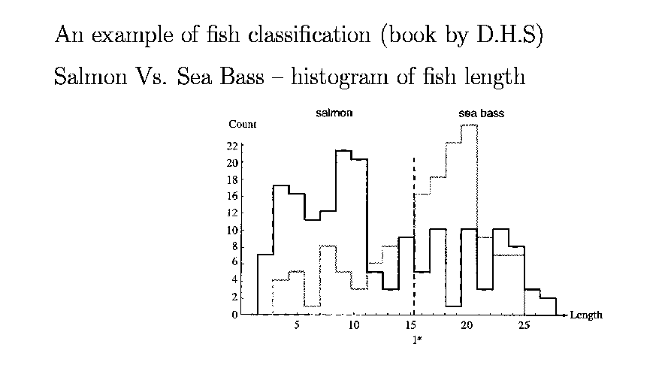
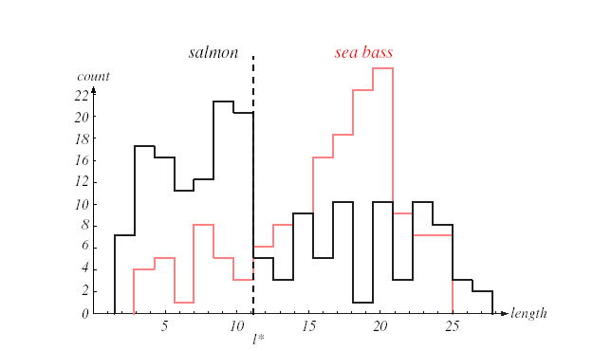

Slide 57
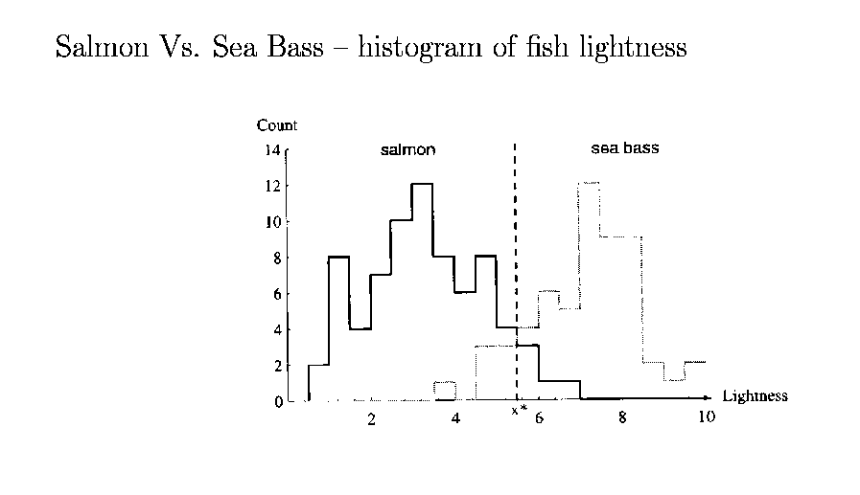
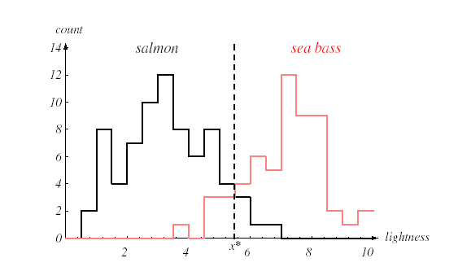

Slide 58
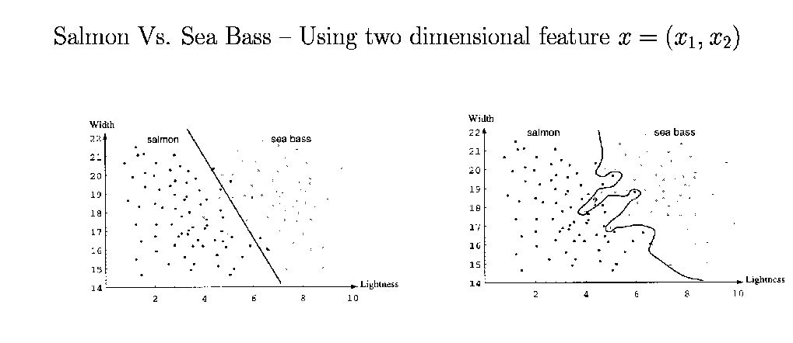
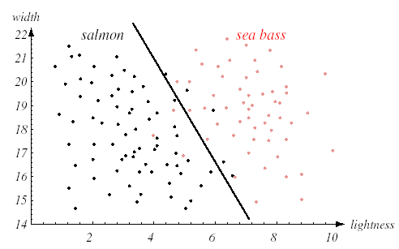
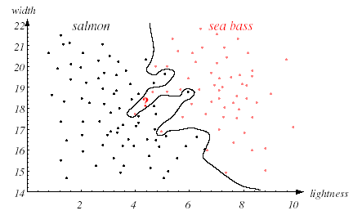
Too simple
Too complicated

Slide 59
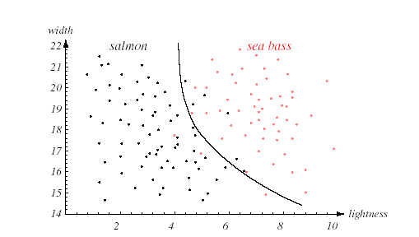
Optimal tradeoff between performance and generalization

Slide 60
Importance of Features
Cannot be over-stated
We usually don’t know which to select, what they represent, and how to tune them (face, gait recognition, tumor detection, etc.)
Classification and regression schemes are mostly trying to make the best of whatever features are available

Slide 61
Features
One is usually not descriptive (no silver bullet)
Many (shotgun approach) can actually hurt
Many problems:
Relevance
Dimensionality
Co-dpendency
Time and space varying characteristics.
Accuracy
Uncertainty and error
Missing values

Slide 62
Feature Selection (cont.)
Q: How to decide if a feature is effective?
A: Through a training phase
Training on typical samples and typical features to discover
Whether features are effective
Whether there are any redundancy
The typical cluster shape (e.g., Gaussian)
Decision boundaries between samples
Cluster centers of particular samples
Etc.

Slide 63
Classifiers
ϖ_{i} if g_{i} ( x ) > g _{j} ( x ) for all j ≠ i
g_{i} ( x ) = P(ϖ_{i} )
if no measurements are made minimize misclassification rate minimize associated risk
g_{i} ( x ) = P(ϖ_{i} | x )
g_{i} ( x ) = R(α_{i} | x )
g₁
g₁ (x)
g₂ (x)
g₂
max
decision
x
g_{n} (x)
g_{n}

Slide 64
Traditional Pattern Recognition
Parametric methods
Based on class sample exhibiting a certain parametric distribution (e.g. Gaussian)
Learn the parameters through training
Density methods
Does not enforce a parametric form
Learn the density function directly
Decision boundary methods
Learn the separation in the feature space

Slide 65
Parametric Methods
I. population
II. population
size
IV. population
size
III. population
size
size
1
(2π )^{n/ 2}σ ^{n}
₋ 1 |x− x |²
e
2
_{σ} 2

Slide 66


Density Methods

Slide 67

Feature space
d dimensional (d the number of features)
populated with features from training samples
f_{d}
f₂
f₁

Slide 68
Decision Boundary Methods
f_{d}
?
f₂
f₁
Decision surfaces
Cluster centers
f_{d}
f_{d}
?
?
f₂
f₂
f₁
f₁

Slide 69


Slide 70
“Modern” vs “Traditional” Pattern Recognition
Hand-crafted features
Simple and low-level concatenation of numbers or traits
Syntactic
Feature detection and description are separate tasks from classifier design
Automatically learned features
Hierarchical and complex
Semantic
Feature detection and description are not jointly optimized with classifiers

Slide 71


Traditional Features

Slide 72

Modern Features

Slide 73

Modern Features

Slide 74

Modern Features

Slide 75

Modern Features

Slide 76

Modern Features

Slide 77


“Modern” vs “Traditional” Pattern Recognition

Slide 78
Mathematical Foundation
Does not matter what methods or techniques you use, the underlying mathematical principle is quite simple
Bayesian theory is the foundation

Slide 79
Review: Bayes Rule
Forward (synthesis) route:
From class to sample in a class
Grammar rules to sentences
Markov chain (or HMM) to pronunciation
Texture rules (primitive + repetition) to textures
Backward (analysis) route:
From sample to class ID
A sentence parsed by a grammar
A utterance is “congratulations” (not “constitution”)
Brickwall vs. plaid shirt

Slide 80
Review: Bayes Rule
Backward is always harder
Because the interpretation is not unique
Presence of x has multiple possibilities
ϖ ₂
ϖ ₁
x
ϖ
n
ϖ ₃

Slide 81
The simplest example
Two classes: pennies and dimes
No measurements
Classification:
based on the a prior probabilities
Error rate:
ϖ₁ if P(ϖ₁ ) > P(ϖ₂ )
ϖ₂ if P(ϖ₁ ) < P(ϖ₂ )
ϖ₁ or ϖ₂ otherwise
ϖ ₁
ϖ ₂
min( P(ϖ₁ ), P(ϖ₂ ))

Slide 82
A slightly more complicated example
Two classes: pennies and dimes
A measurement x is made (e.g. weight)
Classification
based on the a posterior probabilities with Bayes rule
ϖ₁ if P(ϖ₁| x ) > P(ϖ₂| x )
ϖ₁ or ϖ₂
x
ϖ
ϖ
ϖ if P(ϖ | x ) < P(ϖ | x )
1
2
2
1 2
otherwise
p( x,ϖ )
p( x|ϖ )P(ϖ )
P(ϖ | x ) =
i
=
i
i
i
p( x )
p( x )

Slide 83
p( x|ϖ₁ )
probability
p( x|ϖ₂ )
weight
× P(ϖ )
× P(ϖ )
1
2
probability
p( x|ϖ₁ )P(ϖ₁ )
p( x|ϖ₂ )P(ϖ₂ )
weight
÷ p( x)
÷ p( x)
probability
p(ϖ₁| x )
p(ϖ₂ | x )
weight
50
PR , ANN, & ML

Slide 84
Why Both?
p(x |ϖ_{i} ) & P(ϖ_{i} )?
In the day time, some animal runs in front of you on the bike path, you know exactly what it is (p(x|w) is sufficient)
In the night time, some animal runs in front of you on the bike path, you can hardly distinguish the shape (p(x|w) is low for all cases, but you know it is probably a squirrel, not a lion because of p(w))

Slide 85
Essence
Turn a backward (analysis) problem into several forward (synthesis) problem
Or analysis-by-synthesis
Whichever model has a highly likelihood of synthesizing the outcome wins
The formula is not mathematically provable

Slide 86
Error rate
Determined by
The likelihood of a class
The likelihood of measuring x in a class
min( P(ϖ₁| x ), P(ϖ₂| x )) or
1
min( p( x|ϖ₁ )P(ϖ₁ ), p( x|ϖ₂ )P(ϖ₂ ))
p( x )

Slide 87
Error Rate (cont.)
Bayes Decision Rule minimizes the average error rate:
error = ∫ p(error | x) p( x)dx
∑ p(ϖ
^{ϖ} i ^{≠ϖ} ( x )*
p(error | x) =
| x) = 1 − p(ϖ
* | x)
i
( x )
where
ϖ * = arg max p(ϖ | x)
i
( x )
i

Slide 88


Various types of errors

Slide 89


Slide 90

Precision vs. Recall
A very common measure used in PR and MI community
One goes up and the other HAS to go down
A range of options (Receiver operating characteristic curves)
Area under the curve as a goodness measure

Slide 91
Various ways to measure error rates
Training error
Test error
Empirical error
Some under your control (training and test)
Some not (empirical error)
How: n-fold validation
Why: Overfitting and underfitting problems

Slide 92
An even more complicated example
Two classes: pennies or dimes
A measurement x is made
Risk associated with making a wrong decision
Based on the a posterior probabilities with Bayesian risk
R(α₁| x ) = λ₁₁P(ϖ₁| x ) + λ₁₂ P(ϖ₂| x )
R(α₂| x ) = λ₂₁P(ϖ₁| x ) + λ₂₂ P(ϖ₂| x )
λ_{ij} :thelossof actionα_{i} in stateϖ _{j}
R(α_{i} | x ):theconditional risk of action α_{i} with x

Slide 93
State2
State1
Mis-classification Math
Observation
Decision1
Decision2
Mis-interpretation Human factor
Observation

Slide 94
State1
State2
Decision1
Decision2
Observation
Observation
Decision1
Decision2 Decision1
Incorrect decisions
Incur domain-specific cost
Decision2
State1
State2
Observation
61
PR , ANN, & ML

Slide 95
An even more complicated example
R(used as pennies | x) =
r(pennies used as pennies) *
p(x|pennies)P(pennies)
P(pennies | x)
+
r(dimes used as pennies) *
P(dimes | x)
p(x|dimes)P(dimes)
R(used as dimes | x) =
r(pennies used as dimes) * P(pennies | x) +
r(dimes used as dimes) * P(dimes | x)

Slide 96
A more credible example
R(call FD|smoke) = r(call,fire)*P(fire|smoke) + r(call, no fire)*P(no fire|smoke)
R(no call FD|smoke)=
False positive
r(no call, no fire)*P(no fire|smoke) +
r(no call, fire)*P(fire|smoke)
False negative
The risk associated with false negative is much higher than that of false positive

Slide 97
A more credible example
R(attack|battle field intelligence) =
r(attack,<50%)*P(<50%|intelligence) +
r(attack,>50%)*P(>50%|intelligence)
R(no attack|battle field intelligence)=
r(no attack, >50%)*P(>50%|intelligence) +
False positive
r(no attack, <50%)*P(<50%|intelligence)
False negative

Slide 98
Baysian Risk
Determined by
likelihood of a class
likelihood of measuring x in a class
the risk of making a wrong action
Classification
Baysian risk should be minimized
min( R(α₁ | x), R(α₂ | x))or
min(λ₁₁P(ϖ₁ | x) + λ₁₂ P(ϖ ₂ | x), λ₂₁P(ϖ₁ | x) + λ₂₂ P(ϖ ₂ | x)) or R(α₁ | x) < R(α₂ | x) ⇒ ϖ₁
(λ₂₁ − λ₁₁ )P(ϖ₁ | x) > (λ₁₂ − λ₂₂ )P(ϖ ₂ | x)

Slide 99
Bayesian Risk (cont.)
Again, decisions depend on
likelihood of a class
likelihood of observation of x in a class
Modified by some positive risk factors
Why?
Because in the real world, it might not be the misclassification rate that is important, it is the action you assume
(λ₂₁ − λ₁₁ )P(ϖ₁ | x) > (λ₁₂ − λ₂₂ )P(ϖ ₂ | x)

Slide 100
Other generalizations
Multiple classes
n classes
n
∑ P(ϖ_{i} ) = 1
i=1
Multiple measurements
X is a vector instead of a scalar
Non-numeric measurements
Actions vs. decisions
Correlated vs. independent events
speech signals and images
Training allowed or not
Time-varying behaviors

Slide 101
Difficulties
What features to use
How many features (the curse of dimensionality)
The a prior probability
P(ϖ _{i} )
The class-conditional density ^{p( x|ϖ}i ⁾
The a posterior probability
P(ϖ_{i} | x)

Slide 102
Typical Approaches
Supervised (with tagged samples x):
parameters of a probability function (e.g. Gaussian
)
p( x|ϖ_{i} ) = N (μ_{i} , Σ_{i} )
density functions (w/o assuming any parametric forms)
decision boundaries (classes are indeed separable)
Unsupervised (w/o tagged samples x):
minimum distance
hierarchical clustering
Reinforced (with hints)
Right or wrong, but not correct answer
Learning with a critic (not a teacher as in supervised)

Slide 103
Pattern Recognition
Uncorrelated Events
Correlated Events
Supervised Learning
Un-supervised Clustering
Hidden Markov Models
Density
Decision Boundary
Minimum Distance
Hierarchical Clustering
Parameter

Slide 104
Applications
DNA sequence
Lie detectors
Handwritten digits recognition
Classification based on smell
Web document classification and search engine
Defect detection
Texture classification
Image database retrieval
Face recognition
etc.

Slide 105
Other formulations
We talked about 1/3 of the scenarios – that of classification (discrete)
Regression – continuous
Extrapolation and interpolation
Clustering
Similarity
Abnormality detection
Concept drift (discovery), etc.

Slide 106
Classification vs. Regression
Classification
Large vs. small hints on category
Absolute values does not matter as much (can actually hurt)
Normalization is often necessary
Fitting order stays low
Regression
Large means large, small means small
Absolute values matter
Fitting orders matter

Slide 107
Recent Development
Data can be “massaged” Surprisingly, massaging the data and use simple classifiers is better than massaging the classifiers and use simple data (for simple problems & small data sets)
Hard-to-visualize concept
Transform data into higher dimensional space (e.g., infinite dimensional) has a tendency to separate data and increase error margin
Concept of SVM and later kernel methods

Slide 108
More Recent Development
Think about fitting linear data with a model
Linear, quadratic, cubic, etc.
Higher the order, better the fit
n data points can be perfectly fit by an (n-1) order
polynomial
However
Overfitting is likely
No ability to extrapolate
“Massage” the classifiers (using deep networks)
Feature detection and description
Classification
Jointly optimization

Slide 109


Slide 110


Slide 111


Slide 112


Slide 113


Slide 114


Slide 115


Slide 116


Slide 117


Slide 118


Slide 119


Slide 120


Slide 121


Slide 122


Slide 123


Slide 124


Slide 125


Slide 126


Slide 127


Slide 128


Slide 129


Slide 130


Slide 131


Slide 132


Slide 133


Slide 134


Slide 135
Overfitting and Underfitting in Machine Learning
The two most common difficulties in machine learning are overfitting and underfitting, both of which affect the performance of machine learning models.
Each machine learning model's key goal is to generalize well. The capacity of an ML model to offer an acceptable output by adapting the provided set of unknown input is referred to as generalization. It indicates that after training on the dataset, it can give accurate and dependable results. As a result, the two words underfitting and overfitting must be examined for the model's performance and whether it is generalizing well or not.
Before we get into overfitting and underfitting, let's define a few terms that will help us better comprehend this topic:
Signal: The genuine underlying pattern of the data that aids the machine learning model in learning from the
data is referred to as the signal.
Noise: It is unimportant and irrelevant input that degrades the model's performance.
Bias: It is a prediction inaccuracy incorporated into the model as a result of oversimplifying machine learning methods. Or it could be the disparity between projected and actual numbers.
Variance: It occurs when a machine learning model performs well on the training dataset but not on the test
dataset.

Slide 136


Slide 137
How to avoid the Overfitting in Model
The machine learning model's performance is harmed by both overfitting and underfitting. However, because overfitting is the main reason, there are certain approaches to limit the likelihood of overfitting in our model.
Cross-Validation
Training with more data
Removing features
Early stopping the training
Regularization
Ensembling

Slide 138


Slide 139

How to avoid underfitting:
By increasing the model's training time.
By expanding the number of features available.
Goodness of Fit
The term "goodness of fit" is derived from statistics, and it is the purpose of machine learning models to accomplish it. It
defines how closely the result or anticipated values match the true values of the dataset in statistics modeling.
The model with a good fit is halfway between underfitted and overfitted, and it gives predictions with zero errors in theory, but it's difficult to obtain in practice.

Slide 140


Slide 141


Slide 142
Approaches of Dimension Reduction
There are two ways to apply the dimension reduction technique, which are given below:
Feature Selection
Feature Extraction
Feature Selection:
Feature selection is the process of selecting the subset of the relevant features and leaving out the irrelevant features present in a dataset to build a model of high accuracy. In other words, it is a way of selecting the optimal features from the input dataset.
Three methods are used for the feature selection:
Filters Methods
In this method, the dataset is filtered, and a subset that contains only the relevant features is taken. Some common techniques of filters method are:
Correlation
Chi-Square Test
ANOVA
Information Gain, etc.

Slide 143
Approaches of Dimension Reduction
Wrappers Methods
The wrapper method has the same goal as the filter method, but it takes a machine learning model for its evaluation. In this method, some features are fed to the ML model, and evaluate the performance. The performance decides whether to add those features or remove to increase the accuracy of the model. This method is more accurate than the filtering method but complex to work. Some common techniques of wrapper methods are:
Forward Selection
Backward Selection
Bi-directional Elimination
Embedded Methods: Embedded methods check the different training iterations of the machine learning model and evaluate the importance of each feature. Some common techniques of Embedded methods are:
LASSO
Elastic Net
Ridge Regression, etc.

Slide 144
Approaches of Dimension Reduction
Feature Extraction:
Feature extraction is the process of transforming the space containing many dimensions into space with fewer dimensions. This approach is useful when we want to keep the whole information but use fewer resources while processing the information.
Some common feature extraction techniques are:
Principal Component Analysis
Linear Discriminant Analysis
Kernel PCA
Quadratic Discriminant Analysis

Slide 145


Slide 146


Slide 147


Slide 148


Slide 149


Slide 150


Slide 151


Slide 152


Slide 153


Slide 154


Slide 155


Slide 156


Slide 157


Slide 158


Slide 159


Slide 160


Slide 161


Slide 162


Slide 163


Slide 164


Slide 165


Slide 166


Slide 167



Slide 168


Slide 169


Slide 170


Slide 171


Slide 172


Slide 173


Slide 174


Slide 175


Slide 176


Slide 177


Slide 178


Slide 179


Slide 180


Slide 181


Slide 182


Slide 183


Slide 184


Slide 185


Slide 186


Slide 187


Slide 188


Slide 189


Slide 190


Slide 191


Slide 192


Slide 193


Slide 194


Slide 195


Slide 196


Slide 197


Slide 198


Slide 199


Slide 200


Slide 201


Slide 202


Slide 203


Slide 204


Slide 205


Slide 206


Slide 207


Slide 208


Slide 209


Slide 210


Slide 211


Slide 212

How do we find the perfect project for this dataset?

Slide 213

Centering the points

Slide 214


Slide 215


Slide 216

Lets make up the matrix with some values.
X-variance is 9 becase dataset is more spread in x axis.
And it seems like positive covariance so cov is +4

Slide 217


Slide 218


Slide 219


Slide 220


Slide 221


Slide 222


Slide 223


Slide 224


Slide 225


Slide 226


Slide 227


Slide 228


Slide 229


Slide 230


Slide 231


Slide 232


Slide 233


Slide 234


Slide 235


Slide 236


Slide 237


Slide 238


Slide 239


Slide 240


Slide 241
Statistical Decision Making
Parametric Decision Making
In which we know or are willing to assume the general form of the probability distribution function or density function for each class, but not the values of the parameters such as mean or variance.
Non Parametric Decision Making
When we do not have sufficient basis of assuming even the general form of the relevant densities.

Slide 242
Bayes’ Theorem
Bayesian decision making refers to choosing the most likely class, given the value of the feature or features.
The probability of class membership are calculated from Bayes’ Theorem.
Let feature value is x and a class of interest is C
Then P(x) is the probability distribution of x in the entire population.
P(C) is the prior probability that a random sample is a member of class C.
P(x|C) is the conditional probability of obtaining x given that the sample is from C class.
We have to estimate the probability P(C|x) that a sample belongs to class C, given that it has the feature x.

Slide 243
Bayes’ Theorem
Conditional Probability
The probability of occurring
A given That B has occurred
is denoted by P(A|B), and is read
as “P of A given B”.
Since we know in advance that B has occurred, so P(A|B) is the fraction of B in which A occurs. Thus
A+B
B
A

Slide 244
Bayes’ Theorem
The conditional probability of a sample comes from class C and has the feature value x is
Rearranging
Which is known as Bayes’ Theorem. The variable x can represent a single feature or a feature vector.

Slide 245
Bayes’ Theorem for k-classes
Let C₁, …… , C_{k} are mutually exclusive i.,e., they will not overlap each other and every sample belongs to exactly one of the classes.
If a sample belongs to one of the classes A or B, or both or neither, then four new mutually exclusive classes C₁ ,C₂ ,C₃ ,and C₄ defined by
C₁ = A and B C₂ = A and B
C₃ = A and B C₄= A and B
Thus k-nonexclusive classes could define up to 2k mutually exclusive classes.

Slide 246

Bayes’ Theorem for k-classes

Slide 247

Bayes’ Theorem for Multiple Features
Bayes Theorem for multiple features is obtained by replacing the value of a single feature x by the value of a feature vector x.
In the discrete case, if there are k classes we obtain

Slide 248
Nonparametric Decision Making
Nearest Neighbor Classification Techniques
The single Nearest Neighbor Technique
Beyond of the problem of probability densities, the single Nearest Neighbor Technique completely and simply classifies an unknown sample as belonging to the relevant class as the most similar or “nearest” sample point in the training set of data, which is often called a reference set.
Nearest can mean the smallest Euclidean distance in n-dimensional feature space, which is the distance between two points
and

Slide 249
The single Nearest Neighbor Technique
Defined by
Where n is number of features.
Although Euclidean distance is the most commonly used measure of dissimilarity / similarity between feature vectors, it is not always the best metric.
Before summation, squaring the distance places emphasis on features with large dissimilarity.

Slide 250
The single Nearest Neighbor Technique
A more moderate approach is simply the sum of the absolute differences in each feature, and saves computing time.
The distance metric would than be
The sum of absolute distances is sometimes called the city block distance, the Manhattan metric, or the taxi-cab distance.
Because it seems the distance between two locations in a city. If in a two-way street of rectangular shape, the number of blocks north (or south) plus the number of block east (or west) would equal the total distance traveled.

Slide 251
The single Nearest Neighbor Technique
An extreme metric which considers only the most dissimilar pair of features is the Maximum distance metric
A generalization of the three distances is the Minkowski distance defined by
Where r is an adjustable parameter
Problem: Given two samples in separate data files, write a C program to determine distances between two samples using nearest neighbor techniques.

Slide 252
Clustering
Clustering refers to the process of grouping samples so that the samples are similar within each group. The groups are called clusters.
Clustering can be classified into two major types, Hierarchical and Partitional clustering. Hierarchical clustering algorithms can be further divided into agglomerative and divisive.
Hierarchical clustering refers to a process that organizes data into large groups, which contain smaller groups, and so on.
Hierarchical clustering usually drawn pictorially by a tree or dendrogram in which the finest grouping is at the bottom, each sample forms a cluster.

Slide 253

Clustering
Below is an example of a dendrogram

Slide 254
Clustering
Hierarchical clustering algorithms are called agglomerative if they build the dendrogram from the bottom up and they are called divisive if they build the dendrogram from the top down.
Agglomerative clustering algorithms with n number of samples is as below
Begin with n clusters, each consisting of one sample.
Repeat step 3 a total of n-1 times.
Find the most similar clusters C_{i} and C_{j} and merge C_{i} and C_{j} into one cluster. If there is a tie, merge the first pair found.

Slide 255
Hierarchical Clustering
One way to measure the similarity between clusters is to define a function that measures the distance between clusters.
In cluster analysis nearest neighbor techniques are used to measure the distance between pairs of samples.

Slide 256

Hierarchical Clustering
The Single-Linkage Algorithm
It is also known as the minimum method or the nearest neighbor method.
The Single-Linkage Algorithm is obtained by defining the distance between two clusters to be the smallest distance between two points such that one point is in each cluster.
Formally, if C_{i} and C_{j} are clusters, the distance between them is defined as
Where d(a,b) denotes the distance between the samples a and b.

Slide 257
Hierarchical Clustering: The Single-Linkage Algorithm Example
Perform hierarchical clustering of five Samples with two features, use Euclidean distance for the distance between two samples.
The smallest distance is 4.0 between cluster {1} and {2}, so they are merged. Now the number of clusters become four : {1,2}, {3}, {4}, {5}
 | x | y
1 | 4 | 4
2 | 8 | 4
3 | 15 | 8
4 | 24 | 4
5 | 24 | 12
 | 1 | 2 | 3 | 4 | 5
1 | - | 4.0 | 11.7 | 20.0 | 21.5
2 | 4.0 | - | 8.1 | 16.0 | 17.9
3 | 11.7 | 8.1 | - | 9.8 | 9.8
4 | 20.0 | 16.0 | 9.8 | - | 8.0
5 | 21.5 | 17.9 | 9.8 | 8.0 | -

Slide 258
Hierarchical Clustering: The Single-Linkage Algorithm Example
 | {1,2} | 3 | 4 | 5
{1,2} | - | 8.1 | 16.0 | 17.9
3 | 8.1 | - | 9.8 | 9.8
4 | 16.0 | 9.8 | - | 8.0
5 | 17.9 | 9.8 | 8.0 | -
The distance d(1,3)=11.7 and d(2,3)=8.1, Thus for S L Algorithm the distance between clusters {1,2} and {3} is the minimum 8.1 and so on.
Since the minimum value in the matrix is 8, clusters {4} & {5} are merged.

Slide 259
Hierarchical Clustering: The Single-Linkage Algorithm Example
Thus in this level, There are three clusters: {1,2}, {3}, {4,5}
Since the minimum value in this step is 8.1, thus clusters {1,2} and {3} are merged. Now there are two clusters : {1,2,3} and {4,5}.
 | {1,2} | 3 | {4,5}
{1,2} | - | 8.1 | 16.0
3 | 8.1 | - | 9.8
{4,5} | 16.0 | 9.8 | -

Slide 260
Hierarchical Clustering: The Single-Linkage Algorithm Example
The next step will merge the two remaining clusters at a distance of 9.8. Finally the dendrogram is as below.
10
8
6
4
2
0
1
2
3
4
5

Slide 261

Hierarchical Clustering
The Complete-Linkage Algorithm
It is also known as the maximum method or the farthest neighbor method.
And is obtained by defining the distance between two clusters to be the largest distance between a sample in one cluster and that in other cluster.
Formally, if C_{i} and C_{j} are clusters, we define

Slide 262
Hierarchical Clustering: The Complete-Linkage Algorithm Example
Perform hierarchical clustering of five Samples with two features, use Euclidean distance for the distance between two samples.
The nearest distance is 4.0 between cluster {1} and {2}, so they are merged. Now the number of clusters become four : {1,2}, {3}, {4}, {5}
 | x | y
1 | 4 | 4
2 | 8 | 4
3 | 15 | 8
4 | 24 | 4
5 | 24 | 12
 | 1 | 2 | 3 | 4 | 5
1 | - | 4.0 | 11.7 | 20.0 | 21.5
2 | 4.0 | - | 8.1 | 16.0 | 17.9
3 | 11.7 | 8.1 | - | 9.8 | 9.8
4 | 20.0 | 16.0 | 9.8 | - | 8.0
5 | 21.5 | 17.9 | 9.8 | 8.0 | -

Slide 263
Hierarchical Clustering: The Complete-Linkage Algorithm Example
 | {1,2} | 3 | 4 | 5
{1,2} | - | 11.7 | 20.0 | 21.5
3 | 11.7 | - | 9.8 | 9.8
4 | 20.0 | 9.8 | - | 8.0
5 | 21.5 | 9.8 | 8.0 | -
The distance d(1,3)=11.7 and d(2,3)=8.1, Thus for C L Algorithm the distance between clusters {1,2} and {3} is the Maximum 11.7 and so on.
Since the minimum nearest value in the matrix is 8, clusters {4} & {5} are merged.

Slide 264
Hierarchical Clustering: The Complete-Linkage Algorithm Example
Thus in this level, There are three clusters: {1,2}, {3}, {4,5}
Since the minimum value in this step is 9.8, thus clusters {3} and {4,5} are merged. Now there are two clusters : {1,2} and {3,4,5}.
The next step will merge the last two clusters at a distance of 21.5.
 | {1,2} | 3 | {4,5}
{1,2} | - | 11.7 | 21.5
3 | 11.7 | - | 9.8
{4,5} | 21.5 | 9.8 | -

Slide 265
Hierarchical Clustering
The Average-Linkage Algorithm
The Average-Linkage Algorithm is a compromise between the extremes of the single- and complete-linkage algorithms.
It is also known as the unweighted pairgroup method using arithmetic averages (UPGMA).
And is obtained by defining the distance between two clusters to be the average distance between a sample in one cluster and that in other cluster.

Slide 266

Hierarchical Clustering: The Average-Linkage Algorithm
Formally, if C_{i} with n_{i} members and C_{j} with n_{j} members are clusters, we define
After the first table of past example, the clusters in second step was {1,2}, {3}, {4}, {5}. In this step, for A L Algorithm, the distance between clusters {1,2} and {3} will be the average of the distances d(1,3)=11.7 and d(2,3)=8.1, and so on.

Slide 267
Hierarchical Clustering: The Average-Linkage Algorithm Example
Since the minimum nearest value in the matrix is 8, clusters {4} & {5} are merged. Thus now the clusters are {1,2}, {3}, {4,5}
 | {1,2} | 3 | 4 | 5
{1,2} | - | 9.9 | 18.0 | 19.7
3 | 9.9 | - | 9.8 | 9.8
4 | 18 | 9.8 | - | 8.0
5 | 19.7 | 9.8 | 8.0 | -

Slide 268
Hierarchical Clustering: The Average-Linkage Algorithm Example
Since the minimum value in this step is 9.8, thus clusters {3} and {4,5} are merged. Now there are two clusters : {1,2} and {3,4,5}.
The next step will merge the last two clusters at a distance of 14.4.
 | {1,2} | 3 | {4,5}
{1,2} | - | 9.9 | 18.9
3 | 9.9 | - | 9.8
{4,5} | 18.9 | 9.8 | -

Slide 269
Hierarchical Clustering : Ward’s Method
Word’s Method is also called the minimum-variance method. It begins with one cluster for each sample.
At each iteration, among all cluster pairs, it merges the pair that produces the smallest squared error for the resulting set of clusters. The squared error for each cluster is defined as follows:
Let a cluster contains m samples x₁,….,x_{m} where x_{i} is the feature vector (x_{i1},….,x_{id})

Slide 270
Hierarchical Clustering : Ward’s Method
Word’s Method is also called the minimum-variance method. It begins with one cluster for each sample.
At each iteration, among all cluster pairs, it merges the pair that produces the smallest squared error for the resulting set of clusters. The squared error for each cluster is defined as follows:
Let a cluster contains m samples x₁,….,x_{m} where x_{i} is the feature vector (x_{i1},….,x_{id})

Slide 271

Hierarchical Clustering : Ward’s Method

Slide 272
Hierarchical Clustering : Ward’s Method
i | J=1 | J=2 | J=3 | J=4 |  |  |  |  |  |  |  |  |  | J=d
X₁ | 2 | 4 | 5 | 7 | 2 | 7 | 9 | 2 | 6 | 3 | 2 | 5 | 2 | 6
X₂ | 6 | 3 | 2 | 5 | 2 | 4 | 5 | 7 | 2 | 7 | 9 | 2 | 5 | 2
X₃ | 2 | 7 | 9 | 2 | 6 | 3 | 2 | 5 | 2 | 4 | 5 | 7 | 2 | 6
X₄ | 5 | 7 | 2 | 7 | 2 | 4 | 5 | 7 | 2 | 2 | 5 | 2 | 4 | 5
X₅ | 2 | 5 | 2 | 4 | 6 | 3 | 2 | 5 | 2 | 9 | 2 | 6 | 3 | 2
X₆ | 9 | 2 | 6 | 3 | 2 | 7 | 9 | 2 | 6 | 2 | 7 | 2 | 4 | 5
X_{m} | 7 | 9 | 2 | 6 | 2 | 7 | 2 | 4 | 5 | 2 | 4 | 6 | 3 | 2
µ_{j} | 4.7

Slide 273



Hierarchical Clustering : Ward’s Method
The vector composed of the means of each feature
is called the mean vector or centroid of the cluster.
The squared error for a cluster is the sum of the squared distances in each feature from the cluster members to their mean.
The squared error is thus equal to the total variance of the cluster times the number of samples in the cluster m, where the total variance is defined to be
the sum of the variances of each feature. The squared error for a set of clusters is defined to be the sum of the squared errors for the individual clusters.

Slide 274
Hierarchical Clustering : Ward’s Method
Example : Begin with five cluster, one sample in each. The squared error is 0, 10 possible ways to merge a pair of clusters: merge {1} & {2}, merge {1} & {3}, and so on.
Let merging {1} and {2}, feature vector of sample 1 is (4,4) & feature vector of sample 2 is (8,4), so feature means are 6 & 4. The squared error for cluster {1,2}:
The squared error for cluster {3}, {4}, {5} is 0. Thus the total squared error for the clusters {1,2},{3},{4},{5}:
8+0+0+0=8.
 | x | y
1 | 4 | 4
2 | 8 | 4
3 | 15 | 8
4 | 24 | 4
5 | 24 | 12

Slide 275
Hierarchical Clustering : Ward’s Method
Clusters | Squared Error, E
{1,2},{3},{4},{5} | 8.0
{1,3},{2},{4},{5} | 68.5
{1,4},{2},{3},{5} | 200.0
{1,5},{2},{3},{4} | 232.0
{2,3},{1},{4},{5} | 32.5
{2,4},{1},{3},{5} | 128.0
{2,5},{1},{3},{4} | 160.0
{3,4},{1},{2},{5} | 48.5
{3,5},{1},{2},{4} | 48.5
{4,5},{1},{2},{3} | 32.0
Since minimum error is 8, so merging
{1,2},{3},{4},{5}
is excepted.

Slide 276
Hierarchical Clustering : Ward’s Method
There are 6 possible sets of clusters resulting from {1,2},{3},{4},{5}.
From the table shown, the minimum squared error is 40 and it is for {1,2},{4,5},{3}
Clusters | Squared Error, E
{1,2,3},{4},{5} | 72.7
{1,2,4},{3},{5} | 224.0
{1,2,5},{3},{4} | 266.7
{1,2},{3,4},{5} | 56.5
{1,2},{3,5},{4} | 56.5
{1,2},{4,5},{3} | 40.0

Slide 277
Hierarchical Clustering : Ward’s Method
There are 3 possible sets of clusters resulting from {1,2},{4,5},{3}.
From the table shown, the minimum squared error is 94 and it is for {1,2},{3,4,5}
At Last, Two remaining clusters are merged and Hierarchical clustering is complete.
Clusters | Squared Error, E
{1,2,3},{4,5} | 104.7
{1,2,4,5},{3} | 380.0
{1,2},{3,4,5} | 94.0

Slide 278

Hierarchical Clustering : Ward’s Method
The resulting dendrogram is shown as below:

Slide 279
Partitional Clustering
In partitional clustering, the goal is usually to create one set of clusters that partitions the data into similar groups.
Samples close to one another are assumed to be similar and the task is to group data that are closed together.
In many cases, the number of clusters to be constructed is specified in advance.
If a partitional clustering algorithm divide the data set into two groups, then each of these is further divided into two parts, and so on, a hierarchical dendrogram could be produced from the top-down.

Slide 280
Partitional Clustering
The hierarchy produced by this divisive technique is more general than the bottom-up hierarchies because the groups can be divided into more than two subgroups in one step.
Another advantage of partitional techniques is that only the top part of the tree which shows the main groups and possibly their subgroups, may be required, and there may be no need to complete dendrogram.

Slide 281
Partitional Clustering: Forgy’s Algorithm
Besides the data, input to the algorithm consists of k, the number of clusters to be constructed, and k samples called seed points.
The seed points could be chosen randomly, or some knowledge of the desired cluster structure could be used to guide their selection.
Step-1. Initialize the cluster centroids to the seed points.
Step-2. For each sample, find the cluster centroid nearest it. put the sample in the cluster identified with this nearest cluster centroid.
Step-3. If no samples changed clusters in step 2, stop.
Step-4. compute the centroids of the resurting clusters and go to step 2.

Slide 282
Forgy’s Algorithm : Example
Set k=2 which will produce two clusters, and use the first two samples (4,4) and (8,4) in the list as seed points.
In this algorithm, the samples will be denoted by their feature vectors rather than their simple numbers to aid in the computation.
For step 2, find the nearest cluster centroid for each sample.
 | x | y
1 | 4 | 4
2 | 8 | 4
3 | 15 | 8
4 | 24 | 4
5 | 24 | 12

Slide 283
Forgy’s Algorithm : Example
The ctusters {(4,4)} and {(8,4), (15,8), (24,4), (24,12)} are produced.
For step 4, compute the centroids of the clusters. The centroid of the first and second clusters are (4,4) and (17.75,7) since (8+15+24+24)/4=17.75 (4+8+4+12)/4=7
Sample | Nearest cluster centroid
(4,4) | (4,4)
(8,4) | (8,4)
(15,8) | (8,4)
(24,4) | (8,4)
(24,12) | (8,4)

Slide 284
Forgy’s Algorithm : Example
Some sample changed cluster, return to step-2
Resulting table shows the results. The clusters {(4, 4),(8, 4)} and {(15, 8), (24, 4), (24,12)} are produced.
Again for step 4, compute the centroids (6,4) and (21, 8) of the clusters. Since the sample (8,4) changed clusters, return to step 2.
Sample | Nearest cluster centroid
(4,4) | (4,4)
(8,4) | (4,4)
(15,8) | (17.75,7)
(24,4) | (17.75,7)
(24,12) | (17.75,7)

Slide 285
Forgy’s Algorithm : Example
Find the cluster centroid nearest each sample. Table shows the results.
The clusters {(4,4), (8,4)} and {(15,8), (24, 4), (24,12)} are obtained.
For step 4, compute the centroids (6,4) and (21,8) of the clusters.
Since no sample will change clusters, the algorithm terminates.
Sample | Nearest cluster centroid
(4,4) | (6,4)
(8,4) | (6,4)
(15,8) | (21, 8)
(24,4) | (21, 8)
(24,12) | (21, 8)

Slide 286

Partitional Clustering: k-means Algorithm

Slide 287
Partitional Clustering: k-means Algorithm
An alternative version of the ,k-means algorithm iterates step 2. Specifically step-2 is replaced by the following steps 2 through 4:
2. For each sample, find the centroid nearest it. Put the sample in the cluster identified with this nearest centroid.
3. If no samples changed clusters, stop
4. Recompute the centroids of altered clusters and go to step 2.

Slide 288
k-means Algorithm : Example
Set k:2 and assume that the data are ordered so that the first two sarnples are (8,4) and (24,4).
For step 1, begin with two clusters {(8,4)} and {(24,4)} which have centroids at (8,4) and (24,4).
For each of the remaining three samples, find the centroid nearest it, put the sample in this cluster, and recompute the centroid of this cluster.

Slide 289
k-means Algorithm : Example
The next sample (15,8) is nearest the centroid (8,4) so it joins cluster {(8,4)}.
At this point, the clusters are {(8,4),(15,8)} and {(24,4)}. The centroid of the first 3 cluster is updated to (11.5,6) since (8+15)/2=1.1.5, (4+8)/2=6.

Slide 290
k-means Algorithm : Example
The next sample (4,4) is nearest the centroid (11.5,6) so it joins cluster {(8,4), (15,8)}. At this point, the clusters are {(8,4),(15,8),(4,4)} and {(24,4)}. The centroid of the first cluster is updated to (9,5.3).
The next sample (24,12) is nearest the centroid (24,4) so it joins cluster {(24,4)}. At this point, the clusters are {(8,4), (15, 8), (4, 4)} and {(24,12), (24,4)}. The centroid of the second cluster is updated to (24,8). At this point, step 1 of the algorithm is complete.

Slide 291
k-means Algorithm : Example
For step 2, examine the sarnples one by one and put each one in the cluster identified with the nearest centroid. As Table shows, in this case no sarnple changes clusters.
The resulting clusters are
{(8, 4), (15, 8), (4, 4)}
and {(24, 12), (24, 4)}.
Sample | Distance to Centroid (9, 5.3) | Distance to cetroid (24, 8)
(8, 4) | 1.6 | 16.5
(24,4) | 15.1 | 4.0
(15, 8) | 6.6 | 9.0
(4,4) | 6.6 | 40.4
(24,12) | 16.4 | 4.0

Slide 292
k-means Algorithm : Example
The goal of Forry's algorithm and the, k-means algorithm is to minimize the squared error for a fixed number of clusters. These algorithms assign samples to clusters so as to reduce the squared error and, in the iterative versions, they stop when no further reduction occurs.
However, to achieve reasonable computation time, they do not consider all possible clusterings. For this reason, they sometimes terminate with a clustering that achieves a local minimum squared error.
Furthermore, in general, the clusterings, that these algorithms generate depend on the choice of the seed points.

Slide 293
k-means Algorithm : Example
If Forgy's algorithm is applied to the original data using (8,4) and (24, 4) as seed points, the algorithm terminates with the clusters
{(4, 4), (8, 4), (15, 8)}, {(24, 4), (24, 12)}.
This is different from the clustering produced in forgy’s. The above clustering has a squared error of 104.7 whereas the Forgy’s clustering has a squared error of 94.
The clustering above produces a local minimum and the forgy’s clustering can be shown to produce a global minimum.
For a given set of seed points, the resulting clusters may also depend on the order in which the points are checked.

Slide 294
Partitional Clustering: Isodata Algorithm
The isodata algorithm can be considered to be an enhancement of the approach taken by Forgy,s and k-means algorithm.
Like those algorithms, it tries to minimize the squared error by assigning samples to the nearest centroid.
Unlike those algorithms, it does not deal with a fixed number of clusters but rather it deals with k clusters where k is allowed to range over an interval that includes the number of clusters requested by the user.
It discards clusters with too few elements. Clusters are merged if the number of clusters grows too large or if clusters are too close together.
A cluster is split if the number of clusters is too few or if the cluster contains very dissimilar samples.

Slide 295
Partitional Clustering: Isodata Algorithm
Besides the data and seed points, the following parameters are required by the isodata algorithm:
no-clusters: the desired number of clusters, which is also the number of seed points.
min_elements: the minimum number of samples permitted per cluster
min_dist: the minimum distance permitted between cluster centroids without merging them
split_size: a parameter that controls splitting
iter_start: muximum number of iterations in the first part of the algorithm
max_merge: maximum number of cluster merges per iteration
iter_body: maximum number of iterations within the main part of the algorithm

Slide 296
Forgy’s Part: Isodata Algorithm
(Steps 1 through 4 are like Forgy’s algorithm) Initialize the cluster centroids the seed points.
For each sample, find the cluster centroid nearest it. Put the sample into the cluster identified with this nearest cluster centroid.
Compute the centroids of the resulting clasters.
If at least one sample changed clusters and the number of iterations is less than iter-start, go to step 2.

Slide 297
Isodata Algorithm
Discard clusters with fewer than min_elements samples. Also discard the samples they contain.
If the number of clusters is greater than or equal to 2*no_clusters or the number of this iteration is even, execute step 7 (merging operation); otherwise, go to step 8.
If the distance between two centroids is less than min_dist, merge these clusters and update the centroid; otherwise, go to step 8.Repeat this step max_megre times and then goto step 8.
If the number of clusters is less than or equal to no_clusters/2 or the number of this iteration is odd, execute step 9 (splitting operation); otherwise, go to step 10.

Slide 298
Isodata Algorithm
Find a cluster that has a standard deviation for some variable, say x, which exceeds where
is the standard deviation of x in the complete original set of samples. If none, go to step 10. Compute the mean of x within the cluster. Separate the samples in this cluster into two sets, one consisting of those in which x is greater than or equal to the mean, and the other consisting of those in which x is less than the mean. Compute the centroids of these two clusters. If the distance between these centroids is greater than or equal to 1.1*min-dist; replace the original cluster by these two clusters; otherwise, do not split the cluster.
If step 10 has been executed iter_body times or no changes occurred in the clusters during last execution of 10, stop. Otherwise take the centroids of the clusters as new seed points and goto step2.

Slide 299
Isodata Algorithm : Example
Number | x | y | Number | x | y
1 | 0.0 | 0.0 | 8 | 6.0 | 0.75
2 | 0.0 | 1.0 | 9 | 6.0 | 1.00
3 | 0.0 | 3.0 | 10 | 6.0 | 2.00
4 | 0.5 | 0.5 | 11 | 6.0 | 2.10
5 | 0.5 | 3.5 | 12 | 6.2 | 0.80
6 | 1.0 | 1.0 | 13 | 6.2 | 2.05
7 | 1.0 | 3.0 | 14 | 8.0 | 12.0

Slide 300
Isodata Algorithm : Example
Let the parameters are :
no_clusters =3, min-elements= 2,
min_dist=3, split_size=0.2
iter_start=5, max_merge=1,
iter_body=5
And seed points are samples 1, 3, and 13.
The first iteration is numbered 0.
One pass through the data is required for convergence of the Forgy part of the algorithm (steps 1 through 4).
At this point, there are three clusters:
{1,2,,4,6}, {3, 5, 7}, {8, 9, 10, 11, 12,13,14}.
For step 5, since no cluster has fewer than min_elements members, none is discarded.

Slide 301
Isodata Algorithm : Example
For step 6, the number of clusters is not greater than or equal to 2*no_clusters and the number (0) of this iteration is even, so the merging operation (step 7) is executed.
Since the distance between the centroids of the clusters {1,2,4,6} and {3,5,7} is less than min_dist, these clusters are merged. At this point, there are two clusters: {1,2,3, 4,5,6,7}, {8,9, 10, 11, 12, 13,14}.
The merge step is not repeated (since max_merge=1) so proceed to step 8. (In this case, the remaining clusters could not be merged anyway since the distance between their centroids is greater than min_dist.)
For step 8, the number of clusters (2) is greater than no_clusters/2 =1.5 and the number of this iteration is not odd, so go to step 10.
For step 10, since the number of iterations is less than the requested number (5) and the clusters changed, proceed to step 2.

Slide 302
Isodata Algorithm : Example
This time the Forgy part of the algorithm (steps 1 through 4) does not change the clusters.
For step 5, since no cluster has fewer than nin-elements members, none is discarded.
For step 6, the number of clusters is not greater than or equal to 2 * no_clusters and the number (1) of this iteration is odd, so proceed to step 8.
For step 8, the number of clusters (2) is greater than no_clusters/2 and the number of this iteration is odd, so the splitting operation (step 9) is executed.
For step 9, there is a cluster {8,9,10, 11,12,13,14} that has a standard deviation for the variable (y) exceeding The samples are then divided into two sets that have y values less than, or greater than, the mean value of y in the cluster:
{8,9, 10, 11,12,13}, {14}.

Slide 303
Isodata Algorithm : Example
Since the distance between their centroids is greater than or equal to 1.1 * min_dist,the cluster remains split. At this point there are three clusters:
{1,2,3,4,5,6,7}, {8,9, 10, 11, 12, 13}, {14}.
For step 10, since the number of iterations is less than the requested number and the clusters changed, proceed to step 2. Again, the Forry pa,rt of the algorithm (steps 1 through 4) does not change the clusters.
For step 5, cluster {14} is discarded since it has fewer than min-elements members. At this point there are two clusters:
{1,2,3,4,5,6,7}, {8,9, 10, 11, 12, 13}.

Slide 304
Isodata Algorithm : Example
For step 6, the number of clusters is less than 2*no_clusters and the number (2) of this iteration is even, so so the merging operation (step 7) is executed.
Since the distance between the centroids of the clusters {1,2,3,4,5,6,7} and {8, 9, 10, 11, 12, 13} is not less than min_dist, these clusters are not merged. Proceed to step 8.
For step 10, since the number of iterations is less than the requested number and the clusters changed, proceed to step 2.
Again, the Forgy part of the algorithm (steps 1 through 4) does not change the clusters.

Slide 305
Isodata Algorithm : Example
For step 5, since no cluster has fewer than min_elements members, none is discarded.
For step 6, the number of cluster is less than 2*no_clusters and the number (3) of this iteration is odd, so proceed to step 8.
For step 8, the number of clusters (2) is greater than no_clusters/2 and the number of this iteration is odd, so the splitting operation (step 9) is executed.
For step 9, no cluster has a variable whose standard deviation exceeds so proceed to step 10.
For step 10, the number of iterations is less than the requested number, but no clusters changed, so the algorithm terminates.

Slide 306
Neural Network: Introduction
It was more than 2000 years ago, our ancestors had started to discover the architecture and behavior of human brain.
Ramon Y. Cajal and Hebb continued the work of Aristotle and tried to build the artificial "thinking machine".
Based on the information about the functions of the brain and the quest for obtaining a mathematical model for our learning habits, a new technology Artificial Neural Networks was started.

Slide 307
Neural Network: Introduction
Our brain can process information quickly and accurately. You can recognize your friend's voice in a noisy railway station. How is the brain able to process the voice signal added with the noise and retrieve the original signal?
Can we duplicate this amazing process through a machine? Can we make a machine to duplicate some learning habits of a human? Can a machine be made to learn from experience?
We will get answer during the study of Neural Network.

Slide 308
Neural Network: Definition
An artificial neural network is an information processing system that has been developed as a generalization of the mathematical model of human cognition (sense of knowing).
A neural network is a network of interconnected neurons, inspired from the studies of the biological nervous system. In other words, neural network functions in a way similar to the human brain.
The function of a neural network is to produce an output pattern when presented with an input pattern.

Slide 309
Neural Network: Definition
Neural network is the study of networks consisting of nodes connected by adaptable weights, which store experimental knowledge from task examples through a process of learning.
The nodes of the brain are adaptable; they acquire knowledge through changes in the node weights by being exposed to samples.

Slide 310
Neural Network: Biological Neural Net.
Neural network architectures are motivated by models of the human brain and nerve cells. Our current knowledge of human brain is limited to its anatomical and physiological information.
Neuron (from Greek, meaning nerve cell) is the fundamental unit of the brain. The neuron is a complex biochemical and electrical signal processing unit that receives and combines signals from many other neurons through filamentary input paths, the dendrites (Greek: tree links).

Slide 311
Neural Network: Biological Neural Net.
A biological neuron has three types of components namely dendrites, soma and axon. Dendrites are bunched into highly complex "dendritic trees", which have an enormous total surface area. The dendrites receive signals from other neurons.
Dendritic trees are connected with the main body of the neuron called the soma (Greek: body).

Slide 312
Neural Network: Biological Neural Net.
The soma has a pyramidal or cylindrical shape. The soma sums the incoming signals. When sufficient input is received, the cell fires.
The output area of the neuron is a long fiber called axon. The impulse signal triggered by the cell is transmitted over the axon to other cells.

Slide 313
Neural Network: Biological Neural Net.
The connecting point between a neuron's axon and another neuron’s dendrite is called a synapse (Greek: contact). The impulse signals are then transmitted across a synaptic gap by means of a chemical process.
A single neuron may have 1000 to 10000 synapses and may be connected with around 1000 neurons. There are 100 billion neurons in our brain, and each neuron has 1000 dendrites.

Slide 314

Neural Network: Biological Neural Net.

Slide 315
Neural Network: Artificial Neuron
The artificial neuron (also called processing element or node) mimes the characteristics of the biological neuron. A processing element possesses a local memory and carries out localized information processing operations.
The artificial neuron has a set of ‘n’ inputs x_{i}, each representing the output of another neuron.
The subscript i in x_{i} takes values between i and n and indicates the source of the vector input signal.

Slide 316
Neural Network: Artificial Neuron
The inputs are collectively referred to as X.
Each input is weighed before it reaches the main body of the processing element by the connection strength or the weight factor (or simply weight) analogous to the synaptic strength.
The amount of information about the input that is required to solve a problem is stored in the form of weights. Each signal is multiplied with an associated weight w₁, w₂, w₃,...,w_{n} before it is applied to the summing block.

Slide 317
Neural Network: Artificial Neuron
In addition, the artificial neuron has a bias term w₀, a threshold value ‘θ ‘ that has to be reached or extended for the neuron to produce a signal, a nonlinear function 'F' that acts on the produced signal 'net' and an output 'y' after the nonlinearity function.

Slide 318

Neural Network: Artificial Neuron

Slide 319
Neural Network: Artificial Neuron
The following relation describes the transfer function of the basic neuron model.
y = F (net)
Where
net = w₀ + x₁w₁ + x₂w₂ + x₃w₃ +...... + x_{n}w_{n}
or
and the neuron firing condition is:
[for linear activation function], x₀=1
or
[for nonlinear activation function]

Slide 320
Neural Network: Classification
Artificial neural networks can be classified on the basis of
1. Pattern of connection between neurons, (architecture of the network)
2. Activation function applied to the neurons
3. Method of determining weights on the connection (training method)

Slide 321
Neural Network: ARCHITECTURE
The neurons are assumed to be arranged in layers, and the neurons in the same layer behave in the same manner.
All the neurons in a layer usually have the same activation function. Within each layer, the neurons are either fully interconnected or not connected at all.
The neurons in one layer can be connected to neurons in another layer.
The arrangement of neurons into layers and the connection pattern within and between layers is known as network architecture.

Slide 322
Neural Network: ARCHITECTURE
lnput layer:
The neurons in this layer receive the external input signals and perform no computation, but simply transfer the input signals to the neurons in another layer.
Output layer:
The neurons in this layer receive signals from neurons either input layer or in the hidden layer.
Hidden layer:
The layer of neurons that are connected in between the input layer and the output layer is known as hidden layer.

Slide 323
Neural Network: ARCHITECTURE
Neural nets are often classified as single layer networks or multilayer networks.
The number of layers in a net can be defined as the number of layers of weighted interconnection links between various layers.
While determining the number of layers, the input layer is not counted as a layer, because it does not perform any computation.
The architecture of a single layer and a multilayer neural network is shown in the following figures.

Slide 324

Neural Network: ARCHITECTURE
Single Layer Network
A single layer network consists of one layer of connection weights. The net consists of a layer of units called input layer, which receive signals from the outside world and a layer of units called output layer from which the response of the net can be obtained.
This type of network can be used for pattern classification problems

Slide 325
Neural Network: ARCHITECTURE
Multilayer Network:
A multilayer network consists of one or more layers of units (called hidden layers) between the input and output layers. Multilayer networks may be formed by simply cascading a group of layers; the output of one layer provides the input to the subsequent layer.
A multilayer net with nonlinear activation function can solve any type of problem.
However training a multilayer neural network is very difficult.

Slide 326

Neural Network: ARCHITECTURE
Multilayer Network:

Slide 327
Neural Network: ACTIVATION FUNCTIONS
The purpose of nonlinear activation function is to ensure that the neuron's response is bounded - that is, the actual response of the neuron is conditioned or damped, as a result of large or small activating stimuli and thus controllable.
Further, in order to achieve the advantages of multilayer nets compared with the limited capabilities of single layer networks, nonlinear functions are required.
Different nonlinear functions are used, depending upon the paradigm and the algorithm used for training the network.

Slide 328


Neural Network: ACTIVATION FUNCTIONS
The various activation functions are:
Identity function (Linear function):
Identity function can be expressed:
f(x) = x for all x.
Binary step function: Binary step function is defined as:

Slide 329



Neural Network: ACTIVATION FUNCTIONS

Slide 330

Neural Network: ACTIVATION FUNCTIONS

Slide 331

Neural Network: ACTIVATION FUNCTIONS

Slide 332
TRAINING AN ARTIFICIAL NEURAL NETWORK
The most important characteristic of an artificial neural network is its ability to learn.
Generally, learning is a process by which a neural network adapts itself to a stimulus by properly making parameter adjustments and producing a desired response.
Learning (training) is a process in which the network adjusts its parameters the (synaptic weights) in response to input stimuli so that the actual output response converges to the desired output response.

Slide 333
TRAINING AN ARTIFICIAL NEURAL NETWORK
When the actual output response is the same as the desired one, the network has completed the learning phase and the network has acquired knowledge.
Learning or training algorithms can be categorized as:
Supervised training
Unsupervised training
Reinforced training

Slide 334
TRAINING AN ARTIFICIAL NEURAL NETWORK
Supervised Training:
Supervised training requires the pairing of each input vector with a target vector representing the desired output. These two vectors are termed together as training pair.
During the training session an input vector is applied to the net, and it results in an output vector.
This response is compared with the target response. If the actual response differs from the target, the net will generate an error signal.
This error signal is then used to calculate the adjustment that should be made in the synaptic weights so that the actual output matches the target output.

Slide 335
TRAINING AN ARTIFICIAL NEURAL NETWORK
The error minimization in this kind of training requires a supervisor or a teacher, hence the name supervised training.
In artificial neural networks, the calculation that is required to minimize errors depends on the algorithm used, which is normally based on the optimization techniques.
Supervised training methods is used in to perform nonlinear mapping in pattern classification nets. pattern association nets and multilayer neural nets.

Slide 336
TRAINING AN ARTIFICIAL NEURAL NETWORK
Unsupervised Training:
Unsupervised training is employed in self-organizing nets and it does not require a teacher.
In this method, the input vectors of similar types are grouped without the use of training data to specify how a typical member of each group looks or to which group a member belongs.
During training the neural network receives input patterns and organizes these patterns into categories. When new input pattern is applied, the neural network provides an output response indicating the class to which the input pattern belongs.

Slide 337
TRAINING AN ARTIFICIAL NEURAL NETWORK
lf a class cannot be found for the input pattern, a new class is generated.
Even though unsupervised training does not require a teacher, it requires certain guidelines to form groups.
Grouping can be done based on color, shape or any other property of the object. If no guidelines are given grouping may or may not be successful.
Reinforced Training
Reinforced training is similar to supervised training. In this method, the teacher does not indicate how close is the actual output to the desired output, but yields only a pass or a fail indicator. Thus, the error signal generated during reinforced training is binary.

Slide 338
McCULLOCH - PITTS NEURON MODEL
Warren McCulloch and Walter Pitts presented the first mathematical model of a single biological neuron in 1943. This model is known as McCulloch - Pitts model.
This model is not require learning or adoption and the neurons are binary activated. If the neuron fires, it has an activation of l and otherwise, it has an activation of 0.
The neurons are connected by excitatory or inhibitory weights. Excitatory connection has positive weights, and inhibitory connection has negative weights.

Slide 339

McCULLOCH - PITTS NEURON MODEL
All the excitatory connection in a particular neuron have the same weight. Each neuron has a fixed threshold such that if the net input to the neuron is greater than the threshold the neuron should fire.
The threshold is set such that the inhibition is absolute. This means any non-zero inhibitory input will prevent the neuron from firing.

Slide 340

McCULLOCH - PITTS NEURON MODEL

Slide 341

McCULLOCH - PITTS NEURON MODEL
Implementation of McCULLOCH - PITTS Networks for logic functions

Slide 342


McCULLOCH - PITTS Networks for logic functions

Slide 343

McCULLOCH - PITTS Networks for logic functions
2. OR Function

Slide 344


McCULLOCH – PITTS: NOT Function
3. NOT Function

Slide 345

McCULLOCH – PITTS: AND NOT Function
4. AND NOT Function

Slide 346

McCULLOCH – PITTS: XOR Function
5. XOR Function

Slide 347
Applications of Neural Networks
There have been many impressive demonstrations of artificial neural networks. A few areas where neural networks are mentioned below.
Classification
which is an important aspect in image classification. Neural successfully in a large number of classification tasks which includes
(a) Recognition of printed or handwritten characters.
(b) Classification of SONAR and RADAR signals.

Slide 348
Applications of Neural Networks
Signal Processing
In digital communication systems, distorted signals cause inter-signal interference.
One of the first commercial applications of ANN was to suppress noise cancellation and it was implemented by Widrow using ADALINE.
The ADALINE is trained to remove the noise from the telephone line signal.

Slide 349
Applications of Neural Networks
Speech Recognition
In recent years, speech recognition has received enormous attention.
It involves three modules namely, the front end which samples the speech signals and extracts the data.
The word processor, finds the probability of words in the vocabulary.
The sentence processor, to determine the sense in the sentence.

Slide 350
McCULLOCH – PITTS: NOT Function
Medicine
Intelligent control
Function Approximation
Financial Forecasting
Condition Monitoring
Process Monitoring and Control
Neuro Forecasting
Pattern Analysis

Slide 351

HEBB Net, ADALINE, MADALINE AND PERCEPTRON

Slide 352

AMARI’S GENERAL LEARNING RULE

Slide 353

AMARI’S GENERAL LEARNING RULE

Slide 354

AMARI’S GENERAL LEARNING RULE

Slide 355
HEBB LEARNING RULE
In the brain, learning is particularly done by the change in the synaptic gap (strength).
The first person to comment upon this was the psychologist Donald Hebb in 1949.
Hebb's original statement was:
"When an axon of cell A is near enough to excite a cell B and repeatedly or persistently takes place in firing it, some growth process or metabolic change takes place in one or both cells such that A’s efficiency, as one of the cells firing B, is increased."

Slide 356
HEBB LEARNING RULE
To put it in a more accurate manner, Hebb's hypothesis may be stated as:
"Increase the value of weight if the output is active when the input associated with that weight is also active.“
If we assume the input x and the output y have binary values, the weight value will be incremented only when the output is 1 and the corresponding input is 1.

Slide 357
HEBB LEARNING RULE
Stent [73] rephrased the Hebb's hypothesis as:
1. If two neurons on either side of a synapse (connection) are activated simultaneously, then the strength of that synapse is selectively increased.
2. If two neurons on either side of a synapse are activated asynchronously, then synapse is selectively weakened or eliminated.
For Hebbian rule, the weight vector increases proportional to the product of input and the learning signal, where the learning signal is equal to the neuron's output.

Slide 358

Hebb Net
Based on Hebbian Learning rule, McClelland and Rumelhart (1988) developed the Hebb net.
This net consists of a single layer feed forward neural network. This net has a fixed bias value of 1. The input and the output patterns must be of bipolar form.
The Hebb net does not learn if the input-output patterns are in binary form. This is the extreme limitation of Hebb net.

Slide 359

Hebb Net

Slide 360
Linear Separability
The intension of training a network is to find the weights that will respond correctly when the net is presented with a input pattern that is similar to one of the training pattern. The activation function of the output neuron is a step function.
Consider a sample neural net with n input neurons and one output neuron. If the response of the output neuron is 1 for an input pattern then the input pattern is a member of the class. If the response of the output is -1 then the input pattern does not belong to the class.

Slide 361
Linear Separability
The net input to the output neuron can be written as
Y_{m} = w₀ + ∑ x_{i}w_{i}
Using the above equation, the decision boundary between the region where y_{in}> 0 and yin< 0 can be determined. Depending on the number of input neurons in the network, this equation represents a line or a plane or a hyper plane.
If it is possible to find the weights so that all of the training input vectors for which the correct response is 1 lie on one side of the boundary and all of the training patterns for which the correct response is -1 lie on the either side , then the problem is linearly separable otherwise the problem is non separable.

Slide 362

Example: AND get Implementation

Slide 363

Example: AND get Implementation

Slide 364

Example: AND get Implementation

Slide 365

Example: AND get Implementation

Slide 366

Example: AND get Implementation

Slide 367
Example: The T-C Problem
The objective of T-C problem is to distinguish the letters T and C. Below is the data representation for T and C by 3x3 matrix.
Empty cell’s is filled by -1 and is not shown here
1 | 1 | 1
 | 1
 | 1
1 | 1 | 1
1
1 | 1 | 1

Slide 368

Example: The T-C Problem

Slide 369

Example: The T-C Problem

Slide 370

Example: The T-C Problem

Slide 371

DELTA RULE
Delta rule is also called Widrow–Hoff rule or least mean squire (LMS) rule.
It is applicable for supervised training of NN.
Here the change in weight is directly proportional to error signal (t_{j}-y_{j}) and the input.

Slide 372

DELTA RULE

Slide 373

DELTA RULE

Slide 374

DELTA RULE

Slide 375

DELTA RULE

Slide 376

DELTA RULE

Slide 377


ADALINE

Slide 378

ADALINE

Slide 379


DELTA RULE

Slide 380

ADALINE

Slide 381

DELTA RULE

Slide 382

MADALINE

Slide 383

MADALINE

Slide 384

MADALINE

Slide 385

MADALINE

Slide 386

MADALINE

Slide 387

MADALINE

Slide 388

MADALINE

Slide 389

MADALINE

Slide 390

MADALINE

Slide 391

MADALINE

Slide 392

MADALINE

Slide 393

MADALINE

Slide 394

MADALINE

Slide 395

MADALINE

Slide 396


MADALINE

