Slide 1



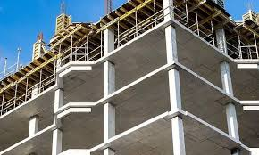



University of Global Village (UGV), Barishal
Design of Concrete Structures-II
Content of Theory Course
Prepared By
Rubieyat Bin Ali
Assistant Professor & HOD
Department of Civil Engineering
University of Global Village (UGV), Barishal
Program: B.Sc. in CE

Slide 2
Course Title | Design of Concrete Structures-II
Course Code | CE 0732-3103
Credits | 04
CIE Marks | 120
SEE Marks | 80
Exam Hours | 2 hours (Mid Exam) 3 hours (Semester Final Exam)
Level | 5th Semester
BASIC COURSE INFORMATION

Slide 3
Design of Concrete Structures-II
Course Code: CE 0732-3103 | CREDIT:04
 | TOTAL MARKS:200
Mid Exam Hours 2 | CIE MARKS: 120
Semester End Exam Hours 3 | SEE MARKS: 80
Course Teacher: Rubieyat Bin Ali
Course Learning Outcomes (CLOs): After completing this course successfully, the students will be able to-
CLO 1 | Understand the concepts of Structural Design of Reinforced concrete members.
CLO 2 | Apply the knowledge to analyze and design column supported slab system (Two-way slab) as per code provisions.
CLO 3 | Design columns, slab, and footing
CLO 4 | Generate the detailing of various structural components of buildings and bridges.

Slide 4
SL | Content of Course | Hrs | CLOs
1 | Load Transferring Mechanism of Structure, Basic of frame structures | 8 | CLO1
2 | Introduction to column, Tied column, spiral column, short column, long column, composite column, Steel column, Column under uni/bi-axial loading condition, Confinement effect, Design of spiral column. | 8 | CLO3, CLO4
3 | Differences between one way and two-way slab, Crank bar, straight bottom bar, extra top, distribution bar, temperature reinforcement, shrinkage reinforcement, binding bar, corner reinforcement. | 9 | CLO2, CLO4
4 | Introduction for footing and foundation, single column footing, combined footing, strip footing, strap beam, mat foundation, skin friction pile, end bearing pile, negative skin friction, Design of single column footing. | 9 | CLO1, CLO3
Text Book:
1. Design of Concrete Structures by Arthur H. Nilson, David Darwin, Charles W. Dolan (Mc Graw Hill) – 13th edition.
2. Design of Concrete Structures by Arthur H. Nilson – 7th edition.
3. Design of Reinforced Concrete by Jack C. McCormac, Russell H. Brown – 9th edition
4. Design of Prestressed Concrete Structures by T. Y. Lin and Ned H. Burns

Slide 5
ASSESSMENT PATTERN
CIE- Continuous Internal Evaluation (120 Marks)
SEE- Semester End Examination (80 Marks)
Bloom’s Category | Tests
Remember | 10
Understand | 15
Apply | 15
Analyze | 15
Evaluate | 15
Create | 10
Bloom’s Category Marks (out of 120) | Tests (min 4) (60) | Assignments (min 4) (20) | Quizzes (20) | External Participation in Curricular/Co-Curricular Activities (20)
Remember | 10 |  | 10 | Attendance/Field Visit/Presentation/Project Exhibition (20)
Understand | 10 |  | 10
Apply | 10
Analyze | 10
Evaluate | 10
Create | 10 | 20

Slide 6
Course plan specifying content, CLOs, teaching learning and assessment strategy mapped with CLOs
Week | Topic | Teaching-Learning Strategy | Assessment Strategy | Corresponding CLOs
1 | Basic of load transfer, Load Transferring Mechanism of Structure | Lecture, discussion, group work | Quiz, Written Exam | CLO1
2 | Basic of frame structures, Definition of Column, Tied column and spiral column | Oral Presentation, debate | Assignment, Written, Quiz | CLO1
3 | Short column and long column, L,T,Y shape column, Stub and neck column | Video lecture, Field visit | Report writing, Demonstration | CLO1
4 | Composite column | Lecture | Viva, Quiz | CLO1, CLO3
5 | FEC Column, PEC Column | Project exhibition | Project, Field visit | CLO1
6 | Confinement Effect, Steel column, Column under uni-axial loading condition, Column under bi-axial loading condition | Discussion, Video Presentation | Quiz, Written Exam | CLO1
7 | Slender Column, Buckling Formula, USD and WSD | Case-based Learning, Demonstration | Assignment, Written, Quiz | CLO1, CLO4
8 | Design of spiral column-I, Design of spiral column-II | Lecture, discussion, group work | Report writing, Demonstration | CLO3, CLO4
9 | Differences between one way and two-way slab, Crank bar | Oral Presentation, debate | Viva, Quiz | CLO2
10 | Straight bottom bar and extra top, Distribution Bar/Binder, Corner Reinforcement | Video lecture | Project, Field visit | CLO2

Slide 7
Course plan specifying content, CLOs, teaching learning and assessment strategy mapped with CLOs
Week | Topic | Teaching-Learning Strategy | Assessment Strategy | Corresponding CLOs
11 | Two-way Slab Design Problem-I, Slab Design Problem-II | Lecture | Quiz, Written Exam | CLO3, CLO4
12 | Two-way Slab Design Problem-III, Slab Design Problem-IV | Project exhibition | Assignment, Written, Quiz | CLO3, CLO3
13 | Introduction for footing and foundation, Single column footing and combined footing | Discussion, Video Presentation | Report writing, Demonstration | CLO1
14 | Strip footing and strap beam, Mat Foundation, Skin friction pile and end bearing pile | Case-based Learning, Demonstration | Viva, Quiz | CLO1
15 | Negative skin friction, Design of single column footing-I, Design of single column footing-II | Lecture, discussion, group work | Project, Field visit | CLO3, CLO4
16 | Design of single column footing-III, Caisson and Cofferdam, Viaduct and aqueduct | Oral Presentation, debate | Quiz, Written Exam | CLO3, CLO4
17 | Practice and Exercise, Practice and Exercise, Practice and Exercise | Video lecture | Assignment, Written, Quiz | CLO3, CLO4

Slide 8
Column Types
Week 1
Pages 9-12

Slide 9
Basic Load Transferring Mechanism:
The load transfer mechanism in a building structure is how loads are transmitted from one element to another, eventually reaching the foundation and the ground. There are two main types of loads that a building structure must transfer: vertical loads and horizontal loads:
Vertical loads
These loads are transferred from the roof to the foundation through the slabs, columns, and piles. Columns are vertical members that support the loads from above and transfer them to the foundation.
Horizontal loads
These loads are transferred to the walls and then to the foundation through shear walls or moment frames. Beams are horizontal elements that connect the columns and distribute horizontal loads to the columns.

Slide 10
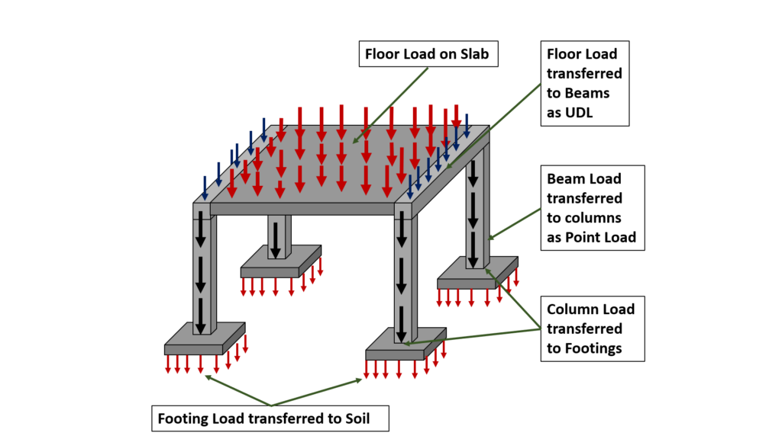
Basic Load Transferring Mechanism:
Column might transfer loads from a ceiling, floor slab, roof slab, or from a beam, to a floor or foundations.

Slide 11
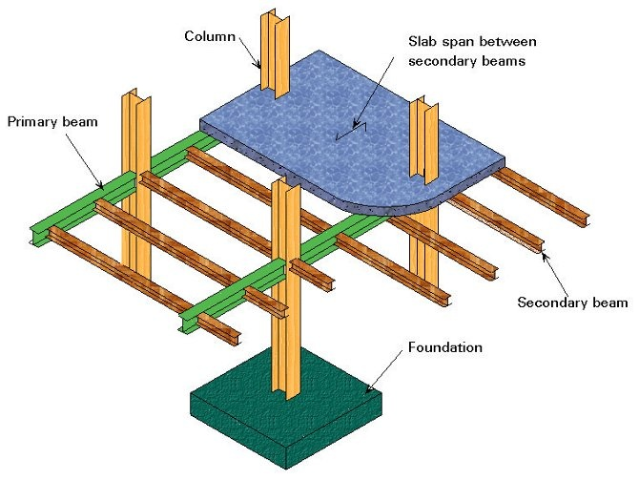
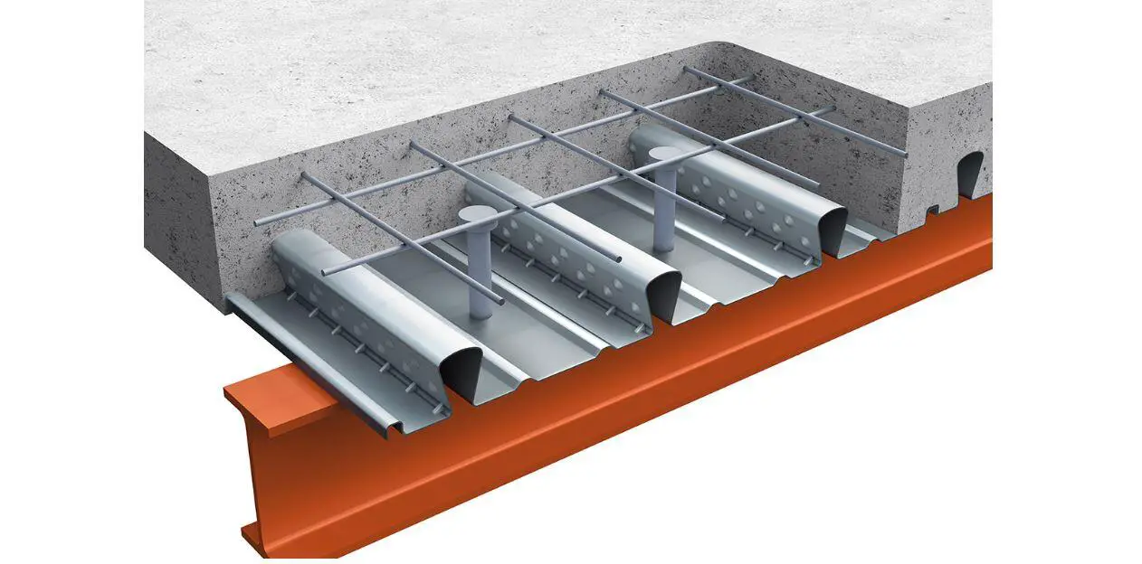
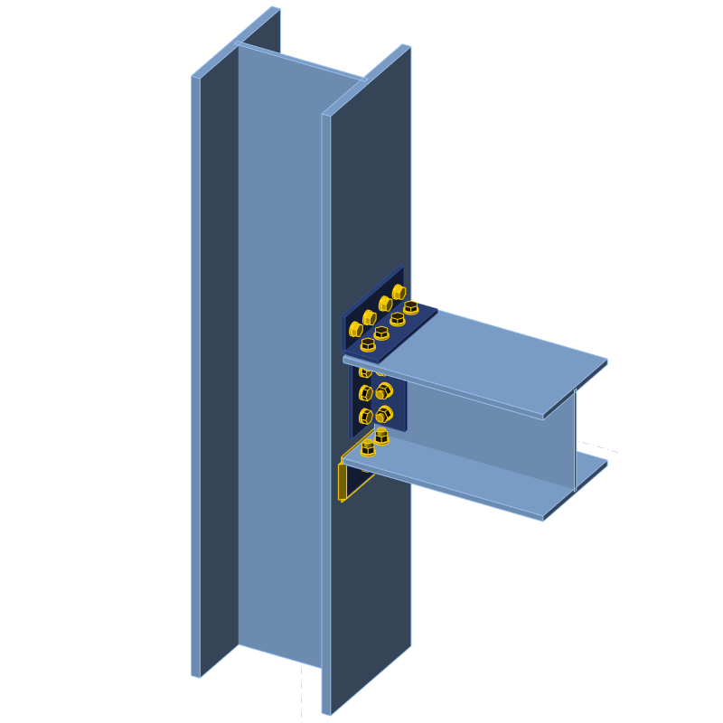
Shear Stud Connector
Web
Flange
Steel Connection
Shear Connection – Hinged – Column to web connection – Web releases moment in earthquake (LF+Moment)
Moment Connection – Moment /fixed connection – Column to flange+wed connection
LF means Lateral force

Slide 12
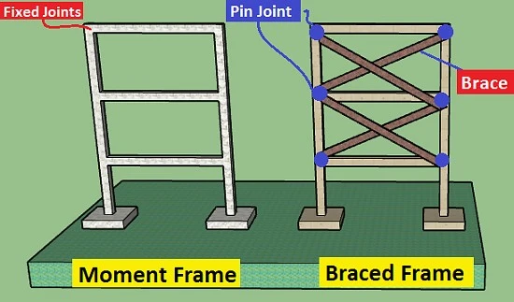
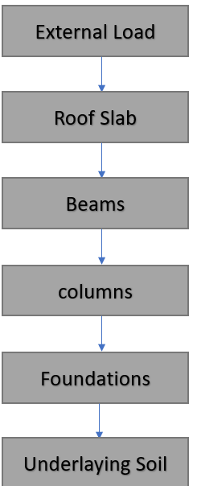

Slide 13
Column Types
Week 2
Pages 14-18

Slide 14
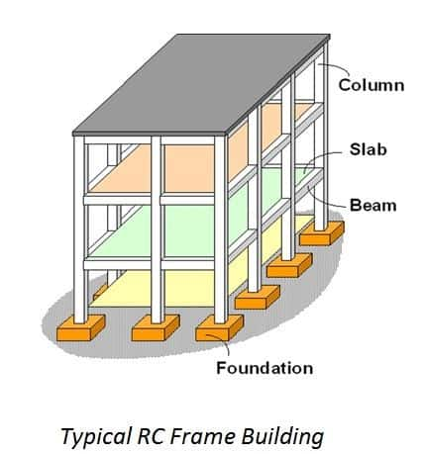
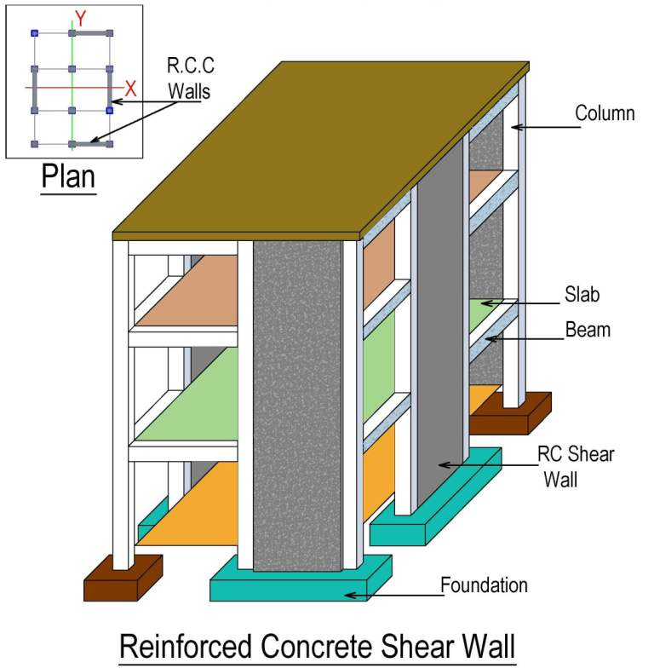
Frame structures
Frame structures can be made from different materials, including reinforced concrete, steel and wood. Frame structures comprise a combination beam, column, and slab that can withstand lateral and gravitational loads. These structures are often used to overcome large moments that result from the applied loading.

Slide 15
Definition of Column:
A vertical member whose effective length is greater than 3 times Its least lateral dimension carrying compressive loads is called as a column. Columns transfer the loads from the beams or slabs to the footings or foundations. The inclined member carrying compressive loads as In the case of frames and trusses is called as struts. The pedestal is a vertical compression member whose effective length Is less than 3 times Its least lateral dimension.
There are several types of columns which are used in different parts of structures. Column is a vertical structural member that carry loads mainly in compression. It might transfer loads from a ceiling, floor slab, roof slab, or from a beam, to a floor or foundations.
Commonly, columns also carry bending moments about one or both of the cross-section axes. In this article, different types of column used in building construction will be discussed.

Slide 16

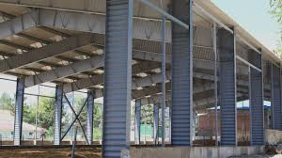

Why we provide Columns?
Primarily, Columns carry Axial Loads and therefore are designed for compression. Other loads from snow, wind or other horizontal forces can cause bending in the columns. Columns then need to be designed for Axial Load and Bending.
Columns

Slide 17
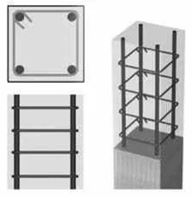
Types of Columns in Building Construction:
Columns are classified based on the several conditions which include:
Based on Types of Reinforcement
1. Tied Column
This type of column is commonly construction from reinforced concrete. Longitudinal reinforcement are confined within closely spaced tie reinforcement. It is estimated that 95% of all columns in buildings are tied.

Slide 18
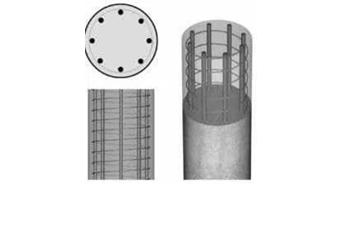
Types of Columns in Building Construction:
Columns are classified based on the several conditions which include:
Based on Types of Reinforcement
2. Spiral Column
Spiral column is also construction from reinforced concrete. In this type of column, longitudinal bars are confined within closely spaced and continuously wound spiral reinforcement. Spiral reinforcement provide lateral restrains (Poisson’s effect) and delays axial load failure (ductile).

Slide 19
Column Types
Week 3
Pages 20-29

Slide 20
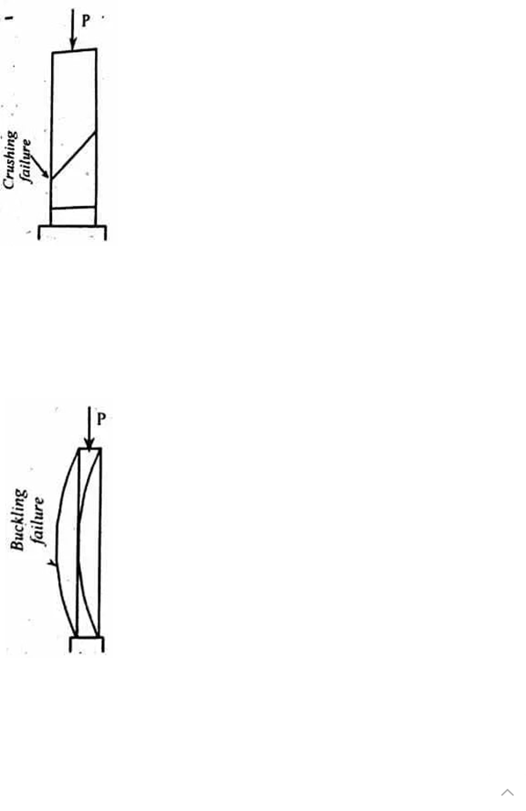
Types of Columns in Building Construction:
Columns are classified based on the several conditions which include:
Based on Slenderness Ratio
3. Short Column
If the ratio effective length of the column to the least lateral dimension is less than 12, the column is called as the short column. Also, column fails by crushing (pure compression failure).

Slide 21
Types of Columns in Building Construction:
Columns are classified based on the several conditions which include:
Based on Slenderness Ratio
4. Long Column
If the ratio effective length of the column to the least lateral dimension exceeds 12, it is called as long column. A long column fails by bending or buckling.

Slide 22
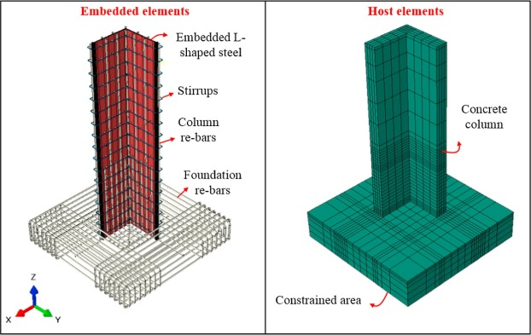
Types of Columns in Building Construction:
Columns are classified based on the several conditions which include:
Based on Shape
L-Shape Column
Commonly, L-shaped column is utilized in the corners of the boundary wall and has similar characteristics of a rectangular or square column.

Slide 23
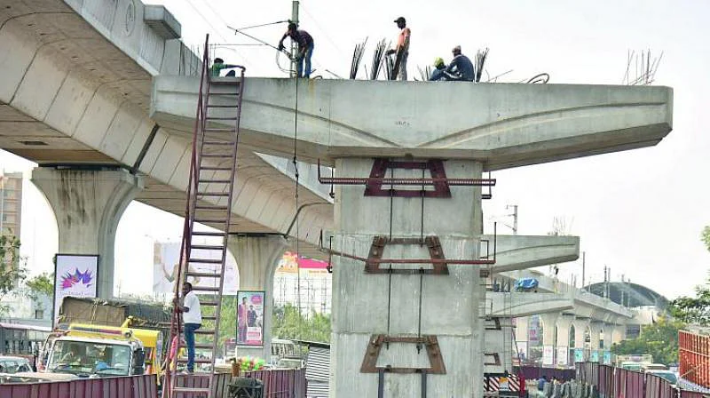
Types of Columns in Building Construction:
Columns are classified based on the several conditions which include:
Based on Shape
T-shape column
It is utilized based on design requirements of a structure. T-Shaped column is widely used in the construction of bridges.

Slide 24
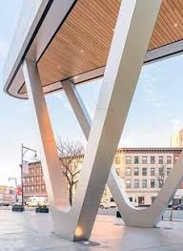
Types of Columns in Building Construction:
Columns are classified based on the several conditions which include:
Based on Shape
V- Type Column
As a name itself, it showcasing the column is in V shape and generally used if the shape of the room is in trapezoidal. As it requires more amount of concrete when compared to the other columns.

Slide 25
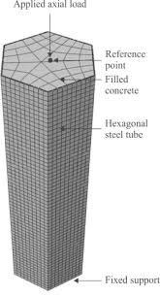
Types of Columns in Building Construction:
Columns are classified based on the several conditions which include:
Based on Shape
Hexagon Column
Hexagon columns are generally modified columns. It has six sides and it gives good pictorial view generally used in elevation. It is adopted to give a good look to the column. It is generally provided in open verandas, Auditoriums, Cinema halls etc.

Slide 26
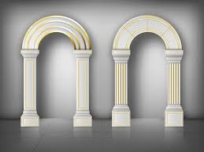
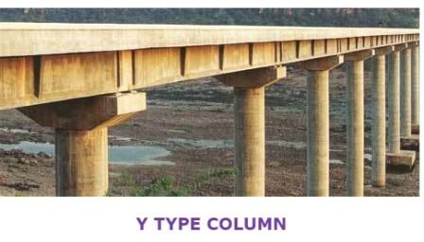
Arch type columns:
These type of columns are used when the room has a shape of an arch. It is adopted where there is a no chance of building square or rectangular or circular type of column. it is rarely used as it possess very difficulty in casting.
Arch type columns
Y – Type Column:-
These types of columns are generally used in the construction of bridges, flyovers, etc.

Slide 27
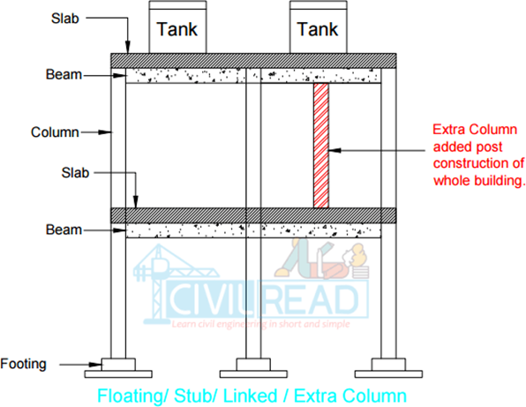
Some other types:
1. Stub Column/ Floating column / Linked Column:-
We know that column stands on the footing. but when coming to the stub column. It won’t have any footing. The column stands on the slab or beam.
For making you clear, here I am giving an example, for suppose you constructed a house with a capacity of 50 members so according to the members using building you design a water tank. Suddenly due to the scarcity of land building is using by 90 members so initially, you are provided one tank which will sufficient to 50 members. Now, you have to provide another tank to cover all the 90 members. But you constructed a building with the design of only one tank but additionally, another tank is added inorder to bear that load another column is added beneath the tank and it rests on either beam or column.

Slide 28
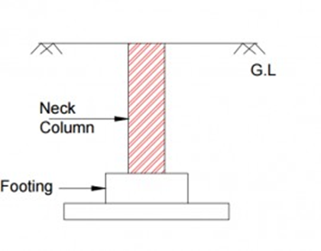
Neck column:
It is a part of the column (any type of column) which is buried in earth is called Neck column. The word Neck column is usually used while building footings.

Slide 29
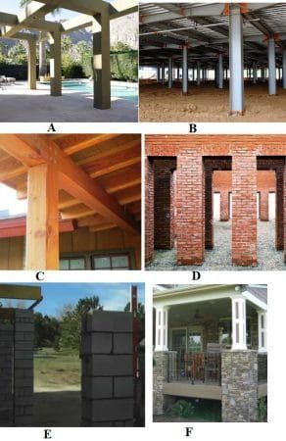
Reinforced Concrete, Steel, timber, Brick, Block, and Stone Column:

Slide 30
Column Types
Week 4
Pages 31-32

Slide 31
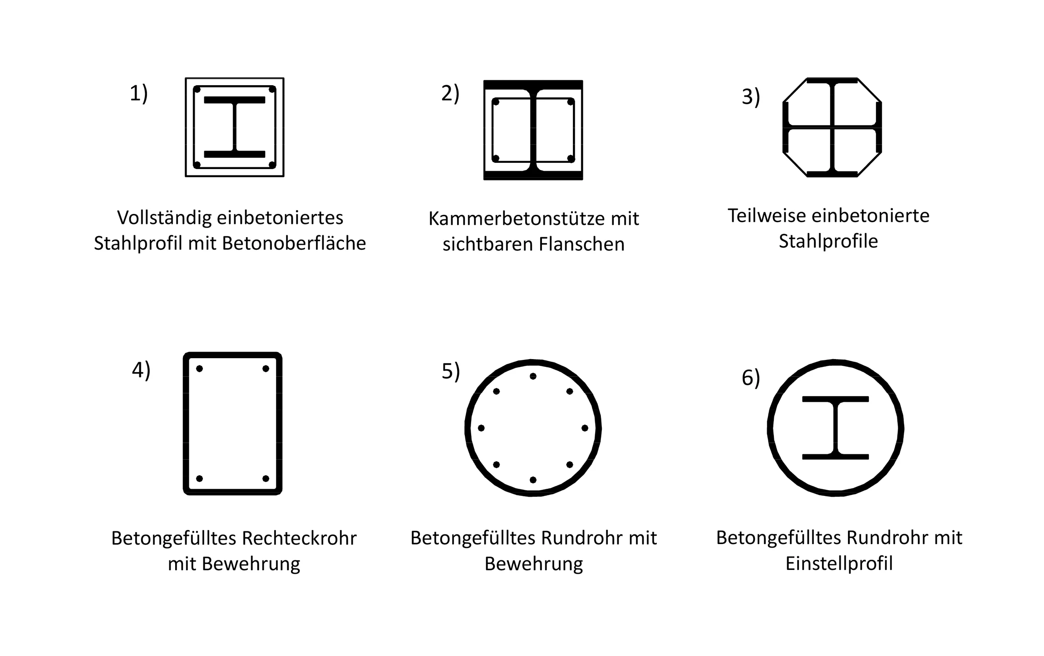
Types of Columns in Building Construction:
Based on Materials
Composite column
When the longitudinal reinforcement is in the form of structural steel section or pipe with or without longitudinal bars, it is called as composite column. This type of column have high strength with fairly small cross section, in addition to exhibit good fire performance.

Slide 32
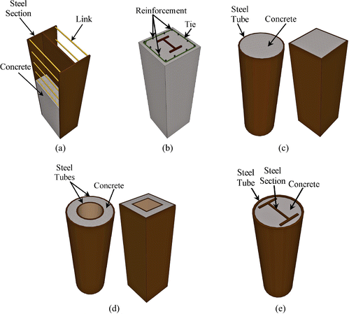
Concrete filled steel tubular Column (CFST)
Partially encased Composite Column
Fully encased Composite Column

Slide 33
Column Types
Week 5
Pages 34-37

Slide 34
Fully Encased Composite column (FEC):
A fully encased composite column is a load-bearing member made of structural steel encased in reinforced concrete:
Composition
A fully encased composite column is made up of a structural steel section, longitudinal and transverse reinforcement, and concrete.
Benefits
The concrete encasement stiffens the steel member, which helps prevent buckling and fireproofs the column. The combination of materials also allows the column to support a large amount of load while having a smaller cross-sectional area.
Uses
Fully encased composite columns are often used in composite framed structures.
Design
The design and analysis of concrete encased steel composite columns can be done under various loading conditions, such as seismic loading, fire, impact loading, and blast loading.

Slide 35
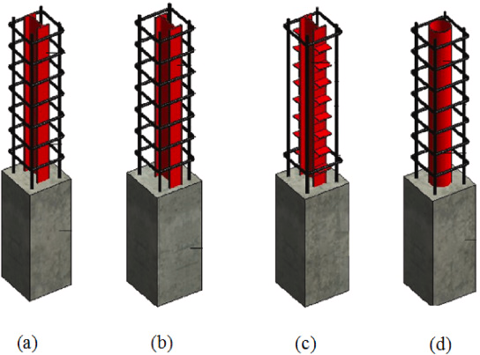

Slide 36
Partially Encased Composite column (PEC):
A partially encased composite column (PEC) is a column made of a thin-walled steel section and concrete poured in the space between the flanges of the steel section. The behaviour of PEC columns can be complex due to the interaction between the concrete and the steel.
Here are some things to know about PEC columns:
Behaviour
The behaviour of PEC columns under axial loading can be complex, especially when using high strength concrete.
Failure modes
PEC columns can fail due to global buckling, concrete spalling, and crushing.
Factors that affect behaviour
Factors that can affect the behaviour of PEC columns include:
Concrete strength: Increasing concrete strength can increase the stiffness and bearing capacity of the connection

Slide 37
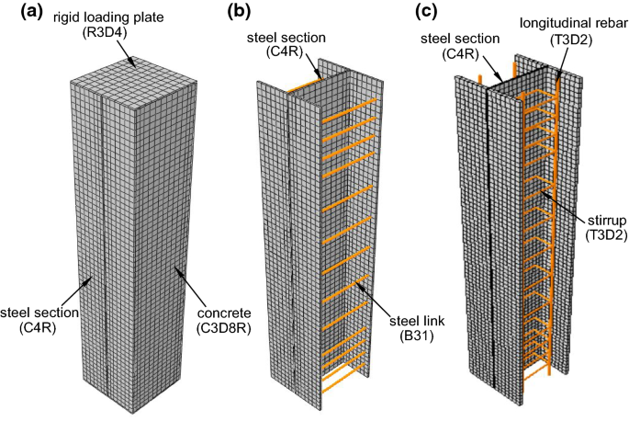

Slide 38
Column Types
Week 6
Pages 39-50

Slide 39
Confinement Effect For CFST Column:
The confinement effect is an important feature of the structural behaviour of CFST columns, where is related to the cross-sectional properties as well as the material properties. The confinement effect in the first phase of loading can be neglected, where the Poisson's ratio of the concrete is smaller than that of the steel. Therefore, the steel tube expands faster than the concrete core in the radial direction in the first (elastic) stage. This behaviour leads to an unconfined or free concrete behaviour until the concrete cracks occur. Likewise, this behaviour postpones the confinement effect and decreases the effectiveness of the steel tube in the elastic stage. Micro-cracking of concrete increases under loading and Poisson's ratio of the concrete increases in a lateral direction, hence the confinement of steel develops.

Slide 40
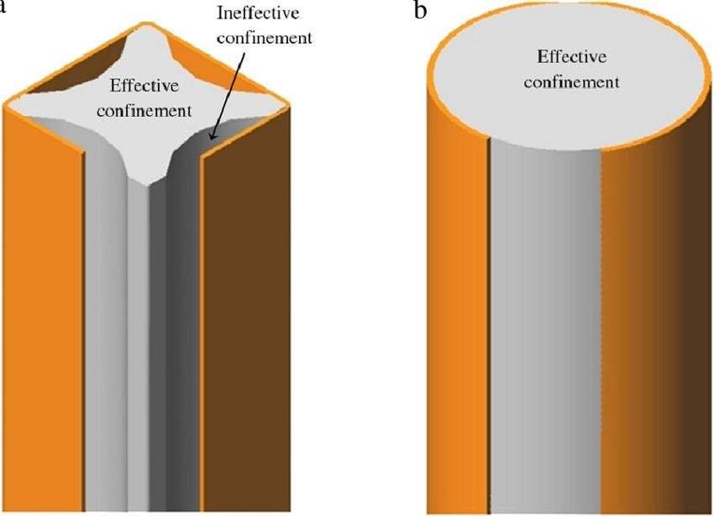
Improving Confinement for Square/Rectangular CFST:
Rounded Corner
Welded longitudinal Steel Plates

Slide 41
Steel Column:
Steel column is a vertical structural element that provides support to buildings and other structures. It's a key part of a building's frame, transferring loads from upper floors, roofs, or beams to the foundation or other supporting members.
Steel columns are made from high-strength steel, which allows them to withstand heavy loads and forces without deforming. They are known for their resilience, sturdiness, and ability to support massive weights.
Steel columns have several advantages over concrete or timber columns, including:
High strength-to-weight ratio, Better ductility, Recyclability, Design flexibility, Earthquake resistance, and Structural integrity.
Steel columns are also known as stanchions. They are used in industrial structures to support beams and trusses.

Slide 42
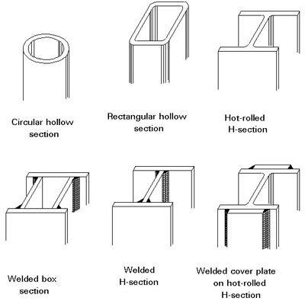
Steel Column

Slide 43
Hot rolled versus Cold Formed Steel:
The main difference between hot rolled and cold formed steel is the temperature at which they are processed:
Hot rolled steel
Rolled at a temperature above the material's recrystallization temperature, usually over 1,700°F. This process allows the steel to be easily shaped and formed into larger sizes. Hot rolled steel is often used in large, rugged structural sections like bridges, railway tracks, and structural frames.
Cold formed steel
Rolled or bent at room temperature without heat. Cold formed steel is often used for smaller shapes and thinner gauges, and is more precise and stronger than hot rolled steel. Cold rolled steel is often used for more aesthetic applications like furniture or appliances.
Here are some other differences between hot rolled and cold formed steel:

Slide 44
Surface quality
Hot rolled steel has rough edges and surfaces, while cold rolled steel has a shiny, smooth surface.
Material hardness
Cold rolled steel is harder and stronger than hot rolled steel.
Internal stress
Cold rolled steel has greater internal stresses than hot rolled steel, which must be relieved before processing.
Cost
Hot rolled steel sections are often more cost-effective for large quantities.
Ductility
Cold rolled steel is more ductile than hot rolled steel, meaning it can bend under greater stress without breaking.

Slide 45
Hot Rolled Steel Uses in:
Constructions, Pipes and tubes, Truck frames, Doors and shelving, Railroad tracks, Railroad car parts
Examples of cold rolled steel products include; bars, strips, rods and sheets. These products are normally smaller than hot-rolled ones.
Click the link
Differences Between Hot rolled and cold formed Steel

Slide 46
Residual stress:
Surface residual compressive stresses are generally helpful because they reduce the effects of applied tensile stresses. In most cases, surface compressive stresses contribute to the improvement of fatigue strength and resistance to stress-corrosion cracking
In general, compressive residual stress at the surface of a component is beneficial: it tends to increase fatigue strength and fatigue life, slow crack propagation, and increase resistance to environmentally assisted cracking, such as stress corrosion cracking and hydrogen-induced cracking.
Usually Residual stresses have negative effects on the performance of structures. For example, tensile stresses within un-heat-treated welds can lead to premature cracking when combined with applied alternating service loads. Thus they may treat as negative effects.
The compressive residual stresses resist cracking because cracking is brought on by tensile forces, tearing at the surface of the material, and the negative compressive stresses increase the tensile stresses required to form a crack.

Slide 47
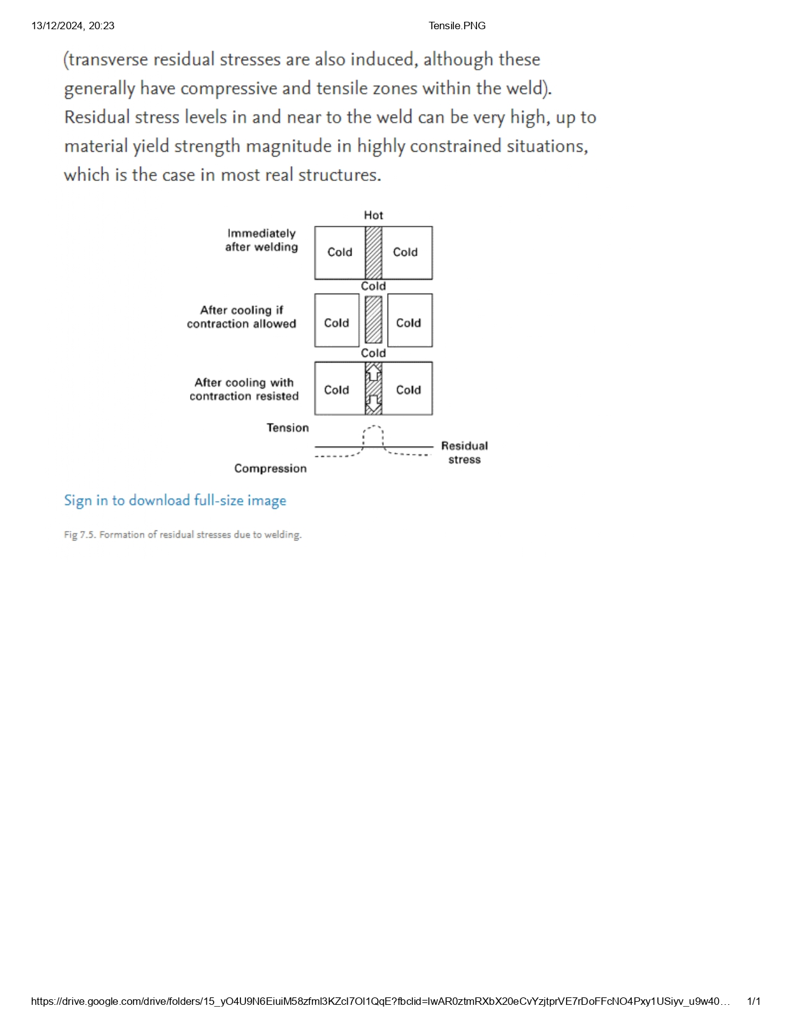
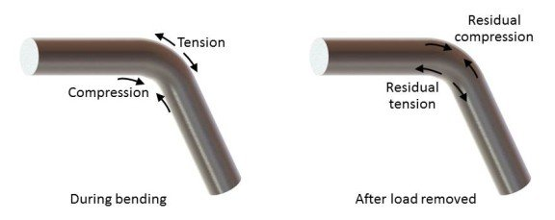

Slide 48
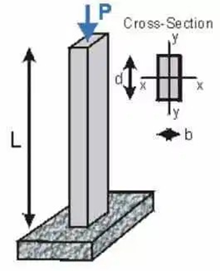
Types of Columns in Building Construction:
Columns are classified based on the several conditions which include:
Based on Types of Loading
Axially Loaded Column
If vertical axial loads act on the centre of gravity of the cross-section of the column, then it is termed as axially loaded column. Axially loaded column is rare in construction since coinciding vertical loads on the centre of gravity of column cross section is not practical. Interior column of multi-storey buildings with symmetrical loads from floor slabs from all sides is an example of this type of column.
Axially loaded column

Slide 49
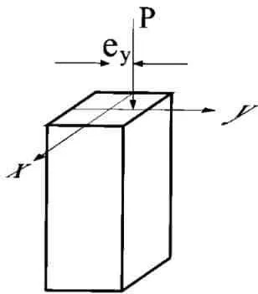

Column with Uniaxial Eccentric Loading
When vertical loads do not coincide with centre of gravity of column cross section, but rather act eccentrically either on X or Y axis of the column cross section, then it is called uni-axially eccentric loading column. Column with uniaxial loading are generally encountered in the case of columns rigidly connected beam from one side only such as edge columns.
Column with uniaxial eccentric loading
Column with Biaxial Eccentric Loading
When vertical on the column is not coincide with centre of gravity of column cross section and does not act on either axis (X and Y axis), then the column is called bi-axially eccentric loaded column. Columns with biaxial loading is common in corner columns with beams rigidly connected at right angles at the top of columns.
Column with biaxial eccentric loading

Slide 50
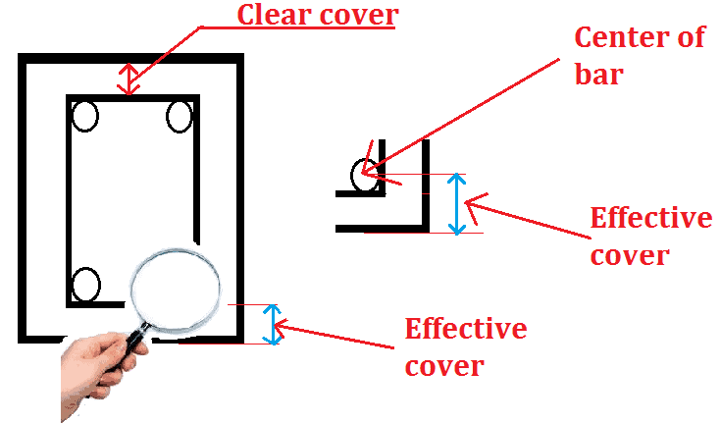
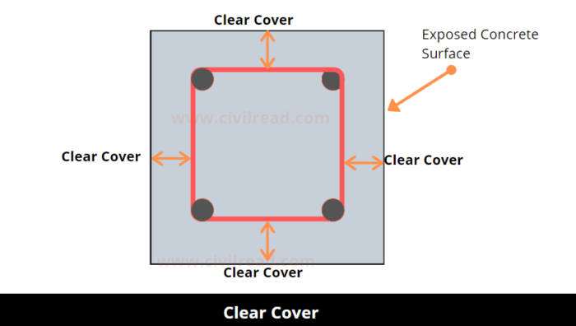
Click the link
Basic Rules of Column design rebar reinforcement
10 Basic Rules of Column Design - Don't Forget Basic Rules of RCC Column

Slide 51
Column Types
Week 7
Pages 52-73

Slide 52
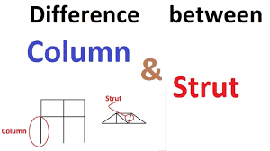
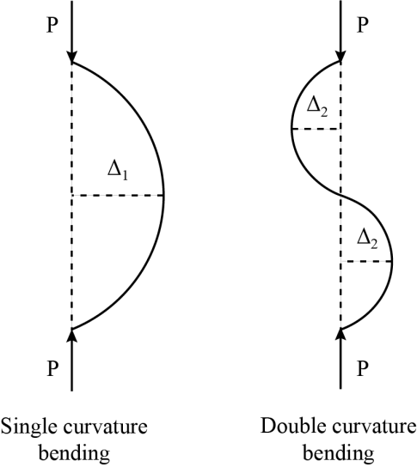
Strut:
Struts are supports, generally made of steel or concrete but sometimes also of timber, which are used to retain the walls of a vertical excavation. They are installed inside the excavation as the earthworks progress and generally support each side of the excavation.
Figure: Column (only vertical member), Strut (Any direction)
Point of contraflexure is defined for bending moment DIAGRAM is the point at which BMD is zero. And point of inflection is defined for deflected shape where there is change in curvature.
Curvature in structural analysis refers to the degree of bending or deformation in a structural element, such as a beam or column. It is typically quantified as the change in angle per unit length along the member.

Slide 53
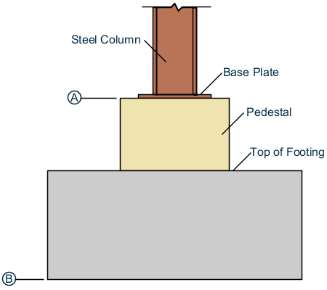
Pedestals are structural members between columns and footings, which distribute loads evenly on the footings. The construction of Pedestals on footings and columns reduces this tendency of loads.
Click this link
Column and Strut

Slide 54
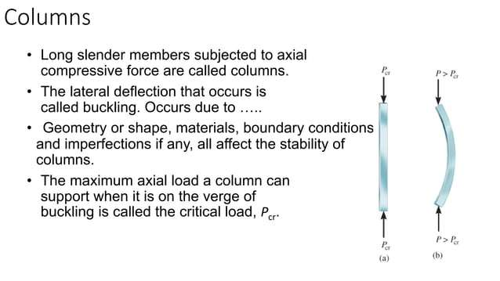

Slide 55
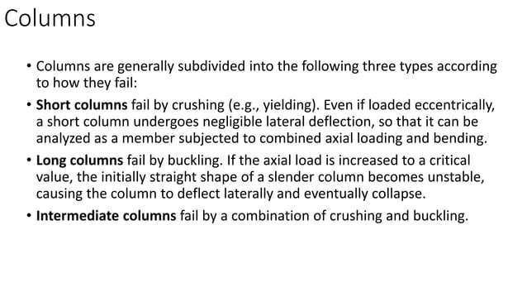

Slide 56
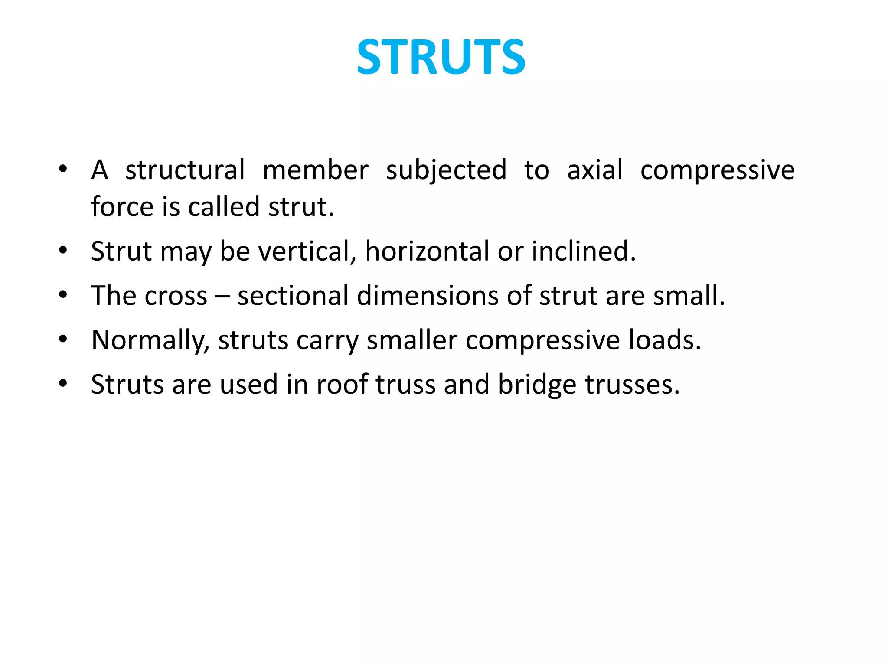

Slide 57
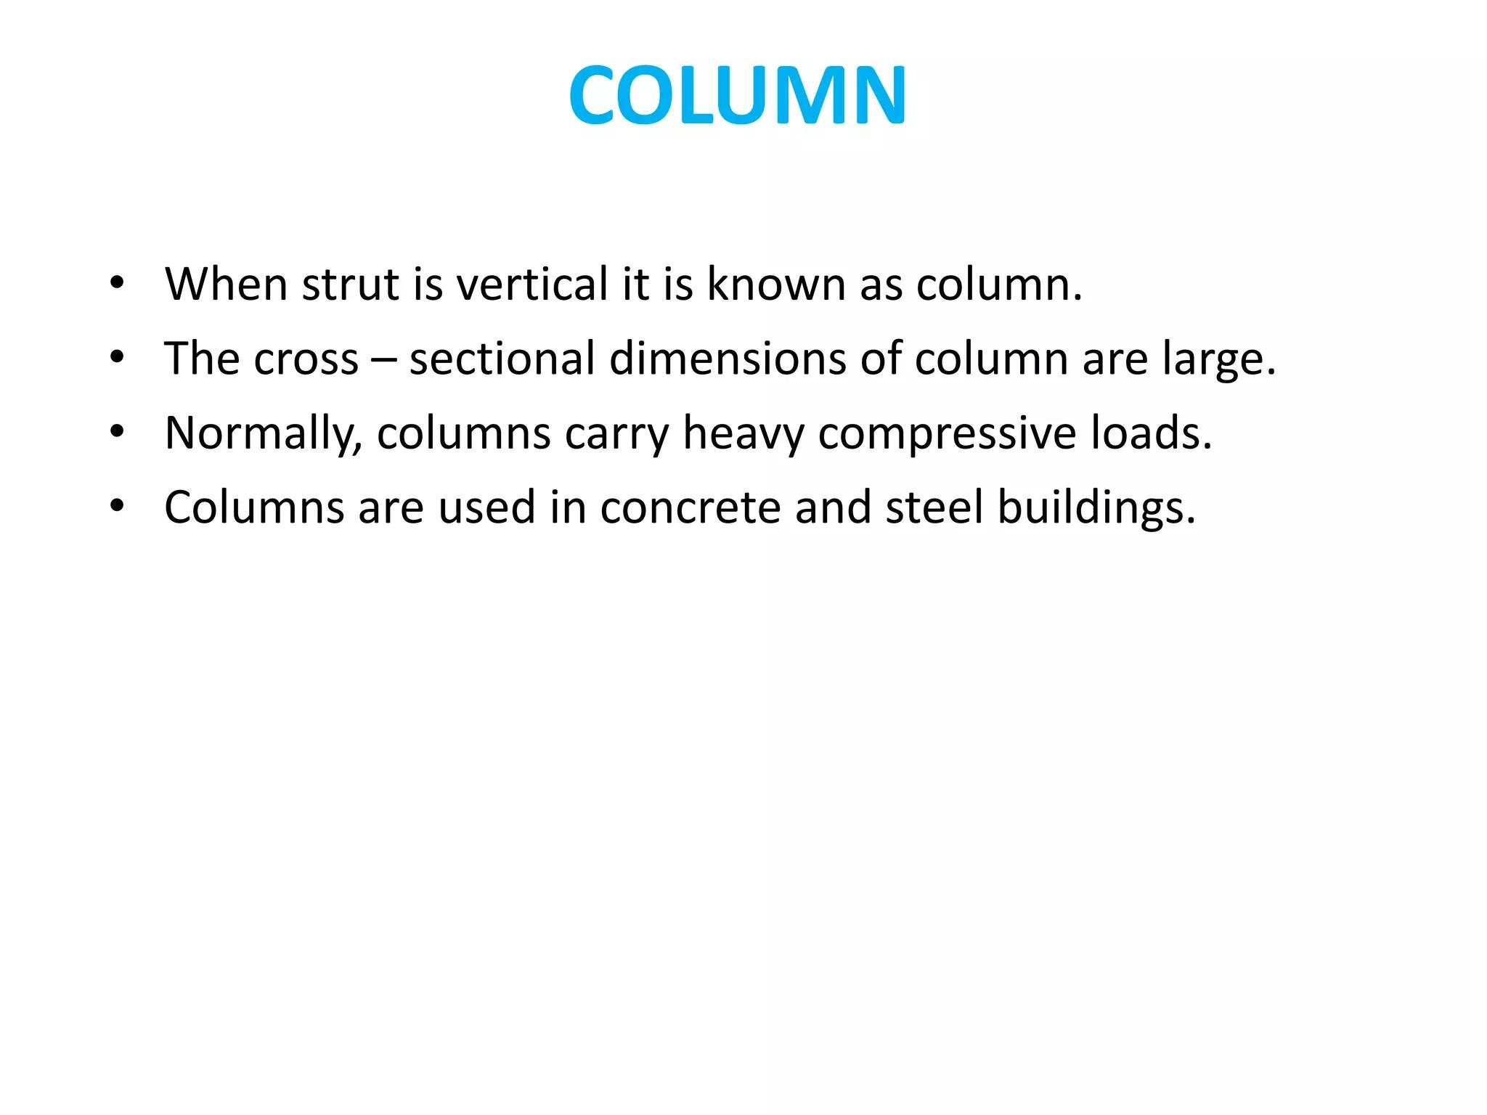

Slide 58
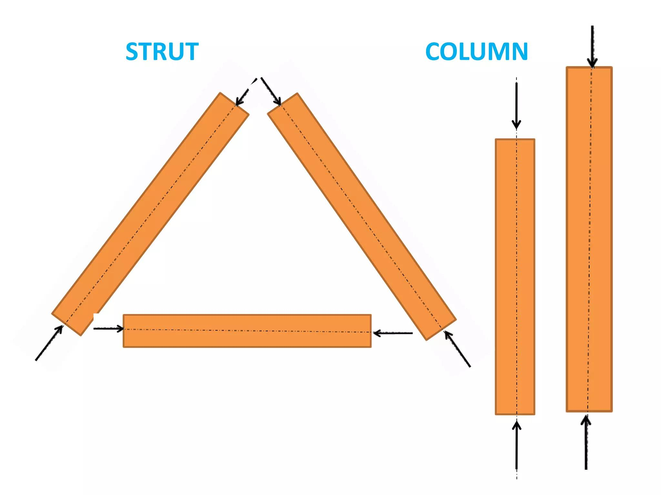

Slide 59
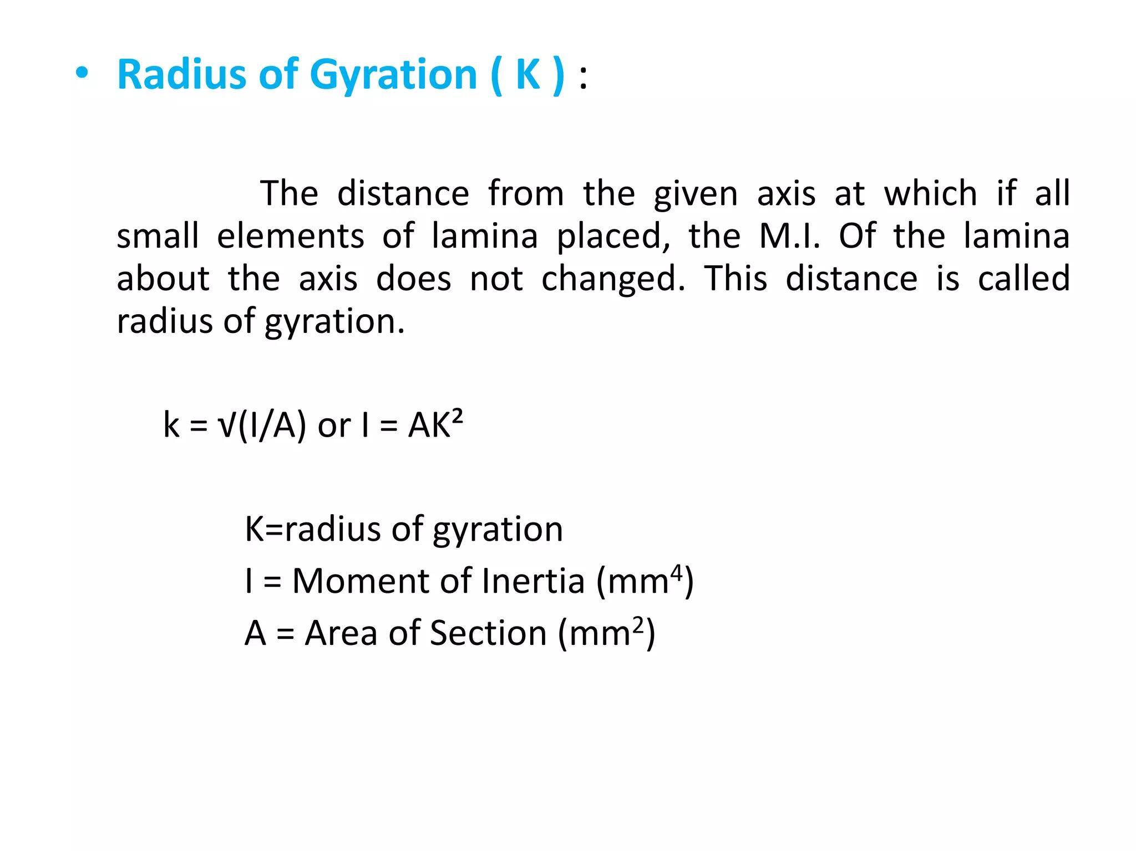

Slide 60
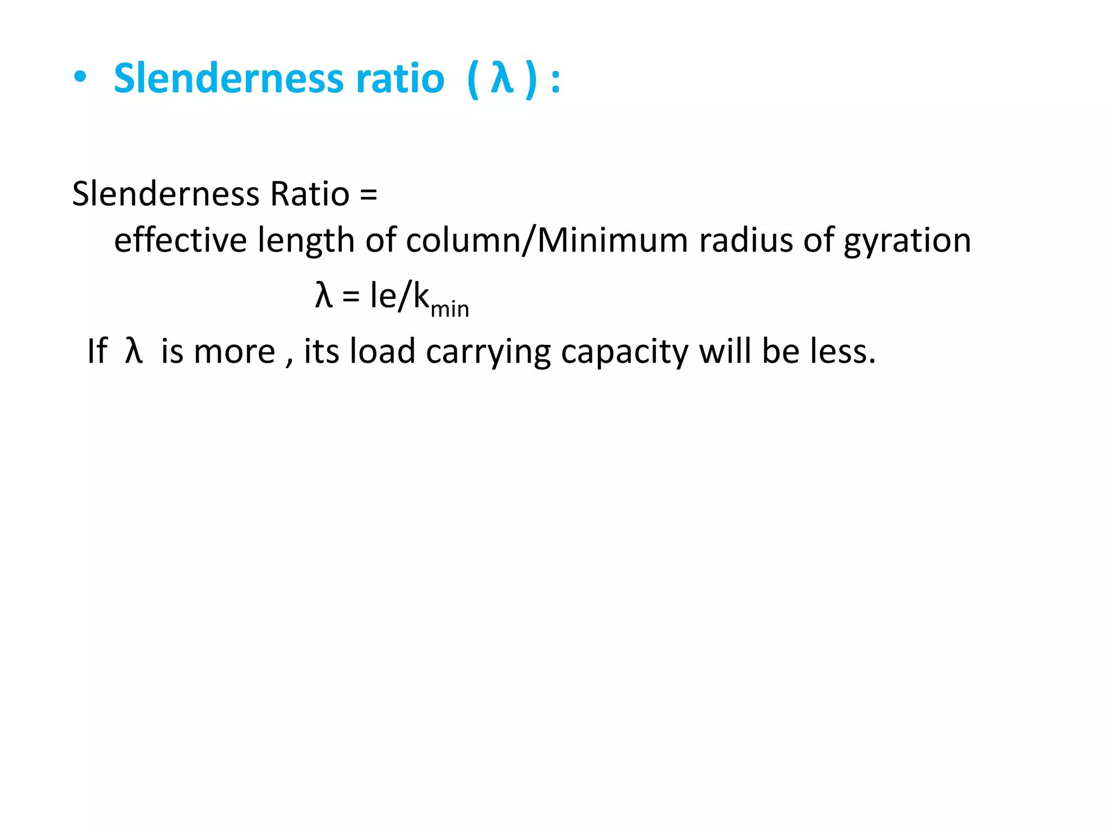

Slide 61
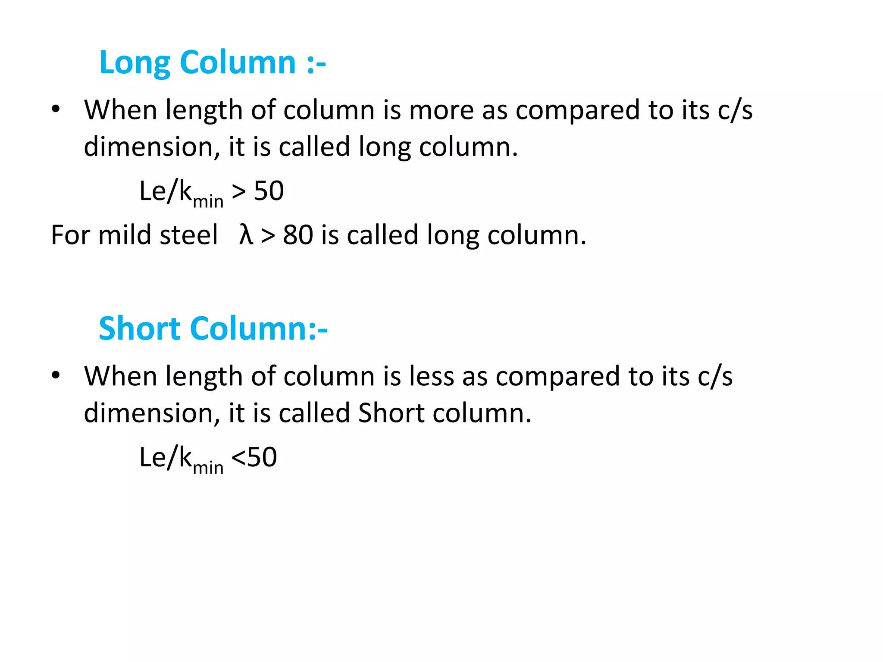

Slide 62
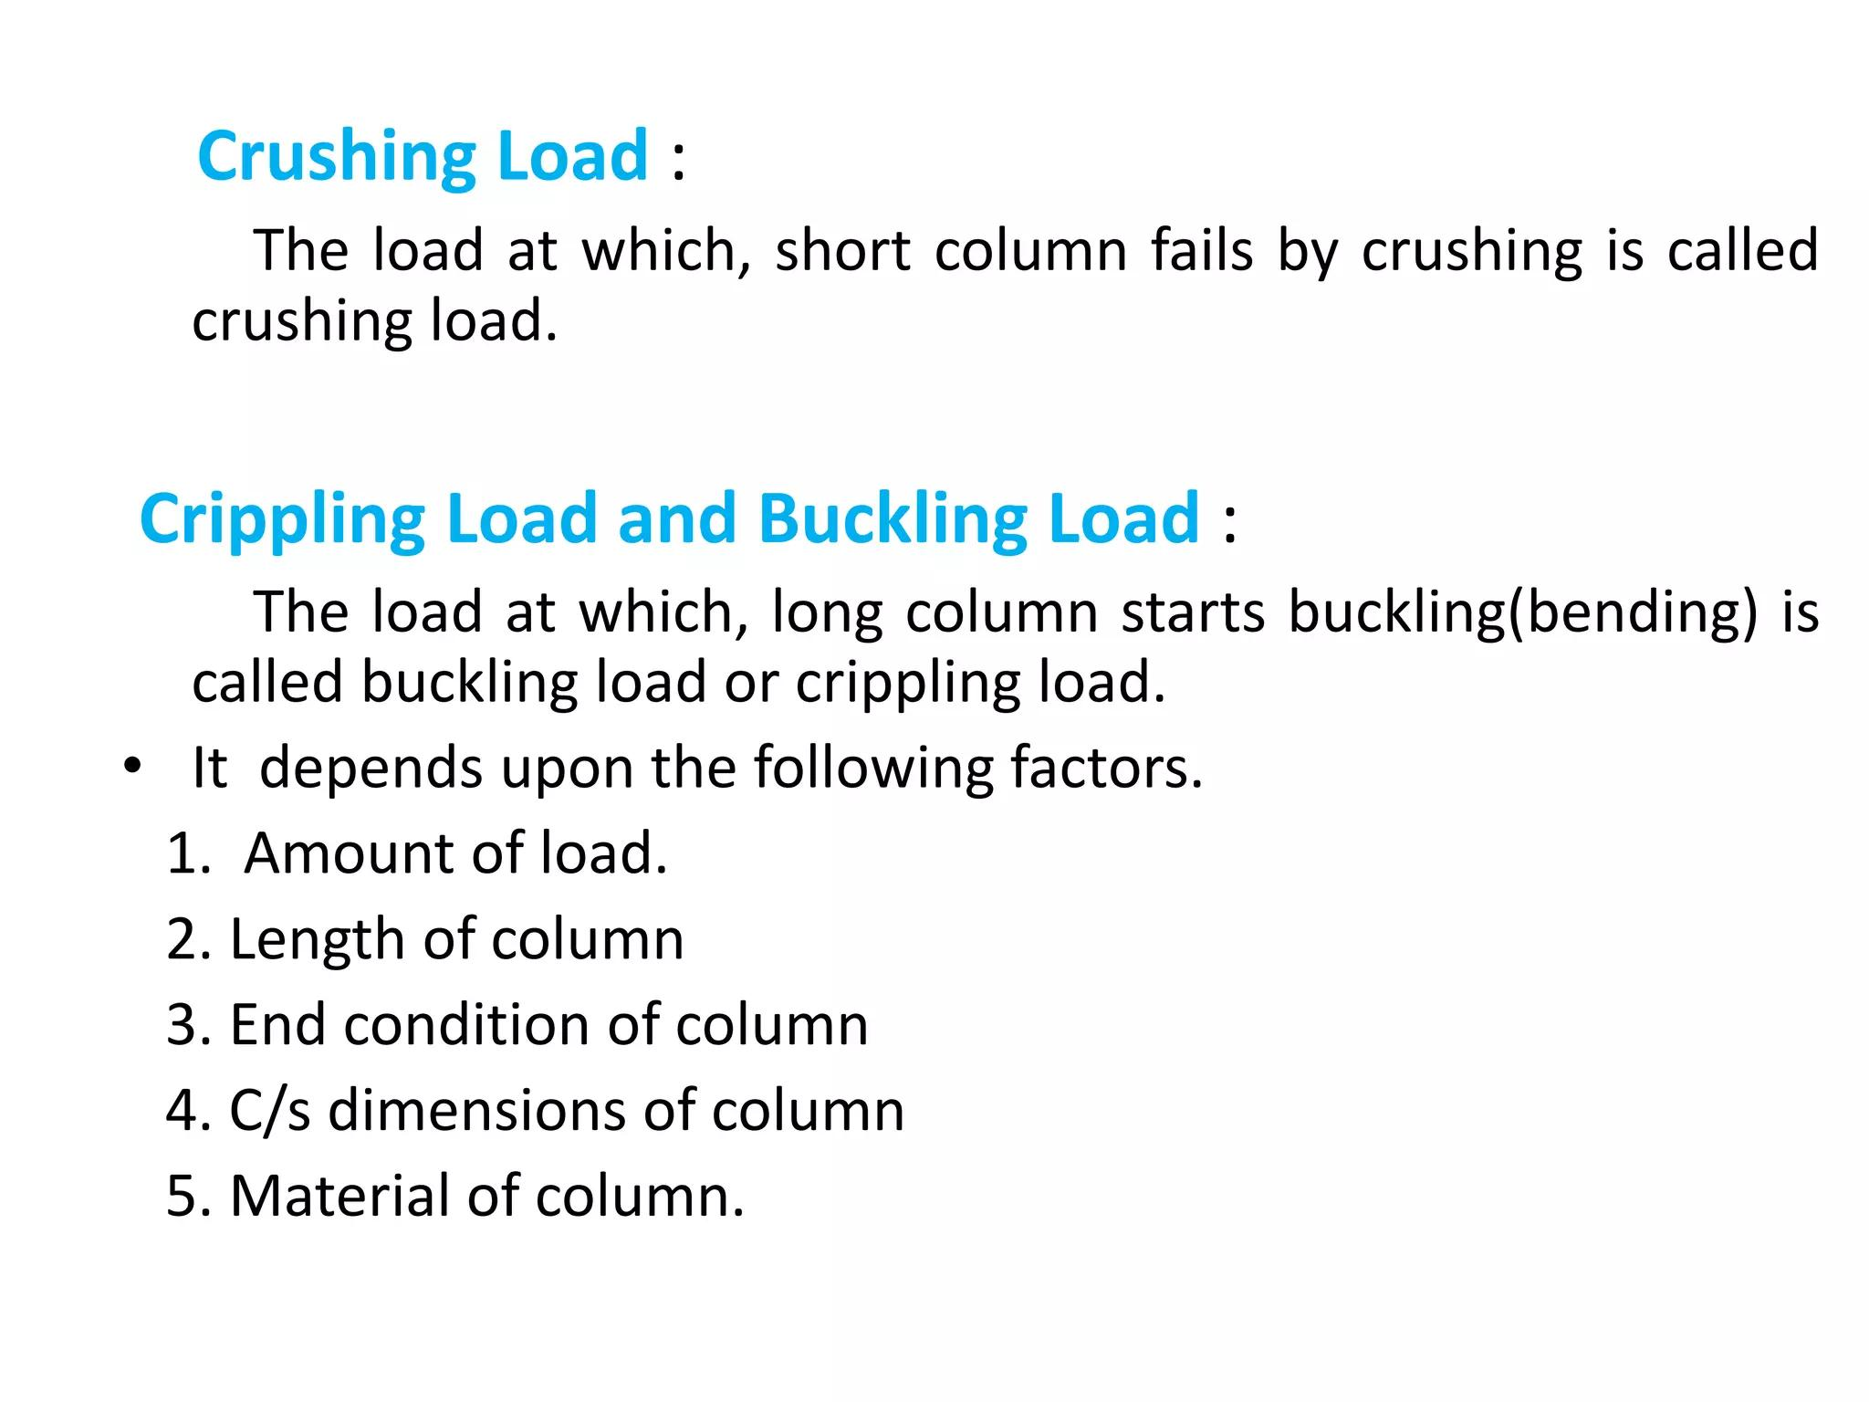

Slide 63
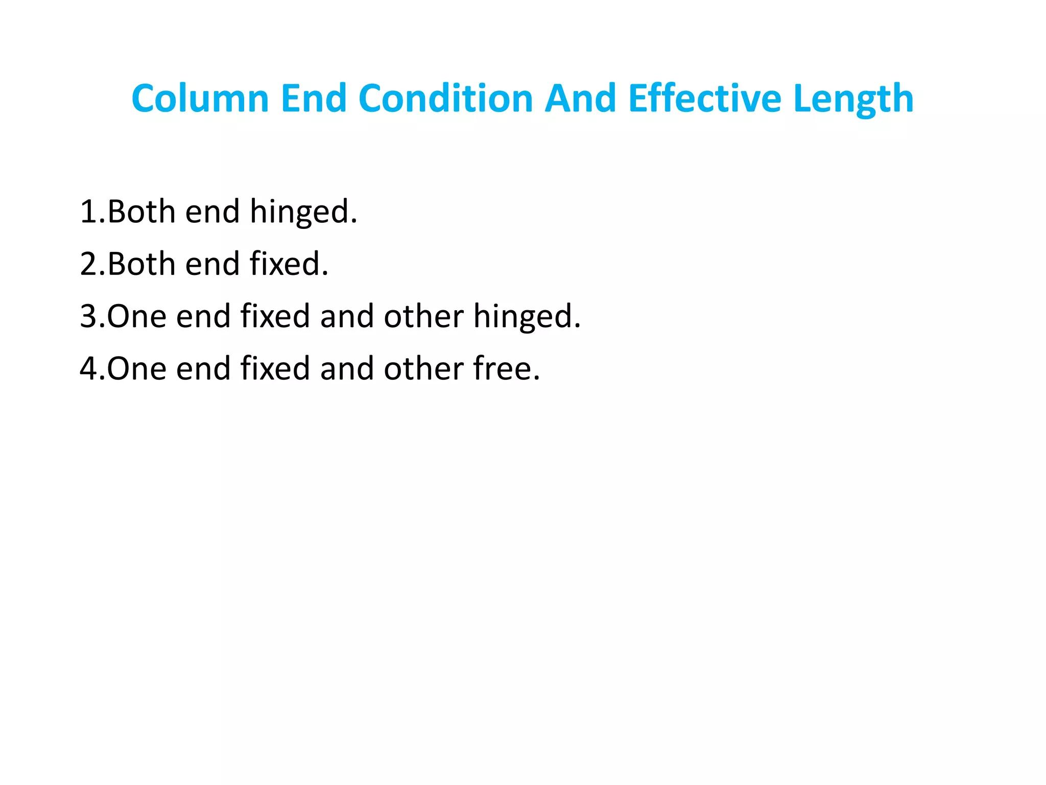

Slide 64
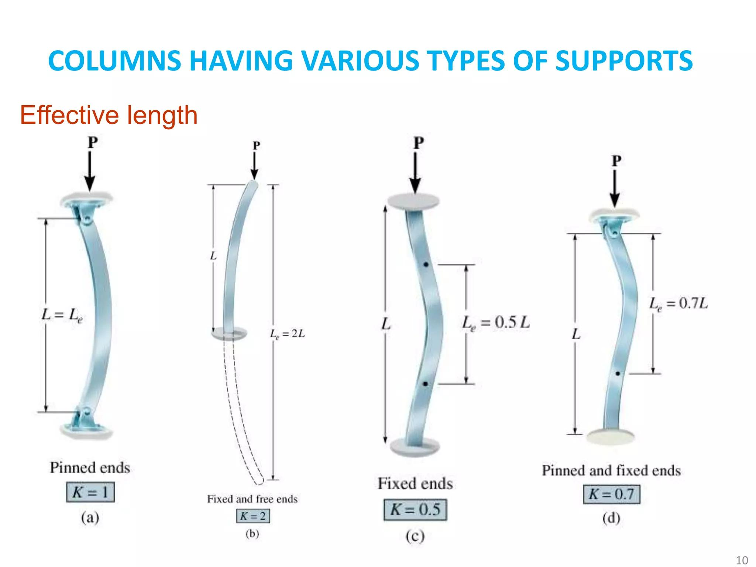

Slide 65
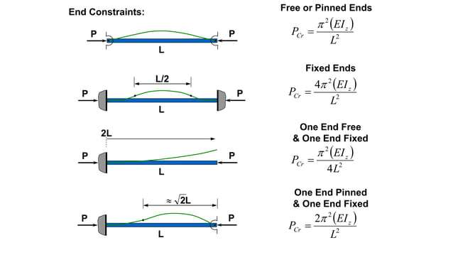

Slide 66
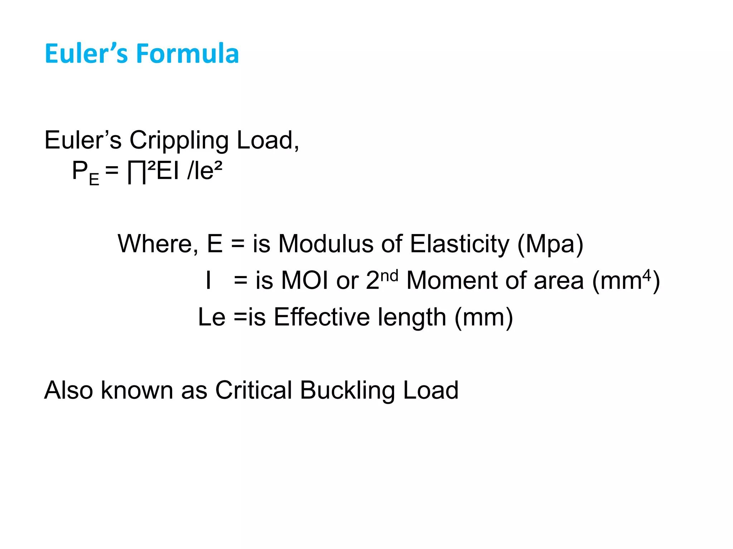

Slide 67


Slide 68


Slide 69


Slide 70


Slide 71
USD (Ultimate strength Design) (New and Popular)
Column
Φ Pue ≥ Pfactored
P_{factored} = 1.2 D.L + 1.6 L.L
P_{ue} = Actual capacity (kN/kip) Φ P_{ue} = Design Strength
Φ = 0.65 to 0.75 (approximate) (column) (Compression controlled) Φ = 0.90 to 0.95 (approximate) (Beam) (Tension controlled)
Beam
Φ Mn ≥ Mfactored
M_{n} = Nominal Monent (Actual moment) (kN-m) Φ M_{n} = Design Moment

Slide 72
WSD (Working Stress Design)
Pue ≥ PD.L+L.L.
Pue
(f_{c} = Allowable concrete stress = 0.45 f_{c}/)
(f_{s} = Allowable steel stress = 0.40 f_{y})
USD | WSD
It is the modern method and universally used | It is the old method and used for particular cases
It counts stress upon yield point | It counts stress upon proportional limit
Its Consider to Design Critical Combination of load | Its Consider to Design carrying load
Low Cost Design Method | High Cost Design Method
Stability of Structure is more than WSD | Stability of Structure is less than USD
Factored load is used | Factored load is not used

Slide 73
History of methods
New
LSD: Limit States Design (Canada)
LRFD: Load and Resistance Factor Design (USA) (After 1980) (Steel Design) USD (Ultimate Strength Design) (popular name in UK) (Concrete Design)
LSD/LRFD: This is basically same as USD but here you have two limit states to satisfy in your design-- serviceability limit state and ultimate limit state. The first refers to basically the concept that in no case structure shall become unfit for its service for example the deflection, vibration etc. should be within permissible limits. And the second means that your structure should not fail in its capacity to carry the design loading.
Old
WSD: Working Stress Design (Canada)
ASD: Allowable Stress Design (USA) (Before 1980)

Slide 74
Spiral Column Design
Week 8
Pages 75-85

Slide 75


Slide 76


Slide 77


Slide 78


Slide 79


Slide 80


Slide 81


Slide 82


Slide 83


Slide 84


Slide 85


Slide 86
Two-Way Slab
Week 9
Pages 87-95

Slide 87

Two-way
slab

Slide 88

What is two-way slab?
A slab carrying loads in both directions (length and width) to its supports (Beams or Columns).
The length /width ratio is less than two.
Main reinforcement is provided in both directions.

Slide 89


Straight bar,
Crank bar
Extra top
Corner reinforcement
Distributed bar
Fig: Two way slab reinforcement layout

Slide 90

What is Crank Bar?
Crank Bar, also known as bent up bar is provided in the slab and other structural members. Bars are bent near the supports normally at an angle of 45°. The angle bent may also be 30° in shallow beams.

Slide 91
Why Crank Bar is provided?
Purpose of crank bar :
To resist both positive and negative bending moment (Sagging and hogging) at the supports of the slab.
To reduce the shear force which is greater at the supports.
To reduce the risk of brittle failure at slab-column connection.
To reduce the amount of steel used.
For the economization of materials

Slide 92


Slide 93



Slide 94


Slide 95


Slide 96
Two-Way Slab
Week 10
Pages 97-111

Slide 97
Types of two-way slab?
Two-way Edge-supported Slab
Two-way Column Supported Slab
Flat Plate Slab
Flat Slab
Grid
or waffle slab

Slide 98



Flat Plate Slab
Does not have drop panels or column capitals and beams between the concrete columns.
Loads are transferred directly to the supporting concrete columns.
It has lower shear capacity and deflection control.

Slide 99
Flat Plate Slab
Flat Plate: Span not exceeding 6.0 to 7.5 m and live load not exceeding 3.5 to 4.5 KN/m2
Advantages:
Low cost formwork
Exposed flat ceilings
Fast
Disadvantages:
Low shear capacity
Low Stiffness (notable deflection)
Need of special formwork for drop panels and capitals

Slide 100


Flat Slab
These slabs usually have drop panels or column capitals but do not have beams and girders.
Loads are transferred directly to the supporting columns.
Appropriate for heavier loads encountered in office or industrial buildings.

Slide 101

Types of flat slab construction
1. Simple flat slab.
2. Flat slab with drop panels.
3. Flat slab with column heads.
4. Flat slab with both drop panels and column heads.

Slide 102

Types of flat slab construction
Uses of column heads :
Uses of drop panels :
Shear strength of flat slab is increased by using column heads.
Column heads reduce the clear or effective span, and therefore, reduce the moment in the flat slab floor
Drop panels increase the shear strength of flat slab floor.
Drop panels increase flat slab's negative moment capacity.
Drop panels reduce deflection by stiffening the flat slabs.

Slide 103
Flat Slab
Advantages:
1. Flexibility in room layout.
Partition walls can be placed anywhere.
Offers a variety of room layout to the owner.
False ceilings can be omitted.
2. Building height can be reduced.
Lower storey height will reduce building weight due to lower partitions and cladding to façade.
Approximately saves 10% in vertical members.
Reduced foundation load.

Slide 104


Flat Slab
Advantages:
3. Shorter Construction Time.
4. Use of prefabricated welded mesh.
Use of flat slabs requires less time for construction by the use of big table formwork.

Slide 105
Flat Slab
Advantages:
5. Ease of Installation of Flat Slabs.
6. They provide better fire resistance than a conventional floor system.
7. They provide a better appearance and offer better diffusion of light.
All mechanical and electrical services can be mounted directly on the underside of the slab instead of bending them to avoid the beams. This allows standardized structural members and prefabricated sections to be integrated into the design for ease of construction.

Slide 106
Flat Slab
Disadvantages:
Having many benefits of the flat slab also has some disadvantages, which are as follows.
It has span limitations. It doesn’t offer a large span.
They are not suitable for masonry partition of brittle nature.
It uses drop panels that may interfere with oversized mechanical ducting.
They have middle strip deflection, which may be critical.
They have more thickness as compared to typical RCC Slabs.

Slide 107



Grid or waffle slab
A waffle slab or two-way joist slab is a concrete slab made of reinforced concrete with concrete ribs running in two directions on its underside, giving the appearance of waffles.
Relatively lightweight and hence economical.

Slide 108
Grid or waffle slab
Advantages:
The various advantages of waffle slab areas follows:
1. Larger span of slab and floor with less number of columns.
2. load carrying capacity is greater than the other types of slab.
3. Savings on weight and materials.
4. Good vibration control capacity.
5. Attractive soffit appearance when exposed.
6. Lightweight.
7. Vertical penetrations between ribs are easy.
8. Economical when reusable formwork is used.
9. Fast and speedy construction.

Slide 109
Grid or waffle slab
Disadvantages:
1. Require greater floor-to-floor height.
2. Requires special or proprietary formwork which is costly.
The disadvantages of waffle slab are as follows:
3. requires strict supervision and skilled labour.
4. Difficulty in maintenance.
5. Not suitable in highly windy area.

Slide 110

Corner reinforcements
The twisting moments at the extreme corners of a two way slab system , where they tend to crack the slab at the bottom along the panel diagonal & at the top perpendicular to the panel diagonal. Hence special reinforcement is provided at exterior corners of a beam supported two way slab.
Corner panel :
Top = parallel to diagonal
Bottom = perpendicular to diagonal
Provided at the extreme corner in both the top & the bottom of the slab , distance is equal to 1/5th of the longer span

Slide 111
Distribution Bar
Distribution steel/temperature/shrinkage reinforcement is the minimum area of the steel bars provided in cross direction of the main steel bars to resist temperature stresses and also to tie up with the main steel bars so as to keep them in proper straight position.
Distribution bars are provided in one way slabs as temperature reinforcement
against possible stresses and strains due to difference in temperature.

Slide 112
Two-Way Slab
Week 11
Pages 113-118

Slide 113
The main difference between a simply supported slab and a restrained slab is that a simply supported slab's corners are free to lift, while a restrained slab's corners are prevented from lifting:
Simply supported slab
A slab that is supported on all four sides by columns or stanchions, but the corners are free to lift due to transverse load.
Restrained slab
A slab that is cast monolithic with the beams, preventing the corners from lifting. The slab is also provided with reinforcement to resist torsion.
The edge strips of a two-way slab are restrained against rotation when the corners of the slab are prevented from lifting. This is achieved by casting the slab monolithic with the beams.
The minimum mild steel reinforcement required in the edge strip of a two-way slab is half of the area of steel in the middle strip of the shorter span.

Slide 114



Slide 115


Slide 116


Slide 117


Slide 118



Slide 119
Two-Way Slab Design
Week 12
Pages 120-132

Slide 120

(Two-way Slab Design)

Slide 121


Slide 122


Slide 123


Slide 124


Slide 125


Slide 126


Slide 127


Slide 128


Slide 129


Slide 130


Slide 131


Slide 132
Please Click this link
Design of Concrete Structures by Arthur H. Nilson, David Darwin, Charles W. Dolan (Mc Graw Hill) – 13th edition-See Two-way slab math and 214 page for reinforcement guidelines
See Chapter: Slab for Co-efficient chart

Slide 133
Foundation Details
Week 13
Pages 134-144

Slide 134



Slide 135

Introduction :
A structure essentially consists of two parts, namely the super structure which is above the plinth level and the substructure which is below the plinth level.
Substructure is otherwise known as the foundation and this forms the base for any structure. Generally about 30% of the total construction cost is spent on the foundation.
The soil on which the foundation rests is called the “foundation soil”.

Slide 136
Objectives of a foundation :
A foundation is provided for the following purposes:
To distribute the total load coming on the structure on a larger area.
To support the structures.
To give enough stability to the structures against various disturbing forces, such as wind and rain.
To prepare a level surface for concreting and masonry work.

Slide 137
Factors affecting design of foundation
•
Soil types and ground water table conditions.
•
Structural requirements and foundations.
•
Site condition and environmental factor.
•
Economy etc.

Slide 138

Types of foundation :
The two main types of foundation:
•
•
Shallow foundation Deep foundation
Types of Shallow foundation :
•
•
Isolated footing (single footing, Column footing) Combined footing
Types of Deep foundation :
•
•
Pile foundation Pier foundation

Slide 139
Types of Shallow foundation :
Isolated Footing/ Pad footing/ Spread footing/ Isolated column footing/Single column footing
Combined Footing
Strip footing/ foundation
Strap footing
Mat foundation

Slide 140



Slide 141



Shallow foundation (spread foundation):
Depth of foundation is less than or equal to its width.
Isolated footing (single footing, column footing):
In framed structures where
several columns are to be constructed, isolated footings can be adopted.
The columns involved can be provided with masonry or concrete footing.
If masonry footing is provided,
steps are given and the foundation area is thus increased so that the stresses developed at the base is within the limit.

Slide 142


•
Isolated footing (single footing, column footing)…

Slide 143


•
Isolated footing (single footing, column footing)…

Slide 144


Combined footing:
This type of footing is adopted when the space between two columns is so small that the foundation for individual columns will overlap.
Combined footings are proportioned in such a way that the center of gravity of the loads coincides with the centre of gravity of the foundation. Hence these footings have either a trapezoidal or a rectangular shape.
Combined Footing
A combined footing is used in the following conditions: When two columns are very close enough to each other such that their footing overlaps. When the load-bearing capacity of the soil is low, the requirement of more area under the individual footing.

Slide 145
Foundation Details
Week 14
Pages 146-159

Slide 146


Strip footing
A wall footing or strip footing is a continuous strip of concrete that serves to spread the weight of a load-bearing wall across an area of soil. It is the component of a shallow foundation.

Slide 147


Strap footing
A strap footing is a component of a building’s foundation. It is a type of combined footing, consisting of two or more column footings connected by a concrete beam. This type of beam is called a strap beam. It is used to help distribute the weight of either heavily or eccentrically loaded column footings to adjacent footings.
A strap footing is often used in conjunction with columns that are located along a building’s property or lot line. Typically, columns are centered on column footings, but in conditions where columns are located directly adjacent to the property line, the column footings may be offset so that they do not encroach onto the adjacent property. This results in an eccentric load on a portion of the footing, causing it to tilt to one side. The strap beam restrains the tendency of the footing to overturn by connecting it to nearby footings.
Fig. Strap Footing

Slide 148
Mat Foundation
A raft or mat foundation is a large continuous rectangular or circular concrete slab that carries the entire load of the superstructure and spreads it over the whole area beneath the building. It is considered as one type of shallow foundation and is useful in controlling the differential settlement.
A mat foundation spreads out under the footprint of the building and declines the contact pressure compared to conventional strip or trench footing.
It is a suitable solution for low bearing capacity soil, spread footing cover about 70% of the structure, high structure loads, soft pockets or cavities of in the soil to unknown extent raft, and highly compressible soil that extends to a great depth.
Functions of Mat Foundation
Transfer superstructure loads and spread it over the entire area of the building footprint.
Reduce differential settlement of structures constructed over weak soil.

Slide 149
Uses of Mat Foundation
It is employed for the construction of commercial buildings. In this case, the loads are commonly large. Mat foundations are popular in areas where basements are common.
Mat foundation is also used for low bearing capacity soil in order to spread the load of a building and hence construct a stable foundation.
It is used to reduce differential settlement of buildings.
Raft or mat foundation is used when the soil layer is unstable. In this case, strip foundation would cover more than 70% of the ground area beneath the building. There are also situations usually in mining areas that soil layer may suffer movements.

Slide 150


Mat + Pile = Raft Foundation

Slide 151


Pile :
A slender, structural member consisting steel or concrete or timber.
It is installed in the ground to transfer the structural loads to soils at some significant depth below the base of the structure.

Slide 152


Deep foundation :
Deep foundation consists of pile and pier foundations.
This consists in carrying down
through the soil a huge masonry cylinder which may be supported by the sides of soil or may be supported on solid rock (hard stratum).
Pile foundation :
Pile is an element of construction used as foundation. It may be driven in the ground vertically or with some inclination to transfer the load safely.

Slide 153

Pile foundation…
•
•
Loads are supported in two ways.
If the load is supported by the
effect of friction between the soil and the pile skin, it is called friction pile.
Friction piles may be made of cast iron, cement concrete,
timber, steel, wrought iron and composite materials.
If the load is supported by resting the pile on a very hard
stratum, it is called load bearing pile.
Load bearing piles are steel sheet piles, concrete piles and timber piles.
•
•
•
•
Piles may be cast-in-situ or precast.
They may be cased or uncased.
•

Slide 154
Friction Piles

Slide 155
Load Bearing Pile
Friction Pile

Slide 156


MATERIAL USED FOR FOUNDATION…
Foundation must be constructed of a durable material of an adequate strength.
•
•
•
•
•
Concrete Metal Aggregate
Waterproofing Materials Wood

Slide 157

Negative Skin Friction
Negative skin friction is the process where skin friction acts downward due to soil. When skin friction is acting downwards it would decrease the pile capacity. Negative skin friction (also known as down drag), could be a major problem in some sites.
Negative skin friction occurs when concrete piles are situated in soft soils, consolidating soil-mass, etc., resulting in a downward force that increases loading on shaft piles and reduces the bearing capacity of the piles.

Slide 158
What are the methods to tackle negative skin friction?
Use slender pile sections (e.g. H-pile or precast pile) because smaller pile area when subject to the same working load would produce higher deformation, thus increasing the relative downward movement of piles.
In a certain region of H-piles for ground water table fluctuation, painting is applied on the surface of H-piles because the rise and fall of water table contribute to the corrosion of H-piles. On the other hand, to reduce the effect of additional loads brought about by negative skin friction, bitumen is applied on the pile surface corresponding to the region of soils that has negative skin friction. However, bitumen should not be applied to the whole section of H-piles because it would be unable to derive the designed frictional reaction from soils.
Design the piles as end-bearing so that they can take up more load.

Slide 159
Hindawi
Advances in Civil Engineering
Volume 2019, Article ID 4201842, 10 pages https://doi.org/10.1155/2019/4201842
Research Article
Experiments on Reducing Negative Skin Friction of Piles
Zhongju Feng, Haibo Hu , Ruixin Zhao, Jingbin He , Yunxiu Dong , Kai Feng, Yawan Zhao, and Huiyun Chen
School of Highway, Chang’an University, Xi’an, Shaanxi 710064, China
Correspondence should be addressed to Haibo Hu; huhaibo@chd.edu.cn and Jingbin He; Hejingbin_0407@163.com
Received 31 July 2019; Revised 23 October 2019; Accepted 5 November 2019; Published 3 December 2019
Academic Editor: Dimitris Rizos
Copyright © 2019 Zhongju Feng et al. This is an open access article distributed under the Creative Commons Attribution License, which permits unrestricted use, distribution, and reproduction in any medium, provided the original work is properly cited.
Abstract
The objective of this study was to investigate the eﬀect of diﬀerent moisture contents of clay (13%, 15%, 17%, 19%, and 21%) and diﬀerent coatings on the ability to reduce negative skin friction during a large-scale shear test. Four coating treatments of the concrete surface were investigated, i.e., no treatment, coating with a paraﬃn-oil mixture, coating with a polymer nanomaterial, and coating with paint. The results showed that when the moisture content of the clay was slightly larger than that of the plastic limit, the ability to reduce negative skin friction was the best, and the performance was similar for the paraﬃn-oil mixture, the polymer nanomaterial, and the paint. When the moisture content of the clay was lower than that of the plastic limit, the paraﬃn- oil mixture provided the best performance. The position of the neutral point can be determined by diﬀerent methods, and the negative skin friction of piles should be reduced by applying coatings that are most suitable to diﬀerent conditions.

Slide 160
Foundation Design
Week 15
Pages 161-175

Slide 161


Slide 162


Slide 163


Slide 164


Slide 165


Slide 166


Slide 167


Slide 168


Slide 169


Slide 170


Slide 171


Slide 172


Slide 173


Slide 174


Slide 175
Please click the link
Design of Single Column footing

Slide 176
Foundation Design
Week 16
Pages 177-178

Slide 177

Cofferdams and caissons are both watertight structures used in construction projects in submerged areas, but they differ in their purpose and permanence:
Cofferdam
A temporary structure used to create a dry work area by diverting water away from the construction site. Cofferdams are often used for repairs or maintenance, but can also be used in new construction. They can be made from a variety of materials, including earth, rocks, timber, steel, and concrete. Cofferdams are generally suitable for depths of up to 18 meters below high water level.
Caisson
A permanent structure that remains in place as part of the completed structure. Caissons are typically box-shaped structures made from timber, steel, masonry, or reinforced concrete. They are often custom-designed for the project they will be used in. Caissons are more suitable for greater depths than cofferdams.
The choice between a cofferdam and a caisson depends on the ground conditions and the depth of the work. During construction, a caisson can function as a cofferdam.

Slide 178


The main difference between an aqueduct and a viaduct is their purpose: aqueducts carry water, while viaducts carry roads or railways:
Aqueduct
A system of pipes, ditches, canals, tunnels, and other structures that use gravity to move water from a source to a destination. Aqueducts are often built on canals and can be made from stone, brick, concrete, or other materials.
Viaduct
A long bridge or series of bridges that carry roads or railways over water, valleys, or other roads. Viaducts are typically made up of arches and supported by tall towers made from stone, concrete, iron, or steel.

Slide 179
Week 17

Slide 180

Any Questions?

Slide 181
Thank you for your kind attention
Prepared By
Rubieyat Bin Ali
Assistant Professor & HOD
Department of Civil Engineering
University of Global Village (UGV), Barishal

