Slide 1

INDUSTRIAL MANAGEMENT
Course Code: IPE 481 | CREDIT:03
Course Teacher: Iftekhar mahmud | TOTAL MARKS:150
Mid Exam Hours 2 | CIE MARKS: 90
Semester End Exam Hours 3 | SEE MARKS: 60

Slide 2
Course Learning Outcomes (CLOs): After completing this course successfully, the students will be able to-
CLO 1 CLO 2 CLO 3 | Describe the role of the company in the society, the different business cultures, and how companies are organized and managed from a business concept to ongoing operations Analyze the cash flow and the financial tools for a company and be able to describe how the accounting system of a company is constructed. Communicate effectively with a range of audiences.
CLO 4 | Function effectively on a team whose members together provide leadership, create a collaborative and inclusive environment, establish goals, plan tasks, and meet objectives.
CLO 5 | Recognize ethical and professional responsibilities in engineering situations and make informed judgments, which must consider the impact of engineering solutions in global, economic, environmental, and societal contexts.

Slide 3
SL | Content of Course | Hrs | CLOs
1 | Introduction, Definition of Quality, Methods of control chance causes and assignable causes, | 8 | CLO1
2 | Theory of Control Charts, control chart for variables X & R Chart, Standard deviationchart, Process capability studies Control Chart for attributes, fraction defective and of defective charts chart sensitivity Control chart for non conformities ( p, np chart, c &u charts ) problems using SQC tables | 8 | CLO3, CLO4
3 | Acceptance sampling, Fundamental concepts & terms ,Operation characteristic curves(OC curves) AQL, LTPD, AOQL, sampling plans for single ,Double Multiple sampling plan,sequential sampling plan,Dodge Roming sampling plans Lot by Lotacceptance sampling by Attributes ,AQL system for Lot by Lot sampling,Acceptancesampling by variables. | 9 | CLO2, CLO6
4 | Quality policy, Quality planning, designing for quality, Manufacturing for quality,Quality philosophies by Deming and Jurang, Crosby & Muller,TQM definition,customer focus, Top Management commitment, Team work, Implementation of TQM,Concepts of Kaizen, 5S, just in time JIT, Taguchi methods, need for ISO 9000,clausesof ISO 9000 Implementation,Case studies. | 9 | CLO5, CLO7
Text Book:
Introduction to Statistical Quality Control - Douglas C. Montgomery
Statistical Quality Control – Grant & Lavenworth

Slide 4
Course plan specifying content, CLOs, teaching learning and assessment strategy mapped with CLOs
Week | Topic | Teaching-Learning Strategy | Assessment Strategy | Corresponding CLOs
1 | Introduction, Definition of Quality, Methods of control chance causes and assignable causes, | Lecture, discussion, group work | Quiz, Written Exam | CLO1
2 | causes,Seven statistisfial tools ,problem solving methodology ( PDCA ) | Oral Presentation, debate | Assignment, Written, Quiz | CLO1
3 | seven management Tools ,SQC Benefits and limitations, Quality function | Video lecture, Field visit | Report writing, Demonstration | CLO1
4 | Quality assurance,Quality audit, Quality cost, Quality circle, Team of Quality circle,Benefits | Lecture | Viva, Quiz | CLO1, CLO3
5 | Theory of Control Charts, control chart for variables X & R Chart, Standard deviationchart | Project exhibition | Project, Field visit | CLO1
6 | Process capability studies Control Chart for attributes, fraction defective and of defective charts chart | Discussion, Video Presentation | Quiz, Written Exam | CLO1
7 | sensitivity Control chart for non conformities ( p, np chart, c &u charts ) problems using SQC tables | Case-based Learning, Demonstration | Assignment, Written, Quiz | CLO1, CLO4
8 | Acceptance sampling, Fundamental concepts & terms ,Operation characteristic curves(OC curves) AQL | Lecture, discussion, group work | Report writing, Demonstration | CLO3, CLO4
9 | LTPD, AOQL, sampling plans for single ,Double Multiple sampling plan,sequential sampling plan, | Oral Presentation, debate | Viva, Quiz | CLO2
10 | Dodge Roming sampling plans Lot by Lotacceptance sampling by Attributes | Video lecture | Project, Field visit | CLO2
11 | ,AQL system for Lot by Lot sampling,Acceptancesampling by variables. | Lecture | Quiz, Written Exam | CLO3, CLO4
12 | Quality policy, Quality planning, designing for quality, Manufacturing for quality | Project exhibition | Assignment, Written, Quiz | CLO3, CLO3
13 | quality philosophies by Deming and Jurang, Crosby & Muller,TQM definition,customer focus | Discussion, Video Presentation | Report writing, Demonstration | CLO1
14 | Top Management commitment, Team work, | Case-based Learning, Demonstration | Viva, Quiz | CLO1
15 | Implementation of TQM,Concepts of Kaizen, 5S, | Lecture, discussion, group work | Project, Field visit | CLO3, CLO4
16 | just in time JIT, Taguchi methods, ; | Oral Presentation, debate | Quiz, Written Exam | CLO3, CLO4
17 | need for ISO 9000,clausesof ISO 9000 Implementation,Case studies | Video lecture | Assignment, Written, Quiz | CLO3, CLO4

Slide 5
Week 1

Slide 6
INDUSTRIAL MANAGEMENT
Definition of Management:
ASME: Management is the art & science of preparing, organizing and directing human effort applied to control the forces and utilize materials of nature for the benifit of man.
Prof. John F Mec: Management is the art of securing maximum results with a minimum effort so as to secure maximum prosperity and happiness for both employer & employee and giving public the best possible results.
Brief History of The Development of Management Theories:
Scientific Management: Fredrick Taylor( 1856 – 1912) is called the father of scientific management.
Major Concern: Increase in efficiency in production as the application of scientific method.
BOOK: “PRINCIPLES OF SCIENTIFIC MANAGEMENT”

Slide 7
INDUSTRIAL MANAGEMENT
Taylor’s Plinciple:
Replacing rule of thumb with science ( Organized known ).
Obtaining harmony in group action.
Achiving the co-operation of human being.
Working maximum output rather than restricted output
Developing all workers fullent extent.
Workers are to be paied according to their productivity.
Follower of Taylor:
Henry L. Gantt ( 1861-1919 ): He developed Gantt chart “Scientific Selection of Worker”.
Frank and Gilbrethy ( 1878-1972 ): Worked with “ Motion and Time Study”. Gilbreth was an industrial psychologist, understanding worker personality and needs.
Modern Operational Management Theory: Henry Fayal is a French industrialist. He is the father of modern operational management theory.

Slide 8
INDUSTRIAL MANAGEMENT
Division of Industrial Activities According to Fayol:
Technical ( production ).
Commercial ( buying, selling & exchange ).
Financial ( search for and optimum use of capital ).
Security ( protection of property and persons ).
Accounting.
Managerial ( planning, organizing/organizaton command, co-ordination and control ).
Principles of Management by Fayol:
Divison of work ( specialization for efficient work ).
Authority & Responsibility ( Both should go together ).
Discipline.
Unity of command ( order from one superior ).
Unity of direction (each group of activities with same objective must have one head & one plot).

Slide 9
INDUSTRIAL MANAGEMENT
Subordination of individual to general interest ( individual interest should be honoured ).
Remuneration ( fair method of payment ).
Centralization ( Centralization of authority only to that extent which is not necessary ).
Scalar chain.
Order ( a place for everything [everyone] and everything [everyone] in its [his] place ).
Equity ( equal treatment to all ).
Stability of .
Initiative.
Team spirit.
Fayol’s Functions of Management ( Element of Mangement :
(1) Planning (2) Organizing (3) Commanding (4) Co-ordinating (5) Controlling

Slide 10
INDUSTRIAL MANAGEMENT
The Emergency of The Behavioral Science:
That concerns “Industrial psychology and social theory/science”. Hugo ( 1912 ) is the father of industrial psychology. His books name “Psychology & Industrial Efficiency”.
Vilferdo Pareto ( 1806-1917 ) is the father of social theory.
Max. Weber (1946), his book’s name is “Theory of Bureaucracy”.
Management Function:
1. Planning 2. Organizing 3. Staffing
Controlling
Principles of Management:
According to Taylor
According to Fayal
4. Co-ordinating 5. Directing 6. Leadership

Slide 11
INDUSTRIAL MANAGEMENT
Organization:
It is defining and grouping the activities of the enterprise and establish the relation among them.
Organization:
Formal organization
Informal organization
Formal Organization: When the activities of two or more person are conciously co- ordinated toward a given objective.
Informal Orgaization: Its a network of personal and social relation not established or required by formal organization but arising spontaneously as people associate with one another.

Slide 12
INDUSTRIAL MANAGEMENT
AMA’S ( American Management Association):
Holds some commandments about a good organization:
Define and clearcut responsiblity.
Responsiblity must be coupled with appropriate authority.
No one should get orders from more than one source.
Orders should not be given over the heads of the responsible executives.
Ceiticism of the subordinates should be made privately.
No one should be assistant to and critic of a person at the same time.
Method of Departmentation:
By function ( sales, purchase, production, accounting ).
By process ( M/C shop, welding, foundry etc ).
By product or service ( SQUARE pharmacuticals, SQUARE toiletries).
By teritory or location.

Slide 13
INDUSTRIAL MANAGEMENT
Types of Orgnization:
Traditionally there are 5 principle/basic types:
Line organization
Functional organiazation
- Line & stuff organization
- Line & functional organization
Committee type organization
Matrix

Slide 14
Week 2

Slide 15
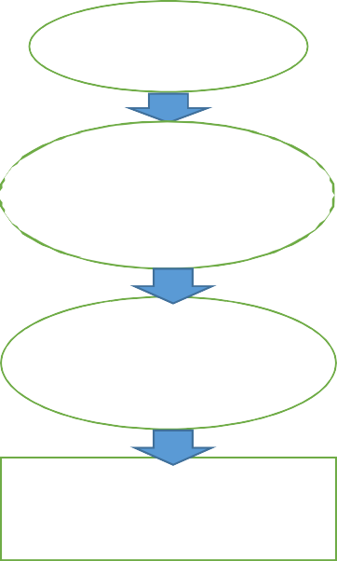
INDUSTRIAL MANAGEMENT
Line Organization:
Owner
Board of Directors
GM
Salesman
Plant Manager
Purchase Manager
Foreman
Foreman
Foreman
Workers
Workers
Workers

Slide 16
INDUSTRIAL MANAGEMENT
Advantages :
I. Very simple
Clear cut division of authority & responsibility
Extremely stable
Quick action
Discipline is easily maintained

Slide 17
INDUSTRIAL MANAGEMENT
Limitations :
Rigid & inflexible
Autocratic system
Department heads work independently often according to their own desire.
Lack of expert advice
Key men are too much loaded
Difficult to operate in large & complex organization.

Slide 18
INDUSTRIAL MANAGEMENT
2.Functional organization :
Instead of one superior as inline organization, a group of specialist to boss the workers.

Slide 19
Owner
Board of Director General Manager
Plant Manager
Expert 1 Expert 2
Foreman 1
Expert 3
Expert 4 Expert 5
Foreman 4 Foreman 5
Foreman 2
Foreman 3
Worker
Worker
Worker
Worker

Slide 20
INDUSTRIAL MANAGEMENT
Advantages:
Based on expert knowledge
Division of labour
Highest functional efficiency
Limitations :
Lack of stability
Overlapping authority loads to friction
Inability to locate & fix responsibility, may affect discipline.

Slide 21
INDUSTRIAL MANAGEMENT
Line & staff organization :
It is a combination of line & functional organization.
Basic structure is line structure
Experts are introduced at different level
Line members – Do
Staff(Expert) members - Advice

Slide 22
Industrial Management
GM
Quality Control Manager
Engg.
Manager
Plant Manager
Product Control Manager
Foreman
Workers

Slide 23
Week 3

Slide 24
Industrial Management
Advantages :
Based on specialization.
Individual responsibility with self specialization.
Increased efficiency.
Limitations :
The staff (expert) may be ineffective due to lack of authority.
Friction between line & staff superiors.
Unless duties and responsibilities of staff are well defined,

Slide 25
Industrial Management
there may be confusion about their functions.
Line &Functional Staff Organization :
Here expert people become more than advisers. They Become executives in charge of a single technique which is common in different units.
Committee Organization :
A committee is a group of people usually on the same authoritative level specially designated to perform a managerial act.

Slide 26
Industrial Management
Two types :-
Permanent
Temporary.
Advantages :
Under a strong executive chairman or committee can solve a problem more quickly and successfully. Because two loads better than one.
Decisions are unusual.
Co-operative action.

Slide 27
Industrial Management
Limitations :
Quite expensive.
The committee may be too large for constructive action.
Action may be superficial due to lack of time and interest.
Important executives may be called too frequently for meeting, affecting their regular activities.
Aggressive and outspoken members may dominate the meeting and affect the decision sometimes adversely.
Matrix Organization :
It is a combination of functional and project/ product printed structure.

Slide 28
Industrial Management
Advantages :
Result is oriented.
Professional identification is maintained.
Proper utilization of specialized people.
Limitation :
Conflict between functional and project manager.
Imbalance of authority and power.
Needs time consuming meeting between functional and project manager.

Slide 29
FACTORS DETERMINING THE SPAN OF CONTROL
The capacity and skill of executive.
the capacity and skill of the sub-ordinate.
Stability of operation.
Types of operation.

Slide 30



span
narrow
wide

Slide 31
Narrow span of control
ADVANTAGES
Close supervision.
Close control.
Fast communication.
LIMITATIONS
Superior too involve
Many level of management
High cost due to many level.
Excessive distance between down level to top level

Slide 32
Wide Span of Control
ADVANTAGES
Superiors are forced to deli gate.
Clear policies
sub-ordinate must be selected carefully.
LIMITATIONS
Superiors are overloaded .
dangers of loss of superiors control.
need quality manages.

Slide 33
Conditions that influence the selection of span
Narrow
Little or no training of subordinate
Unclear authority delegation 3 unclear plans.
Use of poor communication
Complex task
Incomplete and untrained manages
Subordinate willingly to take responsibility & risk.

Slide 34
Wide
Proper training of subordinator.
clear delegation of authority.
Well defined clear plans.
Proper communication between subordinator & executive
Simple task.
competent & trained manager.
Subordinate willingly to take responsibility & risk

Slide 35
Week 4

Slide 36
PERSONEL MANAGEMENT
personnel management is the planning organizing directing & controlling of the procurement development , compensation, integration, maintenance and separation of human resources so that individual organizational and societal objectives are accomplished.
FLIPPO

Slide 37
FUNCTIONS OF PERSONEL MANAGEMENT
Management function
planning
organizing
Direction
controlling
Operative function
Procurement
Development
Compensation
Maintenance
Separation

Slide 38
Procurement~requirement of required manpower Development~develop manpower by training Compensation~salaries & other facilities given to the employee.

Slide 39
Industrial Management
Integration: Integrating all
Maintenance: To continue in job before retirement
Separation: Some benefits given to retirement
Manpower planning, Recruitment and Development
Planning: To set the standard for comparing the applicants or candidates
Std: Minimum human qualities required to perform the job properly
Steps:
Job analysis
Job description
Job specification
Job classification
Job evaluation

Slide 40
Industrial Management
Job analysis : To study and collect information about the duties and the responsibilities of the job
Job description: Written description
Job specification: Minimum human qualities required to perform the job properly
Job classification: Grouping the job on some basis
Job evaluation: Determination of the worth of the job
Manpower requirements:
Determination of number of personnel for each type
Steps:
Human resource demand forecasting
Human resource supply forecasting
Human resource action forecasting

Slide 41
Industrial Management
Long range demand(Factors)
Long range business plan
Demographics
Economy
Technological trends
Social trends
Short range demand(Factors)
Production schedule and budgets
Affirmative actions: Govt. orders/court orders
Relocation/Plant closing

Slide 42
Industrial Management
Supply forecasting:
Current inventory(Existing manpower in the organization)
Productivity levels
Turnover rate(Leaving job, retirement, death)
Absenteeism rate
Movement among jobs
Action:
Hiring(Recruitment): If the supply is less than the demand
Training: To cope with new technology
Career management
Productivity programs: Motivating of work force to get more output
Firing(Reduction of manpower): If the supply is more than the demand

Slide 43
Industrial Management
Hiring (Recruitment)
Internal
External
Reasons:
Entry post
Qualified candidate not available

Slide 44
Industrial Management
Advantages:
More info
Increased morale
Scope of promotion/transfer etc.
Source of External Recruitment:
Advertisement
Employment agencies

Slide 45
Industrial Management
Source of External Recruitment:
1.
2.
Recommendation of present employees
Educational institutions
Labor union
Casual applicants
Leasing
Nepotism

Slide 46
Week 5

Slide 47
Industrial Management
Framework of Recruitment
Recruitment Program
Sales forecast
Job analysis
Work load & work force analysis
Employee requisition
applicants
Job description
Job specification
Screening devices
Application information
Reference checks
Interviews
Test
Physical exams
Selection Induction(Orientation)

Slide 48
Industrial Management
Interviews: Most widely used method of selection.
Interview steps:
Preparation
Setting
Conduct of the interview
Close
Evaluation

Slide 49
Industrial Management
Principles(Guidelines) of good interview:
Preparation:
Determine the specific object of the interview.
Determine the method of accomplishing the objectives.
Inform yourself as much as possible about the candidate from the information provided.
2. Setting:
i. The physical setting for the interview should be both private & comfortable.

Slide 50
V. Metal cutting should be communicative
3. Conduct
VI. The interview should passes and demonstrate basic liking and respect for people.
Question should be asked in a manner that encourages the candidate to talk.
Listen attentively and if possible projectively.
4. Close
IX. The interviewer should make some sign to indicate the end of interview.
X. The candidate should be given some type of answer on indication of future action.
5. Evaluation
XI. The interviewer should immediately evaluate the candidate while the detals are fresh in mind.

Slide 51
Development
Management development (Complex in nature)
Operative training (To increase a specific skill)
Methods:
On the job trining.
vestibule school
Apprenticeship programmes
Special course

Slide 52
# Developments Requirements(Management Development)
Types of training needed:
Decision making skills.
Inter personal skills.
Job knowledge skills.
Organizational skills.
General knowledge.
Specific individual knowledge.

Slide 53
Methods:
Decision making skills
In basket
In business
Case studies(Past records of manager’s decision)
Interpersonal skills
Role playing
Behavior modelling
Sensitivity training
Transactional analysis
Structure insight

Slide 54
Job knowledge
On the job experience .
Coaching.
Understudy.
Organizational knowledge
Position rotation.
Multiple management.
General knowledge
Special courses.
Special meeting.
Selective reading.

Slide 55
Industrial management
Leadership:
leadership is the act or process of () and encouraging people so that they will work with () and enthusiastically towards the achievements of objectives or () goals.
Types of leader:
a. Based on the authority (how they use it)
Autocratic
Democratic or perceptive
Free rain or laissez fair.

Slide 56
Week 6

Slide 57
Industrial management
b. Based on human relation
Personal
Non personal
Paternalistic
c. Based on the personality of the leader
Intellectual
Persuasive-Magnetic personality
Creative or positive
Non creative or negative

Slide 58
Industrial management
Types of disciplinary actions:
Warnings
Suspensions
()
Progressive discipline means these are stronger penalties for repeated offences. The objective is to give scope of self-correction.
Typical example:
Steps of progressive disciplinary actions:
Steps:
Verbal warning by the supervisor.

Slide 59
Industrial management
Written warning with a record in personal.
Few day suspension from work.
Suspension for longer period.
Discharge.
Specific individual needs:
Special projects
Committee assignment.

Slide 60
Industrial management
Discipline is management action to enforce organizational standards and rules.
Preventive discipline is
Corrective discipline is an action that follows after
action taken to encourage employees
the violation of a rule. It
to follow standards and rules on that violations do not occur. The basic
seeks to discourage further violation. The typical corrective action is
objective encourage self-discipline.
is to
a punishment of some type and is called a disciplinary action.
employee

Slide 61
Industrial management
Objectives of disciplinary actions:
To reform the offender.
To deter others from similar action.
To maintain constant group standards.

Slide 62
Industrial Management
Functions of a Leader:
To co-ordinate individual effects.
To act as a friend, philosopher and guide of the subordinates.
To keep the morale of the group high.
To encourage team work.
To channelize the group functioning.
Qualities of a Leader:
Physical Energy and Mental Stamina.
Sense of Purpose and Direction.
Intelligence. 4.Impartiality.
5. Technical Competence Etc.

Slide 63
Industrial Management
Leadership Style:
Defination: (1) The total pattern of leader’s action as perceived by the employees is called leadership style.
(2) A Leadership style can be defined as a pattern of behavoir designed to intigrate organizational & personal interest of persuit of some objectives.
Types of Leadership Style:
Mcgregor’s Theory X & Theory Y (1957). (2)Contingency approach to leadership style.
Fiedler’s contingency model.
Hersey & Blanchand’s situation model.
Path Goal Model.
Reddin 3-D theory.
Management Grid.
Self Leadership.

Slide 64
Industrial Management
McGregor’s Theory X & Theory Y (1957):
Type X
Most people dislike work & will avoid if possible.They do not want to take responsibility.They must be forced, controlled & threatened to get them work.
Type Y
Work is as natural as play or rest people are not inherently lazy.They will work with self direction & self control if they get proper environment.
Manager’s Role:
The employees should be forced & controlled.
Manager’s Role:
Is to develop the potential of the employee & help to release the potential towards common objectives.

Slide 65
Week 7

Slide 66
Industrial Management
Contingency approach to leadership style:
No single style is appropiate for all situations. The Leader has to change his style according to the situation. The most appropiate style of leadership depends on the analysis of the nature of the situation.

Slide 67
Leadership Style:
Task Oriented
Relationship Oriented/ Employee oriented
Situational factors/ Critical situational dimensions
a)Fielders Contingency Model
Critical dimension of Leadership situation:-
1) Position Power- Types a) Strong b) Weak
2) Task Structure- a) Structred
b) Unstructred
b) Moderately
3) Leader Member Relation- a) Good

Slide 68
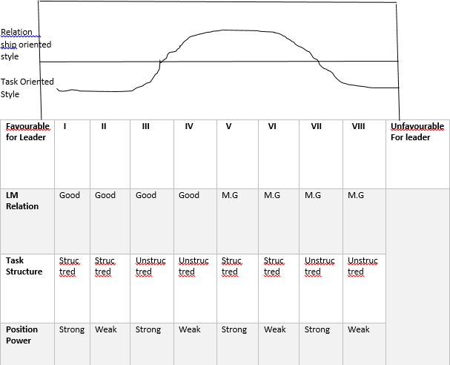

Slide 69
Hersey & Blandchand’s situational model:-
Only one factor affecting the selection of leadership style.
I) Development | (maturity) level of subordinates.
4 types of level | situations | style
(Behaviour)
a) | Low ability, low willingness | Telling (Directive lowsupportive)
b) | Low ability, high willingness | Selling(Directive supportive)
c) | High ability, low willingness | Participating (low d lows)
d) | High ability, high willingness | Delegating( lowds )

Slide 70
Pathgoal model situational factors:
Characteristics of the subordinates
Work Environment.
4 situations- 4 styles suggested Pathgoal model (Robert house) Main
Function of a Leader:
To set the goal.
To help to find the best path & remove obstacles from the path.

Slide 71
Styles ( Leadership behavior):
Supportive- to work for leader support
Participative
Instrumental (Directive)
Achievement oriented

Slide 72
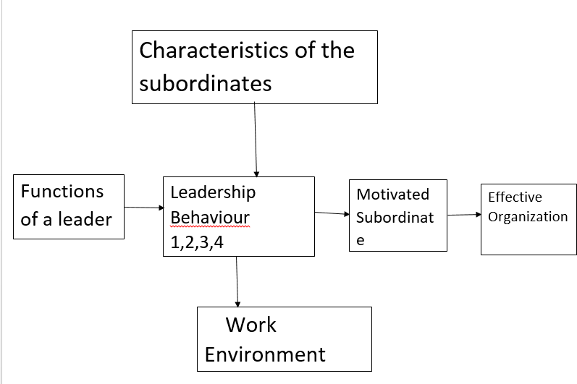

Slide 73
INDUSTRIAL MANAGEMENT
Reddin 3-D theory / consideration:
4 basic type of situation based on
Task or output orientation
Relationship or human orientation
He suggested two types style for each situation One is more effective
another is less effective
Relationship or Human orientation | Missionary Developer 1 | executive Compromiser 2
 | Bureaucrat 3 Deserter | Benevolent 4 Autocrat
Task or output orientation
Situation most effective style
Developer
Executive
Bureaucrat
benevolent autocrat
Suggested
style

Slide 74
Week 8

Slide 75
INDUSTRIAL MANAGEMENT
Management / Managerial Grid:
(1,9)
9
(9,9)
8
7
6
5
4
3
2
1
Concer n
for People
(5,5)
(9,1)
↑
0
→
1
2
3
4 5 6
Concern for output
7
8
9

Slide 76
INDUSTRIAL MANAGEMENT
5 basic cycle:
(1,1) little concern for either output and people (similar to deserter of reddin 3-D model )
(9,1) stress for output and operating efficiency with neglect or unconcern for human component.
c) (1,9) human consideration are placed before organizational requirement, little
concern for output (missionary)
d) (5,5) attempt to balance work in exchange for a satisfactory level of co operation (compromiser)
e) (9,9) seek high output through committed people (executive)

Slide 77
INDUSTRIAL MANAGEMENT
Self leadership:
Highly trained and highly willing people are required for this If employee are such then this model is applicable.
Communication:
Communication is defined as the process of meaningful interaction among human being. It is the transfer of information from sender to receiver.
Purpose / Importance of Communication in an Organization:
To establish & circulate the goals of the organization.
To plan for the achievement.
To lead, direct, motivate the people.
To organize the human resource.
To control performance.

Slide 78
Types of communications:
Written
Oral/Verbal
Non verbal
1.Written Communication:
Advantages:
Provides records, references, legal defer
Less costly
Limitations:
Mountains of paper
Poorly expressed if written ineffectively
No immediate feedback

Slide 79
Oral/Verbal Communication:
Advantages:
Speedy interchange of communication
Immediate feedback
People can ask questions and clarify
Limitations:
May not save time
Costly
3.Non verbal: Facial communication and body gestures. Used to support the oral/verbal communication.

Slide 80
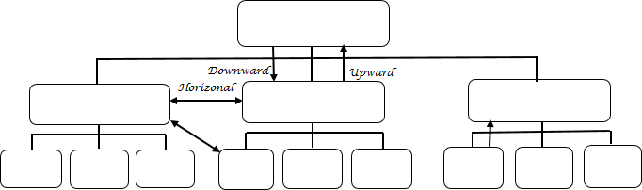
Types of flow communications in an organization:
Downward communication
Upward communication
Crosswise communication
Horizontal
Diagonal
Guidelines for proper communication in an organization:
The message must be clean.
There should be consistency in the message.

Slide 81
iii)The communication must be adequate and
complete.
The context of the message should fit the level of knowledge of the receiver.
There should be feedback system.
Effective communication is the responsibilities of both sender and receiver.
Morale is a mental condition or attitude of individuals and groups which determines their willingness to co- operate.

Slide 82
Morale
Good/High morale morale
Is evidence by employee of good
enthusiasm, conformance morale.
With regularities and Willingness to co-operate.
Bed/low
It is reverse
or high

Slide 83
Characteristics of high morale
Positive and favorable attitude towards those authority.
Self induced obedience.
Positive feeling of respect and confidence for authorities.
Mental peace and satisfaction. v)Productivity and system in work.
vi)Sense of enthusiasm and rejection of frustration.

Slide 84
Essential requirement of high morale in an organization:
A physical requirement: i)Favorable condition of work.
ii)Proper position and promotion. iii)Increase in salary.
Proper method of distribution of salary.
Ability to profit.

Slide 85
Week 9

Slide 86
Industrial Management
B. Mental requirement:
Praise of good work.
Knowledge of success.
Fulfilment of the collective needs(social, prestigious and recognition).
Forbearance and good behavior of authority.
Freedom of work.
Sense of being organized and united.
Motivation: Motivation means inspiring people to intensify their desire and willingness to execute their duties effectively and cooperate the accomplishment of common objectives.

Slide 87
Industrial management
Model of motivation :
Environment
Opportunity
Needs and drives
Tension
Effort
Performance
Reward
Goals and incentives
Ability
Need satisfaction

Slide 88
Industrial management
Theories /models of Motivation
Basic Models
Hierarchy of needs theory of Maslow(1940s)
Herzberg’s two factor model(1950s)
Alderfer’s ERG model(1960s)

Slide 89
Industrial management
B. Modern theory of motivation
Expectancy theory of motivation
The Vroom theory
The Porter and Lawler model
Equity theory of motivation
Reinforcement of motivation
Medulland’s need theory of motivation

Slide 90
Industrial management
Maslow model:
Human needs are not of equal strength and emerge in a certain priority. He divided the needs into 5 types.
1st order: Basic need for satisfying human life. Food, cloth, shelter, education, treatment.
2nd order: Need for free of physical danger and free of fear of loss of jobs, property, food, shelter.
3rd order: People need to belong and accepted by others.
4th order: Satisfaction of power, prestige, status and self confidence.
5th order: The desire to become what one is capable of becoming.

Slide 91
Industrial management
5th order
Need for self
actualization and fulfilment
4th order 3rd order
Status needs Belonging and social needs Safety and Security needs
2nd order
1st order
Physiological needs

Slide 92
INDUSTRIAL MANAGEMENT
# Herzberg’s two factor model:
He considered two types of factor influencing motivation:
1) Hygiene factors or maintenance factor
Absence Presence
High negative feelings
Neutral feeling ( Dissatisfied not motivational )
Example: company policy & administration, supervision, working condition, salary, status, job security etc.
Three types of mental condition of the employee:
High negative feelings
Neutral feelings
High possitive feelings

Slide 93
Week 10

Slide 94
INDUSTRIAL MANAGEMENT
2) Motivational Factor:
Presence: High positive feelings
Absence: Neutral feelings (dissatisfied or motivational) Example: achievement, recognition, advancement etc.
High Negative feelingsNeutral feelings
High positive feelings
(Absence) Maintenance factor (presence)
(Absence) Motivation factor (presence)

Slide 95
INDUSTRIAL MANAGEMENT
Alderfer’s ERG model:
He devided the needs into three types.
Existence needs: Intitially interested in satisfying. It combines security & physiological needs. Example: pay, working condition, job security, fringe benifits.
Relatedness needs: Next level needs being understood & accepted by people above, below or around the employee at work & away from it.
Growth needs: Third level needs. Desire for self esteem, self actualization, achievement etc.
ERG model does not assume a progression from level to level, like Maslow.
Instead it accept the likelyhood that all the three levels of needs might be active at a time.

Slide 96
A person trusted at either of the two higher levels may return to &concentrate on a lower level.
Compare between two factors:
1. Firstly definition 2.Differnce between two

Slide 97
The expectancy theory of Motivation
1.Vroom Theory(1964): Force=Valence*Expectancy
Where,
Force :The strength of a Tperson’s motivation.
Valence: The strength of an individual’s preferences for an outcome.
Expectancy :The probability that a particular action will lead to a desired outcome.
[Force will be zero if either valence or expectancy is zero.]

Slide 98
The expectancy theory of Motivation
2.The Porter & Lawler Theory(1968):
The amount of effort (the strength of motivation) depends on the value of rewards plus the amount of energy a person believes is required and the probability of receiving the reward.

Slide 99
Continued …
Value of reward
Ability to do a specific task
(knowledge
Perceived equitable rewards
and skill)
Value of reward
Intrinsic rewards
Effort
Performance
Satisfaction
Extrinsic rewards
Perceived effort reward probability
Perception of task required
(the goal required activities and other elements of the task)

Slide 100
INDUSTRIAL MANAGEMENT
Equity Theory:
It refers to the individual subjective judgement about the equity or fairness of the reward they get in relation to the input in comparison to others.
O = Outputs; actual pay & benefits, social & psychological rewards.
I = Inputs; job effort, education experience, seniority etc.
A = The employee/person
B = Relevant other person/employee Input-Output ratio
O , O O
,
I I
I
A
B

Slide 101
INDUSTRIAL MANAGEMENT
Probable Situations:
i.
O I O I O I
<
O I O I O I
- Inequity due to being under rewarded
A
B
ii.
=
- Equity
A
B
iii.
>
- Inequity due to over rewarded
A
B

Slide 102
Week 11

Slide 103
INDUSTRIAL MANAGEMENT
Reactions under the different situations of inequity:
Types of Reactions |  | Types of Inequity
 |  | Over Rewarded | Under Rewarded
Internal | Physical | Work harder | Lower productivity
 | Psychological | Discount the reward | Inflate the value of reward
External | Physical | Encourage the referent person to obtain more | Bargain for more possibility quit
 | Psychological | Change the referent person | Change the referent person

Slide 104
INDUSTRIAL MANAGEMENT
McClleland’s Need Theory:
3 basic types of need.
Need for power (n/power)
Need for affiliation (n/aff)
Need for achievement (n/achi)

Slide 105
INDUSTRIAL MANAGEMENT
Job Rotation | Job Enlargement | Job Enrichment
Rotation to another job at the same level that has similar skill requirement | Enlarging the scope of the job by adding similar tasks without enhancing responsibility | To build a higher level of challenge & achievement
It reduces boredom | Horizontal expansion of work | Vertical expansion of work

Slide 106
INDUSTRIAL MANAGEMENT
Performance Appraisal & Compensation:
Objectives of compensation programs
To affect capable employees to the organization
To motivate them toward superior performance
To retain their services over an extended period of time

Slide 107
INDUSTRIAL MANAGEMENT
Factors Affecting The Final Payment Decision:
Supply & demand of manpower.
Labor organization.
Ability to pay.
Productivity of the organization.
Cost of living.
Government regulation.

Slide 108
INDUSTRIAL MANAGEMENT
Job Evaluation:
It is the process of analysis & assessment of jobs to determine reliably their relative worth. It measures the input requirements from employees (skill, effort, responsibility etc.) for minimum job performance & translates such measures into scientific monetary returns.

Slide 109
INDUSTRIAL MANAGEMENT
Objectives of Job Evaluation:
To obtain internal & external consistency in wages & salaries.
To bring new jobs into their proper relative position with existing jobs.
To reduce staff grieveness.
To help determine the specification for a job new employment.
To provide a base for individual performance measurement

Slide 110
Week 12

Slide 111
INDUSTRIAL MANAGEMENT
Job Evaluation System
Quantitive system or analytical system
Non quantitive system or non-analytical system
1. Factor comparison method
1. Ranking method
2. Grading method
2. Point rating method

Slide 112
INDUSTRIAL MANAGEMENT
Ranking Method:
The job is considered as a whole. A job is compared with another job. The evaluation is done by a committee.
Procedure:
The jobs to be ranked are first paired.
No. of Pair = ^{𝑛(𝑛−1)}
2
n = No. of Jobs
After pairing the jobs underline in each pair the job which is more difficult.
Summarize the rating. Rank the more difficult job as rank-1 (The job which is found to be difficult among the two in step 2) & maximum times is the most difficult job.

Slide 113
INDUSTRIAL MANAGEMENT
Example: 6 Job
A, B, C, D, E & F
No. of pair = ^{𝑛(𝑛−1)} = ⁶⁽⁶⁻¹⁾ = 15
2 2
Pairs for 6 jobs:
Pair No. | Pair | Pair No. | Pair | Pair No. | Pair
1 | AB | 6 | BC | 11 | CE
2 | AC | 7 | BD | 12 | CF
3 | AD | 8 | BE | 13 | DE
4 | AE | 9 | BF | 14 | DF
5 | AF | 10 | CD | 15 | EF

Slide 114
INDUSTRIAL MANAGEMENT
Job | No. of times found difficult | Rank
A | 5 | 1
B | 2 | 4
C | 3 | 2
D | 3 | 3
E | 1 | 5
F | 0 | 6

Slide 115
INDUSTRIAL MANAGEMENT
Ranking Method:
Advantages
Simple, inexpensive & speedy.
Easily understood & administrated .
Limitations
Jobs may be ranked on the basis of incorrect plate information.
No committee member is likely to be familiar with all the jobs.
Evaluation of jobs as a whole does not allow any analysis and can not give accurate results

Slide 116
INDUSTRIAL MANAGEMENT
Grading System:
Sorting the jobs into grades or classes which have been predetermined & arranged in order of importance. There will be grade definitions.
There will be also be job descriptions.
The job descriptions matched with grade definitions and a job will be placed to a grade which matches most.

Slide 117
INDUSTRIAL MANAGEMENT
Grade I
II III IV
.
.
. XX
Jobs
A,P
B D G
.
.
. J

Slide 118
Week 13

Slide 119
Industrial management
Grading system
Advantages:
Simple inexpensive and easy to apply.
Very flexible and vague.
Limitations:
Classification in general term and only an overall assessment is possible.
Difficulty may arise in locating the jo into a grade due to overlap in specifications.
Steps:
Select the job factors.
Select key jobs.
Determine the correct rates of key jobs.
Rank key jobs under each job factor.
Allocate the correct rate of each key job among the job factors.
Evaluate all the other jobs in terms of these factor yardsticks.
Design, adjust and operate the wage structure.

Slide 120
Industrial management
Description:
Step 1
Select job factors: input requirements.
Generally these are 4 major job factors-
Skill
Responsibility
Effort
Working condition
Skill sub factors:
Education
Experience
Initiative
Training
Mental skill etc.

Slide 121
Industrial management
Responsibility:
Equipment or process
Material or product
Safety of others etc.
Effort:
Physical
Mental
Working condition:
Hazards
Surroundings

Slide 122
Industrial management
Step 2
Select key jobs: Key jobs are jobs of which duties are clearly defined, responsibly stable and representative of all levels of jobs.
Step 3
Determine the correct rates of key jobs: The correct rates of key jobs are determined by wage survey.

Slide 123
INDUSTRIAL MANAGEMENT
STEP 4 and ONWARDS
The key jobs are ranked by factors at a time.
The committee ranks the key jobs. The correct rate is divided among the factors for each key jobs.
A series of scales thus obtained. Face scale contains job tittle and money.
Other jobs are then evaluated using these scales.

Slide 124
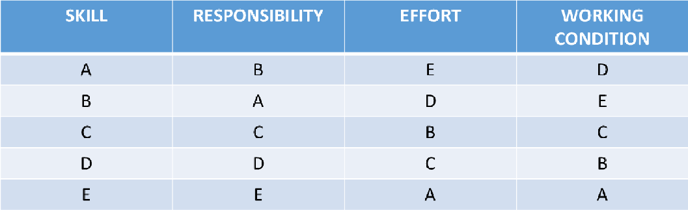
INDUSTRIAL MANAGEMENT
FACTOR COMPARISON METHOD:
EXAMPLE: Let us consider 5 key jobs these are A,B,C,D,E.
RANKING the JOBS:

Slide 125
INDUSTRIAL MANAGEMENT
KEY JOBS | CORRECT RATE | SKILL |  | RESPONSI BILITY |  | EFFORT |  | WORKIN G CONDITI ON
A | 6.00 | A | 3.40 | B | 2.00 | E | 1.20 | D | 1.20
B | 5.60 | B | 2.20 | A | 1.80 | D | 1.00 | E | 0.90
C | 4.40 | C | 1.80 | C | 1.20 | B | 0.80 | C | 0.80
D | 4.00 | D | 1.10 | D | 0.70 | C | 0.60 | B | 0.60
E | 3.50 | E | 0.90 | E | 0.50 | A | 0.40 | A | 0.40

Slide 126
Week 14

Slide 127
INDUSTRIAL MANAGEMENT
FACTOR SCALES:
Skill
Responsibility | 0 | 1 | 2 |  | 3 | 4
Effort | 0 | 1 | 2 |  | 3 | 4
Working Condition | 0 | 1 | 2 |  | 3 | 4
 | 0 | 1 | 2 |  | 3 | 4

Slide 128
INDUSTRIAL MANAGEMEN
A NEW JOB X:
Requirement:
Skill |  | similar to B | 2.2
Responsibility | similar to | C | 1.2
Effort | similar to | A | 0.4
Working condition |  | similar to | B | 0.6
 |  | Total |  | 4.40

Slide 129
INDUSTRIAL MANAGEMENT
Advantages:
More systematic comparison of job
Limited no of factors are used and it reduces the possibility of overlap.
Excellent description of how to construct a job comparison are available.
Limitations:
Difficult to explain to workers.
Some important factors may be omitted.

Slide 130
INDUSTRIAL MANAGEMENT
Point Rating Method:
Most widely used job evaluation method.
Steps:
Select job factors.
Construct a scale or yardstick of values for each job factor.
Evaluate all jobs in terms of the scale.
Conduct a wage survey for selected key jobs.
Design the wage structure.
Adjust and operate the wage structure.

Slide 131
INDUSTRIAL MANAGEMENT
Description:
Step-1: Select the jobs factors. Generally There are 4 major job factors:
(a) Skill (b) Responsibility (c) Effort (d) Working Condition
Skill Sub-factors:
Education
Experience
Initiative
Training
Mental Skill etc.

Slide 132
INDUSTRIAL MANAGEMENT
Responsibility sub-factors:
Equipment or process
Material or product
Safety of others etc.
Effort Sub-factors:
Physical
Mental
Working Conditions:
Hazards
Surroundings

Slide 133
Factors | No of Point | % | % × EROX.
Skill | 250 | 50% | 55%
Responsibility | 100 | 20% | 40%
Effort | 75 | 15% | 2.5%
Working Condition | 75 | 15% | 2.5%
 | 500(Total) | 100%(Total) | 100%(Total)
.

Slide 134
Week 15

Slide 135
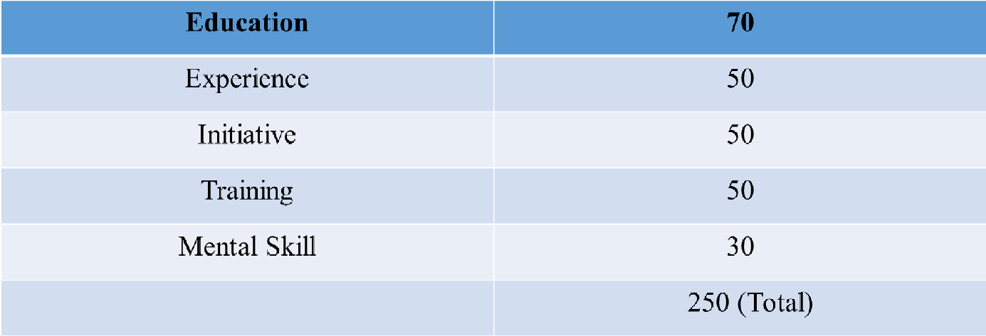
INDUSTRIAL MANAGEMENT
Factor: Skill 250 points.
Sub-factors:

Slide 136
INDUSTRIAL MANAGEMENT
Scale of Education Sub-factor (Total point 70) of skill factor (Total point 250):

Slide 137
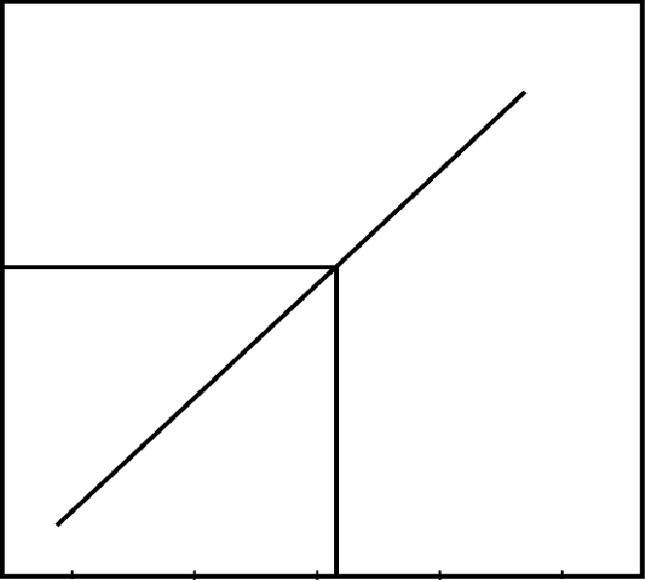

INDUSTRIAL MANAGEMENT
Step 3: Evaluation of the jobs
Job specification Factor & Sub-factor
A totaling all the points for all the factors will give the evaluations of the jobs in terms of points.
Step 4: Select some key jobs:
Wage survey for the selected key jobs.
Step 5: Design the wage structure:

Slide 138
INDUSTRIAL MANAGEMENT
Advantages:
The graphic & descriptive types of rating scales used have been accepted and most reliable and valid.
Factors are not limited. Factors decided as important can be used.
Job class or grades which is the aim of all job evaluation can easily set up. Job classes can be determined in terms of point range.
Limitations:
a)Difficult to develop. b)Difficult to explain.
Time concerning.
Assigning people weightages to each factor and sub-factor requires careful and detailed study.

Slide 139
INDUSTRIAL MANAGEMENT
Wage incentive plans:
Wage is the payment made by the employer for the effort put in by the worker in production.

Slide 140
INDUSTRIAL MANAGEMENT
Methods of Paying
Day Rates
Pay a man for his time
Piece Rates/Piece Work/Incentive Plans
Pay a man for his output
Characteristics :
Simple to compute
Easily understood
Good when production rate
is high
Save more when output is high
Characteristics :
Difficult to compute
Difficult to explain
Save less when high output
iv) High incentive value

Slide 141
INDUSTRIAL MANAGEMENT
The term incentive plan means counting a man’s output and paying him more money or less money depending on his output.
Requirements of an incentive plan to be successful :
Should apply only to situations where the worker by his effort can increase output.
Should pay more probably proportionally more for output above standard.
The Standards should be fairly set so that extra effort will result in bonus pay.
The reward should come soon.
The plan should be reasonably simple so that employee can withstand

Slide 142
INDUSTRIAL MANAGEMENT
Some common incentive plans :
Straight Piece Work
Helsey Premium Plan
Rowan Premium Plan
Taylor’s Different Piece Rate System
Emesion Efficiency Bonus

Slide 143
Week 16

Slide 144
INDUSTRIAL MANAGEMENT
Wage incentive plan :
Straight Piece work
Most common incentive plan.
It plays a fixed amount of money for excess piece produced.
The more one produces, more he earns. The less one produces, the less he earns.
Normally a worker gets a basic rate if produces less than the standard.

Slide 145
INDUSTRIAL MANAGEMENT
Total Earning, E
E = Standard Pay (Basic rate) + (No. of pieces produced more than the standard) × (Piece rate)
Total Earning
Production

Slide 146
INDUSTRIAL MANAGEMENT
Advantage:
Provides great incentive to workers.
The lost of suspension becomes less.
The working arrangement may be improved by the workers themselves to speed up the production.
Great speed means lower lost of production per piece.
Easy to calculate.
Limitation:
Quality of the production may be lower.
Great wastage of raw materials.
Great depreciation of machines and tools due to high speed.

Slide 147
INDUSTRIAL MANAGEMENT
Helsey premium plan:
The plan guarantees to a worker a certain basic rate plus in addition a bonus on certain percentage of time he saved on the job. If the time saved is equally shared by management net worker then it is called 50-50 Helsey plan.
Earning by 50-50 plan
E= 𝐻𝐴+ ^{𝑆−𝐴} × 𝐻
2
Where E = Earning TK,
H= Hourly rate TK, A= Actual time spent,
S= Standard time need for the job done.

Slide 148
INDUSTRIAL MANAGEMENT
Let, H= 5TK, A=8 hr.
S=12hr
E=5× 4 + ¹²⁻⁸ × 5 = 40 + 10 = 50 𝑇𝐾
2
Advantage:
Simple in design and easy to introduction
It guarantees a fixed base rate for slow workers.
It presents extra pay for efficient workers.
Limitation:
Motivating incentive is less than standard piece used.
Earning
100% std production Production

Slide 149
Week 17

Slide 150
INDUSTRIAL MANAGEMENT
Rowan Premium Plan:
It is a modification of Helsey premium plan. There is no way that an employee can double his pay.
Example: 𝐸 = 𝐻 × 𝐴 +
= 5 × 8 +
= 53.33
𝑆−𝐴
× 𝐻 × 𝐴
× 5 × 8
𝑆 12−8
12
Earning
Advantage:
Simple in design and easy to introduce.
It guarantees a fixed base rate for slow workers.
It permits extra pay for efficient workers.
100% std production Production
4.Employers protection against inaccurate setting of standard.

Slide 151
INDUSTRIAL MANAGEMENT
Limitation:
1.Minimal incentive value at higher production’s level. 2.Frequentially unpopular with the worker.
Taylors Differential Piece Rate System:
Standard output is determined carefully by motion & time study. Those who achieve standard or produce are paid at higher rate than those who fail to reach the standard.
Example:
Standard output = 10 pieces/day.
Rate for standard or mere = TK 1/piece. Rate for less than standard = TK 0.80/piece.

Slide 152
INDUSTRIAL MANAGEMENT
worker producing 12 pieces = 12× 1 = 12 TK
Worker producing 10 pieces = 10×1
Worker producing 08 pieces = 8×.8
Advantage:
= 10 TK
= 6.40 TK
Great incentive for efficient workers.
Penalize inefficient workers.
Limitation:
Does not guarantee a basic pay.
Very much disliked workers.

Slide 153
INDUSTRIAL MANAGEMENT
Granlt task & Bonus Plan:
The most liberal incentive plan.
Example:
Let, 20% bonus rate
Rate = 5 TK/hr Actual Time = 8 hr Standard Time = 12 hr
Earning, E = 12×5 + (12×5) ×20%
= 72 TK
Very difficult to cross the standard situation. Granlt plan used when standard are demanding & management needs strong incentive.

Slide 154
INDUSTRIAL MANAGEMENT
Advantage:
Easy to introduce.
Great incentive to efficient workers.
A certain base rate is guaranteed.
FRINGE BENEFITS:
Fringe benefits include all expenditure designed to benefit employees over & above the regular base pay plus incentives for higher production.
TYPES:
Payment for time not worked
Example: Lunch period, Prayer time, Washes time, Holidays, Vacation, Leaves.
Hazard protection:
Example: Injury, Old age, Death.

Slide 155
INDUSTRIAL MANAGEMENT
Employee services
Example: Medical service, Housing loan, use of Official Vehicles, Canteen, Education loan etc.
Legally Required Payment. Payment due to Govt. rule
Example: Group Insurance, Old age service etc.

