Slide 1
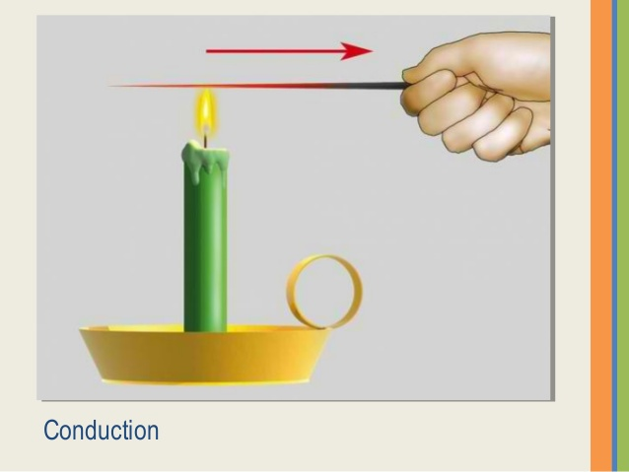
Heat Transfer
Course Code: ME 305 | CREDIT:03
 | MARKS:150
Mid Exam Hours 2 | CIE MARKS: 90
Semester End Exam Hours 3 | SEE MARKS: 60
Course Teacher: Iftekhar Mahmud

Slide 2
Course Learning Outcomes (CLOs): After completing this course successfully, the students will be able to-
CLO1 | Describe the basic understanding of heat transfer; General conduction equation; Steady state conduction in different geometries and composite structures
CLO2 | Identify the properties of thermal contact resistance; Unsteady heat conduction in solids; Laws of radiation heat transfer
CLO3 | Outline the radiation shape factor; Radiation interchange between two surfaces; Gas radiation; Heat and momentum transfer associated with laminar and turbulent flows of fluids in forced convection
CLO4 | Demonstrate the various engineering velocity and thermal boundary layer developments in tubes (ducts) and over flat plate
CLO5 | Differentiate essential experience with natural convection heat transfer; Heat transfer mechanism with change of phase; Boiling and condensation
CLO6 | Solve essential experience on mechanism and heat transfer correlations, mechanism of mass transfer by diffusion, convection and change of phase, analogy between heat and mass transfer

Slide 3
Sl. No. | Course Content | Hrs | CLOs
1 | Basic modes of heat transfer; General conduction equation; Steady state conduction in different geometries and composite structures | 5 | CLO1
2 | Thermal contact resistance; Unsteady heat conduction in solids; Laws of radiation heat transfer | 6 | CLO2
3 | Radiation shape factor; Radiation interchange between two surfaces; Gas radiation; Heat and momentum transfer associated with laminar and turbulent flows of fluids in forced convection | 6 | CLO3
4 | Velocity and thermal boundary layer developments in tubes (ducts) and over flat plate; Natural convection heat transfer | 6 | CLO4
5 | Heat transfer mechanism with change of phase; Boiling and condensation: mechanism and heat transfer correlations | 5 | CLO5
6 | Mechanism of mass transfer by diffusion, convection and change of phase; Analogy between heat and mass transfer | 6 | CLO6
TEXTBOOK
―Introduction to Heat Transfer‖ by F P Incropera and D P Dewitt.
―Fundamentals of Heat and Mass Transfer‖ by Lavine Bergman.
―Fundamentals of Momentum, Heat, And Mass Transfer‖ by Rorrer and Wilson.
―Fundamentals of Heat and Mass Transfer‖ by Mohan Gupta.
―Convective Heat and Mass Transfer‖ by W M Kays.

Slide 4
ASSESSMENT PATTERN
CIE- Continuous Internal Evaluation (90 Marks)
Bloom's Category Marks (out of 90) | Tests (45) | Assignments (10) | Class Test (20) | Quiz (5) | External Participation in Curricular/Co-Curricular Activities (10)
Remember | 5 |  | 10 | 05
Understand | 5 | 05 | 10
Apply | 10 |  |  |  | 10
Analyze | 15
Evaluate | 10
Create |  | 05

Slide 5
SEE- Semester End Examination (60 Marks)
Bloom's Category | Test
Remember | 10
Understand | 10
Apply | 10
Analyze | 10
Evaluate | 10
Create | 10

Slide 6
Course plan specifying content, CLOs, teaching learning and assessment strategy mapped with CLOs
Week | Topic | Teaching-Learning Strategy | Assessment Strategy | Corresponding CLOs
1 | Basic modes of heat transfer | Lecture, discussion, group work | Quiz, Written Exam | CLO1
2 | Steady state conduction in different geometries and composite structures | Oral Presentation, debate | Assignment, Written, Quiz | CLO1
3 | Thermal contact resistance | Video lecture, Field visit | Report writing, Demonstration | CLO1
4 | Unsteady heat conduction in solids; | Lecture | Viva, Quiz | CLO1, CLO3
5 | Laws of radiation heat transfer | Project exhibition | Project, Field visit | CLO1
6 | Radiation shape factor; Radiation interchange between two surfaces | Discussion, Video Presentation | Quiz, Written Exam | CLO1
7 | Gas radiation; Heat and momentum transfer associated with laminar and turbulent flows of fluids in forced convection | Case-based Learning, Demonstration | Assignment, Written, Quiz | CLO1, CLO4
8 | Velocity and thermal boundary layer developments in tubes (ducts) and over flat plate. | Lecture, discussion, group work | Report writing, Demonstration | CLO3, CLO4
9 | ; Natural convection heat transfer | Oral Presentation, debate | Viva, Quiz | CLO2
10 | Heat transfer mechanism with change of phase | Video lecture | Project, Field visit | CLO2
11 | Boiling and condensation: mechanism and heat transfer correlations | Lecture | Quiz, Written Exam | CLO5, CLO6
12 | convection and change of phase | Project exhibition | Assignment, Written, Quiz | CLO3, CLO6
13 | Analogy between heat and mass transfer | Discussion, Video Presentation | Report writing, Demonstration | CLO1

Slide 7
Week 1

Slide 8
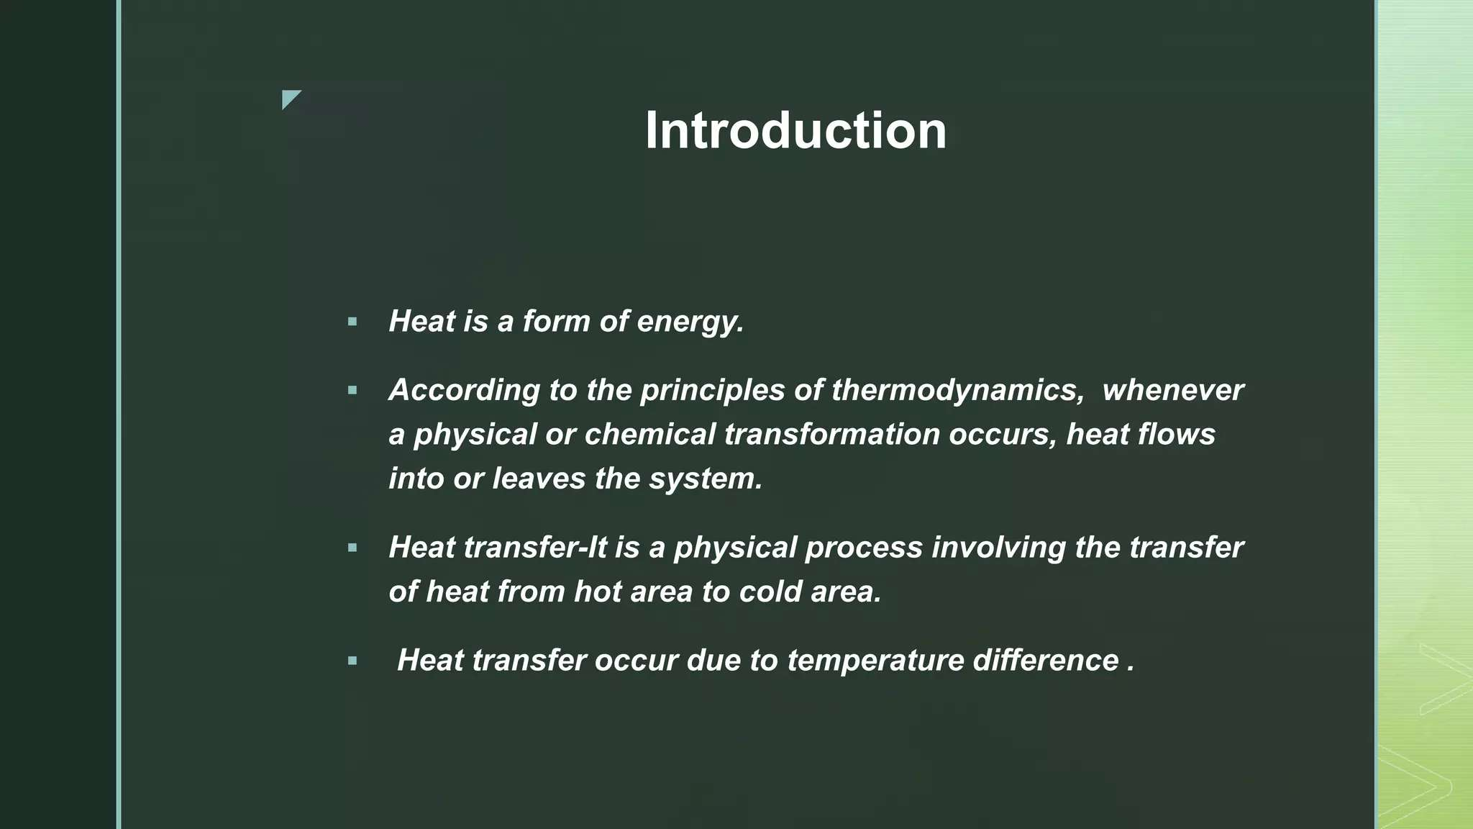

Slide 9
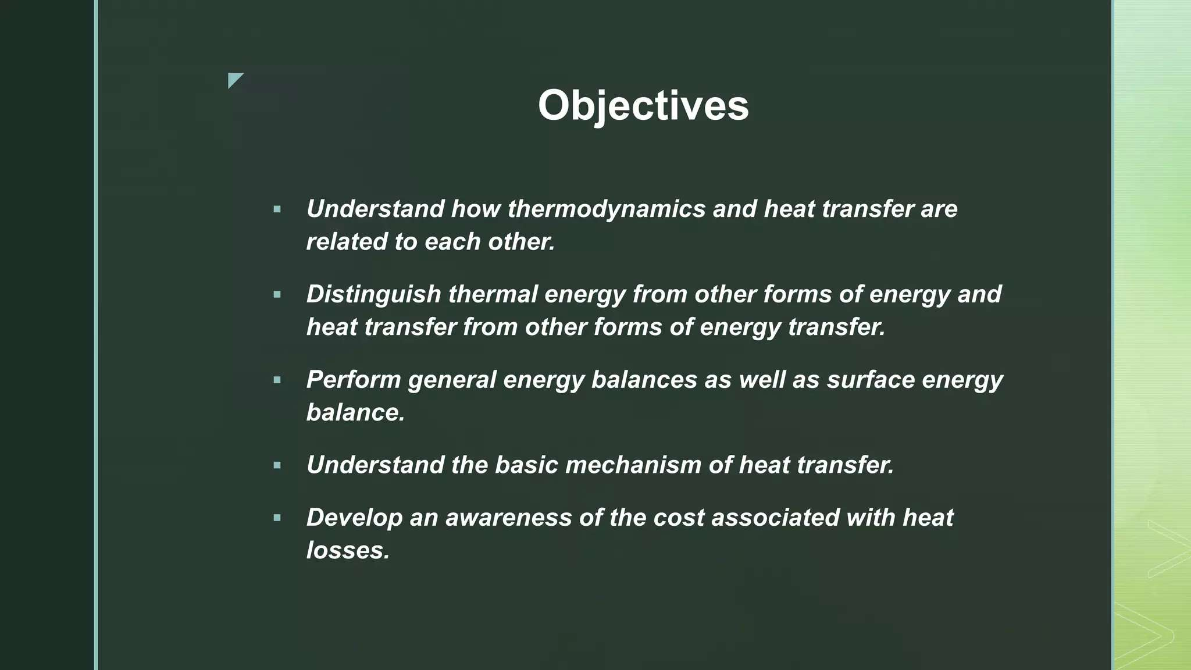

Slide 10
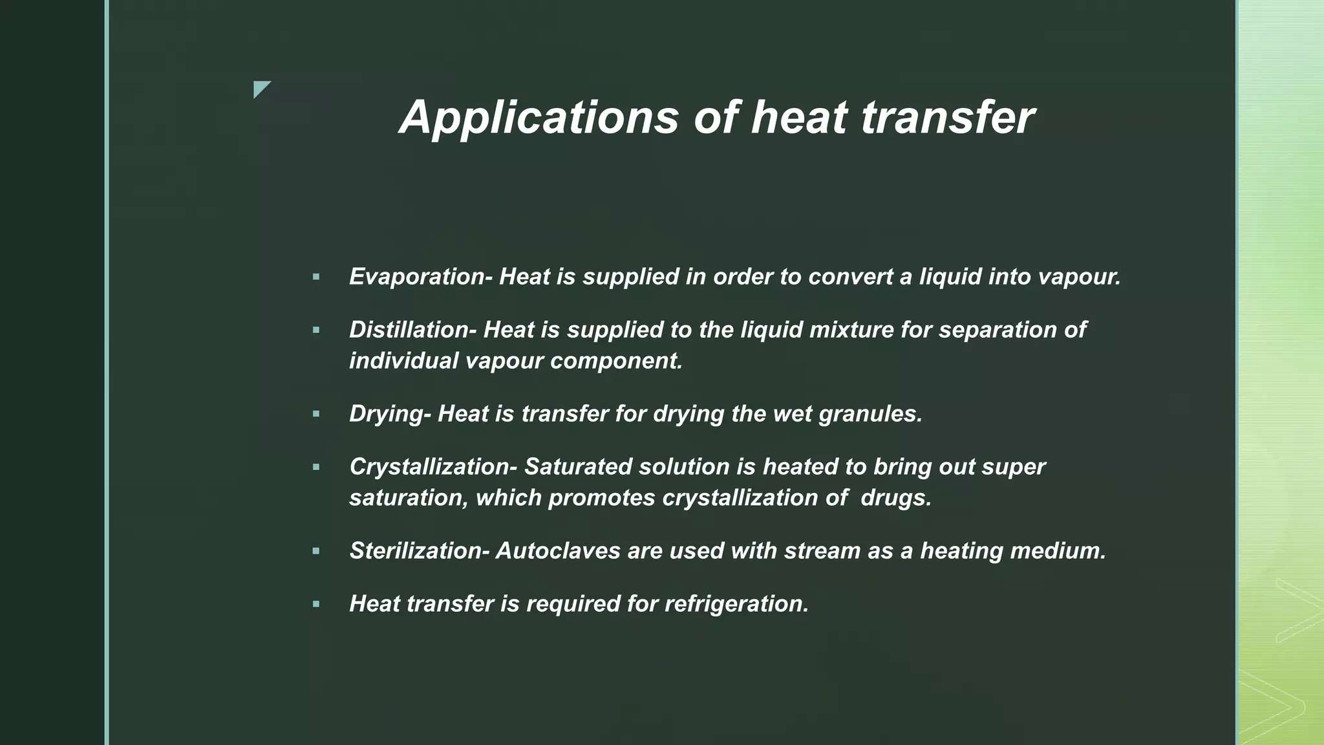

Slide 11
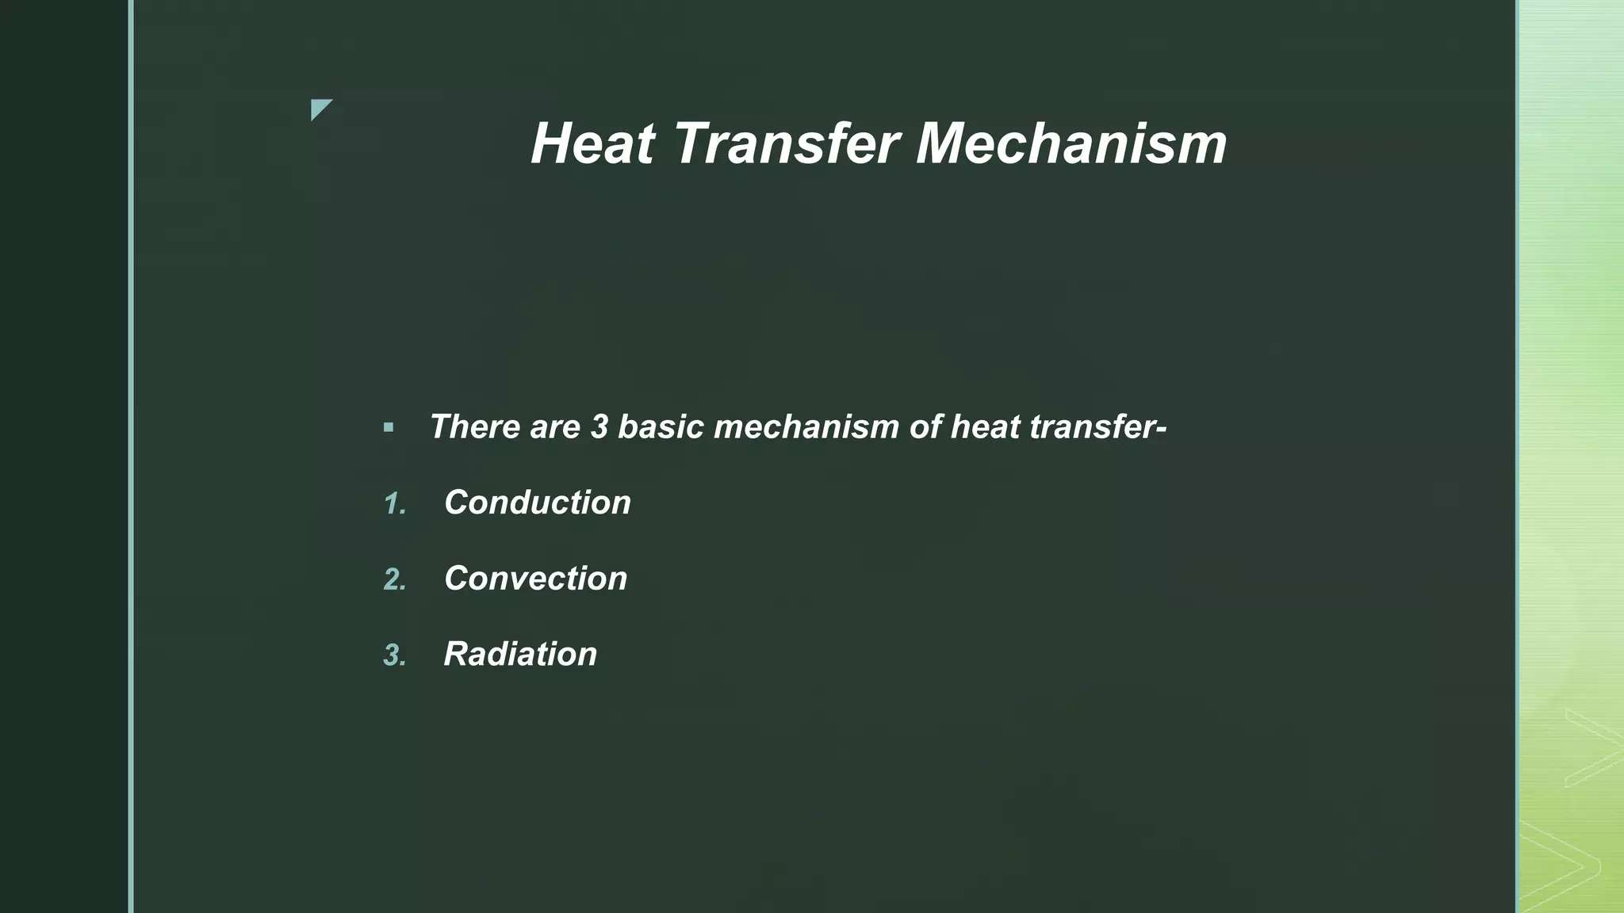

Slide 12
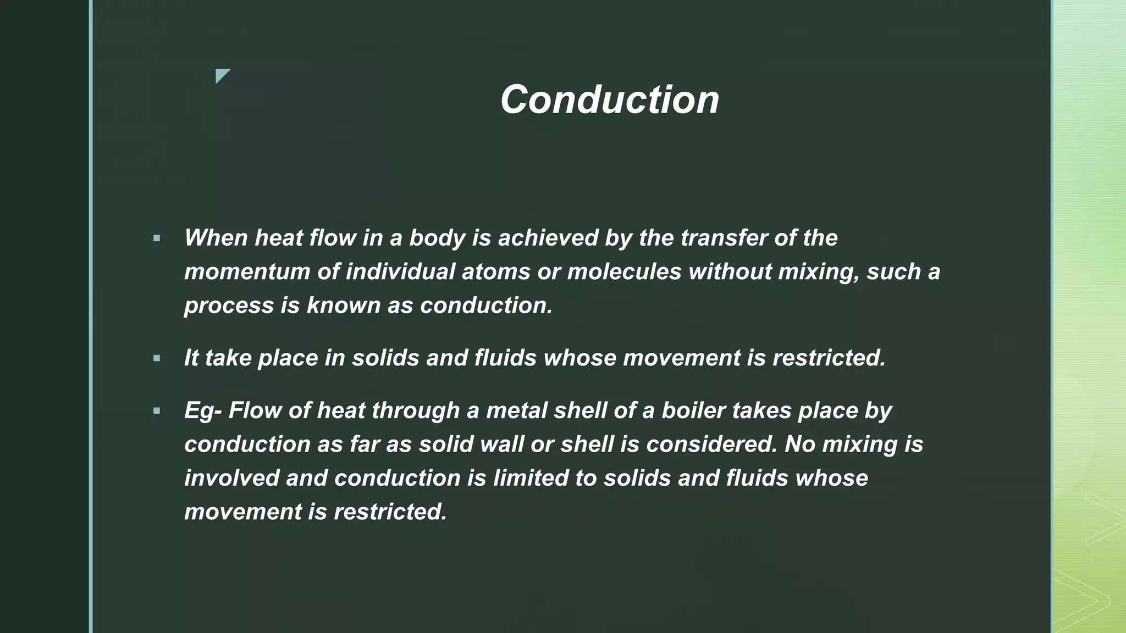

Slide 13
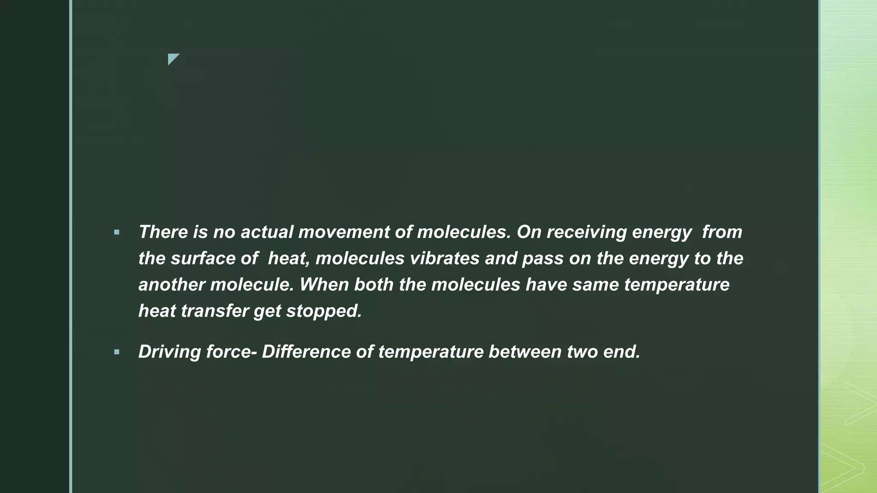

Slide 14
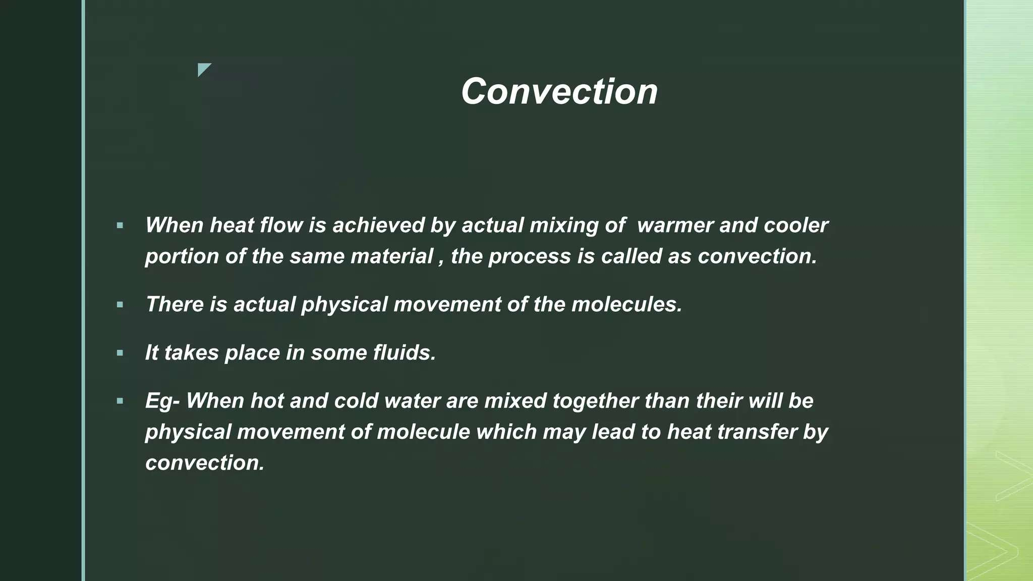

Slide 15
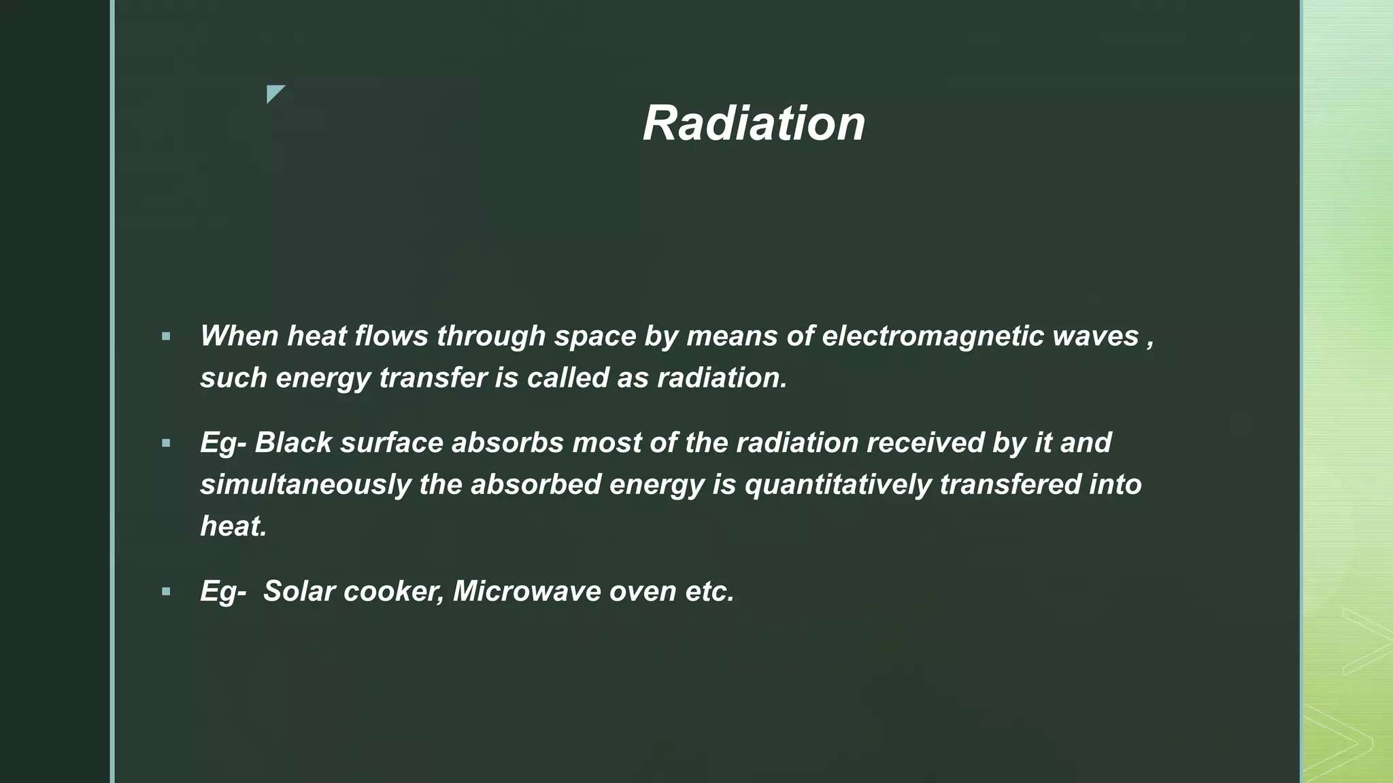

Slide 16
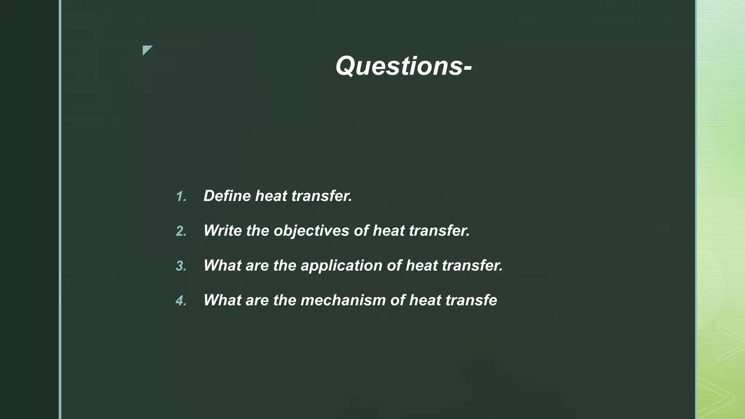

Slide 17
Week 2

Slide 18
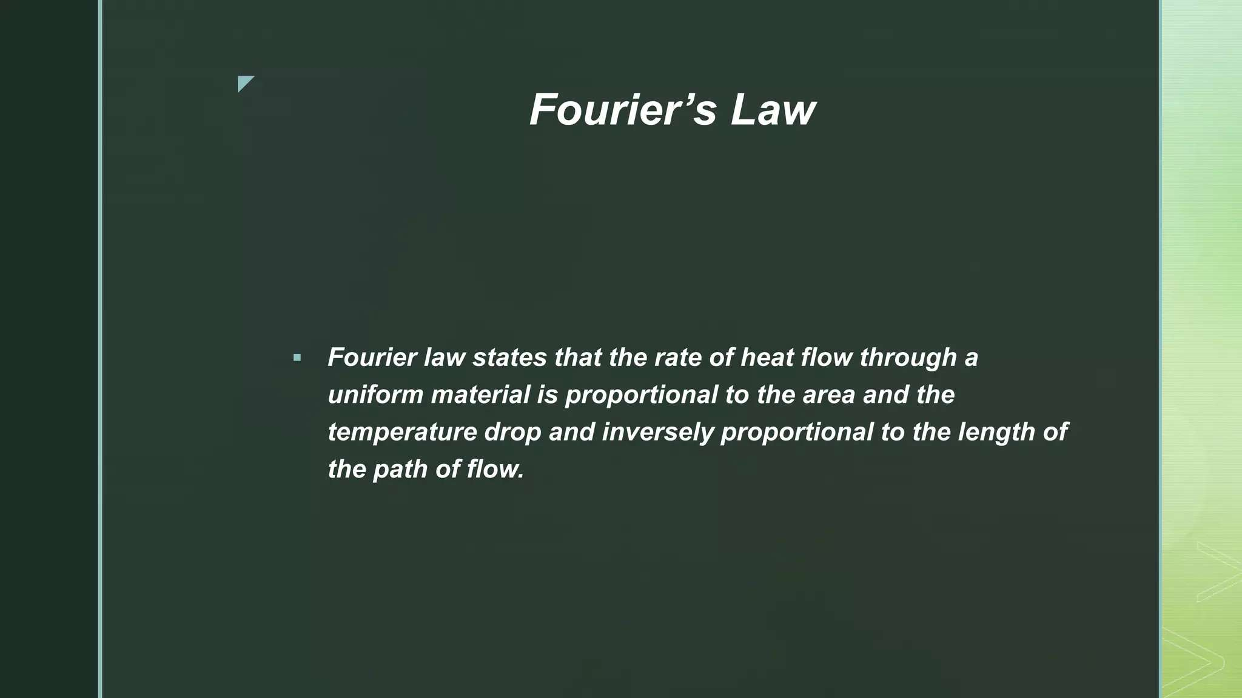

Slide 19
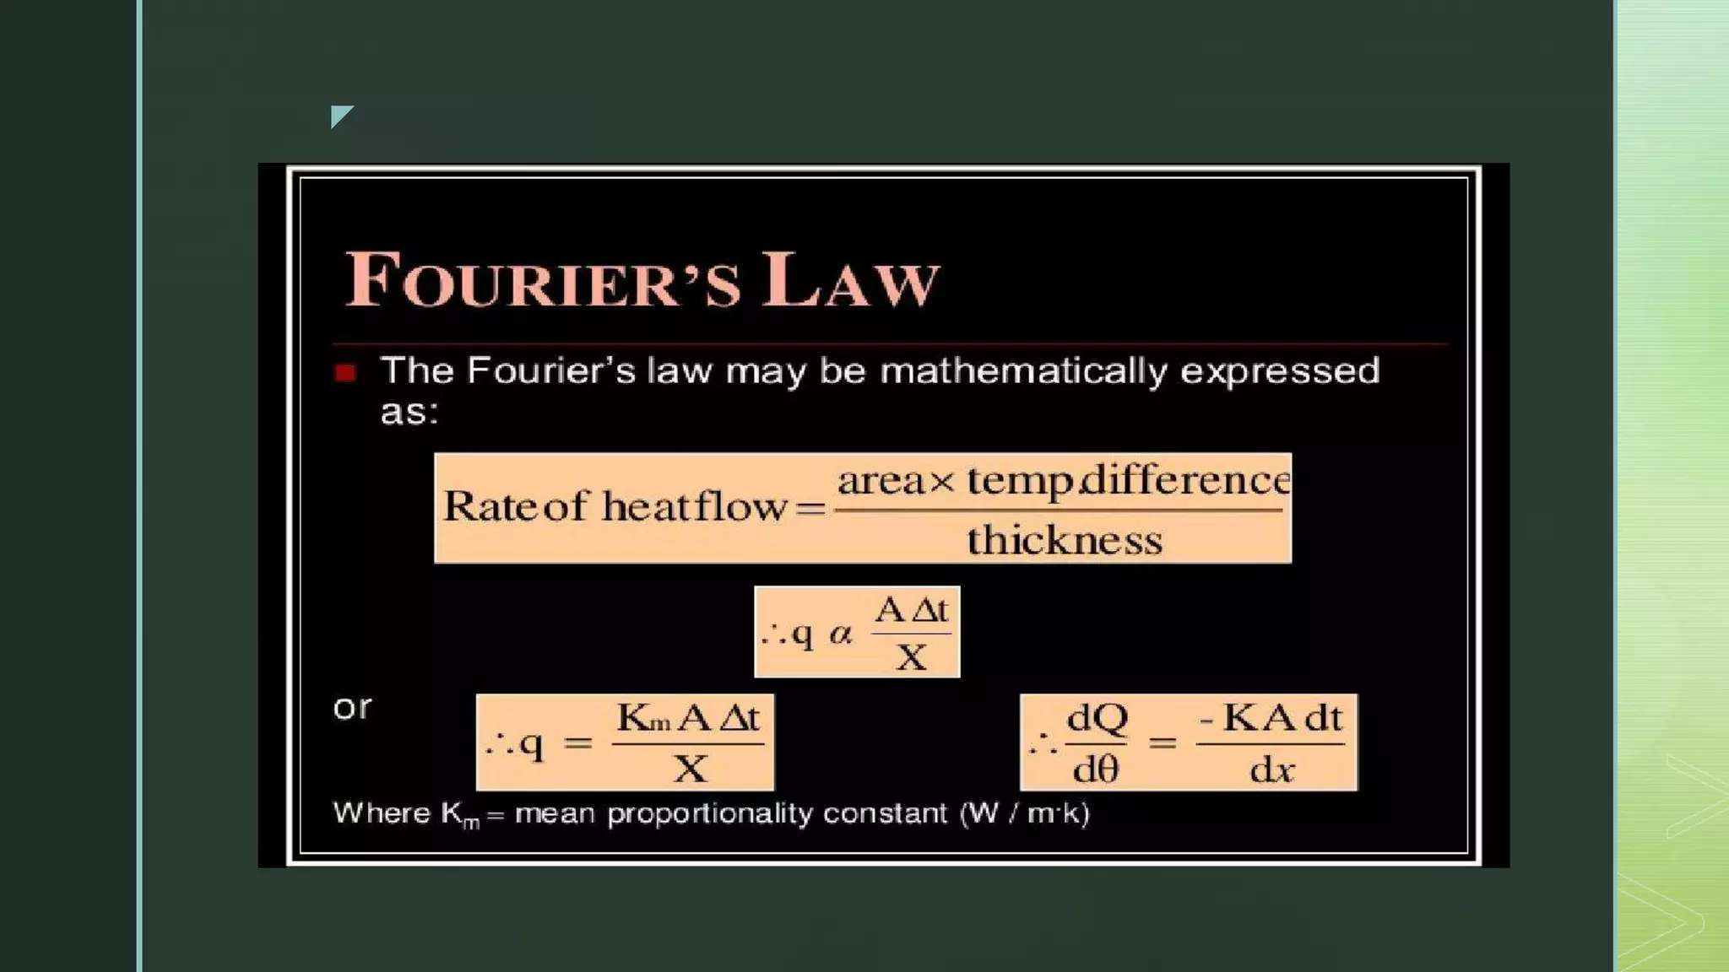

Slide 20
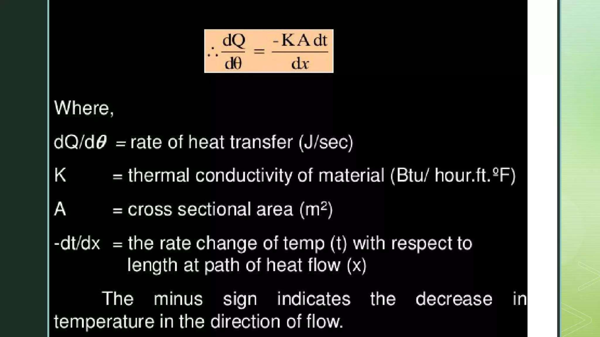

Slide 21
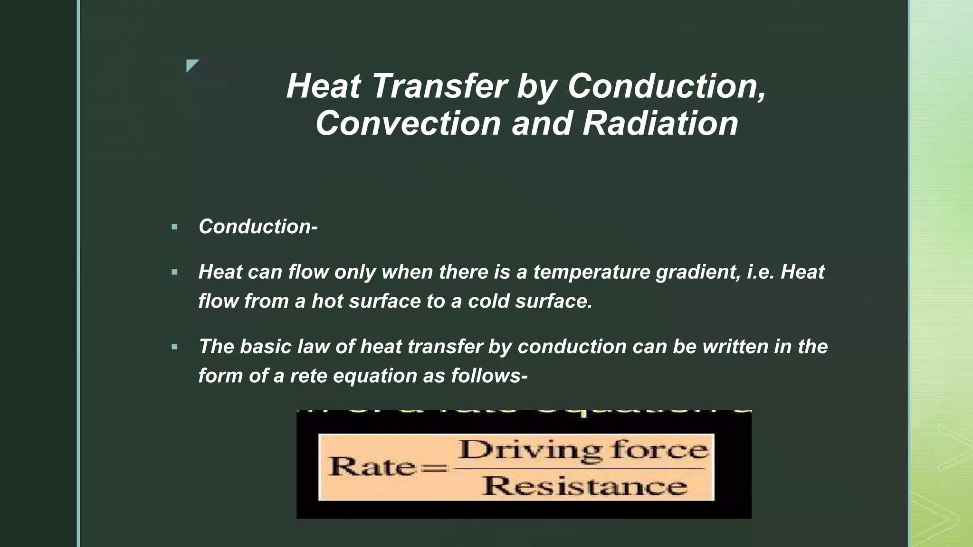

Slide 22
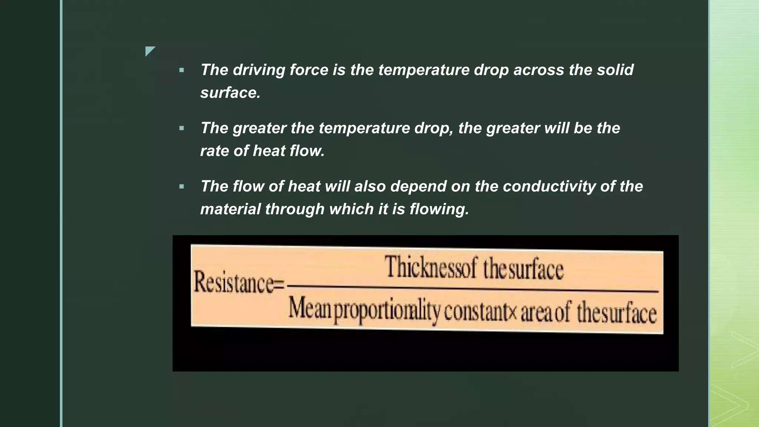

Slide 23
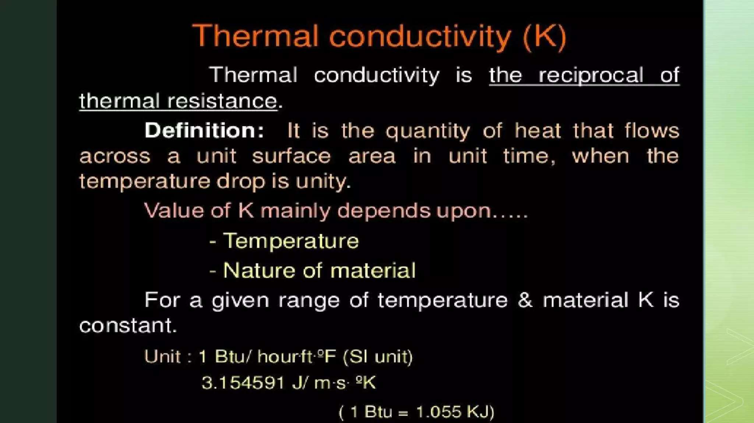

Slide 24
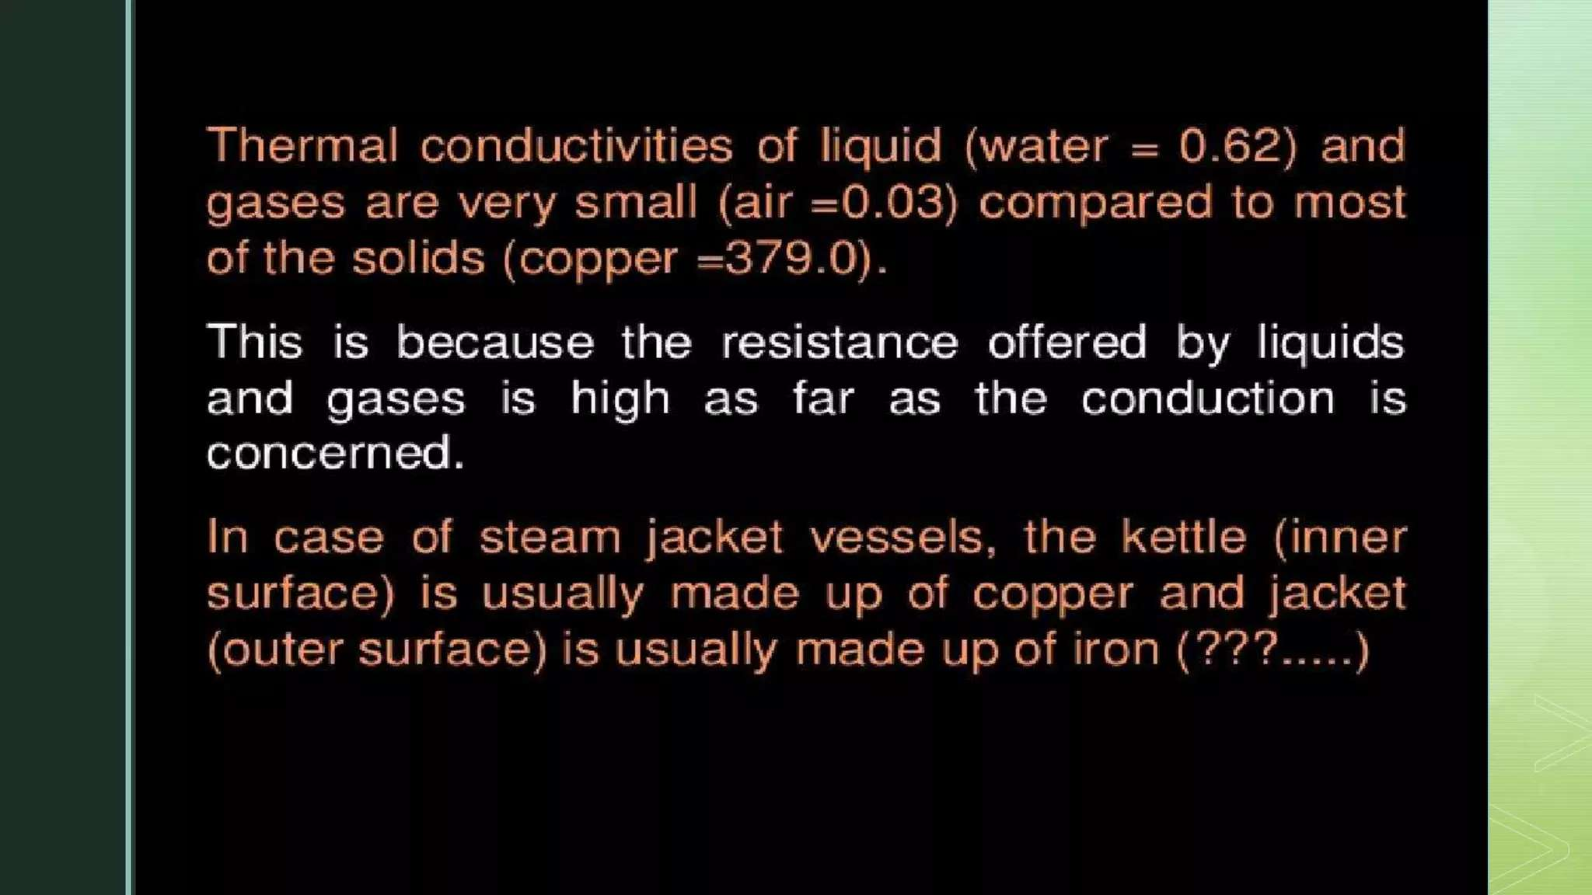

Slide 25
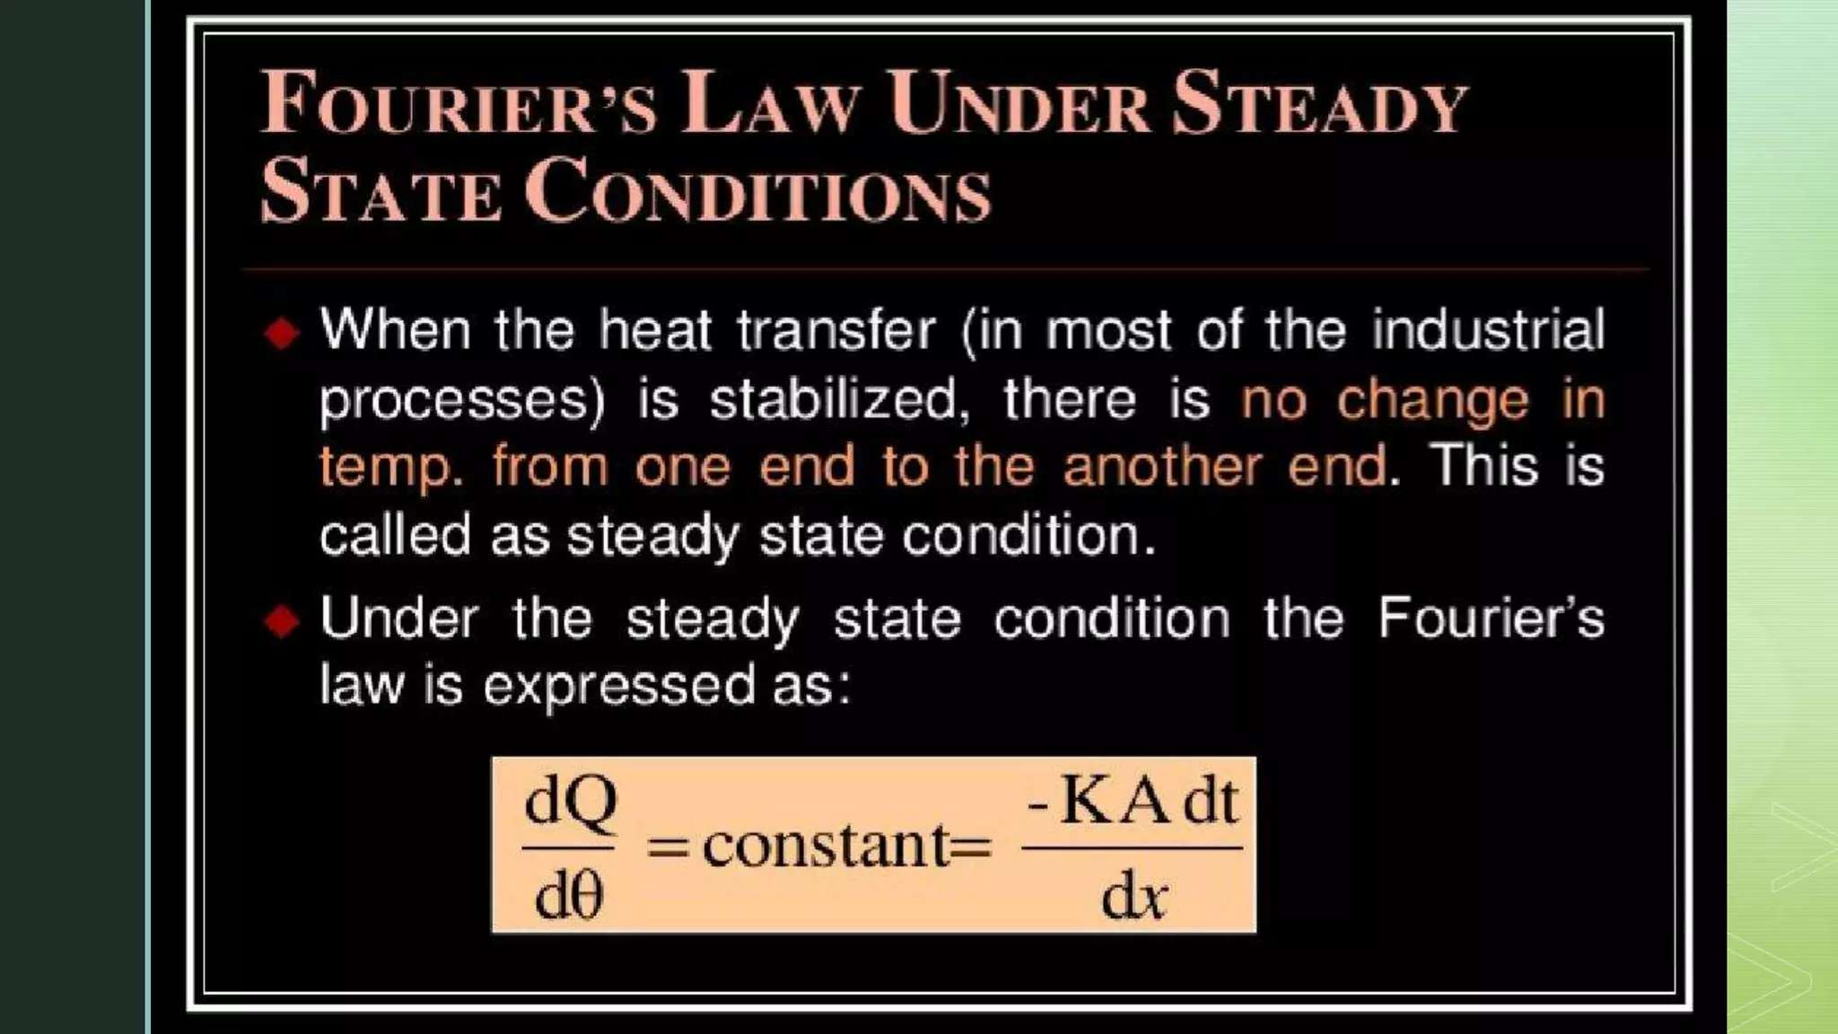

Slide 26
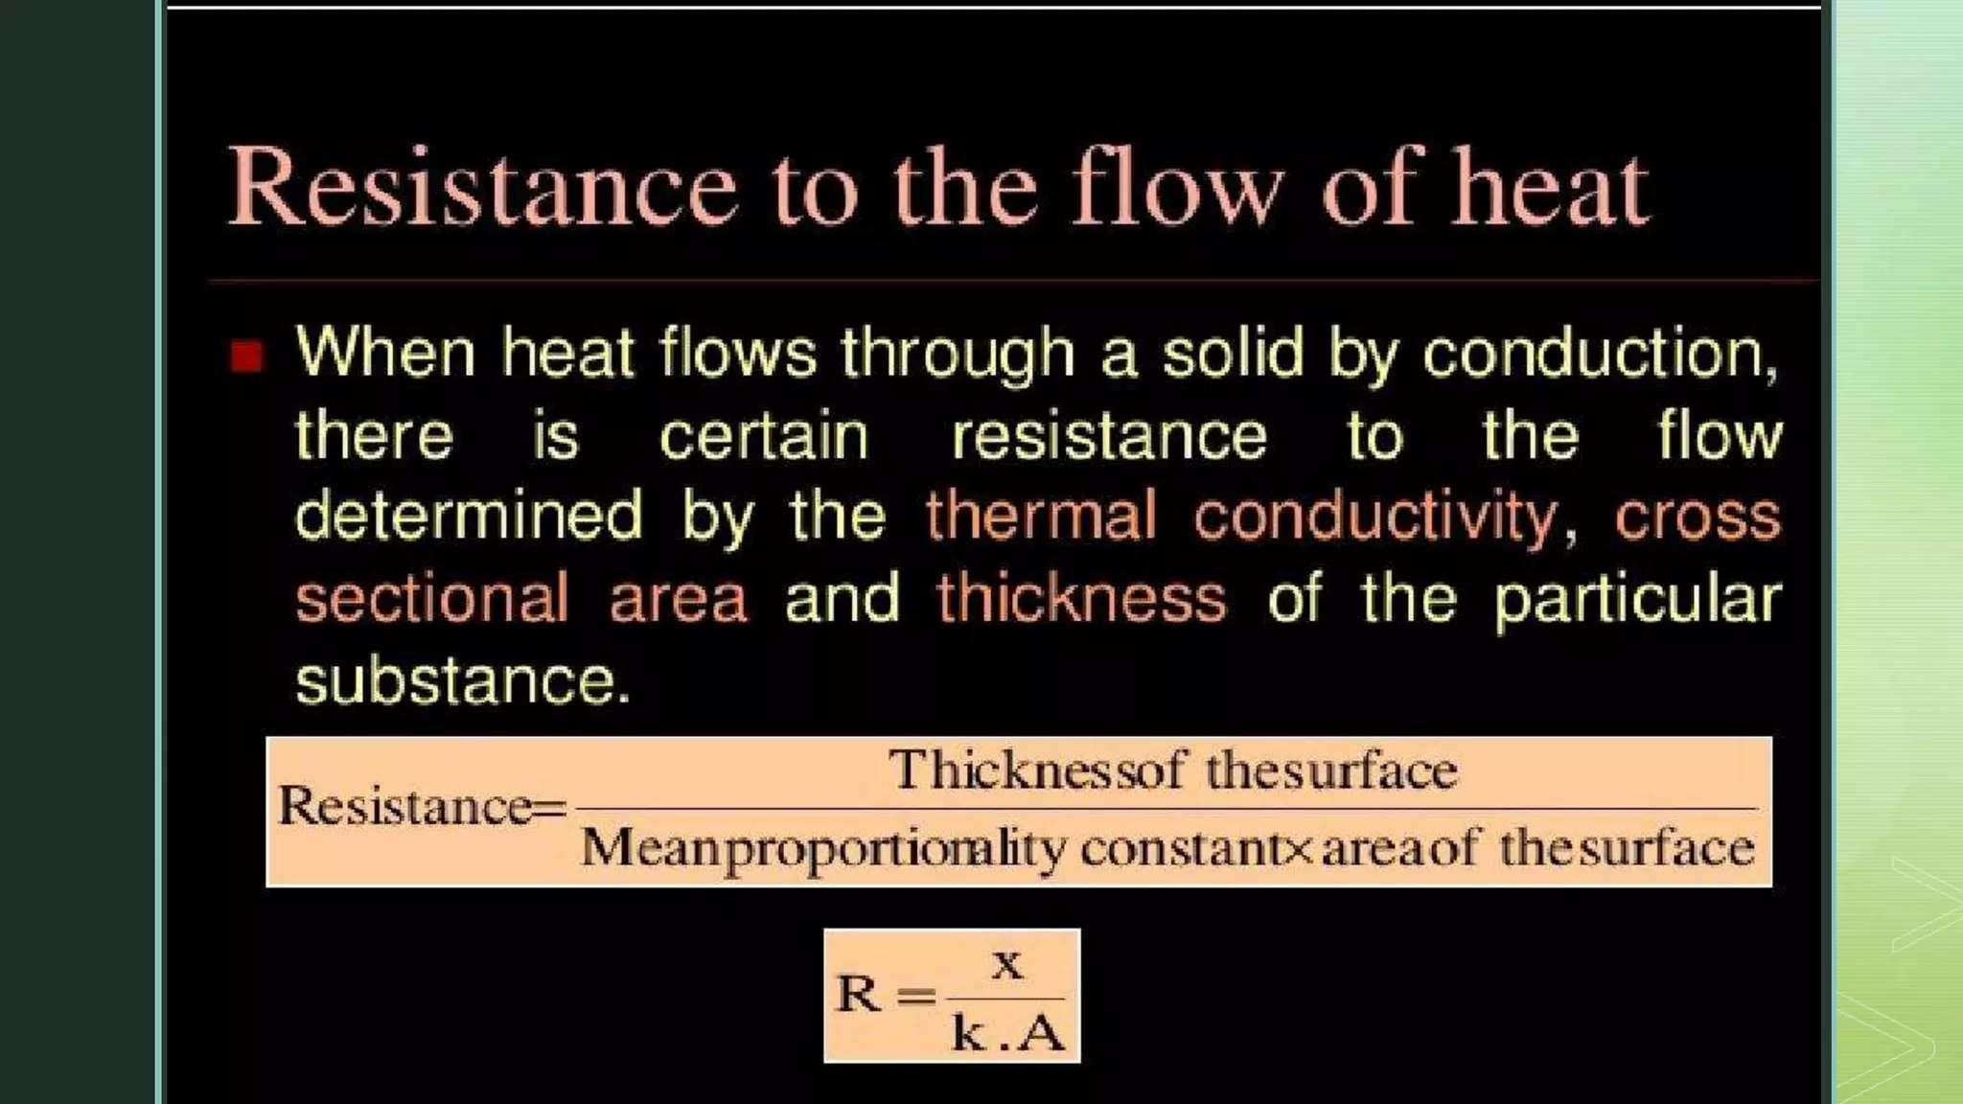

Slide 27
Week 3

Slide 28
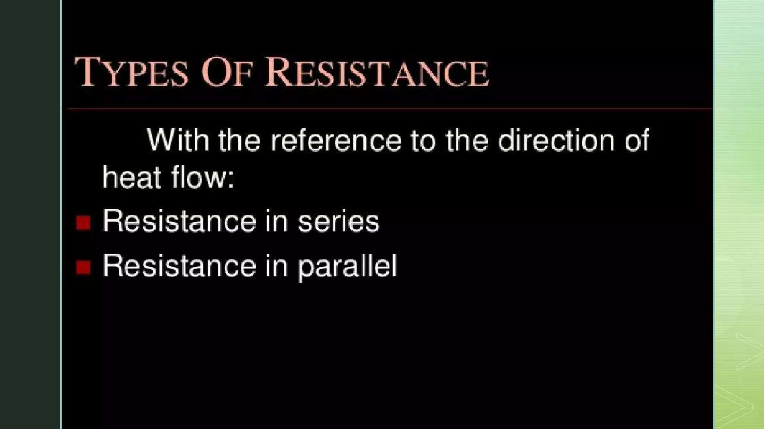

Slide 29
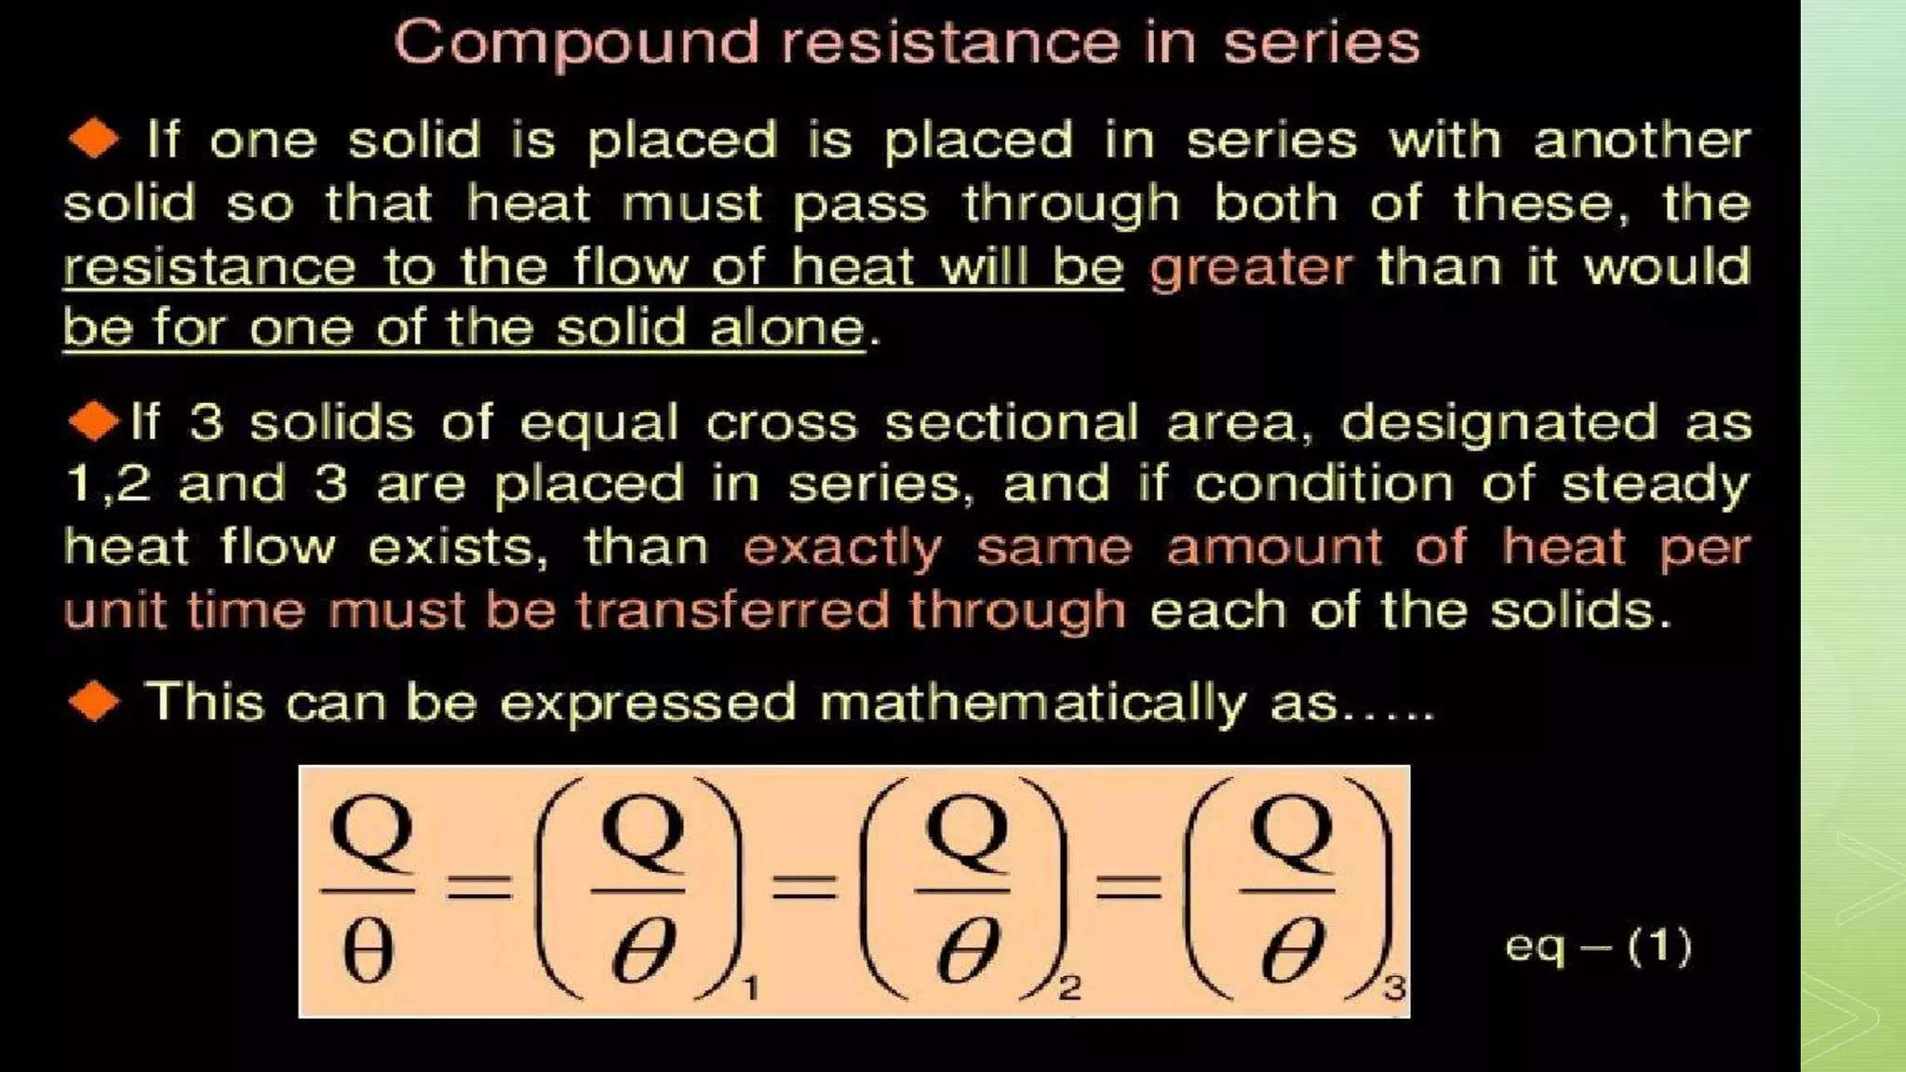

Slide 30
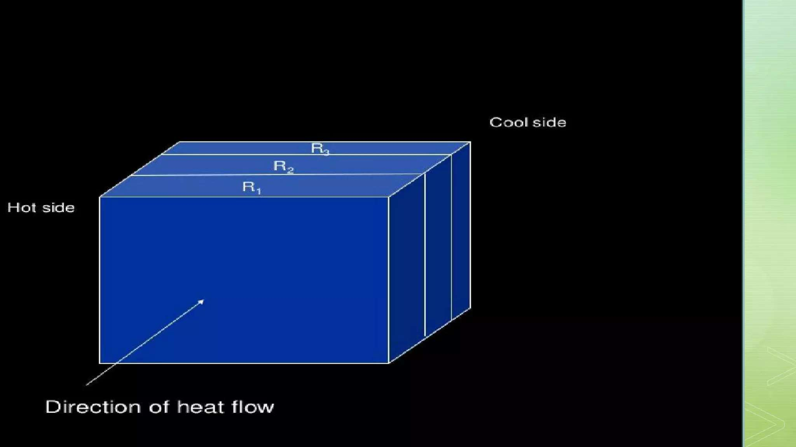

Slide 31
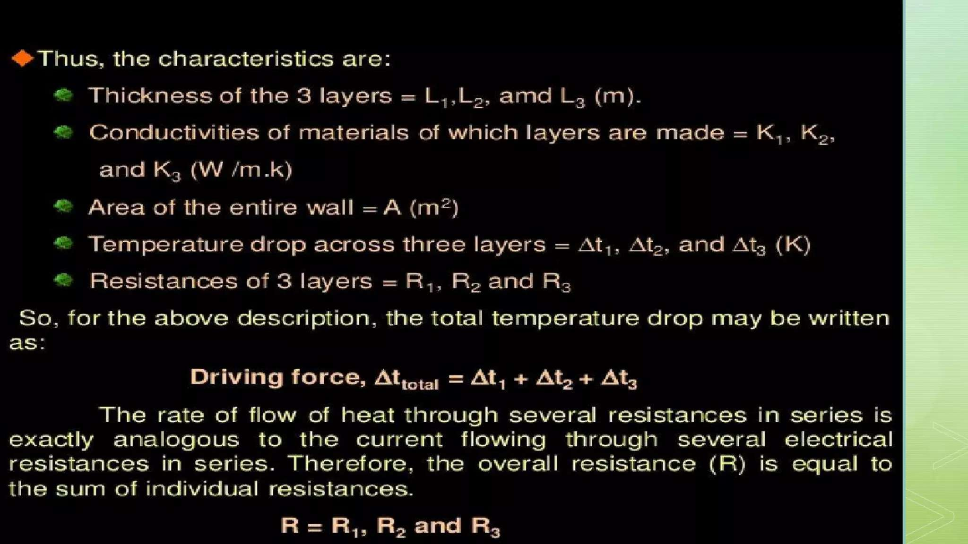

Slide 32
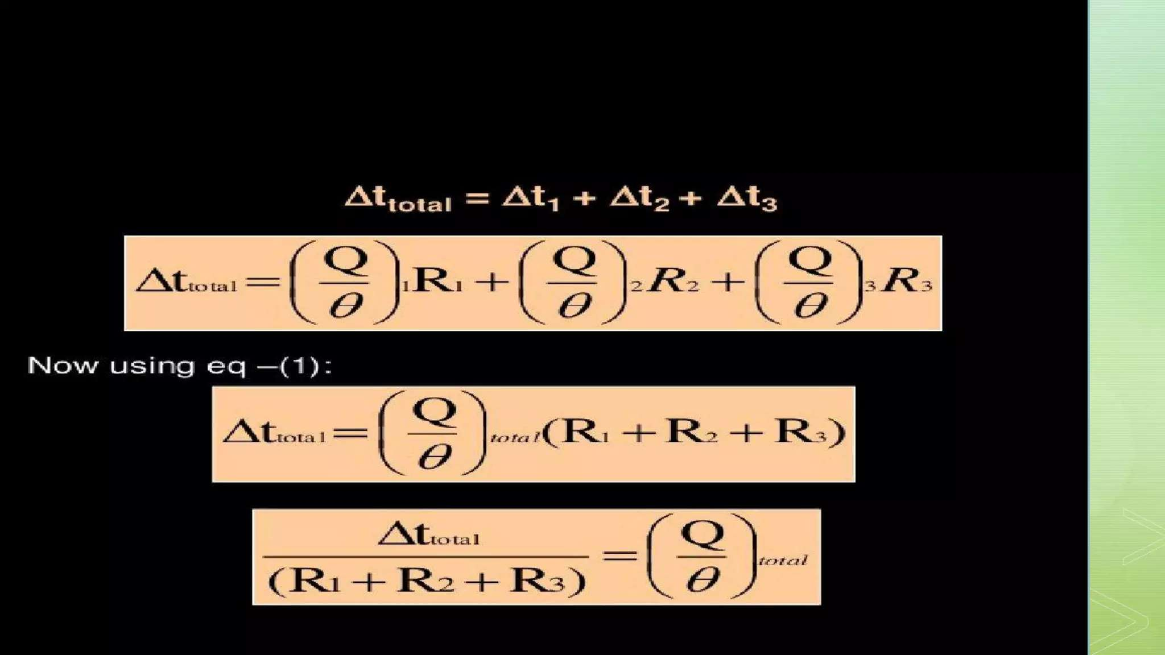

Slide 33
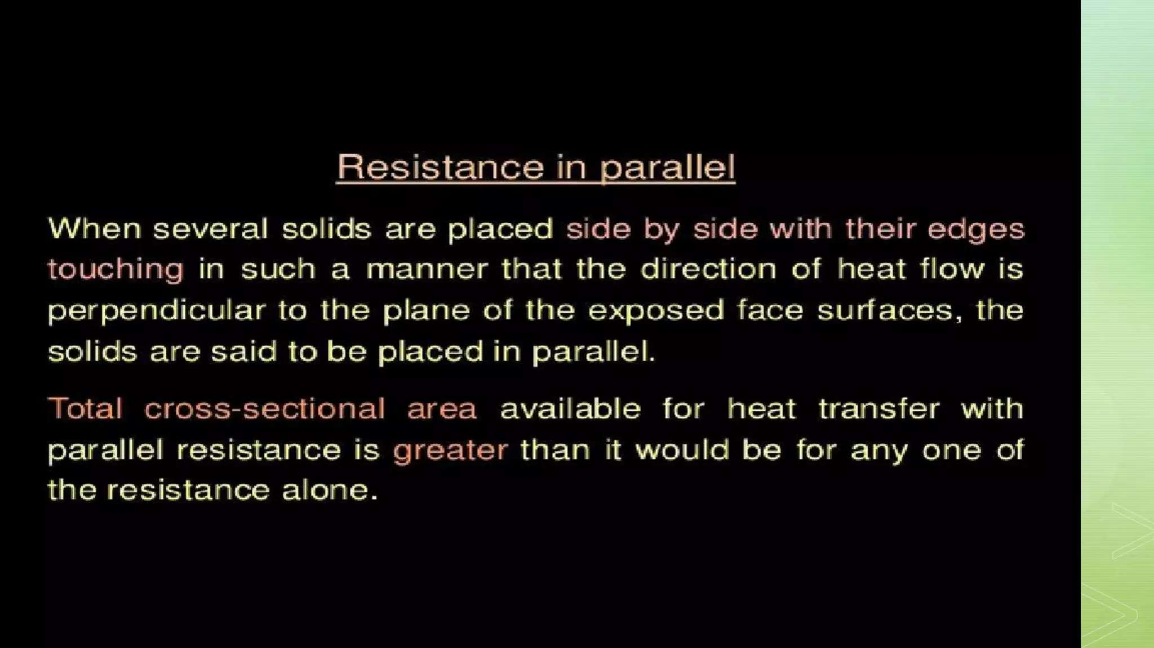

Slide 34
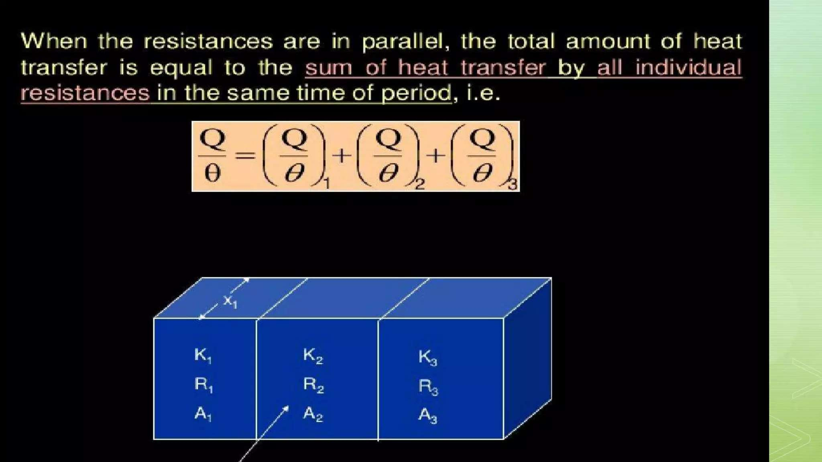

Slide 35
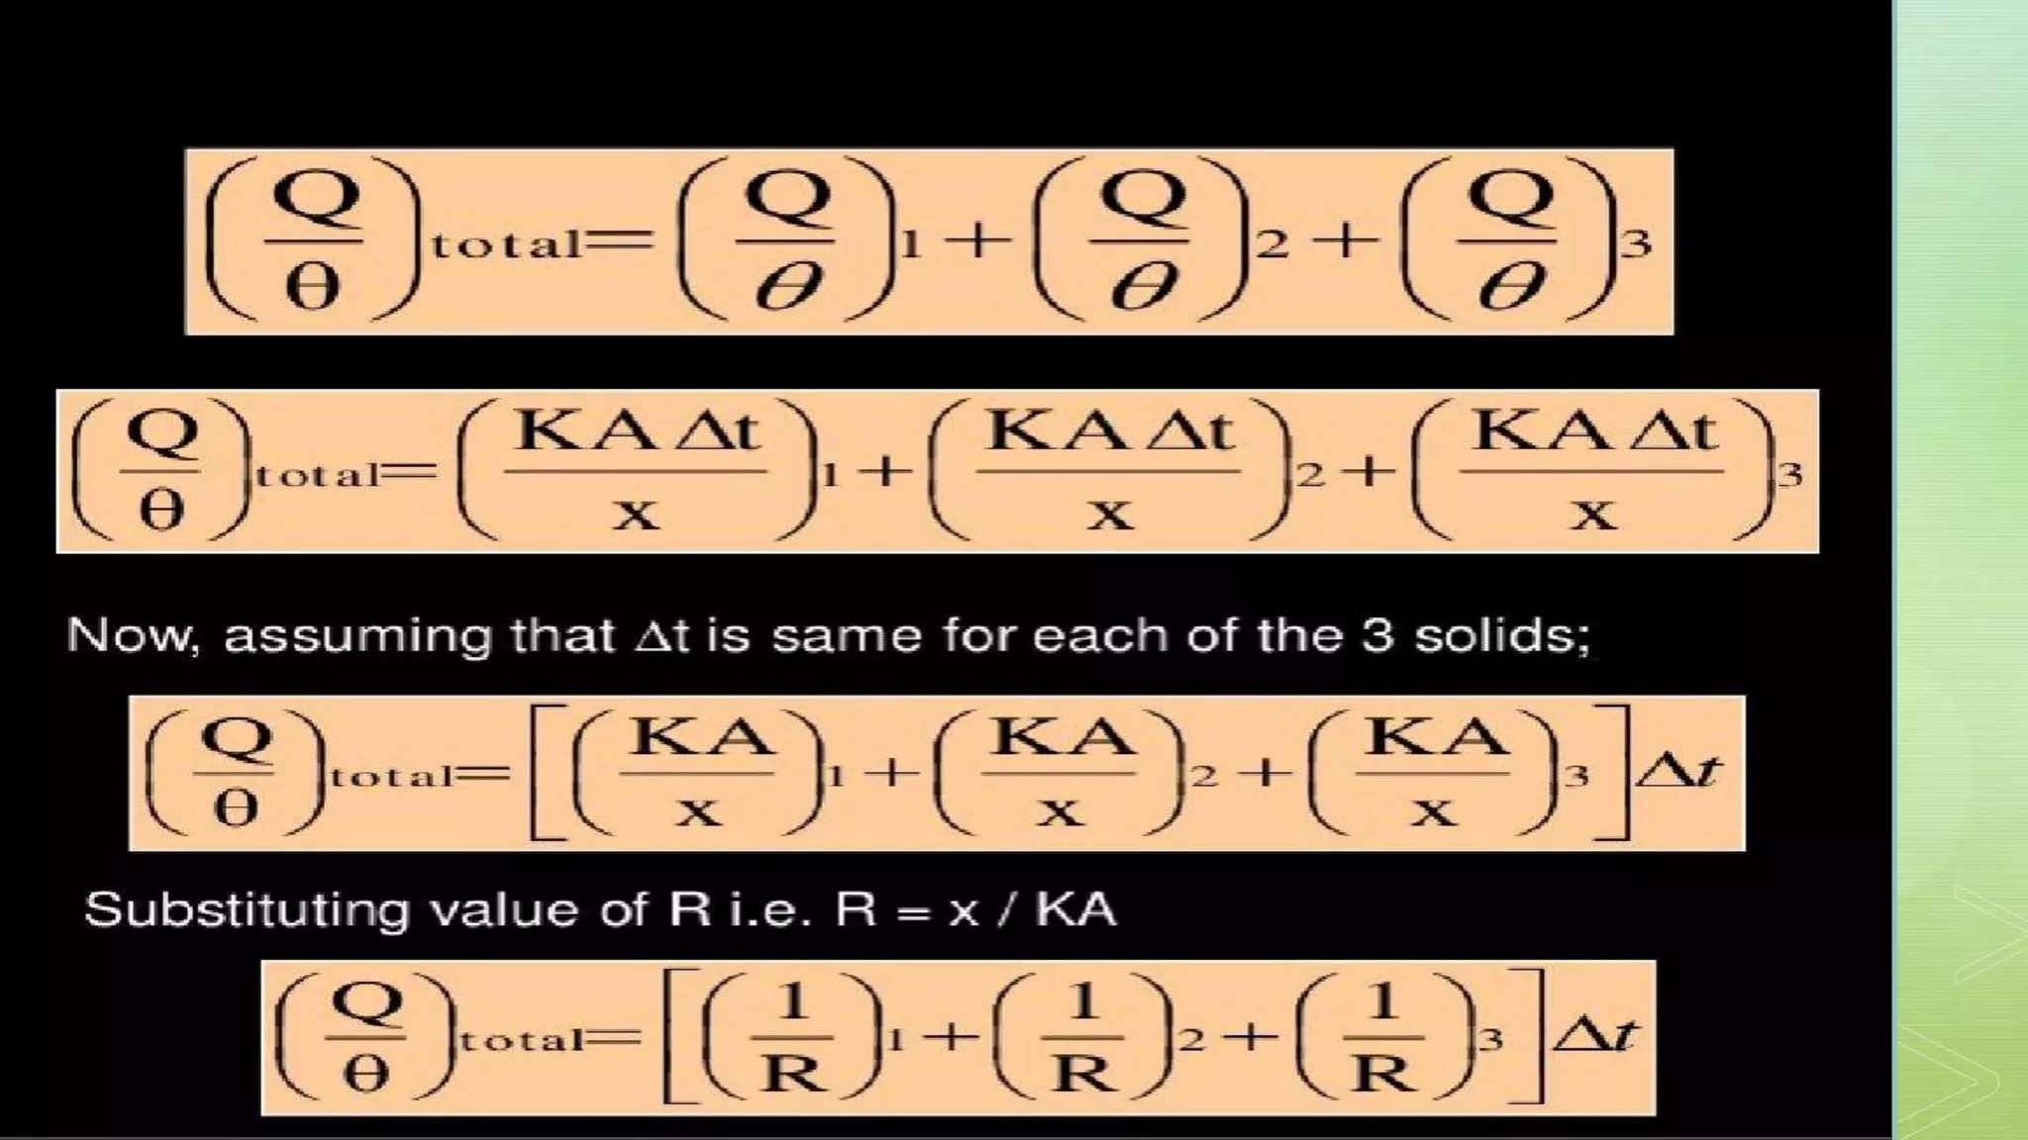

Slide 36
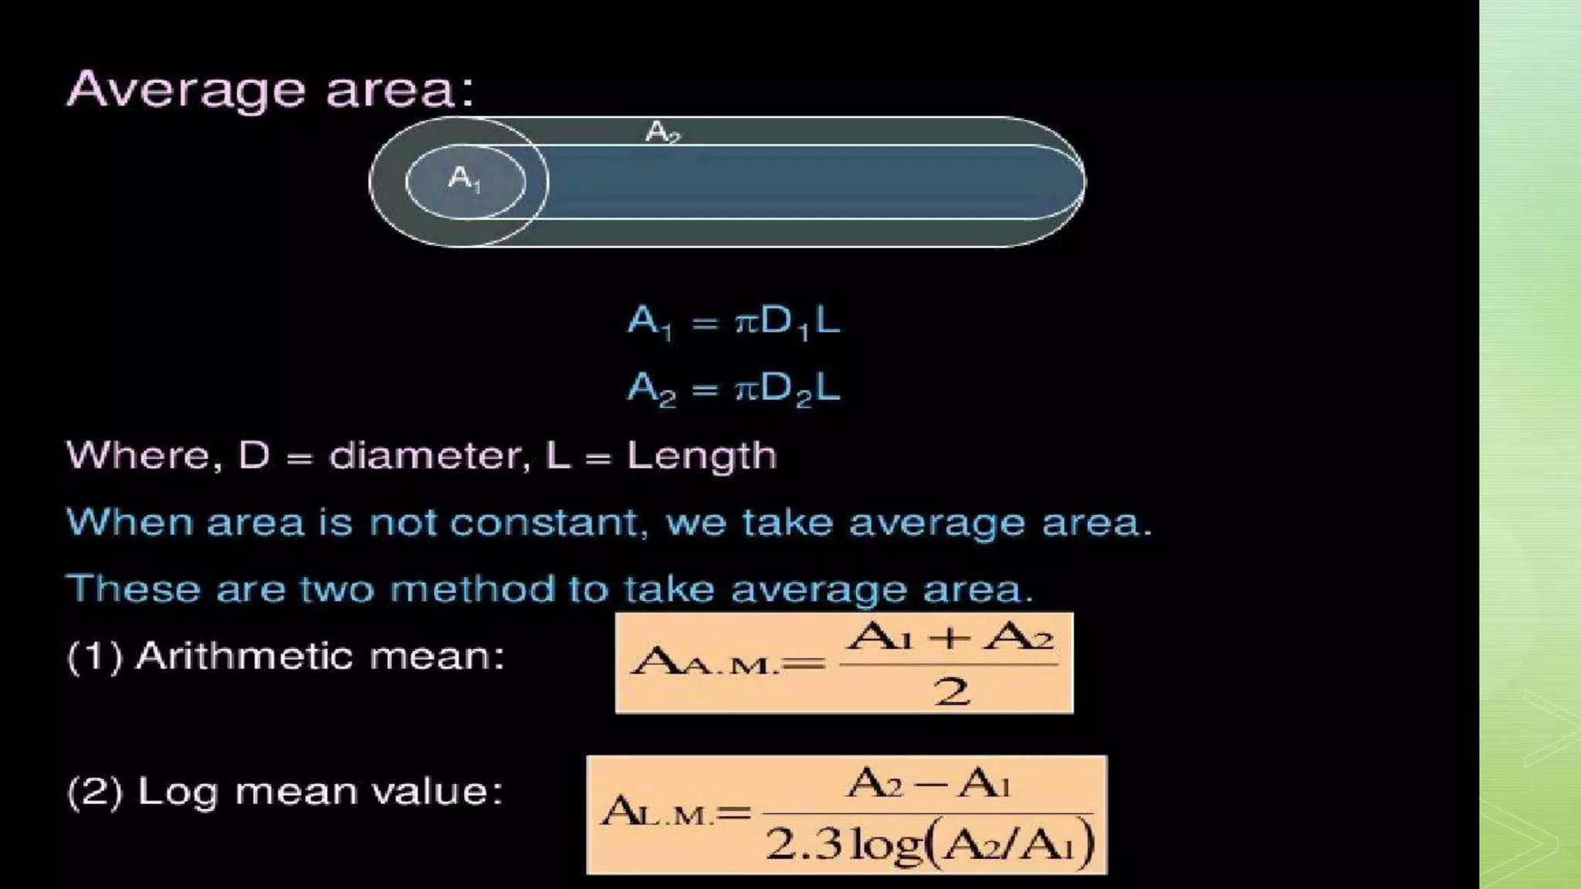

Slide 37
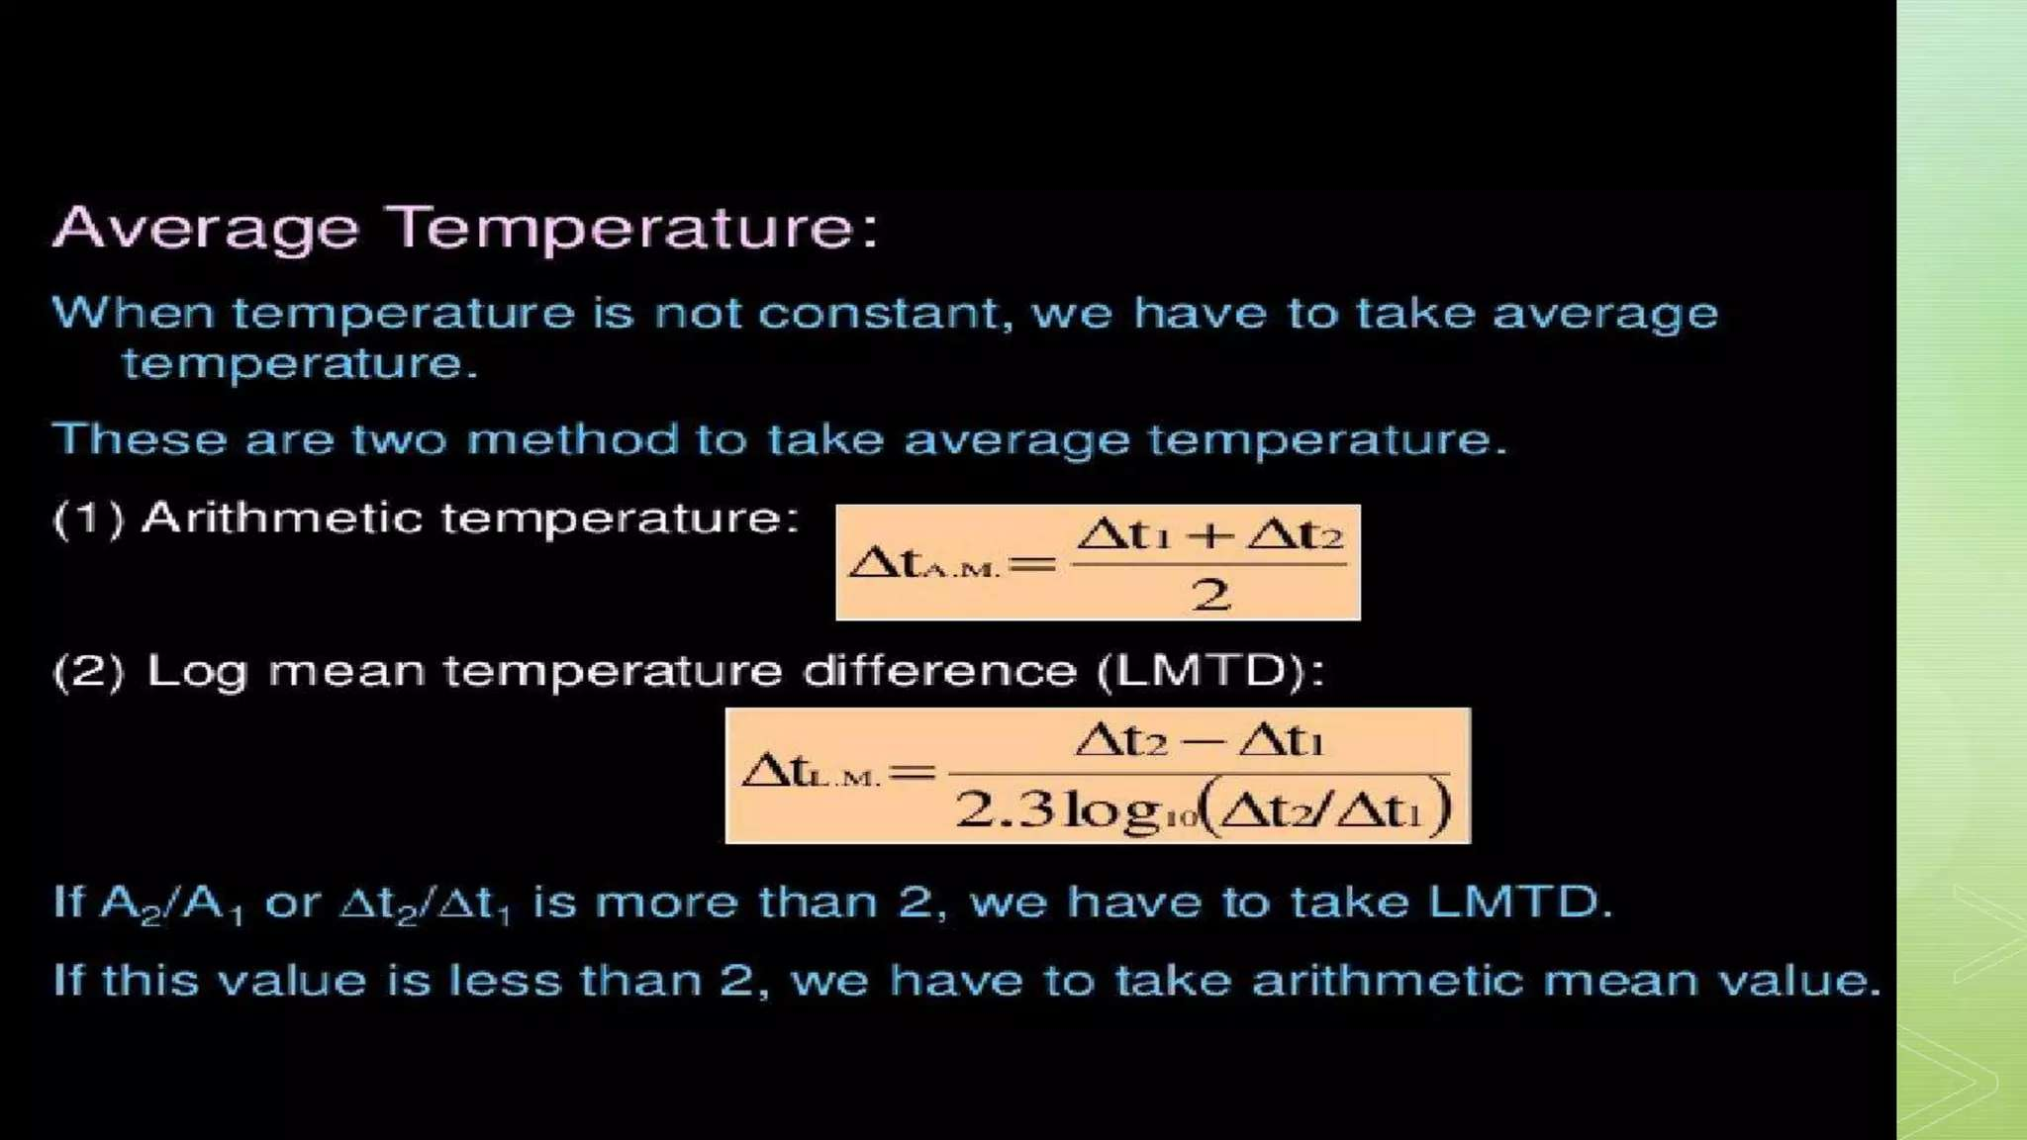

Slide 38
Week 4

Slide 39
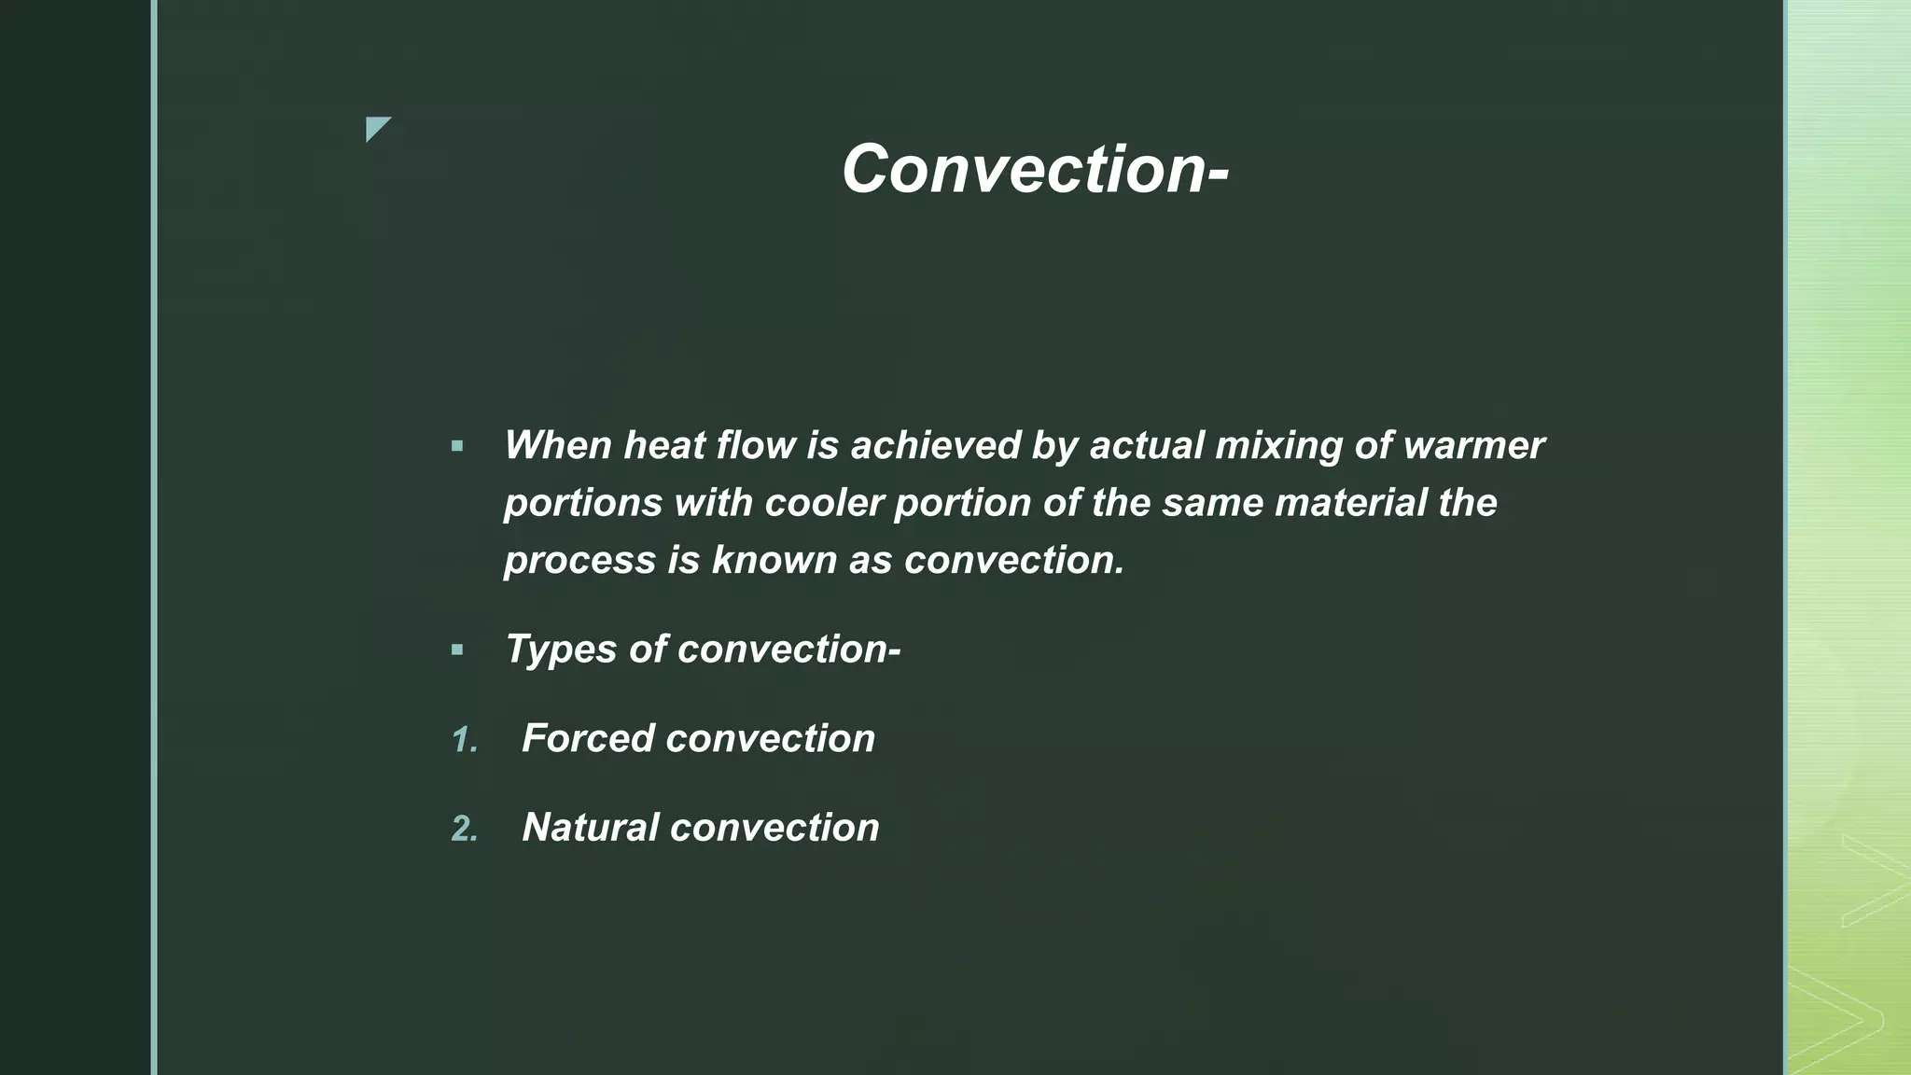

Slide 40
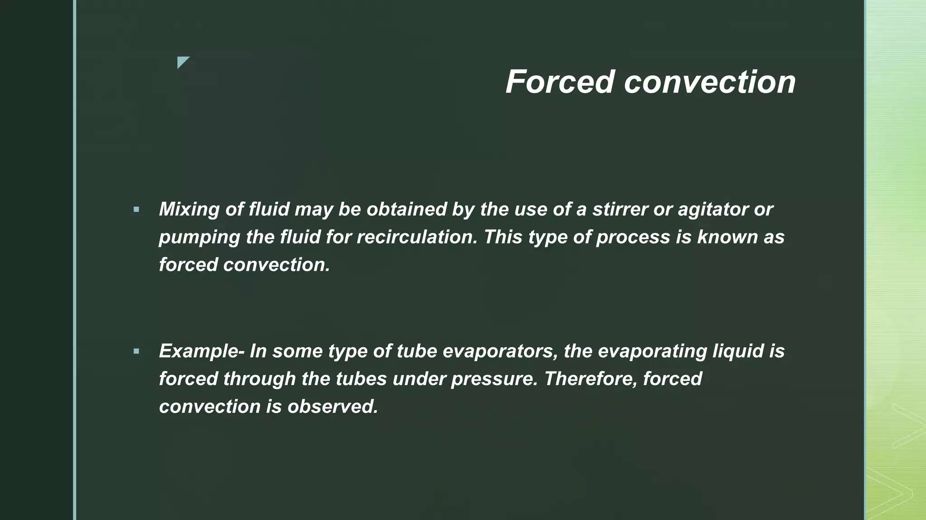

Slide 41
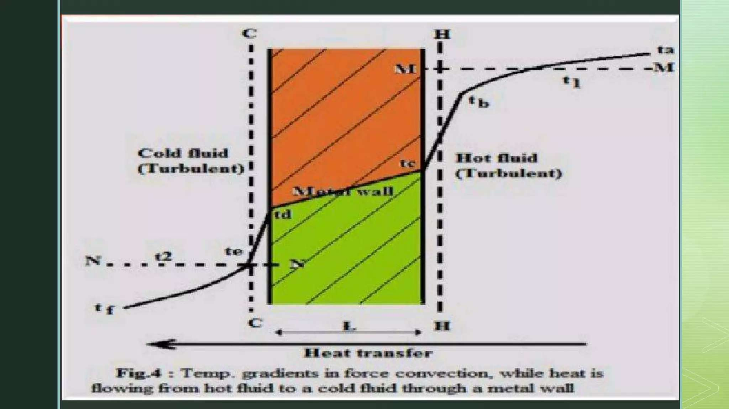

Slide 42
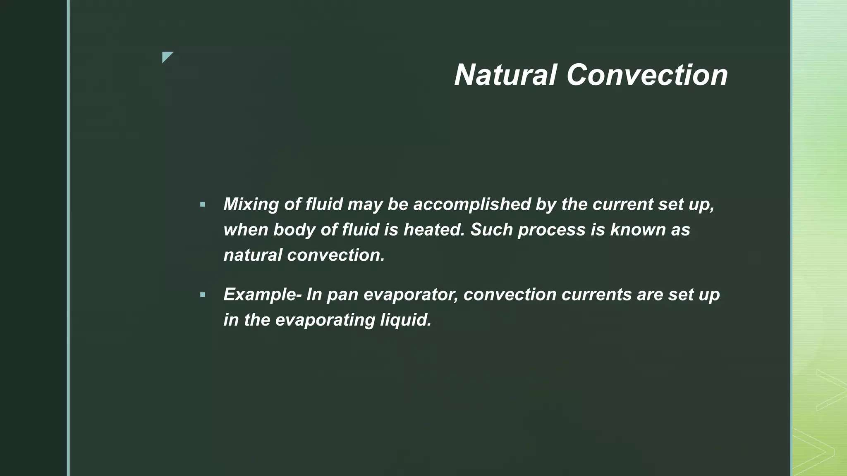

Slide 43
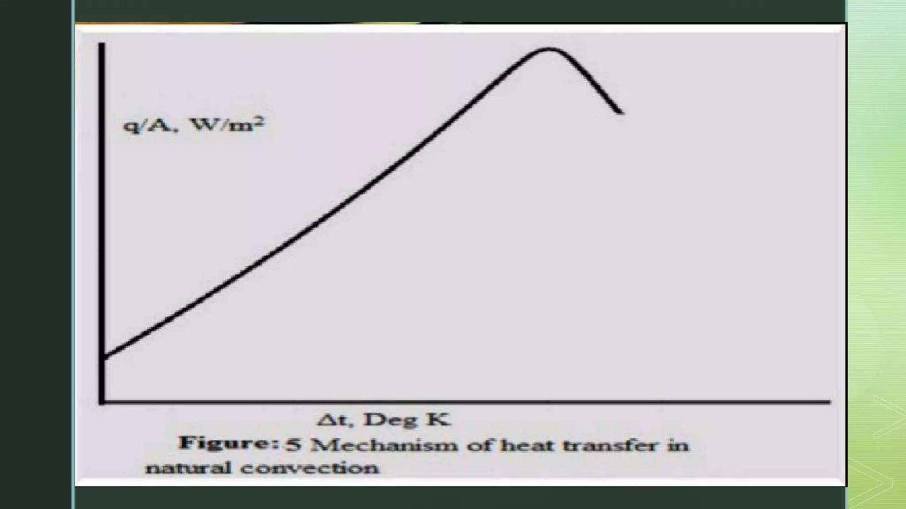

Slide 44
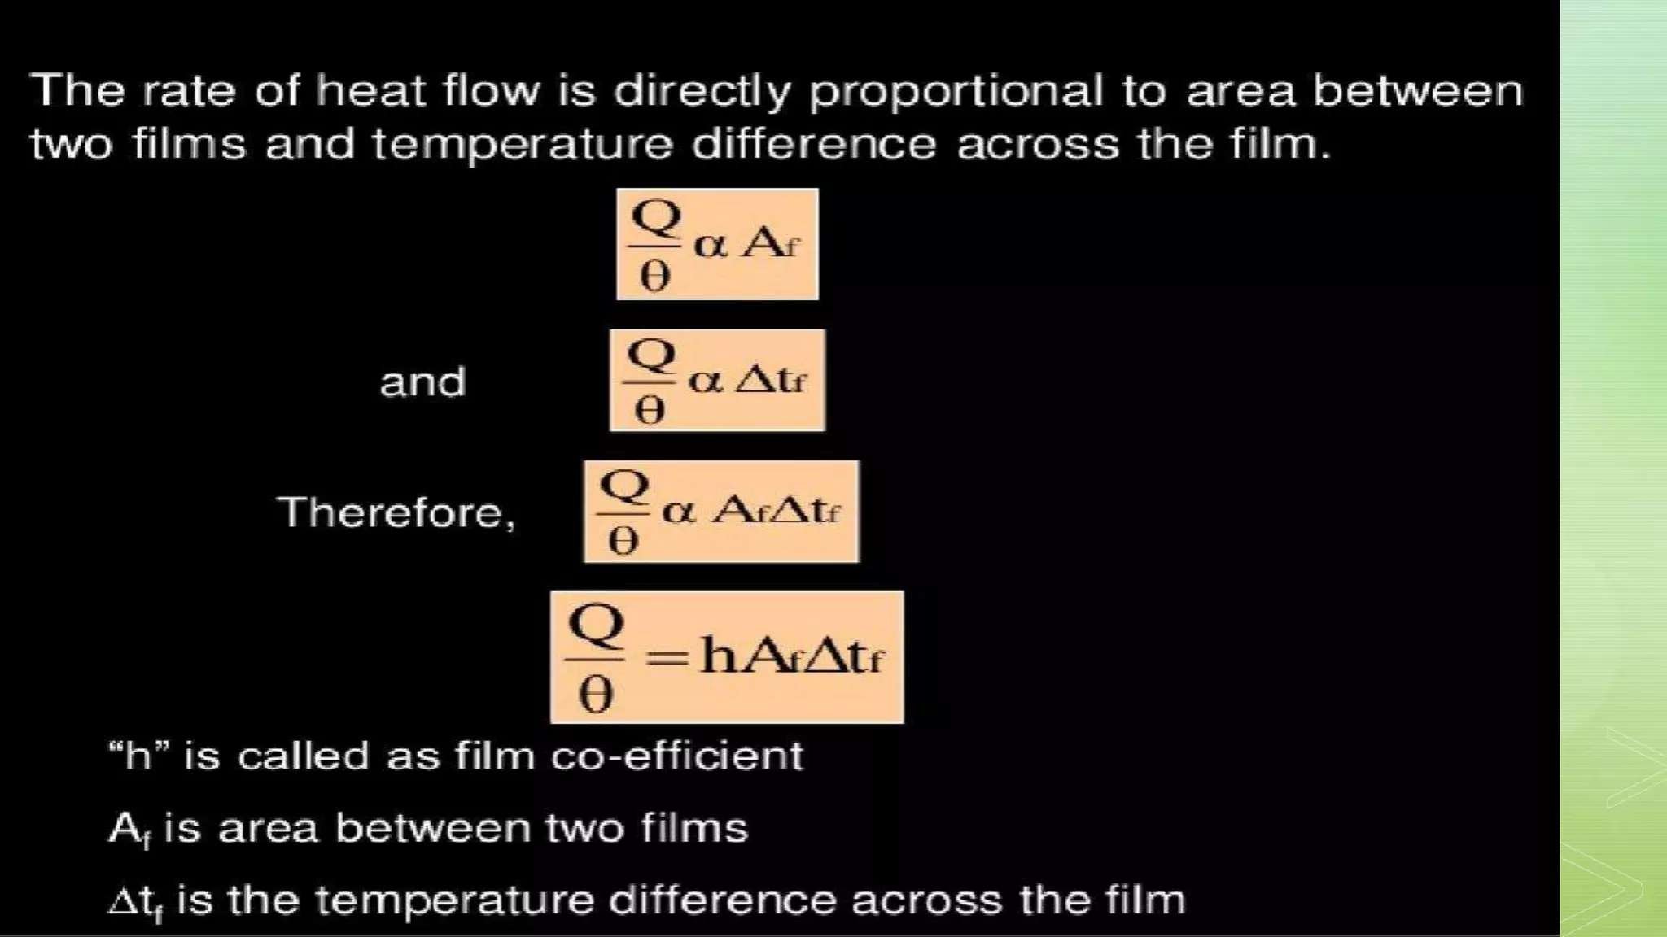

Slide 45
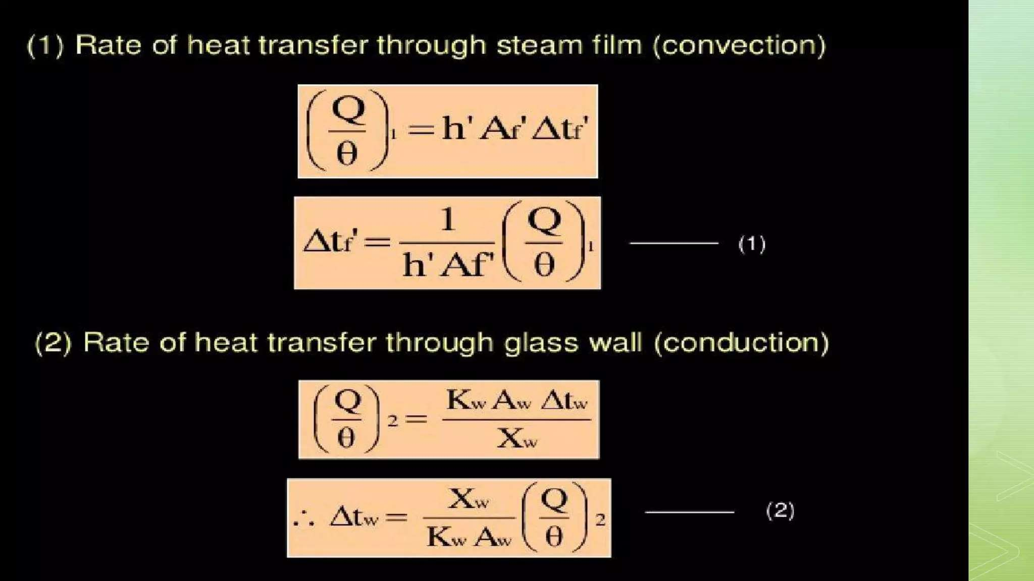

Slide 46
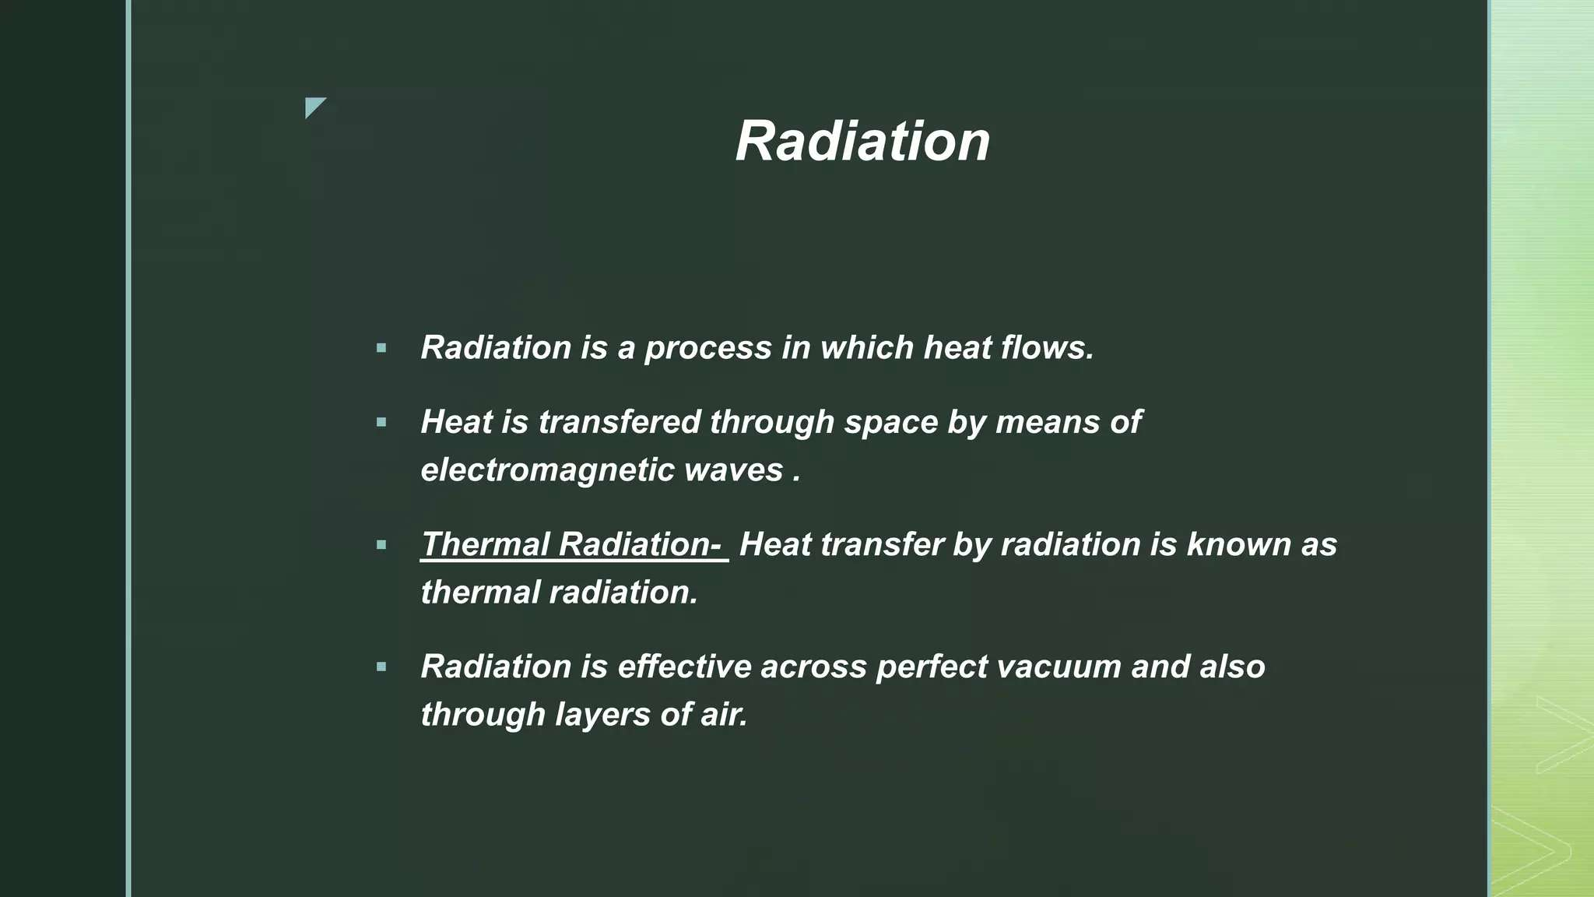

Slide 47
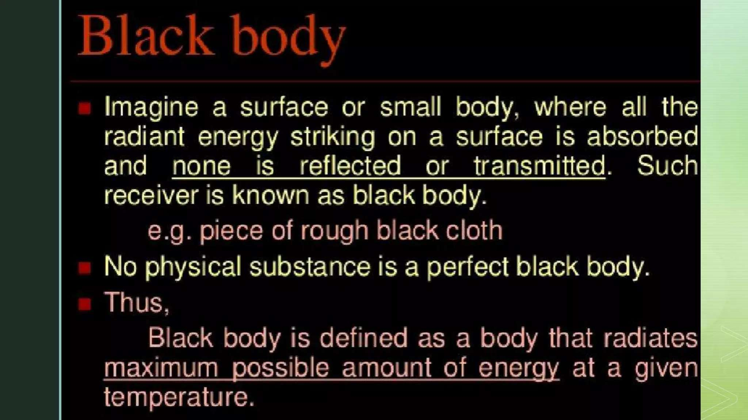

Slide 48
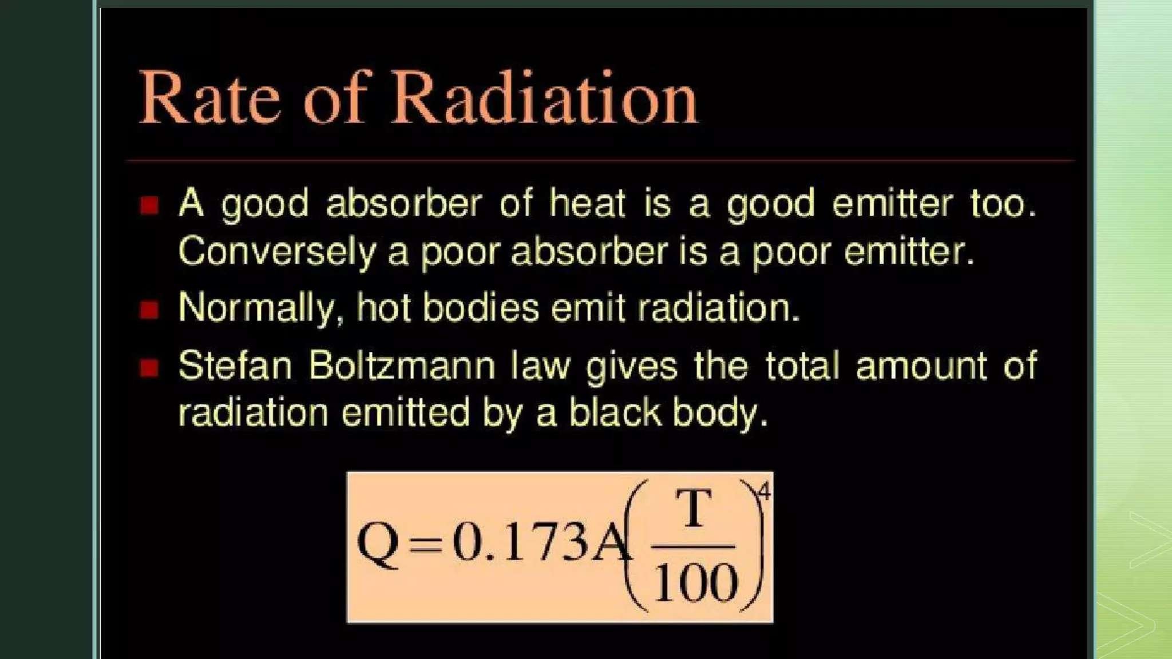

Slide 49
Week 5

Slide 50
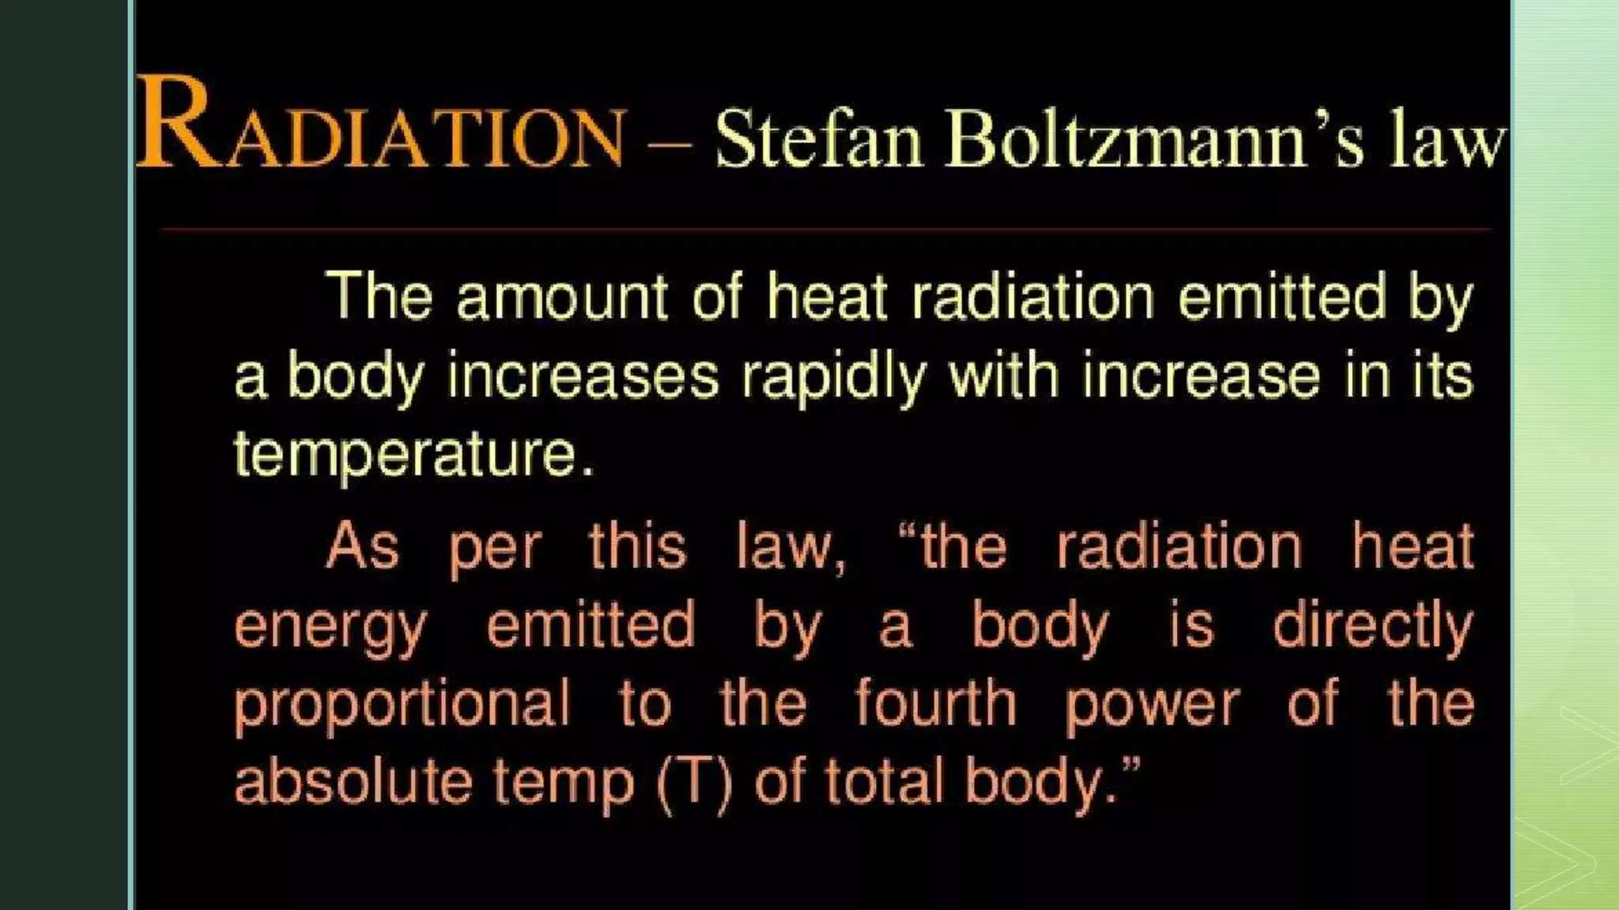

Slide 51
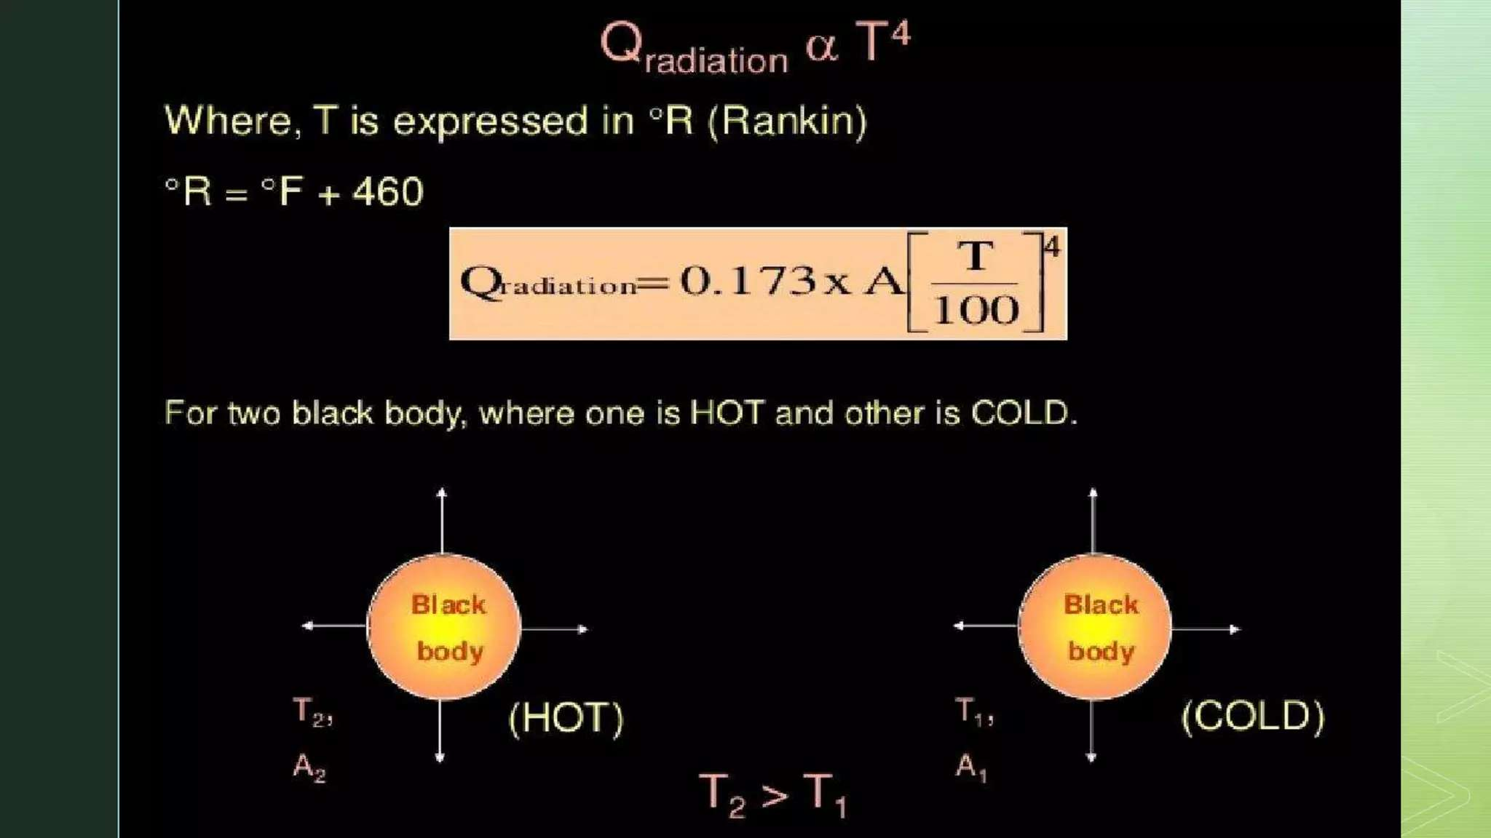

Slide 52
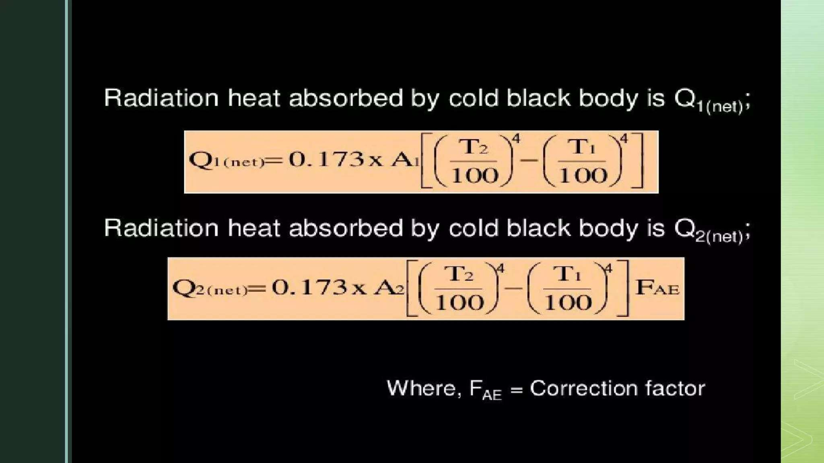

Slide 53
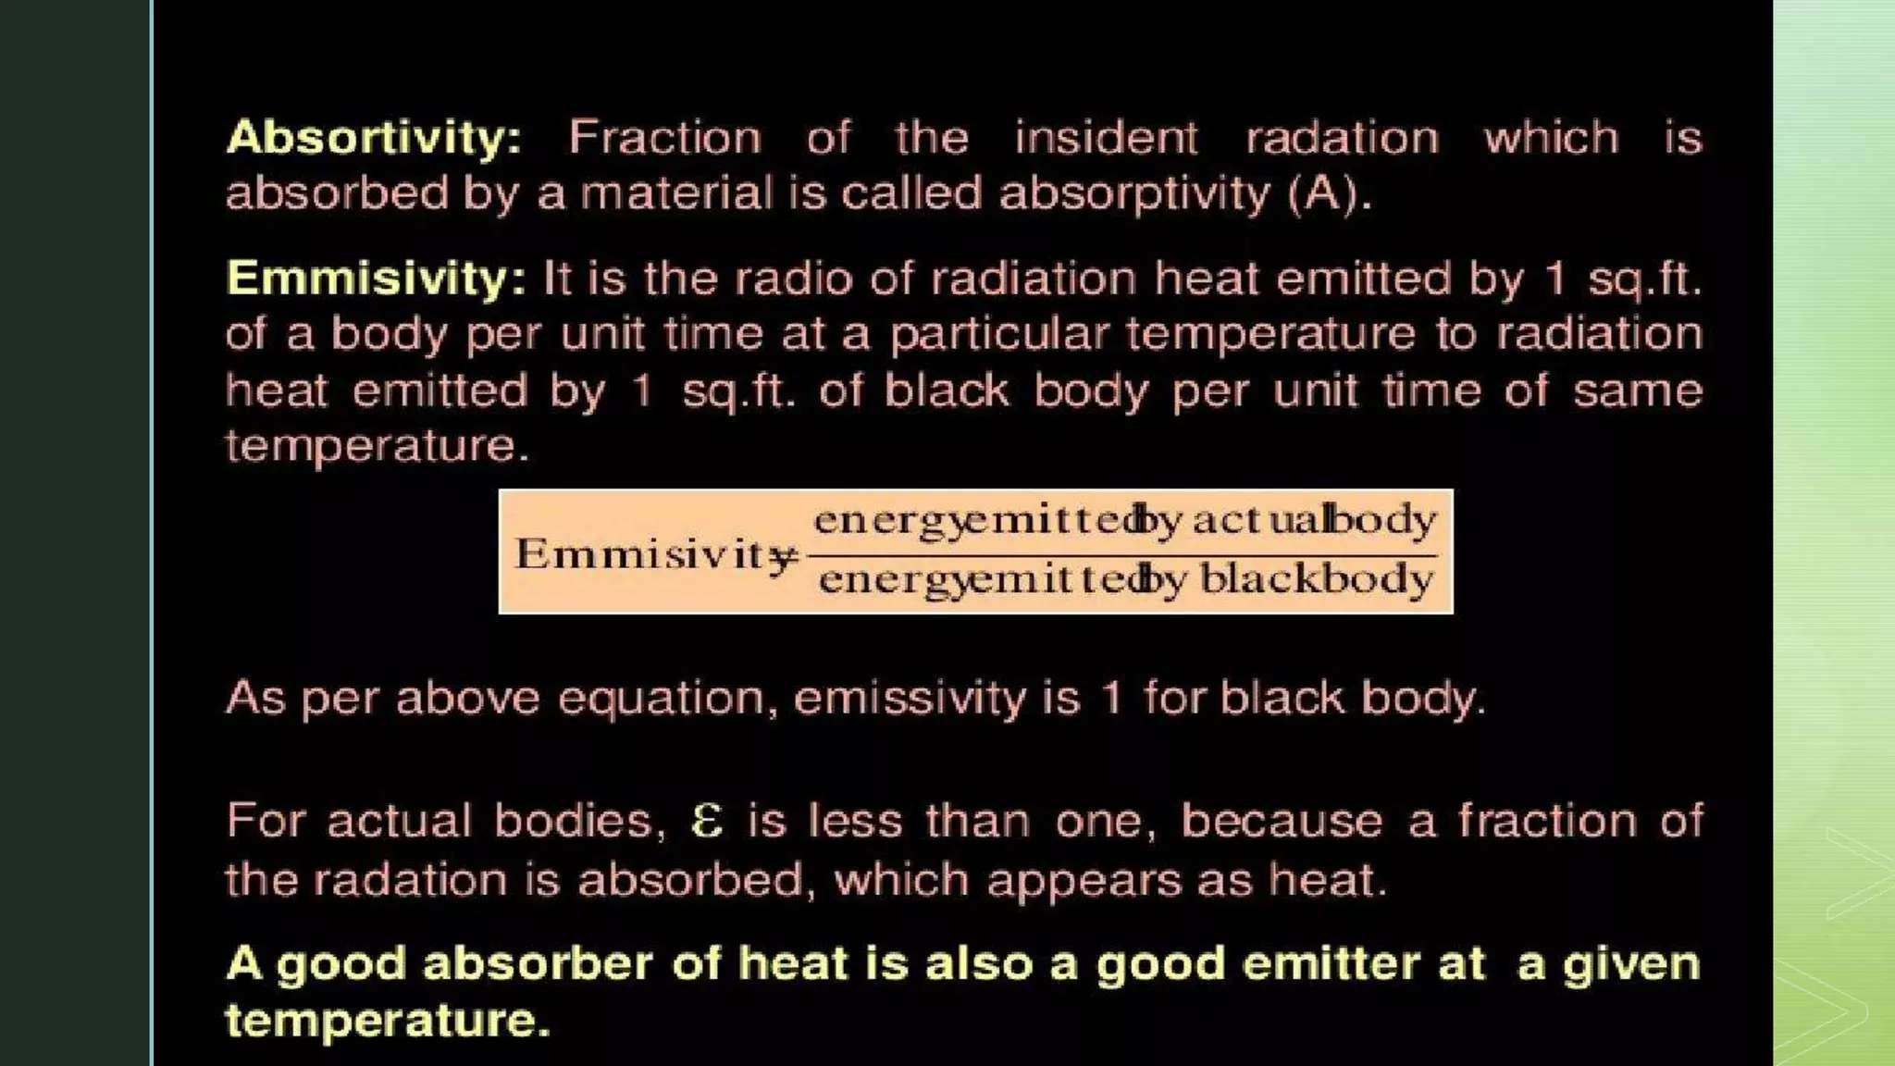

Slide 54
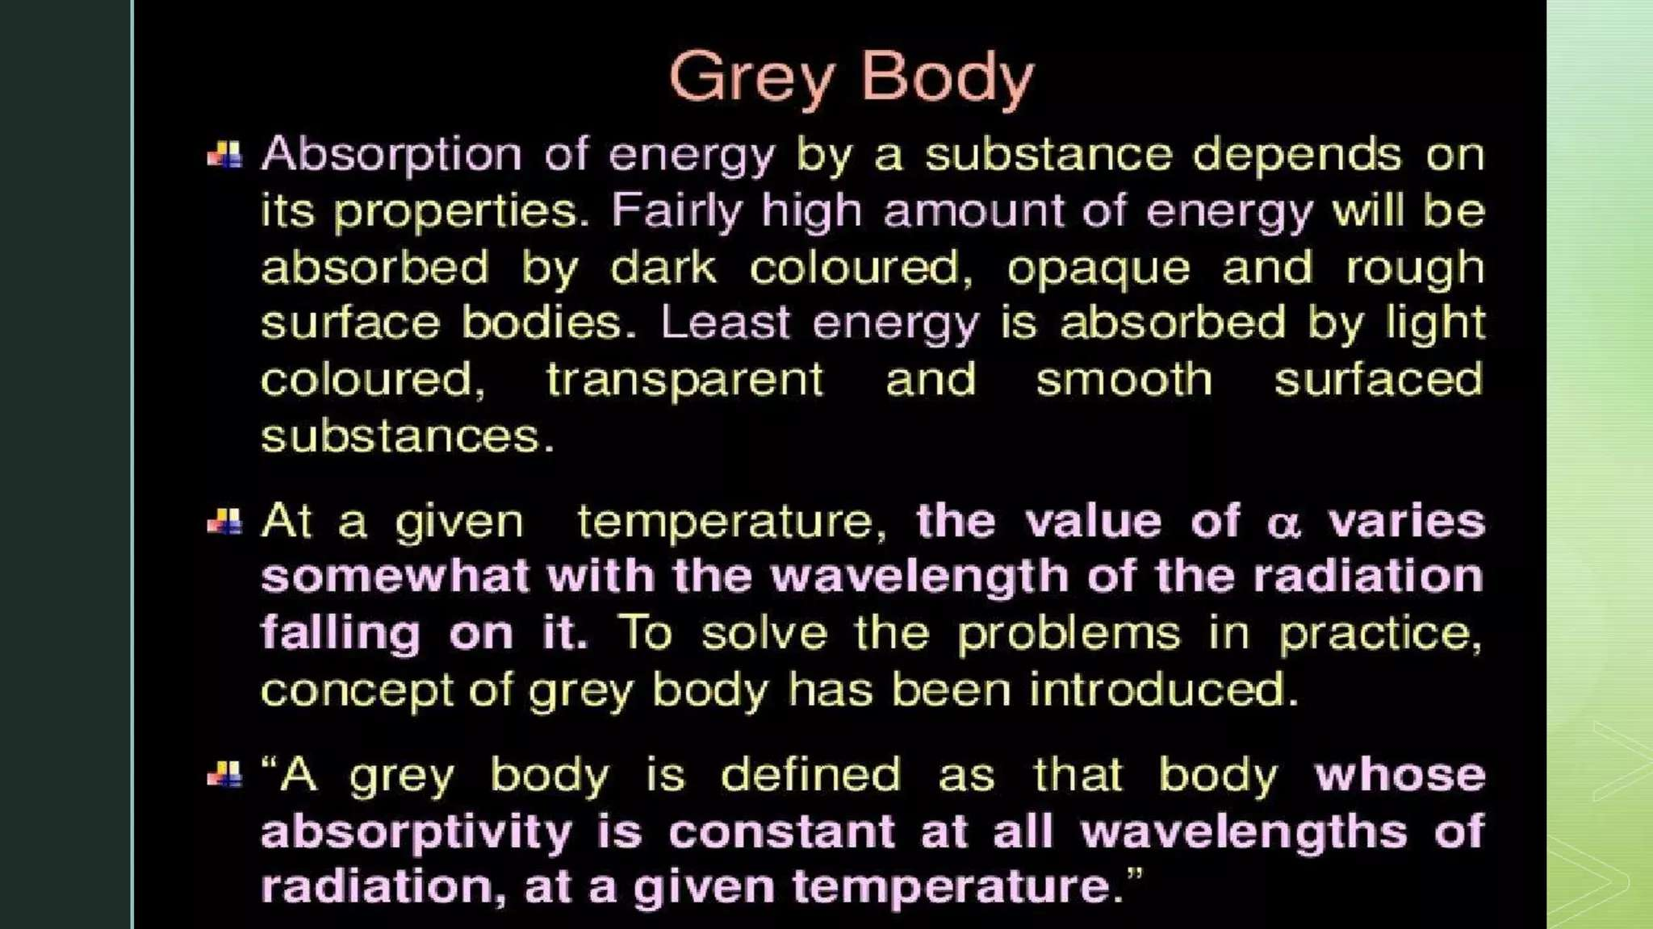

Slide 55
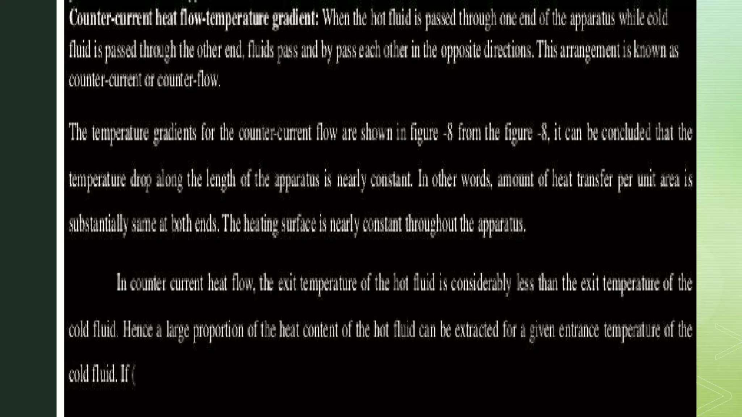

Slide 56
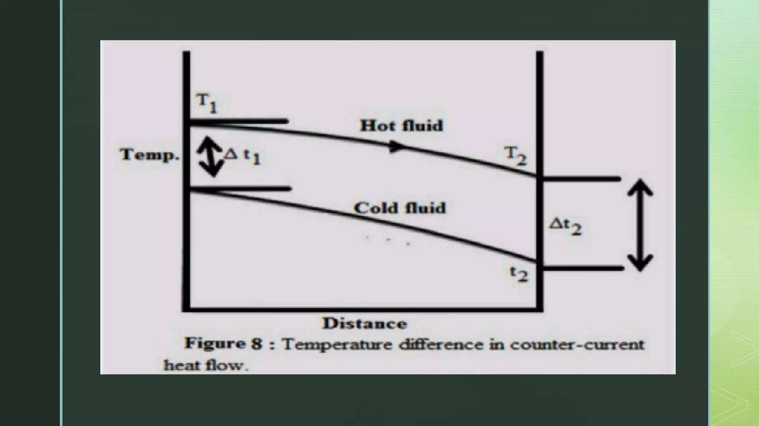

Slide 57
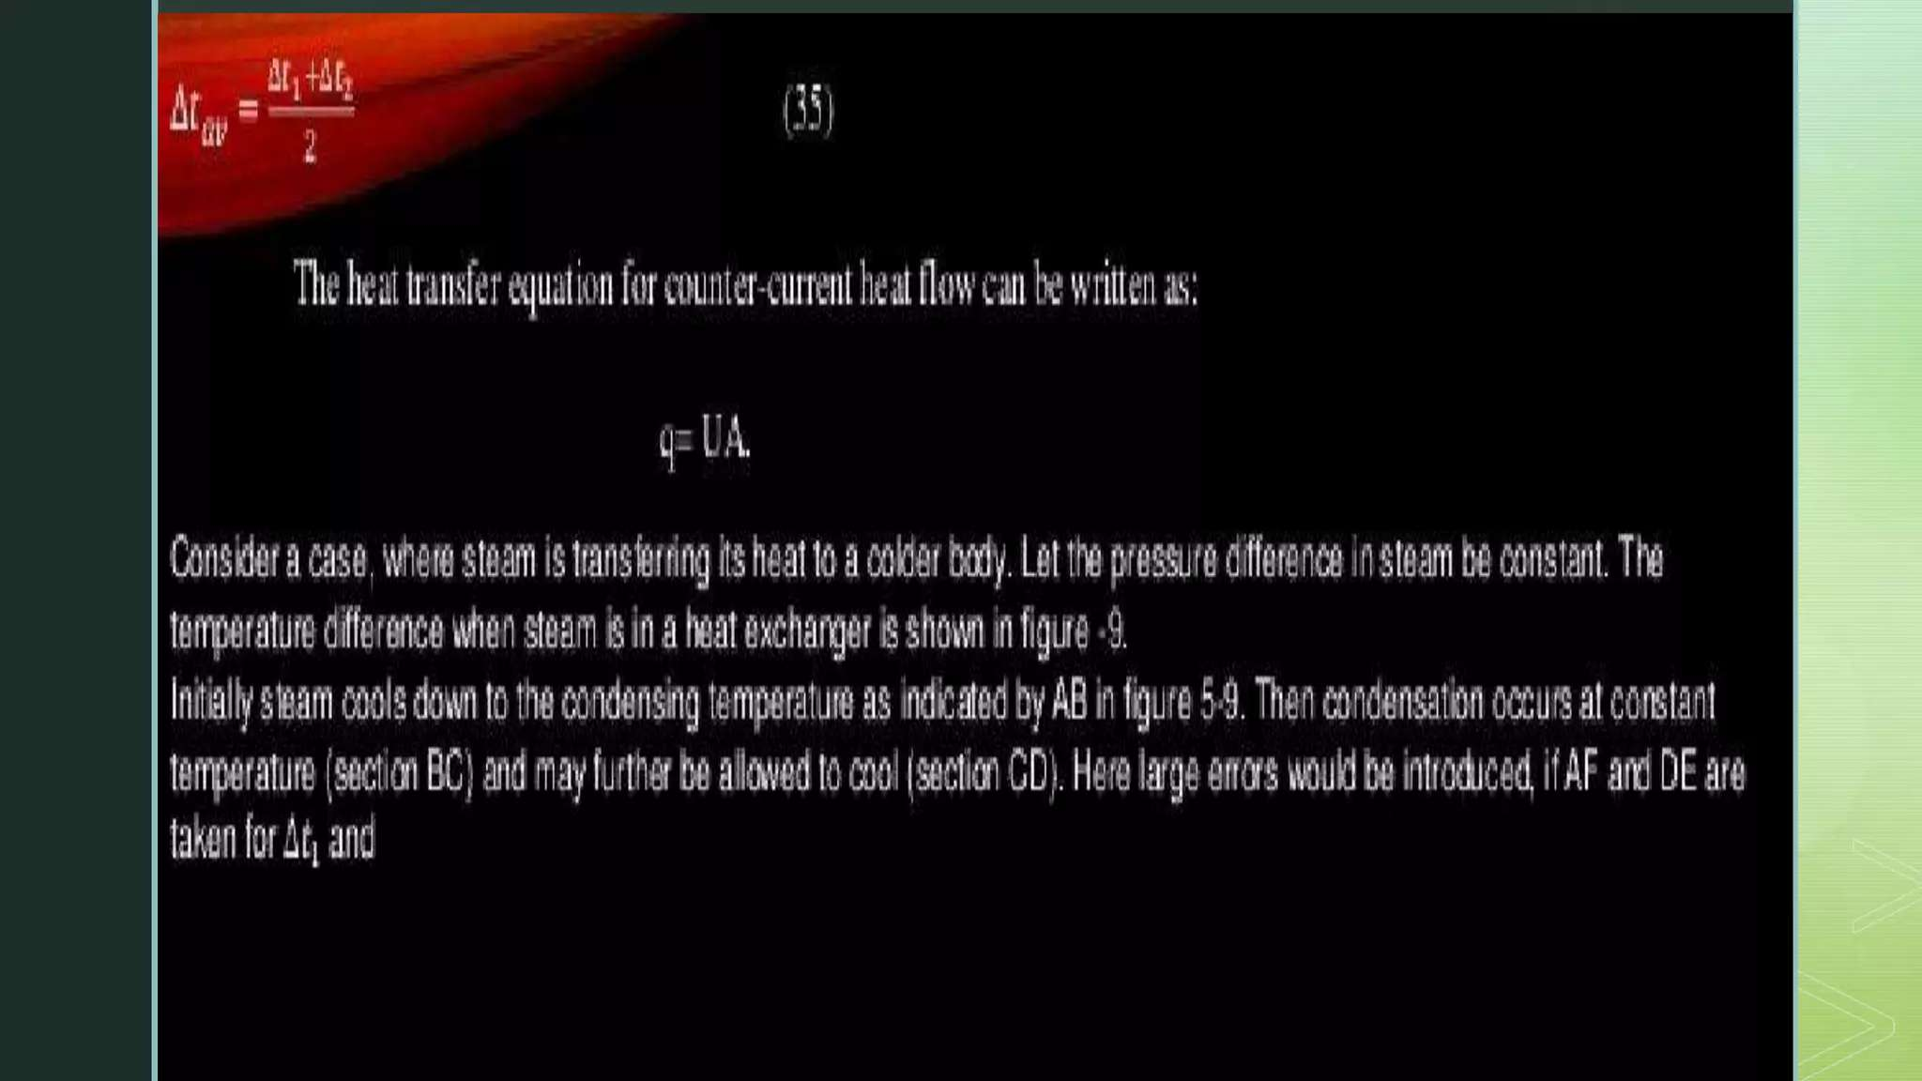

Slide 58
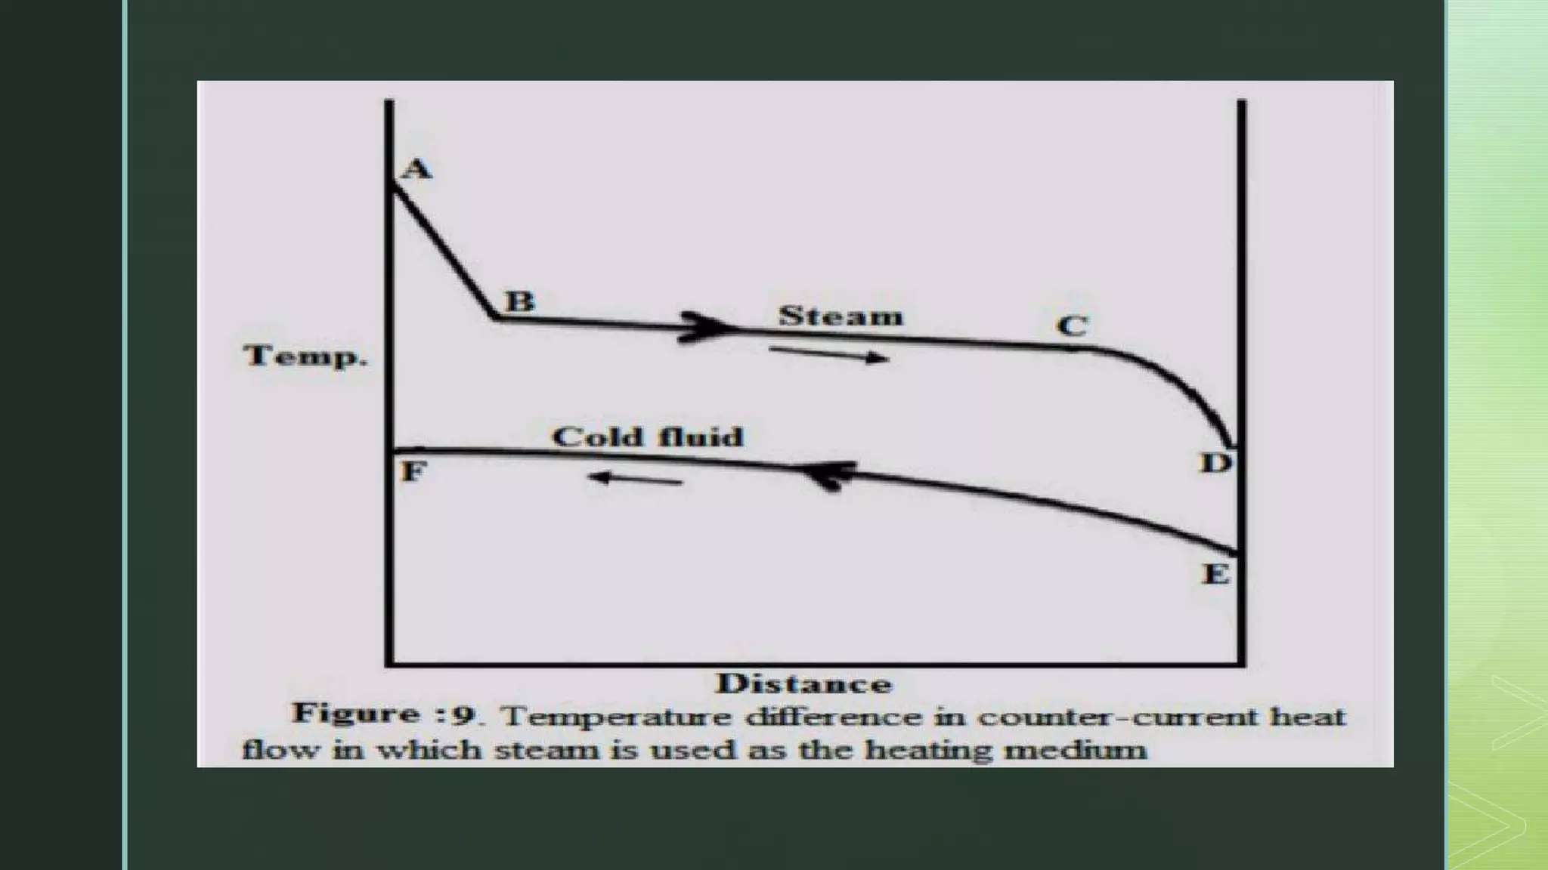

Slide 59
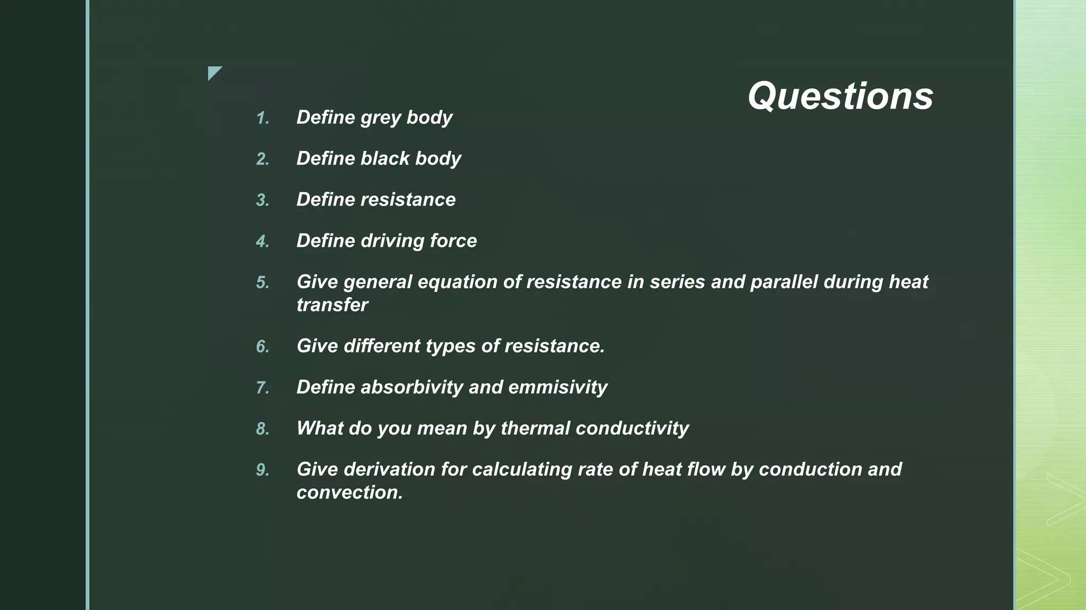

Slide 60
Week 6

Slide 61
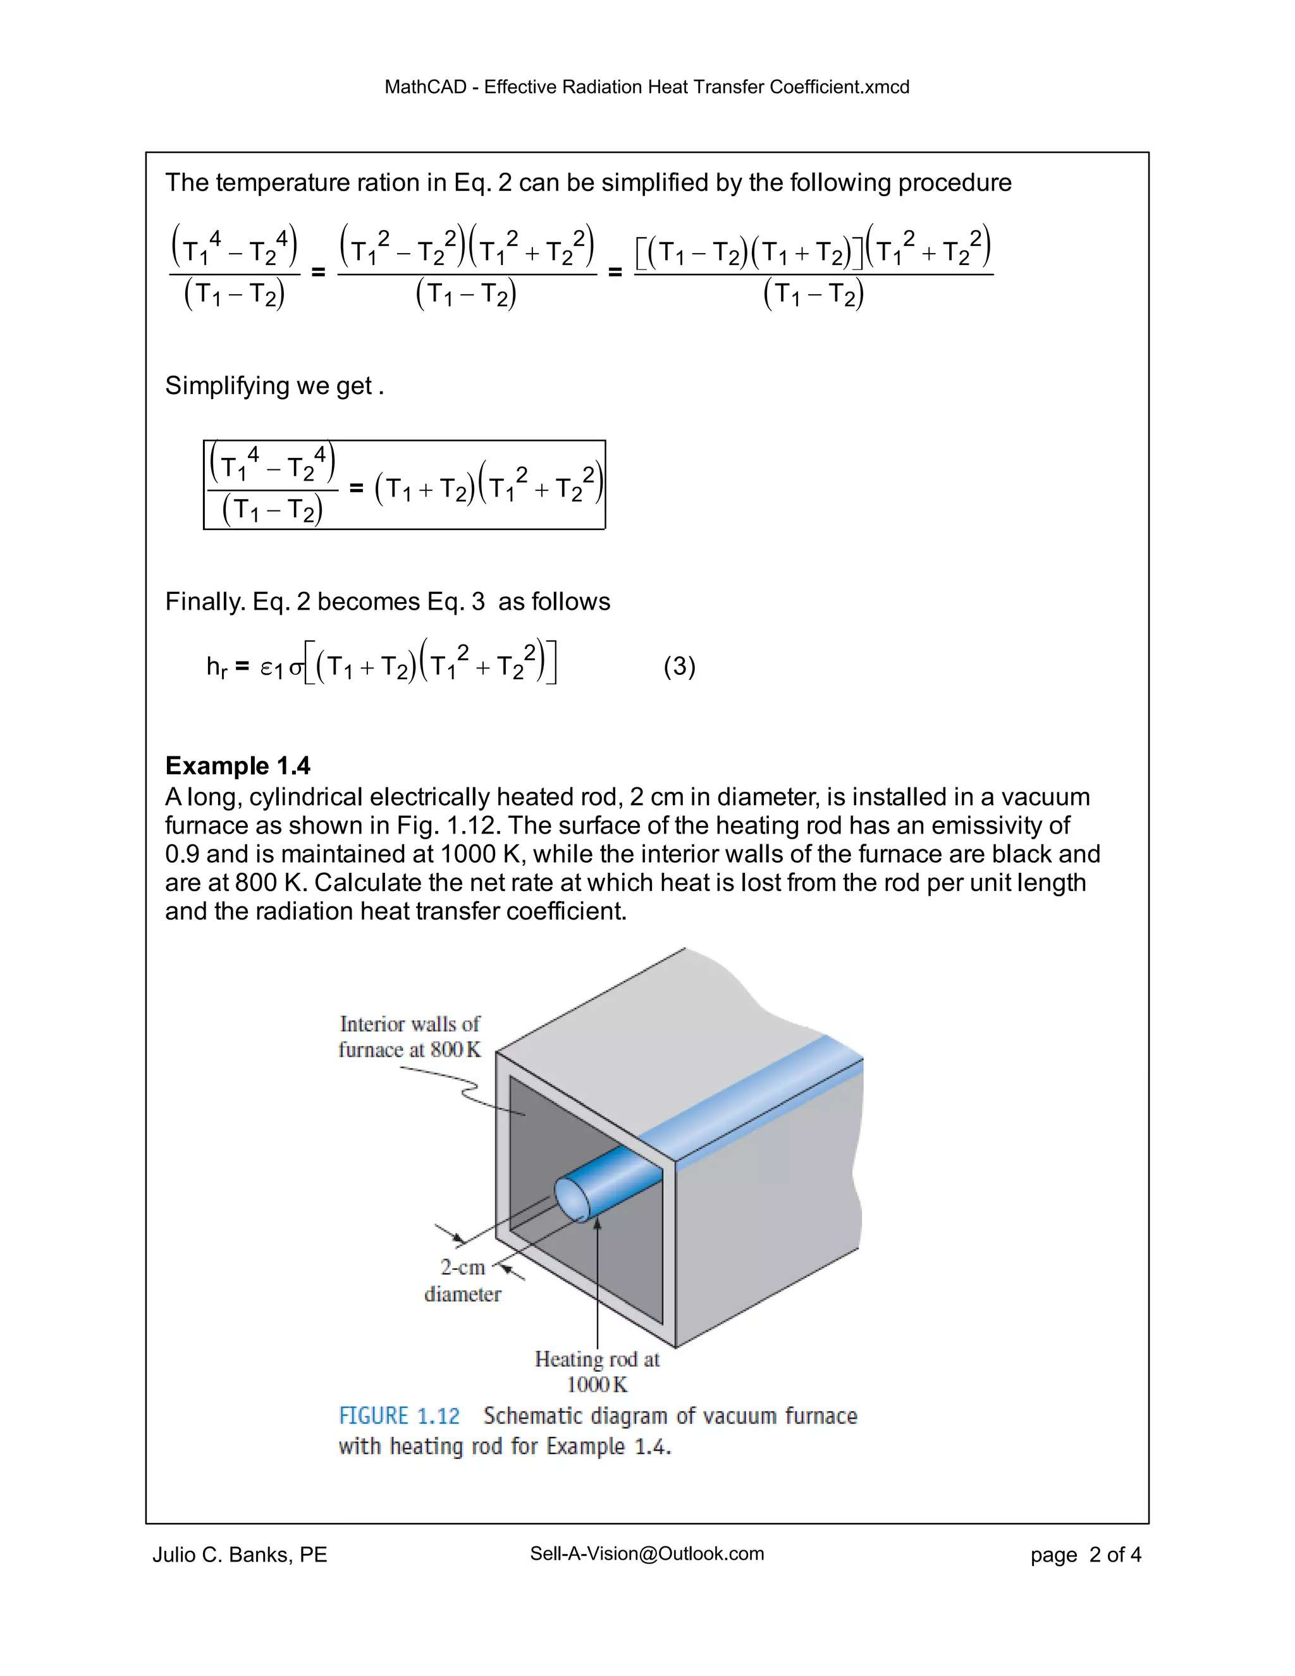

Slide 62


Slide 63


Slide 64


Slide 65
Week 7

Slide 66


Slide 67


Slide 68


Slide 69


Slide 70


Slide 71


Slide 72


Slide 73


Slide 74
Week 8

Slide 75


Slide 76


Slide 77


Slide 78


Slide 79


Slide 80


Slide 81
Week 9

Slide 82


Slide 83


Slide 84


Slide 85


Slide 86


Slide 87
Week 10

Slide 88


Slide 89


Slide 90


Slide 91
Week 11

Slide 92


Slide 93


Slide 94


Slide 95


Slide 96


Slide 97


Slide 98
Week 12

Slide 99


Slide 100


Slide 101
Week 13

Slide 102


Slide 103


Slide 104


Slide 105


Slide 106


Slide 107


Slide 108
Thank you for your kind attention
Prepared By
Iftekhar Mahmud
Lecturer
Department of Mechanical Engineering
University of Global Village (UGV), Barishal

