Slide 1




LAB MANUAL
Mechanical Engineering Drawing & CAD
Course Code: ME-0715-2102
University of Global Village (UGV), Barishal Department of Mechanical Engineering
Prepared by
Md. Naeem Hosen Hredoy
Lab Instructor
Department of Mechanical Engineering

Slide 2
COURSE INFORMATION
Course Title | Introduction To Mechanical Engineering Drawing & CAD Sessional. | Lecture Contact Hours | 85
Covered Lab | Mechanical Engineering Drawing-1 Engineering Drawing-2 | Credit Total Marks | 01 50
PRE-REQUISITE CIE 20 SEE 30
Course Code:0715-2102 SEE exam time: 2 Hours

Slide 3
Course Learning Outcomes (CLOs):
After completion of this course successfully, the students will be able to……
CLO1 | Understand Comprehend fundamental concepts of engineering drawing and CAD software.
CLO2 | Analyze designs for errors and identify areas for improvement.
CLO3 | Apply skills Implement designs using CAD software.
CLO4 | Evaluate designs for errors and identify areas for improvement.

Slide 4
Sl. No. | Course Content | Hrs | CLOs
1 | Computer Aided Drafting (CAD) | 05 | CLO1
2 | Drawing, Editing and Dimensioning | 10 | CLO2, CLO3, CLO 4
3 | Plan, Elevation and Section of a Building | 15 | CLO2, CLO3
4 | Reinforcing Detailing | 15 | CLO2, CLO3, CLO 4
5 | Plan, Section and Elevation of Slab Culvert. | 10 | CLO2, CLO3, CLO 4
6 | Plan, Elevation and Section of an Underground Water Reservoir | 10 | CLO 2 CLO 4
7 | Sectional Views of Culvert | 10 | CLO 1 CLO 3
8 | Assignment | 10 | CLO2, CLO3

Slide 5
REFERENCE BOOKS
Engineering Drawing by N.D. Bhatt A Textbook of Engineering Drawing by R.K. Dhawan. Engineering Graphics with AutoCAD by James D. Bethune. Machine Drawing by K.L. Narayana, P. Kannaiah, and K. Venkata Reddy. AutoCAD 2024: A Problem-Solving Approach by Sham Tickoo.

Slide 6
ASSESSMENT PATTERN
CIE- Continuous Internal Evaluation
(20 Marks) SEE- Semester End Examination (30
Marks)
SEE- Semester End Examination
(50 Marks) (should be converted in actual marks (30)
Bloom’s Category Cognitive | Tests (20)
Remember | 05
Understand | 07
Apply | 08
Analyze | 07
Evaluate | 08
Create | 05

Slide 7
Bloom’s Category Psychomotor | Practical Test (30)
Imitation | 10
Manipulation | 5
Precision | 5
Articulation | 5
Naturalization | 5

Slide 8
CIE- Continuous Internal Evaluation (40 Marks) (should be converted in actual marks (20)
Bloom’s Category Marks (out of 60) | Lab Report (10) | Continuous lab performance (10) | Presentation & Viva (10) | External Participation in Curricular/Co-Curricular Activities (10)
Remember |  |  | 02 | Attendance 10
Understand | 05 | 04 | 03
Apply |  | 02
Analyze |  | 02
Evaluate | 05 | 02
Create |  |  | 05

Slide 9
 | Course Plan Specifying Content, CLOs, Teaching Learning Strategy and Assessment Strategy
Week | Topics | Teaching Learning Strategy | Assessment Strategy | Corresponding CLOs
1,2 | Computer Aided Drafting (CAD) | Lecture, Oral Presentation | Quiz | CLO1
3,4 | Drawing, Editing and Dimensioning | Lecture, discussion, Video Presentation, Experiment | Lab Report Assessment, viva, Lab Test, Quiz | CLO2, CLO3, CLO 4
5.6 | Plan, Elevation and Section of a Building | Lecture, discussion, Video Presentation, Experiment | Lab Report Assessment, viva, Lab Test, Quiz | CLO2, CLO3, CLO 4
7,8 | Reinforcing Detailing | Group Discussion, Experiment Practice | Skill Development Test | CLO2, CLO3, CLO 4
Week | Topics | Teaching Learning Strategy | Assessment Strategy | Corresponding CLOs

Slide 10
9,10 | Plan, Section and Elevation of Slab Culvert. | Lecture, discussion, Video Presentation, Experiment | Lab Report Assessment, viva, Lab Test, Quiz | CLO2, CLO3
11,12 | Plan, Elevation and Section of an Underground Water Reservoir | Lecture, discussion, Video Presentation, Experiment | Lab Report Assessment, viva, Lab Test, Quiz | CLO2, CLO3
13,14 | Sectional Views of Culvert | Group Discussion, Experiment Practice | Skill Development Test | CLO2, CLO3
15,16,17 | Assignment | Lecture, discussion, Video Presentation, Experiment | Lab Report Assessment, viva, Lab Test, Quiz | CLO2, CLO3,

Slide 11
Index Page No.
Chapter 1. Computer Aided Drafting (CAD)..........................................................
Chapter 2. Drawing, Editing and Dimensioning .....................................................
Chapter 3. Plan, Elevation and Section of a Building.............................................
Chapter 4. Reinforcing Detailing ............................................................................
Chapter 5: Plan, Section and Elevation of Slab Culvert .........................................
Chapter 6: Plan, Elevation and Section of an Underground Water Reservoir........
Sectional Views of Culvert ....................................................................................
Assignment..............................................................................................................

Slide 12
Table of Figures
Page No.
Figure 1.1: 2D User Interface...............................................................................
Figure 2.1: List of all tool bar...............................................................................
Figure 2.2: X-Y Co-ordinate ................................................................................
Figure 2.3: Co-ordinate System ...........................................................................
Figure 2.4: Cartesian Co-ordinate System ...........................................................
Figure 2.5: Polar Co-Ordinate System.................................................................
Figure 2.6: The Pickbox.......................................................................................
Figure 2.7: The Window selection box is shown as a rectangle with a solid line
Figure 2.8: The Crossing Window selection box is shown as a rectangle with a broken line
Figure 2.9: Drawing Unit Selection .....................................................................
Figure 2.10: Direction Control.............................................................................
Figure 2.11: Available snap options...................................................................
Figure 2.12: Start point and end point of arc .....................................................
Figure 2.13: Polygon..........................................................................................
Figure 2.14: Ellipse ............................................................................................
Figure 2.15: Hatch Properties Manager .............................................................
Figure 2.16: Hatching options............................................................................
Figure 2.17: Choosing Area to be Hatched........................................................

Slide 13
Figure 2.18: Island Style ....................................................................................
Figure 2.19: A dining table as block ..................................................................
Figure 2.20: Chamfering ....................................................................................
Figure 2.21: Linear Dimension ..........................................................................
Figure 2.22: Dimensioning Along Align Plane .................................................
Figure 2.23: Selecting Line Color......................................................................
Figure 2.24: Selecting Line Type.......................................................................
Figure 2.25: Loading Line Type ........................................................................
Figure 2.26: Selecting Line Type Scale .............................................................
Figure 3.1: Plan of a residential building ...........................................................
Figure 3.2: Front view of the building ...............................................................
Figure 3.3: Section 1-1.......................................................................................
Figure 4.1: Wall Footing and Column Footing
Figure 4.2: Reinforcement detailing of slab...........................................................
Figure 4.3: Longitudinal and Cross section of beam .............................................
Figure 4.4: Reinforcement detailing of stair
Figure 5.1: Plan of Culvert
Figure 5.2: Sectional Views of Culvert…
Figure 6.1: Plan of underground reservoir
Figure 6.2: Section A-A

Slide 14
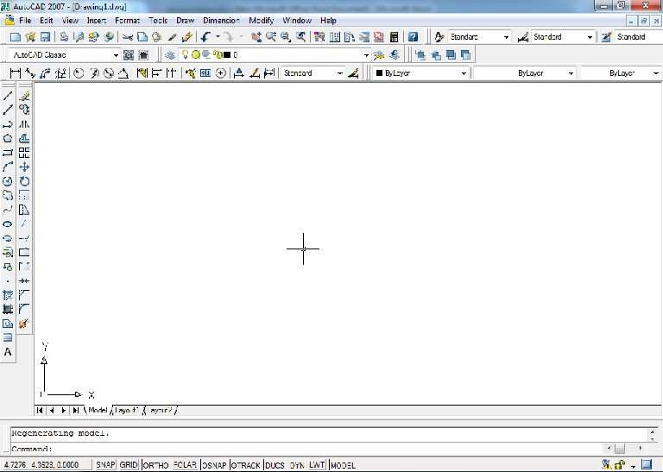
Computer Aided Drafting (CAD)
The use of computer technology for the process of design documentation (i.e. drafting). 3D space.
2D User Interface (AutoCAD 2007)
Drop Down Menu
Standard Tool Bar
CAD may be used to draft in 2D or
Style Tool Bar
Draw Tool Bar
Layer Tool Bar
Properties Tool Bar
Modify Tool Bar
Cursor
Axis
Command Bar
Coordinates
Status Bar
Figure 1.1: 2D User Interface

Slide 15
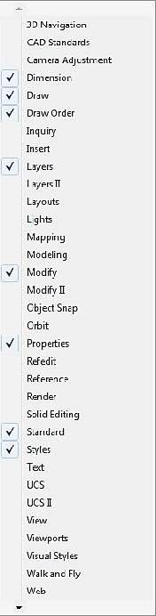
Chapter 2
Drawing, Editing and Dimensioning
Drop-Down Menu: All options of AutoCAD can be accessed from this menu.
Standard Tool Bar: Shows copy, cut, paste, save, zoom icons.
Style Tool Bar: Shows current text style, dimension style, table style.
Layer Tool Bar: Shows current layer name.
Properties Tool Bar: Shows color, line type, line weight.
Draw Tool Bar: Shows line, rectangle, circle icons.
Modify Tool Bar: Shows modification icons.
Command Line: Shows activated command.
Frequently Asked Questions
How to bring a toolbar on user interface? Right click on any toolbar (i.e. Draw)
Select required toolbar (i.e. Dimension) from list (Shown in the figure) Set the position of the toolbar (click at the double line border and drag it)
How to Change workspace from 3D to 2D or vice versa?
Press “Tools”
Select “Workplaces”
Select “ 3D modeling” or “AutoCAD classic” Figure 2.1: List of all tool bar

Slide 16
How to start and terminate commands in AutoCAD?
Three ways to start a command (i.e. Line)
From Drop Down Menu ( Draw > Line)
From Command line with short key (Type “ l ” in the command line and press “Enter”)
From Toolbar (Click on the line command icon on the draw toll bar) Press “Esc” button on keyboard to terminate any command.
How to start and complete a drawing? Set drawing unit (Format > Unit)
Create text styles (Format > Text Style)
Create dimension style (Format > Dimension Style) Create new layers (Format > Layer)
Draw and modify objects (Use Draw and Modify toolbar or menu) Provide dimensions ( Use dimension toolbar or menu)
Write texts (Use draw toolbar or menu) How to save a file?
Click “File” on Drop Down Menu bar Click “Save as”
Select “Drive” to save
Rename file name only (keep .dwg as extension) Press “Save”
Or
Press “Ctrl” + S Select “Drive” to save
Rename file name only (keep .dwg as extension)

Slide 17

Press “Save” How to plot a file?
Press “Ctrl” + P
Select printer name / DWG to PDF.pc3 (Use “Printer name” to print and DWG to
PDF to publish as pdf) Check “Fit to paper” Check “Center the Plot”
Select paper size
Press more option (if necessary)
Select Plot style table (None is ok. Select Monocrome.ctb for black and white print)
Select quality
Select drawing orientation Press “Preview”
Press “Plot”
Why one may use polyline?
Polylines have some unique qualities that make them very useful:
Polylines drawn under one single command can be selected by single click. varying)
They can have width (constant or
They can consist of arcs and lines They can be edited They can be joined together.
They can be exploded into individual segments Especially useful for 3D drawing How to cancel the last command?
Press “undo” button on standard toolbar Or
Press “Ctrl” + “Z”

Slide 18
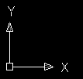
The X-Y Co-Ordinate System
The UCS Icon
Figure 2.2: X-Y Co-ordinate
In the bottom left corner of the AutoCAD drawing window you will see a symbol like one shown in top. This is called the UCS (User Co-ordinate System) icon and it is there to remind you which is the X axis and which is the Y axis. In AutoCAD, there are two co-ordinate systems:
World Co-ordinate System: A fixed system. User Co-ordinate System: A movable system.
You can relocate the user co-ordinate system using any of these methods: Move the UCS by defining a new origin.
Align the UCS with an existing object or with the current viewing direction. Rotate the current UCS around any of its axes. Restore a saved UCS.

Slide 19
Using Co-ordinate
+ve quadrant
(0,0)
-ve quadrant
Figure 2.3: Co-ordinate System
Co-ordinates fall into two types, namely Cartesian and Polar. In addition, these two co- ordinates types come in two distinct flavors. They can be absolute and relative.
Cartesian Co-ordinates
Despite the fancy title, the Cartesian co-ordinate system is the standard co-ordinate system. The position of a point can be described by the distance from the axes, X and Y. This results in a simple point description using two numbers separated by a comma e.g.
34.897, 45.473.
Y Axis
34.897,45.473

Slide 20
X Axis
Figure 2.4: Cartesian Co-ordinate System
Polar Co-ordinate System
Polar co-ordinates achieve the same result i.e. the description of the position of a point. The main difference is that polar co- ordinates use one distance and one angle to describe the position of a point rather than the two distances in the Cartesian system. The distance and angle measured relative to an origin. This results in a point description which looks like this 34.897<30 where the first figure is the distance and the second is the angle.
Y Axis
(35.8, 60)
X Axis
Figure 2.5: Polar Co-Ordinate System

Slide 21
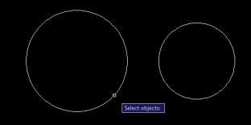
Object Selection
Before you start to use your AutoCAD commands, you need to know something about selecting objects. All of the modify commands require that you make one or more object selections. AutoCAD has wide range of tools which are designed to help you select just the object you need.
1. Selecting Object by Picking
Perhaps the most obvious way to select an object is simply to pick it. To select an object, place the pick-box over a part of the object and left click the mouse. When the object has been picked, it is highlighted in a dashed line to show that it is part of the current selection and the command line reports “1 found”.
Figure 2.6: The Pickbox

Slide 22
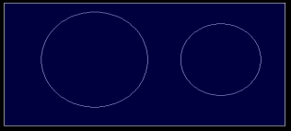
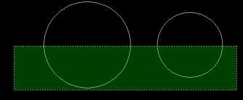
2. Window Selection
The window option is invoked by typing W in response to the “select objects” prompt. Window allows you to define a rectangle using two points in exactly the same way as the RECTANGLE command. Once all objects which lie within the window will be selected.
Figure 2.7: The Window selection box is shown as a rectangle with a solid line
3. Crossing Window Selection
The crossing window option is invoked by typing C at the “Select objects” prompt and is variation of the Window command. The command sequence is exactly the same but objects are selected which lie within the window and those which cross the window border.
Figure 2.8: The Crossing Window selection box is shown as a rectangle with a broken line

Slide 23
Selecting All Object
The All option is invoked by typing ALL at the “Select objects” prompt. You can use this option to select all the objects in the drawing, no picking is required. Objects on Locked or Frozen layers are not selected but objects on layers which are simply turned off are selected.
Using Previous Selection
AutoCAD always remembers the last selection set you defined. This is very useful because you may need to make a number of changes using different commands to the same group of objects. In order to reselect the last selection, you can use the previous selection. The previous option is invoked by typing P at the “Select objects” prompt.
Selecting the Last Object
You can select the last object created by entering L at the “Select objects” prompt.
Units and Scales Introduction:
Among the most important concepts that newcomers to AutoCAD need to get to grips with are those of drawing scale and units.
You cannot start crating sensible drawings with AutoCAD until you are familiar with scale, units and commands you use to control them.

Slide 24
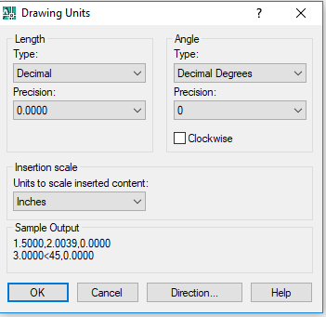
Units Control:
Command line: Type UN (units) and press Enter
Format menu: Units
Figure 2.9: Drawing Unit Selection

Slide 25
Toolbar: none
When you start the Units command, the first thing you see is the Drawing Units dialogue box. The dialogue box is divided into four main sections:
Length: You can see from the dialogue box that there are five different linear unit types for you to choose from, one of which is “Decimal”, the default. The table shows the effect of the different unit settings on two drawing unit values to give you an idea how various settings must be used along with a brief description.
Unit type | 1.5 Drawing Units | 1500 Drawing Units | Description
Decimal | 1.5000 | 1500.0000 | Metric or SI units
Scientific | 1.5000E+00 | 1.5000E+03 | Decimal value raised to a power
Engineering | 0’-1.5000” | 125’-0.0000” | Feet and decimal inches
Architectural | 0’- 1 ½” | 125’-0” | Feet and fractional inches
Fractional | 1 ½ “ | 1500 | Whole numbers and fractions
Notice that when you change the unit type, the co-ordinate display on the status bar changes to show co-ordinates using the current unit type. Units such as “Architectural” and “Engineering” are mainly for AutoCAD users where Feet and inches are still in common use.
Angles: Looking at the Drawing Units dialogue box again, you will notice that there are also five angular unit types. The default is decimal degrees, but there are other options. The table below shows the effect of the different unit types on two angular unit values.

Slide 26
Unit type | 12.5 Angular units | 180 Angular Units | Description
Decimal Degrees | 12.500 | 180.000 | Metric units
Deg/Min/Sec | 12d30’0” | 180d0’0” | Degrees, Minutes and Seconds
Grads | 13.889g | 200.000g | 400 grads=360 degrees
Radians | .218r | 3.142r | 2 Pi radians= 360 degrees
surveyor | N77d30’0”E | W | Compass bearings

Slide 27
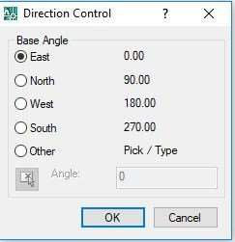
Figure 2.10: Direction Control
AutoCAD also allows you to control the direction in which angular units are measured and the position of the start angle. AutoCAD starts with the zero angle at the 3 o’clock position (East) with angles increasing in an anti-clockwise direction. This case may be changed for other modes.
Drawing Units for Design Center Blocks: Allows you to assign a specific unit to the drawing so that when blocks are inserted via the AutoCAD Design Centre, they will automatically be scaled.
Sample output: Gives you a preview of the drawing units as they will be displayed using the current settings.
Unit Precision The Drawing Units dialogue box can also be used to set the precision of linear and angular units. By default, AutoCAD sets the linear unit precision to four places of decimal, so appear in the form 0.0000. Angular unit precision is set to whole degrees only.To change the precision with which linear and angular values are displayed, simply click the down arrow against the appropriate drop-down list and select the number of decimal places required. The default setting of four decimal places is usually adequate for linear units. It is, however, often necessary to change the precision for angular units. Working in whole degrees does not usually give an adequate level of detail for many drawing functions. However, you do not need to change the precision of either linear or angular units unless you have a specific reason for doing so. Changing the unit precision does not make your drawing more accurate, it just means that the co-ordinate display on the status bar and the results from the various inquiry commands will be displayed with a higher degree of precision. The accuracy of your drawing will be determined by the values you enter for the size of objects when ou draw and edit them and by the correct use of the various object snaps and drawing aids.

Slide 28

Zoom (Standard Tool Bar) (z)
Pan real time: Move display.
Zoom real time: Increase or decrease display size. (Use mouse scroll as alternative)
Zoom window: Enlarge the part of the drawing
Zoom previous: Returns to the last Zoom view.
N.B.: To bring all drawings on screen use zoom all (Z⮠ A⮠ ).
Status Bar
ORTHO (Ortho mode)
Click on “ORTHO” button on Status bar or Press F8 Enforces to draw horizontal or vertical lines only
OSNAP (Object snap)
Click on “OSNAP” button on Status bar or Press F3
Right click on “OSNAP” button on Status bar
Press “Setting”
Check desired object snap options
Press “ok”
Helps to snap (grip) different points during drafting

Slide 29
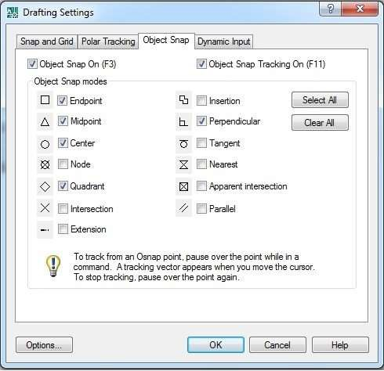
Figure 2.11: Available snap options.

Slide 30

DYN (Dynamic Input)
Click on “DYN” button on Status bar or Press F12
Shows command line with cursor during execution of any command
LWT (Line weight)
Click on “LWT” button on Status bar Shows line thickness
Draw Toolbar
Line (l)
By picking two points
Specify first point (click at any point)
Or
By direct distance entry
Specify first point (click at any point). Press “Tab” on the keyboard
Input angle (type angle with the X axis)
Specify next point (click at any point)
Input length (type length of the line)
Press enter( ⮠ ) on the keyboard
Horizontal or vertical line
Specify first point (click at any point)
Press “ORTHO” in status bar or press F8 on keyboard.
Input length (type length of the line) [Keep the cursor appropriately] Press enter( ⮠ ) on the keyboard

Slide 31
Rectangle (rec)
By picking two points
Specify first corner point (click at any point)
Or
By direct distance entry
Specify first corner point (click at any point)
Specify other corner point
Input length along X (type length of the rectangle) Press “Tab” on keyboard
Input width along Y (type width of the rectangle) Press enter( ⮠ ) on the keyboard
3. Circle (c)
Specify center point (click at any point)
Input radius of the circle (type radius of the circle) Press enter( ⮠ ) on the keyboard
Or
Specify center point (click at any point) Type d
Press enter( ⮠ ) on the keyboard
Input diameter of the circle (type diameter of the circle) Press enter( ⮠ ) on the keyboard

Slide 32
4. Arc (a)
To draw an arc three points on the arc are necessary. The choice of these points depends on the user or availability of defined points. AutoCAD by default draw arc anticlockwise. So select start and end points properly to get the desired arc shape.
Start point End point
End point
Start point
Figure 2.12: Start point and end point of arc

Slide 33
Available options | Steps
Center, Start, End | Type c Press enter( ⮠ ) on the keyboard Specify center point of the arc (Click at the center point of the desired arc) Specify start point of the arc (Click at the start point of the desired arc) Specify end point of the arc (Click at the end point of the desired arc)
Start, center, end | Specify start point of the arc (Click at the start point of the desired arc) Type c Press enter( ⮠ ) on the keyboard Specify center point of the arc (Click at the center point of the desired arc) Specify end point of the arc (Click at the end point of the desired arc)
Start, Center, Angle | Specify start point of the arc (Click at the start point of the desired arc) Type c Press enter( ⮠ ) on the keyboard Specify center point of the arc (Click at the center point of the desired arc) Input angle (Angle of end point with X axis at center)
Start, End, Radius | Specify start point of the arc (Click at the start point of the desired arc) Type e Press enter( ⮠ ) on the keyboard Specify end point of the arc (Click at the center point of the desired arc) Type r Press enter( ⮠ ) on the keyboard Input radius. (type radius of the desired arc)

Slide 34
Special note:
For simplicity use polyline to draw arc.
5. Donut (do)
Input inside diameter (generally zero (0)) Press enter( ⮠ ) on the keyboard Input outside diameter ( choose a value based on your drawing ) Press enter( ⮠ Specify center of donut (click at points where donuts are necessary)
) on the keyboard
Polygon (pol)
Input number of sides
Specify center of polygon (click at point) Select an option
Inscribed in circle
Circumscribed about circle Input radius of circle
Inscribed in circle Circumscribed about circle
Figure 2.13: Polygon

Slide 35
7. Ellipse (el)
Specify first point of major axis (click at point) point)
Specify endpoint of major axis (click at
Input distance from the midpoint of the first axis to the endpoint of the minor axis
Distance
First point
End point
Major axis
Minor axis
Figure 2.14: Ellipse
8. Region (reg)
Select objects ( lines intersect at end points are appropriate objects) Press enter( ⮠
) on the keyboard
Choice of objects
Appropriate | Not appropriate

Slide 36
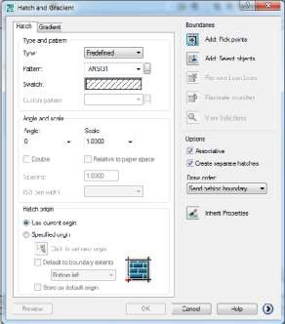
9. Hatch (h)
Use predefined type
Choose the desired pattern ( i.e. concrete, brick etc)
Choose angle (Change the orientation of the hatch lines but default is recommended) Input scale value (Large value lightens the hatch and small value densifies hatch) Choose appropriate boundary selection option
Add pick points: Click at any point in a closed boundary (does not work if any gap on the boundary)
Add select objects: Select objects (objects may or may not create closed boundary
Press enter( ⮠ ) on the keyboard Choose option
Check “ Associative” option to allow modification of hatch shape with the boundary shape
Check “Create separate hatches” option to create separate hatches in case of multiple boundary selection
Press “Preview”
Observe hatch created
Press enter( ⮠ ) on the keyboard
If obtain desired hatch press “ok” or Change parameters and repeat from preview.
Figure 2.15: Hatch Properties Manager

Slide 37
Angle and Scale |  |  |  |  |  |  |  |  |  | Type
Angle |  | 0 |  |  |  |  | 0 |  | 0 | Concrete | Brick | Sand
Angle 45 |  |  |  |  |  |  | 90 |  | 135
 |  |  |  |  |  |  |  |  |  | Brick | Grass | Gravel
Scale |  | 1 |  |  |  |  | 5 |  | 10
Figure 2.16: Hatching options

Slide 38
Choice of boundary selection
“Add pick points” Or “Add select objects” | “Add select objects”
Figure 2.17: Choosing Area to be Hatched
Special Notes:
One can choose more than one boundary at a time to create hatch (use separate option for convenience).
One can modify any hatch by double clicking.
Choose proper island style [if necessary]. Any enclosed area inside the hatch boundary is island.
Hatch boundary
Figure 2.18: Island Style
Island style :
Normal
Outer
Ignore

Slide 39
10. Text (t)
Draw small window
Select text style and font (if necessary) Write on the shaded box
Choose text height
Press enter( ⮠ ) on the keyboard to go next line (if necessary) Press “ok”
Special Notes:
One can modify text by double clicking.
One can underline a sentence or make a word bold etc.
One can insert symbol ( use @ icon)
One can insert fraction or subscript or superscript.
 | Command | Output
Superscript | Type X2^ Select 2^ Press “Stack ( ^{𝑎} )” icon 𝑏 | _{X}2
Subscript | Type X^2 Select ^2 Press “Stack ( ^{𝑎} )” icon 𝑏 | X2
Fraction | Type X/Y Select X/Y Press “Stack ( ^{𝑎} )” icon 𝑏 | 𝑋 𝑌

Slide 40
Block
Insert block (i)
Browse (C:\Program Files \AutoCAD 2007 \Sample\Design center\ House designer)
Check explode Press “ok”
Specify insertion point for block (click at any point of window) Zoom all to see blocks
Figure 2.19: A dining table as block
b. Make Block (b)
Draw an object
Define a name to the block
Input base point (Press pick point and click at any point closer to the object) to make block)
Press enter( ⮠ ) on the keyboard Check “Convert to Block” Choose appropriate block unit Press “ok”
Keep the file for further use as block
Select object ( select the desired object

Slide 41

Modify Toolbar
1. Offset (o)
Input offset distance (perpendicular distance between parallel lines)
Press enter( ⮠ ) on the keyboard
Select object ( only one line can be selected)
Specify point on side to offset ( select any side of the line)
2. Copy (co or cp)
Select object or objects
Press enter( ⮠ ) on the keyboard
Specify the base point
Specify second point or input distance (horizontal or vertical or inclined)
3. Move (m)
Select object or objects
Press enter( ⮠ ) on the keyboard
Specify the base point
Specify second point or input distance (horizontal or vertical or inclined)
4. Rotate (ro)
AutoCAD by default considers anticlockwise rotation as positive. So to rotate clockwise one should assign negative angle.
Select object or objects

Slide 42
Press enter( ⮠ ) on the keyboard Input angle ( angle with X axis)
Specify the base point
5. Mirror (mi)
Select object or objects
Press enter( ⮠ ) on the keyboard
Specify first point of the mirror line
Specify second point of the mirror line Press enter( ⮠ ) on the keyboard
Extend (ex)
Select line or lines as boundary edge ( Right click mouse to select all lines as boundary edges and skip next step)
Press enter( ⮠ ) on the keyboard
Select end of the object or objects closer to boundary edge to extend
Trim (tr)
Select line or lines as cutting edge ( Right click mouse to select all lines as cutting edges and skip next step)
Press enter( ⮠ ) on the keyboard Select object or objects to trim
Special Notes:
Hold “Shift” key to alter trim and extend command.

Slide 43
Array (ar)
Rectangular array
Input number of row and column
Input row and column offset (Offset means c/c distance of rows or columns ) Input angle of array (if necessary) ( indicates the angle of row with positive x axis) Select object
Press enter( ⮠
Press “Preview”
Observe the array created
If obtain desired array press “accept” otherwise press “Modify” and repeat steps
Polar array
Specify center point
Choose appropriate method of array (i.e. choose any two parameter from total no. of item, angle to fill and angle between item)
Input parameter values
Total no. of items: Input number of items to be considered as array element
Angle to fill: Input angle to be filled up by the array elements
Angle between items: Input angle between array elements at center of the circle. Check/uncheck rotate items as copied (allow/disallow the rotation of array elements) Select object
Press enter( ⮠ ) on the keyboard Press “Preview”
Observe the array created
If obtain desired array press “accept” otherwise press “Modify” and repeat steps
) on the keyboard

Slide 44

9. Scale (sc)
Select object or objects
Press enter( ⮠ ) on the keyboard
Specify the base point
Type scale factor (Greater than 1 to enlarge and less than 1 to shrink proportionally) Press enter( ⮠ ) on the keyboard
10. Stretch (s)
Select object or objects (select only by crossing window) Press enter( ⮠
Specify the base point
Type distance (the distance of the base point movement) Press enter( ⮠
) on the keyboard
) on the keyboard
11. Fillet (f)
Type r ( to input radius first)
Press enter( ⮠ ) on the keyboard
Input radius
Select the first object (line)
Press enter( ⮠ ) on the keyboard Select the second object (line)
Special Notes: Use Fillet + “Shift” key to get sharp corner.
12. Chamfer (cha)
Type d ( to input distance first)
keyboard
Input second chamfer distance
Press enter( ⮠ )
on the keyboard Select the first
object (line)
Press enter( ⮠ keyboard chamfer distance
Press enter( ⮠
) on the Input first
) on the

Slide 45
Select the second object (line)
Chamfer distance
Chamfer distance
13.Explode (x)
Select object
Press enter( ⮠
Figure 2.20: Chamfering
) on the keyboard
14. Match properties (ma)
Select source object
Select destination object or objects
Grips: Important Modification Tool
Grips are those dots appear at the endpoint and midpoint of a line after selection.

Slide 46


 | (Just after keeping the cursor on the grip)
Unselect ed Grip (Blue)
Hover Grip (Green)
Selected /Hot Grip (Red) | (Just after clicking on the grip)

Slide 47
Action | Command appears | Result
Click on any end point | Stretch | Activate Stretch command
Click on the midpoint | Move | Activate Move command
Press “Ctrl” + click on the midpoint (Hold “Ctrl” until make one copy) | Copy | Activate Copy command
Click on any point then press “Enter” | - | Change from Stretch to Move, Rotate, Scale and Mirror
Press “Shift” + click on any point | - | Allow to select multiple grips
Format Tab
1. Unit
Choose appropriate unit system as drawing unit
Choose proper precision
Choose insertion scale (Unit of any value inserted without unit (i.e. ft/inch/mm etc.))
2. Text Style
Press “New” Define style name
Specify font name (i.e. Times New Roman) Press “Apply” Press “Close”
Choose a height
3. Dimension Style
Press “New”
Define new style name
Press “continue”

Slide 48
Press “ Symbol and arrows” tab
Select first and second arrow head Press “ Text” tab
Choose text style
Press “ Fit” tab
Set use overall scale of ( Large value enlarges dimension text) Press “ Primary Unit” tab
Choose unit format ( Generally same as Drawing Unit )
Choose proper precisions (Generally same as Drawing Unit )
Zero suppression ( Don’t show 0’ or 0” etc)
Suffix ( if necessary to show something as suffix of the dimension text)
Prefix ( if necessary to show something as prefix of the dimension text)
Scale factor (if necessary to multiply dimensions with any value) Press “ ok”
Select dimension style created
Press “Set Current” Press “Close”
Layer
Press “New layer”
Double click and rename “Layer Name” Click and choose color
Click and choose line weight Click on line type
If new line type is needed press “Load”
Choose a line type
Press “ok”
Select the loaded line type and press “ok” Repeat steps to create more layers
Press “ok”

Slide 49

Special Notes:
New objects are drawn automatically with current layer.
One can change objects layer manually from layer toolbar.
When a layer is on, it is visible and available for plotting. When a layer is off, it is invisible and not plotted, even if Plot is on.
If plotting is off for a layer, the objects on that layer are still displayed but will not be plotted.
Objects on a locked layer cannot be modified.
Objects on frozen layers are not displayed, plotted or regenerated.
If dashed lines are not visible then change line type scale
Type “ ltscale ”
Press enter( ⮠ ) on the keyboard
Input scale factor ( larger value make the gap visible)
Dimension Toolbar
1. Linear
Click at the first extension line origin Click at the second extension line origin
Click to fix dimension line location

Slide 50
Dimension Line
Extension Line origin
Extension Line origin
Extension Line
Extension Line
Figure 2.21: Linear Dimension

Slide 51
2. Aligned
Click at first extension line origin Click at second extension line origin
Click to fix dimension line location
Continue
Continue from last dimension
Click at only second extension line origin and so on
Or
Continue from any dimension
Types (to select a dimension)
Press enter( ⮠ ) on the keyboard
Select desired dimension
Click at only second extension line origin and so on
4. Angle
Select the first line Select the second line
Click to fix dimension line (arc) location
5. Radius
Select circle
Click to fix dimension line (leader) location

Slide 52
6. Diameter
Select circle
Click to fix dimension line (leader) location
7. Quick Leader
Click at first leader point Click at next point of leader
Click at next point of leader (if necessary)
Press enter( ⮠ ) on the keyboard Press enter( ⮠) on the keyboard
Input text width (default is ok) Type first line of annotation text
Type second line of annotation text (if necessary, otherwise skip) Press enter( ⮠
) on the keyboard
Dimension Text Edit
Select dimension
Click at desired location to set dimension text
Dimension Edit
Press “New”
Select and delete “ 0” ”
Type desired dimension with unit or text Press “ok”
Select dimension to be changed
Press enter( ⮠
Or
) on the keyboard
Type “ddedit”
Press enter( ⮠ ) on the keyboard Select existing dimension and delete Type desired dimension with unit or text Press “ok”

Slide 53
Miscellaneous commands
1. Polyline (pl)
Specify first point (click at any point) Specify next point (click at any point) or
Specify first point (click at any point). Press “Tab” on the keyboard
Input angle (type angle with the X axis)
Special note
Input length (type length of the line)
Press enter( ⮠ ) on the keyboard
You can draw arc, line with certain width using polyline. For this just look at the command line.
Multiline (ml)
Press “s” to input parallel line distance
Press enter( ⮠ ) on the keyboard
Press “j” to select zero (centerline)/top/bottom length Press “z” or “t” or “b”
Press enter( ⮠ ) on the keyboard
Specify first point (click at any point) Input length (type length of the line)
Divide (div) [Draw > Point > Divide]
Select object to divide Input number of segments
Press enter( ⮠ ) on the keyboard

Slide 54
Special notes:
To see the points on the line, create point style
Format > Point style > Choose point icon > ok
Measure (me) [Draw > Point > Measure]
Select object to measure Input length of segments
Press enter( ⮠ ) on the keyboard
Special notes:
To see the points on the line create point style
Format > Point style > Choose point icon > ok
If total length is not a multiple of the length of segments then AutoCAD measures segments from the left side. Right most segment will be the remainder.
5. Align (al)
Select objects
Press enter( ⮠ ) on the keyboard Specify first destination point
Specify first source point
Specify second source point
Specify second destination point Press enter( ⮠ ) on the keyboard Scale objects based on alignment points?
Yes (distribute and scale objects within the destination points)
No ( only align objects without scaling)
Scale objects based on alignment points (Yes)

Slide 55


20'
Second Destination
5'
20'
Second Destination point
2'-6"
First Destination point
Scale objects based on alignment points (No)

Slide 56
Figure 2.22: Dimensioning Along Align Plane
Group (g)
Create group
Type group name
Press “New”
Select desired objects
Press enter( ⮠ ) on the keyboard Press ok
Check “selectable”
b. Modify group
Select group name
Pick desired edit option (remove or add objects or explode)
Select desired objects
Press enter( ⮠ ) on the keyboard
6. Oops (oops)
Type “oops” in command bar
Press enter( ⮠ ) on the keyboard
Special Notes:
Press ok
This command restores the last deleted item only even you use other command in between.
Different from undo option because it (undo) only cancel last command.
7. Wipeout (wipeout)
Type “wipeout” in the command bar
Press enter( ⮠ ) on the keyboard
Draw any shape to clean hatch pattern

Slide 57
Important Control Keys
Control Keys | Result
CTRL+8 | Launches calculator window
CTRL+A | Select all
CTRL+N | Create new drawing
CTRL+P | Opens the plot dialogue box
CTRL+S | Opens the save dialogue box
CTRL+Z | Undo the last operation
CTRL+TAB | Switches between open drawings
Esc | Cancel command
Object Properties
Every AutoCAD, such as or a line or a circle has properties. Some properties such as color, Line type and Layer are common to all objects. Some object have properties which are specific to themselves. Text, for example, is the only object type which has a style property. In AutoCAD Release 14, the easiest way to control object properties is to use the object Properties toolbar, illustrated below. This is one of AUTOCAD,s default toolbars and can usually be found directly below the standard toolbar in the top left hand corner of the AUTOCAD window.
Take time to work through this tutorial, it is particularly important to get to grips with object properties since it can make the

Slide 58
difference between a really good AUTOCAD drawing and a really terrible one. If you just need information quickly, use the Quick Find toolbar below to go straight to the information you need or select a topic from the contents list above.
Layers
Probably the most important object property to understand well is the layer property. Experienced AutoCAD users use layer all the time and that is why the object properties toolbar contains so many layer function. Good use of layer is the most important aspect of good drawing practice.
The concept of layer is very important in AUTOCAD and the correct use of layer can make your drawing much easier to work with. Basically, layers are the computer equivalent to tracing overlays on a drawing board. However, layers are much more powerful because you can have many layers in a single drawing and you can control the visibility, color and line type of layers independently. This makes working with very complicated drawings much more efficient. Layers are effectively a way of ordering your drawing. For example, you may need to create a number of construction lines in a drawing which will not form a part of the finished image. You could create a layer called “Construction” and use this for your construction lines. When the drawing is completed, you could simply turn this layer off so that it can’t be seen. The beauty is that you can could always turn this layer back on at some future time if modifications to the drawing are required. Experienced AUTOCAD uses will use layers to order their drawing by drawing components. For example, if you were creating landscape master plan, you may have layers called “Trees’’ “Shrubs’’ “Path” etc. The main reason for this, apart from it being a simple way to control the drawing, is that the different drawing components may need to be printed in different colors with different line type and with different line widths. Layers can be used to control the way objected are displayed on the computer monitor and how they appear when they are printed.
It is a common misapprehension amongst new users that layer can be used to control the visual hierarchy of objects. In other words, if two object overlap, it seems reasonable to assume that you could cause one object to display “above” another with the model is common to illustration software such as core IDRAW. However, AutoCAD uses a 3 dimensional drawing space where all object coexist and are position in their correct co-ordinate locations. The concept of an object being displayed above or below another, therefore, is not consistent with this logic. In AUTOCAD the displayed of one object in relation to another is determined by the objects place in the drawing database. objects draw more recently will display over another if the two objects occupy the same physical space.it is possible to override this effected Display order tools found on the Tools pull-down, Tolls Display order option

Slide 59
these option are particularly useful to control the display of overlapping solids and solid hatches that are coplanar. The layer of an object has no its display order,
Although you can have many layers in a drawing, you can only draw on one layer at a time. The layer you are drawing on is said to be the current layer. The object properties toolbar displays the current layer information. In the illustration above, you can see that layer “0’’ is the current layer and that the color and line type are set ‘By layer’’
When you start a new drawing, AUTOCAD has only one layer. This layer is special and is called layer ‘0’’ (zero).layer 0 is special because you cannot change its name or delete it and is has certain properties which we do not need to consider just now. By default layer 0 is assigned the color white (color number 7) and this “Continues” line type. Layer 0 is always the current layer when start a new drawing, however, it is bad drawing practice to use layer 0 for normal drawing. The first thing you should do therefore, when you start a new AUTOCAD is to create some new layers.

Slide 60
The layer command
LAYER (manages or LAYER and layer properties) Command line: Type LA or LAYER(layer) and press enter. Format menu: layer.........
Layers toolbar: pick Layer Properties Manager tool
Although AUTOCAD provides many shortcuts for working with layer, many of which will be covered later, the layer command provides the most comprehensive control over layers and layer operations. This command uses a dialogue box. The dialogue box is a tabbed dialogue box and can be modified to show more or less details. This is quite nice because in its simplified form it looks much less intimidation to beginners. The following sections demonstrate how the layer command can used to perform many of the most layer operations.
Creating a New Layer
To create a new layer, click on in the layer toolbar, the Layer properties Manager dialogue box, illustrated below, appears. This is a tabbed dialogue box and can be used to control either layer properties depending upon which tab is selected. The layer tab is always selected by default. Now click on the ‘New’’ button. A new layer called ‘layer’’ is automatically created in the layer list below layer 0. As you can see from the illustration the layer name is automatically highlighted for you so that you can give the layer a more meaningful name. When you have entered an appropriate name, press key to complete the operation. You have now created a new layer and given it a name. Notice that by default it has been assigned the color white and the line type ‘Continues ‘.
There are a few restriction to consider when you are naming layers. The most annoying is that you cannot use spaces within layer names. So, for example, the layer name “ Tree trunk” is illegal, However, it is common practice to replace the space with either a
hyphen or an underscore, both of which are valid layer name character. So, the layer name “Tree trunk” and “Tree trunk” are both acceptable. Some other special characters are also not allowed. If you do use an illegal character, Auto CAD will alert you with the error message box illustrated above. Notice that it very helpfully tells you which characters are legal. Basically, if your stick with letters and numbers you won’t experience any problems. In addition to the hyphen and underscore mentioned above, the dollar sign is the only other symbol allowed.
The only other restriction relating to layer names is the number of characters used. Layer names can be between one and thirty-one

Slide 61
character long. This should give you plenty of scope to devise understandable and descriptive names for your layers. It is good drawing practice to name your layer sensibly, bear in mind that other people may have to work with drawing which you creator. If you enter a layer name longer that 31 characters, Auto CAD will display the error message box.
Layers are always listed alphabetically in layer lists, the user has no way to control the list order. It is worth bearing this in mind when naming your layers. Keep similar object layers together by devising a hierarchical naming structure. For example, if you are drawing a tree symbol which comprises a number of elements, your layer names might be, “Tree canopy” “Tree text” “Tree trunk” etc. This will cause all the Tree layer to be displayed together, see the illustration on the left. This is quite important because in complicated drawing there may be many layers and searching for the right group of layers can waste a lot of time.
Setting Color and Line type “ByLayer”
Auto CAD two methods of setting the color and Line type of a drawing object. First of all, color and Line type can be set ByLayer. In other words, and object will be displayed in their color and Line type of its layer. For example, if your draw a circle on a layer which your have called “Details” and you have also set the color of Details to blue and the Line type to dashed, then the circle will be display in a dashed blue line. When an object takes on the properties of its layer, the color and Line type are said to be set “ByLayer.
The second method AutoCAD offers is to set the color and Line type by object. Setting properties by object overrides those set ByLayer. In general it is drawing practice to set color and Line type properties ByLayer, this is more efficient and less confusing in the long- run. For example, imagine that you have drawn hundreds of objects on the same layer and have set their color to green.
Later in the drawing process you decide that these objects should, in fact, be yellow. In order to make the change you would have to
use the Properties command and select every one of the objects by picking them. By contrast, if you had set the objects color ByLayer, you would only have to change the layer color from green to yellow and all of the objects would change.

Slide 62
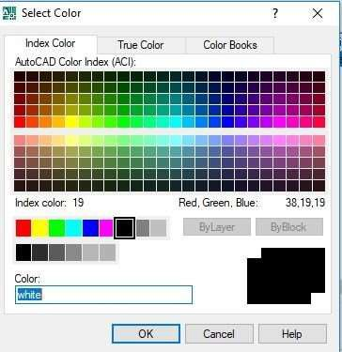
Setting the Color of Layer
It is often convenient to set the layer color when the layer is created. Although this can be done at any time. The layer color can be changed as many times as you like. Each time it is changed, any objects on that layer will change to the new color, providing their color is set to “ByLayer”
To set a layer color, open the Layer Properties Manager dialogue box, click on and then click on the color icon in the layer list associate with the layer you want. Notice that all layers have their own color icon and that this changes to display the layer color. Clicking on the icon brings up Select Color dialogue box, shown on the right. You can select nay of the 255 standard AutoCAD colors by picking on the color palette or by entering the color name or number in the text edit box. When you have selected the color you want, click on th “OK” button to set the color. AutoCAD uses only 255 color plus the drawing background color, irrespective of the capability you video displ
Figure 2.23: Selecting Line Color

Slide 63
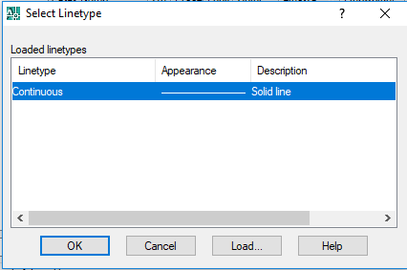
Assigning different colors to your layers will make working with complex drawings much easier. You will be able to see at a glance what a particular line represents. For example, your construction lines may be on a layer called “Construction” and have the color yellow. This will visually differentiate these lines from lines on other layers with different colors.
Setting the Line type of a Layer
In the same way that you can assign a color to a layer you can also assign a Line type to a layer. For example, you could have all the
lines. To set a Line type to layer, click on and then click on the current Line type name associated with your layer in the layer list. By default, layer have the “Continuous” Line type. Clicking on the line type name brings up the Select Line type dialogue box, shown on the bottom. You will notice that the “Continue” Line type is the only one listed. That’s because all Line types, except “Continue” are stored in an external file and have to be loaded before they can be used.
Figure 2.24: Selecting Line Type

Slide 64
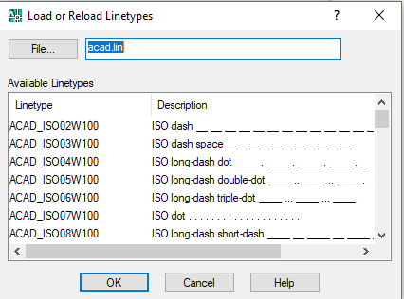
Loading Line type
To load a Line type, click on the “Load. ” button in the Select Linetypye dialogue box. The
Load of Reload Line type dialogue box appears and display list of the available Line types. Select as many of the listed Line types as you wish and then click the OK button to return to the Select Linetpye dialogue box.
Figure 2.25: Loading Line Type
Selecting from list boxes works the same way in AutoCAD as it does in any other Windows application. For example, if you wish to select a block Line types from the list at one time, select the first Line type in the block, hold the shift key down on the keyboard and select the last Line type in the block. All Line types in the block will be highlighted and you can click the “OK” button to load them all one go. You can hold the Control (Ctrl) key down on the keyboard to make multiple selections which aren’t adjacent in the list (see illustration above).

Slide 65
When you return to the Select Line type dialogue box the loaded Line types are display in the list. To assign a particular Line type to a layer, simply click on the name to highlight it and then click on the OK button, when you return to the Layer & Line type Properties dialogue box, the new Line type name will be listed against your layer in the “Line type” column. From now on, all object drawn on this layer will be drawn with the chosen Line type. However just like colors, you may change the Line type at any time and the objects drawn on that layer will automatically be updated to display the new Line type.
Changing Line weight of a Layer
Command line: Type LA (layer) and press Enter (↵) Format menu: Layers toolbar: pick Layer Properties Manager tool
Layer.......
Procedure:
Step1: Input Layer command (any one of above way) [A Layer Properties Manager box will appear] Step 2: Select a Layer
Step 3: In the Line weight column, click box on the line weight size of the layer to change (Line weight box will appear)
Step4: Select any Line weight you want and click on Ok button (Line weight box will disappear) Step 5: Click on OK button again to terminate the command
Making a Layer the Current Layer
Once you have created some layers you will want to start using them. As indicated above, you can only draw on one layer at an item. In order to draw on a particulars layer you must first make it the current layer. As usual with AutoCAD there are a number of alternatives. You could, for example, use the Layer command, Layer... from the Format menu of from the Layers toolbar. As you have seen previously, this command brings up the Layer Properties Manager dialogue box. To set the current layer, select a layer name from the list and then click on the “Current” button and then click the “OK” button to finish. The selected layer is now the current layer and its properties are displayed on the Layer toolbar.
Most experienced Auto CAD users change the current so frequently that the method starts to seem very long winded. It is much

Slide 66
quicker and therefore more efficient to set the current layer directly from the layers toolbar using the “Layer Control” drop down list. To set the current layer, click on the down arrow next to the layer control window to reveal the layer list. Simply click on the name of the layer you wish to make current. If the layer name is not visible because the list is quite long, Scroll down the list until you see it. The drop down list only display 10 layer at a time. As a beginner, you may feel that this is quite a lot but a complex and well structured drawing may have 50 or 100 layers.
There is an even quicker way to change the current layer providing you know which layer objects are on. You can use the Make Object’s Layer Current command to set the current to the layer of any picked object.
Option 1:
Command Line: Type LA (layer) and press Enter. Format menu: Layer Layers Toolbar: pick Layer Properties Manager tool. Procedure:
Step 1: Input Layer command (any of the above way) Step 2: Select a layer and click on Current
button.
Step 3: Click on OK button to terminate the command.
Option 2:
Procedure:
Step 1: Select any object of the layer you want to make current (with-out any command) Step 2: Click on the Make Object’s layer Current tool from the Layers toolbar.

Slide 67
Option 3:
Procedure:
Step 1: From the Layers toolbar, open the layer control drop down menu.
Step 2: Click on the layer’s name you want to make it current.
Sending Object from One Layer to Other Layer Procedure:
Step 1: select any object you want to transfer to other layer.
Step 2: From the Layers toolbar, open the layer control drop down menu.
Step 3: Click on the layer’s name where you want to transfer. Step 4: Press Esc button.
Freezing and Thawing Layers
Freezing and thawing layers works in exactly the same way as turning them on or off. By freezing a layer, you can effectively instruct the AutoCAD to ignore the objects on that layer when regenerating the drawing. Objects on freezing layers are not displayed or plotted.
Locking and Unlocking Layers
Locking and unlocking layers work as for turning layers off and on and freezing and thawing them. Simply click on lock button to toggle an unlocked layer so that it becomes locked and click on unlock button to reverse the process.
Deleting a Layer
To delete a layer, click the name of the layer to highlight it, click the “Delete” button and then click “OK”.

Slide 68
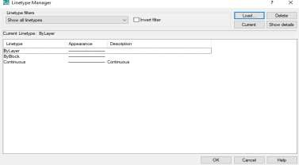
Setting the Line-type Scale
In many cases your line-types will display just as you want them. However, it is inevitable that at some time you will need to change the scale at which yours line-types are displayed. By default the line-type scale is set to 1.0, this means that each line-type pattern will repeat every
1.0 drawing units. To make the pattern appear larger, change the scale to a larger number. Setting the line-type scale to 5.0 for example causes the line type pattern to repeat every 5.0 drawing units so that the pattern will appear 5 times larger. Conversely, setting the scale to 0.2 drawing units which will make the pattern appear 5 times smaller. See the illustration below.
Figure 2.26: Selecting Line Type Scale
Changing Object Properties
There will be occasions when an object properties will need to be changed. Say, for example, you have drawn an object on the wrong layer. It’s much simpler to change the layer for that object rather than to erase the object, set the current layer and draw it again. There are a number of ways in which an objects properties can be changed but the most common method is to use the Properties command. Remember that you cannot change the properties of the objects on locked layers.

Slide 69
The Properties Command
Command Line: Type PR or PROPERTIES and press Enter. Modify Menu: Properties Standard Toolbar: Pick Properties tool.
The followings are eight general properties common to all objects: Layer
Linetype
Color
Linetype scale Lineweight
Plot style
Hyperlink Thickness
Editing with the Object Properties Toolbar
Although editing object properties using the Properties command is easy enough, AutoCAD introduces a new and more efficient way to modify the Layer, Color, and Line-type of an object. By using the Object Properties Toolbar, the layer, color, line-type of an object or objects can be modified directly, without the use of a command.
The Match Properties Command
Another way to change the properties of an object or object is to match the properties of any other object using the Match Properties command on the standard toolbar.
Command line: Type MATCHPROP (match properties) and press enter
Modify menu:Match Properties
Standard toolbar: pick Match Properties tool.
Command Sequence:
Command: MATCHPROP
Select a source object: (pick the object you wish to match)
Current active setting: Color Layer Ltscale Line weight THICKNESS PLOTESTYLE Text DIM HATCH POLYLINE VIEWPORT.
Select destination object(S) of [setting]: (pick the objects to inherit properties) Select destination objected (s) or [setting]
(to terminate the command)

Slide 70
Once the command sequence has been completed, the destination object will inherits all of the current active setting which are specific to that object type. You can control which properties are matched and which are not by using the ‘setting’’ command line option.
Changing Line weight or layer
Command: menu type a layer and press Enter Format menu: Layer Layer toolbar: pick layer Properties Manager
Procedure:
Step: 1: Input Layer command (any one of the above way) [A Layer Properties Manager box will appear) Step 2: Select layer
Select 3: In the Line weight column, click on the line weight size of the layer to change (Line weight) box will appear) Select 4: Select any Line weight you want and click on OK button (Line weight box will disappear)
Select 5: Click on OK button again to terminate the command.
Tips for Working Faster in AutoCAD
Working faster is not simply beneficial for finishing exams by deadlines, but also very important to employers for whom efficiency and production speed are critical to business success.
At first think about the drawing to indentify centerlines or a starting point.
Try to develop a preference for using commands at the keyboard rather than selecting icons in toolbars or items in menus. It is much faster.
Always look at the command line for guidance when you are learning new AutoCAD commands. The command line will
prompt you for information and this is the easiest way to find out how a new command works.
When a command is used, apply it as many times as you can before going on to something else.
Press the “Enter” or “Space” button to activate last used command.

Slide 71
Press the up-arrow and down-arrow keys to cycle through the stack of commands that you’ve used recently.
Try to think ahead as you draw. This will enable you to do more things at the same time, and it will reduce down time needed for thinking before proceeding to the next task.
To trim overlapping lines at corners, use the Fillet command with a “0” radius. If the fillet radius is set to round corners,
remember that you can hold down on the Shift key to use Fillet as though the radius were set at "0" even though it is not. You will save the time required to reset the radius.
Fillet two parallel lines to get an arc.
To extend or trim try to select all as destination line or cutting edge by using Right click of mouse. Use Shift key to alter extend and trim command.
Every command makes it faster to do something. Practice and remember such commands as Copy, Mirror, Stretch, and
Array etc.
Often Copy and Paste objects rather than recreating them. Even objects as simple as circles are often copied more quickly than drawing each one individually.
Copy and Edit text, leader lines, and arrows rather than re-invoking the Text or Leader command and taking time to go
through the basic options. Leader lines can very easily be adjusted by manipulating the grips.
If a line or other object is drawn incorrectly, think first of correcting it by manipulating its grips. It is usually much faster than deleting it and redrawing it correctly. Don’t go slow for fear of making mistakes.
Avoid switching back and forth between layers. Create everything on the layer that most objects will be on, and then at the
end reassign objects to the correct layers. Reassign one object, and use Match Properties to reassign all other objects that should be on the same layer.
Compete with yourself to increase drawing speed and efficiency.
Courtesy: http://www2.hawaii.edu/~dmadden/acad%20tips.htm

Slide 72
Chapter 3
Plan, Elevation and Section of a Building
This chapter covers the application of AutoCAD as drawing tool of Civil engineering structures specially Building plans, elevations and sections. In this chapter plan of a masonry building has been presented first and elevation and section has been demonstrated based on that particular plan. This will enable student to understand practical use of AutoCad in Civil engineering.
Necessary Drawing Tools: Line, Rectangle, Arc, Circle, Hatch, Text etc.
Necessary Modifying Tools: Erase, Copy, Move, Mirror, Offset, Rotate, Trim, Extend, Fillet, Chamfer

Slide 73
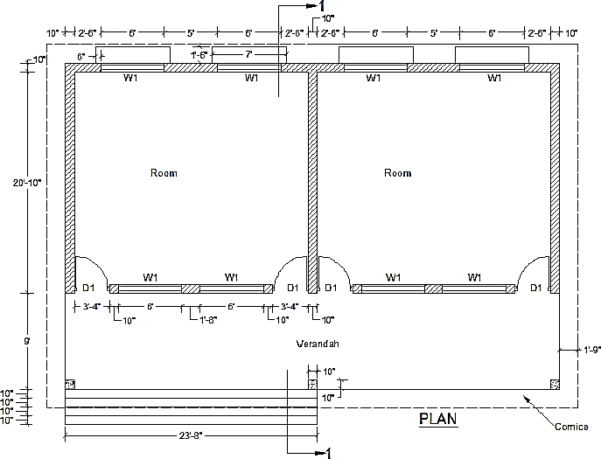
Figure 3.1: Plan of a residential building

Slide 74
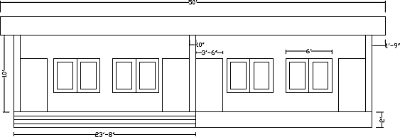
Figure 3.2: Front view of the building

Slide 75
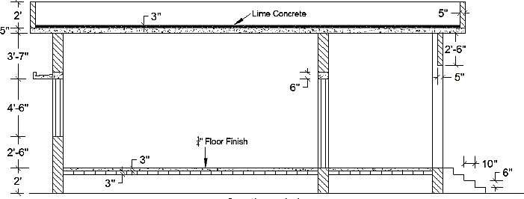
Figure 3.3: Section 1-1

Slide 76
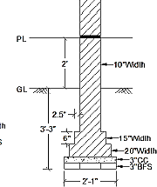
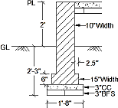
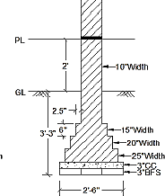
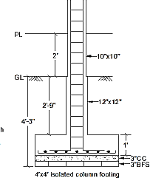
Chapter 4 Reinforcement Detailing
This chapter covers the application of AutoCad as a drawing tool of Civil engineering structures specially foundation, reinforcement detailing of slab, beam and stair. This will enable student to understand practical use of AutoCad in Civil engineering.
Necessary Drawing Tools: Line, Rectangle, Arc, Circle, Hatch, Text etc.
Necessary Modifying Tools: Erase, Copy, Move, Mirror, Offset, Rotate, Trim, Extend, Fillet, Chamfer etc.
Figure 4.1: Wall Footing and Column Footing

Slide 77
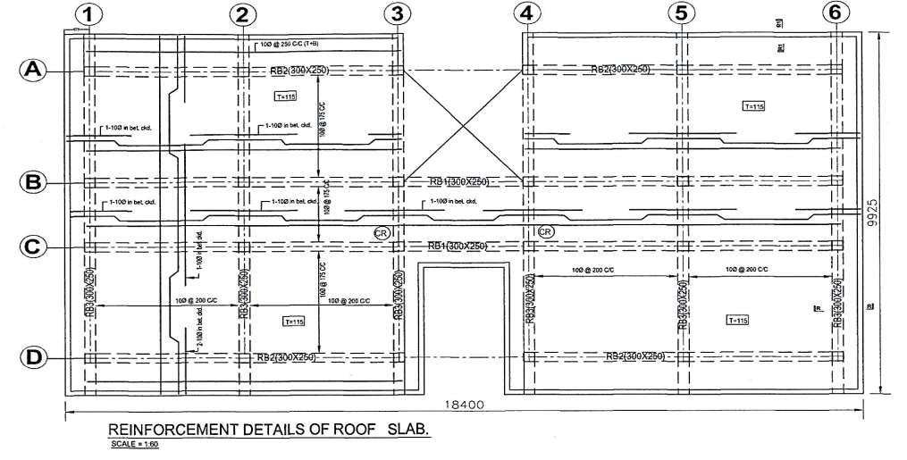
Figure 4.2: Reinforcement detailing of slab

Slide 78
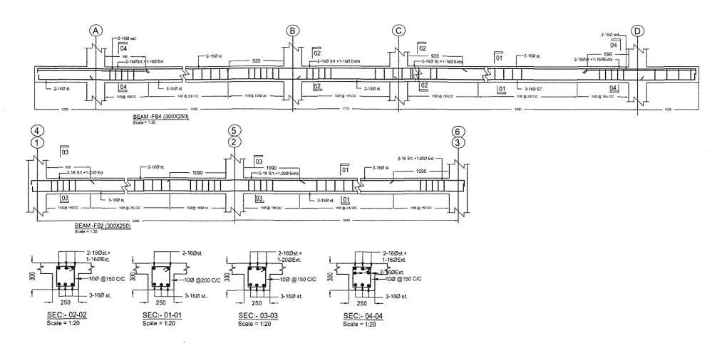
Figure 4.3: Longitudinal and Cross section of beam

Slide 79
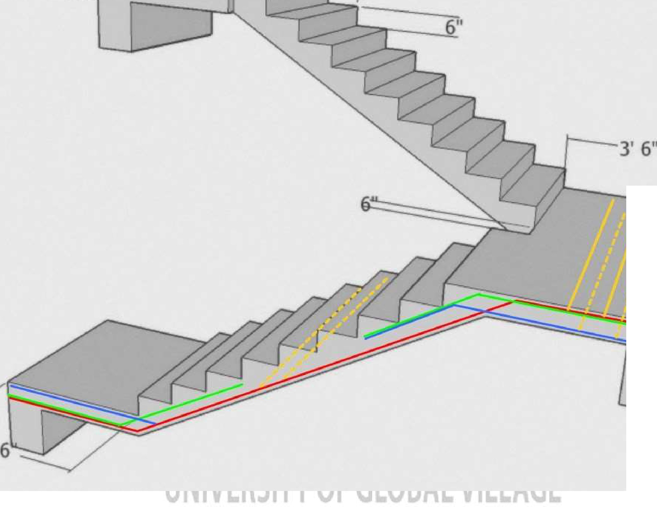

Slide 80
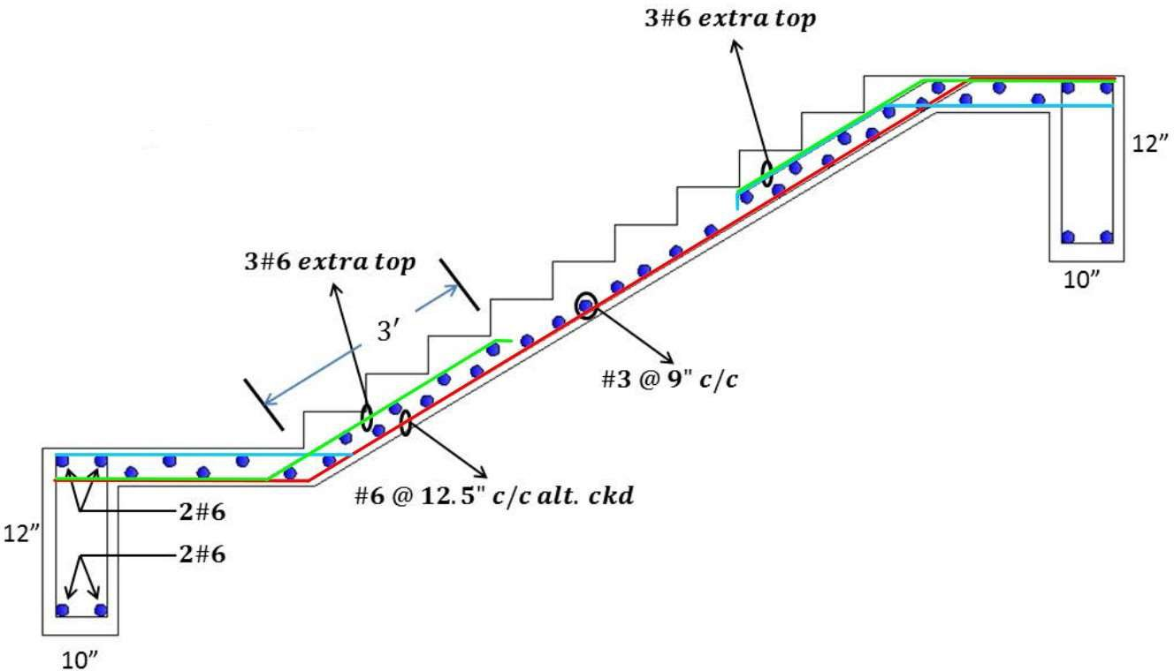
Figure 4.4: Reinforcement detailing of stair

Slide 81

Chapter 5
Plan, Section and Elevation of Slab Culvert
From this Chapter Students will able to learn about different types of Culvert and they will be able to draw the plan and Sectional Elevation View of Slab Culvert by using different tools of AutoCAD.
Water Flow
450 mm
450 mm
Abutment
Abutment
Roadway
7800 mm
3600 mm

Slide 82
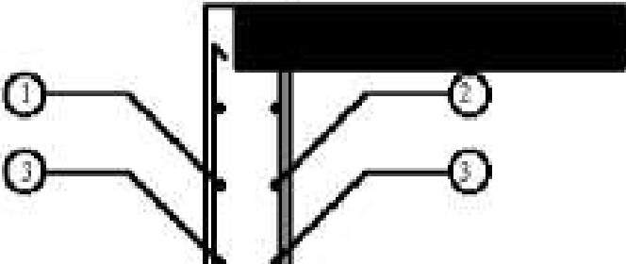
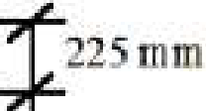
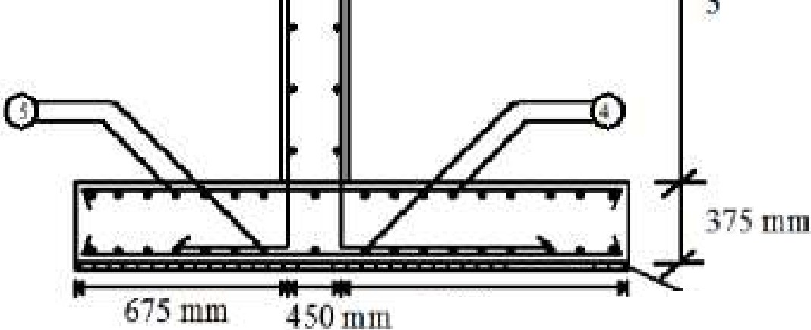

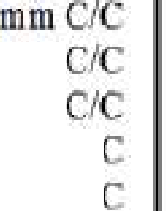



150mm 300mm
i-+-4
fob
L t:ilds:
1 ]9 mm@. !2
]2 mm @ ]5 m111 c
]0 mm @ ]50mm.
1) 16 mm @ ] mm ct
") ]o m, @ ! 5· nHn l
"600 mm
12.00 IDffl
"---- 7
mm (one I
ling
cr)BrickFJal
u
R ITYO
IL

Slide 83
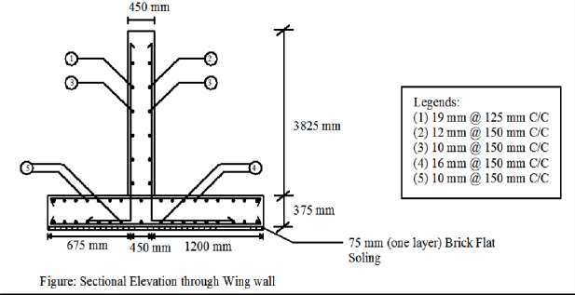
Figure 5.2: Sectional Views of Culvert

Slide 84
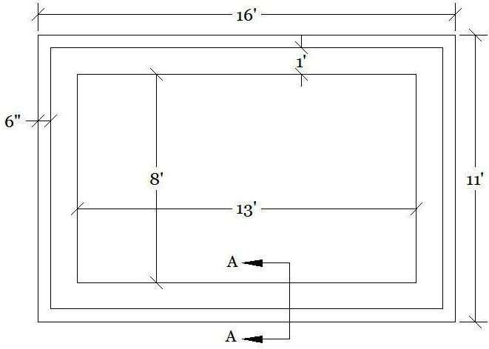
Chapter 6
Plan, Elevation and Section of an Underground Water Reservoir
Figure 6.1: Plan of underground water reservoir

Slide 85
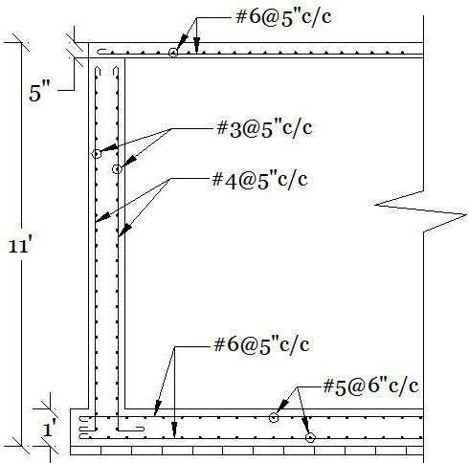
Figure 6.2: Section A-A

Slide 86
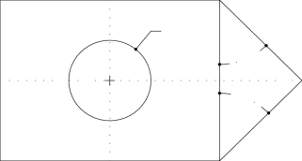
Assignment
Draw the following diagrams using AutoCAD (follow the instructions where given):
1.
16'
6'
12'
R3'
45°
45°
2.
10'
45°
10'
10'
1'
1'
2'
2'

Slide 87



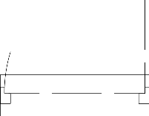

Use Line, Arc / Polyline
3.
2'-10"
10"
1.5"
2.5"
3'
1.5"
1"
Use Line, Arc

Slide 88
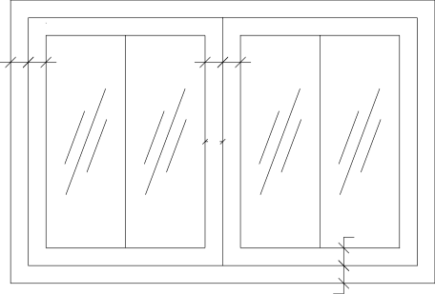
4. | 1'-8" 1'-5" 1'-5" 1'-8" 3" 3" 3" 3" 3" 4' 3" 3" Use Rectangle , Line, Offset
5.

Slide 89
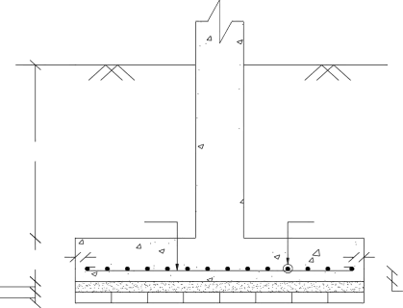
GL
4'
#6 @ 5" C/C
#5@ 5" C/C
1' 3"
3"
3"
3"
3"
Use Copy(for donut) ,Hatch (Conc. ,Sand)

Slide 90
6.
Roof
10'
4th Floor
10'
3rd Floor
10'
2nd Floor
10'
1st Floor
10'
Ground Floor
6'
Base
18'
20'
18'

Slide 91
6'
4'
6"
Use Offset, Copy, Scale factor of Dimension Style

Slide 92
7.
12'
12'
2'
12'
7'-6"
2'-6"
2'-6"
3'
12'

Slide 93
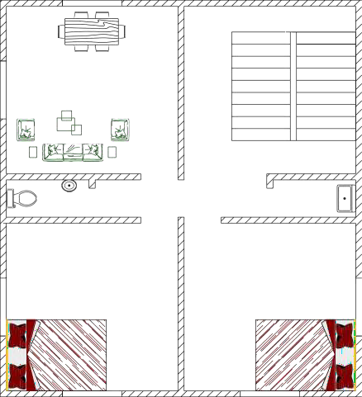
Use Center line
8. | 12' 12' 12' 3' 12' Use Block

Slide 94
9.
1'-6"
1'-6"
1'-6"
1'-6"
R2"
1'
1'
1'
1'
Use Offset, Rectangular Array
10.

Slide 95
3"
R3'
Center
Use Offset, Polar Array

Slide 96

11.
_{3"} R3' Center Use Offset, Polar Array

Slide 97
12.
Use Polar Array

Slide 98
13.
10"
3'
2.5"
2.5"
6"
6"
6"
6"
3"
30"
Use Offset, Trim, Hatch (brick)
14.

Slide 99
5"
1"
1"
1"
6"
2"
1'-6"
Use Hatch (Conc.)

Slide 100
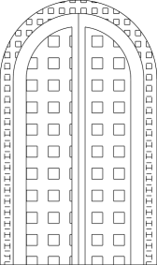
15.
3'
5'
6'
Use Line, Arc, Offset, Hatch
16.

Slide 101
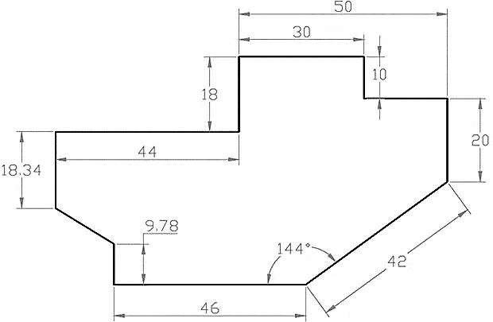
Use Line

Slide 102
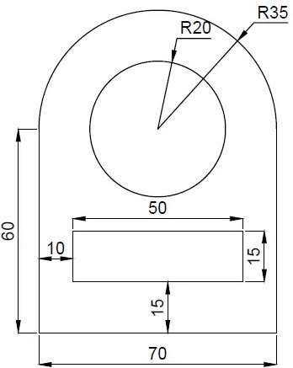
17. | Use Line and Arc

Slide 103
THANK YOU
University of Global Village (UGV), Barishal Department of Mechanical Engineering
Prepared by
Md. Naeem Hosen Hredoy Lab Instructor
Department of Mechanical

