Slide 1
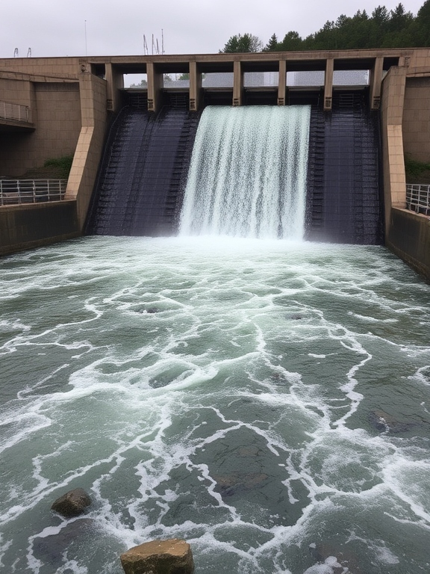

Lecture on Fluid Mechanics II
Prepared By :
Anisul Islam
Lecturer
Department of ME (UGV)

Slide 2
BASIC COURSE INFORMATION
Course Title | Fluid Mechanics II
Course Code | ME-323
Credits | 03
CIE Marks | 90
SEE Marks | 60
Exam Hours | 2 hours (Mid Exam) 3 hours (Semester Final Exam)
Level | 6th Semester

Slide 3
















Course Learning Outcomes (CLOs):
CLO 2
CLO 4
Apply the concepts of Bernoulli equation, Mach Number and Reynolds Number
Calculate and Evaluate losses on pipes, Pipe design, Nose Pressure, Pressure on Merged and Submerged Condition
CLO 1
CLO 3
Explain Fluid Properties, Velocity and Head loss, Pipe friction, Drag & Lift force, Open Channel flow
Analyze Complex problems on Fluid flow, Pressure, Line of Action

Slide 4


Slide 5
Serial No | Course Content | Hours | CLOs
01. | Fluid Properties, Bernoulli Equation, Boundary Layer Development | 10 | CLO 1, CLO 2
02. | Mach Number, Drag and Lift Force (Problem Solving), Reynolds Number (Problem Solving) | 10 | CLO 2, CLO 3
03. | Hydrostatic Pressure , Problem Solving on Hydrostatic Pressure | 04 | CLO 3
04. | Open Channel Flow, Buoyancy & Stability of Submerged Bodies (Problem Solving) | 08 | CLO 3, CLO 4

Slide 6
ASSESSMENT PATTERN
CIE- Continuous Internal Evaluation (90 Marks)
Bloom's Category Marks (out of 90) | Tests (45) | Assignments (10) | Class Test (20) | Quiz (5) | External Participation in Curricular/Co-Curricular Activities (10)
Remember | 5 |  | 10 | 05
Understand | 5 | 05 | 10
Apply | 10 |  |  |  | 10
Analyze | 15
Evaluate | 10
Create |  | 05

Slide 7
SEE- Semester End Examination (60 Marks)
Bloom's Category | Test
Remember | 10
Understand | 10
Apply | 10
Analyze | 10
Evaluate | 10
Create | 10

Slide 8
Week No. | Topics | Teaching Learning Strategy | Assessment strategy | Alignment To CLO
1. | Fluid Properties | Lecture, PPT | Quiz, Written exam, CT | CLO 1
2. | Fluid Properties (Problem Solving) | Lecture, Video Presentation, PPT, Problem Practice | Quiz, Written exam, CT | CLO 1
3. | Bernoulli Equation | Lecture, PPT | Assignment, Quiz, Written exam, CT | CLO 2
4. | Bernoulli Equation (Problem Solving) | Lecture, Problem Practice, Video Presentation, PPT | Assignment, Quiz, Written exam, CT | CLO 2, CLO 3

Slide 9
Week No. | Topics | Teaching Learning Strategy | Assessment strategy | Alignment To CLO
5. | Boundary Layer Development | Lecture, Video Presentation, PPT | Quiz, Written exam, CT | CLO 2
6. | Mach Number | Lecture, Video Presentation, PPT | Quiz, Written exam, CT | CLO 1, CLO 2
7. | Drag and Lift Force | Lecture, Oral Presentation, Video Presentation, PPT | Assignment, Quiz, Written exam, CT | CLO 1, CLO 2
8. | Drag and Lift Force (Problem Solving) | Lecture, Oral Presentation, Video Presentation, PPT, Problem Practice | Assignment, Quiz, Written exam, CT | CLO 1, CLO 2

Slide 10
Week No. | Topics | Teaching Learning Strategy | Assessment strategy | Alignment To CLO
9. | Reynolds Number | Lecture, Oral Presentation, Video Presentation, PPT | Quiz, Written exam, CT | CLO 2
10. | Reynolds Number (Problem Solving) | Lecture, PPT, Problem Solving | Assignment, Quiz, Written exam, CT | CLO 2
11. | Hydrostatic Pressure | Lecture, Oral Presentation, Video Presentation, PPT | Assignment, Quiz, Written exam, CT | CLO 3
12. | Hydrostatic Pressure (Problem Solving) | Lecture, PPT, Problem Solving | Assignment, Quiz, Written exam, CT | CLO 3

Slide 11
Week No. | Topics | Teaching Learning Strategy | Assessment strategy | Alignment To CLO
13. | Open Channel Flow | Lecture, Oral Presentation, Video Presentation, PPT | Assignment, Quiz, Written exam, CT | CLO 3, CLO 4
14. | Open Channel Flow (Most Economical Sections) | Lecture, PPT, Problem Solving | Assignment, Quiz, Written exam, CT | CLO 3, CLO 4
15. | Buoyancy & Stability of Submerged Bodies | Lecture, Oral Presentation, Video Presentation, PPT | Assignment, Quiz, Written exam, CT | CLO 3, CLO 4
16. | Buoyancy & Stability of Submerged Bodies (Problem Solving) | Lecture, PPT, Problem Solving | Assignment, Quiz, Written exam, CT | CLO 3, CLO 4
17. | Review Class on Problem solving | Group discussion

Slide 12
Week | Topic | Page No.
1 | Fluid Properties | 13-20
2 | Fluid Properties (Problem Solving) | 21-35
3 | Bernoulli Equation | 36-42
4 | Bernoulli Equation (Problem Solving) | 43-49
5 | Boundary Layer Development | 50-59
6 | Mach Number | 60-67
7 | Drag and Lift Force | 68-72
8 | Drag and Lift Force (Problem Solving) | 73-78
9 | Reynolds Number | 79-85
10 | Reynolds Number (Problem Solving) | 86-91
11 | Hydrostatic Pressure | 92-97
12 | Hydrostatic Pressure (Problem Solving) | 98-108
13 | Open Channel Flow | 109-124
14 | Open Channel Flow (Most Economical Sections) | 125-134
15 | Buoyancy & Stability of Submerged Bodies | 135-145
16 | Buoyancy & Stability of Submerged Bodies (Problem Solving) | 146-150

Slide 13

Week -1
Lecture
on
Fluid Properties

Slide 14
Fluid Properties: Density, Viscosity, and Surface Tension
Density
Viscosity
Surface Tension
Density measures the mass of a fluid per unit volume. It plays a crucial role in buoyancy and determining how a fluid responds to external forces.
Viscosity represents a fluid's resistance to flow. It impacts the speed of flow, energy losses, and the formation of boundary layers.
Surface tension arises from cohesive forces within a liquid, creating a thin film at its surface. It influences droplet formation, capillary action, and the behavior of bubbles.

Slide 15
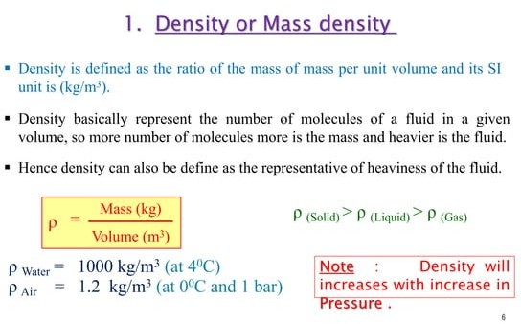

Slide 16
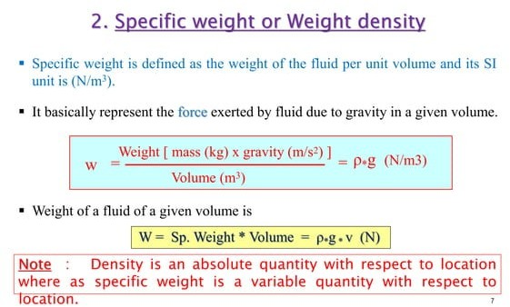

Slide 17
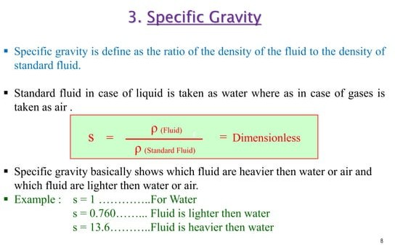

Slide 18
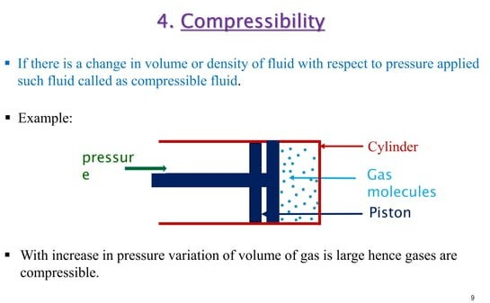

Slide 19
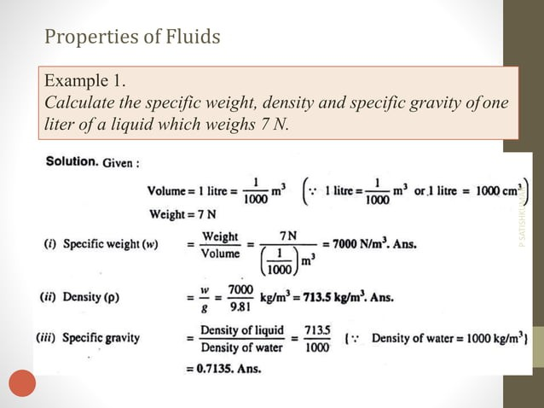

Slide 20
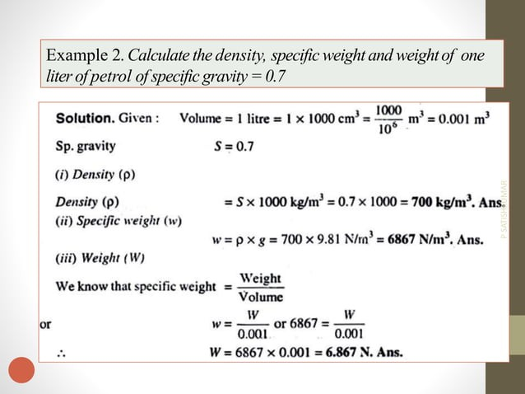

Slide 21
Week -2
Lecture
on
Fluid Properties
Problem Solving

Slide 22
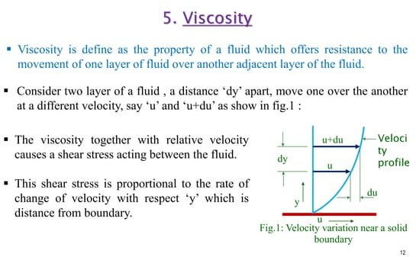


Slide 23
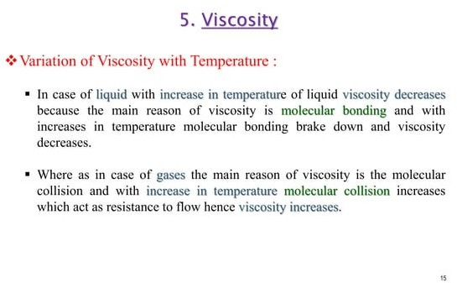

Slide 24
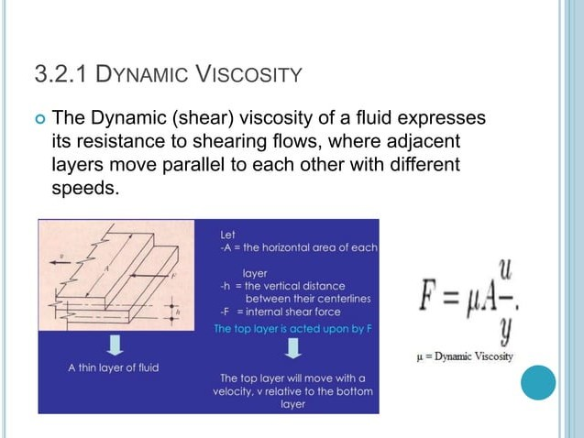

Slide 25
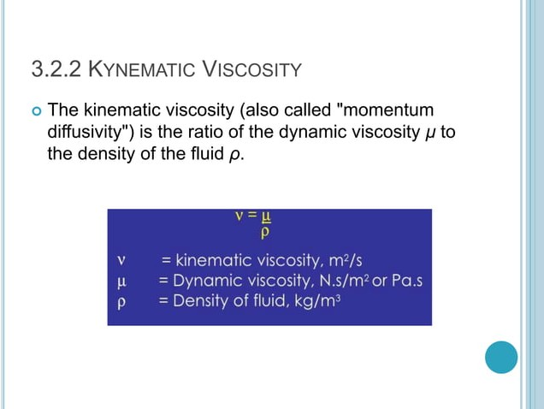

Slide 26
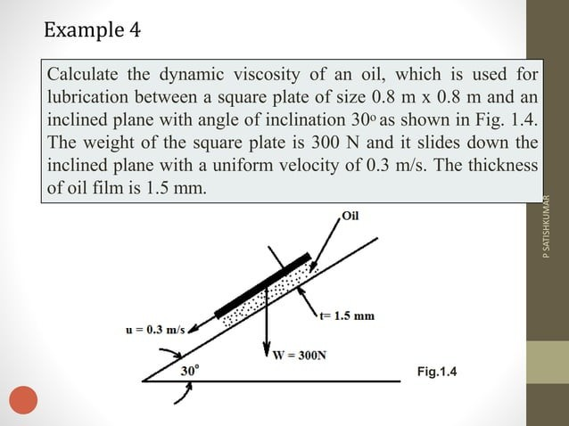

Slide 27
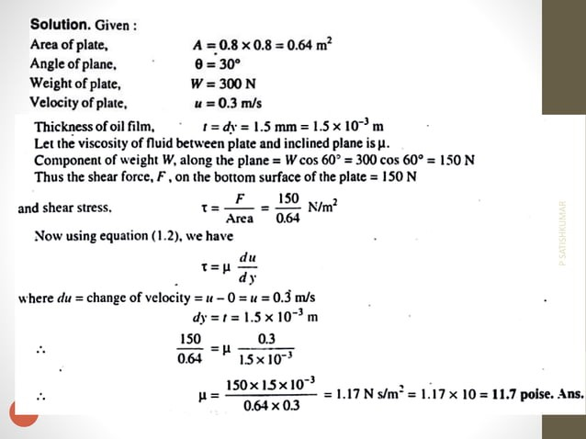

Slide 28
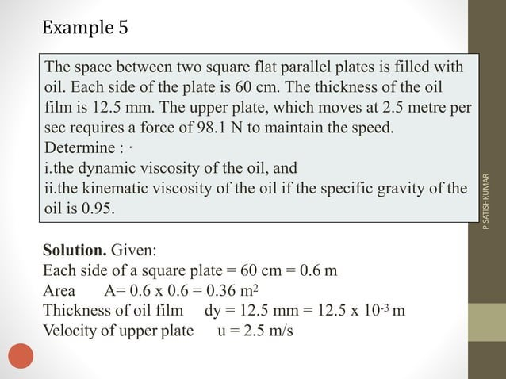

Slide 29
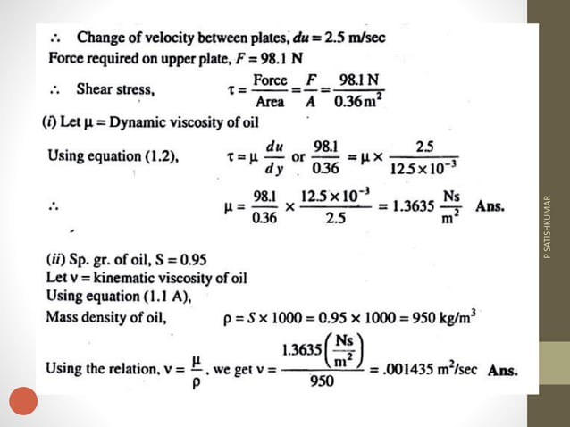

Slide 30
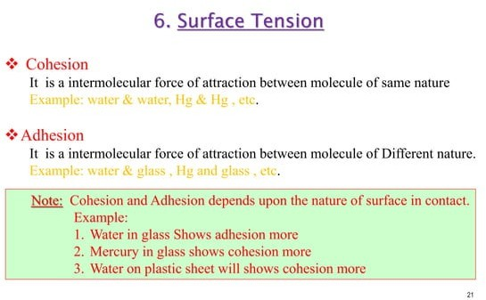

Slide 31
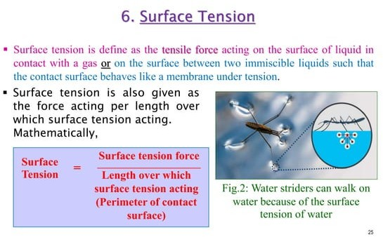

Slide 32
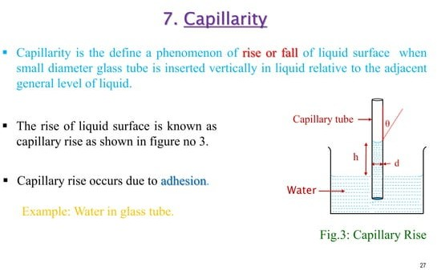

Slide 33
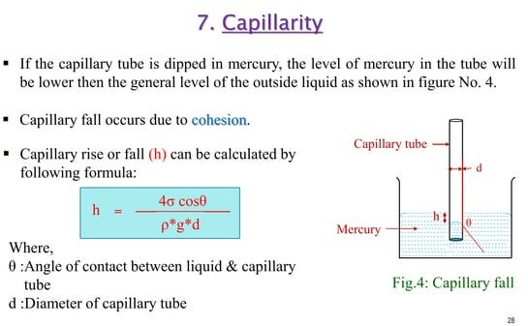

Slide 34
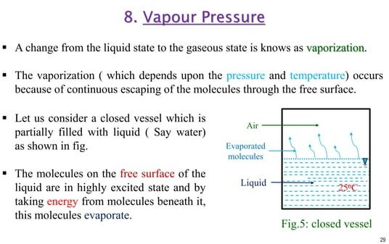

Slide 35
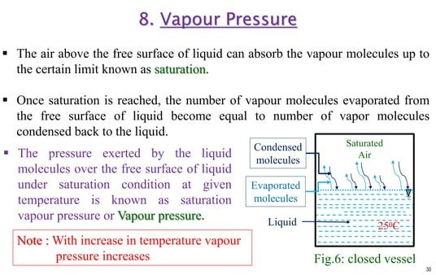

Slide 36
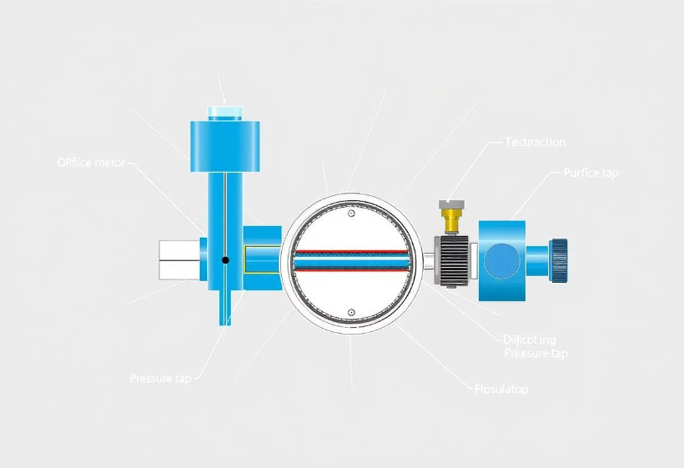
Week -3
Lecture
on
Bernoulli Equation

Slide 37
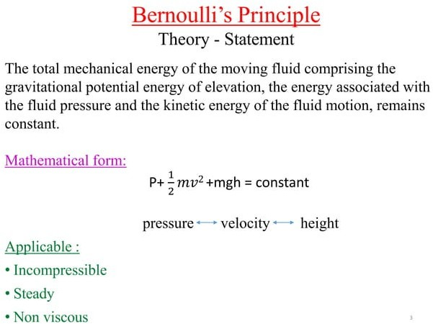

Slide 38
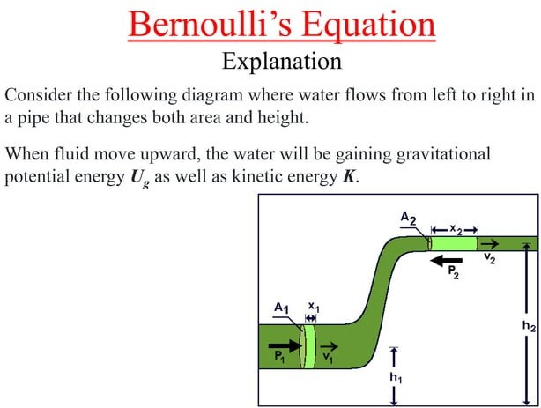

Slide 39
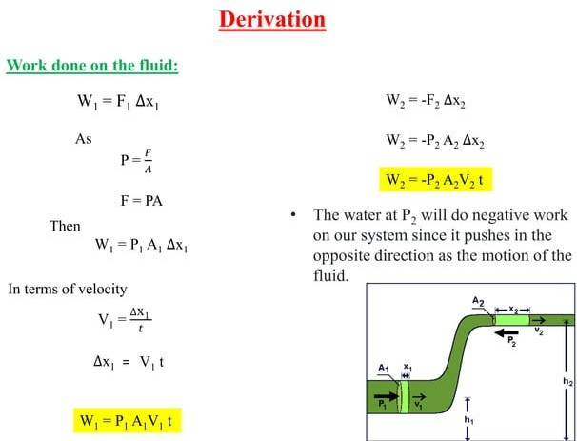

Slide 40
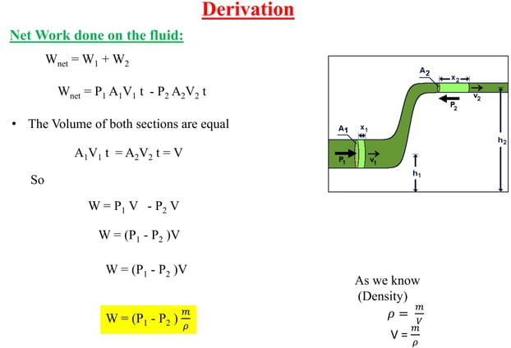

Slide 41
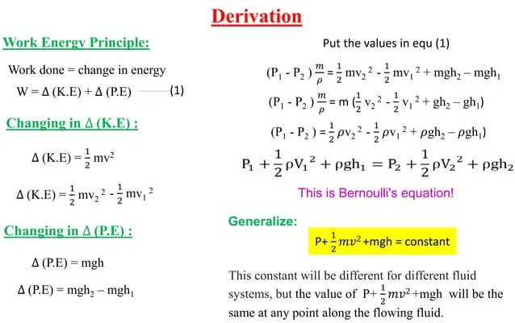

Slide 42
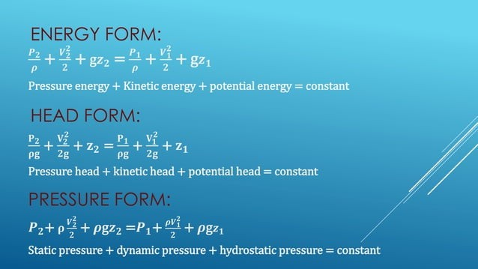

Slide 43
Week -4
Lecture
on
Bernoulli Equation
Problem Solving

Slide 44
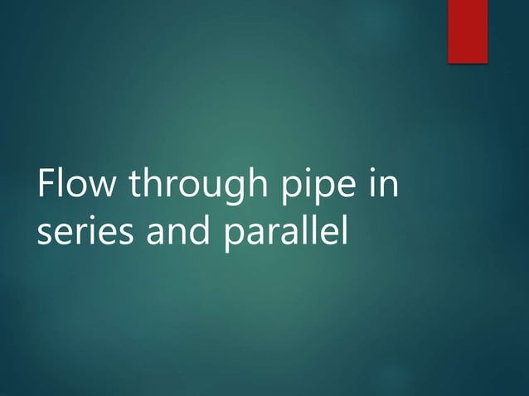

Slide 45
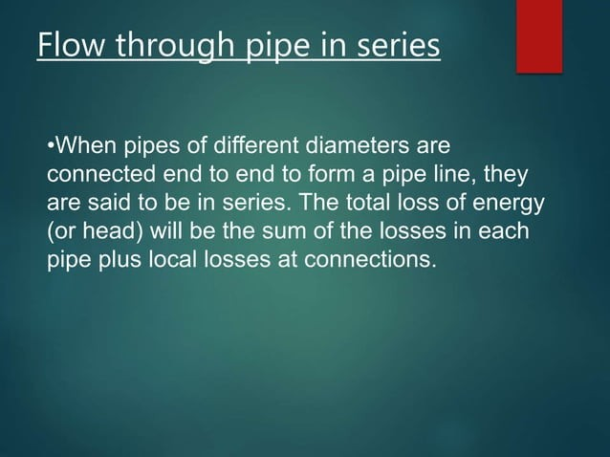

Slide 46
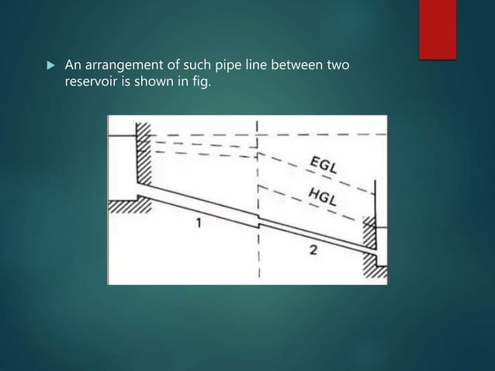

Slide 47
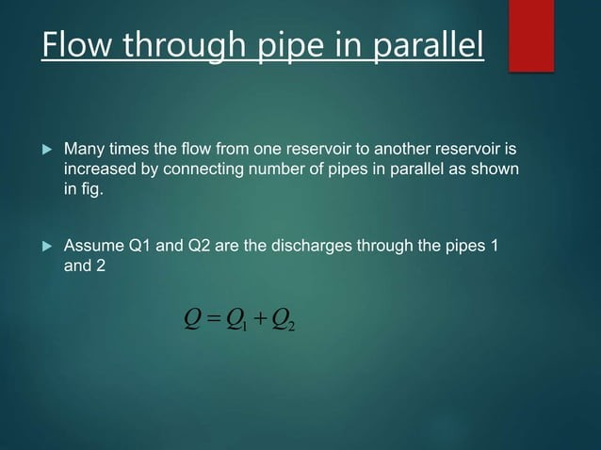

Slide 48
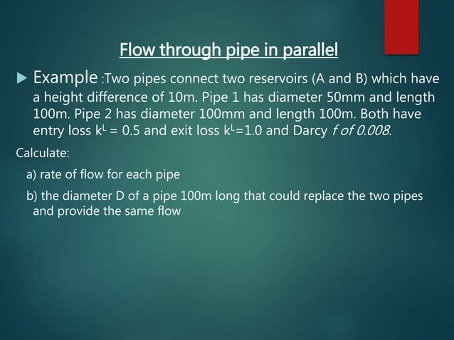

Slide 49







Mathematical Problems on Bernoulli Equation
Mathematical problems related to Bernoulli Equation will be practiced and solved during classroom sessions. Problems from the prescribed reference book will be addressed, and additional practice materials will be provided to enhance understanding and proficiency.

Slide 50

Week -5
Lecture
on
Boundary Layer Development

Slide 51
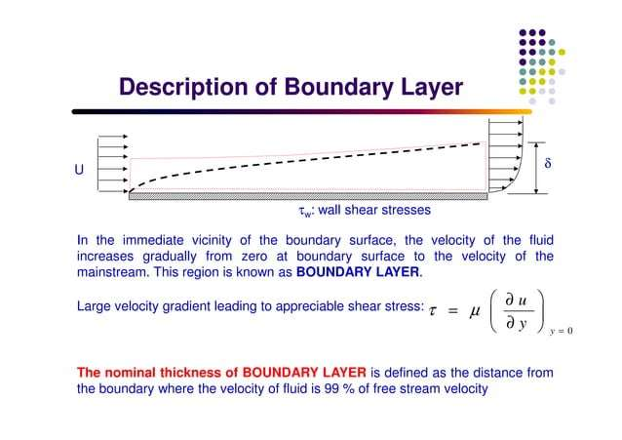

Slide 52
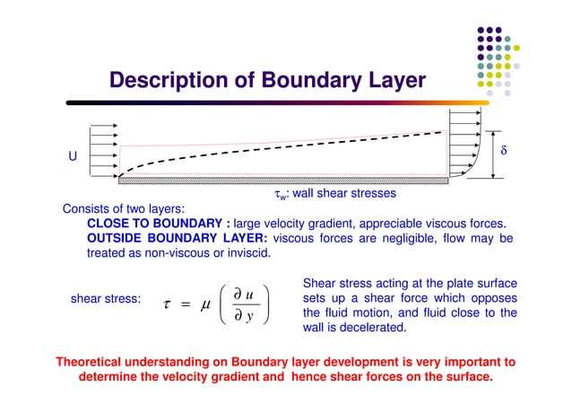

Slide 53
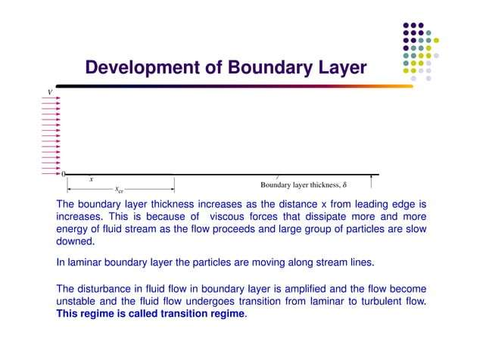

Slide 54
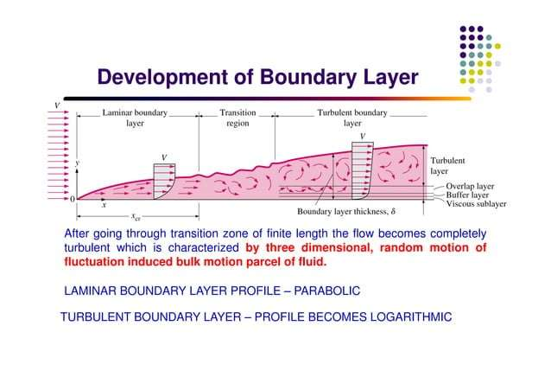

Slide 55
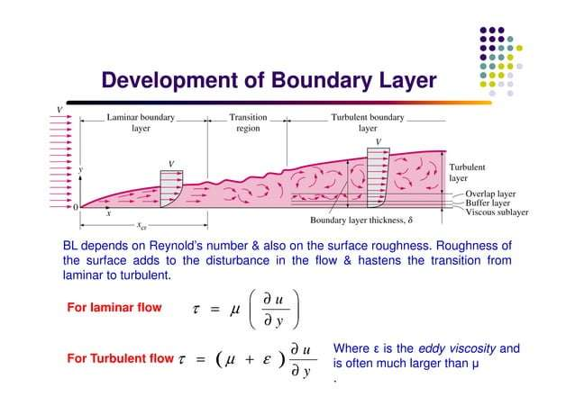

Slide 56
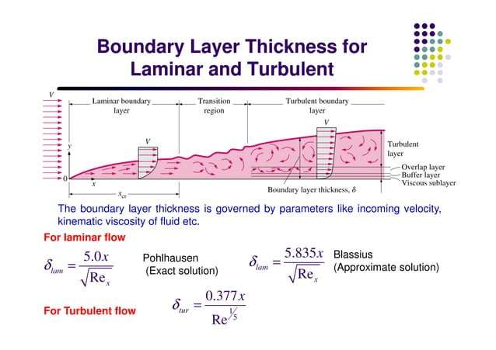

Slide 57
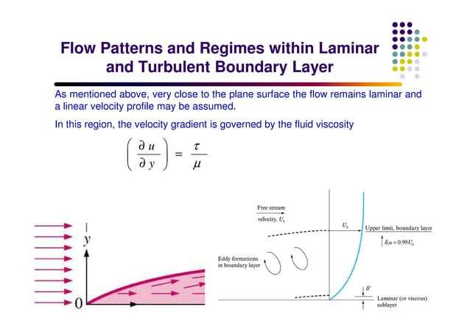

Slide 58
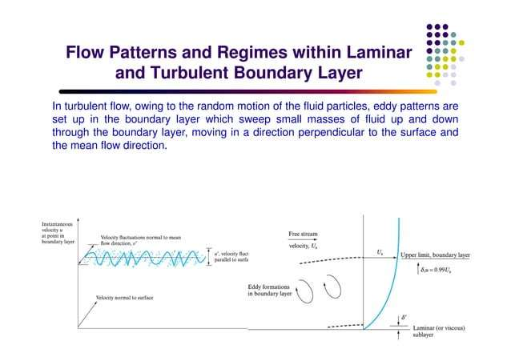

Slide 59
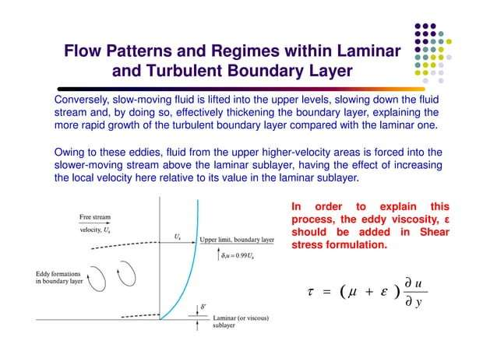

Slide 60
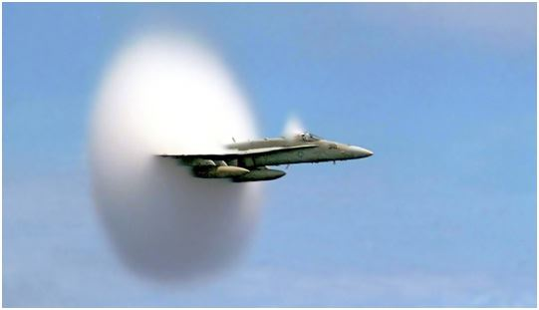
Week -6
Lecture
on
Mach Number

Slide 61
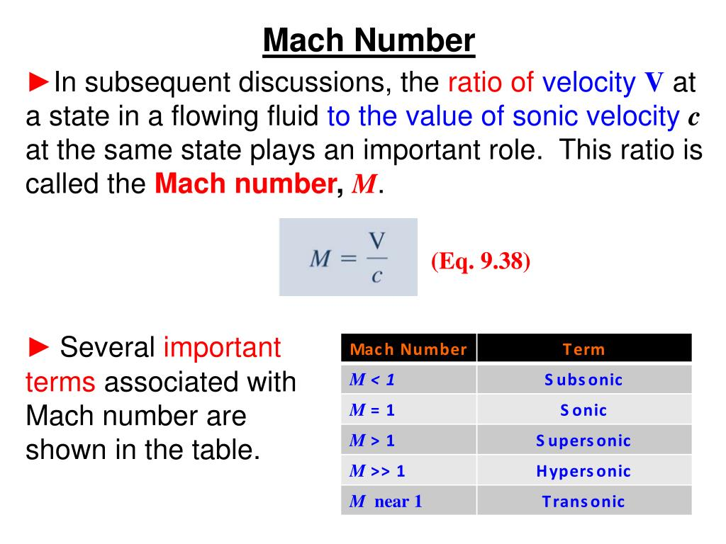

Slide 62
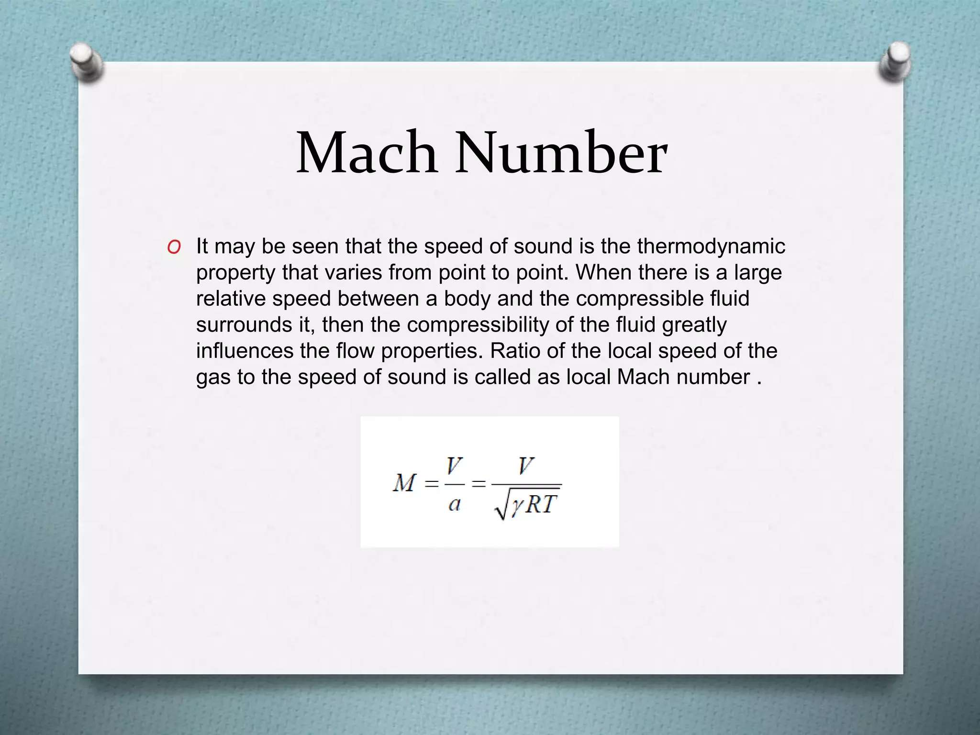

Slide 63
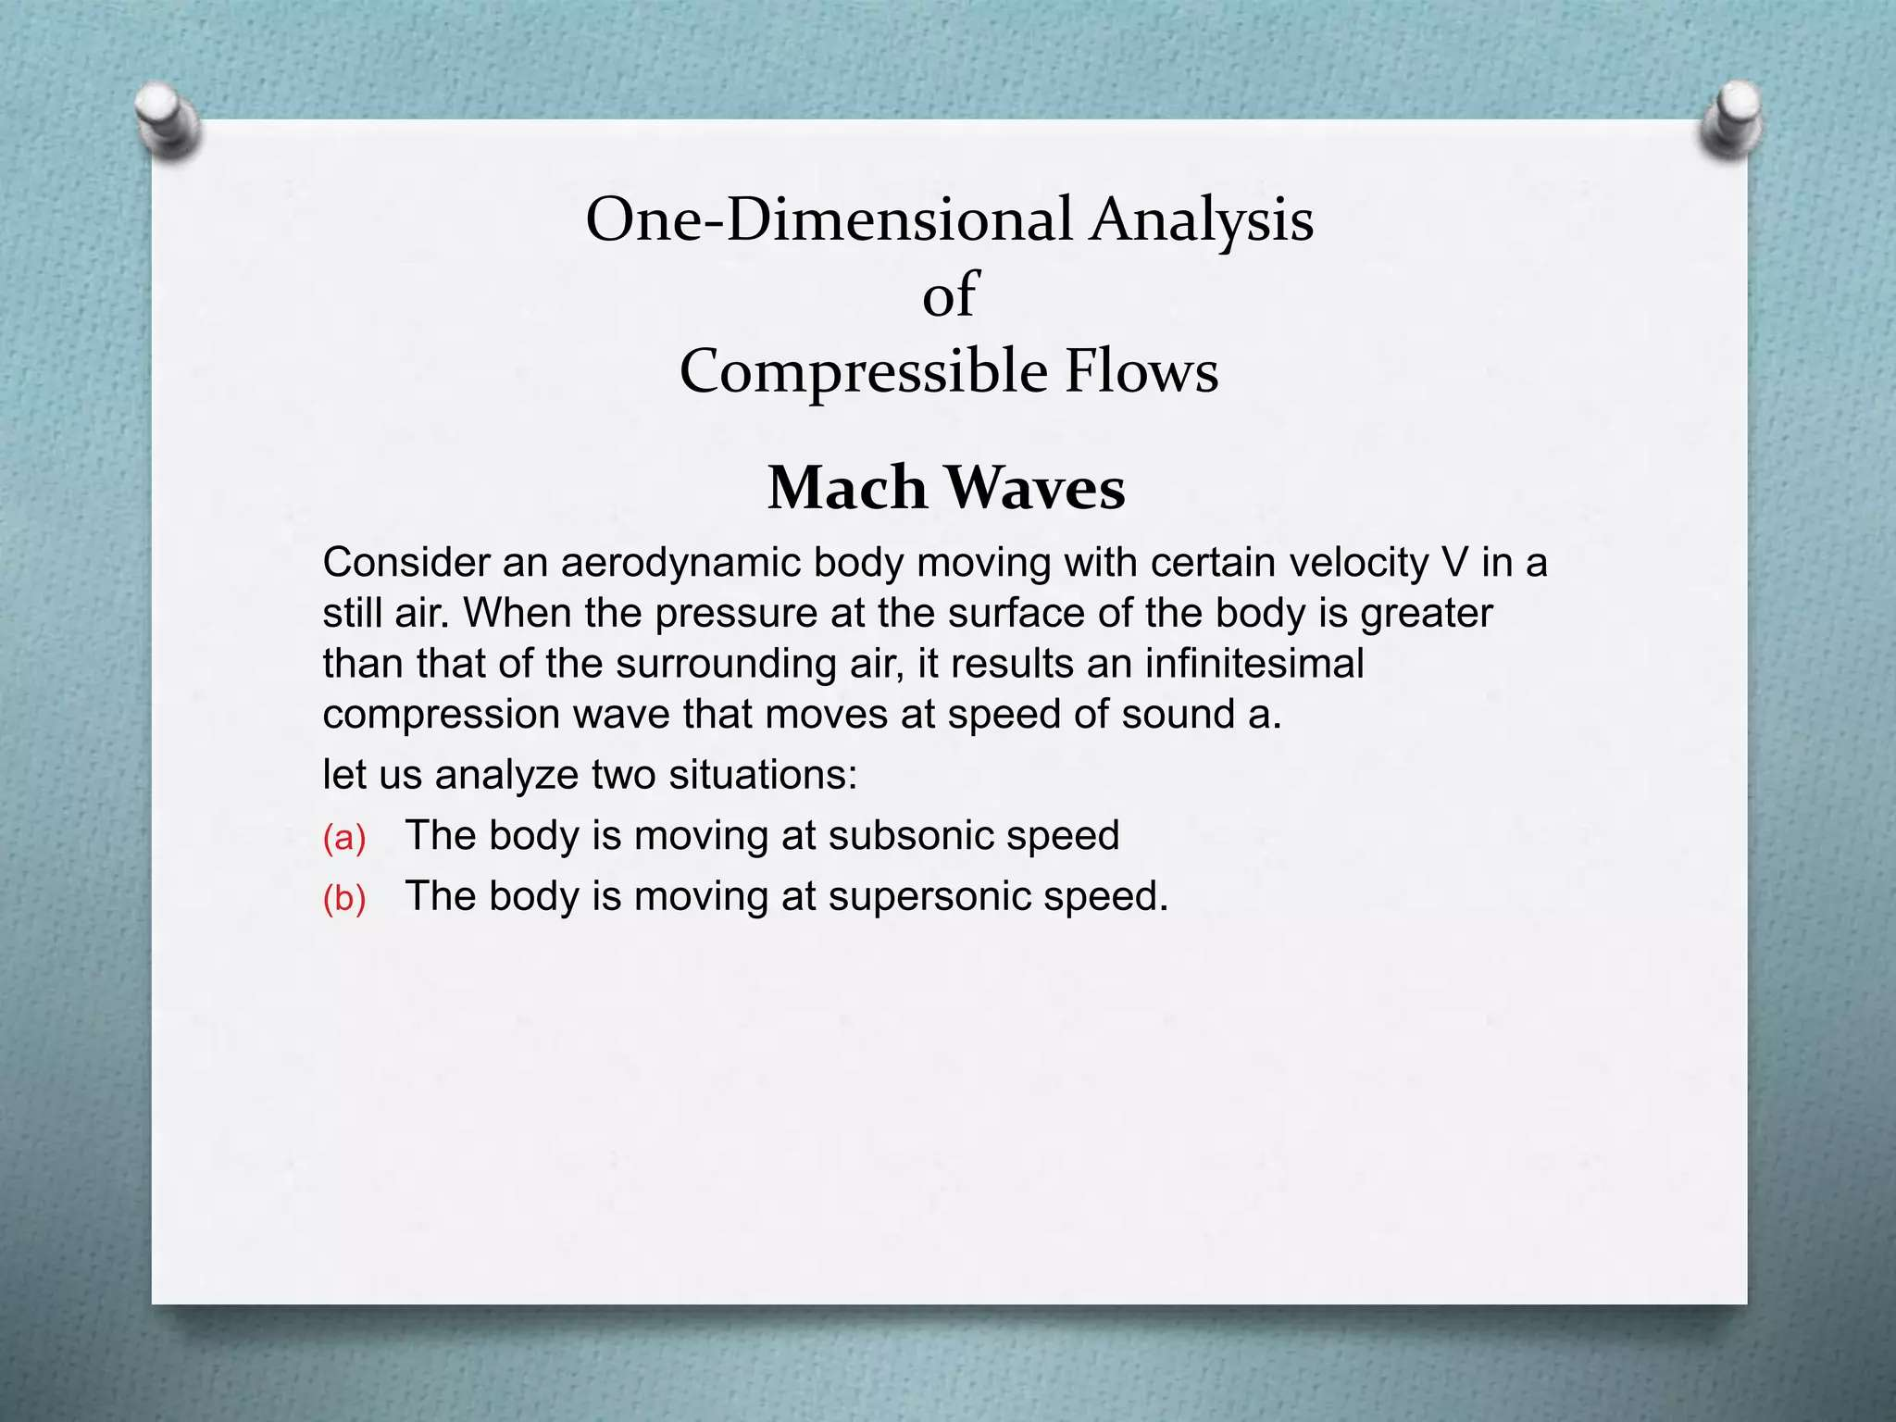

Slide 64
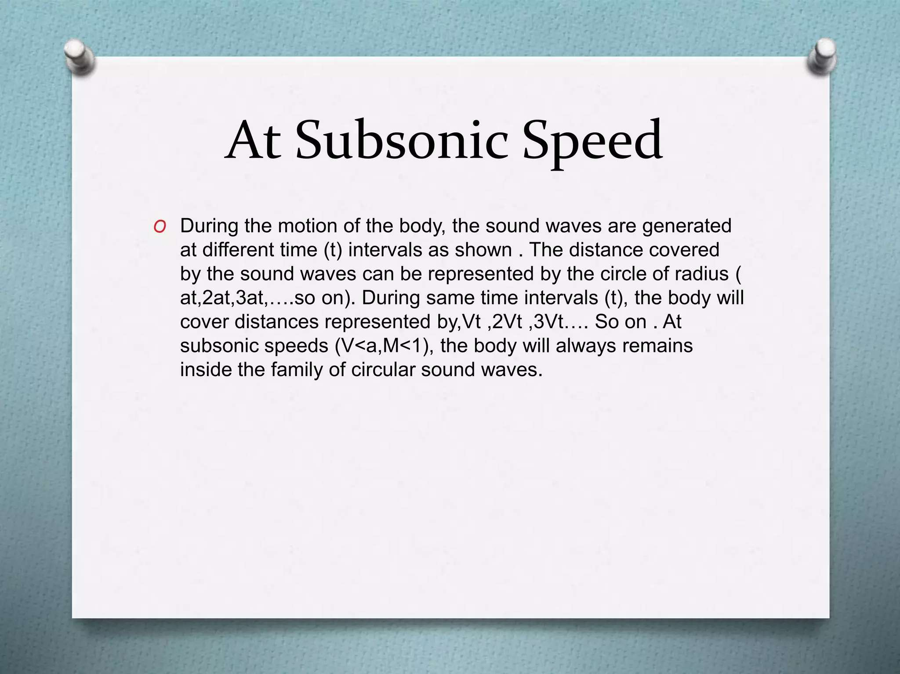

Slide 65
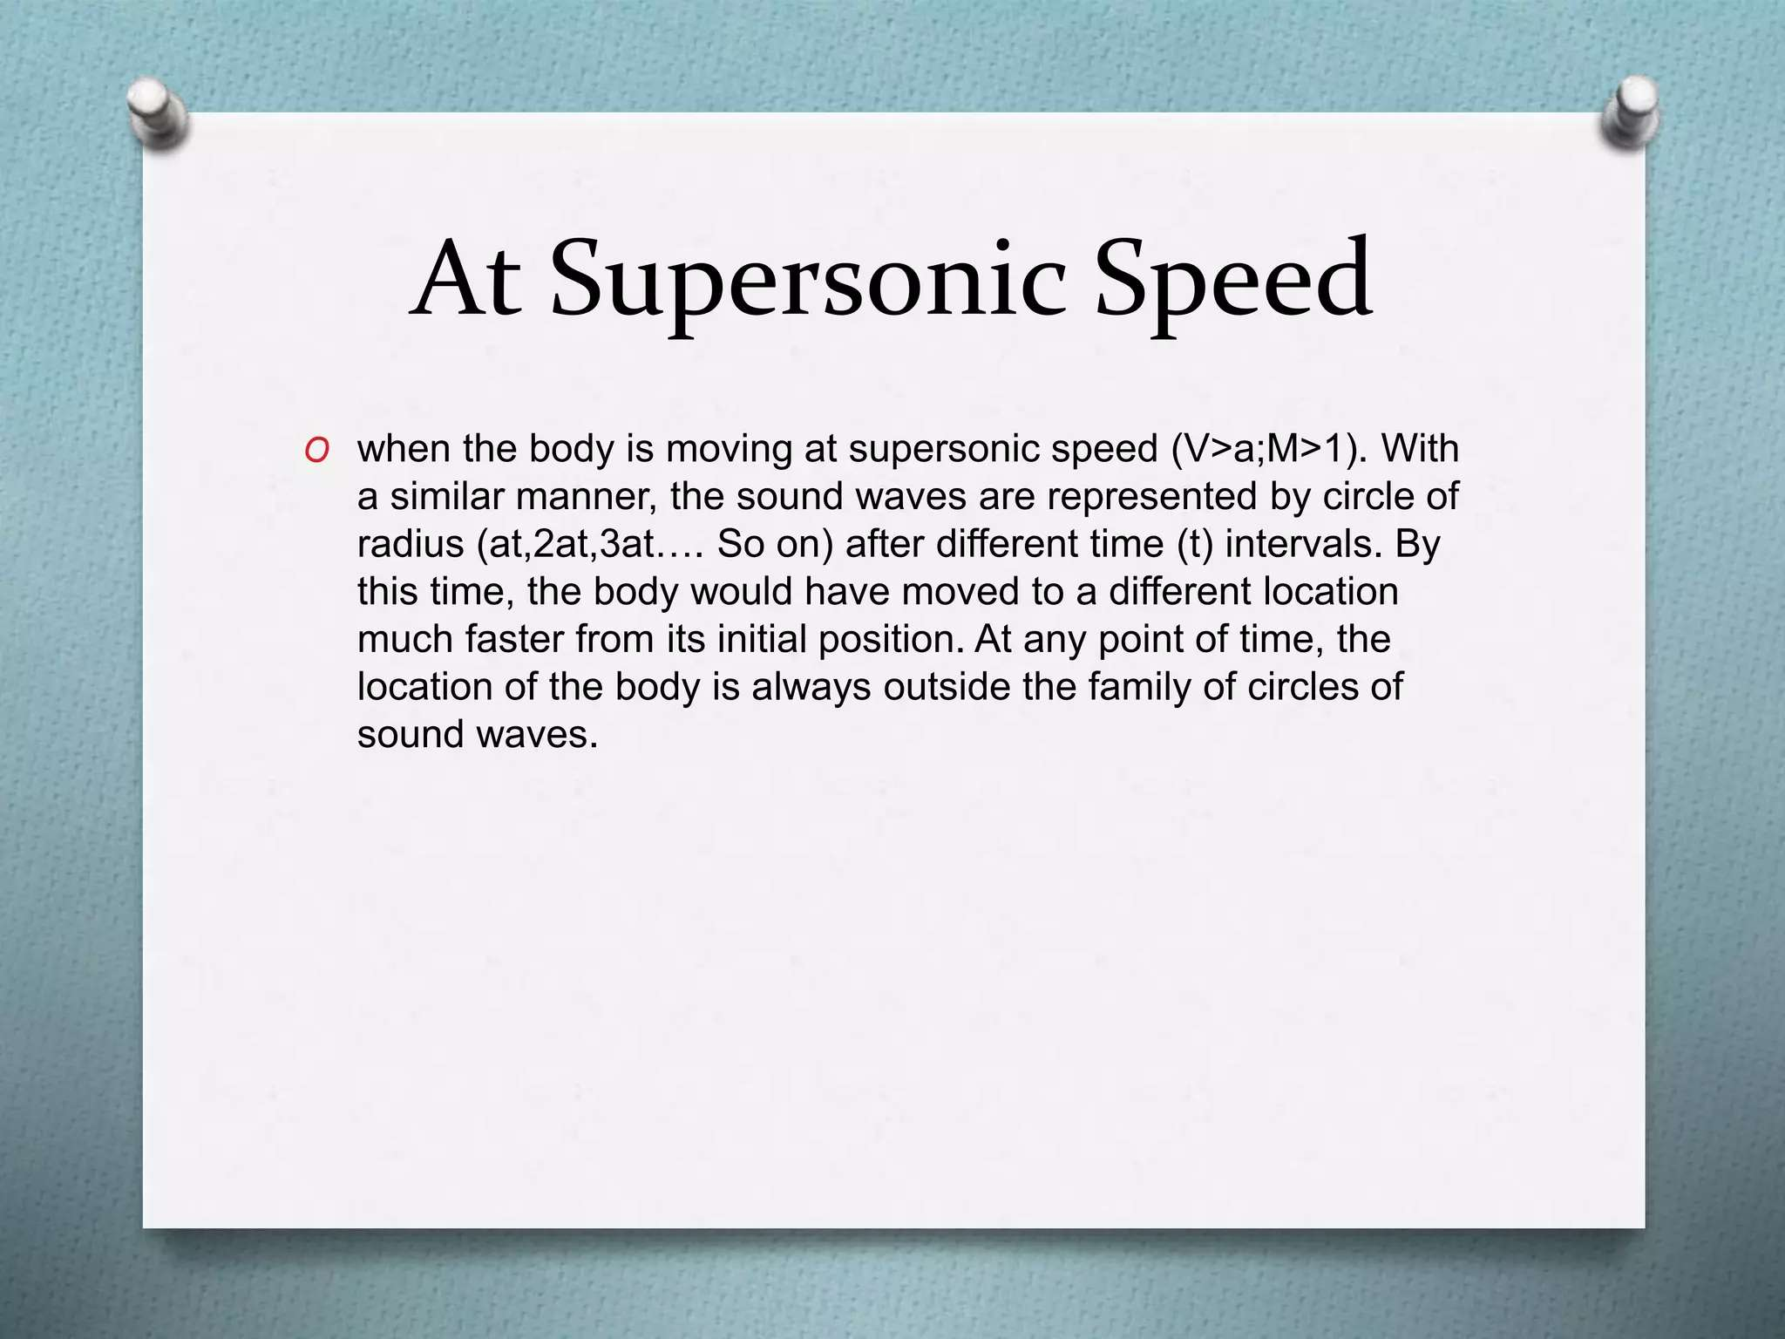

Slide 66
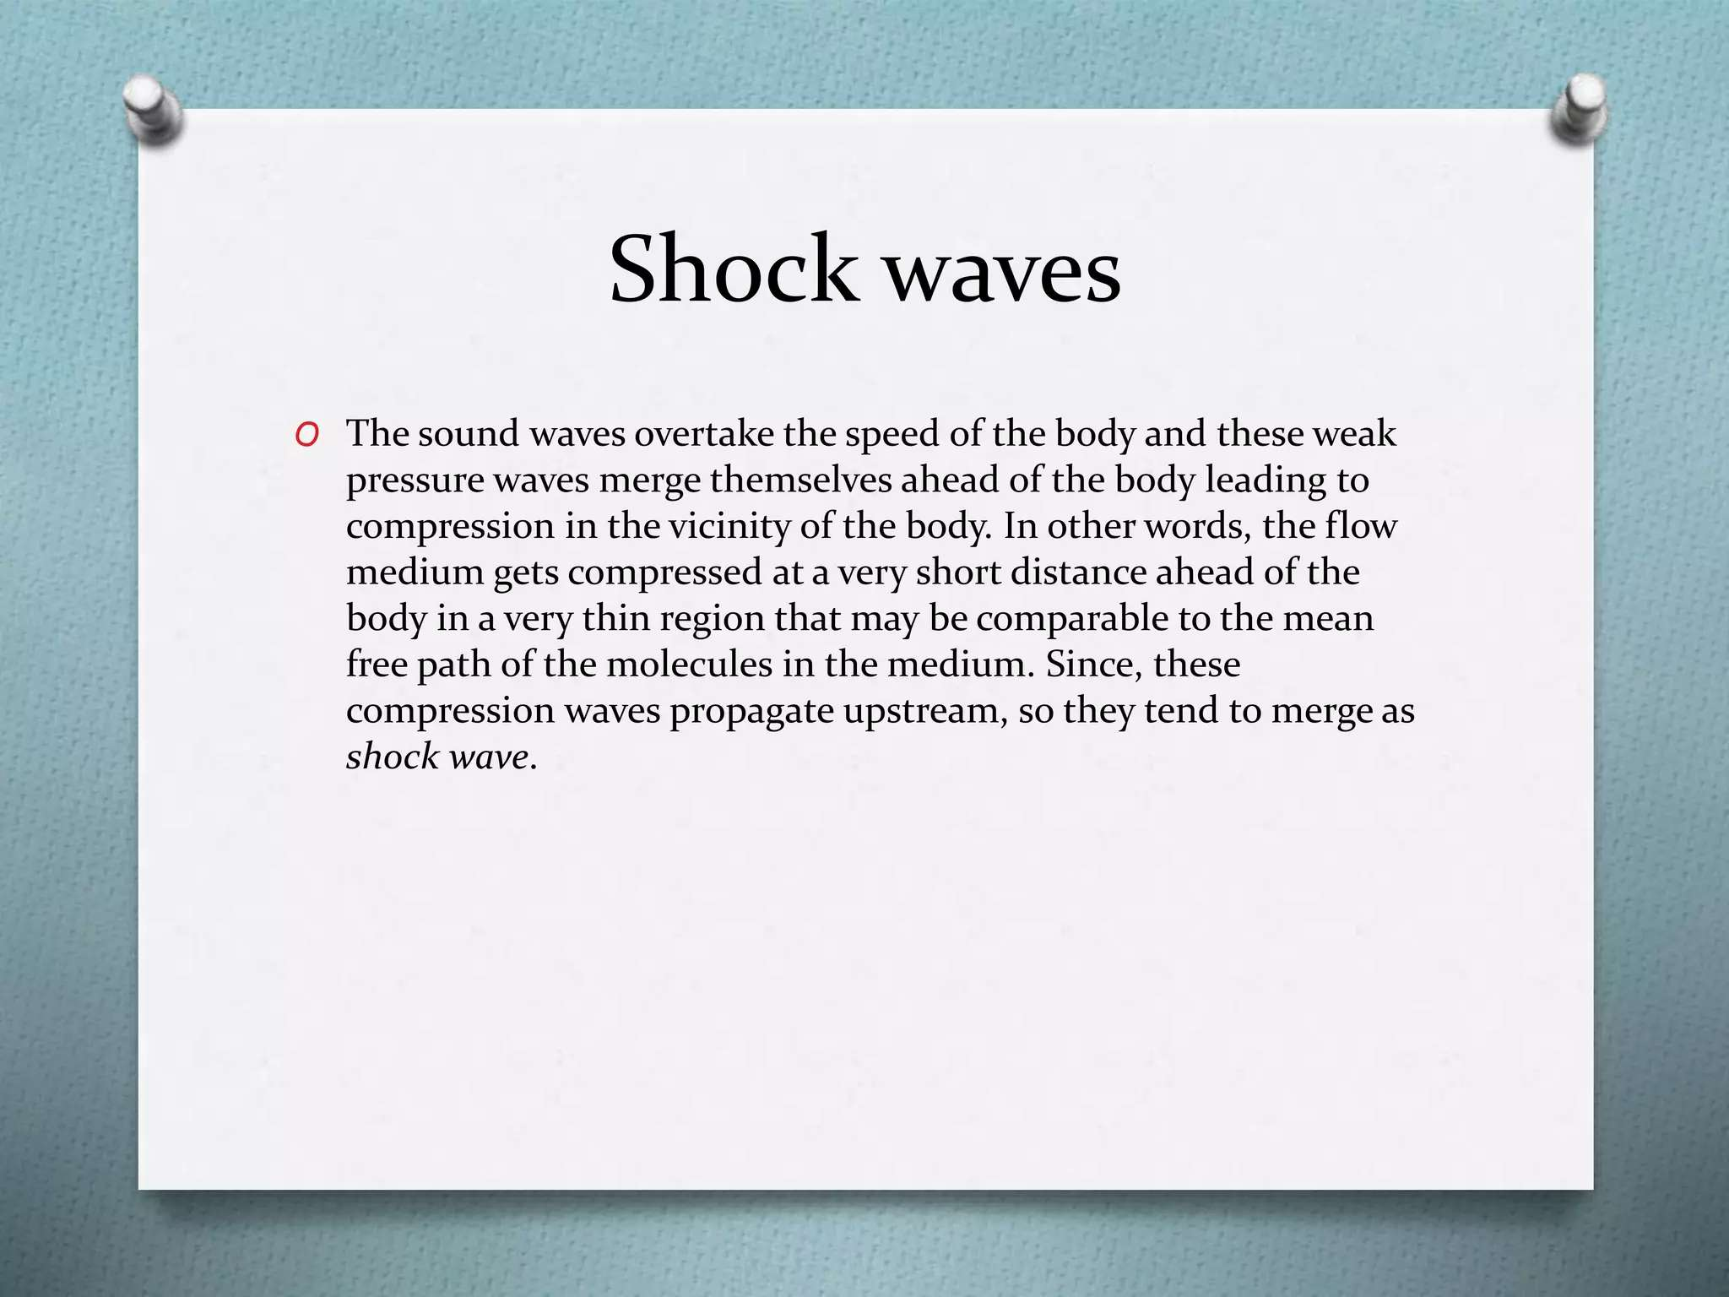

Slide 67
Mathematical Problems on Mach Number
Mathematical problems related to Mach Number will be practiced and solved during classroom sessions. Problems from the prescribed reference book will be addressed, and additional practice materials will be provided to enhance understanding and proficiency.

Slide 68
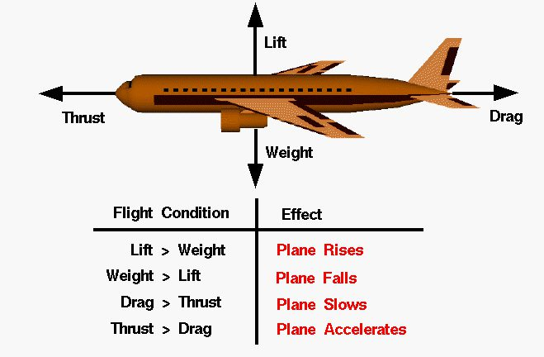
Week -7
Lecture
on
Drag and Lift Force

Slide 69

Drag and Lift Force :
Fluid dynamic forces are due to pressure (normal) and viscous (shear) forces acting on the body surface.
Drag: Force component parallel to flow direction.
Lift: Force component normal to flow direction.

Slide 70

Lift Coefficient, CL
In addition to geometry, Lift force FL is a function of
density ρ and velocity U.
𝐹𝐿
𝐶𝐿 =
Drag coefficient, CL
½ 𝜌𝑈²𝐴
Area A is a reference area: can be frontal area (the are projected on a plane normal to the direction of flow) (drag applications), plan-form area (wing aerodynamics), or wetted-surface area (ship hydrodynamics).

Slide 71


Drag Coefficient, C_{D}.
In addition to geometry, drag force F_{D} is a function of density ρ and
velocity V.
drag coefficient, C_{D}:
Area A is a reference area: can be frontal area (the area projected on a plane normal to the direction of flow) (drag applications), plan-form area (wing aerodynamics), or wetted-surface area (ship hydrodynamics).
For applications such as tapered wings, C_{D} may be a function of span location. For these applications, a local C_{D,x} is introduced and the total drag is determined by integration over the span L

Slide 72
Pressure Coefficient, C_{p}
𝑝 − 𝑝₀
𝐶_{𝑝} = ₁
₂ 𝜌𝑈²
Where ρ density, 𝑝₀ reference pressure and U velocity.

Slide 73
Week -8
Lecture
on
Drag and Lift Force
Problem Solving

Slide 74


Slide 75


Slide 76


Slide 77


Slide 78


Slide 79


Week -9
Lecture
on
Reynolds Number

Slide 80


Slide 81


Slide 82


Slide 83


Slide 84


Slide 85


Slide 86
Week -10
Lecture
on
Reynolds Number
(Problem Solving)

Slide 87


Slide 88


Slide 89


Slide 90


Slide 91


Slide 92

Week -11
Lecture
on
Hydrostatic Pressure

Slide 93


Slide 94


Slide 95


Slide 96


Slide 97


Slide 98
Week -12
Lecture
on
Hydrostatic Pressure
Problem Solving

Slide 99


Slide 100


Slide 101


Slide 102


Slide 103


Slide 104


Slide 105


Slide 106


Slide 107


Slide 108


Slide 109

Week -13
Lecture
on
Open Channel Flow

Slide 110


Slide 111


Slide 112


Slide 113



Slide 114


Slide 115


Slide 116


Slide 117



Slide 118


Slide 119


Slide 120


Slide 121


Slide 122


Slide 123


Slide 124


Slide 125
Week -14
Lecture
on
Open Channel Flow
(Most Economical Sections)

Slide 126


Slide 127


Slide 128


Slide 129


Slide 130


Slide 131


Slide 132


Slide 133


Slide 134


Slide 135

Week -15
Lecture
On
Buoyancy & Stability of Submerged Bodies

Slide 136


Slide 137


Slide 138


Slide 139


Slide 140


Slide 141


Slide 142


Slide 143


Slide 144


Slide 145


Slide 146
Week -16
Lecture
On
Buoyancy & Stability of Submerged Bodies
Problem Solving

Slide 147


Slide 148


Slide 149


Slide 150


Slide 151










Thank You For Your Attention

