Slide 1
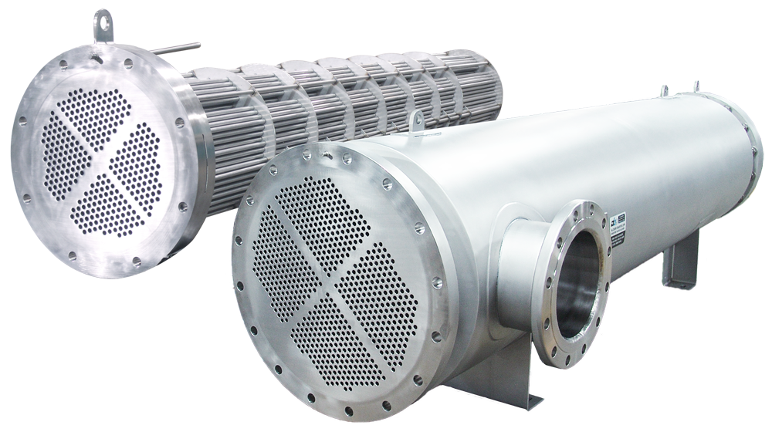
Heat Transfer Equipment
Design
Course Code: ME 307 | CREDIT:03
 | MARKS:150
Mid Exam Hours 2 | CIE MARKS: 90
Semester End Exam Hours 3 | SEE MARKS: 60
Course Teacher: Iftekhar Mahmud

Slide 2
Course Learning Outcomes (CLOs): after completion of this course successfully, the students will be able to……
CLO1 | Describe the basic understanding of thermal system design: Heat transfer requirements: Mechanical design: Design parameters: Materials, cost, and economics
CLO2 | Identify the properties of Optimization: Cyclic service | safety and | reliability: | Choice | and | availability;
CLO3 | Outline the heat transfer from finned surface: Basic fin design, Types of fins: Fin Performance, Efficiency of fins, Equation of heat transfer from fins, Analysis of unsteady heat conduction
CLO4 | Demonstrate the basic thermal design methods of heat exchangers: Types of heat exchangers; Parallel flow, counter flow, cross flow, shell-and-tube, mixed and unmixed, single, and multiple pass, compact heat exchangers
CLO5 | Differentiate essential experience with thermo-fluid characteristics: Sizing of heat exchangers; Fouling of heat exchangers: Performance of heat transfer equipment; the log means temperature difference
CLO6 | Determine the knowledge on Effectiveness-NTU method; F correction factor
CLO7 | Solve essential experience on two-phase heat transfer equipment: Boiler, Evaporator, Condenser, Cooling tower
CLO8 | Create the thermal systems with internal heat source: Modeling of thermal equipment

Slide 3
S. L | Course Content | Hrs | CLOs
1 | Concept of thermal system design: Heat transfer requirements: Mechanical design: Design parameters: Materials, cost, and economics: Safety and reliability: Choice and availability; Optimization: | 6 | CLO1
2 | Cyclic service. Heat transfer from finned surface | 6 | CLO2
3 | Basic fin design, Types of fins: Fin Performance, Efficiency of fins, Equation of heat transfer from fins, Analysis of unsteady heat conduction. Basic thermal design methods of heat exchangers | 5 | CLO3 CLO4
4 | Types of heat exchangers; Parallel flow, counter flow, cross flow, shell-and- tube, mixed and unmixed, single, and multiple pass, compact heat exchangers | 5 | CLO5
5 | Thermo-fluid characteristics: Sizing of heat exchangers; Fouling of heat exchangers: Performance of heat transfer equipment; the log mean temperature difference: Effectiveness-NTU method; F correction factor | 6 | CLO7 CLO6
6 | Two-phase heat transfer equipment: Boiler, Evaporator, Condenser, Cooling tower. Thermal systems with internal heat source: Modeling of thermal equipment. | 6 | CLO8
TEXTBOOKS:
―Heat Exchangers – Thermal Hydraulic Fundamentals and Design‖ by S Kokac.
―Extended Surface Heat Transfer‖ by D Q Kern and A D Kraus.
―Compact Heat Exchangers‖ by W M Kays and A C London.
―Design and Technology of Heat Pipes for Cooling and Heat Exchange‖ by Cal Silverstein.
―Closed Feedwater Heaters for Power Generation: A Working Guide‖ by Stanley Yokell.

Slide 4
ASSESSMENT PATTERN
CIE- Continuous Internal Evaluation (90 Marks)
Bloom's Category Marks (out of 90) | Tests (45) | Assignments (10) | Class Test (20) | Quiz (5) | External Participation in Curricular/Co-Curricular Activities (10)
Remember | 5 |  | 10 | 05
Understand | 5 | 05 | 10
Apply | 10 |  |  |  | 10
Analyze | 15
Evaluate | 10
Create |  | 05

Slide 5
SEE- Semester End Examination (60 Marks)
Bloom's Category | Test
Remember | 10
Understand | 10
Apply | 10
Analyze | 10
Evaluate | 10
Create | 10

Slide 6
Course plan specifying content, CLOs, teaching learning and assessment strategy mapped with CLOs
Week | Topic | Teaching-Learning Strategy | Assessment Strategy | Corresponding CLOs
1 | Concept of thermal system design: Heat transfer requirements: | Lecture, discussion, group work | Quiz, Written Exam | CLO1
2 | Mechanical design: Design parameters: Materials, cost, and economics: Safety and reliability | Oral Presentation, debate | Assignment, Written, Quiz | CLO1
3 | Choice and availability; Optimization: | Video lecture, Field visit | Report writing, Demonstration | CLO1
4 | Basic fin design, Types of fins: Fin Performance | Lecture | Viva, Quiz | CLO1, CLO3
5 | Basic thermal design methods of heat exchangers | Project exhibition | Project, Field visit | CLO1
6 | Types of heat exchangers; Parallel flow, counter flow | Discussion, Video Presentation | Quiz, Written Exam | CLO1
7 | cross flow, shell-and- tube, mixed and unmixed, single | Case-based Learning, Demonstration | Assignment, Written, Quiz | CLO1, CLO4
8 | and multiple pass, compact heat exchangers . | Lecture, discussion, group work | Report writing, Demonstration | CLO3, CLO4
9 | Thermo-fluid characteristics: Sizing of heat exchangers; Fouling of heat exchangers: | Oral Presentation, debate | Viva, Quiz | CLO2
10 | Performance of heat transfer equipment; the log mean | Video lecture | Project, Field visit | CLO2
11 | temperature difference: Effectiveness-NTU method; F correction factor | Lecture | Quiz, Written Exam | CLO5, CLO6
12 | Two-phase heat transfer equipment: Boiler, Evaporator, Condenser, Cooling tower | Project exhibition | Assignment, Written, Quiz | CLO3, CLO6
13 | Thermal systems with internal heat source: Modeling of thermal equipment. | Discussion, Video Presentation | Report writing, Demonstration | CLO1

Slide 7
Week 1

Slide 8
Heat Exchangers
Heat Transfer Basics
Tubular Exchangers
Heat Exchanger Design
Compact Heat Exchangers

Slide 9
Three Mechanisms of Heat Transfer
Conduction
Affects wall resistances, which are usually negligible for heat transfer equipment
Convection
Usually the governing mechanism in most process applications
Radiation
Important in fired heaters
Q = U A ΔT
Q = heat duty
A = area
T = absolute temperature
k = thermal conductivity
U = heat transfer coefficient
σ = Stefan Boltzman const.
ε = transmission factor
Q = A σ ε (ΔT⁴)

Slide 10
Combined Conduction and Convection
L
For a flat plate, overall resistance is the sum of the individual resistances
Hence overall heat transfer coefficient, U is given by
h₁
hot
h₂
cold
k
T
T_{h}
T_{c}
x

Slide 11
Cylindrical Geometry (Tubes)
By convention, U is based on outside diameter
Add terms for fouling:
r_{o}
r_{i}
Outside h.t.c. h_{o} depends strongly on equipment type

Slide 12
Convective Heat Transfer in a Tube
Dittus-Boelter Equation:
(for inside h.t.c. h_{i} based on inside diameter d_{i})
Collect variables:
So if we increase then h_{i} will:
Fluid thermal conductivity, k increase
Fluid heat capacity, C_{p} increase
Fluid density, ρ increase
Velocity, v increase
Fluid viscosity, μ decrease
Pipe diameter, d_{i} decrease
Notes:
I usually run this as a small exercise. Answers reveal in slide show mode
In heat transfer at a boundary (surface) within a fluid, the Nusselt number (Nu) is the ratio of convective to conductive heat transfer across (normal to) the boundary.

Slide 13
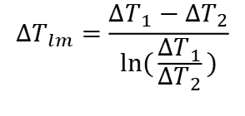
LMTD
q = U_{o}A_{o}ΔT_{lm} = U_{i}A_{i}ΔT_{lm}
(a) Parallel flow (b) Countercurrent flow
$${∆T}_{lm}=\frac{{∆T}_{1}−{∆T}_{2}}{ln(\frac{{∆T}_{1}}{{∆T}_{2}})}$$
For counter flow ΔT₁ = T_{hi} − T_{co} and ΔT₂ = T_{ho} − T_{ci}

Slide 14
Week 2

Slide 15
Heat Exchangers
Heat Transfer Basics
Tubular Exchangers
Heat Exchanger Design
Compact Heat Exchangers

Slide 16
Shell and Tube Heat Exchangers
How do we turn this -
Into this -

Slide 17
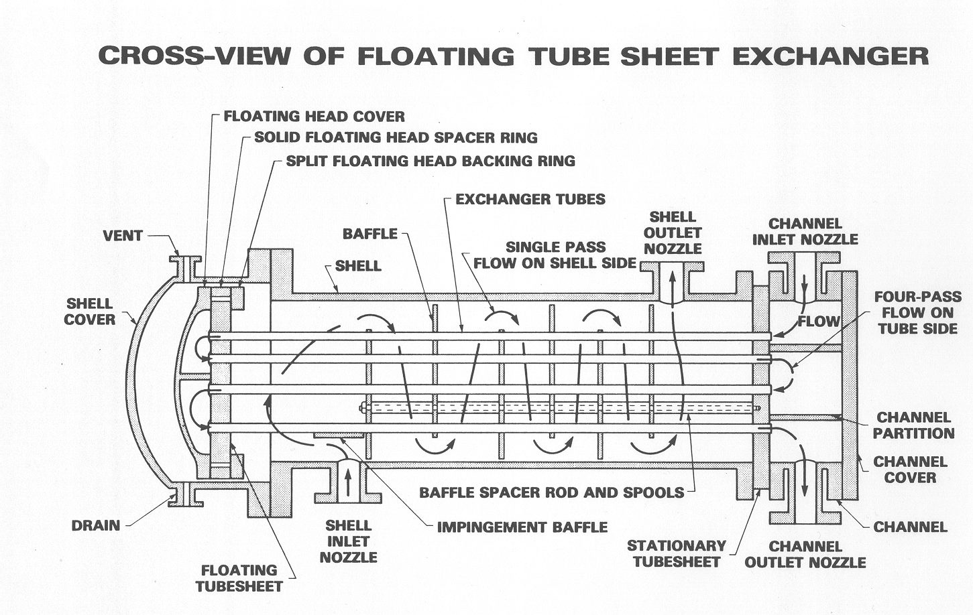
Shell and Tube Heat Exchangers
Source: Perry’s Chemical Engineers Handbook, McGraw-Hill

Slide 18
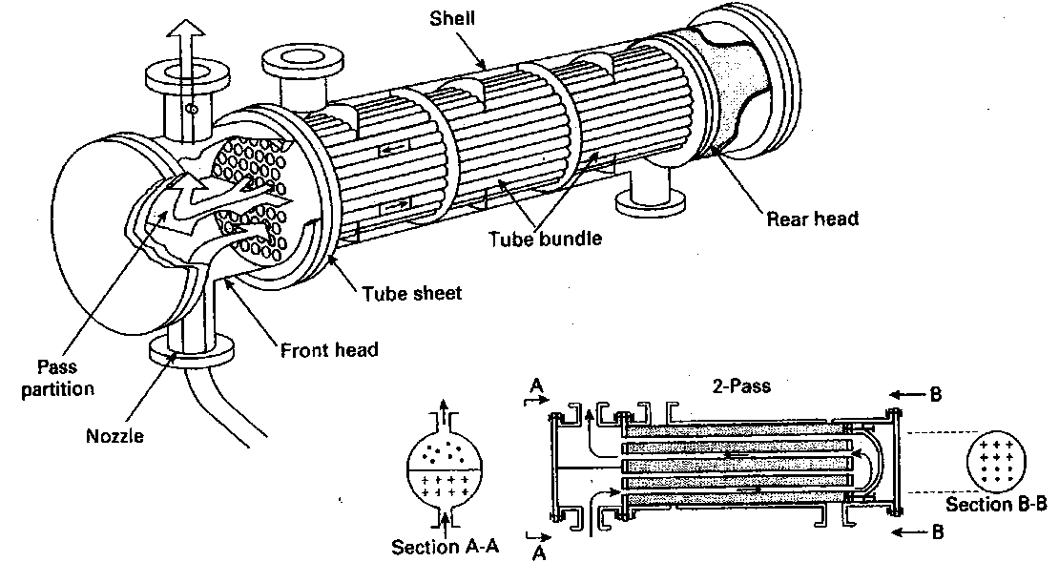
Shell-and-tube heat exchanger with one shell pass and two tube passes

Slide 19
Cross-view of a floating tube sheet exchanger

Slide 20
Baffle
Hold tubes in position (preventing sagging
Prevent the effects of vibration
Direct shell-side fluid flow along tube field. This increases fluid velocity and the effective heat transfer co-efficient of the exchanger

Slide 21
Week 3

Slide 22
Tube Pitch
Triangular or square pitch, each with two orientations
TEMA minimum pitch is 1.25 x tube outside diameter
Sometimes use larger pitch for easier cleaning (but bigger shell, lower shellside h.t.c.)

Slide 23
Exercise: Selection of Sides
Process Fluid | Side Selection | Reason
Fouling fluid | Tube | Easier to clean
Viscous fluid | Shell | Lower Δp
Suspended solids | Tube | No dead spots for settling
Highest T | Tube | Cheaper, mechanically stronger
Highest pressure | Tube | Cheaper, mechanically stronger
Cooling water | Tube | Easier to clean
Corrosive fluid | Tube | Cheaper, easier to replace tubes
Much larger flow | Shell | Lower Δp
Condensing fluid | Shell | Drains better
Notes:
Answers reveal in slide show mode

Slide 24
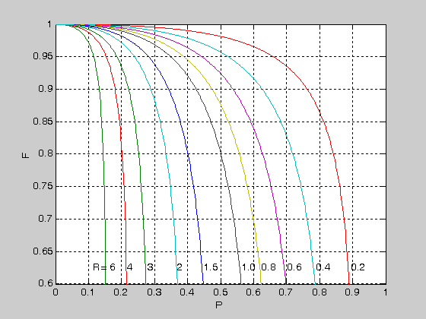
Ft Factor
For heat exchanger geometries such as cross flow and shell and tube heat exchanger, the heat transfer rate is given by
q = U_{o}A_{o}FΔT_{lm} where ΔT_{lm} is based on counter flow
F is the correction factor to account for the configuration in a heat exchanger for which the flow is neither parallel nor counter current. The F factor for cross-flow heat exchangers with both fluids unmixed are shown
F factor - 1 shell pass, 2 tube passes

Slide 25
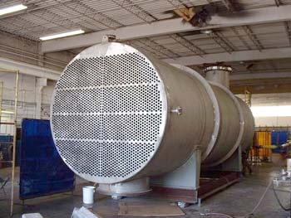
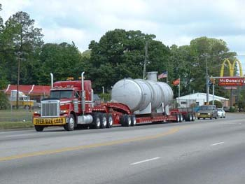
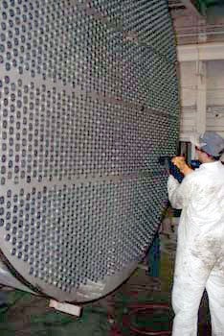
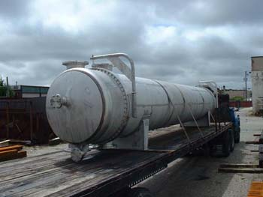
Shell and Tube Exchangers
Source: Riggins Company:
www.rigginscompany.com

Slide 26
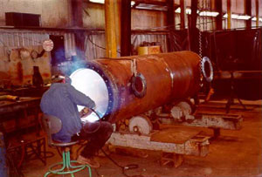
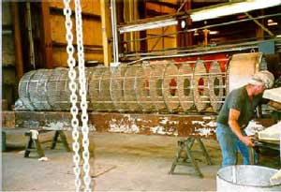
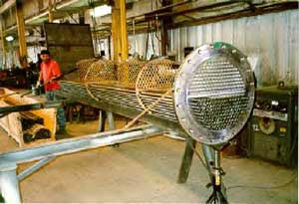
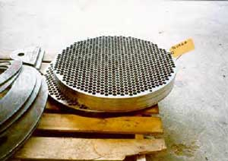
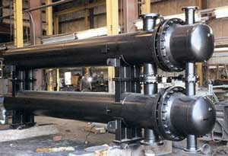
S&T Exchanger Construction
Baffle assembly
Inserting
tubes
Welding the shell
Final
product
Tubesheet
Source: Bos-Hatten Inc.: www.Bos-Hatten.com

Slide 27
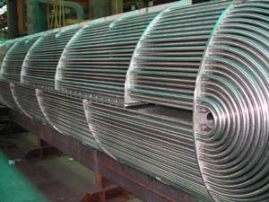
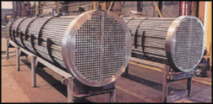
Tube Bundles
U-tubes
Tubesheet
Baffles
Source: UOP
Notes:
https://www.youtube.com/watch?v=G6iyiM-IjrM
https://www.youtube.com/watch?v=EMzne8d-jJs
https://www.youtube.com/watch?v=LDF6gFKl7Gc

Slide 28
Week 4

Slide 29
Heat Exchanger Design
Heat exchange design must:
Provide required area
Contain process pressure
Prevent leaks from shell to tubes or tubes to shell
Allow for thermal expansion
Allow for cleaning if fouling occurs
Allow for phase change (some cases)
Have reasonable pressure drop
S&T heat exchangers are built to standards set by the Tubular Exchanger Manufacturers Association (TEMA)

Slide 30
TEMA Nomenclature: Front Heads
A Type
Easy to open for tubeside access
Extra tube side joint
B Type
Must break piping connections to open exchanger
Single tube side joint
C Type
Channel to tubesheet joint eliminated
Bundle integral with front head
N Type
Fixed tubesheet with removable cover plate
D Type
Special closures for high pressure applications

Slide 31
TEMA Nomenclature: Shells
E Type
Most common configuration without phase change
F Type
Counter current flow obtained. Baffle leakage problems.
G Type
Lower pressure drop
H Type
Horizontal thermosyphon reboilers
J Type
Older reboiler designs
K Type
Phase separation integral to exchanger
X Type
Lowest pressure drop, low F factor

Slide 32
TEMA Nomenclature: Rear Heads
L Type
Same as A type front head
M Type
Same as B type front head
N Type
Same as N type front head
P & W Types
Rarely used
S Type
Floating head with backing ring
T Type
Floating head pulls through shell
U Type
Removable bundle without floating head

Slide 33
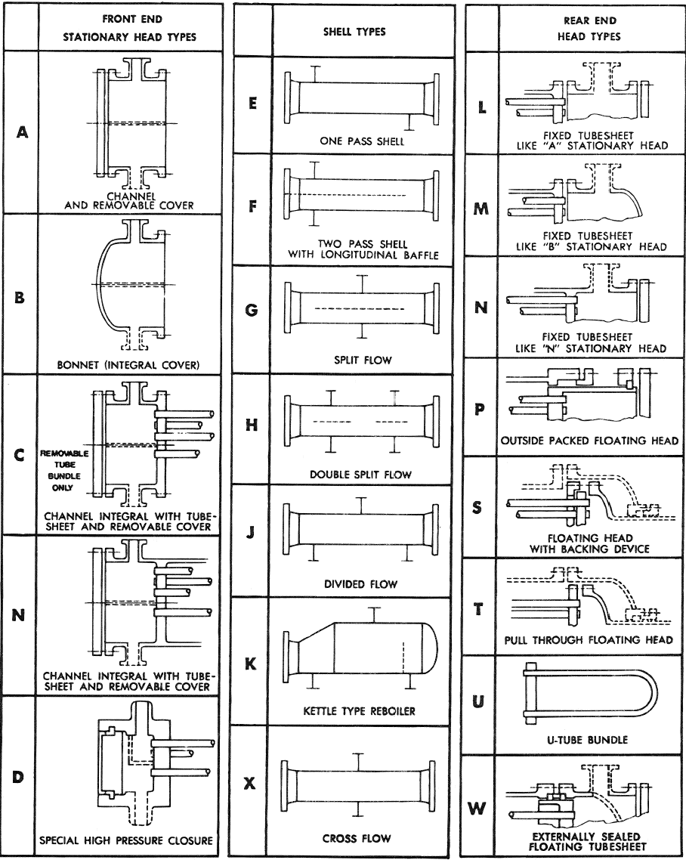

Slide 34
Selection of Exchanger Type: Examples
1) Feed preheater
Low pressure
Tubeside - Steam
Shellside – Naphtha
2) Crude preheat train
Low pressure
Tubeside – Vacuum Residue
Shellside – Crude oil
BEU
AES or AET
3) Reboiler
Medium pressure
Tubeside - Steam
Shellside - Kerosene
4) Sterilizer Preheat
Low pressure
Tubeside - Milk
Shellside - Steam
BKU or BHM
AET
Notes:
Answers reveal in slide show mode

Slide 35
Week 5

Slide 36
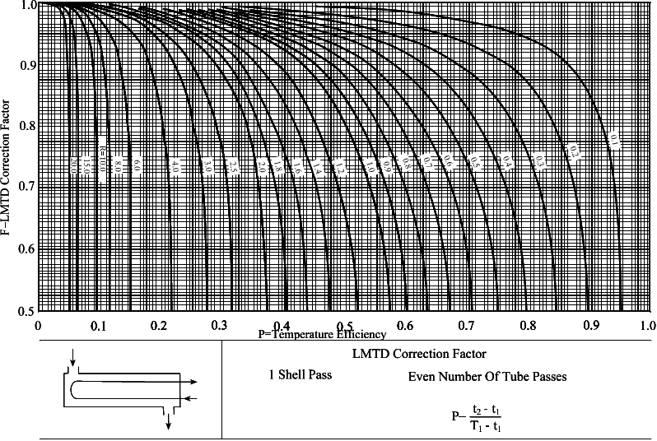
Lmtd Correction Factors
E Shell - 1 Shell Pass: Similar correlations exist for other shell arrangements
Source: Perry’s Chemical Engineers Handbook, McGraw-Hill
T₁
t₂
t₁
R = (T₁ - T₂)
T₂
(t₂ – t₁)

Slide 37
Temperature Cross
When T_{h, out} < T_{c, out} we have a “temperature cross”
Temperature cross causes problems if exchanger is not counter-current and gives low F factors
If T_{c,out} – T_{h,out} > 5% of Lmtd then F < 0.8 and it is usually best to split the exchanger into multiple shells in series
Number of shells can be estimated by stepping off on T-H diagram
T
Duty, or Enthalpy, H
T
Note:
Real exchangers can have non-constant C_{p}
Size & duty of HX in series is not necessarily the same
Large number of shells in series approximates pure counter-current exchange
H

Slide 38
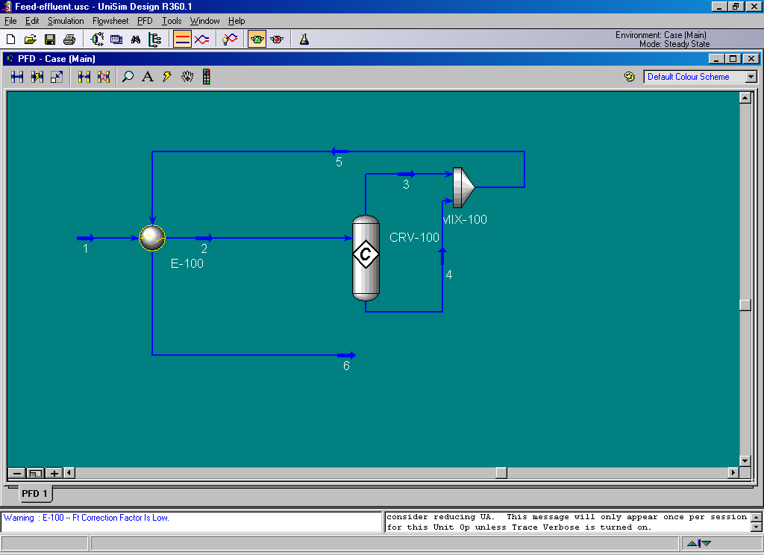
Temperature Cross in Simulation
Most simulators show an error if there is a low F factor
For example, in UniSim Design the exchanger shows up yellow

Slide 39
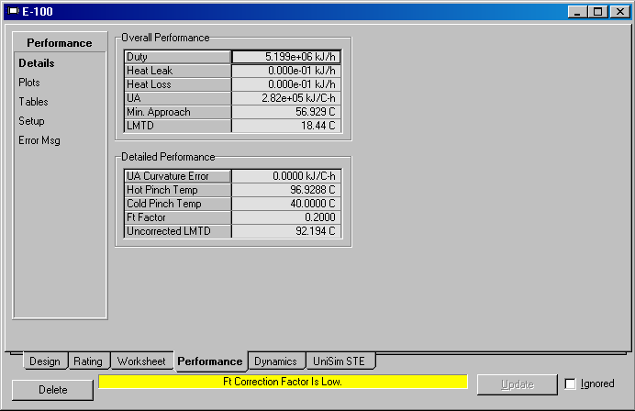
Temperature Cross in Simulation
Opening the exchanger shows the low F factor

Slide 40
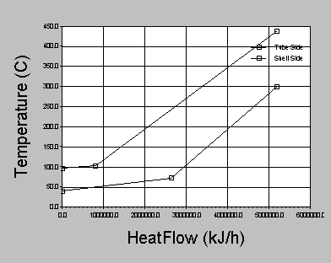
Temperature Cross in Simulation
Can use the “plots” tab to plot temperature against heat flow and visualize the temperature cross

Slide 41
Temperature Cross in Simulation
3
2
1
Stepping off between profiles suggests we need three exchangers and gives target inlet and outlet temperatures

Slide 42
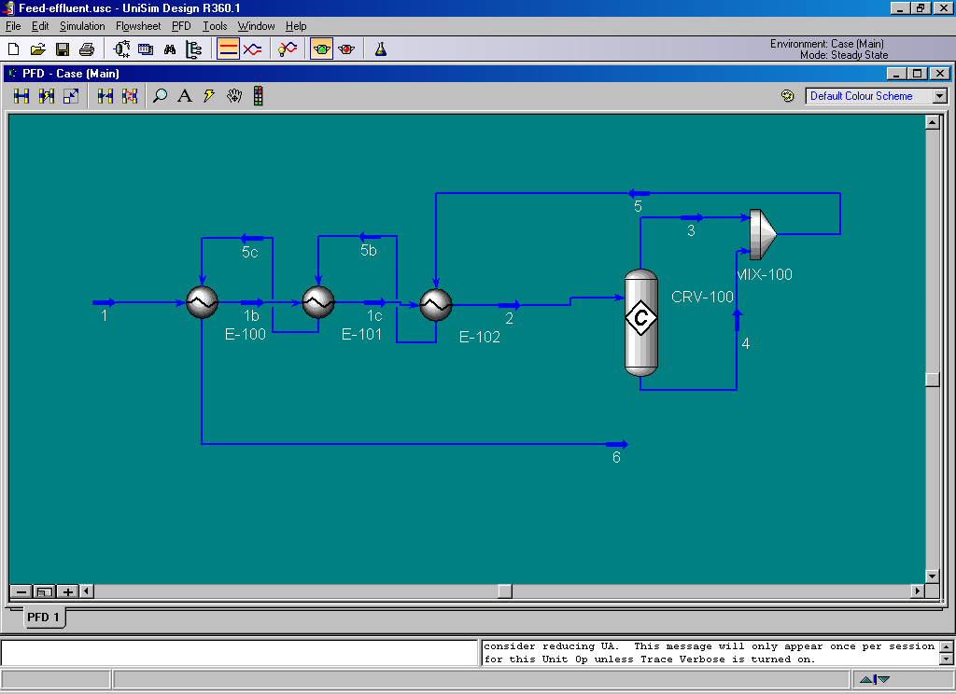
New design with temperature cross eliminated

Slide 43
Week 6

Slide 44
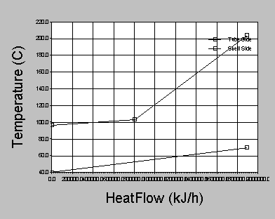
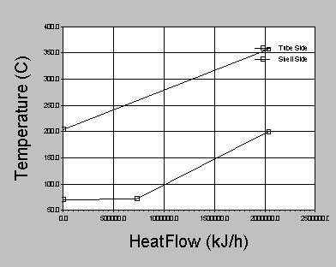
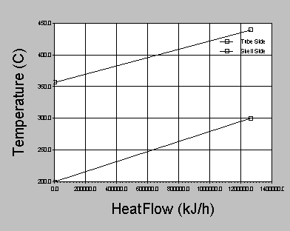
Profiles for the New Exchangers
(a) E100
(b) E101
(c) E102

Slide 45
Heat Exchangers
Heat Transfer Basics
Tubular Exchangers
Heat Exchanger Design
Compact Heat Exchangers

Slide 46
Heat Exchanger Design
Determine duty, check for temp cross
Estimate U and hence calculate area
Determine exchanger type and tube layout
Pick d, L and calculate number of tubes, hence shell diameter
Calculate h_{i}, h_{o} and confirm U. Return to 2 if needed.
Calculate Δp. Return to 3 if needed.
Q = (m C_{p} ΔT) + (δm ΔH_{vap})
Q = U A F ΔT_{lm}

Slide 47
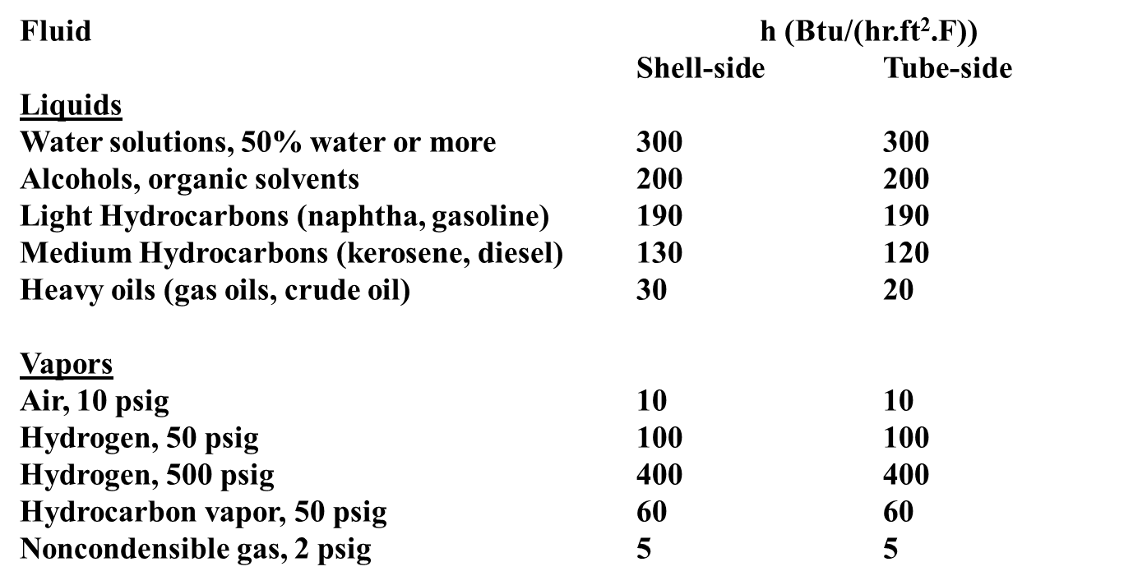
Approximate Heat Transfer Coefficients
Note: Coefficients are based on 3/4 inch diameter tubes. For Tube side flows, correct by multiplying by 0.75/Actual OD. Estimated accuracy is 25%. For 50% hydrogen in vapor, reduce h to 2/3 of pure H₂ value.

Slide 48
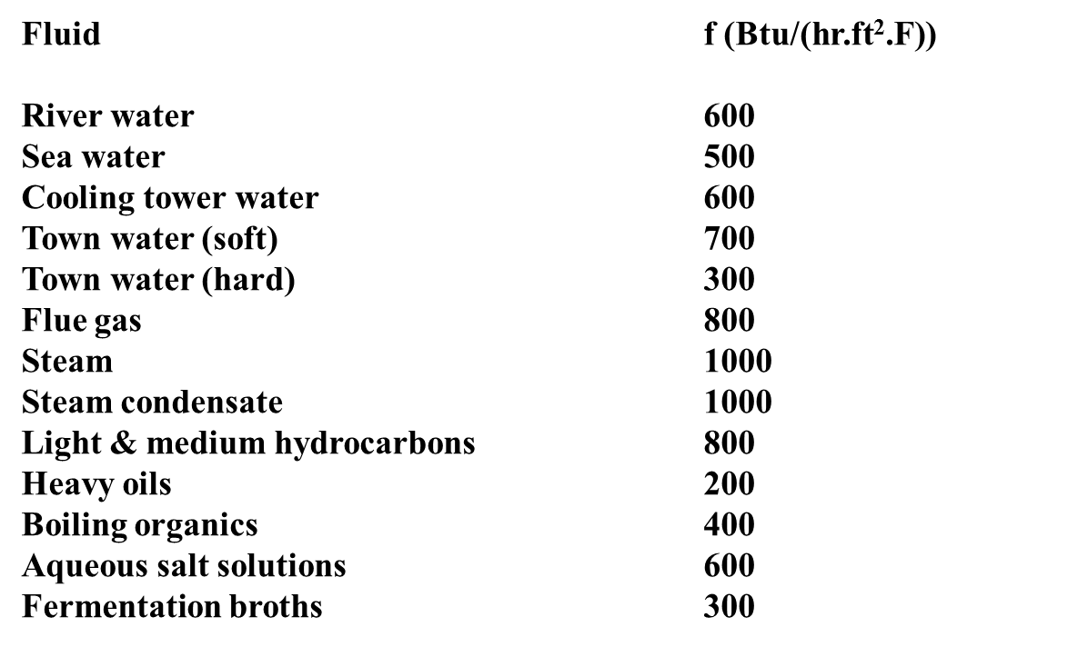
Approximate Fouling Factors

Slide 50
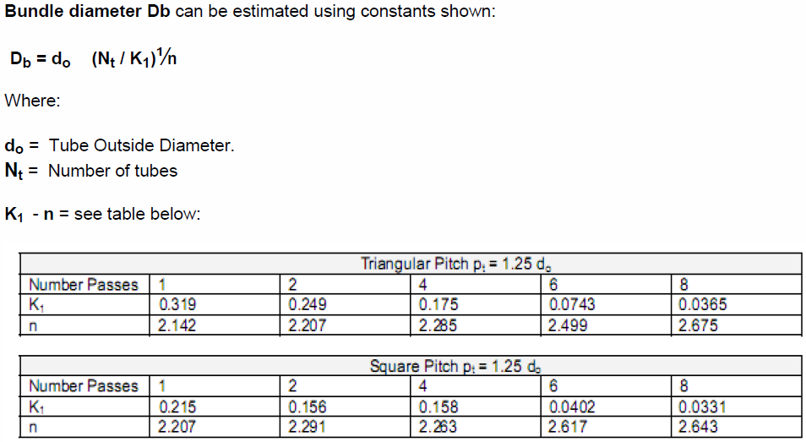
Estimate Shell D on Tube OD + # Tube

Slide 51
Example: S&T HX Design
What size of exchanger is needed to heat 375,000 lb/h of naphtha from 150F to 300F using medium pressure steam at 360F? Heat capacity = 0.5 BTU/lb°F. Steam h = 1500 Btu/hr-ft2-F
Q = m.C_{p}.ΔT = 375 x 10³ x 0.5 x 150 = 28.125 MMBtu/h
Put steam shell-side, oil tube-side, TEMA BEU
Estimate h_{i} = 190 Btu/(h.ft².F), h_{o} = 1500 Btu/(h.ft².F)
Estimate f_{i} = 400 Btu/(h.ft².F), f_{o} = 1000 Btu/(h.ft².F)
Estimate 1/U = 1/190 + 1/400 + 1/1000 + 1/1500
U = 106 Btu/(h.ft².F)
R ≈ 0 (negligible ΔT on shell-side) so F = 1.0
Lmtd = (60 – 210)/ln(60/210) = 119.7°F
Hence A = Q/U.F.Lmtd = 28.1 x 10⁶ / (106 x 1.0 x 119.7) = 2215 ft²
For 20’ long 3/4” tubes area/tube = 3.9 ft², hence need 564 tubes
From table in Perry’s Hbk, 1” triangular pitch TEMA U, nearest shell size is 29” i.d., with 648 tube count.
Notes:
Answer reveals in slide show mode. This can also be run as an exercise.

Slide 52
Week 7

Slide 53
Shell Heat Transfer Coefficient Calculation
Clearance between tube = pitch – OD
Baffle spacing = length / (No. of Baffle +1)

Slide 54
Tube Heat Transfer Coefficient and U Calculation
Check calculated U and assumed U. Iterate procedure if necessary.

Slide 55
Hydraulics & Pressure Drop
Heat exchanger design is a trade off between better heat transfer (high velocity, low diameter) and pressure drop
In early stages of design, we usually allow for a “typical” pressure drop:
5 psi shell-side
10 psi tube-side
But we have to calculate Δp rigorously where it is critical to performance, e.g. thermosyphon reboilers
In detailed design, use correlations or simulation programs to more rigorously optimize if pressure drop is important to process performance

Slide 56
Tube Side Pressure Drop Calculation

Slide 57
Shell Side Pressure Drop Calculation

Slide 58
Week 8

Slide 59
Example 2:
Please write down your procedure.

Slide 60
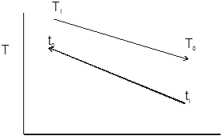
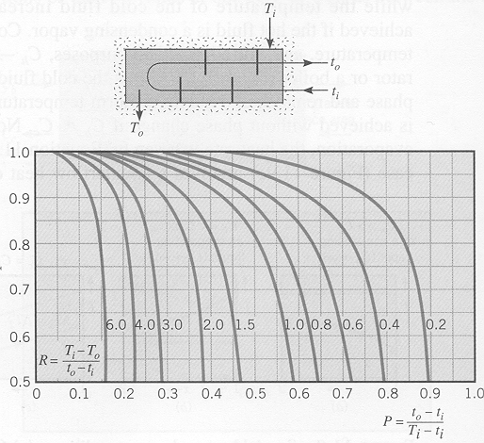
Example 2 Solution

Slide 61
Example 2 Solution

Slide 62
Example 2 Solution

Slide 63
Example 2 Solution

Slide 64
Example 2 Solution

Slide 65
Example 2 Solution

Slide 66
Example 2 Solution

Slide 67
Week 9

Slide 68
Heat Exchangers
Heat Transfer Basics
Tubular Exchangers
Heat Exchanger Design
Compact Heat Exchangers

Slide 69
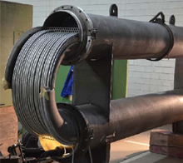
Hairpin Exchangers
When small duties are required, hairpin exchangers are specified:
cheaper than very small shell and tube
highly effective (single pass, true countercurrent)
75 → 1500 ft² surface area
4 → 16" shell diameter, 20 ft long
This design is used for double-pipe and multi-tube exchangers.

Slide 70
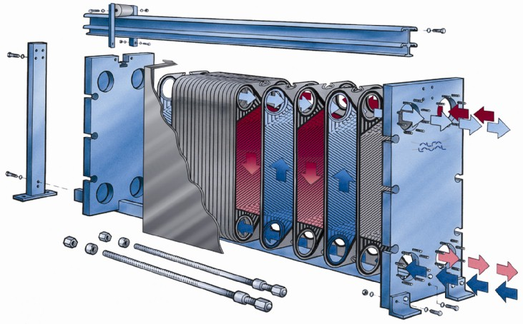
Plate & Frame Exchangers
Plates
Gasket
Source: Alfa-Laval, www.AlfaLaval.com

Slide 71
Gasket Layout of Alternating Plates

Slide 72
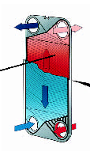
Plate & Frame Exchangers
Advantages
Close to counter-current heat transfer, so high F factor allows temperature cross and close temperature approach
Easy to add area
Compact size
Relatively inexpensive for high alloy
Can be designed for quick cleaning in place
Disadvantages
Lots of gaskets
Lower design pressure, temperature
External leakage if gaskets fail
Applications
Food processing, brewing, biochemicals, etc.
Source: Alfa-Laval
Source: Alfa-Laval, www.AlfaLaval.com

Slide 73
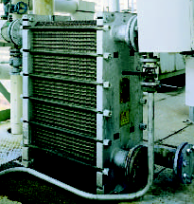
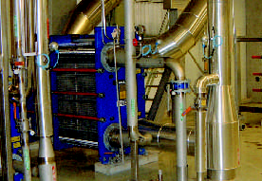
Plate & Frame Exchangers
Source: Alfa-Laval
Source: Alfa-Laval, www.AlfaLaval.com

Slide 74
Week 10

Slide 75
Welded Plate Heat Exchangers
Advantages
Higher thermal efficiency
Single unit can replace multiple shell & tube units
Closer approach to hot inlet temperature
Low pressure drop
Little chance of vibration problems
Excellent distribution of two phase flows
Disadvantages
Single alloy material for plates
Difficult to clean
Few manufacturers at large scale (Alfa Laval Packinox)
Used in large scale clean services that need close temperature approach
Source: Alfa-Laval Packinox

Slide 76
A heat exchanger is to be designed to cool 10 kg/s an engine oil from 360 K to 300 K with cooling water entering the tube side at 290 K at a rate of 15 kg/s.
Given, U_{o} = 500 W/m^{2 o} C. Estimate heat transfer area, for:
parallel flow DPHX
counter flow DPHX
one shell pass and two tube pass STHX
cross-flow, both fluids unmixed CFHX
cross-flow, one fluid unmixed CFHX
2.A cross-flow recuperator (common heat exchanger for gas turbines) with both fluids unmixed is to be designed under a set of conditions and to be operated under different conditions. The hot exhaust gases flow through the tubes, and the cold intake air flow across these tubes. The wall thickness of the tubes is negligible. The heat exchanger do be designed with mass flow rates m_ _{h} = m_ = 10 kg/s, heat transfer coefficients h_{h} = h = 150 W/m² K, and three end temperatures T_{hi} = 425º C, T _{i} = 25º C, and T _{o} = 210º C. We wish to determine:
the heat transfer area of the heat exchanger, and
the new outlet temperatures after doubling the flow of (1) the hot fluid, (2) the cold fluid, while maintaining the same inlet temperatures.

Slide 77
Week 11

Slide 78
A heat exchanger (condenser) using steam from the exhaust of a turbine at a pressure of 4.0-in. Hg abs. is to be used to heat 11500 kg/h of water from 15.6º C to 43.3º C. The exchanger is to be sized for one shell pass and four tube passes with 60 parallel tube circuits of 0.995-in.-ID and 1.125-in.-OD brass tubing (k = 104 W/mK). For the clean exchanger the average heat transfer coefficients at the steam and water sides are estimated to be 3400 and 1700 W/m² K, respectively. Calculate the tube length required for long-term service.
Hot oil is to be cooled by water in a 1-shell-pass and 8-tube-passes heat exchanger. The tubes are thin-walled and are made of copper with an internal diameter of
1.4 cm. The length of each tube pass in the heat exchanger is 5 m, and the overall heat transfer coefficient is 310 W/m² K. Water flows through the tubes at a rate of
0.2 kg/s, and the oil through the shell at a rate of 0.3 kg/s. The water and the oil enter at temperatures of 20º C and 150º C, respectively. Determine the rate of heat transfer in the heat exchanger and the outlet temperatures of the water and the oil.

Slide 79
Water is use to cool ethylene glycol in a 18.3-m long double pipe heat exchanger made of 4-std and 2-std (both type M) copper tubing. The water inlet temperature is 15.6º C and ethylene glycol inlet temperature is 82.2º C.
The flow rate of ethylene glycol is 9.0 kg/s, while that for water is 14.0 kg/s. Cal- culate the expected outlet temperature of the ethylene glycol and the pressure drop expected for both streams. Assume counter-flow, and place the ethylene glycol in the inner tube.
Reverse the direction of either fluid, and repeat the calculation for parallel flow.
Repeat calculation by placing water in the pipe and ethylene glycol in the annulus.
A plate and frame heat exchanger is used to exchange heat in a water-to-water flow system. Hot water enters the exchanger at 32.2º C with a flow rate of 0.0126 m³ /s. Cold water also at 0.0126 m³ /s enters the exchanger at 12.8º C. The exchanger contains 27 plates. The plate spacing is 5.08 mm, the plate material is stainless steel, the plate thickness is 1.016 mm, the plate width is 381 mm, the plate height is 0.914 m. Determine the outlet temperatures of the both the fluids.

Slide 80
Week 12

Slide 81
7.Water enters a cross-flow heat exchanger at a temperature of 85º C and a flow rate of 2.5 kg/s. Air enters the exchanger at 20º C, leaves at 40º C, and has a flow rate of 12 kg/s. Which type of cross-flow heat exchanger will have the greater effectiveness
- mixed-unmixed or unmixed-unmixed? Does it make a difference which fluid is mixed?
A bank of four diesel engines is used with alternators for the generation of electricity. The exhaust from the engines is discharged to the atmosphere. It is proposed to use all or part of the exhaust for heating air, which can then be used for space heating to reduce costs. From measurements of velocity, it is determined that the mass flow rate of exhaust available from the engines is 90 kg/hr. The exhaust-gas temperature is 600 K. The air is available at 20º C and is not of much use unless it can be heated to at least 80º C at a mass flow rate of 100 kg/hr. There are a number of 4 x 3 double-pipe exchangers that are 2 m long and made of type K copper tubing with compression fittings. Determine (a) how many of them are required,
(b) the overall coefficient of (all) the exchanger(s), and (c) the pressure drop for each stream. Assume that, diesel exhaust has the same properties as carbon dioxide gas.

Slide 82
Water at a flow rate of 5,000 kg/h will be heated from 20º C to 35º C by hot water at 140º C. A 15º C hot water temperature drop is allowed. A number of 3.5 m hairpins of 3 in. (ID = 0.0779 m) by 2 in. (ID = 0.0525 m, OD = 0.0603 m) counterflow double- pipe heat exchangers with annuli and pipes, each connected in series, will be used. Hot water flows through the inner tube. Fouling factors are: Rf_{i} = 0.000176 m² K/W, Rf_{o} = 0.000352 m² K/W. Assume that the pipe is made of carbon steel (k = 54 W/mK). The heat exchanger is insulated against heat losses.
Calculate the number of hairpins.
Calculate the pressure drops.
Steam at a saturation temperature of 100º C is condensing in a bundle of 320 tubes within a 0.56 m wide duct. The tubes are arranged in a square, in-line pitch (p = 35.0 mm). The bundle is made of up to 20 rows of tubes with 3 cm OD and with 16 tubes in each row. The tube wall temperature in each row is kept constant at 93º C. The steam flows downward in the bundle, and at the 6th row of tubes, the local mass flow rate of vapour is 14.0 kg/s. Find the average heat transfer coefficient.

Slide 83
Week 13

Slide 84
Design a shell-and-tube heat exchanger to be used as a engine oil cooler. 120 kg/s of oil enters the shell side of the heat exchanger at 102º C and leaves at 65º C. The coolant to be used is city water entering the tube side at 21º C with a flow rate of 65 kg/s. Shell-side pressure drop is limited to 150 kPa.
Consider the following data to design a water-cooled, shell-and-tube Freon condenser for the given heat duty:
Cooling load of the condenser: 125 kW
Refrigerant: R-134a
Condensing temperature, 37º C
In-tube condensation
Coolant: City water
Inlet temperature: 18º C
Outlet temperature: 26º C
Mean pressure: 0.4 MPa
Heat transfer matrix: 3/4 inch OD 20 BWG
Copper tubes

Slide 85
20. One counter-flow heat exchanger functions as a boiler. Water enters with mass flow rate of 0.01 kg/s and temperature 30º C. The water flows through the heat exchanger at constant pressure of 30 bar. The combustion gas used to heat the water enters at 400º C and flows at atmospheric pressure constant pressure with mass flow rate of 0.10 kg/s. The specific heat capacity of the combustion gas is approximately constant and equal to 1000 J/kg-K. Assuming the required pinch temperature = 5
2º C, estimate the steam generation rate and steam exit temperature. Recalculate the values for steam pressures of 1 bar and 10 bar.

Slide 86
Questions ?

Slide 87
Thank you for your kind attention
Prepared By
Iftekhar Mahmud
Lecturer
Department of Mechanical Engineering
University of Global Village (UGV), Barishal

