Slide 1

Manufacturing Process
Course Code: ME 2291 | CREDIT:03
 | TOTAL MARKS:150
Mid Exam Hours 2 | CIE MARKS: 90
Semester End Exam Hours 3 | SEE MARKS: 60
Course Teacher: Iftekhar Mahmud

Slide 2
Course Learning Outcomes (CLOs): After completing this course successfully, the students will be able to-
CLO 1 CLO 2 | Discuss in detail the processes of manufacturing of metallic and plastic parts Compare between different types of metal forming processes and differentiate between their output product characteristics
CLO 3 | Describe different types of joining processes and introduce the concept of sustainable manufacturing
CLO 4 | Contribute positively at the individual as well as team level

Slide 3
SL | Content of Course | Hrs | CLOs
1 | Rolling; rolled products, rolling types: flat, shape, thread, gear, ring rolling, and rolling mill configurations. Forging; open die, impression die, press, upset, roll, net shape, isothermal forging and swaging. Extrusion; solid & hollow shapes, direct & indirect, hot & cold, continuous & discrete, impact extrusion, hydrostatic. | 8 | CLO1
2 | Sand Casting: Introduction: Sand casting, molding, heating and pouring, solidification and cooling. Pattern: making, material, types, construction, pattern allowances. Core: making, types, sand conditioning, testing of sand, molding process, tools and equipment, molding machines, different types of casting, cleaning and finishing of castings, inspection of castings. | 8 | CLO1, CLO3
3 | Welding Processes: Classification, Fusion welding and its types such as oxyfuel gas welding and oxygen torch cutting, arc welding (shielded metal, flux cored, gas metal, submerged, gas tungsten, plasma, stud welding, Arc cutting), resistance welding (spot, seam and projection. Heating, pressure, current control and power supply for resistance welding). Solid state welding and its types including diffusion welding, friction welding and ultrasonic welding. | 9 | CLO2, CLO3
4 | Fabrication of Plastics: Casting, Blow molding and its types, Compression molding, Transfer molding, Cold molding, Injection molding: injection molding machine, mold design and construction, types of mold, cooling and ejection of mold, Reaction injection molding, Welding of plastics | 9 | CLO4

Slide 4
Course plan specifying content, CLOs, teaching learning and assessment strategy mapped with CLOs
Week | Topic | Teaching-Learning Strategy | Assessment Strategy | Corresponding CLOs
1 | rolled products, rolling types: flat, shape, | Lecture, discussion, group work | Quiz, Written Exam | CLO1
2 | thread, gear, ring rolling, and rolling mill configurations. | Oral Presentation, debate | Assignment, Written, Quiz | CLO1
3 | Forging; open die, impression die, press, upset, roll, net shape, isothermal forging and swaging | Video lecture, Field visit | Report writing, Demonstration | CLO1
4 | Extrusion; solid & hollow shapes, direct & indirect, hot & cold, continuous & discrete, impact extrusion, hydrostatic | Lecture | Viva, Quiz | CLO1, CLO3
5 | Sand casting, molding, heating and pouring, solidification and cooling. Pattern: making | Project exhibition | Project, Field visit | CLO1
6 | material, types, construction, pattern allowances. | Discussion, Video Presentation | Quiz, Written Exam | CLO1
7 | Core: making, types, sand conditioning, testing of sand, molding process, tools and equipment, molding machines | Case-based Learning, Demonstration | Assignment, Written, Quiz | CLO1, CLO4
8 | ,different types of casting, cleaning and finishing of castings, inspection of castings. | Lecture, discussion, group work | Report writing, Demonstration | CLO3, CLO4
9 | Welding Processes: Classification, Fusion welding and its types such as oxyfuel gas welding and oxygen torch cutting, | Oral Presentation, debate | Viva, Quiz | CLO2
10 | arc welding (shielded metal, flux cored, gas metal, submerged, gas tungsten, plasma, stud welding, Arc | Video lecture | Project, Field visit | CLO2
11 | resistance welding (spot, seam and projection. Heating, pressure, current control and power supply for resistance welding). | Lecture | Quiz, Written Exam | CLO3, CLO4
12 | Solid state welding and its types including diffusion welding | Project exhibition | Assignment, Written, Quiz | CLO3, CLO3
13 | friction welding and ultrasonic welding. | Discussion, Video Presentation | Report writing, Demonstration | CLO1
14 | Fabrication of Plastics: Casting, Blow molding and its types, | Case-based Learning, Demonstration | Viva, Quiz | CLO1
15 | Compression molding, Transfer molding, Cold molding, | Lecture, discussion, group work | Project, Field visit | CLO3, CLO4
16 | mold design and construction, types of mold, | Oral Presentation, debate | Quiz, Written Exam | CLO3, CLO4

Slide 5
ASSESSMENT PATTERN
CIE- Continuous Internal Evaluation (90 Marks)
Bloom's Category Marks (out of 90) | Tests (45) | Assignments (10) | Class Test (20) | Quiz (5) | External Participation in Curricular/Co-Curricular Activities (10)
Remember | 5 |  | 10 | 05
Understand | 5 | 05 | 10
Apply | 10 |  |  |  | 10
Analyze | 15
Evaluate | 10
Create |  | 05

Slide 6
SEE- Semester End Examination (60 Marks)
Bloom's Category | Test
Remember | 10
Understand | 10
Apply | 10
Analyze | 10
Evaluate | 10
Create | 10

Slide 7
Week 1

Slide 8
Rolling

Slide 9
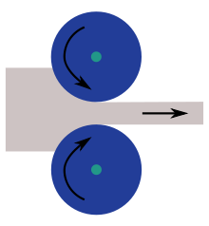
In metalworking, rolling is a metal forming process in which metal stock is passed through a pair of rolls.

Slide 10
Definition of Rolling : The process of plastically deforming metal by passing it between rolls.
Rolling is the most widely used forming process, which provides high production and close control of final product.
The metal is subjected to high compressive stresses as a result of the friction between the rolls and the metal surface.

Slide 11
Classification of Rolling Process
i) Hot Rolling
ii) Cold Rolling
iii) Powder Rolling

Slide 12
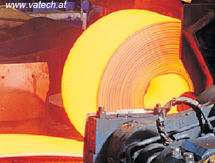
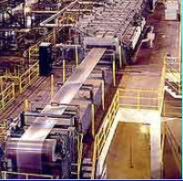
Hot Rolling:
Hot working ---- above the re-crystallization temperature
It is employed whee large reduction in cross-sectional area is required.
Used for bars, rods, rails etc.
Cold Rolling:
Cold working ---- below the re-crystallization temperature
Employed for finishing the metal to given specification of sizes and surface quality.
Produces sheets, strips and foils with good surface finish and increased mechanical strength.

Slide 13
Powder Rolling:
Metal powder is introduced between the rolls and turned into a “green strip” which is subsequently sintered to high density.
This produces a tough sheet with very fine grain size or minimum of preferred orientation.

Slide 14
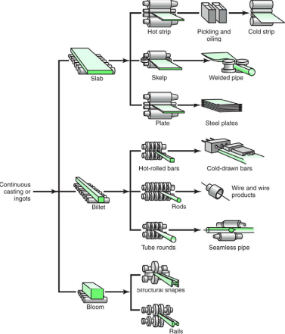
Schematic outline of various process

Slide 15
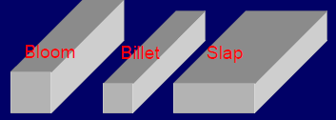


Terminology
Semi finished products
Bloom is the product of first breakdown of ingot (cross sectional area > 230 cm² )
Billet is the product obtained from a further reduction by hot rolling ( cross sectional area > 40x40 mm² )
Slab is the hot rolled ingot ( cross sectional area > 100 cm² and width > 2 x thickness )
Mill products
Plate is the product with a thickness > 6mm
Sheet is the product with a thickness < 6mm and width > 600mm
Strip is the product with a thickness <6mm and width < 600mm

Slide 16
Rolling Process:
In the process of rolling the billet is fed from one side into the rolls and reduces in thickness according to the section and gap between the rolls.
The reduction ratios have maximum allowable values for different metals beyond which reduction is not practicable in a single process.
Rolling sets in series may be employed.
** There are fundamentally two types of rolls:
    Supporting rolls
    Driving rolls
** the rolls must be rigid or the rolled material will have a loop like shape.

Slide 17
ROLLING MILLS:
A rolling mill consists basically of rolls, bearings, a housing for containing these parts, and a drive for applying power to the rolls and controlling there speeds.
Rolling mills can be conventionally classified with respect to the number and arrangement of the rolls.
Classification of rolling mills:
    Two-high mills
    Two-high reversing mills
    Three-high mills
    Four-high mills
    Cluster mills
    Continuous mills
    Planetary mills

Slide 18
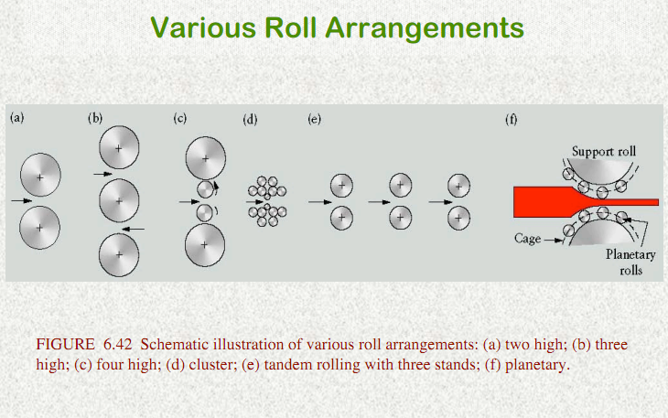

Slide 19
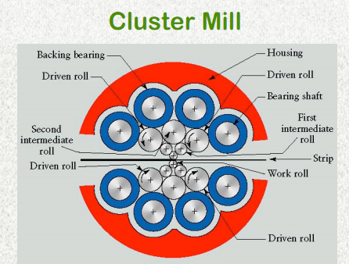

Slide 20

Continuous rolling
Use a series of rolling mill and each set is called a stand.
The strip will be moving at different velocities at each stage in the mill.
The speed of each set of rolls is synchronised so that the input speed of each stand is equal to the output speed of preceding stand.
The uncoiler and windup reel not only feed the stock into the rolls and coiling up the final product but also provide back tension and front tension to the strip.

Slide 21
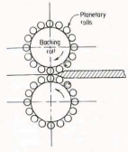
Planetary mill
Consist of a pair of heavy backing rolls surrounded by a large number of planetary rolls.
Each planetary roll gives an almost constant reduction to the slab as it sweeps out a circular path between the backing rolls and the slab.
As each pair of planetary rolls ceases to have contact with the work piece, another pair of rolls makes contact and repeat that reduction.
The overall reduction is the summation of a series of small reductions by each pair of rolls. Therefore, the planetary mill can hot reduces a slab directly to strip in one pass through the mill.
The operation requires feed rolls to introduce the slab into the mill, and a pair of planishing rolls on the exit to improve the surface finish.

Slide 22
Week 2

Slide 23
Different types of rolling processes
Continuous rolling
Transverse rolling
Shaped rolling or section rolling
Ring rolling
Powder rolling
Continuous casting and hot rolling
Thread rolling

Slide 24
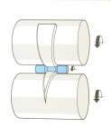
Transverse rolling
Using circular wedge rolls.
Heated bar is cropped to length and fed in transversely between rolls.
Rolls are revolved in one direction.

Slide 25
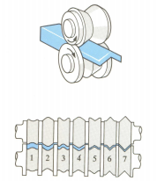

Shaped rolling or section rolling
A special type of cold rolling in which flat slap is progressively bent into complex shapes by passing it through a series of driven rolls.
No appreciable change in the thickness of the metal during this process.
Suitable for producing moulded sections such as irregular shaped channels and trim.

Slide 26
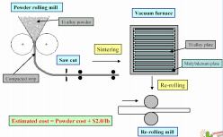
Powder rolling
Metal powder is introduced between the rolls and compacted into a ‘green strip’, which is subsequently sintered and subjected to further hot-working and/or cold working and annealing cycles.
Advantage :
Cut down the initial hot-ingot breakdown step (reduced capital investment).
Economical - metal powder is cheaply produced during the extraction process.
Minimise contamination in hot-rolling.
Provide fine grain size with a minimum of preferred orientation.

Slide 27
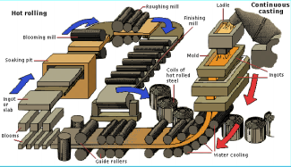
Continuous casting and hot rolling
Metal is melted, cast and hot rolled continuously through a series of rolling mills within the same process.
Usually for steel sheet production.

Slide 28

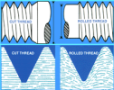
Thread rolling
Dies are pressed against the surface of cylindrical blank. As the blank rolls against the in-feeding die faces, the material is displaced to form the roots of the thread, and the displaced material flows radially outward to form the thread's crest.
A blank is fed between two grooved die plates to form the threads.
The thread is formed by the axial flow of material in the work piece. The grain structure of the material is not cut, but is distorted to follow the thread form.
Rolled threads are produced in a single pass at speeds far in excess of those used to cut threads.
The resultant thread is very much stronger than a cut thread. It has a greater resistance to mechanical stress and an increase in fatigue strength. Also the surface is burnished and work hardened

Slide 29
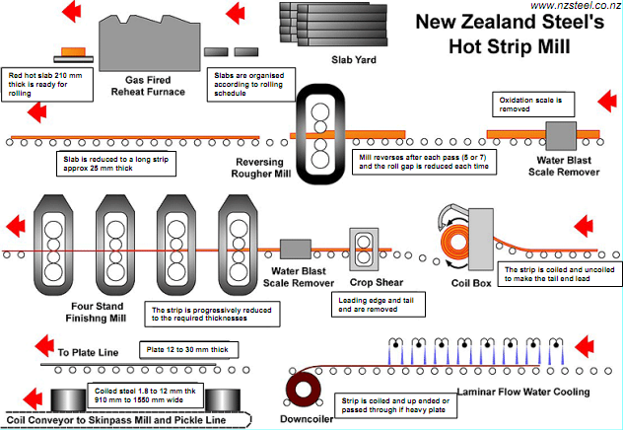

Slide 30
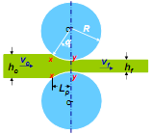
Fundamental concept of metal rolling
1) The arc of contact between the rolls and the metal is a part of a circle.
2) The coefficient of friction, µ , is constant in theory, but in reality µ varies along the arc of contact.
3) The metal is considered to deform plastically during rolling.
4) The volume of metal is constant before and after rolling. In practical the volume might decrease a little bit due to close-up of pores.
5) The velocity of the rolls is assumed to be constant.
6) The metal only extends in the rolling direction and no extension in the width of the material.
7) The cross sectional area normal to the rolling direction is not distorted.

Slide 31
Forces and geometrical relationships in rolling
A metal sheet with a thickness h₀ enters the rolls at the entrance plane xx with a velocity v_{0.}
It passes through the roll gap and leaves the exit plane yy with a reduced thickness h_{f} and at a velocity v_{f}
Given that there is no increase in width, the vertical compression of the metal is translated into an elongation in the rolling direction.
Since there is no change in metal volume at a given point per unit time throughout the process, therefore
………. Eq. 1
Where b is the width of the sheet
v is the velocity at any thickness h intermediate between h₀ and h_{f}

Slide 32
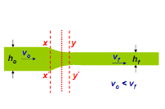


From Eq. 1
Given that b₀ = b_{f}
Then we have
When h₀ > h_{f} , we have v₀ < v_{f}
…… Eq. 2
The velocity of the sheet must steadily increase from entrance to exit such that a vertical element in the sheet remain undistorted

Slide 33
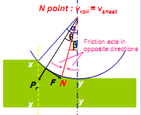
At only one point along the surface of contact between the roll and the sheet, two forces act on the metal: 1) a radial force P_{r} and 2) a tangential frictional force F. if the surface velocity of the roll v_{r} equal to the velocity of the sheet, this point is called neutral point or no-slip point.
Between the entrance plane (xx) and the neutral point the sheet is moving slower than the roll surface, and the tangential frictional force, F, act in the direction (see Fig) to draw the metal into the roll.
On the exit side (yy) of the neutral point, the sheet moves faster than the roll surface. The direction of the frictional force is then reversed and oppose the delivery of the sheet from the rolls

Slide 34
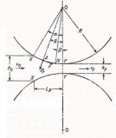


P_{r} is the radial force, with a vertical component P (rolling load – the load with which the rolls press against the metal).
The specific roll pressure, p, is the rolling load divided by the contact area.
…….Eq. 3
Where b is the width of the sheet
L_{p} is the projected length of the arc of contact
…….. Eq. 4

Slide 35
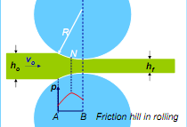
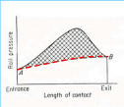
The distribution of roll pressure along the arc of contact shows that the pressure rises to a maximum at the neutral pint and then falls off.
The pressure distribution does not come to a sharp peak at the neutral point, which indicates that the neutral point is not really a line on the roll surface but an area.
The area under the curve is proportional to the rolling load.
The area in shade represents the force required to overcome frictional forces between the roll and the sheet.
The area under the dashed line AB represents the force required to deform the metal in plane homogeneous compression.

Slide 36
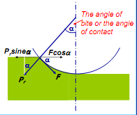

Roll bite condition
For the workpiece to enter the throat of the roll, the component of the friction force must be equal to or greater than the horizontal component of the normal force.

Slide 37
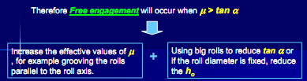
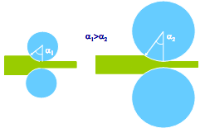

Slide 38
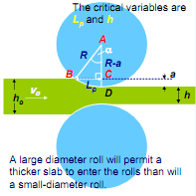


The maximum reduction
from triangle ABC, we have
As a is much smaller than
R, we can then ignore a²
^{…….. Eq. 6}

Slide 39


Problem with roll flattening
When high forces generated in rolling are transmitted to the workpiece through the rolls, there are two major types of elastic distortions:
The rolls tends to bend along their length because the workpiece tends to separate them while they are restrained at their ends. Thickness variation.
The rolls flatten in the region where they contact the workpiece. The radius of the curvature is increased R R’
According to analysis by Hitchcock,

Slide 40
Simplified analysis of rolling load
The main variables in rolling are:
• The roll diameter.
• The deformation resistance of the metal as influenced by metallurgy, temperature and strain rate.
• The friction between the rolls and the workpiece.
• The presence of the front tension and/or back tension in the plane of the sheet.
We consider in three conditions:
1) No friction condition
2) Normal friction condition
3) Sticky friction condition

Slide 41
Therefore the rolling load P increases with the roll radius R^{1/2} , depending on the contribution from the friction hill.
The rolling load also increases as the sheet entering the rolls becomes thinner ( due to the term e^{Q} ).
At one point, no further reduction in thickness can be achieved if the deformation resistance of the sheet are both severely elastically deformed.
Small diameter rolls which are properly stiffened against deflection by backup rolls can produce a greater reduction before roll flattening become significant and no further reduction of the sheet is possible.

Slide 42
Frictional force is needed to pull the metal into the rolls and responsible for a large portion of the rolling load.
High friction results in high rolling load, a steep friction hill and great tendency for edge cracking.
The friction varies from point to point along the contact arc of the roll. However it is very difficult to measure this variation in µ, all theory of rolling are forced to assume a constant coefficient of friction.
For cold-rolling with lubricants, µ ~ 0.05 – 0.10
For hot rolling, µ ~ 0.2 up to sticky condition.

Slide 43
Week 3

Slide 44
Process Variables
Diameter of the roll
Angle of bite
Speed of rolling
Strength of the work material
Temperature
Roll gap or draft
Co-efficient of friction
Dimensions of the sheet

Slide 45
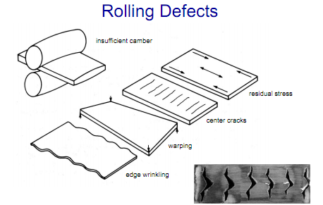

Slide 46
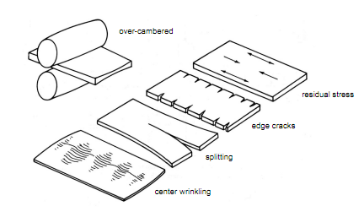
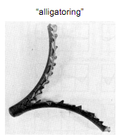

Slide 47
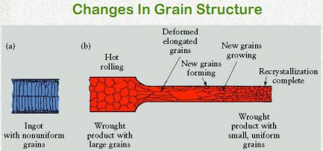

Slide 48
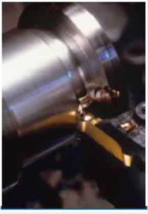
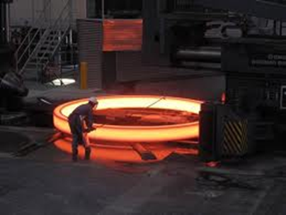
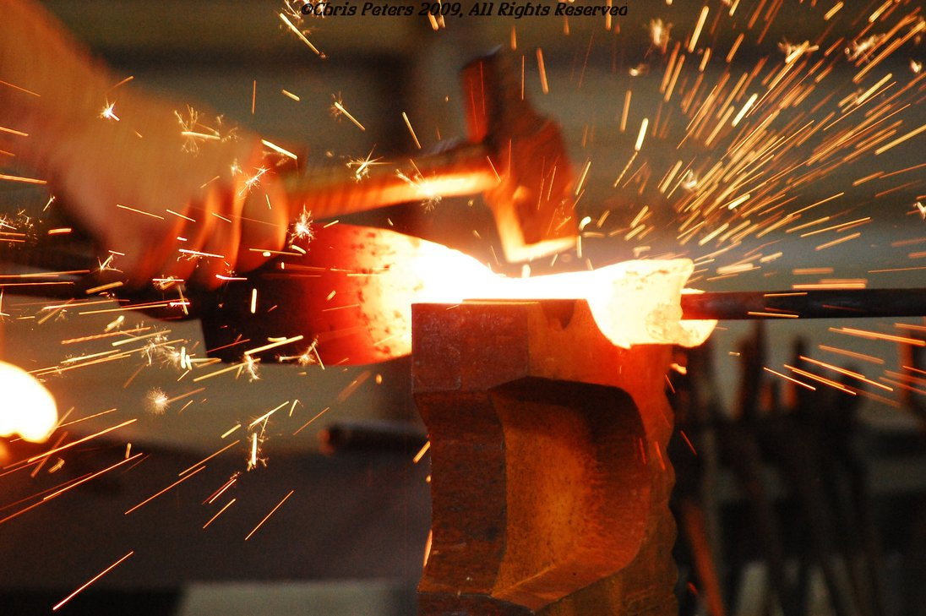
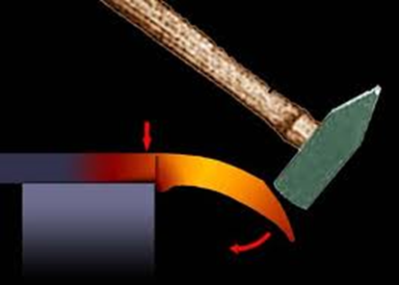
Forging

Slide 49
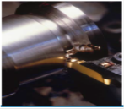
Forging
Forging denotes a family of process to make discrete parts in which plastic deformation take place by compressive forces applied through various dies and tooling
forging is one of the Oldest metalworking operations known, dating back too 5000 B.C and used in making parts with a wide range of sizes and shapes and from a variety of material.
Simple forgings can be made with a heavy hammer and an anvil by techniques practiced by blacksmiths for centuries.
Typical parts, now mostly made on modern machinery and at high production rates are : automotive engine components, [engine crankshafts, connecting rods, gears], turbine disc, Aircraft structural components, jet engin, turbine parts
Also, basic metals industries use forging to establish basic shape of large and small parts that are subsequently machined to final geometry and size
The forging process can produce parts that are in the category of net-shape manufacturing.

Slide 50
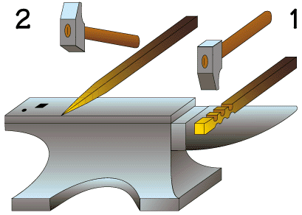
Forging
What is forging?
A compressive force is applied to the metal
with a hammer to give it the required shape
Modern Components: engine crankshafts, connecting rods, gears, aircraft structural components, jet engine turbine parts.
Classified by working temperature:
Hot or warm forging – most common, high deformation, lowers the strength but increases ductility of the forged part.
Cold forging –advantage: increased strength due to strain hardening.
Classified by type of load:
Forge hammer (impact) - applies an impact load.
Forge press (press) - applies gradual pressure.

Slide 51
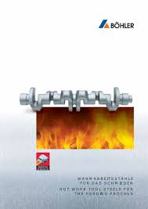
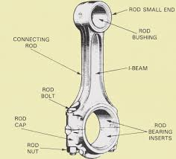
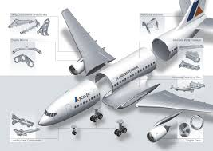
Products of forging
Connecting rods
Engine crankshafts
Aircraft structural components

Slide 52
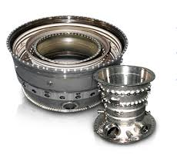
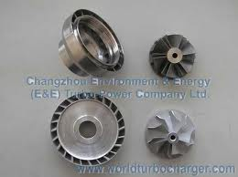
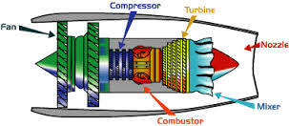
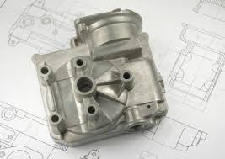
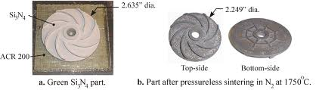
Products of forging
Jet engine turbine parts
Basic shape of small parts

Slide 53
Forging
Forging refines the microstructure of the metal, eliminates the hidden defects such as hair cracks and voids, and rearranges the fibrous macrostructure to conform with the metal flow. By successful design of the dies, the metal flow during the process can be employed to promote the alignment of the fibers with the anticipated direction of maximum stress.

Slide 54
Forging
The process begins with starting stock, usually a cast ingot, which is heated to its plastic deformation temperature, then upset or "kneaded" between dies to the desired shape and size.
During this hot forging process, the cast, coarse grain structure is broken up and replaced by finer grains. Low-density areas, gas porosity and microshrinkage inherent in the cast metal are consolidated through the reduction of the ingot, achieving structural integrity.
Mechanical properties are therefore improved through the elimination of the cast structure, enhanced density, and improved homogeneity.

Slide 55
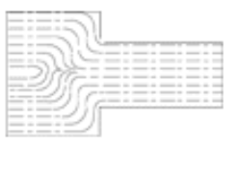
Forging
Forging also provides means for aligning the grain flow to best obtain desired directional strengths

Slide 56
Grain Flow Comparison
Forged Bar:
Directional alignment through the forging process has been deliberately oriented in a direction requiring maximum strength. This yields to increase resistance to impact and fatigue.
Machined Bar:
Unidirectional grain flow has been cut when changing contour. This renders the material more liable to fatigue and more sensitive to stress corrosion cracking.
Cast Bar:
No grain flow or directional strength is achieved through the casting process.

Slide 57
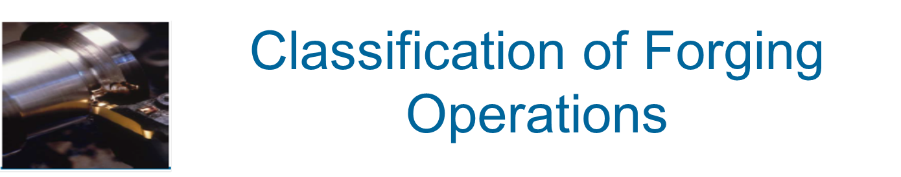
Cold forging: is done at room temperature or near room temperature.
Hot forging: is done at a high temperature, which makes metal easier to shape and less likely to fracture.
Warm forging: is done at intermediate temperature between room temperature and hot forging temperatures.
Forged parts can range in weight from less than a kilogram to 170 metric tons.
Forged parts usually require further processing to achieve a finished part.

Slide 58

Classification of Forging
Operations
Cold vs. hot forging:
Hot or warm forging – advantage: reduction in strength and increase in ductility of work metal
Cold forging – advantage: increased strength due to strain hardening
Impact vs. press forging:
Forge hammer - applies an impact force
Forge press - applies gradual force

Slide 59

Types of Forging Operations
Open-die forging – work part is compressed between two flat dies, allowing metal to flow laterally with minimum constraint
Impression-die forging - die contains cavity or impression that is imparted to work part
Metal flow is constrained so that flash is created
3. Flashless forging (closed die forging) - work part is completely constrained in die
No excess flash is created

Slide 60
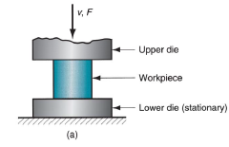
Types of Forging Operations
(a) Open-die forging

Slide 61
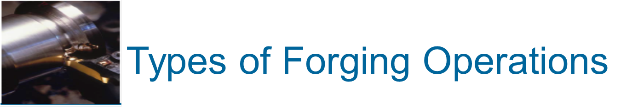
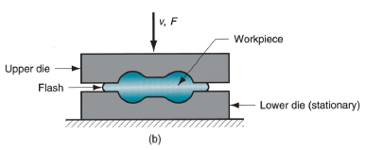
(b) Impression-die forging

Slide 62
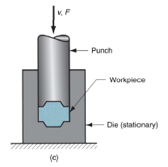
(c) Flashless forging

Slide 63
Week 4

Slide 64
Open-Die Forging
Compression of work part (solid cylindrical) between two flat dies and reducing its height by compressing it, an operation that is also known as upsetting
Similar to compression test when workpart has cylindrical cross section and is compressed along its axis
Under ideal condition, a solid cylinder deforms uniformly, in a process known homogeneous deformation.
Deformation operation reduces height and increases diameter of work. Because in plastic deformation the volume of the cylinder remains constant, any reduction in the height is followed by an increase in its diameter

Slide 65
Open-Die Forging
While impression or closed die forging confines the metal in dies, open die forging is distinguished by the fact that the metal is never completely confined in the dies. Most open die forgings products are produced on flat dies. However, round swaging dies and V-dies are also used depending on the desired part configuration and its size.

Slide 66
Open-Die Forging
Although the open die forging process is often associated with larger, simpler-shaped parts such as bars, blanks, rings, hollows or spindles, in fact it can be considered the ultimate option in "custom-designed" metal components.
High-strength, long-life parts optimized in terms of both mechanical properties and structural integrity are today produced in sizes that range from a few pounds to hundreds of tons in weight.

Slide 67
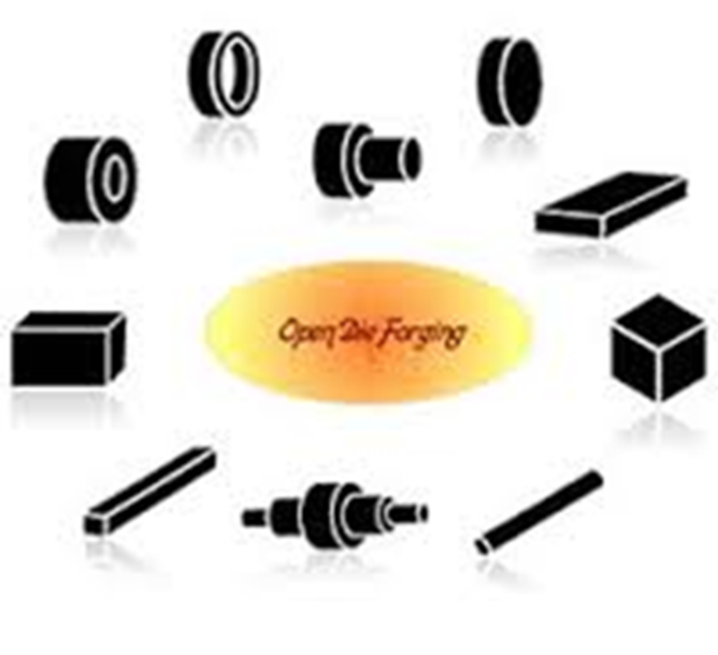
Open-Die Forging products

Slide 68
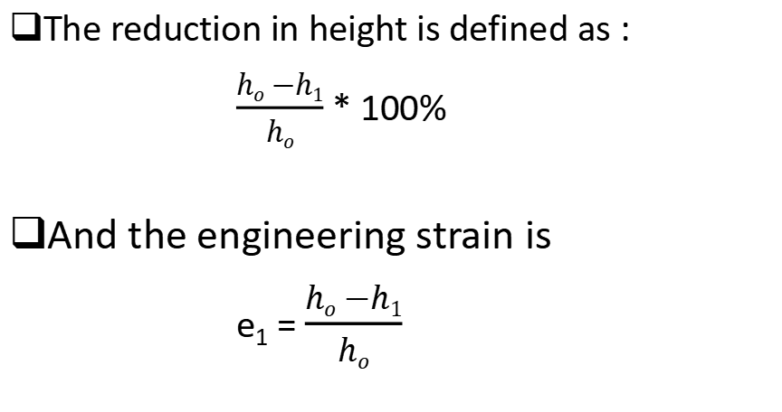
Open-Die Forging
The reduction in height is defined as :
$\frac{ho −h1}{ho}$ * 100%
And the engineering strain is
e₁ = $\frac{ho −h1}{ho}$

Slide 69
Open-Die Forging with No Friction
If no friction occurs between work and die surfaces, then homogeneous deformation occurs, so that radial flow is uniform throughout workpart height and true strain is given by:
where ho= starting height; and h = height at some point during compression
At h = final value hf, true strain reaches maximum value

Slide 70

Open-Die Forging with No Friction
(1) Start of process with workpiece at its original length and diameter, (2) partial compression, and (3) final size

Slide 71

Open-Die Forging with Friction
In cold open die forging
Friction between work and die surfaces constrains lateral flow of work
This results in barreling effect
Barreling is caused by frictional forces at the die-workpice interface that oppose the outward flow of the material at these interfaces (friction prevents the top and bottom surfaces from expanding freely)

Slide 72
Open-Die Forging with Friction
In hot open-die forging, effect is even more pronounced due to heat transfer at die surfaces which cools the metal and increases its resistance to deformation
The reason is that the material at and near the die-specimen interfaces cools rapidly, whereas the rest of the specimen remains relatively hot. Since the strength of the material decreases with increasing temperature, the upper and lower portions of the specimen show a greater resistance to deformation than dose the center.
A result of barreling is that the deformation throughout the specimen becomes nonuniform or inhomogeneous

Slide 73
Open-Die Forging with Friction
For cold working operations, barreling can be minimized by applying an effective lubricant.
In hot working operations, barreling can be reduced by using heated dies or a thermal barrier at the interfaces,

Slide 74



Open-Die Forging with Friction
Actual deformation of a cylindrical workpart in open-die forging, showing pronounced barreling: (1) start of process, (2) partial deformation, and (3) final shape
Open-Die Forging
In open-die forging, barreling occurs due to friction between dies and part work surfaces

Slide 75
Open-die Forging
• Fullering
• Edging
Cogging
These operations are used to perform the workpiece for closed die forging

Slide 76
Open-die Forging
• Fullering & edging:
These operations are performed, usually on bar stock, to distribute the material in certain regions prior to forging.
In edging, it is gathered into a localized area, whereas in fullering, the material is distributed away from an area.
Thus these operations are performing techniques to make material flow easier in die cavity.

Slide 77

Open-die Forging
• Fullering
Reducing work piece cross section to prepare for subsequent shaping action. Dies with convex surface cavity are used.

Slide 78

Open-die Forging
• Edging
Similar to Fullering, but the dies have concave surface cavity.

Slide 79

Open-die Forging
• Cogging
Open dies with flat or slightly contoured surfaces to reduce cross-section and to increase length.

Slide 80

Open-Die Forging

Slide 81
Open-Die Forging
Advantages:
  Simple, inexpensive dies, wide range of sizes available, good strength characteristics
Limitations:
  Limited to simple shapes, difficult to hold close tolerances, require further machining, low production rate, relatively poor utilization of material, high degree of skill required

Slide 82





Impression-Die Forging
In impression-die forging, the workpiece acquires the shape of the die cavity (hence the term impression) while it is being deformed between the closing dies.
Schematic illustrations of stages of impression-die forging. Note the formation of a flash, or excess material, that subsequently has to be trimmed off.

Slide 83
Week 5

Slide 84

Impression-Die Forging
The formation of metal flash is an important part of impression die forging manufacture. Why??
First, flash provides a way for excess material from the work stock to exit the forging die. If this material could not escape during the compression, build up of pressure will occur, as the volume of work metal exceeded the volume of the die cavity, could easily crack the die.
Flash, while allowing material to escape, does increase the pressure within the die cavity.

Slide 85
Impression-Die Forging
Flash must be later trimmed, but it serves an important function during compression:
Because of it is high length-to-thickness ratio, the flash is subjected to high pressure. This, in turn indicates the presence of high frictional resistance as the material flows radially out ward direction in the flash gap. Thus the flash gap is an important parameter since high friction there will subject the material in the die cavity to high pressures, thereby encouraging the filling of the die cavity.
Furthermore, if the forging operation is carried out at elevated temperature (hot forging), the flash cools faster than dose the bulk of the workpiece (because of the high surface area-to-thcikness ratio of the flash gap. As a result, the flash resists deformation more than the bulk dose and thus helps filling of the die cavities. [the cooling of the flash from the mating surfaces increases resistance to flow of material out of the die, thus also increasing pressure within the die cavity]
Notes:
Some of the material flows outward and form a flash. The thin flash cools rapidly, and, because of its frictional resistance, it subjects the material in the die cavity to high pressures, thereby encouraging the filling of the die cavity.
In hot forging operations, the flash requires high levels of stress because it is thin, that is, small h, and cooler than the bulk of the forging.

Slide 86
Impression-Die Forging
Forces in impression-die forging can be difficult to predict because of :
The generally complex shapes involved
The fact that each location within the workpiece is typically subjected to different stains, strain rates, and temperatures.
As well as variation in coefficient of friction along the die-workpiece contact lengths.
Higher forging forces are required in this process than open-die forging. The shape factor generally will have a higher value.

Slide 87

Impression-Die Forging
Certain pressure-multiplying by a factor, K_{p}, have been recommended used with the expression :
Where:
F is the forging force (load)
A is the projected area of the forging, including the flash.
Y_{f} is the flow stress of the material.
K_{p} is to be read from the table.

Slide 88

Impression-Die Forging
Value for Kp for the previous equation

Slide 89
Impression-die Forging
The forces are largest at the end of the process when friction between the projected area of the blank and the work part is largest, in order to transform the starting work part into a final desired geometry.
Machining is needed to produce the fine tolerance needed.

Slide 90


Impression-die Forging
A typical impression-die forging load as a function of the die stroke is shown below:

Slide 91
Impression-die Forging
The force first increases gradually as the cavity is filled and then increases rapidly as the flash forms. As the dies must close further (to shape the part), an even steeper rise in forging load takes place.
Notes:
The force then increases rapidly as flash forms

Slide 92
Impression-die Forging
Note that the flash has a finite contact length with the die, called land.
The land ensures that the flash generates sufficient resistance of the outward flow of the material to aid in die filling with an even steeper rise in forging load
Notes:
Some of the material flows outward and form a flash. The thin flash coolsrapidly, and, because of its frictional resistance, it subjects the material in the die cavity to highpressures, thereby encouraging the filling of the die cavity.

Slide 93

Impression-Die Forging
(1) Just prior to initial contact with raw workpiece, (2) partial compression, and (3) final die closure, causing flash to form in gap between die plates

Slide 94

Advantages and Limitations of
Impression-Die Forging
Advantages compared to machining from solid stock:
Higher production rates
Less waste of metal
Greater strength
Favorable grain orientation in the metal
Limitations:
Not capable of close tolerances
  Machining is often required to achieve accuracies and features needed such as holes, and mating surfaces that fit with other components.

Slide 95

Impression-Die Forging Practice-closed die

Slide 96
Impression-Die Forging Practice-closed die
Benefits of the Closed Die Forging Process
Three-dimensional shapes
High strength
Soundness
Homogeneity
Enhanced density
Production of intricate and difficult geometries
Flash does form and the workpiece completely fills the die cavity. Hence, the forging pressure is very high.

Slide 97
Flashless Forging (closed die forging)
In closed-die forging, no flash is formed and workpiece is completely surrounded by the dies.
Net shape forming reduces the need for later finishing
Proper control of the volume of material versus die-cavity volume is essential in order to produce a forging of desired shape and dimensions.
Undersized blank of the material will prevent the complete filling of the die cavity.
Oversized blank may cause premature die failure or jamming of the die.
Notes:
Jamming : unable to work due to a part seizing up or becoming stuck.

Slide 98
Flashless Forging (closed die forging)
Requires:
Special and more complex dies
Precise control of blank volume
Aluminum& Manganese are particularly suited; Steels and Titanium can also be precision forged
Aluminum& Manganese are best for precision forging because they require lower forging load and temperature

Slide 99
Flashless Forging (closed die forging)
Compression of work in punch and die tooling whose cavity does not allow for flash
Starting work part volume must equal die cavity volume within very close tolerance
The volume control is important and the outcome is precision re-production of inverse of cavity geometry
Process control more demanding than impression‑die forging
Best for part geometries that are simple and symmetrical
Often classified as a precision forging process
Typically for aluminum and magnesium alloy.

Slide 100

Flashless Forging
(1) Just before contact with work piece, (2) partial compression, and (3) final punch and die closure

Slide 101

Flashless versus conventional Forging

Slide 102

Flashless versus conventional Forging
flash extension
Conventional forging part
Precision forging part

Slide 103
Week 6

Slide 104
Various Forging equipment's
Forging Hammers
Apply impact load against workpart: Two types:
Gravity drop hammers - impact energy from falling weight of a heavy ram : hammers derive their energy from the potential energy of the ram, which is the converted to kinetic energy; thus hammers are energy limited. Why???
Power drop hammers - accelerate the ram by pressurized air or steam- the ram is accelerated in the downstroke by steam or air.
Hammers speed are high, thus minimizing the cooling of hot forgings and allowing the forging of complex shapes.
􀂃 Disadvantage:
impact energy transmitted through anvil into floor of building
Commonly used for impression-die forging

Slide 105

Forging Hammers
Diagram showing details of a gravity drop hammer for impression-die forging
Dies are normally made from tool steel with high impact strength and high wear resistance.

Slide 106

Forging Hammers
Drop forging hammer (power drop hammer)

Slide 107
Press Forging
Apply gradual pressure to accomplish compression operation
􀂃Types:
Mechanical press [equipment inverts rotation of drive motor into linear motion of ram]
These presses are stroke limited, with speeds varying from a maximum at the center of the stroke to zero at the bottom.
The force available depends on the stroke position and becomes extremely large at the bottom-dead center position; thus proper setup is essential to avoid breaking the dies or other

Slide 108

Press Forging
Apply gradual pressure to accomplish compression operation
􀂃Types:
Hydraulic press - hydraulic piston actuates ram: these presses have a constant low speed and are load limited.
Large amounts of energy can be transmitted to the workpiece by a constant load that is available throughout the stroke.

Slide 109
Press Forging
Apply gradual pressure to accomplish compression operation
􀂃Types:
Screw press - screw mechanism drives ram : these presses deriving their energy from a flywheel
Screw presses transmits the forging load through a vertical screw.
These presses are energy limited and can be used for a variety of forging operations.
The presses are particularly suitable for producing small quantities, producing parts requiring precision ( such as turbine blades), and for controlling the ram speed.

Slide 110
Heading
Various Forging operations
This is basically an upsetting operation, typically performed at the end of a rod to produce a shape with larger cross section.
Examples are the heads of bolts, screws, nails and similar products.
Disadvantage:
There is a tendency for the part to buckle if its length-to-diameter ratio of the part is too high.
Heading is done on machines called headers, which are typically highly automated horizontal machines with high production rates

Slide 111

Heading
Various Forging operations
Wire or bar stock is fed into machine, end is headed, then piece is cut to proper length

Slide 112
Upsetting and Heading
Forging process used to form heads on nails, bolts, and similar hardware products. The leading section of the stock is forged to form a head section using closed-die forging.
Performed cold, warm, or hot on machines called headers or formers
Wire or bar stock is fed into machine, end is headed, then piece is cut to proper length
For bolts and screws, thread rolling is then used to form threads

Slide 113

Upset and head Forging
Upset forging to form a head on a bolt. The cycle consists of:
wire stock is fed to the stop
(2) gripping dies close on the stock and the stop is retracted
(3) punch moves forward
(4) Punching more to form the head

Slide 114

Heading (Upset Forging)
Examples of heading (upset forging) operations:
heading a nail using open dies.
round head formed by punch).
(c) and (d) two common head styles for screws formed by die.
(e) carriage bolt head formed by punch and die .

Slide 115

Heading (Upset Forging)
(a) Heading operation, to form heads on fasteners such as nails and rivets. (b) Sequence of operations to produce a bolt head by heading.

Slide 116
Swaging
Accomplished by rotating dies that hammer a work piece radially inward to taper it as the piece is fed into the dies. Swaging used to reduce the cross-sections of forged rods or tubes using a set of rotating dies. A mandrel is sometimes used to control the internal form of the tube.
Mandrel sometimes required to control shape and size of internal diameter of tubular parts

Slide 117


Swaging and Radial Forging
Swaging process to reduce solid rod stock; dies rotate as they hammer the work
In radial forging, work piece rotates while dies remain in a fixed orientation as they hammer the work

Slide 118
Swaging
Swaging is a process that is used to reduce or increase the diameter of tubes and/or rods.
This is done by placing the tube or rod inside a die that applies compressive force by hammering radially. This can be further expanded by placing a mandrel (has fixed profile or shaped mandrel) inside the tube and applying radial compressive forces on the outer diameter. Thus, the inner diameter can be a different shape, for example a hexagon, and the outer is still circular.

Slide 119

Swaging of Tubes With and Without a Mandrel
(a) Swaging of tubes without a mandrel; not controlling the wall thickness in the die gap.
(b) Swaging with a mandrel; note that the final wall thickness of the tube depends on the mandrel diameter (thickness is controlled).
(c) Examples of cross-sections of tubes produced by swaging on shaped mandrels. Small gun barrels can be made by this process.

Slide 120


Roll Forging
In roll forging, the cross-sectional area of a bar is reduced and altered in shape by passing it through a pair or sets of grooved rolls of various shape.

Slide 121


Roll Forging- Uses
This operation may be used to produce parts that are basically the final product, such as tapered shafts.
Roll forging is also used as a preliminary forming operation, followed by other forging and forming processes, such as in making crankshafts and various automotive components

Slide 122

Skew rolling-Forging
Skew rolling a process which is typically used for making ball bearings.
A round wire or rod stock is fed into the roll gap, and a spherical blanks are formed by the continuously rotating rolls.
The balls then ground and polished in special machinery.

Slide 123
Week 7

Slide 124

Skew rolling-Forging
Another method of making ball bearing is by cutting short pieces from a round bar and upsetting them between a pair of dies.

Slide 125

Skew rolling-Forging
Production of steel balls by the skew-rolling process.
Production of steel balls by upsetting a cylindrical blank. Note the formation of flash. The balls made by these processes are subsequently ground and polished for use in ball bearings

Slide 126
Trimming
Cutting operation to remove flash from work part in impression-die forging
Usually done while work is still hot, so a separate trimming press is included at the forging station
Trimming can also be done by alternative methods, such as grinding or sawing

Slide 127

Trimming After Impression-Die
Forging
Trimming operation (shearing process) to remove the flash after impression-die forging

Slide 128
Forgeability of Metals
The forgeability of a metal may be defined as its capability to be shaped without cracking and requiring low forces.
Although in general the forgeability of metals increases with increasing temperature, for certain metals there is a maximum temperature above which some undesirable phenomena occur, such as fast grain growth [ not wrought] or melting of a phase.
Impurities in the metal [Metals with insoluble inclusions tend to be brittle and have low forgeability] or small changes in the composition of the metal can have a significant effect on the ductility and forgeability

Slide 129
Forgeability of Metals
Two popular tests for determining the forgeability of materials are:
The ‘upset test’ (where cylindrical specimens are upset in steps until they start cracking radially)
The hot ‘twist test’ where a round bar is heated in a tubular furnace then twisted. The number of twist turns to failure is a relative measure of forgeability.
Testing can be carried out in a range of temperatures and strain rates to determine the best conditions for practical forging

Slide 130
Upsetting test
In this test, a solid cylindrical specimen is upset between two flat dies, and observations are made regarding any cracking on the barreled surfaces.
The higher the reduction prior to cracking, the greater is the forgeability of the metal.
The cracks on the barreled surfaces are caused by tensile stresses.
Friction at the die-workpiece interfaces has a marked effect on cracking; as friction increases, the specimen cracks at lower reduction in height

Slide 131
Hot-twist test
This is a torsion test, in which a long, round specimen is twisted continuously until it fails.
The test is performed at various temperatures and the number of turns that each specimen undergoes before failure is observed; the optimal forging temperature is then determined.
The hot-twist test is particularly useful in determining the forgeability of steel

Slide 132
Forgeability of Metals
Based on the results of various tests and observations made during actual forging operations, the foregability of various metals and alloys has been determined.
In general
Aluminum, magnesium, copper and their alloys; carbon and low-alloy steels have good foregability
High-temperature materials such as superalloys, tantalum, molybdenum, and tungsten and their alloys have poor forgeability

Slide 133
Forgeability of Metals
The capability of a material to undergo deformation without cracking

Slide 134
Forging Defects
Thin portions of a metal forging are called ribs and webs.
A rib is a section that runs perpendicular to the forging plane as determined by the parting line.
Long narrow ribs are harder to fill and require more forces, increasing the width of a long rib will better facilitate the filling of the rib with material during the process.
A web is a portion of the metal forging that runs parallel to the forging plane.
When designing a forging die, web thickness should not be too small or else there may be trouble completely filling the web with metal.
Webs that are too thin may also cool faster than the rest of the metal forging, the resulting shrinkage could cause tears or warping of the part

Slide 135


Forging Defects
Webs - Thin section parallel to parting line.
Ribs - thin section perpendicular to parting line
Gutter - area for containing flash
Dies are normally made from tool steel with high impact strength and high wear resistance.

Slide 136


Slide 137

Forging Defects
Forging Defects:
1. Surface cracking.
2. Laps formed by web buckling during forging, web thickness [material in the web area] should be increased to avoid this problem [Laps in a metal forging are caused by a buckling of the part, laps can be a result of too little material in the work piece] .
3. Internal cracks caused by oversized billet.

Slide 138

Forging Defects
In addition to surface cracking. Several defects in forging can be caused by the material flow patterns in the die cavity.
Insufficient volume of material .Material in the web of a forging can buckle during forging and develops lap [Laps formed by web buckling during forging, web thickness should be increased to avoid this problem].

Slide 139

Forging Defects
If the web is too thick, the excess material flows past the already forged portions and develops internal cracks
The previous two defects (1 &2) indicates the importance of probably controlling the volume of the blank and its flow in the cavity.

Slide 140

Forging Defects
The die radii also can significantly affect formation of defects.
The material flows better around a large corner sides that it dose around small radius.
As the work material fills the die cavity, the flow of metal will have to change directions depending upon the part's geometry.
Smooth, large filleted turns will allow the metal flow to change directions while adhering to the die's dimensions.
If corners within the metal forging are too sharp then the material may not completely follow the path of those corners, resulting in vacancies, laps, or cold shuts. Sharp corners will also act as stress raisers within the die cavity.
Good forging die design should provide adequate enough fillet and corner radius to allow for easy metal flow

Slide 141
Forging Defects
The die radii also can significantly affect formation of defects.
With smaller radii, the material can thus fold over itself, producing a lap ( cold shut : which metal does not flow properly into the corner as a result of that small cracks appear at the corners of the forged part).
Cold shuts occur when metal flows of different temperatures meet, they do not combine smoothly, a boundary layer, (cold shut), forms at their intersection. Cold shuts indicate that there is a problem with metal flow in the mold as the part is being formed

Slide 142

Forging Defects
Such a defect can lead to fatigue failure and other problems during the service life of the forged component.
So it is important to inspect the forging part prior to being placed into service, particularly for critical applications.

Slide 143
Week 8

Slide 144
Forging Defects
In general, defects in parts manufactured by metal forging can be controlled first by careful consideration of work stock volume, and by good design of the forging die, (mold).
The main principle is to enact the right material distributions, and the right material flow to accomplish these distributions.

Slide 145

Forging Defects
The effect of die radii in developing defects in the forged parts

Slide 146


Slide 147


Slide 148
Forging Defects
Another important factor is the grain-flow pattern.
The grain flow lines may reaches a surface perpendicularly, exposing the grain boundaries directly to environment (knowing as end grains).
In service, they can be attacked by the environment ( such as salt water, acid rain, or other chemically active environments), thus developing rough surfaces which act as stress raiser.
End grains can be avoided:
by proper selection of blank orientation in the die cavity and
by control of material flow during forging .

Slide 149
Forging Defects
Reasons:
Insufficient volume of material to fill the die cavity completely: laps will be developed.
If the web is too thick: internal cracks can be developed.
Temperature gradients throughout the work piece during forging (Non uniform deformation of the material in the die cavity).
Forging Defects can cause fatigue failures, and wear.

Slide 150

Forging Defects
Examples of defects in forged parts.
Labs formed by web buckling during forging; material should be enough to avoid this problem.
Internal defects caused by oversized billet; die cavities are filled prematurely. Internal cracks will be formed in the rib region.

Slide 151

Forging Process Design
In modern manufacturing industry, metal parts of complex geometry are often forged completely with the need for only minor finishing operations.
These parts can not be manufactured with a single forging. The work stock is taken through a series of metal forging operations that, in steps, alter the geometric shape of the material until the final process creates the desired forging.
In these types of design sequences each operation must be planned in such a way as to prepare the work piece for the next forging process. Together the series of metal forging operations that are required to create a part, make a larger single process and each individual forging operation has its place within the larger process.

Slide 152
Forging Process Design
When designing a complex metal forging process, great consideration should be taken with each step and how it relates to the final product.
Also, design the chosen path for the redistribution of the work material from the start of the process to the end of the last step, concentrating on smooth metal flow

Slide 153
Forging Process Design
Forging design, in general, should first accomplish a redistribution of the material, then the more detailed impression die forging operations, and finally finishing operations.
In addition to providing a smooth transition of material the forging processes, as a whole, should be designed to produce a controlled grain structure in the final product.
When choosing a path for material redistribution, a metal forging design should consider how this particular method of metal deformation will effect and change the grain structure of the part.
It is desirable that the final product contain a favorable grain orientation throughout the structure of its material. Such a grain structure should strengthen the part, particularly with respect to that part's application

Slide 154

Forging Process Design

Slide 155
Forging Process Design
Open die forging often plays a roll in the early stages, providing a general mass redistribution of the work metal.
Before the more detailed impression forgings can shape the work, metal must be formed in such a way as to place higher concentrations of material in regions that will require more material.
Fullering and edging of the metal, discussed in the open die forging section, are very important open die forging processes used to accomplish a rough transfer of material.
Fullering and edging will squeeze more metal into some areas of the work, while causing other areas to have less depending on the needs of the process.

Slide 156

Forging Process Design
Figure shows two rough forms, one was subject to fullering the other to edging, the nature of the different processes should be apparent

Slide 157

Forging Process Design

Slide 158
Design Considerations
Die design:
The design of forging dies and die material selection require knowledge of
The strength and ductility of the workpiece material
Workpiece material sensitivity to strain rate and temperature
Its frictional characteristics
Forging temperature

Slide 159

Design Considerations
The terminology used in die design is as follow:
The bar is first performed (intermediate shape) by techniques such as fullering and edging.
Forged into the final shape
Finally the forged part is trimmed.
The reason for performing is recognizing that for long die life, wear is to be minimized

Slide 160

Design Considerations

Slide 161
Design Considerations
Some general rules of die design include the following:
The parting line : is where the two dies meet. For simple shapes, the parting line is a straight line at the center of the forging; for more complex shapes, the line may be offset and may not be in a single plane.
The selection of the proper location for the parting line is based on:
The shape of the part,
Flow of the metal,
Balance of the forces,
And the flash

Slide 162
Design Considerations
The parting line
Location of the parting line is of primary importance in metal forging die design. The parting line, which defines the forging plane of the operation, is a large determinant in how metal flows through the die during the forging's compression.
The parting line dictates where flash will be formed, and effects the grain structure of the manufactured part. It is easier to fill sections closer to the parting line than further away.

Slide 163
Week 9

Slide 164

Figure shows a metal forging with three possible locations for a parting line. The location of the parting line of C will better facilitate the flow of metal through the die cavity.
Unlike A or B, location C makes use of the maximum periphery of the forging. It is easier to fill material near the forging plane than in the further recesses of the die cavity. In addition to being a major factor in the flow of metal during the forging process, the location of the parting line is also critical in the formation of the grain structure of the forged work. The parting line acts to disrupt the metal's grain. [structure microstructural variations].

Slide 165
Design Considerations
Some general rules of die design include the following:
The flash: the flash is allowed to flow into gutter.
A general guideline for flash clearance (between the dies) is 3% of the maximum thickness of forging .
The length of the land is usually five times that of the flash clearance

Slide 166
Design Considerations
c) - Draft angles
Draft angle, in metal manufacturing processes, is the taper around the internal and external sides of a part.
Draft angle is necessary to include in the forging die design in order to allow the removal of the work from the die after the part has been forged.
The larger the draft angle, the better it will facilitate the metal forging's removal.
As the metal forging cools, it shrinks away from the outer surfaces of the die cavity, therefore exterior draft angles are usually made smaller than interior angles.

Slide 167

Design Considerations
Some general rules of die design include the following:
Draft angles: are necessary in almost all forgings to facilitate removal of the part from die.
Draft angles usually range between 0.052 (2.9⁰ )and 0.174 rad (9.9⁰ ⁾.
Because the forging shrinks in its radial direction as it cools, internal draft angles are made larger than external ones.
Internal angles are about (0.1222 to 0.1745 rad)
External angles are about (0.052 to 0.087)

Slide 168


Slide 169
Design Considerations
Some general rules of die design include the following:
Die radii: the proper selection of die radii for corners and fillets ensures smooth flow of the metal in the die cavity and improves the die life.
Small radii are generally not desirable because of their adverse effect on metal flow and their tendency to wear rapidly from stress concentration and thermal cycling

Slide 170
Design Considerations
Die materials:
Because most forgings, particularly large ones, are performed at elevated temperature, die materials must have
High strength toughness and hardness at elevated temperature
Hardenability and ability to harden uniformly,
Resistance to mechanical and thermal shock
Resistance to wear ( particularly to abrasive wear because of the presence of scale on heated forging)

Slide 171
Design Considerations
Die materials:
Selection of die materials depend on:
The properties of workpiece
Complexity of workpiece shape,
Forging temperature,
Cost of die material
The number of forging required
Heat transfer characteristics of die material
Common die materials are steel containing chromium, nickel, molybdenum, and vanadium

Slide 172
Die Failures
Die failure results from:
Improper design
Defective material
Improper heat treatment and finishing operations
Overheating (cracking caused by temperature cycling)
Overloading-Excessive wear

Slide 173
Forging Advantages
Directional Strength
By mechanically deforming the heated metal under tightly controlled conditions, forging produces predictable uniform grain size and flow characteristics.
These qualities translate into superior metallurgical and mechanical qualities, and deliver increased directional strength in the final part.

Slide 174
Forging Advantages
2. Structural Strength
Forging also provides a degree of structural integrity that is unmatched by other metalworking processes.
Forging stock is also typically pre-worked to refine the structure of the ingot and remove defects or porosity.
Forging eliminates internal voids and gas pockets that can weaken metal parts. By dispersing segregation of alloys or nonmetallics.
Forging provides predictable structural integrity reduces part inspection requirements, and ensures optimum part performance under field-load conditions.

Slide 175
Forging Advantages
3. Impact Strength
Proper orientation of grain flow assures maximum impact strength and fatigue resistance.
.

Slide 176
Advantages of forging
Some common advantages of forging are given as under:
Forging refines the structure of the metal.
It results in considerable saving in time, labor and material as compared to the production of similar item by cutting from a solid stock and then shaping it.
Forging increases the strength by setting the direction of grains.
Because of intense working, flaws are rarely found, so it has good reliability.
The reasonable degree of accuracy may be obtained in forging operation.
The forged part can be easily welded.

Slide 177
disadvantages of forging
Few disadvantages of forging are given as under:
Rapid oxidation in forging of metal surface at high temperature results in scaling which wear the dies.
The close tolerances in forging operations are difficult to maintain (Open-die forging is not a net-shape process and will require a subsequent machining to dimension) .
Some materials are not readily worked by forging.
The initial cost of forging dies and the cost of their maintenance is high.
The metal get cracked or distort if worked below a specified temperature limit.

Slide 178
Metal Casting

Slide 179
METAL CASTING
Overview of Casting Technology
Sand Casting
Investment Casting
Die Casting
Centrifugal Casting

Slide 180
Solidification Processes
We consider starting work material is either a liquid or is in a highly plastic condition, and a part is created through solidification of the material
Solidification processes can be classified according to engineering material processed:
  Metals
  Ceramics, specifically glasses
  Polymers and polymer matrix composites (PMCs)

Slide 181

Classification of solidification processes.
Notes:
PMC -> Precious Metal Clay -> Metal clay is a clay-like medium used to make jewellery, beads and small sculpture. It consists of very small particles of metals (such as silver, gold, platinum, or copper) mixed with an organic binder and water

Slide 182

Casting
Process in which molten metal flows by gravity or other force into a mold where it solidifies in the shape of the mold cavity
The term casting also applies to the part made in the process
Steps in casting seem simple:
  Melt the metal
  Pour it into a mold
  Let it freeze

Slide 183
Week 10

Slide 184
Capabilities and Advantages of Casting
Can create complex part geometries that can not be made by any other process
Can create both external and internal shapes
Some casting processes are net shape; others are near net shape
Can produce very large parts (with weight more than 100 tons), like m/c bed
Casting can be applied to shape any metal that can melt
Some casting methods are suited to mass production
Can also be applied on polymers and ceramics

Slide 185
Disadvantages of Casting
Different disadvantages for different casting processes:
  Limitations on mechanical properties
  Poor dimensional accuracy and surface finish for some processes; e.g., sand casting
  Safety hazards to workers due to hot molten metals
  Environmental problems
Notes:
2. Decrease in mechanical properties because of microstructure because of uncontrolled cooling, decreased alloying composition, etc

Slide 186
Parts Made by Casting
Big parts
  Engine blocks and heads for automotive vehicles, wood burning stoves, machine frames, railway wheels, pipes, bells, pump housings
Small parts
  Dental crowns, jewelry, small statues, frying pans
All varieties of metals can be cast - ferrous and nonferrous
Notes:
A dental crown is a type of dental restoration which completely caps or encircles a tooth

Slide 187
Overview of Casting Technology
Casting is usually performed in a foundry
Foundry = factory equipped for
making molds
melting and handling molten metal
performing the casting process
cleaning the finished casting
Workers who perform casting are called foundrymen

Slide 188

The Mold in Casting
Mold is a container with cavity whose geometry determines part shape
  Actual size and shape of cavity must be slightly oversized to allow for shrinkage of metal during solidification and cooling
  Molds are made of a variety of materials, including sand, plaster, ceramic, and metal

Slide 189

Open Molds and Closed Molds
Cavity is closed
Two forms of mold: (a) open mold, simply a container in the shape of the desired part; and (b) closed mold, in which the mold geometry is more complex and requires a gating system (passageway) leading into the cavity.
Cavity is open to atmosphere

Slide 190
Two Categories of Casting Processes
Expendable mold processes – uses an expendable mold which must be destroyed to remove casting
  Mold materials: sand, plaster, and similar materials, plus binders
Permanent mold processes – uses a permanent mold which can be used over and over to produce many castings
  Made of metal (or, less commonly, a ceramic refractory material)
Notes:
The casting processes are based on mold types

Slide 191

Sand Casting Mold
Sand casting mold.

Slide 192

Sand Casting Mold Terms
Mold consists of two halves:
  Cope = upper half of mold
  Drag = bottom half
Mold halves are contained in a box, called a flask
The two halves separate at the parting line

Slide 193
Forming the Mold Cavity
Cavity is inverse of final shape with shrinkage allowance
  Pattern is model of final shape with shrinkage allowance
  Wet sand is made by adding binder in the sand
  Mold cavity is formed by packing sand around a pattern
  When the pattern is removed, the remaining cavity of the packed sand has desired shape of cast part
  The pattern is usually oversized to allow for shrinkage of metal during solidification and cooling
Difference among pattern, cavity & part ?

Slide 194

Use of a Core in the Mold Cavity
Cavity provides the external features of the cast part
Core provides internal features of the part. It is placed inside the mold cavity with some support.
In sand casting, cores are generally made of sand
Difference b/w, cavity & core ?

Slide 195

Gating System
It is channel through which molten metal flows into cavity from outside of mold
Consists of a down-sprue, through which metal enters a runner leading to the main cavity
At the top of down-sprue, a pouring cup is often used to minimize splash and turbulence as the metal flows into down-sprue

Slide 196

Riser
It is a reservoir in the mold which is a source of liquid metal to compensate for shrinkage of the part during solidification
Most metals are less dense as a liquid than as a solid so castings shrink upon cooling, which can leave a void at the last point to solidify. Risers prevent this by providing molten metal to the casting as it solidifies, so that the cavity forms in the riser and not in the casting
Notes:
Figure (right) Sprues and Riser formed in a bronze casting

Slide 197
Heating the Metal
Heating furnaces are used to heat the metal to molten temperature sufficient for casting
The heat required is the sum of:
  Heat to raise temperature to melting point
  Heat to raise molten metal to desired temperature for pouring

Slide 198
Pouring the Molten Metal
For this step to be successful, metal must flow into all regions of the mold, most importantly the main cavity, before solidifying
Factors that determine success
  Pouring temperature
  Pouring rate
  Turbulence
Pouring temperature should be sufficiently high in order to prevent the molten metal to start solidifying on its way to the cavity

Slide 199
Pouring the Molten Metal
  Pouring rate should neither be high (may stuck the runner – should match viscosity of the metal) nor very low that may start solidifying on its way to the cavity
  Turbulence should be kept to a minimum in order to ensure smooth flow and to avoid mold damage and entrapment of foreign materials. Also, turbulence causes oxidation at the inner surface of cavity. This results in cavity damage and poor surface quality of casting.

Slide 200

Engineering Analysis of Pouring
NOT INCLUDED
v: velocity of liquid metal at base of sprue in cm/sec; g: 981cm/sec.sec; h: height of sprue in cm
v1: velocity at section of area A1; v2: velocity at section of area A2
V: volume of mold cavity
Notes:
For derivations section 10.2.3 is referred.

Slide 201

Calculation of Pouring Parameters: Example
NOT INCLUDED
If sprue area at its entrance is 5cm2, compute metal velocity at sprue entrance.
Calculate velocity & flow rate of metal when metal is in the midway of sprue

Slide 202
Why Sprue X-section is kept taper ??
In order to keep volume flow rate (Q=VA) constant. In case, x-section is fixed, increased fluid velocity due to gravity will increase flow rate. This can cause air entrapment into liquid metal.

Slide 203
Week 11

Slide 204
Fluidity
A measure of the capability of the metal to flow into and fill the mold before freezing.
Fluidity is the inverse of viscosity (resistance to flow)
Factors affecting fluidity are:
Pouring temperature relative to melting point
Metal composition
Viscosity of the liquid metal
Heat transfer to surrounding
Notes:
With higher pouring temperature a metal remains in liquid state for longer time. It results in oxide formation, gas porosity, and penetration of liquid metal into interstitial spaces of sand forming mold, hence producing rough castings
The metals (pure metal and eutectic alloys) freezing at constant temperature show the best fluidity. In contrary, when the metals (most alloys) solidify at a range of temperature, the partially solidified metal badly affects the fluidity.
Composition of metal also determines the heat of fusion (the heat dissipated during solidification from liquid to solid). Higher heat of fusion means higher fluidity in casting.

Slide 205
Solidification of Metals
It is the transformation of molten metal back into solid state
Solidification differs depending on whether the metal is
  A pure element or
  An alloy
  A Eutectic alloy

Slide 206


Solidification: Pure Metals
Ref cooling curve:
Pure metal solidifies at a constant temperature equal to its freezing point (same as melting point).
Local freezing time= Time from freezing begins and completed
Total freezing time= Time from pouring to freezing completed
After freezing is completed, the solid continues to cool at a rate indicated by downward slope of curve

Slide 207


Solidification: Pure Metals
Because of the chilling action of the mold wall, a thin skin of solid metal is initially formed at interface immediately after pouring.
The skin formed initially has equi-axed, fine grained and randomly oriented structure. This is because of rapid cooling.
As freezing proceeds, the grains grow inwardly, away from heat flow direction, as needles or spine of solid metal.
-
Notes:
The rate at which freezing proceeds depends on the heat transfer into the mold as well as the thermal properties of metal (latent heat of fusion, specific heat).
The thickness of wall increases to form a shell around the molten metal as freezing proceeds.

Slide 208
Solidification: Pure Metals
On further growth of spine, lateral branches are formed, and as these branches grow further branches are formed at right angle to the first branches. This type of growth is called dendritic growth.
The dendritic grains are coarse, columnar and aligned towards the center of casting.

Slide 209


Solidification: Most Alloys
Most alloys freeze at range of temperature rather than at a single temperature.
Freezing begins from liquidus temperature and completes at solidus temperature.
The cooling begins in the same manner as that in pure metals; a thin skin is formed at the interface of mold and makes shell as freezing proceeds.

Slide 210

Solidification: Most Alloys
The dendrites begin to form with freezing. However, due to large temperature spread between solidus and liquidus, the earlier portion of dendritic grains extract higher % of elements from liquid solution than the portion of grain formed later.
As a result, the molten metal in the center of mold cavity depletes from the elements and hence forms a different structure (see Fig).
-
Pure metal
Fe
Fe-Ni Alloy
Notes:
1. The composition of elements vary from the mold wall to its center.

Slide 211

Solidification: Eutectic Alloys
Eutectic alloys solidify similar to pure metals.
Eutectic point on phase diagram is a point at which the liquid, on cooling, completely converts into solid at one temp. No intermediate phase (L+S) exists.
Al-Si (11.6% Si) and Cast Iron (4.3% C) are relevant casting eutectic alloys.

Slide 212

Solidification Time & Chorinov’s Rule
NOT INCLUDED
Chorinov’s Rule
Notes:
1. Since casting conditions are same; n for riser is the same as for main casting

Slide 213

Shrinkage in Solidification and Cooling
Shrinkage occurs in 3 steps: a. while cooling of metal in liquid form (liquid contraction); b. during phase transformation from liquid to solid (solidification shrinkage); c. while solidified metal is cooled down to room temperature (solid thermal contraction).

Slide 214

Shrinkage in Solidification and Cooling
(2) reduction in height and formation of shrinkage cavity caused by solidification shrinkage; (3) further reduction in height and diameter due to thermal contraction during cooling of solid metal (dimensional reductions are exaggerated for clarity).
Why cavity forms at top , why not at bottom?
Notes:
The cavity (containing liquid metal) remains at upper level because liquid metal has low density as compared to solid metal. But it is not at the top because the layer of the metal has already solidified at the top due to rapid cooling there

Slide 215
Solidification Shrinkage (Liquid –Solid transformation)
Occurs in nearly all metals because the solid phase has a higher density than the liquid phase
Thus, solidification causes a reduction in volume per unit mass of metal
Exception: cast iron with high C content
  Graphitization during final stages of freezing causes expansion that counteracts volumetric decrease associated with phase change
Why solidification shrinkage is negligible in Cast Irons??
Notes:
Graphitization is the conversion of Fe3C into Fe & C

Slide 216
Shrinkage Allowance
Patternmakers account for solidification shrinkage and thermal contraction by making mold cavity oversized
Amount by which mold is made larger relative to final casting size is called pattern shrinkage allowance
Casting dimensions are expressed linearly, so allowances are applied accordingly
Notes:
A pattern is a replica of the object to be cast, used to prepare the cavity into which molten material will be poured during the casting process

Slide 217
Directional Solidification- Design Optimization
In order to minimize the damaging effects of shrinkage, it is desirable that the regions far from the riser (metal supply) should solidify earlier than those near the riser in order to ensure metal flow to distant regions to compensate shrinkage. This is achieved by using Chvorinov’s rule.
So, casting and mold design should be optimal: riser should be kept far from the regions of casting having low V/A ratio.

Slide 218
Directional Solidification- Use of Chills
The chills increase the heat extraction.
Internal and external chills can also be used for directional cooling.
For thick sections, small metal parts, with same material as that of casting, are put inside the cavity. The metal solidifies around these pieces as it is poured into cavity.
For thin long sections, external chills are used. Vent holes are made in the cavity walls or metal pieces are put in cavity wall.
If Chorinov’s rule can not be employed, use chills

Slide 219
Riser Design
Riser is used to compensate for shrinkage of part during solidification and later it is separated from the casting and re-melted to make more castings
The Chvorinov’s rule should be used to satisfy the design requirements.
There could be different designs of riser:
Side riser: Attached to the side of casting through a channel
Top riser: Connected to the top surface of the casting
Open riser: Exposed to the outside at the top surface of cope- Disadvantage of allowing of more heat to escape promoting faster solidification.
Blind riser: Entirely enclosed within the mold.

Slide 220
METAL CASTING PROCESSES

Slide 221
Two Categories of Casting Processes
Expendable mold processes - mold is sacrificed to remove part
  Advantage: more complex shapes possible
  Disadvantage: production rates often limited by time to make mold rather than casting itself
Permanent mold processes - mold is made of metal and can be used to make many castings
  Advantage: higher production rates
  Disadvantage: geometries limited by need to open mold
Notes:
If we make complex shapes, the mold cannot be detach without damaging it (e.g. chhatri deewar mein aur khul jaati hai)

Slide 222
Overview of Sand Casting
Sand casting is a cast part produced by forming a mold from a sand mixture and then pouring molten liquid metal into the cavity in the mold. The mold is then cooled until the metal has solidified
Most widely used casting process, accounting for a significant majority of total tonnage cast
Nearly all alloys can be sand casted, including metals with high melting temperatures, such as steel, nickel, and titanium
Castings range in size from small to very large
Production quantities from one to millions

Slide 223
Week 12

Slide 224

A large sand casting weighing over 680 kg (1500 lb) for an air compressor frame
Notes:
If u look at the magnified view of the casting, surface defects (especially rough surface) would be clear

Slide 225
Steps in Sand Casting
Pour the molten metal into sand mold CAVITY
Allow time for metal to solidify
Break up the mold to remove casting
Clean and inspect casting
  Separate gating and riser system
Heat treatment of casting is sometimes required to improve metallurgical properties
Notes:
5. Due to rapid cooling, sometimes brittleness (e.g. martensite formation in steel) creeps in, which we need to remove by heat treatment. Also to rectify the grain size

Slide 226

Sand Casting Production Sequence
Figure: Steps in the production sequence in sand casting.
The steps include not only the casting operation but also pattern‑making and mold‑making.

Slide 227
Making the Sand Mold
The cavity in the sand mold is formed by packing sand around a pattern, then separating the mold into two halves and removing the pattern
The mold must also contain gating and riser system
If casting is to have internal surfaces, a core must be included in mold
A new sand mold must be made for each part produced
Notes:
Cores are made of green sand, dry sand, or fusible material (for injection molding only)

Slide 228
The Pattern
A full‑sized model of the part, slightly enlarged to account for shrinkage and machining allowances in the casting
Pattern materials:
  Wood - common material because it is easy to work, but it warps
  Metal - more expensive to make, but lasts much longer
  Plastic - compromise between wood and metal
Notes:
A pattern-removal allowance is also subtracted from the dimensions of the pattern. The removal process enlarges the cavity a little bit

Slide 229

Types of Patterns
Figure: Types of patterns used in sand casting:
(a) solid pattern
(b) split pattern
(c) match‑plate pattern
(d) cope and drag pattern
Notes:
Solid Pattern: Problem in locating the parting line. Locating is skill dependent. Suitable for low production
Split pattern: Relatively easy to locate parting line. Used for low-medium size production
Match-plate pattern -> The cope and drag portions of the pattern are mounted on opposite sides of a wood or metal plate conforming to the parting line. Match plates are also integrally cast in which cast pattern and plate are cast as one piece in sand or plaster molds. It is used with some type of molding machine, in order to obtain maximum speed of molding. Advantages of the match-plate patterns are:
(a) Costly but good production rate
(b) Increase the dimensional accuracy
Cope and Drag pattern ->
Similar to match-plate pattern but split pattern halves are attached to separate plates.
The pattern contains built-in gating system thus save time for making separate gating system in each mold.

Slide 230

Buoyancy Force during Pouring
One of the hazards during pouring is that buoyancy of molten will displace the core with the force:
Fb= Wm-Wc (Archimedes principle)
Wm: Weight of molten metal displaced;
Wc: Weight of core
** In order to avoid the effect of Fb, chaplets are used to hold the core in cavity of mold.

Slide 231
Core in Mold
A core is a full-scale model of interior surfaces of the part.
(a) Core held in place in the mold cavity by chaplets, (b) possible chaplet design, (c) casting with internal cavity.
Like pattern, shrinkage allowances are also provided in core. (-ve or +)?
It is usually made of compacted sand, metal
Notes:
Like pattern, shrinkage allowances are also provided in core.
It is usually made of compacted sand, metal
Chaplet -> A small metal insert or spacer used in molds to provide core support during casting process in order to avoid core lift due to buoyancy force of pouring metal.
Chaplets are made of metal with melting temperature higher than the casting metal
On solidification, the chaplet becomes bonded into the casting. The protruded part of chaplet is cut-off from the casting.

Slide 232
Desirable Mold Properties
Strength ‑ Ability of mold to maintain shape and resist erosion caused by the flow of molten metal. Depends on grain shape, adhesive quality of binders
Permeability ‑ to allow hot air and gases to pass through voids in sand
Thermal stability ‑ ability of sand at the mold surface cavity to resist cracking and buckling on contact with molten metal
Collapsibility ‑ ability to give way and allow casting to shrink without cracking the casting
Reusability ‑ can sand from broken mold be reused to make other molds?
Notes:
Collapsibility: This is also ability to remove sand from casting during cleaning

Slide 233
Foundry Sands
Silica (SiO₂) or silica mixed with other minerals
Good refractory properties ‑ capacity to endure high temperatures
Small grain size yields better surface finish on the cast part
Large grain size is more permeable, allowing gases to escape during pouring
Irregular grain shapes strengthen molds due to interlocking, compared to round grains
  Disadvantage: interlocking tends to reduce permeability
Notes:
Silica sand comes in variety of grain sizes, each one has its own benefits

Slide 234
Binders Used with Foundry Sands
Sand is held together by a mixture of water and bonding clay
  Typical mix: 90% sand, 7% clay and 3% water
Other bonding agents also used in sand molds:
  Organic resins (e.g , phenolic resins)
  Inorganic binders (e.g , sodium silicate and phosphate)
Additives are sometimes combined with the mixture to increase strength and/or permeability
Notes:
1. Clay is a naturally occurring material composed primarily of fine-grained minerals. It show plasticity through a variable range of water content, and which can be hardened when dried and/or fired. The binding properties of clay are generally low compared with cement and, as already noted, reversible with water
3. Resins are hydrocarbon secretion of some plants, possessing good adhesive properties
4. Sodium Silicate Na2SiO3 (water glass or liquid glass)

Slide 235
Types of Sand Mold
Green‑sand molds - mixture of sand, clay, and water;
  “Green" means mold contains moisture at time of pouring
Dry‑sand mold - organic binders rather than clay
  And mold is baked to improve strength
Skin‑dried mold - drying mold cavity surface of a green‑sand mold to a depth of 10 to 25 mm, using torches or heating lamps
Notes:
Green -> possess sufficient strength for most applications; good permeability, collapsibility, and reusability. Least expensive
Dry-sand -> Baked from 200 -320C. More strength and also hardened cavity; better dimensional accuracy
Skin-dried -> cost in between of previous two

Slide 236
Other Expendable Mold Processes
Shell Molding
Vacuum Molding
Expanded Polystyrene Process
Investment Casting
Plaster Mold and Ceramic Mold Casting
Notes:
Shell molding, also known as shell-mold casting,^{[1]} is an expendable mold casting process that uses a resin covered sand to form the mold. As compared to sand casting, this process has better dimensional accuracy, a higher productivity rate, and lower labor requirements. It is used for small to medium parts that require high precision
Vacuum molding, commonly known as vacuforming, is a simplified version of thermoforming, whereby a sheet of plastic is heated to a forming temperature, stretched onto or into a single-surface mold, and held against the mold by applying vacuum between the mold surface and the sheet.
Expanded Polystyrene is a packing or cushioning material
Investment casting is an industrial process based on and also called lost-wax casting.
Plaster mold casting is a metalworking casting process similar to sand casting except the molding material is plaster of paris (Gypsum plaster – Calcium Sulphate) instead of sand

Slide 237



Shell Molding
Other Expendable Mold Processes
Casting process in which the cavity (& gating system) is a thin shell of sand held together by thermosetting resin binder
Steps in shell‑molding: (1) a match‑plate or cope‑and‑drag metal pattern is heated and placed over a box containing sand mixed with thermosetting resin.
part

Slide 238


Shell Molding
Other Expendable Mold Processes
Steps in shell‑molding: (2) box is inverted so that sand and resin fall onto the hot pattern, causing a layer of the mixture to partially cure on the surface to form a hard shell; (3) box is repositioned so that loose uncured particles drop away;

Slide 239


Shell Molding
Other Expendable Mold Processes
Steps in shell‑molding: (4) sand shell is heated in oven for several minutes to complete curing; (5) shell mold is stripped from the pattern;

Slide 240
Shell Molding
Other Expendable Mold Processes
Steps in shell‑molding: (6) two halves of the shell mold are assembled, supported by sand or metal shot in a box, and pouring is accomplished; (7) the finished casting with sprue removed.

Slide 241
Advantages and Disadvantages
Other Expendable Mold Processes
Advantages of shell molding:
  Smoother cavity surface permits easier flow of molten metal and better surface finish
  Good dimensional accuracy - machining often not required
  Mold collapsibility minimizes cracks in casting
  Can be mechanized for mass production
Disadvantages:
  More expensive metal pattern
  Difficult to justify for small quantities

Slide 242


Vacuum Molding

Slide 243
Week 13

Slide 244

Vacuum Molding

Slide 245
Advantages and Disadvantages
Other Expendable Mold Processes
Advantages of vacuum molding:
  Easy recovery of the sand, since no binders
  Sand does not require mechanical reconditioning done when binders are used
  Since no water is mixed with sand, moisture‑related defects are absent
Disadvantages:
  Slow process
  Not readily adaptable to mechanization

Slide 246
Investment Casting (Lost Wax Process)
A pattern made of wax is coated with a refractory material to make mold, after which wax is melted away prior to pouring molten metal
"Investment" comes from a less familiar definition of "invest" - "to cover completely," which refers to coating of refractory material around wax pattern
It is a precision casting process - capable of producing castings of high accuracy and intricate detail

Slide 247

Investment Casting
Other Expendable Mold Processes
Steps in investment casting: (1) wax patterns are produced, (2) several patterns are attached to a sprue to form a pattern tree

Slide 248

Investment Casting
Steps in investment casting: (3) the pattern tree is coated with a thin layer of refractory material, (4) the full mold is formed by covering the coated tree with sufficient refractory material to make it rigid

Slide 249


Investment Casting
Steps in investment casting: (5) the mold is held in an inverted position and heated to melt the wax and permit it to drip out of the cavity, (6) the mold is preheated to a high temperature, the molten metal is poured, and it solidifies

Slide 250

Investment Casting
Steps in investment casting: (7) the mold is broken away from the finished casting and the parts are separated from the sprue

Slide 251

Investment Casting
Other Expendable Mold Processes
A one‑piece compressor stator with 108 separate airfoils made by investment casting

Slide 252
Advantages and Disadvantages
Advantages of investment casting:
  Parts of great complexity and intricacy can be cast
  Close dimensional control and good surface finish
  Wax can usually be recovered for reuse
  Additional machining is not normally required ‑ this is a net shape process
Disadvantages
  Many processing steps are required
  Relatively expensive process

Slide 253
Plaster Mold Casting
Similar to sand casting except mold is made of plaster of Paris (gypsum ‑ CaSO₄‑2H₂O)
In mold-making, plaster and water mixture is poured over plastic or metal pattern and allowed to set
  Wood patterns not generally used due to extended contact with water
Plaster mixture readily flows around pattern, capturing its fine details and good surface finish

Slide 254
Advantages and Disadvantages
Advantages of plaster mold casting:
  Good accuracy and surface finish
  Capability to make thin cross‑sections
Disadvantages:
  Mold must be baked to remove moisture, which can cause problems in casting
  Mold strength is lost if over-baked
  Plaster molds cannot stand high temperatures, so limited to lower melting point alloys can be casted

Slide 255
Ceramic Mold Casting
Similar to Plaster Mold Casting except the material of mold is refractory ceramic material instead of plaster.
The ceramic mold can withstand temperature of metals having high melting points.
Surface quality is same as that in plaster mold casting.

Slide 256
Permanent Mold Casting Processes
Economic disadvantage of expendable mold casting: a new mold is required for every casting
In permanent mold casting, the mold is reused many times
The processes include:
  Basic permanent mold casting
  Die casting
  Centrifugal casting

Slide 257
The Basic Permanent Mold Process
Uses a metal mold constructed of two sections designed for easy, precise opening and closing
Molds used for casting lower melting-point alloys (Al, Cu, Brass) are commonly made of steel or cast iron
Molds used for casting steel must be made of refractory material, due to the very high pouring temperatures
Notes:
1. Riser and gating system can also be machined in the mold.

Slide 258

Permanent Mold Casting
Steps in permanent mold casting: (1) mold is preheated and coated
Notes:
Preheating is done to improve fluidity

Slide 259


Permanent Mold Casting
Steps in permanent mold casting: (2) cores (if used) are inserted and mold is closed, (3) molten metal is poured into the mold, where it solidifies.
Notes:
1. If difficult to remove core from casting, the sand-made core is used. Such a process is called Semi-permanent mold casting.

Slide 260
Advantages and Limitations
Advantages of permanent mold casting:
  Good dimensional control and surface finish
  Very economical for mass production
  More rapid solidification caused by the cold metal mold results in a finer grain structure, so castings are stronger
Limitations:
  Generally limited to metals of lower melting point
  Complex part geometries can not be made because of need to open the mold
  High cost of mold
  Not suitable for low-volume production
Notes:
Mass production: To produce parts in large quantity
Low volume production: To produce parts in low quantity

Slide 261
Variations of Permanent Mold Casting: a. Slush Casting
The basic procedure the same as used in Basic Permanent Mold Casting
After partial solidification of metal, the molten metal inside the mold is drained out, leaving the part hollow from inside.
Statues, Lamp bases, Pedestals and toys are usually made through this process
Metal with low melting point are used: Zinc, Lead and Tin

Slide 262


Variations of Permanent Mold Casting: b. Low-pressure Casting
The basic process is shown in Fig.
In basic permanent and slush casting processes, metal in cavity is poured under gravity. However, in low-pressure casting, the metal is forced into cavity under low pressure (0.1 MPa) of air.
Notes:
Pressure is maintained while solidification

Slide 263
Week 14

Slide 264
Variations of Permanent Mold Casting: b. Low-pressure Casting
Advantages:
Clean molten metal from the center of ladle (cup) is introduced into the cavity.
Reduced- gas porosity, oxidation defects, improvement in mechanical properties
Notes:
Pressure is maintained while solidification

Slide 265
Variations of Permanent Mold Casting: c. Vacuum Permanent-Mold Casting
This is a variation of low-pressure permanent casting
Instead of rising molten into the cavity through air pressure, vacuum in cavity is created which caused the molten metal to rise in the cavity from metal pool.

Slide 266
Die Casting
A permanent mold casting process in which molten metal is injected into mold cavity under high pressure
Pressure is maintained during solidification, then mold is opened and part is removed
Molds in this casting operation are called dies; hence the name die casting
Use of high pressure (7-35MPa) to force metal into die cavity is what distinguishes this from other permanent mold processes

Slide 267
Die Casting Machines
Permanent Mold Processes
Designed to hold and accurately close two mold halves and keep them closed while liquid metal is forced into cavity
Two main types:
  Hot‑chamber machine
  Cold‑chamber machine

Slide 268

Hot-Chamber Die Casting
Metal is melted in a container, and a piston injects liquid metal under high pressure into the die
High production rates - 500 parts per hour not uncommon
Injection pressure: 7-35MPa
Applications limited to low melting‑point metals that do not chemically attack plunger and other mechanical components
Casting metals: zinc, tin, lead, and magnesium
Notes:
The pressure is maintained during liquid cooling and solidification
Because the die material does not have natural permeability (like sand has), vent holes at die cavity needs to be made

Slide 269
Hot-Chamber Die Casting
Permanent Mold Processes
Cycle in hot‑chamber casting: (1) with die closed and plunger withdrawn, molten metal flows into the chamber

Slide 270

Hot-Chamber Die Casting
Cycle in hot‑chamber casting: (2) plunger forces metal in chamber to flow into die, maintaining pressure during cooling and solidification.
Because the die material does not have natural permeability (like sand has), vent holes at die cavity needs to be made
Notes:
Injection pressure: 7-35MPa

Slide 271
Cold‑Chamber Die Casting
Molten metal is poured into unheated chamber from external melting container, and a piston injects metal under high pressure (14-140MPa) into die cavity
High production but not usually as fast as hot‑chamber machines because of pouring step
Casting metals: aluminum, brass, and magnesium alloys
Advantage of cold chamber is that high melting point metals can be casted: Why???
Notes:
Injection pressure: 14-140MPa

Slide 272

Cold‑Chamber Die Casting
Permanent Mold Processes
Cycle in cold‑chamber casting: (1) with die closed and ram withdrawn, molten metal is poured into the chamber

Slide 273

Cold‑Chamber Die Casting
Cycle in cold‑chamber casting: (2) ram forces metal to flow into die, maintaining pressure during cooling and solidification.

Slide 274
Molds for Die Casting
Usually made of tool steel, mold steel, or maraging steel
Tungsten and molybdenum (good refractory qualities) are used to make die for casting steel and cast iron
Ejector pins are required to remove part from die when it opens
Lubricants must be sprayed into cavities to prevent sticking
Notes:
Maraging steel -> are iron alloys which are known for possessing superior strength and toughness without losing malleability. 'Aging' refers to the extended heat-treatment process. The common, non-stainless grades contain 17–19% nickel, 8–12% cobalt, 3–5% molybdenum, and 0.2–1.6% titanium

Slide 275
Advantages and Limitations
Advantages of die casting:
  Economical for large production quantities
  Good accuracy (±0.076mm)and surface finish
  Thin sections are possible
  Rapid cooling provides small grain size and good strength to casting
Disadvantages:
  Generally limited to metals with low metal points
  Part geometry must allow removal from die, so very complex parts can not be casted
  Flash and metal in vent holes need to be cleaned after ejection of part
Notes:
Formation of flash: During injection, the molten metal (called flash) sticks to the surface between two halves of die, also around core. On solidification, this flash needs to be removed.

Slide 276
Centrifugal Casting
A family of casting processes in which the mold is rotated at high speed so centrifugal force distributes molten metal to outer regions of die cavity
The group includes:
  True centrifugal casting
  Semicentrifugal casting
  Centrifuge casting

Slide 277

(a) True Centrifugal Casting
Molten metal is poured into a rotating mold to produce a tubular part
In some operations, mold rotation commences after pouring rather than before
Rotational axes can be either horizontal or vertical
Parts: pipes, tubes, bushings, and rings
Outside shape of casting can be round, octagonal, hexagonal, etc , but inside shape is (theoretically) perfectly round, due to radially symmetric forces
Shrinkage allowance is not considerable factor
Notes:
1. Shrinkage allowance is not considerable factor in centrifugal casting because centrifugal force causes the metal to flow to compensate shrinkage
2. Horizontal axis centrifugal casting is more common. Because, in vertical axis, gravity causes more metal to flow towards bottom of mold. As a result, bottom becomes thicker than the top of casting.

Slide 278

Rotational Speed of Mold
- If GF is very low, the molten metal will not remain forced against the mold, rather it will rain inside cavity
- Therefore, GF must be kept between 60-80 (based on experiments)
Notes:
D is inside diameter of mold or outside diameter of casting
If GF is very low, the molten metal will not remain forced against the mold, rather it will rain inside cavity
Therefore, GF must be kept between 60-80 (based on experiments)

Slide 279

Example
Problem: A true centrifugal casting is to be performed horizontally to make copper tube sections: OD =25cm; ID= 22.5cm; GF= 65. Find rotational speed.
Solution:
OD =D= 25cm= 0.25m; g= 9.81m/s2; GF=65
On solving we get: 681.7 RPM (rev/min)

Slide 280

(b) Semicentrifugal Casting
Centrifugal force is used to produce solid castings rather than tubular parts
Molds are designed with risers at center to supply feed metal
Density of metal in final casting is greater in outer sections than at center of rotation
Axes of parts and rotational axis does not match exactly
Often used on parts in which center of casting is machined away, thus eliminating the portion where quality is lowest
Examples: wheels and pulleys
G factor keeps from 10-15

Slide 281

(c) Centrifuge Casting
Mold is designed with part cavities located away from axis of rotation, so that molten metal poured into mold is distributed to these cavities by centrifugal force
Used for smaller parts
Radial symmetry of part is not required as in other centrifugal casting methods

Slide 282

General Defects: Misrun
A casting that has solidified before completely filling mold cavity
Reasons:
Fluidity of molten metal is insufficient
Pouring temperature is too low
Pouring is done too slowly
Cross section of mold cavity is too thin
Mold design is not in accordance with Chvorinov’s rule: V/A at the section closer to the gating system should be higher than that far from gating system
Some common defects in castings: (a) misrun
Notes:
Reasons:
Fluidity of molten metal is insufficient
Pouring temperature is too low
Pouring is done too slowly
Cross section of mold cavity is too thin
Mold design is not in accordance with Chvorinov’s rule: V/A at the section closer to the gating system should be higher than that far from gating system

Slide 283
Week 15

Slide 284

General Defects: Cold Shut
Two portions of metal flow together but there is a lack of fusion due to premature (early) freezing
Reasons:
Same as for misrun
Some common defects in castings: (b) cold shut
Notes:
Reasons: Same as for misrun

Slide 285

General Defects: Cold Shot
Metal splashes during pouring and solid globules form and become entrapped in casting
Gating system should be improved to avoid splashing
Some common defects in castings: (c) cold shot
Notes:
Gating system should be improved to avoid splashing

Slide 286

General Defects: Shrinkage Cavity
Depression in surface or internal void caused by solidification shrinkage
Proper riser design can solve this issue
Some common defects in castings: (d) shrinkage cavity
Notes:
Proper riser design can solve this issue

Slide 287

General Casting Defects: Hot Tearing
Hot tearing/cracking in casting occurs when the molten metal is not allowed to contract by an underlying mold during cooling/ solidification.
The collapsibility (ability to give way and allow molten metal to shrink during solidification) of mold should be improved
Common defects in sand castings: (e) hot tearing
Notes:
The collapsibility (ability to give way and allow molten metal to shrink during solidification) of mold should be improved

Slide 288

Sand Casting Defects: Sand Blow
Balloon‑shaped gas cavity caused by release of mold gases during pouring
Low permeability of mold, poor venting, high moisture content in sand are major reasons
Common defects in sand castings: (a) sand blow
Notes:
Low permeability of mold, poor venting, high moisture content in sand are major reasons

Slide 289

Sand Casting Defects: Pin Holes
Formation of many small gas cavities at or slightly below surface of casting
Caused by release of gas during pouring of molten metal.
To avoid, improve permeability & venting in mold
Common defects in sand castings: (b) pin holes
Notes:
Caused by release of gas during pouring of molten metal

Slide 290

Sand Casting Defects: Penetration
When fluidity of liquid metal is high, it may penetrate into sand mold or core, causing casting surface to consist of a mixture of sand grains and metal
Harder packing of sand helps to alleviate this problem
Reduce pouring temp if possible
Use better sand binders
Common defects in sand castings: (e) penetration
Notes:
Harder packing of sand helps to alleviate this problem

Slide 291

Sand Casting Defects: Mold Shift
A step in cast product at parting line caused by sidewise relative displacement of cope and drag
It is caused by buoyancy force of molten metal.
Cope an drag must be aligned accurately and fastened.
Use match plate patterns
Common defects in sand castings: (f) mold shift
Notes:
It is caused by buoyancy force of molten metal. Cope an drag must be aligned accurately and fastened.

Slide 292

Sand Casting Defects: Core Shift
Similar to core mold but it is core that is displaced and the displacement is usually vertical.
It is caused by buoyancy force of molten metal.
Core must be fastened with chaplet
Common defects in sand castings: (g) core shift
Notes:
It is caused by buoyancy force of molten metal. Cope an drag must be aligned accurately and fastened.

Slide 293

Sand Casting Defects: Sand Wash
An irregularity in the casting surface caused by erosion of sand mold during pouring.
Turbulence in metal flow during pouring should be controlled. Also, very high pouring temperature cause erosion of mold.
Common defects in sand castings: (h) sand wash
Notes:
Turbulence in metal flow during pouring should be controlled. Also, very high pouring temperature cause erosion of mold.

Slide 294

Sand Casting Defects: Scabs
Scabs are rough areas on the surface of casting due to un-necessary deposit of sand and metal.
It is caused by portions of the mold surface flaking off during solidification and becoming embedded in the casting surface
Improve mold strength by reducing grain size and changing binders
Common defects in sand castings: (i) scab
Notes:
It is caused by portions of the mold surface flaking off during solidification and becoming embedded in the casting surface

Slide 295

Sand Casting Defects: Mold Crack
Occurs when the strength of mold is not sufficient to withstand high temperatures
Improve mold strength by reducing grain size and changing binders
Common defects in sand castings: (j) mold crack

Slide 296
Metals for Casting
Casting alloys can be classified as:
  Ferrous
  Nonferrous

Slide 297
WELDING AND JOINING PROCESSES
4.1 INTRODUCTION TO JOINING PROCESSES
Manufacturing processes discussed so far include operations for producing of a single product,
i.e., product that consists of a single piece of metal. But in the real life very few of the manufactured products consist of a single part.
Most common situation is when a commercial product is an assembly, a composition of single parts, or single parts and so called subassemblies, which are groups of single parts combined to serve certain purpose and forming part of a larger assembly.

Slide 298



4.1 INTRODUCTION TO JOINING PROCESSES
For example, a simple ballpoint pen an assembly composed of three single parts, a plastic tube and two caps, and one subassembly, a cartridge.
The cartridge itself can be considered as an assembly of few more single parts, in which a fine metallic or ceramic ball rotates against a supply of semisolid ink.

Slide 299
Manufacturing processes, in which single parts are combined to form an assembly are referred to as manufacturing processes for joining and assembling.
These processes can be divided into two major classes,
Processes for non-permanent combining, which allow for multiple disassembly and assembly of single parts and/or subassemblies, and
Processes for permanent combining of single parts and/or subassemblies.
Eventual disassembly would result in severe damages to the components in the assembly and the subsequent assembly if attempted would not be possible any more.

Slide 300
Further classification is possible with respect to the operational methods used as follows,
mechanical assembly, which involves the use of various fastening methods to mechanically attach two (or more) parts and/or subassemblies together.
This group includes processes for permanent (riveting, press or shrink fitting) or non-permanent (assembly with threaded fasteners) assembly;
joining processes, in which two (or more) parts and/or subassemblies are jointed together to form a permanent assembly.
Examples are welding, adhesive bonding, brazing and soldering.
Most of these processes are discussed in the present chapter.

Slide 301




ME 333 PRODUCTION PROCESSES II
4.2 MECHANICAL ASSEMBLY
For purpose of organization, we divide processes for mechanical assembly into the following categories;
processes for non-permanent assembly with threaded fasteners - screws, bolts, studs, and nuts
processes for permanent assembly, which include assembly with rivets, and press and shrink fits.

Slide 302
4.2.1 Processes for non-permanent assembly
Threaded fasteners are components that have external or internal threads for assembly of parts. The common threaded fastener types are screws, bolts, studs and nuts.
bolt is an externally threaded fastener that is inserted through holes in the parts and screwed into a nut on the opposite side;
screw is an externally threaded fastener that is generally assembled into a blind threaded hole and no nut is required;
stud is an externally threaded fastener, but without the usual head possessed by a bolt. Studs can also be used to assemble two parts using a nut. They are available with threads on one end or both;
nut is an internally threaded fastener having standard threads.

Slide 303
Week 16

Slide 304



The typical assemblies that result from the use of screws, bolts, studs and nuts are shown in the figure:
Fig. 4.1 Typical assemblies using (a) bolt and nut, (b) screw and (c) stud and nut.

Slide 305
Threaded fasteners come in a variety of sizes, threads, and shapes.
Also, numerous head styles are available on bolts and screws, some of which are illustrated in the figure.
The geometries of these heads, as well as the variety of sizes available, require different hand tools for the operator.
Fig. 4.2 Various head styles available on screws and bolts. There are additional head styles not shown.
In addition to screws, bolts, studs and nuts, other types of threaded fasteners and related hardware are available.
These include screw thread inserts, captive threaded fasteners, and washers.

Slide 306


4.3 WELDING PROCESSES
Welding is a metal joining process where coalescence (unite so as to form one group body or mass) is obtained by heat and/or pressure.
It may also be defined as a metallurgical bond accomplished by the attracting forces between atoms.
Before these atoms can be bonded together, absorbed vapors and oxides on contacting surfaces must be overcome.
Many welding processes have been developed which differ widely in the manner in which heat is applied and in the equipment used. These processes are listed in Table 4.1.
Some require hammering, rolling, or pressing to affect the weld; others bring the metal to a fluid state and require no pressure.

Slide 307
Types of welding processes:
Welding is a material joining process for a permanent combining of two (or more) parts that involves melting and subsequent solidification of the material from two parts thus forming a strong joint between them. The assemblage of parts is called a weldment.
There are two groups of welding processes according to the state of the base material during the welding process:
Liquid-state welding (fusion welding), in which coalescence is accomplished by melting the two surfaces to be joined, in some cases adding filler metal to the joint, and;
Solid-state welding, in which heat and/or pressure are used to achieve coalescence, but no melting of base metal, occurs and no filler metal is added.

Slide 308
Fusion welding is by far the more important category. In fusion welding, the base material is heat to melt.
The most important processes in this group fall in the following categories:
Oxyfuel gas welding: an oxyfuel gas produces a flame to melt the base material;
Arc welding: heating and melting of the material is accomplished by an electric arc;
Resistance welding: the source of heat is the electrical resistance on the interface between two parts held together under pressure.

Slide 309
In solid-state welding, two parts are jointed together under pressure or a combination of pressure and heat.
If heat is applied, the contact temperature is below the melting point of the base metal.
Two welding processes are the most popular from this group,
(1) Diffusion welding: parts coalesce by solid-state diffusion;
(2) Friction welding: coalescence is achieved by the heat of friction between two parts;
Most of the processes for fusion welding and for solid-state welding are discussed in the present section.

Slide 310


Slide 311
Table 4.1 Welding Processes
Braze Welding Forge Welding (P) (S) Gas Welding (Oxyacetylene) (F) Resistance Welding (P) (F) Spot Seam Butt Projection Induction Welding (P) Arc Welding (F) Carbon Electrode Metal Electrode Shielded Unshielded | Electron Beam Laser Welding Friction Welding (P) (S) Termite Welding Cold Welding (P) (S) Flow Welding Explosion Welding (P) (S)

Slide 312



In any form of welding, coalescence is improved by cleanliness of the surfaces to be welded.
Surface oxides should be removed as they tend to become entrapped in the solidifying metal.
Fluxes are often employed to remove oxides in fusible slag, which float on the molten metal and protect it from atmospheric contamination.
In electric-arc welding flux is coated on the electrode, while in gas or forge welding a powder form (borax, NH₄Cl (Ammonium chloride - nışadır) is used.

Slide 313



4.4 SOLDERING and BRAZING
Soldering and brazing are processes that unite metals with a third joining metal (filler metal) which is introduced into the joint in a liquid state and allowed to solidify.
These processes have wide commercial use in the uniting of small assemblies, in repair work and electrical parts.

Slide 314

Soldering (Yumuşak Lehim)
Lead and tin alloys having a melting range at 180⁰C to 370⁰C are principally used in soldering.
Commonly used composition is 50%Pb-50%Sn which melts at 220 ⁰C. To lower price or to increase properties, elements such as: Cd, Ag, Cu or Zn can be added.
Although any heating method can be used such as dipping, torch, electrical resistance, much soldering is done with soldering iron.
Strength is low.
It is commonly used in electronic industry.
Fig. 4.6 Lead Tin phase diagram

Slide 315


Brazing (Sert Lehim)
This is similar to soldering but temperature is above 430⁰C, but lowers than melting points of parent metals.
Non-ferrous film metal is distributed by capillary attraction.
Brazing metals and alloys:
Copper: Melting point 1083⁰C,
Copper Alloys: brasses and bronze, from 870⁰C to 1100⁰C,
Silver Alloys: 630⁰C to 845⁰C,
Aluminum Alloys: 570⁰C to 640⁰C
Techniques such as dipping, furnace, or electric could be used but an oxyacetylene torch provides an excellent source of heat for many applications.
Borax is the commonly used salt as a flux.

Slide 316

Techniques such as dipping, furnace, or electric could be used but an oxyacetylene torch provides an excellent source of heat for many applications. Borax is the commonly used salt as a flux.
Brazing and Braze Welding
Dipping
Metal chemical
Furnace
Gas
Electric
Torch
Oxyacetylene
Oxyhydrogen
Electric
Resistance
Induction
Welding
Torch
Arc
Brazing is used for the assembly of pipes to fittings, cemented carbide cutting tips to holders, radiators, electrical parts etc. It is quite strong comparing to soldering.
Fig. 4.7 Common brazing joints

Slide 317
Brazing: Filler metals
Filler Metals:
Aluminium-silicon, copper, copper-zinc, copper-phosphorus, nickel-gold, heat-resisting materials, magnesium, and silver.
Filler metals are available in many forms; the most common is the wire and rod. They are also available in thin sheet, powder, paste, or as a clad surface of the part to be brazed.
Base metal and the compatible filler metal:
Base Metal Filler Metal
Aluminium Aluminium and Silicon
Nickel-Copper alloys Copper
Copper Copper and phosphorus
Steel and cast iron Copper and zinc
Stainless steel Gold and silver

Slide 318

4.5 WELDED JOINTS
To be efficient, a welded joint must be properly designed according to the service for which it is intended.
Butt weld,
B. Single Vee,
C. Double Vee,
D. U-Shaped,
E. Flange weld,
F. Single-strap butt joint,
G. Lap joint,
H. Joggled lap joint,
I. Tee joint,
Edge weld
Corner welds,
Plug or rivet butt joint.
Fig. 4.8 Basic types of welds and joints

Slide 319
Types of Welds:
1. Fillet weld
2. Groove weld
3. Plug and Slot weld
4. Spot and Seam weld
5. Flange weld
6. Surface weld
Types of Joints:
1. Butt joint
2. Corner joint
3. Lap joint
4. Tee joint
5. Edge joint

Slide 320


4. 6 FORGE WELDING
It is the oldest welding process, usually done in coal-or coke-fired forge.
The pieces are formed to correct shape before heating. Borax alone or in combination with NH4Cl is commonly used as flux.
Generally low carbon steels or wrought irons are welded by this technique. Heated pieces are hammered to form weld.
Forge welding is rather slow and there is considerable danger of an oxide scale forming on the surface.
Considerable skill was required by the craftsmen who practiced it to achieve a good weld. The process is of historic significance in the development of manufacturing technology; however, it is of minor commercial importance today.

Slide 321
4.7 OXYACETYLENE WELDING
Heat is generated by combustion of acetylene gas with oxygen.
No pressure is used.
Oxygen is generally obtained by liquefying air and separating the oxygen from the nitrogen.
Acetylene gas (C₂H₂) is obtained by dropping lumps of calcium carbide in water;
Calcium carbide (Karpit) | Water | Slaked lime (sönmüş kireç) | Acetylene gas

Slide 322
Oxyfuel gas welding is the term used to describe the group of fusion operations that burn various fuels mixed with oxygen to perform welding or cutting and separate metal plates and other parts. The most important oxyfuel gas welding process is oxyacetylene welding.
Oxyacetylene welding (OAW) is a fusion welding process performed by a high-temperature flame from combustion of acetylene and oxygen. The flame is directed by a welding torch and a filler metal in the form of rod is added if the process is applied to weld. Composition of the filler must be similar to that of the base metal.
A typical oxyacetylene welding operation is sketched in the figure.
Fig. 4.9 Oxyfuel gas welding operation.

Slide 323
Week 17

Slide 324

Fig. 4.10 Schematic sketch of a welding torch and its gas supply
A schematic sketch of a welding torch and its gas supply is shown in Figure 4.10. Regulation of the proportion of the two gases is of extreme importance because the characteristics of the flame may be varied.
Oxyacetylene welding uses equipment that is relatively inexpensive and portable. It is therefore an economical, versatile process that is well suited to low-quantity production and repair jobs. It is rarely used on the welding of sheet and plate stock thicker than 6 mm because of the advantages of arc welding in such applications. Although OAW can be mechanized, it is usually performed manually and is hence dependent on the skill of the welder to produce a high-quality weld joint.

Slide 325

Three types of the flame that can be obtained are reducing, neutral and oxidizing:
1. Neutral flame has the widest application in welding and cutting operations. Bright core requires one-to-one mixture. The oxygen for the other envelope comes from atmosphere. The maximum temperature obtained is 3300⁰C to 3500⁰C.
Fig. 4.11 Neutral Flame
2. Reducing Flame (Carburising): When there is excess of acetylene used, flame is reducing or carburizing. In this case flame is longer than neutral flame. The length of which will be determined by the amount of the excess acetylene. Too much acetylene causes sootiness (islilik, kurum). Reducing flame is used in the welding of Monel metal, nickel, certain alloy steels, hard-surfacing materials.
3. Oxidizing Flame: If the torch is adjusted to give excess oxygen, a flame similar in appearance to the neutral flame is obtained but bright cone is much shorter. This flame is generally used in flame cutting.
Oxyacetylene welding is very practical, can be used in the field and in the factory.

Slide 326



Slide 327

Oxyacetylene Torch Cutting
Cutting torch differs from the welding torch in that it has several small holes for preheating flames surrounding a central hole through which pure oxygen passes.
The principle on which flame cutting operates is that oxygen has an affinity for iron and steel. At high temperatures this action is much more rapid.
Oxidation is instantaneous and steel is actually burn into iron oxide. 2.25 m3 of oxygen is required to burn up 1000 cm3 of iron. Metal up to 760 mm in thickness can be cut by this process.
Cast Iron, non-ferrous alloys and high mangenese alloys are not readily cut by this process.
Fig. 4.12 Cutting tip of Oxyacetylene torch

Slide 328

Underwater cutting torches are provided with an extra pressurized air hose which provides bubble around the tip of the torch to displace water.
There are automatically operating machines to cut work-pieces from steel straps over varying thickness.
Fig. 4.13 Automatically operating machine for cutting steel

Slide 329


4. 8 RESISTANCE WELDING
In this process, a heavy electric current is passed through the metals causing local heating at the joint; the weld is completed by pressure.
A transformer reduces the alternating current voltage from 220 V to around 4 - 12 volts, and raises the amperage to heat the sample.
Heating takes place at the point of great resistance in the path.
The amount of current necessary is 50-60 MVA/m² of the area to be united for a time of 10 sec. The necessary pressure will vary from 30 to 60 MPa.

Slide 330

Spot Welding
Two or more sheets of metal can be welded by this technique.
This welding cycle is started with the electrodes contacting the metal under pressure before the current is applied, known as squeeze time.
A low voltage current of sufficient amperage is then passed through the joint, which heats the materials to welding temperature.
Pressure between the electrodes squeezes the metal together and completes the weld, known as weld time. Next, while the pressure is still on, the current is shut off for a period called as hold time during which metal regains some strength.
Fig. 4.14 Spot welding machine

Slide 331


Slide 332
Fig. 4.15 Spot welding machine
In spot welding, there are five zones of heat generation:
one at the interface between the two sheets;
two at the contact surfaces of the sheets with the electrodes,
and the other two in each pieces of metal.
If the sheets are the same in both thickness and analysis the heat balance will be such that the weld nugget will be at the center. If materials are different or thicknesses are not the same it may be necessary to use different electrode size or conductivity.

Slide 333

Projection Welding
It is a process similar to spot welding.
Projection welding is a variation of spot welding.
Projections are designed in one part. These act as current concentrators for the welding process.
When the two parts are mated together, these projections are the high points that first make contact. As the power is cycled, the projections simultaneously carry the current and are welded.
Electrode lives are long since flat surfaces are used.
Fig. 4.16 Projection welding machine

Slide 334


Seam Welding
Seam welding is a continuous spot welding.
It produces a weld at the faying surfaces of overlapped parts progressively along a length of a joint.
Electrodes are rotating and current is regulated by a timer.
Fig. 4.17 Seam welding process

Slide 335

Butt Welding
Welding is produced by gripping together of two pieces of metal that have the same cross-section.
Heat it generated in the contact surface by the electrical resistance through the applied power. Pressure is also applied, which is about 15 to 55 MPa.
Fig. 4.18 Butt welding process

Slide 336


Induction Welding
Heat is generated from the resistance of the weldment to the flow of an induced electrical current.
Pressure is frequently used to complete the weld. The inductor coil is not in contact with the weldment.
Frequencies ranging from 200 kHz to 500 kHz are used in induction welding. Application is generally seam butt-welding

Slide 337

4. 9 ARC WELDING
Heat is generated from an electric arc between the work and an electrode. Contact is first made between the electrode and the work to create an electric circuit, and then, by separating the conductors, an arc is formed. Temperature up to 5500⁰C is possible.
AC or DC current can be used for arc welding.
AC welders are simple and their efficiencies are high.
Welding is above 200 A are generally AC.
DC is used when polarity of the electrode is important. Non-ferrous metals welding, carbon electrode is connected to negative terminal (straight polarity).

Slide 338
A pool of molten metal, consisting of base metal(s) and filler metal (if one is used), is formed near the tip of the electrode.
In most arc welding processes, filler metal is added during the operation to increase the volume and strength of the weld joint.
As the electrode is moved along the joint, the molten weld pool solidifies in its wake.
Movement of the electrode relative to the work is accomplished by either a human welder (manual welding) or by mechanical means (machine welding, automatic welding, or robotic welding).
In manual arc welding, the quality of the weld joint is very dependent on the skill and experience of the human welder. The weld quality is much better in the machine, automatic, and robotic welding.

Slide 339


Slide 340

Carbon Electrode
The first method of arc welding employed carbon electrodes. The carbon electrodes are used only as a heat source as in the case of oxyacetylene welding. Filler metal rods are used if additional metal is necessary.
Metal Electrode
Metal electrode produces arc and it supplies filler metal as well.
There are three types of metal electrodes:
Bare: Used for mild iron and wrought iron, straight polarity is used.
Fluxed: Fluxing materials remove any present oxide on the metal and prevent their formation.
Heavy Coated: over 95% of the electrodes used are coated. Electrode provides a gas shield around the arc to eliminate oxidation and also it forms a slag layer on top of weld to prevent oxidation during cooling.
Fig. 4.19 Arc welding process

Slide 341
Electrode Coatings:
Slag-forming constituents: SiO2, MnO2 and FeO.
Constituents to improve arc: Na4O, CaO, MgO and TiO2
Deoxidizing constituents: Graphite, Al, and wood flour
Binding material: Sodium silicate, potassium silicate, asbestos
Alloying constituents to improve strength: V, Co, Mo, Al, Cr, Ni, Mn, W.
Useful Functions of Electrode Coatings:
Provide a protective atmosphere.
Provide slag to protect the molten metal.
Stabilize the arc.
Add alloying elements to the weld.
Slow down cooling rate of the weld.

Slide 342

TIG (Tungsten Inert Gas) Welding & MIG (Metal Inert Gas) Welding
In these processes heat is produced from an arc between an electrode and the work.
Atmosphere is shielded by the supply of an inert gas; Ar, He, CO₂, etc.
In TIG electrode is tungsten and a filler rod is used to supply material.
In MIG a consumable metal wire electrode is used.
There is no flux or coating on the electrodes. Either AC or DC can be used.
Fig. 4.20 TIG (Tungsten Inert Gas) and
MIG (Metal Inert Gas) welding processes

Slide 343
Week 17

Slide 344


4. 10 SUBMERGED ARC WELDING
Submerged arc welding (SAW) is an arc welding process that uses a continuous, consumable bare wire electrode.
The arc shielding is provided by a cover of granular flux.
The electrode wire is fed automatically from a coil into the arc. The flux is introduced into the joint slightly ahead of the weld arc by gravity from a hopper, as shown in the figure.
Fig. 4.21 Submerged arc welding operation.

Slide 345
The blanket of granular flux completely submerges the arc welding operation, preventing sparks, spatter, and radiation that are so hazardous in other arc welding processes.
The portion of the flux closest to the arc is melted, mixing with the molten weld metal to remove impurities and then solidifying on top of the weld joint to form a glasslike slag.
The slag and infused flux granules on top provide good protection from the atmosphere and good thermal insulation for the weld area. This results in relatively slow cooling and a high-quality weld joint. The infused flux remaining after welding can be recovered and reused. The solid slag covering the weld must be chipped away usually by manual means.
This process is widely used for automated welding of structural shapes, longitudinal and circumferential seams for large-diameter pipes, tanks, and pressure vessels. Because of the gravity feed of the granular flux, the parts must always be in a horizontal orientation.

Slide 346



Slide 347

4. 11 PLASMA ARC WELDING
Plasma Arc Welding (PAW) is a special form of gas tungsten arc welding in which a plasma arc is directed at the weld area. The tungsten electrode is contained in a specially designed nozzle that focuses a high-velocity stream of inert gas (for example, argon or argon-hydrogen mixtures, and helium) into the region of the arc to produce a high-velocity plasma jet of small diameter and very high-energy density, as in the figure:
Temperatures in plasma arc welding reach 30,000º C or greater, hot enough to melt any known metal.
Plasma Arc Welding is used as a substitute for GTAW in applications such as automobile subassemblies, metal cabinets, door and window frames, and home appliances. The process can be used to weld almost any metal, including tungsten.
Fig. 4.22 Other types of metal cutting processes

Slide 348

4. 12 FRICTION WELDING
Coalescence is produced by the heat of friction generated by rotating one piece against another under controlled axial pressure. The two surfaces in contact are heated to a melting temperature; the adjacent material becomes plastic. The relative motion is then stopped and a forging pressure applied which upsets the joint slightly. For a 25 mm carbon steel bar 1500 rpm and 10 MPa are necessary.
Machines used for friction welding have the appearance of an engine lathe. They require a powered spindle to turn one part at high speed and a means of applying an axial force between the rotating part and the non-rotating part.
With its short cycle times, the process is suitable for mass production. It is applied in the welding of various shafts and tubular parts of similar or dissimilar metals. One typical application of friction welding is to coalesce medium-carbon steel shanks to carbide tips in producing twist drills.
Fig. 4.23 Friction welding process

Slide 349

4. 13 COLD ROLL WELDING
Cold roll welding is a solid-state welding process accomplished by applying high pressure by means of rolls between clean contacting surfaces at room temperature:
Metals to be welded must be very ductile and free of work hardening. Contact surfaces must be exceptionally clean.
Metals such as soft aluminum, copper, gold and silver can be readily cold-welded.
For small parts, the forces may be applied by simple hand operated tools. For heavier work, powered presses are required to exert the necessary force.
Applications of cold welding include cladding stainless steel to mild steel for corrosion resistance, making bimetallic strips for measuring temperature, and producing sandwich strips for coins.
Fig. 4. 24 Cold welding (also cladding) process

Slide 350
4. 14 DIFFUSION WELDING
Diffusion welding (DFW) is a solid state welding process by which two metals (which may be dissimilar) can be bonded together. Diffusion involves the migration of atoms across the joint, due to concentration gradients. The two materials are pressed together at an elevated temperature usually between 50 and 70% of the melting point.
Temperatures are well below the melting points of the metals, and plastic deformation at the surfaces is only minimal.
Applications of diffusion welding include the joining of high-strength and refractory metals in the aerospace and nuclear industries. The process is used to join both similar and dissimilar metals, and in the latter case a filler layer of a different metal is often sandwiched between the two base metals to
promote diffusion. A limitation of the process can be the time required for diffusion to occur between the faying surfaces; this time can range from seconds to hours.

Slide 351



Slide 352
4. 15 EXPLOSION WELDING
Explosion Welding is a solid-state welding process in which rapid coalescence of two metallic surfaces is caused by the energy of a detonated explosive.
The process for welding one metal plate on another can be described with reference to the figure:
Fig. 4. 25 Explosive welding showing the initial setup and the process of explosive welding with the propagating shock wave.

Slide 353
In this setup, the two plates are in a parallel configuration, separated by a certain gap distance, with the explosive charge above the upper plate, called the flyer plate.
A buffer layer (for example, rubber or plastic) is often used between the explosive and the flyer plate to protect its surface.
The lower plate, called the backer metal, rests on an anvil for support.
When detonation is initiated, the explosive charge propagates from one end of the flyer plate to the other. The resulting high-pressure zone propels the flyer plate to collide with the backer metal progressively at high velocity, so it takes on an angular shape as the explosion advances, as illustrated in the sketch.
Explosion welding is commonly used to bond two dissimilar metals, in particular to clad one metal on top of a base metal over large areas. Applications include production of corrosion-resistant sheet and plate stock for making processing equipment in the chemical and petroleum industries. The term explosion cladding is used in this context. No filler metal is used in explosion welding, and no external heat is applied.

Slide 354
Thank you for your kind attention
Prepared By
Iftekhar Mahmud
Lecturer
Department of Mechanical Engineering
University of Global Village (UGV), Barishal

