Slide 1



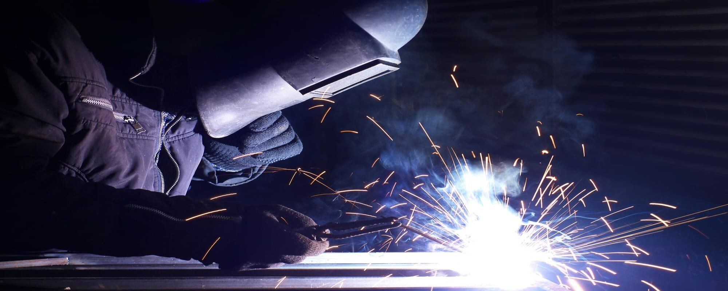
LAB MANUAL
Welding & Carfentry Lab
Course Code: CE 0715-1200
2nd Civil Regular

Slide 2
University of Global Village (UGV), Barishal Department of Mechanical Engineering Prepared by
Md. Naeem Hosen Hredoy Lab Instructor
Department of Mechanical

Slide 3
Course Name: Foundary and welding Lab
Course Teacher: Md.Naeem Hosen Hredoy | CREDIT:01
Course Code: SHOP 0715-2160 | TOTAL MARKS:50
TOTAL Class : 17 Nos | CIE MARKS: 30
Class Hours : 85 Hours | SEE MARKS: 20

Slide 4
Course Learning Outcomes (CLOs): After completing this course successfully, the students will be able to-
CLO 1. Understand
The fundamental principles of welding processes, including arc welding, gas welding, and resistance welding.
CLO 2. Design
Create welding procedures that ensure quality, efficiency, and safety.
CLO 3. Apply
Welding consumables (electrodes, filler rods, shielding gases) correctly.
CLO 4. Calculate
Welding time and material consumption for estimating costs and production schedules.
CLO 5. Analyze
The impact of welding variables on weld quality and mechanical properties.
CLO 6. Generate
Welding reports documenting welding parameters, quality control results, and any deviations from specifications.

Slide 5
Sr No | Content of Course | Hours | CLOs
1 | Welding Terms and Definitions | 05 | CLO1
2 | Arc striking practice & Study of arc physics | 10 | CLO1,CLO3
3 | Study of effect of welding parameters on weld bead by SMAW. | 10 | CLO1,CLO3
4 | Study of different weld joint types and Selection of proper WEP for given condition | 10 | CLO1,CLO6
5 | Study of different weld metal reactions | 10 | CLO2,CLO5
6 | Study of NDT & Hands on DPT | 05 | CLO3
7 | Study of microstructure of weld joint (CS) | 10 | CLO,CLO3
8 | Welding of a Test Coupon & Performance of Mechanical Testing | 10 | CLO2,CLO3
9 | Preparation of WPS & PQR | 10 | CLO5,CLO6
10 | Study of Welding symbols | 05 | CLO1,CLO3

Slide 6
Reference Book :
"Welding Principles and Applications" - Larry Jeffus
"Welding and Welding Technology" - Richard L. Little
"Modern Welding Technology" - Howard B. Cary
"Welding Metallurgy" - Sindo Kou
"The Procedure Handbook of Arc Welding" - The Lincoln Electric Company
"Fundamentals of Welding" - S. V. Nadkarni

Slide 7
ASSESSMENT PATTERN
CIE- Continuous Internal Evaluation
(20 Marks) SEE- Semester End Examination (30
Marks)
SEE- Semester End Examination (50 Marks) (should be converted in actual marks (30)
Bloom’s Category Cognitive | Tests (20)
Remember | 05
Understand | 07
Apply | 08
Analyze | 07
Evaluate | 08
Create | 05

Slide 8
Bloom’s Category Psychomotor | Practical Test (30)
Imitation | 10
Manipulation | 5
Precision | 5
Articulation | 5
Naturalization | 5

Slide 9
CIE- Continuous Internal Evaluation (40 Marks) (should be converted in actual marks (20)
Bloom ’s Catego ry Marks (out of 60) | Lab Report (10) | Continuous lab performance (10) | Presentation & Viva (10) | External Participation in Curricular/Co- Curricular Activities (10)
Remember |  |  | 02 | Attenda nce 10
Understan d | 05 | 04 | 03
Apply |  | 02
Analyze |  | 02
Evaluate | 05 | 02
Create |  |  | 05

Slide 10
Course plan specifying content, CLOs, teaching learning and assessment strategy mapped with CLOs
Week | Topic | Teaching-Learning Strategy | Assessment Strategy | Corresponding CLOs
1 | Welding Terms and Definitions | Lecture,Discussion | Quiz, Written Exam | CLO1
2,3 | Arc striking practice & Study of arc physics | Provide ample practice time for each skill. | Practical Assessments, Quiz | CLO1,CLO3
4,5 | Study of effect of welding parameters | Provide step-by- step explanations and demonstrations. | Perrormance- Based Assessments | CLO1,CLO3

Slide 11
 | on weld bead by SMAW.
6,7 | Study of different weld joint types and Selection of proper WEP for given condition | Showcase different welding techniques, safety procedures, and equipment usage. | Skill Tests | CLO1,CLO6
8,9 | Study of different weld metal reactions | Hands on Practice, discussion | Project, Hands on Practice | CLO2,CLO5
10 | Study of NDT & Hands on DPT | Experiment, Demonstration | Proper equipment setup and use | CLO3
11,12 | Study of microstructure of weld joint (CS) | Performance- Based Assessments | Assignment, Written, Quiz | CLO,CLO3

Slide 12
13,14 | Welding of a Test Coupon & Performance of Mechanical Testing | Problem-Based Learning: | Class Participation | CLO2,CLO3
15,16 | Preparation of WPS & PQR | Hands on Practice | Viva, Quiz | CLO5,CLO6
17 | Study of Welding symbols | Lecture, discussion, group work | Laboratory Reports | CLO1,CLO3

Slide 13
Index
Sr No | Date | Name of Experiment | Page No | Grade | Sign
1 |  | Welding Terms and Definitions
2 |  | Arc striking practice & Study of arc physics
3 |  | Study of effect of welding parameters on weld bead by SMAW.
4 |  | Study of different weld joint types and Selection of proper WEP for given condition

Slide 14
5 |  | Study of different weld metal reactions
6 |  | Study of NDT & Hands on DPT
7 |  | Study of microstructure of weld joint (CS)
8 |  | Welding of a Test Coupon & Performance of Mechanical Testing
9 |  | Preparation of WPS & PQR
10 |  | Study of Welding symbols

Slide 15
EXPERIMENT NO. 1
Aim: Study of Welding Terms & Definitions. Objective
After performing this experiment the students will be able to…
get acquainted with basic welding terms.
Basic Welding Terms
Welding Arc: A controlled electrical discharge between the electrode and the workpiece formed and sustained by the establishment of a gaseous conductive medium, called an arc plasma.
Arc Length: The distance from the tip of the welding elec- trode to the adjacent surface of the weld pool.

Slide 16
Flux: A material applied to the workpiece(s) before or during joining or surfacing to cause interactions that remove oxides and other contaminants, improve wetting, and affect the final surface profile. Welding flux may also
affect the weld metal chemical composition.
Welding Flux (SAW):A granular material comprised of metallic and nonmetallic constituents applied during welding to provide atmospheric shielding and cleaning of the molten weld metal and influence the profile of the solidified weld metal. This material may also provide filler metal and affect the weld metal composition.
Shielding Gas: A gas used to produce a protective atmosphere.
Duty Cycle: The percentage of time during a specified test period that a power source or its accessories can be operated at rated output without overheating. The test periods for arc welding and resistance welding are ten (10) minutes and one (1) minute, respectively.

Slide 17
Welding Electrode:A component of the welding circuit through which current is conducted and that terminates at the arc, molten conductive slag, or base metal.
Open Circuit Voltage (OCV): The voltage between the output terminals of the power source when the rated primary voltage is applied and no current is flowing in the secondary circuit.
Buttering: A surfacing variation depositing surfacing metal on one or more surfaces to provide metallurgically compatible weld metal for the subsequent completion of the weld.
Build-up: A surfacing variation in which surfacing material is deposited to achieve the required dimensions.
Cladding: A surfacing variation depositing or applying surfacing material usually to improve corrosion or heat resistance.

Slide 18
Hard Facing: A surfacing variation in which surfacing material is deposited to reduce wear.
Heat Input: The energy applied to the workpiece during welding.
Heat-Affected Zone (HAZ): The portion of base metal whose mechanical properties or microstructure have been altered by the heat of welding, brazing, soldering, or thermal cutting.
Dilution: The change in chemical composition of a welding filler metal caused by the admixture of the base metal or previous weld metal in the weld bead. It is measured by the percentage of base metal or previous weld metal in the weld bead.
Preheat Temperature: The temperature of the base material in the volume surrounding the point of welding immediately before welding is started. In a

Slide 19
multipass weld, it is also the temperature immediately before the second and subsequent passes are started. Minimum temperature required to start welding.
Interpass Temperature: In a multipass weld, the temperature of the weld area between weld passes. Maximum temperature allowed to deposit next pass in multipass welding.
Joint Efficiency: The ratio of the strength of a joint to the strength of the base metal.
Welder: One who performs manual or semiautomatic welding.
Welding operator: One who operates adaptive control, automatic, mechanized, or robotic welding equipment.
Welding Procedure Specification (WPS): A document providing the required welding variables for a specific application to assure repeatability by properly trained welders and welding operators.

Slide 20
EXPERIMENT NO.2
Aim: Study Of Arc Physics And Hands-On Practice Of Arc Striking On C.S. Plate. Objective
After performing this experiment the students will be able to…
get acquainted with arc physics.
perform arc strike on carbon steel plate.

Slide 21
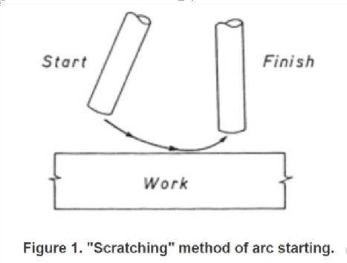
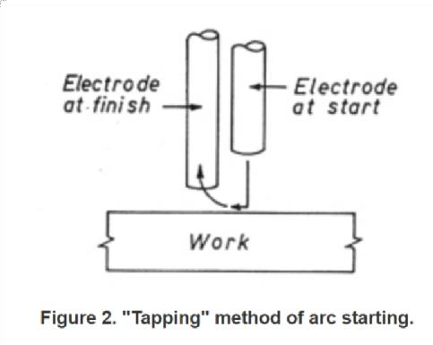
Arc Striking
A welding arc is maintained when the welding current is forced across a gap between the electrode tip and the base metal. A welder must be able to strike and establish the correct arc easily and quickly.
There are two general methods of striking the arc:
Scratching
Tapping
The scratching method is easier for beginners and when using an AC machine. The electrode is moved across the plate inclined at an angle, as you would strike a match. As the electrode scratches the plate an arc is struck. When the arc has formed, withdraw the electrode momentarily to form an excessively long arc, then return to normal arc length(FIG.1)

Slide 22
!
In the tapping method, the electrode is moved downward to the base metal in a vertical direction. As soon as it touches the metal it is withdrawn momentarily to form an excessively long arc, then returned to normal arc length (see figure 2).
The principal difficulty encountered in striking the arc is "freezing," or when the electrode sticks or fuses to the work. This is caused by the current melting the electrode tip and sticking it to the cold base metal before it is withdrawn from contact. The extra high current drawn by the "short circuit" will soon overheat an electrode and melt it or the flux, unless the circuit is broken. Giving the electrode holder a quick snap backward from the direction of travel will generally free the electrode. If it does not, It will be necessary to open the circuit by releasing the electrode from the holder.

Slide 23
Physics Of Arc
Introduction
A welding arc is an electric discharge that develops primarily due to flow of current from cathode to anode. Flow of current through the gap between electrode and work piece needs column of charged particles for having reasonably good electrical conductivity. These charged particles are generated by various mechanisms such as thermal emission, field emission secondary emission etc. Density of charged particles in gap governs the electrical conductivity of gaseous column. In an electric arc, electrons released from cathode (due to electric field or thermo-ionic emission) are accelerated towards the anode because of potential difference between work piece and electrode. These high velocity electrons moving from cathode toward anode collide with gaseous molecules and decompose them into charged particles i.e. electrons and ions. These charged particles move towards electrode and work piece as per polarity and form a part of welding current. Ion current becomes only about 1% of electron current as ions become heavier than the electrons so they move slowly. Eventually electrons merge into anode.

Slide 24
Arc gap between electrode and work piece acts as pure resistance load. Heat generated in a welding arc depends on arc voltage and welding current.
Emission of Free electrons
Free electrons and charged particles are needed between the electrode and work for initiating the arc and their maintenance. Ease of emitting electrons by a material assessed on the basis of two parameters work function and ionization potential. Emission of electrons from the cathode metal depends on the work function. The work function is the energy (ev or J) required to get one electron released from the surface of material. Ionization potential is another measure of ability of a metal to emit the electrons and is defined as energy/unit charge (v) required for removing an electron from an atom. Ionization potential is found different for different metal. For example, Ca, K, and Na have very low ionization potential (2.1-2.3ev), while that for Al and Fe is on the higher side with values of 4 and 4.5 ev respectively. Common mechanisms through which free electrons are emitted during arc welding are described below:

Slide 25
Thermo-ionic emission
Increase in temperature of metal increases the kinetic energy of free electrons and as it goes beyond certain limit, electrons are ejected from the metal surface. This mechanism of emission of electron due to heating of metal is called thermo ionic emission. The temperature at which thermo-ionic emission takes place, most of the metals melt. Hence, refractory materials like tungsten and carbon, having high melting point exhibit thermo ionic electron emission tendency.
Field emission:
In this approach, free electrons are pulled out of the metal surface by developing high strength electro-magnetic field. High potential difference (107 V/cm) between the work piece and electrode is established for the field emission purpose.
Secondary emission
High velocity electrons moving from cathode to anode in the arc gap collide with other gaseous molecules. This collision results in decomposition of gaseuous molecules into atoms and charged particles (electrons and ions).

Slide 26
Zones in Arc Gap
On establishing the welding arc, drop in arc voltage is observed across the arc gap. However, rate of drop in arc voltage varies with distance from the electrode tip to the weld pool (Fig. 3). Generally, five different zones are observed in the arc gap namely cathode spot, cathode drop zone, plasma, anode drop zone and anode spot (Fig. 3).
Cathode spot
This is a region of cathode wherefrom electrons are emitted. Three types of cathode spots are generally found namely mobile, pointed, and normal. There can be one or more than one cathode spots moving at high speed ranging from 5-10 m/sec. Mobile cathode spot is usually produced at current density 100-1000 A/mm2 . Mobile cathode spot is generally found during the welding of aluminium and magnesium. This type of cathode spot loosens the oxide layer on reactive metal like aluminium, Mg and stainless steel. Therefore, mobile cathode spot helps in cleaning action when reverse polarity is used i.e. work piece is cathode. Pointed cathode spot is formed at a point only mostly in case of tungsten inert gas welding at about 100A/mm2 . Pointed

Slide 27
tungsten electrode forms the pointed cathode-spot. Ball shaped tip of coated steel electrode forms normal cathode spot.
Cathode drop region
This region is very close to the cathode and a very sharp drop of voltage takes place in this zone due to cooling effect of cathode. Voltage drop in this region directly affects the heat generation near the cathode which in turn governs melting rate of the electrode in case of the consumable arc welding process with straight polarity (electrode is cathode).
Plasma
Plasma is the region between electrode and work where mostly flow of charged particles namely free electrons and positive ions takes place. In this region, uniform voltage drop takes place. Heat generated in this region has minor effect on melting of the work piece and electrode.

Slide 28
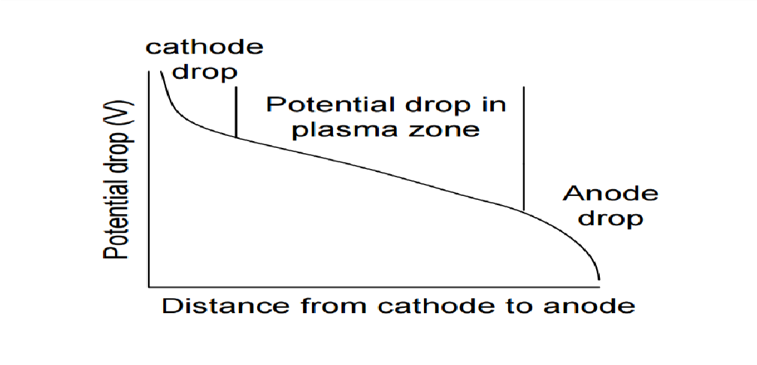
Anode drop region
Like cathode drop region, anode drop region is also very close to the anode and a very sharp drop in voltage takes place in this region due to cooling effect of the anode. Voltage drop in this region affects the heat generation near the anode & so melting of anode. In case of direct current electrode negative (DCEN), voltage drop in this zone affects melting of the work piece.
Anode spot is the region of a anode where electrons get merged and their impact generates heat for melting. However, no fixed anode spot is generally noticed on the anode like cathode spot.

Slide 29
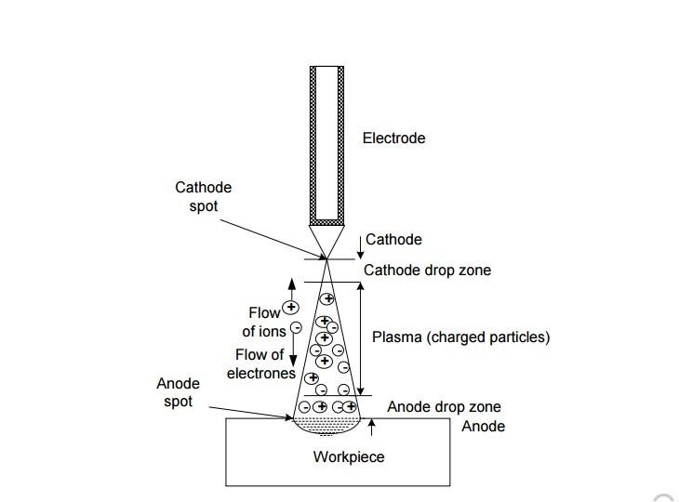
Fig. 3 Zones in arc gap of a welding arc
Electrical Fundamentals of Welding Arc
The welding arc acts as impedance for flow of current like an electric conductor. The impedance of arc is usually found a function of temperature and becomes inversely proportional to the density of charge particles and their mobility. Therefore, distribution of charged particles in radial and axial direction in the arc affects the total impedance of the arc. Three major regions have been noticed in arc gap that accounts for total potential drop in the arc i.e. cathode drop region, plasma and anode drop region. Product of potential difference across the arc (V) and current (I) gives the power of the arc indicating the heat generation per unit time. Arc voltage (V) is taken as sum of potential drop across the cathode drop region (Vc), potential drop across the plasma region (Vp), and potential
drop across the anode drop region (Va) as shown in Fig. 4 . Power of the arc (P) = (Vc+
Vp+ Va) I………………………(2.1)
!

Slide 30
Potential drop in different zones is expressed in terms of volt (V), welding current in ampere (A) and power of arc P is in watt (W). Equation 2.1 suggests that the distribution of heat in three zones namely cathode, anode and arc plasma can be changed. Variation of arc length mainly affects plasma heat while shielding gas influences the heat generation in the cathode and anode drop zones. Addition of low ionization potential materials (namely potassium and sodium) reduces the arc voltage because of increased ionization in arc gap so increased electrical conductivity which in turn reduces the heat generation in plasma region. Heat generation at the anode and cathode drop zones is primarily governed by type of welding process and polarity associated with welding arc. In case of direct current (DC) welding, when electrode is connected to the negative terminal and workpiece is connected with positive terminal of the power source then it is termed as direct current electrode negative polarity (DCEN) or straight polarity and when electrode is connected to the positive terminal of the power source and workpiece is connected with negative terminal then it is termed as direct current electrode positive polarity (DCEP) or reverse polarity. TIG welding with argon as shielding gas shows 8-10 time higher

Slide 31
current carrying capacity (without melting) than DCEP. The submerged arc welding with DCEP generates larger amount of heat at cathode than anode as indicated by high melting rate of consumable electrode. Increase in spacing between the electrode and work-piece generally increases the potential of the arc because of increased losses of the charge carriers by radial migration to cool boundary of the plasma. Increase in the length of the arc column (by bulging) exposes more surface area of arc column to the low temperature atmospheric gas which in turn imposes the requirement of more number of charge carriers to maintain the flow of current. Therefore, these losses of charged particles must be accommodated to stabilize the arc by increasing the applied voltage. The most of the heat generated in consumable arc welding process goes to weld pool which in turn results in higher thermal efficiencies. This is more evident from the fact that the thermal efficiency of metal arc welding processes is found in range of 70- 80% whereas that for non-consumable arc welding processes is found in range of 40- 60%.

Slide 32
Exercise:
Perform arc striking on carbon steel plate using different welding parameters by SMAW process and note your observations.
Observation Welding Process :
Polarity : Consumable, Size : Base Material :
Sr No | Welding Parameter | Observation
1 | Low current

Slide 33
2 | High Current
3 | Eccentric Electrode
4 | Electrode Chamfering not proper
5 | When electrode stick with base plate
6 | When arc directly exposed to eye

Slide 34
EXPERIMENT NO. 3
Aim: Study Of Effect Of Welding Parameters On Weld Bead Objective
After performing this experiment the students will be able to… •understand effect of different welding parameters on weld bead.
perform bead-on-plate welding on carbon steel plate.
Theory
The need to achieve higher productivity and stringent safety requirement have put growing emphasis on the use of automated welding systems, submerged arc welding is employed in semiautomatic or automatic mode in industry (Brien, 1978). In such automated applications, a precise means of selection of the process variables and control of weld bead shape has become

Slide 35
essential because mechanical strength of weld is influenced not only by the composition of the metal, but also by the weld bead shape (Hould, 1989). The acceptable weld bead shape depends on factors such as line power which is the heat energy supplied by an arc to the base plate per unit length of weld, welding speed, joint preparation, etc. To do these precise relationships between the process parameters and the bead parameters controlling the bead shape are to be established. This may be achieved by the development of mathematical expressions, which can be fed into a computer, relating the weld bead dimensions to the important process control variables affecting these dimensions. Also, optimization of the process parameters to control and obtain the required shape and quality of weld beads is possible with these expressions.
Operating Variables: Control of the operating variables in submerged arc welding is essential if high production rates and the welds of good quality are to be obtained. The following are the important variables:
Welding amperage
Welding voltage

Slide 36
Welding speed
Electrode size
Electrode work angle
Electrode stick-out
Depth of flux
Polarity
Melting rate
Flux basicity index
Welding amperage
If the current is too high at a given welding speed, the depth of fusion or penetration will also be too high so that the resulting weld may tend to melt through the metal being joined.

Slide 37
Bead width increases with welding current until a critical value is reached and then starts decreasing if the polarity used is DCEP. When DCEN polarity is employed bead width increases with the increase in current for entire range
If the current is too low, inadequate penetration or incomplete fusion may result. Too low current also leads to unstable arc, inadequate penetration and overlapping.
Welding voltage
The voltage principally determines the shape of the weld bead cross section and its external appearance. Increasing the welding voltage with constant current and welding speed produces flatter, wider, less penetrated weld beads and tends to reduce the porosity caused by rust or scale on steel. Higher voltage also bridges an excessive root opening when fit-up is poor. Increase in arc voltage also increases the size of droplets and hence decreases the number of droplets.
Excessively high voltage produces a wide bead shape that is subject to cracking, increases undercut and creates difficulty in removing slag. Lowering the voltage produces stiffer arc,

Slide 38
which improves penetration in a deep weld groove and resists arc blow. An excessively low voltage produces a narrow bead and causes difficult slag removal along the bead edges.
Welding speed
Weld penetration is affected more by welding speed than any variable other than current. This is true except for excessively slow speeds when the molten weld pool is beneath the welding electrode. Then the penetrating force of the arc is cushioned by the molten pool.
Excessive speed any cause undercutting, porosity, arc blow, uneven bead shape, cracking and higher slag inclusion in the weld metal. Higher welding speed results in less heat affected zone and finer grains (Aksoy et al.1999). Within limits, welding speed can be adjusted to control weld size and penetration. Relatively slow welding speed provides time for gases to escape from the molten metal, thus reducing porosity. An excessive slow speed produces a convex bead shape which is subject to cracking and excessive arc exposure which is uncomfortable for the operator. Too low welding speed may also result in a large molten pool that flows around the arc, resulting in rough bead, slag inclusions and burn through of the weld plate.

Slide 39
Electrode size
Electrode size affects the weld bead shape and the depth of penetration at fixed current. For the same values of current, arc voltage and welding speed, an increase in electrode diameter results in a slight increase in the spread of the bead.
Electrode work angle
The electrode may be held perpendicular to the workpiece or, tilted forward or backward with respect to the weld pool. As the arc stream tends to align itself along the axis of the electrode, the weld pool shape is different in each case, and so is the shape of the weld bead. It is observed that in forehand welding, molten metal flows under the arc, the depth of penetration and reinforcement are reduced while the width of the weld increases, whereas in backhand welding the pressure of the arc scoops the molten metal from beneath the arc, the depth of penetration and height of reinforcement increases while the width of the weld is reduced
Depth of flux

Slide 40
The depth of the layer of the granular flux influences the appearance and soundness of the finished weld as well as welding action. If the granular flux layer is too shallow, the arc will not be entirely submerged in flux. Flashing and spattering will occur.
This may lead to poor appearance of weld and it may also be porous. If the flux layer is too thick, the arc will be too confined and a rough rope like appearing weld will result and the weld bead may be narrow and humped.
Polarity
The amount of heat generated at the electrode and work piece, deposition rate, bead geometry and mechanical properties are affected by polarity. The change in polarity from DCEP to DCEN changes the amount of heat generated at electrode and the work piece and, hence the metal depositing rate, weld bead geometry and mechanical properties of the weld metal.
Exercise:
Perform arc striking on carbon steel plate using different welding parameters by SMAW process and note your observations.

Slide 41
Observation Welding Process :
Polarity : Consumable, Size : Base Material :
Sr No | Welding Parameter | Observation
1 | Low current
2 | High Current
3 | Low arc length
4 | High arc length

Slide 42
5 | Low travel speed
6 | High travel speed
7 | DCEN Polarity
8 | Welding technique (forehand/ backhand)
Q.1 Explain significance of preheat and interpass temperature during welding.

Slide 43
EXPERIMENT NO. 4
Aim: Study Of Different Weld Joint Types And Selection Of Proper WEP For Given Condition
Objective
After performing this experiment the students will be able to…
get acquainted with different weld joints.
select proper WEP for given weld joint.
Types of Joints
The loads in a welded structure are transferred from one member to another through the
welds placed in the joints. The various types of joints used in welded construction and the applicable welds are shown in Figure 2.

Slide 44
The configurations of the various welds are illustrated in figures shown below. Combinations of welds may be used to connect a joint, depending upon the strength requirements and loading conditions. For example, fillet and groove welds are frequently combined in corner and T-joints.
Design Considerations
Although different factors like production operations, manufacturing costs, product performance, appearance and customer acceptance influence the weld joint design but overall it can be said that three major factors that influence the selection of joint design are:
Load requirements
Ease of welding, and
Cost

Slide 45
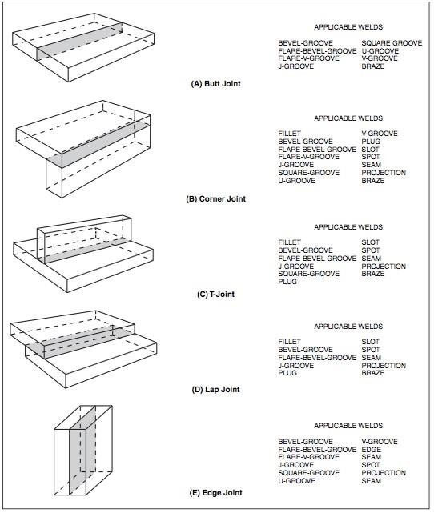


Slide 46
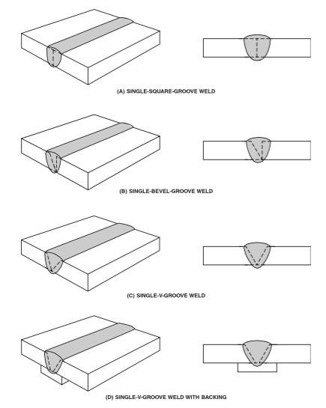

Slide 47
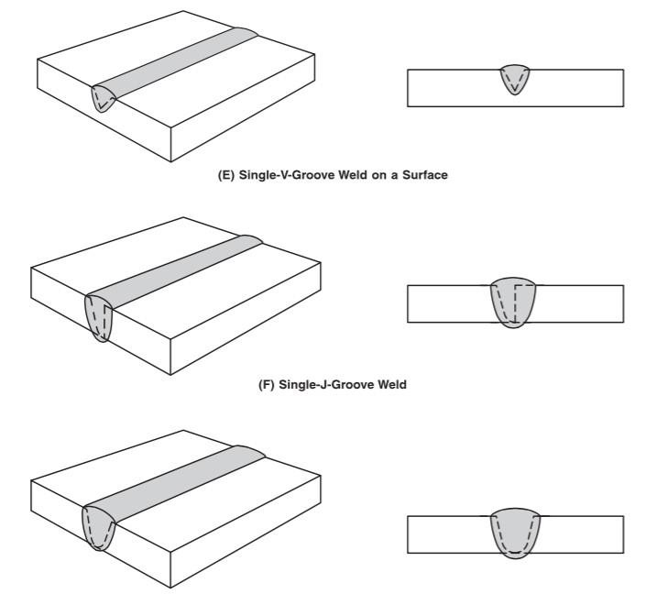
( G) Single-U-Groove Weld

Slide 48
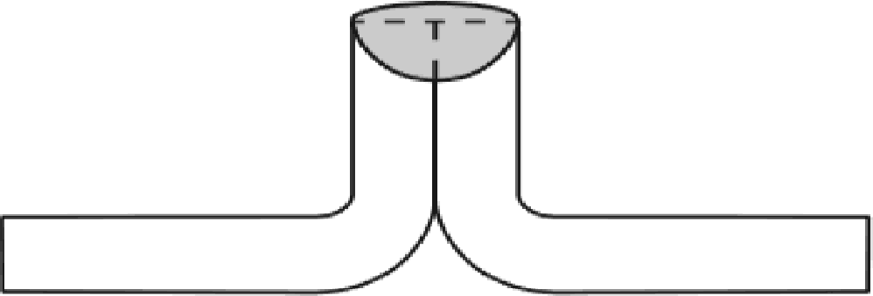
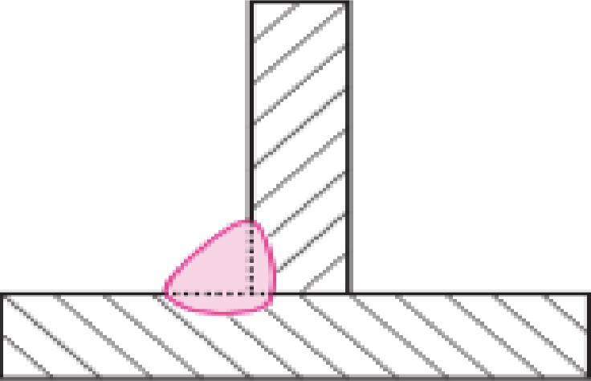
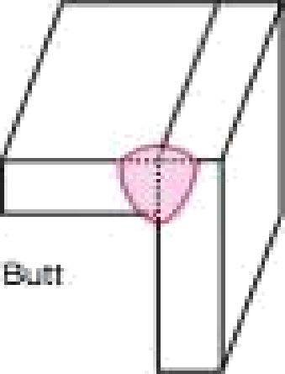
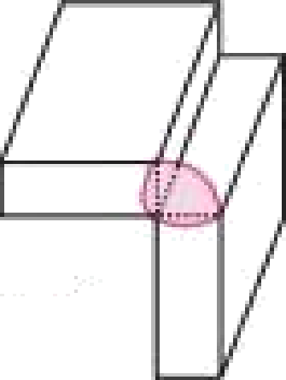
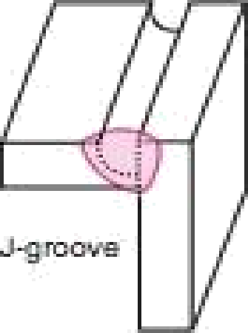
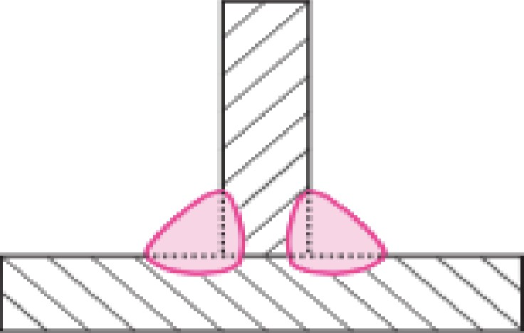
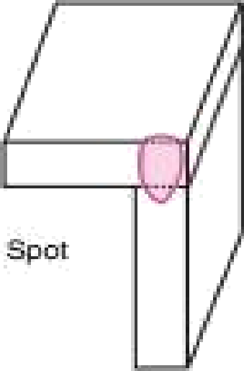
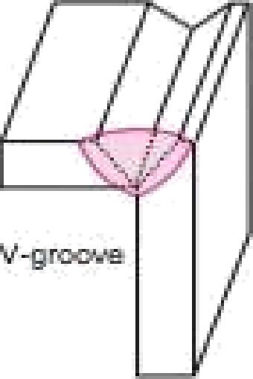

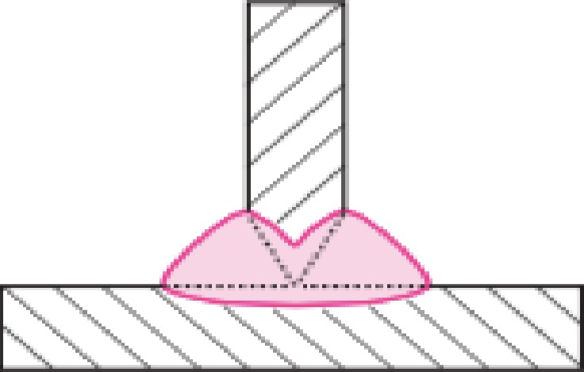

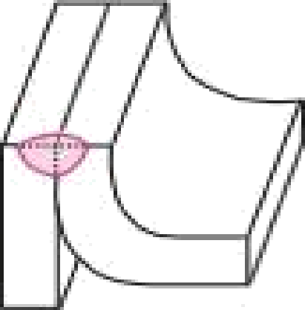
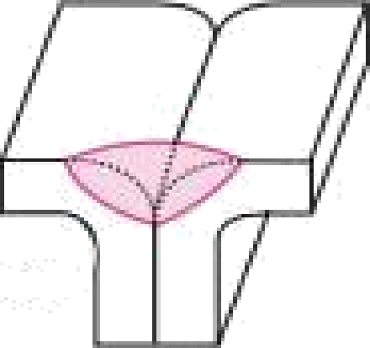
(A} EDGE WELD IN A FLANGED BUTT JOINT
Ski›tpe fillst
Cœnar
Panga
Flare-V

Slide 49
General Design Principles
The design principles that influence the general considerations in selecting a joint design are:
The design should satisfy strength and stiffness requirements. Over designing wastes materials and increases production and shipping costs.
The factor of safety used in design should not be unduly high.
Symmetric sections should be used to efficiently resist bending.
Rigidity may be provided with welded stiffness to minimise the weight of material.
Tubular sections of diagonal bracing should be used for resisting torsional loading.
Standard rolled sections, plate and bar should be used for economy and availability. This will also helpful in balancing the each member about the neutral axis during welding.
Plan the design to minimise the number of pieces. This will reduce assembly time and the amount of welding.

Slide 50
Consider back gouging or chip back grinding for back weld preparation.
Create a corner by bending or forming rather than welding two pieces together.
Bend flanges on plate rather than welding flanges on it.
Use a surfacing weld on an inexpensive material to provide wear resistance, corrosion resistance or other desired properties instead of using expensive alloy component.
Specific Weld Joint Design Principles
Use joint type which requires minimum weld metal to be deposited. However joint root accessibility shall be considered while selecting groove angle.
Double “V” joint configuration can be used for thick plate up to 75-100mm. Narrow groove can be used for plate thickness above 100mm. However, economics of eld edge preparation method shall be considered while selecting joint type.
Distortion control methods should be considered while design of weldment. Type of joint, stiffeners requirement, welding sequencing, block welding, simultaneous welding of symmetric shape objects, etc. methods shall be considered during welding to control distortion.

Slide 51
4. Make maximum uses of weld joint. Several parts can be joined with one pass weld.
E.g. use one weld in place of two or three welds to joint three parts at one location, as shown in figure.
Fillet welds are always designed on the basis of shear stress on the throat.
Component can be placed in such a way that welding can be performed easily. The joint can be made faster, better and more economically if it is easily accessible. In butt welds, accessibility is generally gained by compromising between groove angle and root opening.
Where intermittent fillet welds are satisfactory, they can be used as a means of reducing costs in hand welding operations.
Where possible, use a square groove joint for butt welds using deeper penetration welding processes. This will reduce the welding cycle time drastically and also better distortion control compare to open groove weld joints.
For equivalent strength a continuous fillet weld of a given size is usually less costly than a large sized intermittent fillet weld.

Slide 52
10. Wherever possible manual welding shall be converted to semiautomatic or machine welding to reduce welding cycle time and increase repeatability. To derive maximum advantage of automatic welding, it may be better to use one continuous weld rather than several short welds.
Exercise:
Q.1 Suggest proper WEP for given welding conditions.
Full fusion butt joint of 10mm thickness / Full fusion butt joint of 25mm thickness -
Butt joint of 100 mm thickness -
Q. 2 Do consumable estimation for LAS material, 50mm thick, double V butt joint, 25000 mm seam length to be welded by SMAW process

Slide 53
EXPERIMENT NO. 5
AIM: Study of different weld metal reactions Objective
After performing this experiment the students will be able to…
get acquainted with different weld metal reactions occurs during welding.
Theory:
As weld metal solidifies, series of events occur which affects largely on microstructure and mechanical properties of weldment. These events are gas metal reactions, liquid (slag) metal reaction and solid metal reaction.

Slide 54
Welding process and cleanliness of the weld
In fusion welding, the application of heat of the arc or flame results in the melting of the faying surfaces of the plates to be welded. At high temperature metals become very reactive to atmospheric gases such as nitrogen, hydrogen and oxygen present in and around the arc environment. These gases either get dissolved in weld pool or form their compound. In both the cases, gases adversely affect the soundness of the weld joint and mechanical performance. Therefore, various approaches are used to protect the weld pool from the atmospheric gases such as developing envelop of inactive (GMAW, SMAW) or inert gases (TIGW, MIGW) around arc and weld pool, welding in vacuum (EBW), covering the pool with molten flux and slag (SAW, ESW). The effectiveness of each method for weld pool protection is different. That is why adverse effect ofatmospheric gases in weld produced by different arc welding processes is different (Fig.5.1).

Slide 55
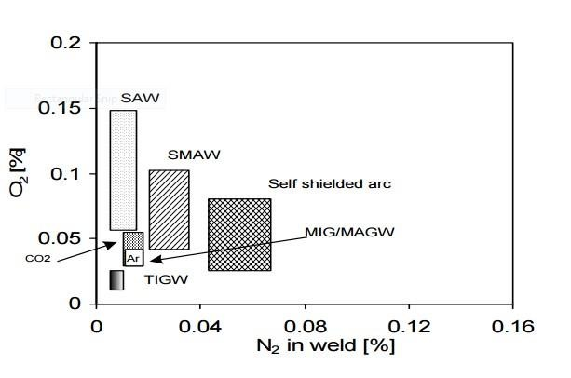
Fig. 5.1 Schematic diagram showing nitrogen and oxygen content in different welding processes
Amongst the most commonly used arc welding processes, the cleanest weld (having minimum nitrogen and oxygen) is produced by gas tungsten arc welding (GTAW) process due to two important factors associated with GTAW: a) short arc length and b) very stable arc produced by using non-consumable tungsten electrode. A combination of short and stable arc with none-consumable tungsten electrode results a firm shielding of arc and protection of the weld pool by inert gases restricts the entry of atmospheric gases in the arc zone. Gas metal arc welding (GMAW) also offers clean weld but not as clean as produced by GTAW because in case of GMAW arc length is somewhat greater and arc stability is poorer than GTAW. Submerged arc weld (SAW) joints are usually high in oxygen and less in nitrogen because SAW uses flux containing mostly metallic oxides.
These oxides decompose and release oxygen in arc zone. The self-shielded fluxed cored
metal arc welding processes use electrodes having fluxes in core act as de-oxidizer and
slag formers to protect the weld pool. However, weld produced by the self-shielded fluxed arc welding processes are not as clean as those produced with GMAW.
!Effect of atmospheric gases on weld joint

Slide 56
The gases present in weld zone (atmospheric or dissolved in liquid metal) affect the soundness of weld joint. Gases such as oxygen, hydrogen, nitrogen etc. are commonly present in and around the liquid metal. Both oxygen and hydrogen are very important in welding of ferrous and non-ferrous metals; these are mostly produced by decomposition of water vapours (H2O) in high arc temperature. Oxygen reacts with carbon in case of steel to form CO or CO2. These gases should escape out during the solidification; due to high solidification rate encountered in welding processes these gases may not come up to the surface of molten metal and may get trapped. This causes gaseous defects in the weldment, like porosity, blowhole etc. Chances for these defects further increases if the difference in solubility of these gases in liquid and solid state is high. Oxygen reacts with aluminium and form refractory alumina which forms inclusions and reduces the weldability. It’s formation can be reduced by proper shielding of arc zone either by inert or inactive gases. Only source of nitrogen is atmosphere and it may form nitrides but it creates fewer problems. Hydrogen is a main problem creator in welding of steel and aluminium alloy due to high difference in liquid and solid state solubility. In case of steel,

Slide 57
besides the porosity and blow holes hydrogen causes the problem of cold cracking even if it is present in very small amount, whereas in case of aluminium hydrogen causes pin hole porosity.
Oxides and nitrides formed by these gases if not removed from the weld, act as site of weak zone in form of inclusions which in turn lower the mechanical performance of the weld joint
e.g. iron reacts with nitrogen to form hard and brittle needle shape iron nitride (Fe4N). These
needle shape micro-constituents offer high stress concentration at the tip of particle matrix interface which under external tensile stresses facilitate the easy nucleation and propagation of crack, therefore fracture occurs at limited elongation (ductility). Similar logic can be given for reduction in mechanical performance of weld joints having high oxygen/oxide content. However, the presence of N2 in weld metal is known to increase the tensile strength due to the formation of hardness and brittle iron nitride needles.

Slide 58
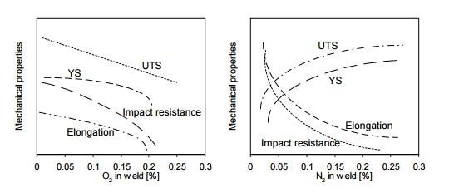
Fig. 5.2 Influence of oxygen and nitrogen as impurities on mechanical properties of steel weld joints
Additionally, these inclusions formed by oxygen, nitrogen and hydrogen break the discontinuity of metal matrix which in turn decreases the effective load resisting cross section area. Reduction in load resisting cross sectional area lowers the load carrying capacity of the welds. Nitrogen is also a austenite stabilizer which in case of austenitic stainless steel (ASS) welding can place crucial role. Chemical composition of ASS is designed to have about 5-8% ferrite in austenite matrix to control solidification cracking of weld. Presence of nitrogen in weld metal either from atmosphere or with shielding gas (Ar) stabilizes the austenite (so increases the austenite content) and reduces ferrite content in weld which in turn increases the solidification cracking tendency because ferrite in these steels acts as sink for impurities like P and S which otherwise increase cracking tendency of weld.
!Effect on weld compositions

Slide 59
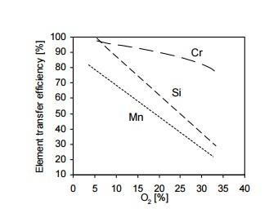
Fig 5.3 Influence of oxygen concentration on element transfer efficiency of common elements
Sometime composition of the weld is adjusted to get desired combination ofmechanical,
metallurgical and chemical properties by selecting electrode of suitable composition. Melting of electrode and coating and then transfer of the elements from the electrode across the arc zone causes the oxidation of some of the highly reactive elements which may be removed in form of slag. Thus transfer of especially reactive elements to weld
pool is reduced which in turn affects the weld metal composition and so mechanical and
!other performance characteristics of weld.

Slide 60
Exercise
Q. 1 Explain in brief reactions of different gases with weld metal and its effects.

Slide 61
EXPERIMENT NO. 6
AIM: Study Of Various Non-Destructive Testings And Hands On DPT Objective
After performing this experiment the students will be able to…
Get acquainted with working principle and operating procedure of different NDTs.
Apply acceptance standard for different NDTs
Understand merits and limitations of different NDTs
Introduction
Non-destructive Examination is a tool, which uses Physical Method to determine soundness &
measurement of characteristics of the raw material, components, structure & equipments etc.
without causing harm to them. A non-destructive test is an examination of a component in any manner which will not impair its future use. Although non-destructive testing do not provide

Slide 62
direct measurement of mechanical properties, yet they are extremely useful in revealing defects in components that could impair their performance when put in service. NDTs make components more reliable, safe and economical. Various NDTs commonly used are as follows:
Visual Examination
Liquid Penetrant Test
Magnetic Particle Test
Ultrasonic Test
Radiographic Test
Eddy Current Test
Dye Penetrant Test (DPT)
A Dye penetrant testing (DPT), also sometimes identified as Liquid penetrant testing (LPT) is a
quick and reliable NDT method for detecting flaws that are open to surface e.g. cracks, seams, laps, lack of bonding, porosity, cold shuts, etc. It can be effectively used not only in the

Slide 63
inspection of ferrous metals but is especially useful for non-ferrous metal products and on non-porous, non-metallic materials such as ceramics, plastics and glass.
Working Principle
The principle of DPT is that the liquids (Dye) used in the testing enter small openings such as
cracks or porosities by capillary action. The rate and extent of this action are dependent upon such properties as surface tension, cohesion, adhesion and viscosity. They are also influenced by factors such as the condition of the surface of material and the interior of the discontinuity.

Slide 64
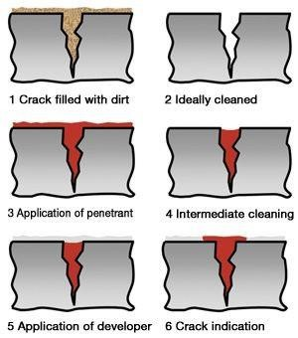
After allowing liquid dye to penetrate in the surface opening, excess dye material is removed throughly. Now to make the dye visible at the location of flaw, a developer having good contrast with dye colour is sprayed on the test plate. The liquid dye penetrated the defect will then bleed out on to the surface by bloating action. This will show the location and general
nature and magnitude of any discontinuity present.
Apply the liquid dye material adequately by any suitable method to cover the area to be tested.
3. Dwell Time
The penetrant is allowed "dwell time" to soak into any flaws
(generally 10 to 20 minutes).

Slide 65
The dwell time mainly depends upon the penetrant being used, material being tested and the size of flaws sought.
Excess penetrant removal
The excess penetrant is then removed from the surface. If excess penetrant is not properly
removed, once the developer is applied, it may leave a background in the developed area that can mask indications or defects. In addition, this may also produce false indications severely
hindering your ability to do a proper inspection. Also, the removal of excessive penetrant is done towards one direction either vertically or horizontally as the case may be.
Application of developer
After removal of excess penetrant, white developer is sprayed evenly on the surface to give a thin even layer. This layer absorbs the penetrant from the openings - often termed as “bleed-
out”. This bleed out appears as a red spot or line on white background to give a visible indication of the flaw.

Slide 66
6.Interpretation
The inspector will use visible light with adequate intensity (100 foot-candles or 1100 lux is typical) for visible dye penetrant, Ultraviolet (UV-A) radiation of adequate intensity (1,000
micro-watts per centimeter squared is common), along with low ambient light levels (less than
2 foot-candles) for fluorescent penetrant examinations. Inspection of the test surface should take place after sufficient development time, depends of product kind. This time delay allows
the blotting action to occur.
7.Post-cleaning
The test surface is often cleaned after inspection and recording of defects, especially if post-
inspection coating processes are scheduled.
Magnetic Particle Test (MPT)
This is a method of detecting the presence of cracks, laps, tears, seams, inclusions and similar
discontinuities too fine to be seen by naked eye and will also detect discontinuities which lie slightly below the surface. It is not applicable to nonmagnetic materials. MPT is a relatively

Slide 67
simple and easy technique. It is free from any restriction as to size, shape, composition and heat-treatment of a ferromagnetic specimen.
Working Principle
When a piece of metal is placed in a magnetic field and the lines of magnetic flux get
intersected by a discontinuity such as a crack or slag inclusion in a casting, magnetic poles are induced on either side of the discontinuity. The discontinuity causes an abrupt change in the path of magnetic flux flowing through the casting normal to the discontinuity, resulting a local flux leakage field and interference with the magnetic lines of force as shown in fig.1. This local flux disturbance can be detected by its affect upon magnetic

Slide 68
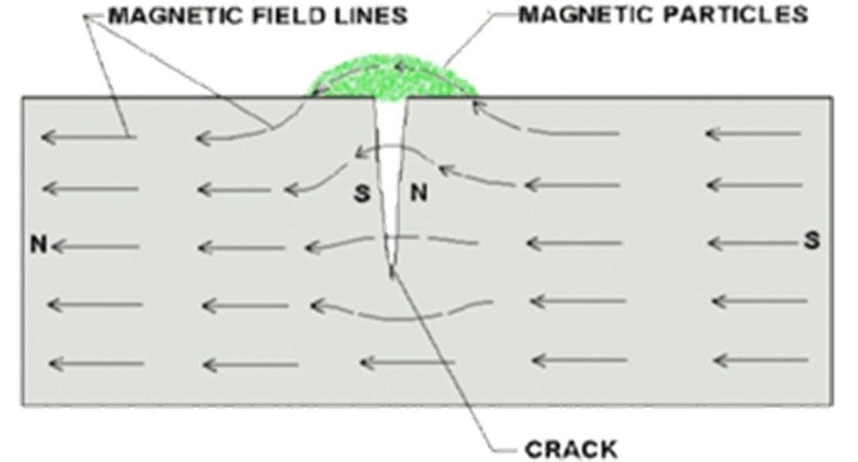
particles which collect on the region of discontinuity and pile up and bridge over the discontinuity.
Fig: 1 Magnetic Flux Leakage due to Discontinuity
A surface crack is indicated (under favourable conditions) by a line of fine particles following the crack outline and a subsurface defect by a fuzzy collection of the magnetic particles on the surface near the discontinuity. Maximum sensitivity of indication is obtained when the discontinuity lies in a direction normal to the applied magnetic field and when the strength of magnetic field is just enough to saturate the section being inspected.
Working Procedure
A) Magnetising the component/specimen

Slide 69
Different methods used to magnetise the specimen may be classified as:
Continuous method in which the magnetisation and application of the metallic particles may occur simultaneously.
In residual method, the piece to be inspected may be magnetised and then covered with fine magnetic particles (iron powder).

Slide 70
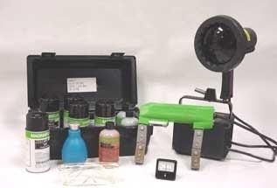
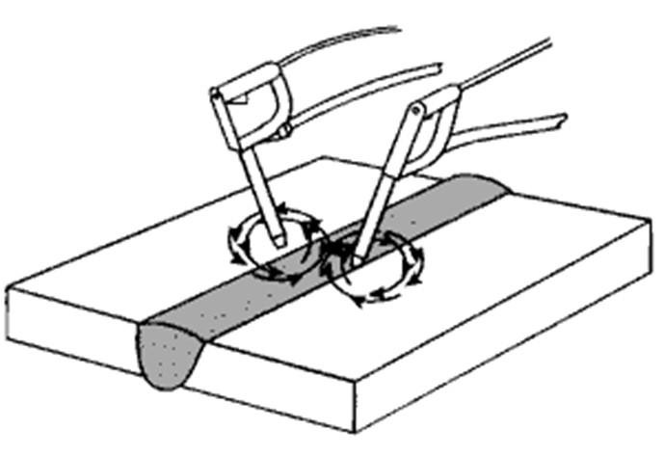
Fig: 2 Portable Equipments for MPT
is produced by circular fields. A conductor carrying an electric
Circular magnetisation
current is surrounded by magnetic field which forms closed circles in a plane at right angles to the direction of current flow.

Slide 71
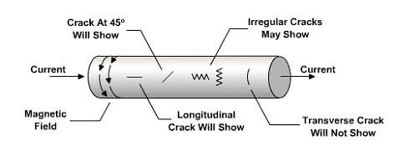
Fig:3 Circular Magnetism using Prods
Circular magnetisation may be produced by,
Passing current through the part itself
Passing current through a conductor placed axially inside the hollow casting 3) Using prods
or contacts.
Longitudinal Magnetisation is produced by passing current through solenoid coil or several turns of conductor surrounding the specimen, the specimen serving as the core of the solenoid.
A) Circular Magnetism

Slide 72
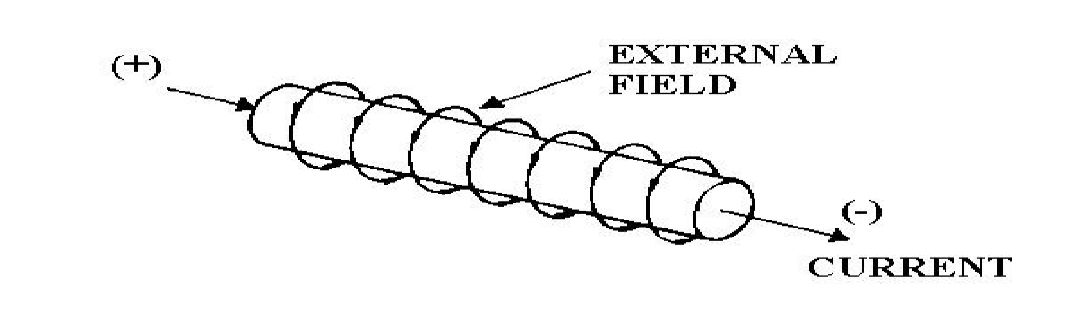
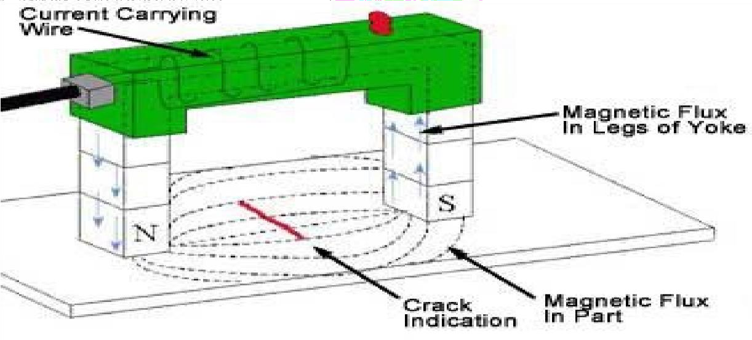
B) Longitudinal Magnetism
Fig: 4 Direction of Magnetic Field

Slide 73
Fig: 5 Longitudinal Magnetism using Yoke
Direct current, AC current and rectified AC current are all used for magnetising purpose. Direct current is more sensitive than AC current for detecting discontinuities that are not open to the surface. AC current will detect discontinuities open to the surface and is used when detection of this type of discontinuity is the only interest. When AC current is rectified, it provides a more penetrating magnetic field.
B) Applying Magnetic Powder
Magnetic particles may be applied during the passage of magnetising current or following the same when the residual magnetism is made use of in detecting cracks in casting; this method avoids the danger of over saturation

Slide 74
The magnetic particles may be held in suspension in a low viscosity noncorrosive liquid such as kerosene that is flushed over the piece, or the piece may be immersed in the suspension. This method is called as wet method. Wet method is better for detecting minute surface defects.
In some applications, the particles, in the form of fine powder, are dusted over the surface of the workpiece. This method is called as dry method.
Magnetic particles prepared with a fluorescent coating and inspected under ultraviolet light are also used. In this case the cracks are marked by glowing indications.
Locating the defects
Surface as well as subsurface defects may be detected as the cluster of metallic powder at the
region of magnetic flux leakage caused by the discontinuity.
Demagnetising
All machine parts that have been magnetised for inspection must be put through a
demagnetising operation. If the parts are placed in service without demagnetising, they will

Slide 75
attract filing, grindings, chips and other steel particles which may cause scoring of bearings and other engine parts.
Merits
Can detect surface as well as subsurface defects also.
Less operator skill is required compare to RT & UT.
Can perform easily on complicated shape as well as in confined space where there is an eye excess to the surface to be examined.
Can produce results quickly. We can have Realtime results of the examination.
Pre-cleaning of the parts are not critical compare to other NDT methods.
Limitations
Can not be performed on Nonmagnetic materials.
Defects present at higher depths (more than 12mm) can not be detected.
Post cleaning and demagnetisation is essential.
Alignment between magnetic flux and defect is important.

Slide 76
Ultrasonic Testing
The use of sound wave to determine defects is a very ancient method. A more refined method
consists of utilising sound waves above the audible range with a frequency of 1 to 5 million Hz
- hence the term ultrasonic. Ultrasonics is a fast, reliable nondestructive testing method which
employs electronically produced high frequency sound waves that will penetrate metals, liquids and many other materials at speeds several thousand feet per second and get reflected
by the subsurface defects. Ultrasonic waves form a basis for detection, location and size estimation of defects. ❖ Working Principle
Ultrasonic waves are usually generated by the Piezoelectric effect which converts electrical energy to mechanical energy. A quartz crystal is widely used as ultrasonic transducer. A
transducer is a device for converting one form of energy to another. The surface of specimen
to be inspected by UT is made fairly either by machining or otherwise so that ultrasonic waves can be efficiently transmitted from the probe into the specimen and even small defects can be detected properly.

Slide 77
EXPERIMENT NO. 7
Aim: Study of microstructure of weldment. Objective
After performing this experiment the students will be able to… •understand change in microstructure of different region of weld joint.
Introduction:
Welding involves many metallurgical phenomena. Welding operation somewhat resembles to casting.
In all welding processes except cold welding, heating & cooling are essential and integral parts of welding.

Slide 78
In most cases the maximum temperature exceeds various critical temperatures at which phase transformation occur in the metals involved in welding.
The study of welding metallurgy requires a consideration of the following metallurgical phenomena that play an important role in fusion welding.
The parent metal and the electrode melt and then resolidify as an integrated mass under the equivalent of chill casting conditions. This causes redistribution of the microconstituents and the alloying elements in the weld metal zone.
The (Unmelted) parent metal is subjected to a complex heat treatment in the form of a temperature gradient extending from the melting range to room temperature and followed by a cooling cycle induced by the neighbouring cold metal and atmosphere (FIGURE NO. 1 & FIGURE NO. 3)

Slide 79
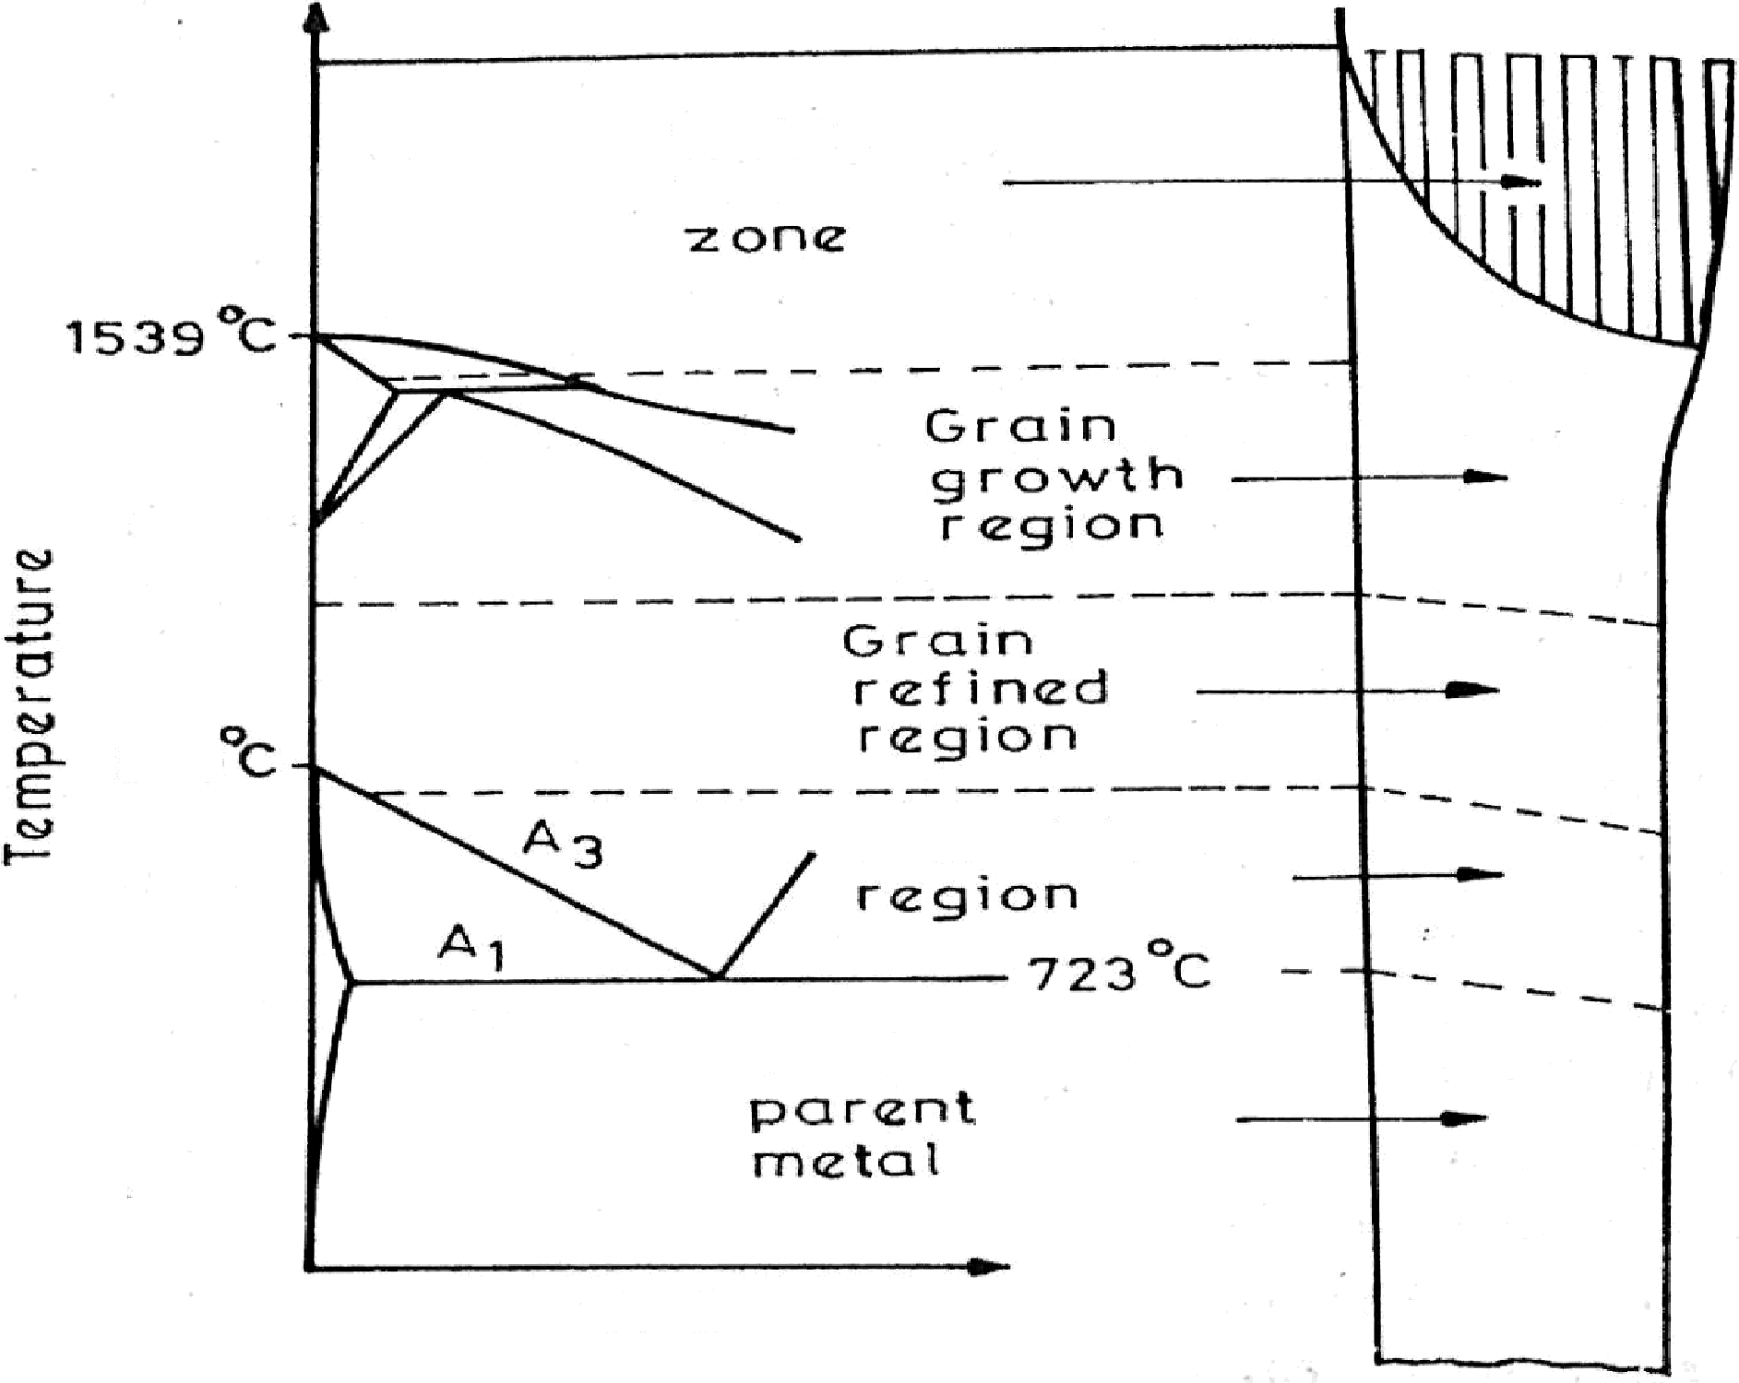

rri ‹zter I
Tr ct rn n i 1 i c› rn
LJ n a f f e cte cł
“ e
Regic›ns c›f a weIU Sci jc› i rit a ncI t lie i r rel at íc›n sit
h te ni pm re t ı re.

Slide 80
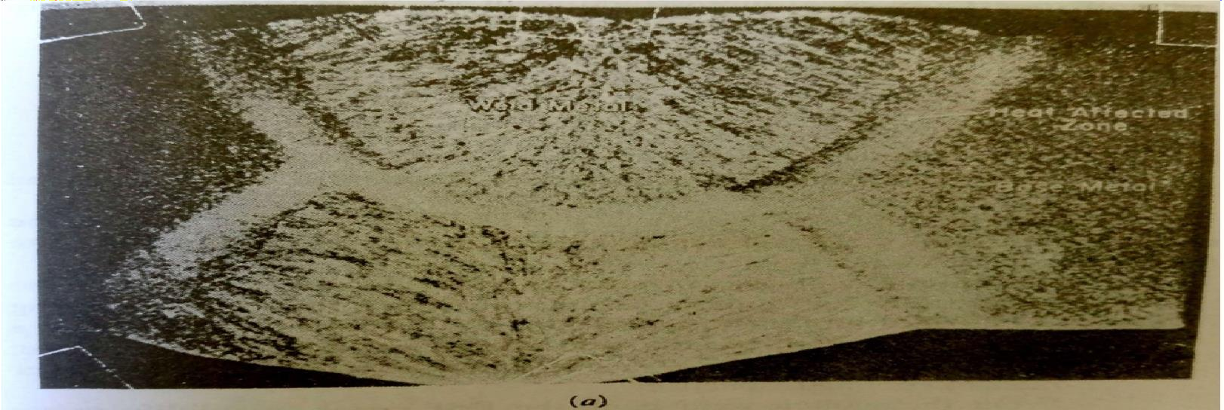
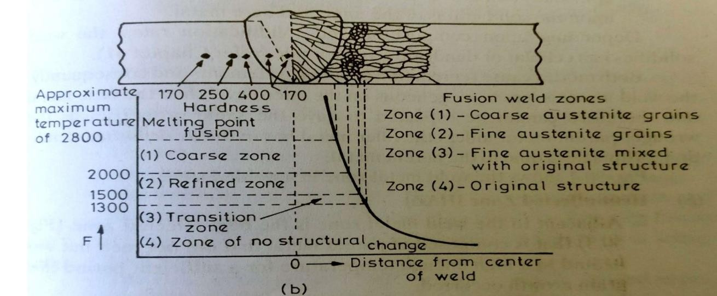
FIGURE NO.2

Slide 81
! ➢ The temperature and thus the phase changes that take place in and around the weld introduce volume changes which result in plastic flow, residual stresses and sometimes cracking too.
If one looks at a microstructure of a welded joint, he clearly visualises three distinct zones, namely:
Weld metal zone
Heat affected zone
(Unaffected) base metal or parent metal.
a. Weld metal zone
Weld metal zone is formed as the weld metal solidifies from the molten state.
This is a mixture of parent metal and electrode (or filler metal), the ratio depending upon the welding process used, the type of joint, the plate thickness etc.

Slide 82
Weld metal zone is cast metal of particular composition of the mixture that has cooled; its microstructure reflects the cooling rate in the weld. Depending upon the chemical composition, a martensite structure in the weld indicates a very fast cooling rate; fine pearlite, and coarse pearlite showing comparatively slower rates of cooling respectively.
From the molten weld pool, the first metal to solidify grown epitaxially(with its orientation controlled by the crystal substrate) upon the solid grains of the unmelted base metal.
Depending upon composition and solidification rates, weld solidifies in a cellular or dendritic growth mode.
Both modes cause segregation of alloying elements and consequently, the weld metal is less homogeneous on the micro level than the base metal and therefore cannot be expected to have the same properties as the wrought parent metal-unless the filler metal has in the as deposited condition, properties equal to the parent metal.

Slide 83
b. Heat affected zone
Adjacent to the weld metal zone is the heat affected zone that is composed of parent metal that did not melt but was heated to a high enough temperature for a sufficient period that grain growth occurred.
Heat affected zone is the portion of base metal whose mechanical properties and microstructure have been altered by the heat of welding.
HAZ, usually contains variety of microstructures. In plain carbon steels these structures may range from very narrow regions of hard martensite to coarse pearlite. These renders HAZ, the weakest area in the weld. Except where there are obvious defects in the weld deposit, most welding failures originate in the heat affected zone.
The heat affected zone is often defined by the response of welded joints to hardness or etching effect test.

Slide 84
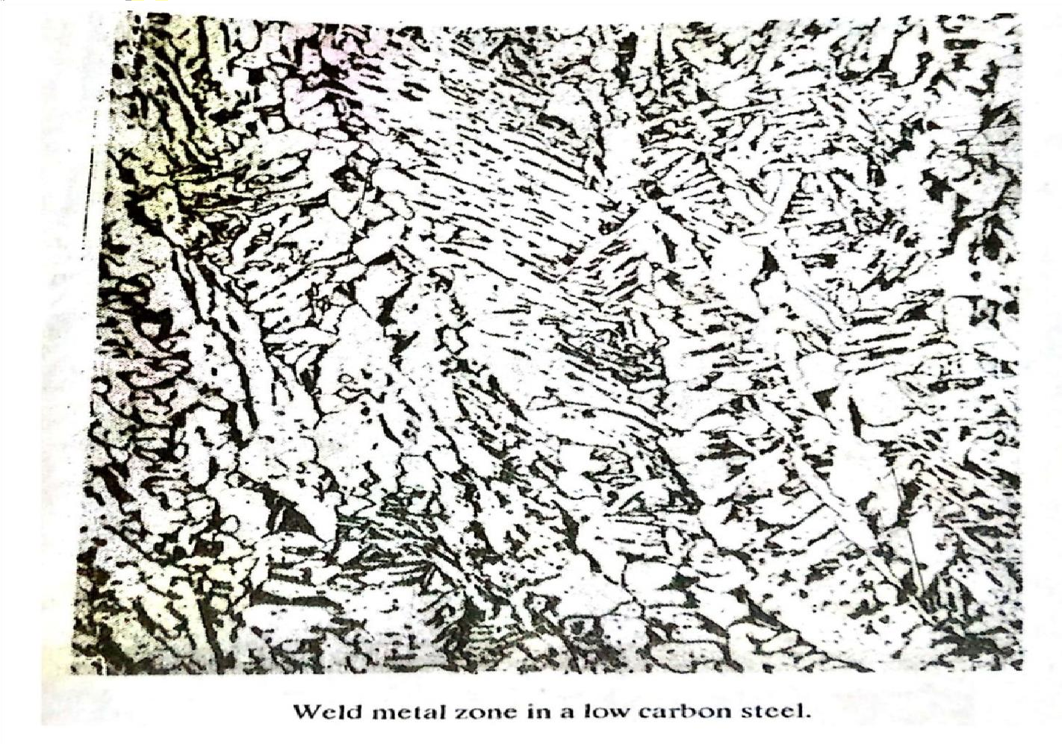
!

Slide 85
The width of HAZ varies according to the welding processes and technique; in arc welds it extends only a few mm from the fusion boundary, but in oxyacetylene and electroslag welds it is somewhat wider.
The HAZ in low carbon steel of normal structure welded in one run with coated electrodes or by submerged arc process comprises three metallurgically distinguished regions.
The grain growth region
The grain refined region
The transition region
1. The grain growth region
Grain growth region is immediately adjacent to the weld metal zone (fusion boundary).

Slide 86
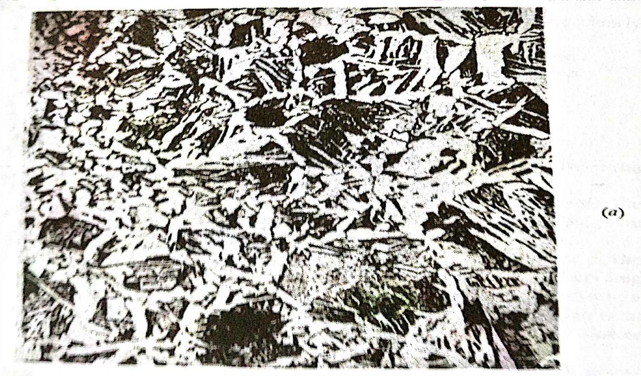

Slide 87
In this zone parent metal has been heated to a temperature well above the upper critical(A3) temperature. This resulted in grain growth or coarsening of the structure.
The maximum grain size and the extent of this grain growth region increases as the cooling rate decreases, and are greatest for elctroslag welds.
Figure shows the large regions of pearlite and smaller grains of ferrite.
2. The grain refined region
Adjacent to the grain growth region is the grain refined zone. Figure shows the structure of refined zone of the low carbon steel. Complete recrystallization is shown in which the ferrite(white) and pearlite(dark) areas are both much finer.
The transition zone
In the transition zone temperature zone exists between A1 and A3 transformation temperatures where partial allotropic recrystallization takes place.

Slide 88
This change was produced by heating into the critical range which transforms the pearlite into austenite and by subsequent cooling reformed the pearlite.
c. Unaffected parent metal
Outside the heat affected zone is the parent metal that was not heated sufficiently to change its microstructure.
Weld metal is essentially a small casting, with the inherent defects and characteristics of a casting. An appreciation of this characteristics can be easily attained by a study of the mechanism of solidification of metals and alloys.
Absorption of gases by weld metal and gas reactions are important in controlling the porosity of a weld, e.g., hydrogen in aluminium.
Gas such as hydrogen is more easily dissolved in the molten metal at high temperature and many subsequently be trapped in the solid metal if cooling is rapid. The gas may either

Slide 89
be retained in the microstructure or may form bubbles which can become trapped as porosity in the fast freezing metal.
Gas metal reaction may take one of the two forms: physical(endothermic) solution, or exothermic reaction to form a stable chemical compound.
Endothermic solution does not exhibit fusion, but can result in porosity, either due to super saturation of the weld pool with a particular gas or by reaction between two gases. Sometimes it may result in the embrittlement of HAZ also.
Slag inclusions are frequently trapped in fusion welds due to joint or bead contour and there is difficulty of removing or melting the slag in subsequent runs.
Hot cracking of welds. Under constrained welding conditions, the contractional strains, sometimes, cause inter crystalline cracks in hot weld, the fractured surface being tinted with oxidation film.

Slide 90
Hot cracking of welds occurs at elevated temperatures. This may be attributed
directly to the low ductility of the base metal at temperatures not too far below melting.
High arc welding currents cause larger columnar crystals to form with definite
planes of weakness at the throat of the weld. Austenitic steels, (e.g. 25 Cr, 20 Ni) which normally solidify with large columnar crystals are prone to these difficulties.
➢
Exercise
How to avoid formation of brittle structure in HAZ after welding?
What is the relationship between hardness, microstructure and toughness in steel heat affected zones?

Slide 91
EXPERIMENT NO. 8
AIM: Weld a Test Coupon (PQR) and Perform Mechanical Testing As Per ASME Sec IX.
Objective
After performing this experiment the students will be able to…
perform mechanical tests on welded joint.
Introduction to WPS & PQR
A Welding Procedure Specification (WPS) is the formal written document describing welding
procedures, which provides direction to the welder or welding operators for making sound and quality production welds as per the code requirements . The purpose of the document is
to guide welders to the accepted procedures so that repeatable and trusted welding techniques are used. A WPS is developed for each material alloy and for each welding type

Slide 92
used. Specific codes and/or engineering societies are often the driving force behind the development of a company's WPS.
A WPS is supported by a Procedure Qualification Record (PQR or WPQR). A PQR is a record of a test weld performed and tested (more rigorously) to ensure that the procedure will produce a good weld. Individual welders are certified with a qualification test documented in a Welder Qualification Test Record (WQTR) that shows they have the understanding and demonstrated ability to work within the specified WPS. As a minimum a PQR shall document the essential variables and other specific information identified in ASME Sec. IX, Article II for each process used during welding the test coupon and the results of the required testing. In addition, when notch toughness testing is required for procedure qualification, the applicable supplementary essential variables for each process shall be recorded.

Slide 93
Welding Variables
The code defines this terminology as "Essential variables are conditions in which a change, as described in the specific variables, is considered to affect the mechanical properties of the
joint".
It means if you have a welding procedure and one of your essential variable changes out of specified range then you need to re-qualify that WPS because that change affects the mechanical property of the weld.
For example, if you have a WPS with shielded metal arc welding (SMAW) process with post weld heat treatment, and then you need to use this WPS for another job without post weld heat treatment, you need to re-qualify your WPS because post weld heat treatment is an essential variable in SMAW process.
Essential Variable in Welding Procedure Specification (WPS) in ASME Code Section IX:
The ASME Code Section IX provides a table for each welding process and identifies essential, nonessential and supplementary essential variables. So if you have a WPS, and you need to

Slide 94
use this WPS in another job with the implication of some changes, then you need to refer these tables to see if these changes fall among of essential variables. If they fall, then you need to re-qualify your WPS. In most of welding process, The P number, F number, A number PWHT, thickness (out of specified range) are essential variable. Based on requirements of ASME Code Section IX all essential variable, nonessential variable and supplementary essential variable (such as Group Number) must be indicated in the welding procedure specification.
When you have a change in the essential variable, you need to write a new welding procedure specification and qualify that with a new procedure qualification record (PQR). To have a PQR you have to prepare a new test specimen that welded based on this new WPS and make two tension test, two root bend test and two face bend test.
This PQR number should be indicated in this new WPS. You need to refer to ASME Code Section IX to find correct size and number of test specimens, test specimen preparation, testing equipment requirements and related acceptance criteria.

Slide 95
The essential variable not limited to the WPS, you have the same variables with the different requirements in the welding performance qualification.
Exercise
Weld a test coupon of CS # CS material of 16mm thickness using SMAW process and perform applicable mechanical tests as per ASME Sec. IX. Note the parameters in standard PQR format.

Slide 96
EXPERIMENT NO. 9
AIM: Study of Welding Procedure & Performance Qualification and Preparation of WPS & PQR
Objective
After performing this experiment the students will be able to…
prepare WPS & PQR
prepare WPQ
Introduction
A Welding Procedure Specification (WPS) is the formal written document describing welding procedures, which provides direction to the welder or welding operators for making sound and quality production welds as per the code requirements . The purpose of the document is to guide welders to the accepted procedures so that repeatable and trusted welding techniques are used.

Slide 97
A WPS is developed for each material alloy and for each welding type used. Specific codes and/or engineering societies are often the driving force behind the development of a company's WPS. A WPS is supported by a Procedure Qualification Record (PQR or WPQR). A PQR is a record of a test weld performed and tested (more rigorously) to ensure that the procedure will produce a good weld. Individual welders are certified with a qualification test documented in a Welder Qualification Test Record (WQTR) that shows they have the understanding and demonstrated ability to work within the specified WPS.
According to the American Welding Society (AWS), a WPS provides in detail the required welding variables for specific application to assure repeatability by properly trained welders. The AWS defines welding PQR as a record of welding variables used to produce an acceptable test weldment and the results of tests conducted on the weldment to qualify a Welding Procedure Specification.
Exercise:
Prepare a WPS from given PQR.

Slide 98
Experiment no. 10
AIM: Study of Welding Symbols Objective
After performing this experiment the students will be able to…
get acquainted with different welding symbols.
apply welding symbols for different weld joints.
Introduction
Welding symbols are used to communicate requirements for the desired welding. They typically include the weld symbol and specify the weld location, type, size, and length. The basic welding symbol is comprised of the reference line, about which the weld symbol and dimensions are located, and an arrow, designating the location for the weld. As shown in Figure 8.3, a tail may be included in the symbol to provide an area to communicate information about the welding specification, the welding process, or other reference data.

Slide 99
A complete welding symbol consists of the following elements:
Reference line (required);
Arrow (required);
Tail;
Basic weld symbol;
Dimensions and other data;
Finish symbols;
Specification, process, or other references; and
Supplementary symbols.
The elements of the welding symbol have a standard location with respect to one another. The location of the elements in the welding symbol is illustrated in Figure 10.4. Apart from the reference line and arrow, which are required, only those elements that provide the required

Slide 100
clarity need be specified. The required and optional elements of the welding symbol are described in detail below.
Reference line
The reference line is the basic and required welding symbol element about which the weld information is located. The reference line is oriented horizontally.
Multiple Reference lines
As shown in Figure 10.2, two or more reference lines may be used with a single arrow to indicate a sequence of operations. The reference line nearest the tip of the arrow specifies the first operation. The second or more reference lines represent the subsequent operations. Subsequent operations are shown sequentially on other reference lines leading away from the tip of the arrow.

Slide 101
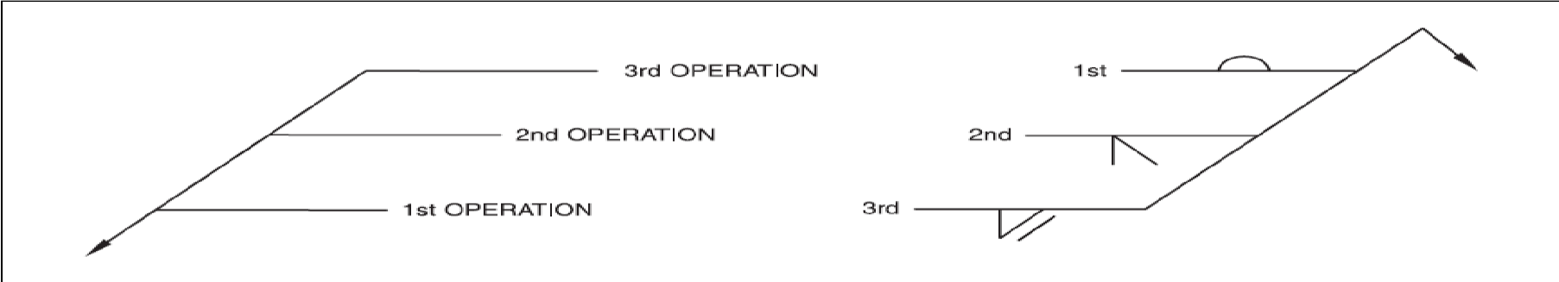
Reference lines are also used to specify data to supplement the welding symbol and to indicate inspection requirements. Figure 10.2 illustrates the application of multiple reference lines to give clear guidance on the procedures (e.g., gouging to sound metal for the weld from the second side).
Fig. 10.2
!Arrow
The significance of the arrow is illustrated in Figure 8.7. Used in conjunction with the reference line, the arrow establishes the locations of the arrow side and the other side of a joint, as shown in Figure 8.7(A). The arrow clearly points to the location on the drawing that identifies the intended joint to which the welding instructions apply. The arrow side of the reference line is always closest to the reader when the drawing is viewed from the bottom and the reference line

Slide 102
is drawn, as preferred, in a horizontal plane. Likewise, the other side of the line provides instructions for the side of the joint furthest from the arrow.
Tail
When a specification, process, test, or other reference is needed to convey additional requirements of the joint to be manufactured, this information is placed in a tail of the symbol, as shown in Figure 8.7(F). The illustrations on the left and in the center indicate specifications, codes, or other referenced documents. In the illustration on the right, the letter designation “CJP” is used in the tail of the welding symbol to specify that a complete joint penetration groove weld is required, regardless of the joint geometry. As previously explained, the tail may be omitted when no specification, process, or other reference is included in the welding symbol.
Basic Weld Symbols
Sixteen basic weld symbols are used. These are shown in Figure 10.3.

Slide 103
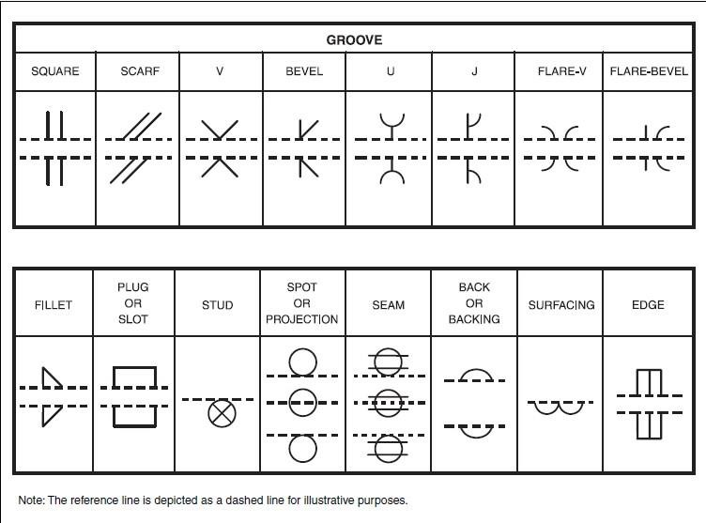
!
Fig. 10.3

Slide 104
Dimensions and other data
The dimensions of a weld are shown on the same side of the reference line as the basic weld symbol. The size of the weld is shown to the left of the weld symbol, and the length of the weld is shown on the right. If a length is not given, the weld symbol applies to that portion of the joint between abrupt changes in the direction of welding or between specified dimension lines. If a weld symbol is shown on each side of the reference line, the dimensions, if used, must be given for each weld even though both welds are identical.

Slide 105
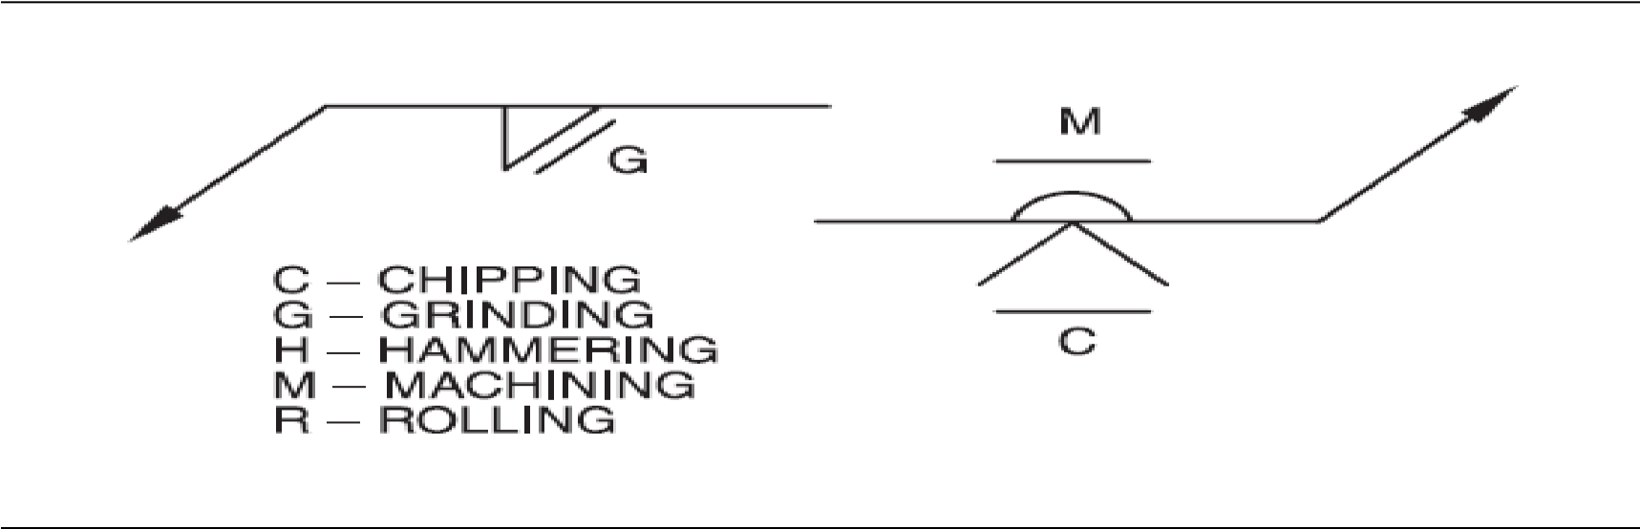
Finishing Symbols
Finishing symbols can be used to specify a mechanical method of achieving the required weld control. They are used in conjunction with contour symbols (see “Supplementary Symbols”). Figure 10.4 presents the finishing symbols and their meaning.
Fig. 10.4
Supplementary Symbols

Slide 106
Supplementary weld symbols complement the basic symbols and provide additional requirements or instructions. Figure 8.12 presents the supplementary symbols that may be used on a welding symbol. Each of these is explained below.
Weld-All-Around Symbol
A weld that extends completely around a series of connected joints is indicated by the weld- all-around symbol. This symbol takes the form of a circle positioned at the junction of the arrow and the reference line. Figures 10.5 illustrates the use of this symbol. In Figure 10.5(A), the weld-all-around symbol indicates that the weld should extend around the entire periphery of the junction between the structural shape and the plate in a typical column-to-base plate connection. In Figure 10.5(B), the weld-all-around symbol indicates that the weld should continue around the entire faying surface of the two work pieces. In Figure 10.5(C), the weld- all-around symbol conveys the fact that the proposed weld occupies more than one plane.

Slide 107
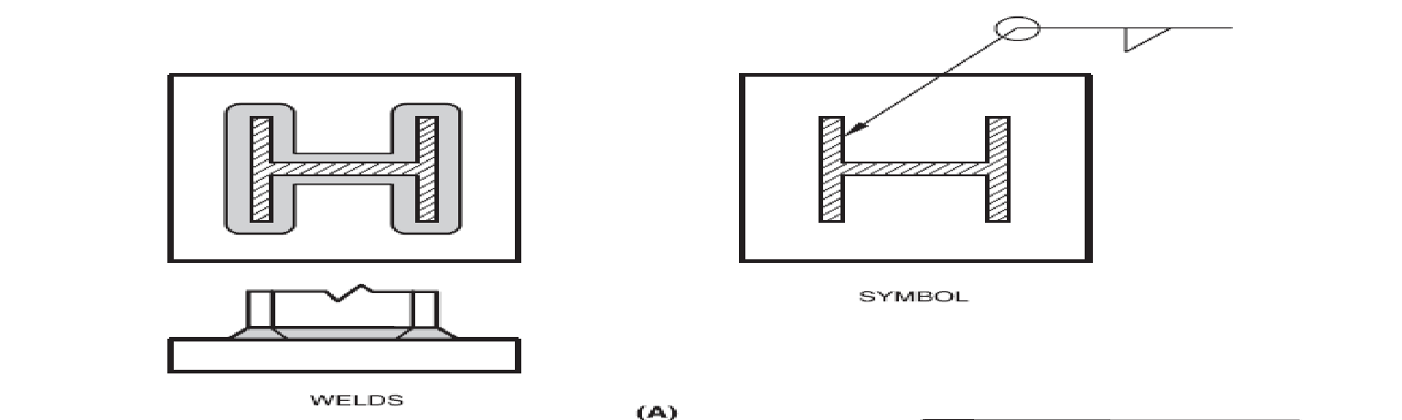
!

Slide 108
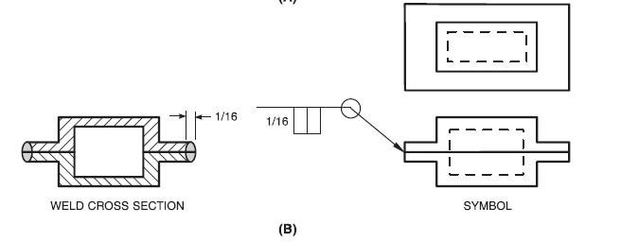
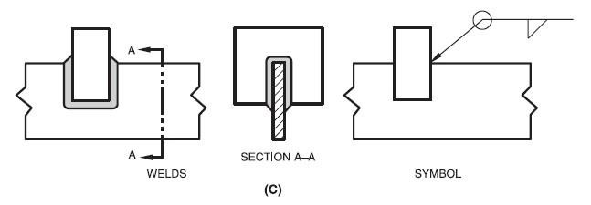
Fig. 10.5

Slide 109
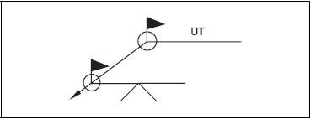
Field Weld Symbol
Field welds are welds that are made at a location such as an installation or erection site, not in a shop or at the place of initial construction. That fact that welds are to be made in the field is communicated by the addition of the field weld symbol to the welding symbol. This symbol takes the shape of a flag. It may be placed either above or below and perpendicular to the reference line at its junction with the arrow.
Figure 10.6 illustrates the field weld symbol used in conjunction with the weld-all-around symbol, communicating, in this case, that a single-V-groove weld is to be applied along the extent of the weld joint in the field followed by ultrasonic testing (UT) of the entire length of the weld.

Slide 110
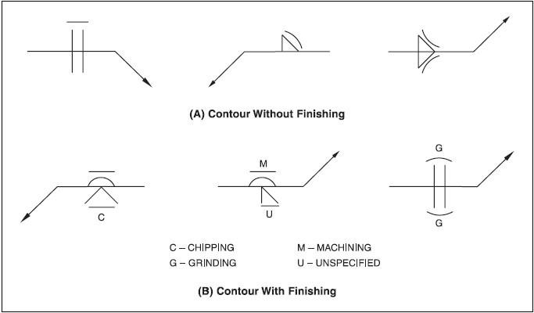
The contour symbol is used on the weld symbol to indicate the desired shape of the finished weld. The configuration of this symbol therefore differs according to the desired weld shape. Welds that are to be made approximately flat (fillet welds), flush (groove welds), convex, or concave without subsequent finishing are represented by adding the flat, flush, convex, or concave contour symbol to the weld symbol, as shown in Figure
10.7 ( A). Welds that are to be finished by mechanical means are depicted by adding the
symbol for the desired finishing technique to the appropriate contour symbol, as shown in
Figure 10.7 (B).

Slide 111

Standard Location of the Elements of the Welding Symbol
Exercise:
Q. 1 Draw weld symbol for given weld joint in figure.
Sr
No
Welds
Symbol
1

Slide 112
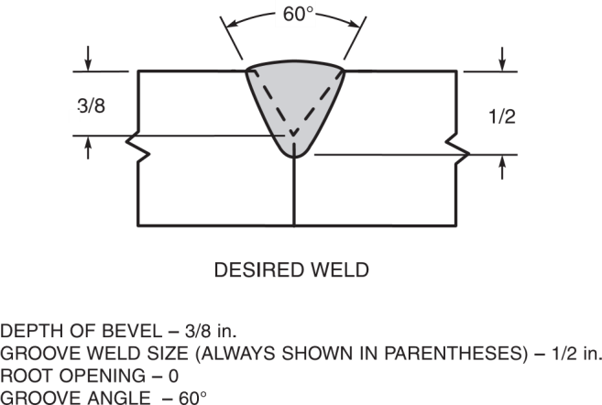
2
3
Exp. Comp. Date:
Sign:
Grade:

Slide 113
Prepared by
Md. Naeem Hosen Hredoy Lab Instructor
Department of Mechanical

