Slide 1
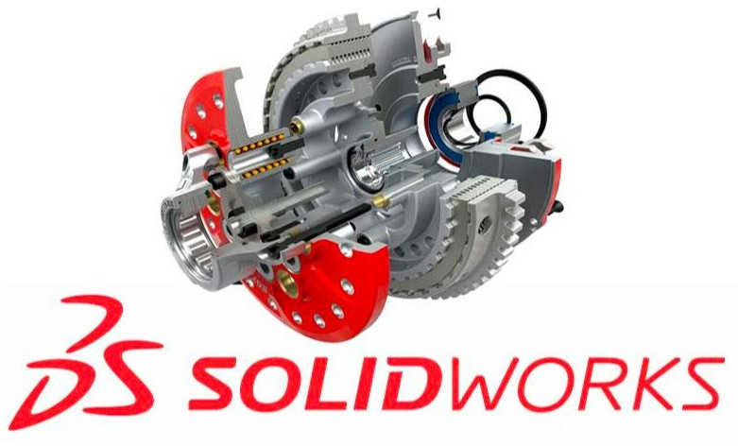





Lab Manual On Solidworks

Slide 2
Class NO: 17
CIE Marks: 20
Class Hours: 85
SEE Marks: 30
CLO1 | Describe the basic understanding to solid works, overview, assemblies, drawings, importing an AutoCAD drawing, using 2D data to create a 3D part.
CLO2 | Identify the creating a drawing from a 3D model, 3Dsketching, 3d sketching with planes, adding, and defining splines, using construction geometry, creating lofts with single 3D sketches, advanced design techniques, adding the screw holes, creating the layout sketch.
CLO3 | Outline the hinge–cuts, advanced drawings, animation, assembly mates I, assembly mates II, assembly visualization, blocks to assembly, customizing solid works, customizing solid works, design checker.
CLO4 | Demonstrate the various flexure formula of curved beams. Introduction to reinforced concrete beams. Torsion formula
CLO5 | Solve design tables, Dimxpert tutorial, event-based motion studies, drive works press, feature works, fillets, import/export, molds design.
CLO6 | Create pattern features, revolve, and sweep, routing – electrical, routing - pipes and tubes, sheet metal, 2Ddrawings from 3D models, smart components, surfaces, to analyst, toolbox, weldments.

Slide 3
Course Learning Outcomes (CLOs): after completion of this course successfully,the students will be able to…
S. L | Course Content | Hrs | CLOs
1 | Basic understanding to solid works, overview, assemblies, drawings, importing an AutoCAD drawing, using 2D data to create a 3D part. | 10 | CLO1
2 | Creating a drawing from a 3D model, 3Dsketching, 3d sketching with planes, adding, and defining splines, using construction geometry, creating lofts with single 3D sketches, advanced design techniques,adding the screw holes, creating the layout sketch. | 15 | CLO2
3 | The hinge–cuts, advanced drawings, animation, assembly mates I, assembly mates II, assembly visualization, blocks to assembly, customizing solid works, customizing solid works, design checker. | 15 | CLO3
4 | Various flexure formula of curved beams. Introduction to reinforced concrete beams. Torsion formula | 15 | CLO4
5 | Design tables, Dimxpert tutorial, event-based motion studies, drive works press, feature works, fillets, import/export, molds design. | 15 | CLO5
6 | Pattern features, revolve, and sweep, routing – electrical, routing - pipes and tubes, sheet metal, 2Ddrawings from 3D models, smart components, surfaces, to analyst, toolbox, weldments. | 15 | CLO6
TEXTBOOKS:
1.Machining Simulation Using SOLIDWORKS CAM 2019 by Kuang-Hua Chang.
2.Beginner's Guide to SOLIDWORKS 2020 Level I by Alejandro Reyes.
3.SOLIDWORKS 2021, A Step-By-Step Tutorial Guide for Beginners by SDCAD Academy.

Slide 4
INDEX
EX.NO | NAME OF THE EXPRIMENTS
1 | Study Of Cad Using Solidworks
2 | Draw the 2D profile in solid works sketcher mode
3 | Draw the 3D profile of given drawing Extrude, Cut Extrude, Revolve.
4 | Draw the 3D profile of given drawing Sweep, Draft, Loft.
5 | Draw the 3D profile using Edit command
6 | Draw the 3D profile in Assembly mode Ex. 1
7 | Draw the 3D profile in Assembly mode Ex. 2
8 | 3D Modeling of Machine Elements like Flanged Coupling, Screw Jack.

Slide 5
EXERCISE: 1
STUDY OF CAD USING SOLIDWORKS
TECHNOLOGY OF CAD:
CAD - Computer Aided Design
CAD technology makes use of the computer to create drawings of parts and assemblies on computer files, which can be further analyses and optimized.
REASONS FOR IMPLEMENTING CAD:
To increase productivity of the designer To improve the quality of design
To improve documentation
To create a database manufacturing

Slide 6
BENEFITS OF CAD
Productivity Improvement in Design:
CAD helps in increased productivity by reducing the time for developing conceptual design,
analysis and drafting. It is also possible to reduce the manpower.
This depends on, Complexity of the drawing.
Degrees of repetitiveness of features in parts.
Degree of symmetry in parts Extensive use of
defined shapes
Shorter Lead Time:
Using CAD systems a finite set of drawings and documentations can be prepared in relatively
short time.
Flexibility in Design:
CAD offers the advantages of easy modification of design to accommodate customer’s specific requirements.
Design Analysis:
The design analysis routines available in a CAD System help to optimize the
Design
Fewer Design Errors:
Interactive CAD Systems have built in capability for avoiding errors in design, drafting and documentation.
Standardization of Design and Drafting:
The single operating system in CAD provides a command basis for design, analysis and drafting process. With interactive CAD, drawings are standardized.

Slide 7
Drawing More Understandable:
With the increase in the use of 3D views and solid modeling, it has become easier to comprehend the features of the component readily. One does not have to reconstruct the solid shape from 2D objects. Many software packages allow 3D view generation from a 2D model.
Improved Procedures of Engineering Changes:
Control and implementations of engineering changes can be significantly and improves with CAD.
Original drawings and reports are available and easily accessible.
Revised Information can be retained and new drawings with changes can be created without destroying previous features.
Introduction to 3D Modeling Using Solid Works
Solidworks is a 3-D modeling tool. Unlike other 3-D modeling tools, Solidworks is not fully three dimensional. Other programs allow the user to easily draw in three dimensional space. In Solidworks, one draws in a plane and then extrudes solids from the plane. Planes are used to obtain position in three dimensional space. It is possible to draw in three
dimensional space using Solidworks, but is very difficult. Therefore the best method of creating three dimensional objects is using planes.
File types
The Default tab contains templates based on the units and drafting standard you selected when you installed Solid Works.
Solid Works file types include: Part (.ipt)
Assembly (.iam)
Drawing (.idw)

Slide 8
CREATING A NEW PART FILE
Go to File:New
Select Part
i.
ii.
Solidworks files consist of parts and assemblies. Individual parts are made and combined together in an assembly
CHANGING UNITS
Go to Tools:Options
Click on Document Properties tab
Select Units from the tree on the l
CREATING A RECTANGLE
Click on Sketch
Sketches are drawings located on a plane
Click on Rectangle
Select Top Plane
Click and Drag to create the rectangle
Click the Return Button in top left corner
SIZING THE RECTANGLE
Select Sketch1
Right Click
Select Edit Sketch
Allows you to modify a sketch you have already drawn
Double Click the left side of the rectangle A properties box appears where you can edit the starting and
ending points, length, and angle of the line.
PAGE 5 OF 23

Slide 9
Set the beginning point in the Y direction to -24
Set the ending point in the Y direction to 24
Set the beginning point in the X direction to -24
e. Double Click the right side of the rectangle
Set the beginning point in the X direction to 24
CREATING A SOLID
a.Click on Features
Features manipulate sketches and creates three dimensional solids
b.Click on Extruded Boss/Base
This creates a solid by extending a two dimensional sketch into
three dimensions. The sketch can be extruded in either or both
directions. It can also be extruded a specified distance or up to
another surface. The extrusion can also be tapered a specified
number of degrees
Change the distance of D1 to 4.25
Click the direction arrow so that the normal vector is pointing in the
Negative Y direction
Click the check box
FILLETS
Click on Features:Fillet
Set fillet radius to .25
Select the four Top Edges
Click the check box

Slide 10
HOLLOWING THE BOTTOM
Click the bottom plane of the solid
Draw a 45x45 Rectangle centered on the plane
Click on Features:Extruded Cut
Extruded Cut is similar to Extruded Boss/Base, but is the opposite. It takes a two dimensional sketch and removes part of a solid in the third dimension.
Change the distance of D1 to 3.5
Click the check box
SAVING
Click on
Name file
File:Save
8. CREATING AN ASSEMBLY
a.
b.
c.
d.
e.
f.
Click on File:New:Assembly with units of Inches Insert the Table Top Part
Click on Insert:Component:Existing Part/Assembly Insert the Leg Part
Click on Insert:Mate
Select the Left Circle of the hole in the Leg and the Inside of one of the Left Circles on the table
Click the check box
Repeat for the three other legs
g.
h.
9.
FINISHED
Result:

Slide 11
EXERCISE: 2
DRAW THE 2D PROFILE USING SOLID WORKS
Aim:
To Create a 2D profile in sketcher mode of the given diagram by using Solid Works.
TOOLS USED :
SOLODWORKS
PROCEDURE:
RESULT:

Slide 12
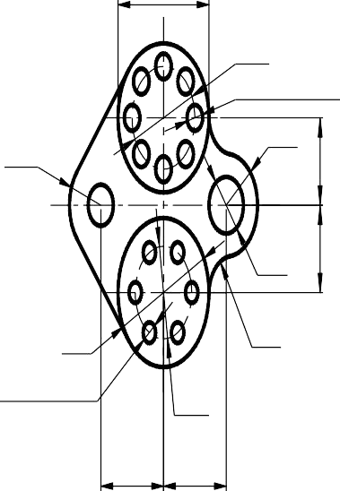
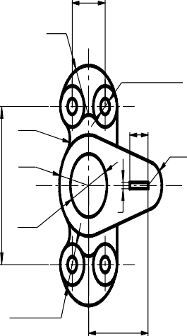
58
Ø40
8 Holes Ø10
R20
34
R20
34
Ø22
Ø58
R15
6 Holes Ø8
Ø36
40 40
Fig: 1
36
R32
4 Holes Ø10
R12
20
R15
R32
100
Ø40
4
4 Holes Ø26
65
Fig: 2

Slide 13
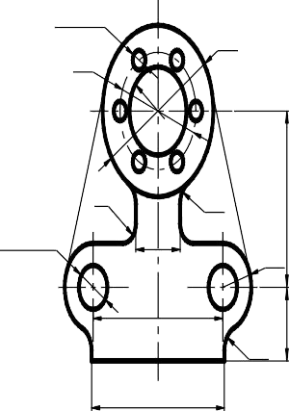
6 holes Ø8
Ø70
Ø48
R8
72
R10
2 holes Ø18
28
R18
30
82
R10
84
Fig: 3

Slide 14
EXERCISE: 3
DRAW THE 3D PROFILE USING SOLID WORKS
Aim:
To Create a 3D Part Modeling by Use of Extrude, Cut Extrude, Revolve, in the given diagram by using Solid Works.
TOOLS USED :
SOLODWORKS
PROCEDURE:
RESULT:
Thus the given components have been created, using Solid Works.

Slide 15
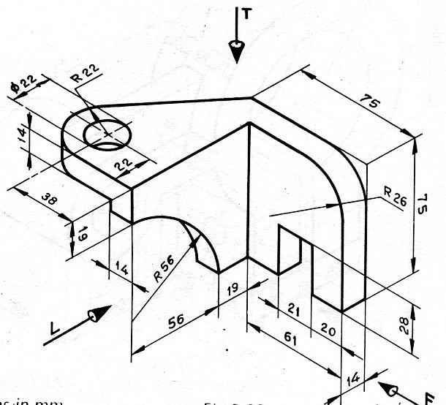
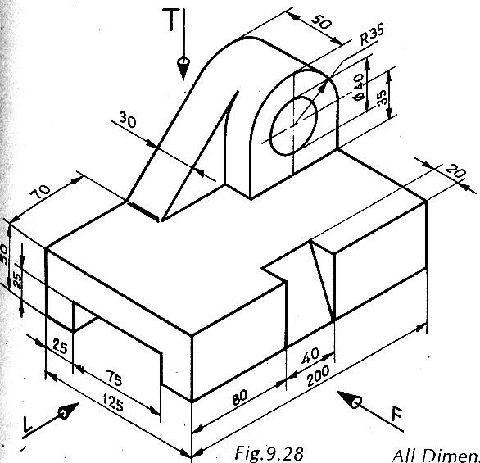
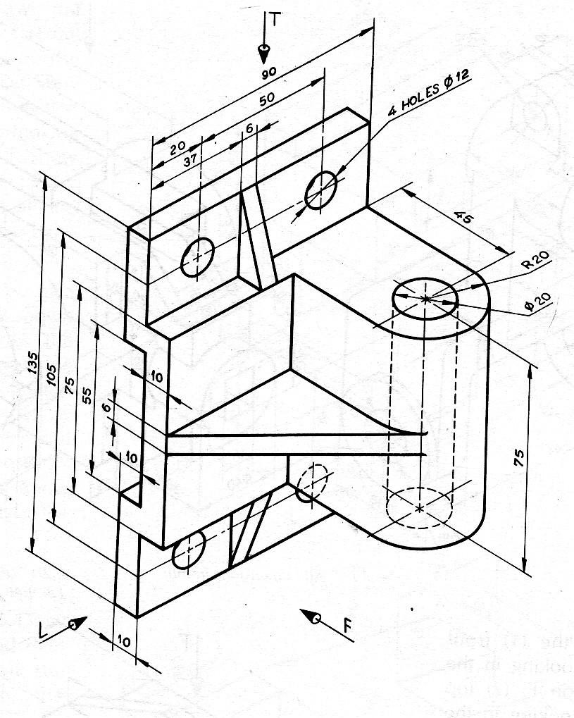
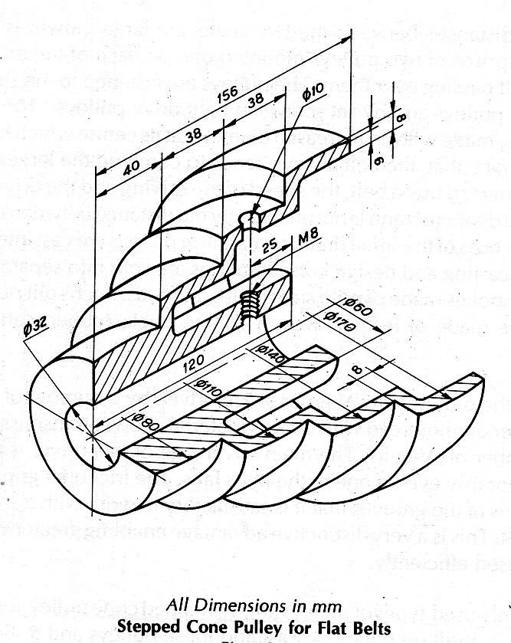
Extrude, Cut Extrude
Extrude, Cut Extrude
Rib
Revolve

Slide 16
EXERCISE: 4
DRAW THE 3D PROFILE USING SOLID WORKS
Aim:
To Create a 3D Part Modeling by Use of Sweep, Draft, loft in the given diagram by using Solid Works.
TOOLS USED :
SOLODWORKS
PROCEDURE:
RESULT:
Thus the given components have been created, using Solid Works.

Slide 17
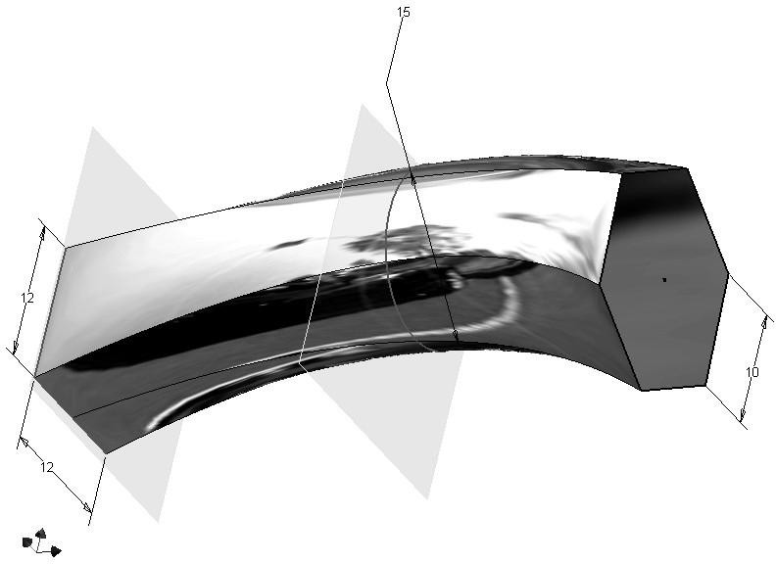
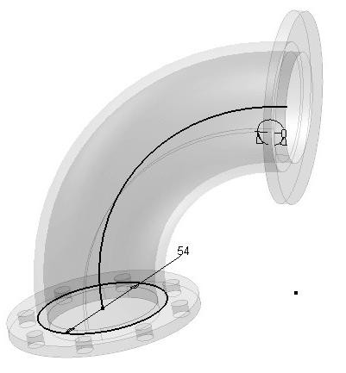
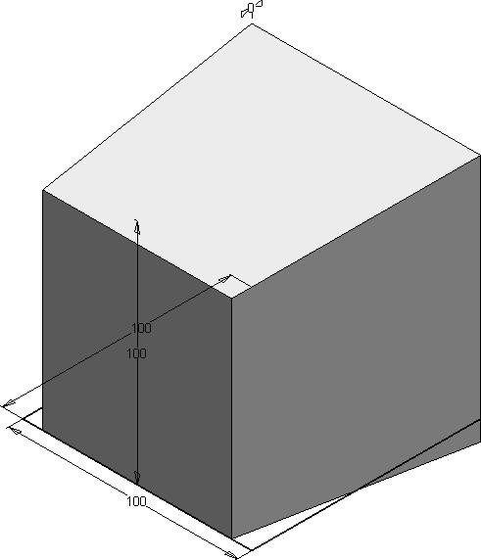
Loft
DRAFT
SWEEP
EXERCISE: 5
DATE :
DRAW THE 3D PROFILE USING SOLID WORKS WITH EDIT COMMANDS
Aim:
To Create a 3D Part Modeling by Use of Move, Pattern, Mirror, Fillet & Chamfer Commands in the given diagram by using Solid Works.
TOOLS USED :
SOLODWORKS

Slide 18
PROCEDURE:
RESULT:
Thus the given components have been created, using Solid Works.

Slide 19
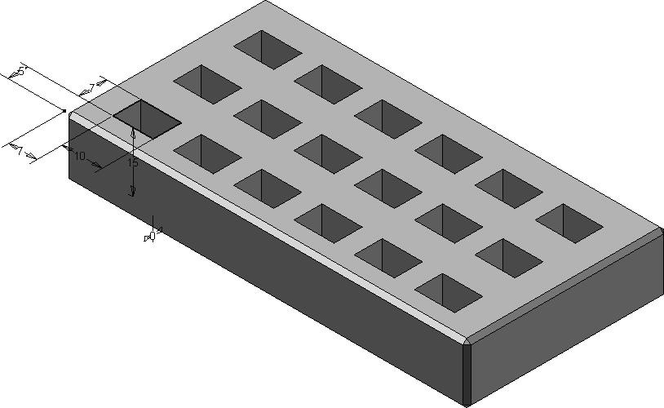
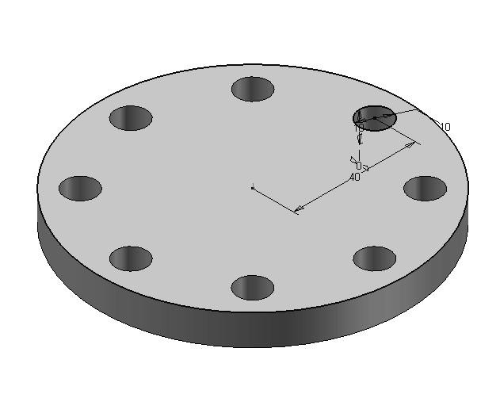
RECTANGULAR PATTERN
CIRCULAR PATTERN
MIRROR

Slide 20
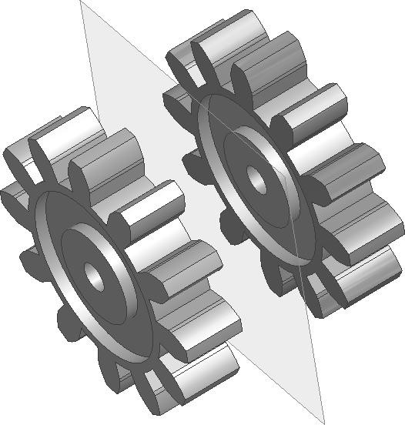

Slide 21
EXERCISE: 6
DRAW THE 3D PROFILE USING SOLID WORKS IN ASSEMBLY MODE
Aim:
To Create a Assembly from 3D Part Modeling Components in the given diagram by using Solid Works.
TOOLS USED :
SOLODWORKS
PROCEDURE

Slide 22
RESULT:
Thus the given Assembly have been created, using Solid Works.
MARKS | STAFF SIGN

Slide 23
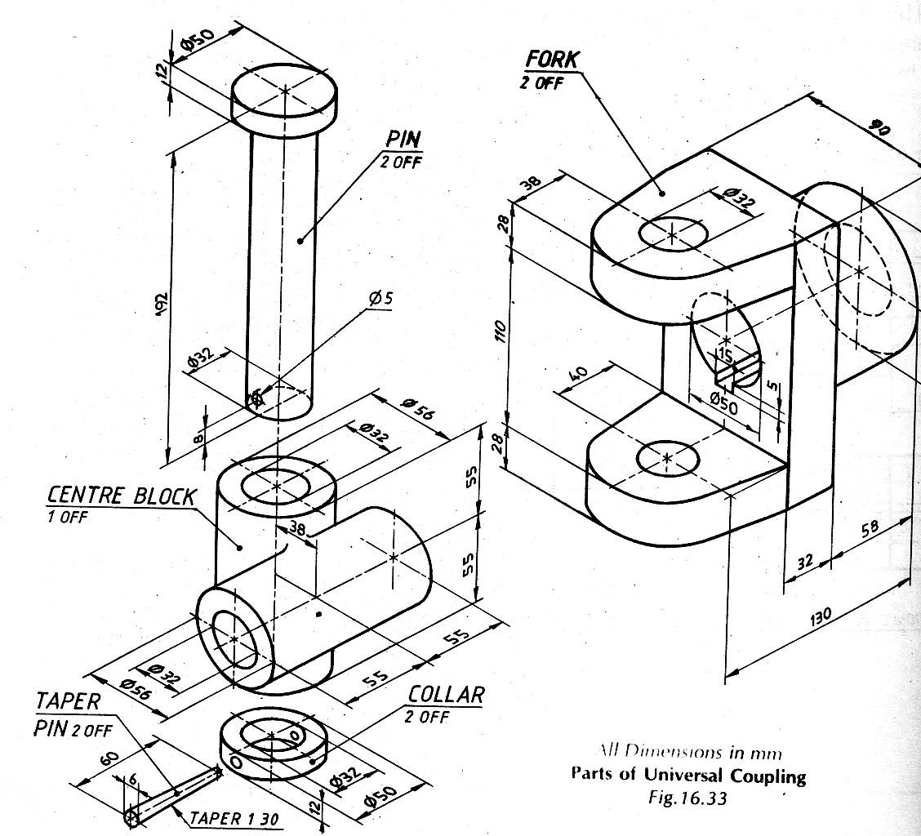

Slide 24
EXERCISE: 7
DRAW THE 3D PROFILE USING SOLID WORKS IN ASSEMBLY MODE
Aim:
To Convert from 3D Solid Modeling to 2D Drawing and Create the Different Views, Sections View, Isometric View and Dimensioning by using Solid Works.
TOOLS USED :
SOLODWORKS
PROCEDURE:
RESULT:
MARKS | STAFF SIGN

Slide 25
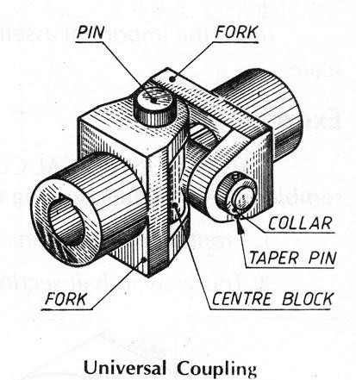
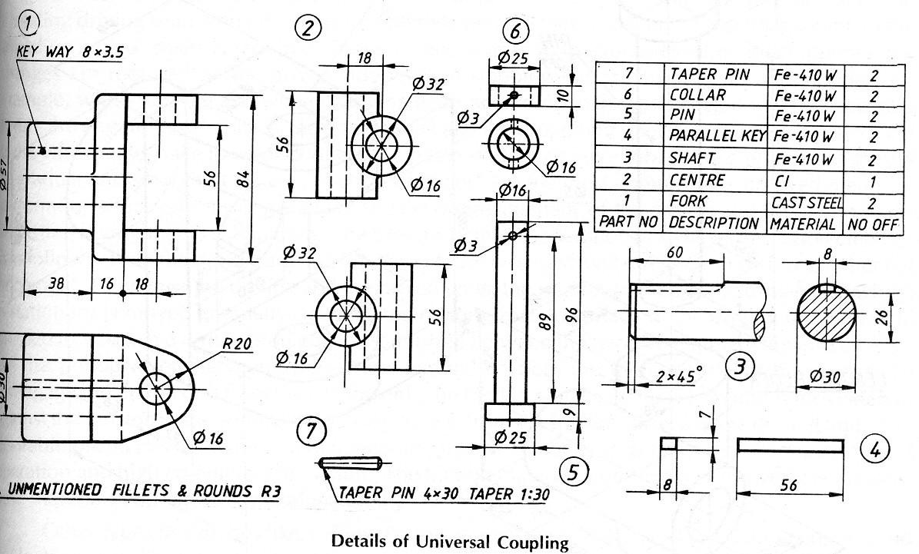
To Create a documented drawing of a simple Assembly.
The skills you learn are:
Creating basic drawings
Placing views
Cutting sections
Using model dimensions
Adding drawing dimensions
Creating a parts list
Adding balloons

Slide 26
EXERCISE: 8 DATE :
DRAW THE 3D PROFILE OF MACHINE PARTS USING SOLID WORKS
Aim:
To Create a 3D Modeling of Machine Elements in Flange Coupling & Screw Jack diagram by using Solid Works.
TOOLS USED :
SOLODWORKS
PROCEDURE:
RESULT:
MARKS | STAFF SIGN

Slide 27
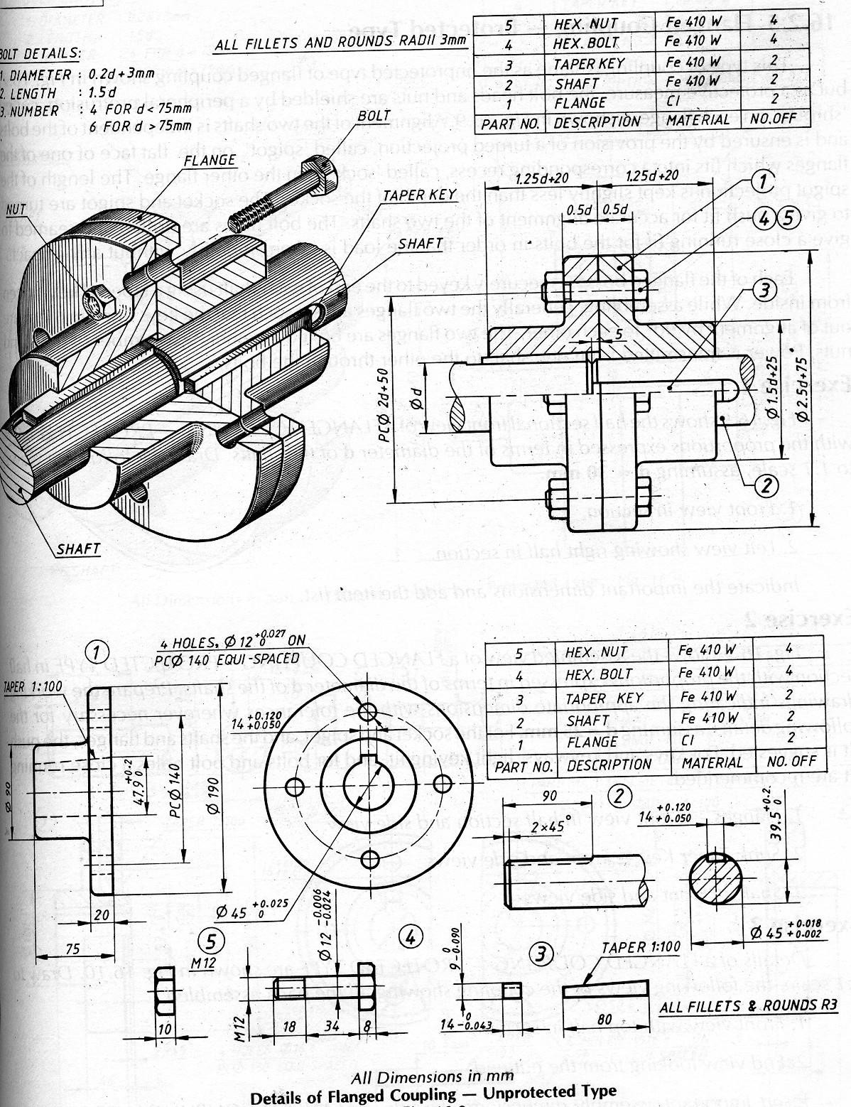

Slide 28
