Slide 1
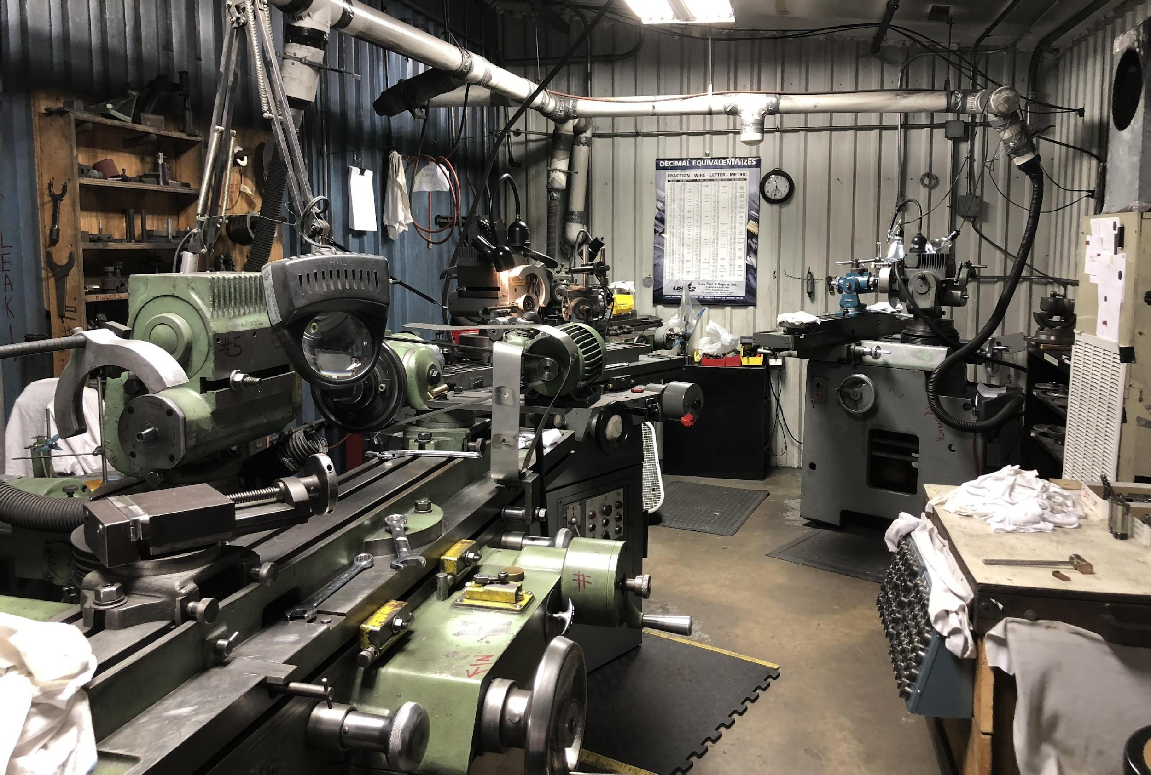





Lab Manual On Machine Shop Practice

Slide 2
Credits |  | 01 | CIE Marks | 20
Total Hours |  | 85 | SEE Marks | 30
Course Learning Objectives: To guide students to use fitting tools to perform fitting operations. To provide an insight to different machine tools, accessories and attachments. To train students into fitting and machining operations to enrich their practical skills. To inculcate team qualities and expose students to shop floor activities. To educate students about ethical, environmental and safety standards.
Sl. No | Experiments
1 | Preparation of at least two fitting joint models by proficient handling and application of hand tools- V- block, marking gauge, files, hack saw drills etc.
2 | Preparation of three models on lathe involving - Plain turning, Taper turning, Step turning, Thread cutting, Facing, Knurling, Drilling, Boring, Internal Thread cutting and Eccentric turning. Exercises should include selection of cutting parameters and cutting time estimation.
3 | Cutting of V Groove/ dovetail / Rectangular groove using a shaper. Cutting of Gear Teeth using Milling Machine. Exercises should include selection of cutting parameters and cutting time estimation.
4 | Study & Demonstration of power tools like power drill, power hacksaw, portable hand grinding, cordless screw drivers, production air tools, wood cutter, etc., used in Mechanical Engineering.

Slide 3
Course Outcomes: At the end of the course, the student will be able to:
CO1: To read working drawings, understand operational symbols and execute machining operations. Prepare fitting models according to drawings using hand tools- V-block, marking gauge, files, hack saw, drills
etc.
CO2: Understand integral parts of lathe, shaping and milling machines and various accessories and attachments used. Select cutting parameters like cutting speed, feed, depth of cut, and tooling for various machining operations.
CO3: Perform cylindrical turning operations such as plain turning, taper turning, step turning, thread Cutting, facing, knurling, internal thread cutting, eccentric turning and estimate cutting time.
CO4: Perform machining operations such as plain shaping, inclined shaping, keyway cutting, Indexing and
Gear cutting and estimate cutting time.

Slide 4
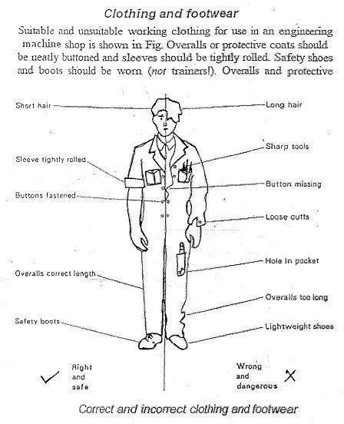
SAFETY PRECAUTIONS
Page 1

Slide 5
INDEX
Sl. No. | Topic | Page No.
1. | Demonstration on use of Hand Tools | 4-30
2. | Fitting models | 31-43
3. | Introduction to Metal Cutting | 44-47
4. | Lathe | 48-53
5. | Drilling | 54-57
6. | Shaping Machine | 58-67
7. | Milling Machine | 68-77
8. | Grinding Machine | 78-81
9. | Models | 82-89
10. | Viva Questions | 90-93

Slide 6
Workshop and Machine Shop Lab layout
store
Store
Store
Store
Door
Door
Door
Door
Staff room
Machine Shop
Fitting Shop
Door
 | Staff room
Door
Main Entrance

Slide 7
1. Demonstration on use of Hand Tools
Fitting is the process of assembling metal parts precisely. The bench working a fitting shop consists of laying out, cutting the metal parts to the size required, and assembling of parts. The fitting shop is generally equipped with measuring and marking tools, work holding and tool holding accessories and shaping or metal cutting tools. One of the characteristics of the skilled fitter is the way in which he selects and uses the tools.
HAND TOOLS FOR BENCH WORK
Measuring and marking tools
A length may be expressed as the distance between two lines (called line
measurement) or as the distance between two faces (called end measurement). The most common example of line measurement is the steel rule and examples of end measurement are calipers, micrometers, etc.
STEEL RULES
The simplest and most common linear measuring instrument is the steel rule shown in fig.1
steel rules are made of spring steel or stainless steel. Lines, called graduations are inscribed on the face of the rule. Metric rules usually have two sets of line graduations. Steel rules are available in different lengths, the common sizes being 1.50 mm, 300 mm, 500 mm, and 1000 mm.
Fig. 1 Steel rule

Slide 8
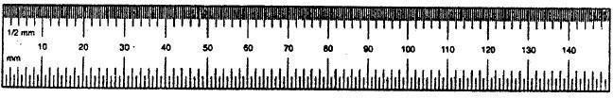
MICROMETER
Micrometer or micrometer caliper is one of the most widely used measuring instruments. Micrometer operates on the principle that an accurate screw will advance the spindle a precise amount for each revolution. It consists of a fixed anvil and a movable spindle. The graduated thimble rotates with the spindle and travels along a graduated
sleeve fixed to the frame. The graduations conform to the pitch of the micrometer screw. To control the pressure between the anvil, the spindle, and the work piece being measured, it is equipped within ratchet or a friction device. Many micrometers are provided with a

Slide 9
spindle lock.
Rotating the lock nut in one direction locks the spindle from turning. Micrometer calipers are available with a variety of specially shaped anvils and spindles.
The metric micrometer has a spindle screw thread with a pitch of 0.5 mm. with one complete revolution of the screw, the contact face at the end of the spindle either moves away iron or toward the face of the anvil exactly 0.5 mm. The upper set of graduation on the sleeve represent whole millimeters and the lowers set divide each millimeter into two equal parts or 0.5mm, The beveled edge of the thimble is graduated into 50 parts, each graduation representing l/50 of 0.5mm or 0.01 mm. The micrometer reading is established by adding the following three values.

Slide 10
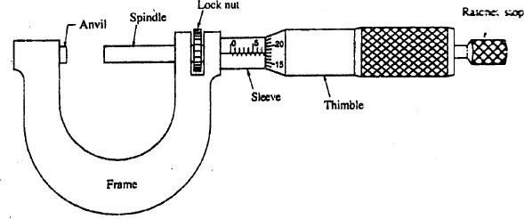
Fig. 2 Micrometer
The last whole number of millimeters that is visible in the top row near the thimble (A)
The half-millimeter graduation in the lower row (B).
The graduation on the thimble that coincide with index line (c)
.. Micrometer reading in mm = A + B x 0.5 + C x 0.01
Referring to fig. 2, the whole number of millimeter that is visible in the top row is 7,
the half-millimeter graduation after 7 in the lower row is 1, and the 18th thimble graduation is coinciding with the index line,
..Micrometer reading in mm = 7 +1 x 0.5 + 1.8 x 0.01= 7.58mm

Slide 11
VERNIERCALIPER
The vernier caliper illustrated in fig. 3 is and end-measuring instrument available in
various sizes that can be used to make both external and internal measurement to an accuracy of 0.02 mm. It consists of a beam carrying the main scale, inside and outside and outside measuring jaws, a depth gauge bar and an adjustable vernier head, which can be moved along the beam. For fine adjustment, an auxiliary head with a micrometer screw is provided. Both the heads are provided with locking screws to lock them firmly at any desired position. The graduated beam of tn. metric vernier caliper is divided into centimeters and millimeters. The 49 divisions (49 mm) of 1mm each on the beam (main scale) are equal to 50 divisions of the vernier scale. Thus one division on the vernier equals 49/50mm. The least count of the instrument, i.e., the difference between a division on main scale and division on the vernier is
= 1 – 49 / 50 = 1/50mm or 0.02mm. The vernier caliper reading is established by adding the following two values.
The number of main scale divisions to the left of the 0 on the vernier scale A.
The line number B on the vernier scale, which is aligned with a line on the beam (main scale)
.. Vernier caliper reading = A x Length of 1 main scale division + B x least count

Slide 12
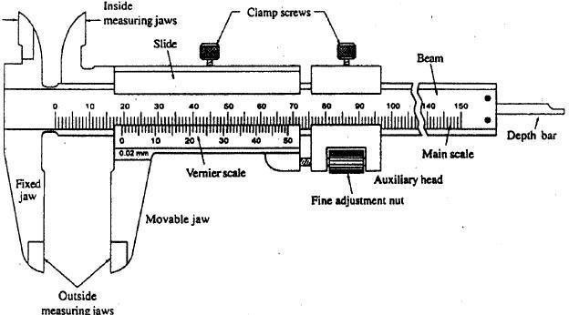
Fig. 3 Vernier caliper
Referring fig.3, the number of divisions on beam left of the 0 one the vernier is 19 and the 22nd line on the vernier scale is aligned with a line on the beam.
.. Vernier caliper reading = 19 x 1 + 22 x 0.02 = 19.44 mm

Slide 13
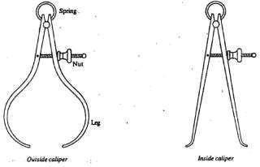
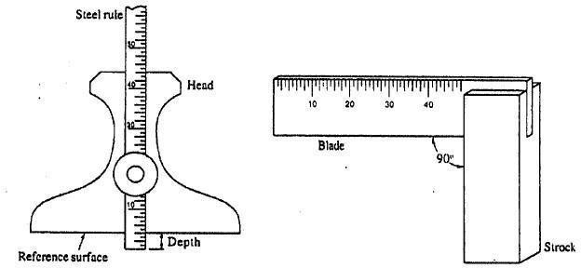
CALIPER S
With a caliper, linear dimension can be transferred from the work piece to a steel rule and vice verse. In spring type calipers shown in fig. 4, a pivot loaded with a spring assembles the legs, for opening and closing the legs. A screw and an adjusting nut are provided. There are outside and inside calipers. In outside calipers, the legs are curved inside and are used for measuring the outside diameters, thickness of plates, etc. The end of the inside caliper's legs are curved outside and are used for measuring inside diameters, width of slots, etc.
Fig.4 Calipers
RULE DEPTH GAUGE
The rule depth gauge shown in fig. 5 consists of a steel head that has a slot to receive a narrow rule. The rule is held in position by a knurled nut. It is used to measure
the depth of holes, slots, keyways, and other recesses.
Fig. 6 Try Square
Fig. 5 Rule depth gauge

Slide 14
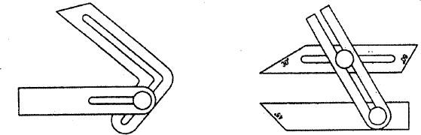
SQUARE S
Solid steel squares (try square): Squaring a work is the operation of making and checking the work surfaces that must be perpendicular. The solid steel square shown in fig, 6 is used to measure right angles, to check the squareness of surfaces and for layout. The right angle is found on both the inside and outside the square. They are available in various sizes.
BEVEL GAUGE
A bevel gauge shown in fig, 7 (a) is used to set and mark angles other than 90º. It consists of a steel stock of rectangular cross section carrying slotted steel blade at its end.
The blade can be made to slide, set at any desired angle and secured in position by means of a screw. The set angle can be measured with the help of bevel protractor. The
combination bevel gauge shown in fig, 7 (b) has an additional blade. This helps in setting large range of angles.
BEVEL PROTRACTOR
The bevel protractor shown in fig. 8 is used for measurement jor layout of angles.
The protractor has a head with a revolving turret graduated to 90⁰ degrees on each side of zero. A vernier is provided to measure the angle accurately. The head is adjustable along a tempered blade.
(a) ) Bevel gauge
(b) Combination bevel gauge
Fig. 7 Bevels

Slide 15
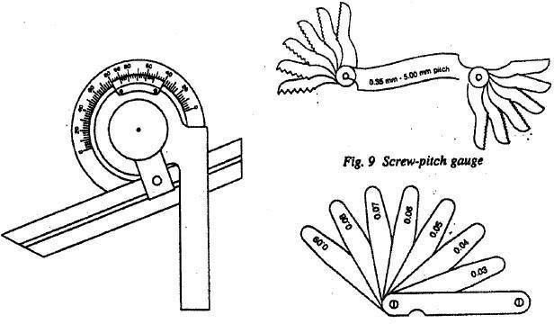
Fig. 8 Bevel Protractor Fig. 10 Thickness gauge
SCREW-PITCH GAUGE
The pitch of threads can be determined by measuring the distance across thread
crests with rule, or by using a screw-pitch of threads can be determined by measuring the distance across the thread crests with a rule, or by using a screw-pitch as shown in fig, 9. It consists of a number of leaves mounted in a holder. The edges of the leaves are cut to represent thread pitches. The pitch is usually marked on each leaf. The check the pitch it is necessary to match the teeth in the gauge with the threaded parts.
THICKNESS OR FEELER GAUGE
A feeler gauge shown in fig.10 consists of thin strips of metal of various thickness
mounted a steel holder. The individual leaves are marked with the thickness size. Such a gauge is widely used for measuring and checking bearing clearances, adjusting tappets, spark plug gaps, etc. Accuracy in using these gauges requires a sense of feel.

Slide 16
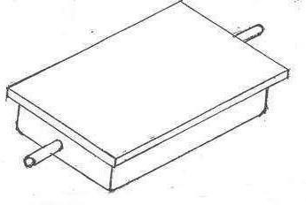
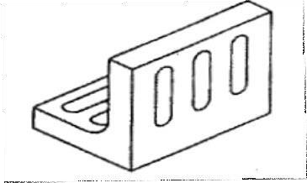
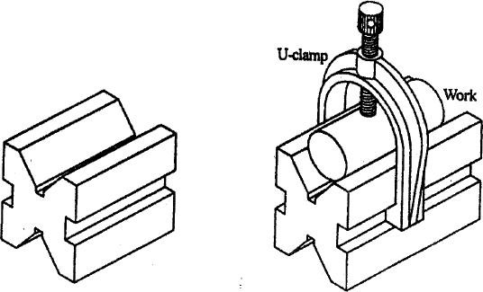
SURFACE PLATE
A surface plate shown in fig.11 is used for laying out and inspecting work pieces.
Surface plates are made of either case iron or granite. The case iron plates are machined very smooth and hand scraped to provide a true flat surface. The flat surface provides a datum for many types of measurements and for checking sizes, parallelism and angles. Surface plates are protected by cover when not in use. They are available in various shapes andsizes.
Fig.11 Surface plate Fig. 12 Angle plate
(Fig. 12) Angle plates are made of cast iron or steel and are used to support the work pieces during marking. The flat faces are at right angles and may have threaded holes or slots for holing the work pieces. Cast iron angle plates are surface ground and hand scraped to a high degree of accuracy. The edges and ends are machined square.
ANGLE PLATE:
Fig.13 V-Block

Slide 17

V-BLOC K:
V- blocks are used for checking the roundness of cylindrical work piece and for marking centers accurately. The v-block shown in fig.13 has and included angel of 90º, but blocks with different angles are also available. V-block are finished to a high accuracy in respect of dimension. Flatness and squareness. U-clamps are also provided which bridge the V to secure the work.
PUNCHE S
Punches are used to mark points on metal. Both ends of the punch should be tempered and ground to the proper angle and the center portion is usually knurled in order to afford a good grip. Most commonly used punches are the prick punch and center punch and are shown in fig l4.
PRICK PUNCH
The point angle of prick punch is 30º or 60º. It is used for marking small dents or establishing points for dividers and trammel points.
CENTER PUNCH
The point angle of center punch is 90º. It is used primarily for marking the location
of points and the centers of holes to be drilled. A large and deep center mark gives a good seating for starting the drill.
Fig. 14 Punches
DIVIDER S
(Fig.15) Dividers are similar to that of calipers. The legs of the dividers are straight and the ends are sharpened to point. The size of divider is the length of the leg from the pivot to the point. Dividers and trammels are used for laying out and scribing circles and arcs, stepping off distances on straight lines or circles, and transferring measurements.

Slide 18
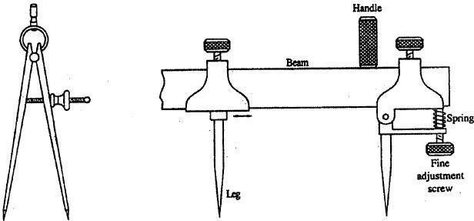
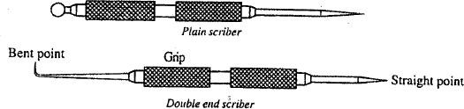
Fig. 15 Divider
Fig. 16 Trammel
TRAMME L
(Fig.16) Trammel is and alternative to dividers particularly in large work. It consists of two adjustable vertical legs. These vertical legs are provided with slotted head at the top so that they can slide on a beam. The bottoms of the legs are shaped to have a sharp point. The heads are clamped to the beam by screws.
SCRIBER
A scriber is a sharp, pointed tool used to scribe lines on metal. The scriber is made from carbon tool steel, hardened and tempered. Scribers are available in various styles and sizes (refer fig.17).
Fig.17 Scribers

Slide 19
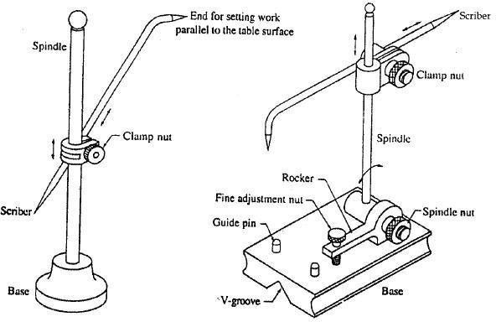
SCRIBING BLOCK OR SURFACE GAUGE
The surface gauge shown in fig.18 consists of a case iron base fitted with a vertical
steel rod. A steel marker or scriber is fitted into an adjustable clamp. Normally it is used n conjunction with a surface plate. It is used to locate centers of round rods held in V-block, scribing lines parallel to datum surface and setting jobs on machines parallel to datum
surface.
Fig.18 Surface gauge
Fig.19 Universal surface gauge
UNIVERSAL SURFACE GAUGE
Universal surface gauge shown in fig.19 consists of a steel base with a rotation clamp, adjustable steel spindle, and an adjustable scriber. The spindle can be rotated and
clamped to any desired position. A rocker is provided at the top of the base and it carries a fine adjusting screw at its rear end so that the spindle may be adjusted to the required
inclination. The base has a shaped groove, which makes it convenient for use on cylindrical work. The two guide pins fitted in the base are used for scribing lines for many
datum edge.

Slide 20
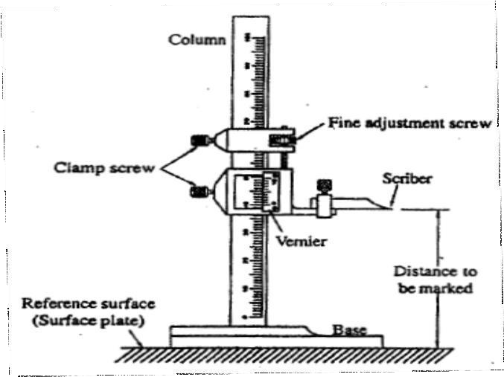
VERNIER HEIGHT GAUGE
The vernier height gauge is widely used in layout work and for height measurement up to and accuracy of 0.02mm. It is generally used on a surface plate. The three main parts
of height gauge are the base, the column, and the slide arm. The main scale is on the column and the vernier scale is attached to the slide arm. A flat scriber is secured to the
slide arm for layout work as shown in fig.20
Fig. 20 Vernier height gauge

Slide 21
WORK HOLDING DEVICE VISES
Vises are used to hold the work in required position during filing, hack sawing, chiseling, and bending light metal. They are also used for holding the work when
assembling and disassembling parts. The most commonly used vises in fitting shop are; bench vise, pipe vise, hand vise, tool, makers vise, etc.
Benches vise: (Fig.21) The bench vise is the work holding device most commonly used by the machinist. It consists of the fixed jaw, movable jaw, the screw and nut assembly, the
handle and jaw inserts. The body of the vise is made of ductile iron or malleable iron. The screw which usually has an Acme thread, is made of steel, and the nut, which is fastened
inside the fixed jaw is of bronze casting. The hardened steel jaw inserts on the jaws are serrated for greater gripping power. The solid base of the vise is mounted on a workbench
by means of bolts and nuts. The size of the bench vise is specified by the width of the jaws.

Slide 22
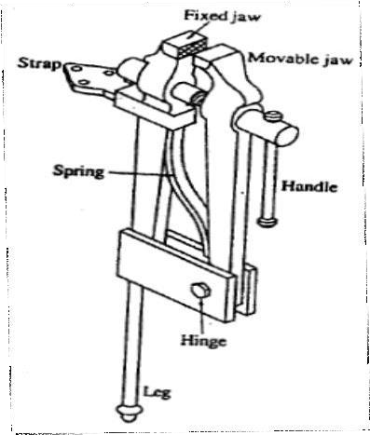
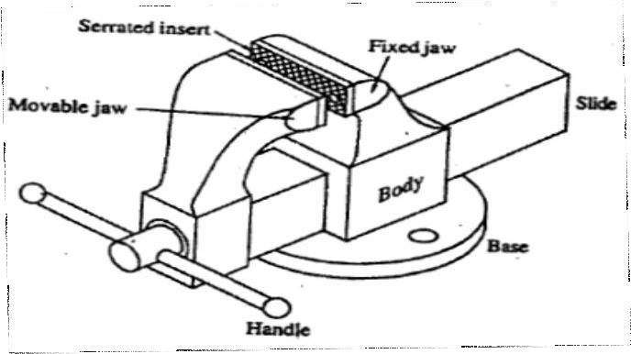
Leg vise: (Fig.22) illustrates a leg vise or black smith's vise4. It consists of a fixed jaw with long leg, a shorter movable jaw, screw and nut-assembly, handle, flat spring and strap plate. The strap plate is fixed to the workbench with bolts and the long leg is fitted into al solid base on floor. The shorter movable jaw is hinged to the leg. By turning the handle provided at the end of the screw, the shorter jaw is moved towards the fixed jaw. A-flat spring is provided in between easy opening. This type of used for gripping work that has to be chipped or hammered.
Fig. 21 Bench Vise
Fig. 22 Leg Vise
Pipe vise: The pipe vise shown in fig.23 used for holding pipes during hack sawing and dieing. It consists of a body. Movable jaw, steel screw, and handle. The movable jaw works vertically along with vertical screw, which passes through the nut in the body.
Hand vise: A hand vise consists of two jaw arms hinged together as shown infig.24. The work is held between the jaws by turning the wing nut provided at the end of screw. A flat spring is provided in between the jaws for easy opening. It is used for holding light work.

Slide 23
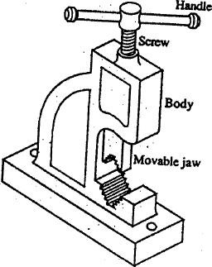
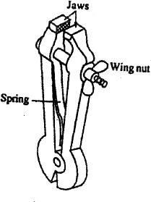
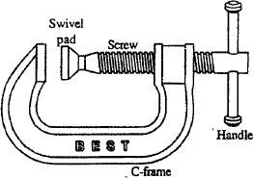
Fig, 23 pipe vise Fig. 24 Hand vise Fig.25 C -clamp
C-clamp: C-clamp shown in fig.25 is used to hold work pieces on machines and is also used of clamping parts together. It consists of a cast steel frame, steel screw handle, and swivel pad. The size of the clamp is determined by the largest opening of its jaws.
Hints for handling vise
Vise should be placed on the workbench at the correct working height for the individual,. The top of the vise jaws should be at elbow with a bent arm.
Bench vises should be mounted on the bench in such a way that a long work piece can be held in a vertical position.
Apply grease on the screws and thrust collarsregularly.
Heavy hammering should not be done on a bench vise.
Do not hammer the handle to tighten the jaws.
Keep the vise clean and remove chops and fillings.
Hammers: The hammer is a very simple striking tool. It is just a weighted head and a wooden handle,. Which directs its course. The head is usually made of medium carbon alloy steel, and is forged to shape. The two ends must be hardened and tempered, the center of the head being left soft. Hammers are made in different shapes and weight varies from 125 gms to 1500 gms. A machinist hammer is a hand tool used for striking purposes while punching, bending, straightening chipping, forging, riveting and swaging.

Slide 24
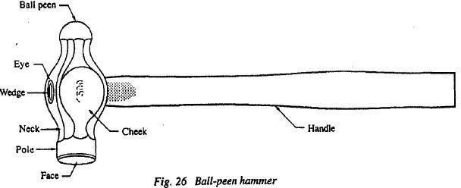
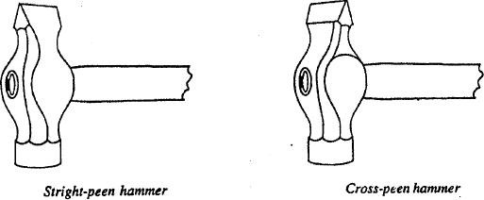
The hammer commonly use de by machinist is the ball-peen hammer as shown in fig.26. The top of the hammer heard is called the peen and the flat bottom is called the face. The cheek is the middle portion of the hammer, where the weight of the head is usually stamped. An eve is a hole in the hammer head to receive the handle. The handle is held in place with a soft steel wedge. The peen is available in three common shapes, the ball peen for riveting, and the straight and cross peen types for swaging. Straight peen hammer has its peen end parallel to the axis of the handle and in cross peen hammer, the peen end is perpendicular to the axis of the handle (fig.27).
Fig.27

Slide 25
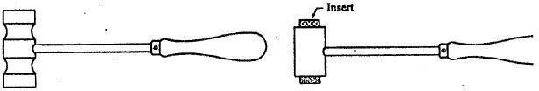
Soft hammers: The head of the soft hammer are made of lead, brass, copper or aluminum and are used when the part being struck must not be dented or scratched (fig. 28). Hammers with cylindrical metal heads with plastic or rawhide inserts at the ends are called soft-faced hammers (fig,29).
Fig,28 Soft hammer Fig. 29 Soft-faced hammer
Hints on hammering
The handle must be tight and secure in the eye of the hammer head.
When striking a blow with the hammer use the elbow as a pivot point, not wrist.
Strike the work with the full face of the hammer parallel to work.
METAL CUTTING TOOLS
Chisels: One method of shaping a metal piece is to chip away the unwanted material with
a hammer and chisel. Chisels may be classified as hot chisel and cold chisel, depending on whether the metal to be cut is hot and cold, Hot chisels are used in smithy shops and cold chisels are used in fitting shops.
Cold chisels: Cold chisels are usually made of medium carbon tool steel of octagonal cross section. After being forged to shape, the cutting edge of the chisel is hardened and tempered to reduce brittleness. The head of the chisel is left soft so it will not chip when struck with hammer. Cold chisels are used to cut metal to required size and shape, to chip the surface of metal to required thickness, to cut off rods and bars to desired lengths, and to cut off rivers or bolt heads.
Chisels are classified by overall length, type of cutting edge, and width of the cutting edge. The four most widely used types of cold chisels shown in fig. 30 are the flat, cape, diamond-point, and round nose chisels.
Flat Chisel: The flat the chisel is the type most commonly used and has a slightly rounded cutting edge

Slide 26
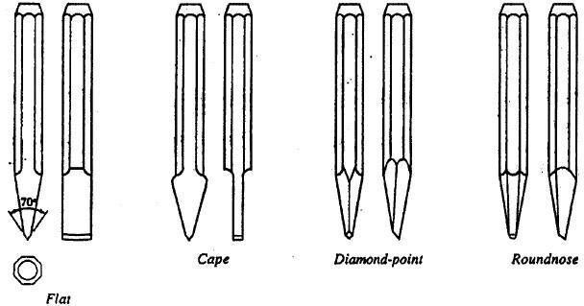
formed by a double bevel. The included angle at the cutting edge is usually
between 50º and 70º depending upon the material on which it is to be used. The cutting angle is high for hard materials and less for soft materials. It is used for chipping a considerable amount of metal from large surfaces that cannot be field or surface machined.
Fig. 30 Type of cold chisels
Cape Chisel: The cutting edge of a cape chisel has a double bevel similar to that of a flat chisel, but is narrower for chipping of grooves and keyways.
Diamond-point nose: The diamond-point chisel has a tapered shank ground on an angle across diagonal corners, forming a diamond shaped cutting edge. It is used for cutting grooves, for squaring up the corners of slots, and for removing broken screws.
Round nose chisel: The cutting edge of a round nose chisel is formed by a single bevel. It is used for cutting semicircular grooves.
Cutting with a chisel: The cold chisel is held loosely between the thumb and the first finger of the left hand. The shank of the tool-is held loosely with the remaining fingers. Hold the cutting edge of the chisel at the point where the cut is desired. Holding the 6all- feen hammer in the right hand, strike sharp, quick blows with the flat face of the hammer and gradually increase the force of the blows as the work progresses.
Hints on chipping
Always wear goggles.
Do not try to chip with a dull chisel.
Do not permit formation of a large mushroom on the head of the chisel. Grind it off

Slide 27
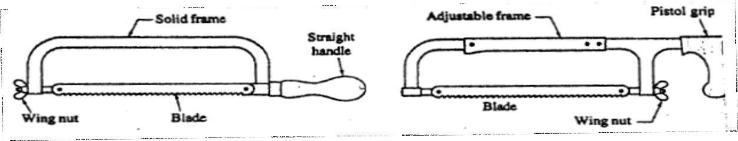
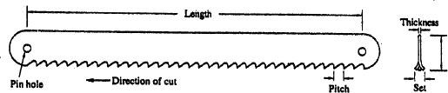

occasionally.
Do not make too deep a cut.
Watch the cutting edge of the chisel and not the end being hammered.
Hand Hacksaws
Hand hack sawing is done with a straight rigid blade having cutting teeth along one
edge. The saw blade is pushed under pressure across the surface of the workspace and each tooth removes a small chip of metal. The hand hack saw is used for cutting different metal bars, rods and tubes to the desired length. It consists of a frame, a handle and a blade. The frame is adjustable or non adjustable. The adjustable frame can hold the blade of various lengths and non-adjustable frame can hold blade of only one length.
Fig. 31 Hacksaws
Hacksaw blades have a hole in each end to fit over pins in the stretchers at each end of the handle frame. The blade is placed between the pins with the teeth pointing away form the handle and the wing nut is tightened until the blade is under proper tension. The handle of the hand hacksaw may be of straight type or of pistol grip. A pistol type grip is usually provided so the operator can grasp the saw firmly and comfortable.
Fig. 32 Hacksaw blade
Fig. 33 Types of set

Slide 28
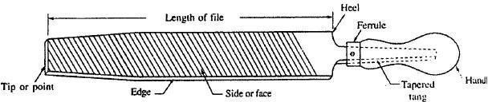
Hacksaw blade: Hacksaw blade shown in fig.32 is straight, relatively rigid with teeth on one edge. It is made with a hole in each end to fit over pins at each end of the hacksaw frame. The length of the blade is the distance between the two end holes. Typically a hand hacksaw blade is 12.7 mm wide, 0.63 mm thick and about 305mm long. The pitch of the hacksaw blade is the stance between the two adjacent teeth. The pitch of the coarse, medium and fine teeth are
1.8 mm, 1mm and 0.8 mm respectively. The teeth on blades are arranged so that the teeth will cut a groove (kerf) in a workpiece, which is wider than the blade thickness and prevents binding of blade and the work piece. This feature is called set. That is, the teeth are alternately pushed out hacksaw blade are shown in fig.33 Hand hacksaw blades are made from high carbon steel or high-speed steel. They may be finished either with the teeth only hardened (flexible blades) or they may be hardened throughout (all hard blades).
Hints on hack sawing
Fix the hacksaw blade correctly with proper tension so that the teeth point away form the handle. Make sure that the work is firmly held.
Slow, steady strokes with the proper pressure are far more effective than fast, uneven cutting.
Hold the saw at an angle that will deep at least three teeth cutting all the time 4. Always keeps the blade of the saw moving in a straight lint and use sufficient pressure
during forward stroke.
Do not use any pressure on the return stroke.
To prevent chatter, saw as close as possible to the point where the work is clamped.
FILE S
File is a hand cutting tool mad of hardened high carbon tool steel. Files are used for finishing and shaping all metals, and for the sharpening of the tools. The parts of a file are
named as shown in fig.34.
Fig. 34 Parts of a file

Slide 29
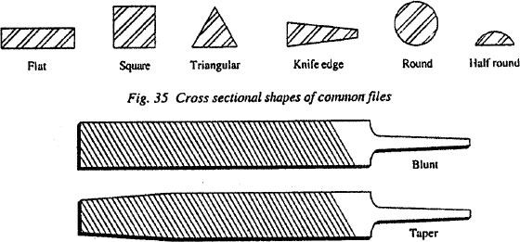
Tang: It is the narrow and tapered part of a file, which fits into the handle.
Heel: It is the broad portion of the file without cutting edges.
Face or side: It is the broad part of the file with teeth cut on its surface.
Edge: It is the thin part of the file with or without teeth cut on its surface. The uncut edge in called safe edge.
Tip or point: It is the end opposite to tang.
Ferrule : It is a protective metal ring to prevent splitting of the handle.
Classification of files
Files can be classified according to the following ways.
According to the cross sectional shape: The standard cross-sectional shapes for files are flat square, triangular, round, and half-round as shown in fig.35. The half-round file in
actually a segment of a circle in cross section. A blunt file has the same cross section size throughout its length and taper file has a cross section that gradually narrows in width and thickness for one half length and taper file has a cross section that gradually narrows in width and thickness for one-half to two thirds of its length. Some flat files have a safe edge with no teeth.
Fig. 36 Blunt and taper file
According to the type of cut:
The cut of a file describes the shape of the shape of the teeth. The basic tooth types are singe-cut, double cut, rasp-cut and curved-tooth as illustrated in fig.37.
Single-cut files: Single-cut files have series of parallel individual teeth that extend at an angle across the face of the file. The angle of the cut to the longitudinal axis may vary between 45degree and 85degree. Single-cut files are used with light pressure to produce a

Slide 30
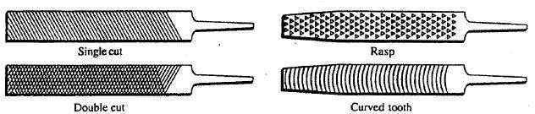
smooth surface finish.
Double-cut files: Double-cut files have two series of diagonal rows of teeth that cross each other on the face. The deep cut is at 70 degree to 80 degree angle to the longitudinal axis of the file, and the shallower cut is at about 110 degree angle to the deep cut. These files are used for fast metal removal and where a rough finish is permissible.
Fig. 37 Types of cut
Rasp-cut files: Rasp-cut files have a series of individual teeth cut by a sharp and narrow
punch like cutting chisel. These files are used for rapid removal of soft materials such as aluminum, lead, wood, and leather.
Curved-tooth files: In curved tooth files, the curved teeth are milled and have a larger opening between the teeth to accommodate heavy chips. The curved-tooth files are ideal for filling aluminum, and lead because of rapid metal removal and the self-cleaning action of the curved teeth.
According to grades of cut: The grade or coarseness of a file is and indication of the spacing of the teeth. Files may be cut with teeth of the following grades. Rough file having 8 teeth per cm, coarse file having l0teeth per cm, Bastard file having l2teeth per cm, second-cut file having l6teeth per cm, smooth file having 20 to 24 teeth per cm, and dead smooth file having 40 or more teeth per cm. For general machine shop work, bastard, second-cut and smooth files are most frequently used.

Slide 31
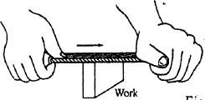
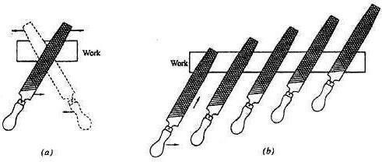
file and retain its contact with the work. The various filing methods are given below: According to the length of file: The length of file is measured form the heel to point. Lengths between l00mm to 150mm are generally used for fine work, between 150mm to 200mm for medium work, and between 200 to 500 mm for heavy work.
Files are specified according to their length, grade, cut and shape.
The art of filing
Filing is a method of removing small amounts of material from the work piece. The method of holding the file and the correct working height are important during filing. The height of the vice should be such that with a bent arm the elbow is at the same level as the
top of the vise. The feet are well apart, left foot about 500mm in advance of the right.
Hold the file with the handle in the right hand and the tip of the file in the left hand. The file handle rests in the palm of the right hand, and the thumb is along the top of the handle. The pressure is applied first to the left hand at the beginning of the stroke, then later to both hands equally in the middle of the stroke, and finally to the right hand at the end of the stroke. On return stroke, relieve the pressure on the
Fig.38 Cross sectional shapes of common files
Straight filing: It is the one of the most common filing operations (refer fig. 38) and is used for rough and finish work.
Fig. 39 Method of holding a file

Slide 32
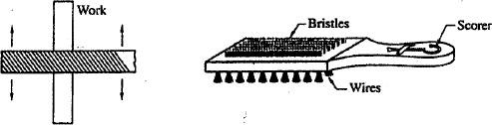
Cross filing: In order to remove the metal at faster rate, the method of crossing strokes should be used. First the file is swept diagonally as in full lines shown in fig 39a and then after a while in the other direction as shown by the dotted lines. The second action has the result of topping off the ridges left form the strokes. These ultimate diagonal positions are continued until the surface is ready for the finishing.
When filing narrow metal pieces, the file may be dept flat by holding it diagonally to the work. Move the file forward and to the right in one stroke as shown in fig. 39b after a few strokes, move forward and to the left.
Draw filing: Draw filing is basically a finishing operation. A single cut smooth file is used for draw filing. Grasp the file firmly at each end and alternately push and pull it sideways across the work with and even pressure (fig.40).
Fig.40 Draw filing Fig. 41 File brush
Pinning of files
Soft metals when filed tend to clog the file. This is called pinning of a file. Pinning reduces the efficiency of the file and causes scratches on the surface of the work. Brush the file frequently along the direction of file teeth with a file card or brush shown in fig.41 one
side of the brush has fine wires, which are used to loosen the embedded material. The other side has bristles, which are used to finish the job. A scorer attached to the hand of the
brush is used to remove pinning that cannot be loosened by the wires.
Types of files
The most commonly used files and their uses are given below.
Flat file: This file is parallel for about two-thirds of its length and then tapers in width and thickness. It is cut on both faces with double cut and both edges with single cut. It is used where fast cutting is needed. This type of file produces rough finish.

Slide 33
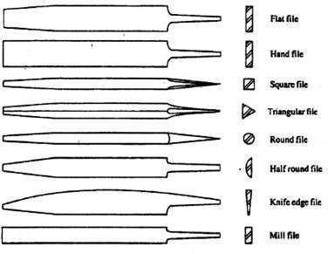
Hand file: The width of the file is parallel throughout, but its thickness tapers similar so that of flat file. It is cut on both faces with double cut and one or both edges. It is used for filing slots and shoulders.
Square file: The sides of the square file are parallel for two-third its length and then tapers off. It is double cut on all sides and is used for filing corners and slots.
Three square or triangular files: These files are usually double cut on all faces and tapered files.
It is used for filing corners less than 90degrees and for sharpening the wood saws. The type that does not taper is known as three square parallel file,
Round file: It is a regular cylinder for two-thirds of its length and then tapers off., the round file is used for filing circular holes, round ended slots, etc.
Fig.42 Types of files
Half round file: ln half round file, the one side of the file is of a segment of a circle and the other side is flat. It is a double cut file used to file curved surfaces.
Knife-edge file: This file tapers to the point in width and thickness. It is double-cut on both flat sides and single cut on both edges. It is used for cleaning out acute-angled corners.
Mill file: It is similar to that of flat file but parallel on both width and thickness and is a single cut file. Mill saw file have one or both edges rounded for forming the radius on saw
teeth and in slots.

Slide 34
Hints on filing
Select the correct file for the given job.
Do not use a file without a handle.
Do not apply pressure on the file during backward stroke.
Do not push the file too fast.
Do not use worn-out and dirty files.
Files should never heap together, but should always be dept each in its separate rack since the teeth of the files are very brittle.
Beep the surface of the work horizontal and only the smallest amount should project form the vise.

Slide 35
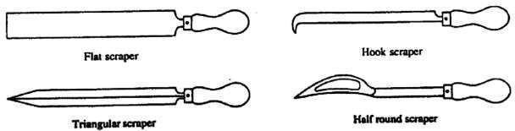
SCRAPER S
Scraping is the operation of removing very thin chips form metal surfaces with special tools called scrapers, to obtain accurate dimensions. Good surface finish and tight contact between mating parts. Scrapers vary in size and shape depending upon the specific work for which they are employed (refer Fig. 43). Old flat and half round files can be converted in to scrapers by grinding and heat treatment.
Fig.43 Scrapers
Hints on scraping
Keep the scraper sharp
Do not allow any oil on the surface being scraped
Drilling
Drilling is the operation of making hole in a work piece by using a rotating tool called a drill. The drill does not produce a precision hole. If hole of accurate size and finish
is required, the reaming or boring must follow the drilling operation.
Twist drill: Twist drill is the most widely used tool in modern drilling practice. It is made form a round bar of tool material such as high speed steel or high carbon steel. It has a pair of helical flutes. Which form the cutting surfaces? Twist drills can be provided with a variety of shanks, but the straight shank and the Morse taper shank are the most common. The different parts of a straight shank twist drill are shown in fig.44.
Drill chuck: The straight shank drills are held in a drilling machine by a drill chuck shown in fig.45. The jaws of the chuck are tightened around the drill by means of a key. Most drill spindles have a tapered hole (Morse taper) into which the tapered shank of the drill chuck is fastened.

Slide 36
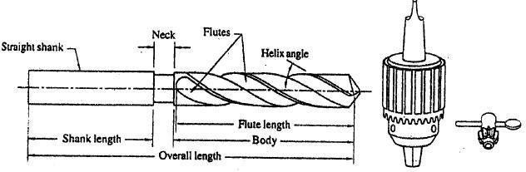
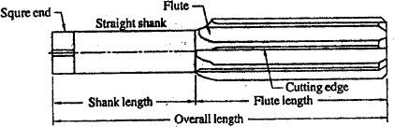
Fig.44 Twist drill
Fig.45 Drill chuck
Reaming: As twist drills do not make accurately sized or good finish holes a reamer of some type is often used to cut the final size and finish. A reamer will not make the original hole; it will only enlarge a previously drilled or bored hole. Reamers are usually made of high speed steel. The hand reamer shown n fig.46 is intended to be turned and fed by hand and to remove a small amount of material. One end of the shank is square shaped for turning it with a tap wrench.
Fig.46 Reamer
Tap and tap wrench: Tapping is the operation of forming internal threads by means of a tool called a tap as shown in fig.47. A tap consists of toothed body having flutes cut on its surface, a round shank and a square formation at the end of the shank. For hand taping, three types of taps are used. A set of taps includes taper tap or starting tap, second or plug tap and bottoming tap. The pitch diameter of all three taps the same and they are used in the same order as taper, plug and bottoming tap in the threading operation. The only difference is the amount of chamfer angle. The taper is tapered from the end for about 4degree-6degree to ensure starting the tap straight, the second is tapered for about for about 7 degree -9degree and the bottoming tap is tapered for about 30degree - 45degree. A tap wrench is used for gripping and holding a tap securely. The taper tap is

Slide 37
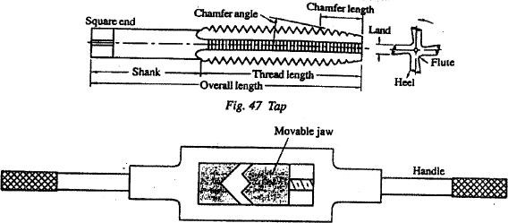
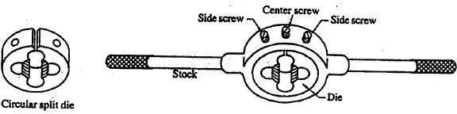
placed over the previously drilled
through hole and is screwed down to start the cutting of threads. After the full length of the toothed body of the taper tap has been screwed down in the hole,. This tap is withdrawn and then a second tap is used to complete the cutting of threads. In blind holes the bottoming tap that is merely "backed off” is used after the second tap to finish the threads.
Fig.48 Tap wrench
A tap wrench is a hand tool for gripping and holding the square end of a tap securely. An adjustable tap wrench is shown in fig.48. The position of the movable jaw can be adjusted by turning the knurled handle.
Die and diestock: External threading on bars and tubes is done with dies held in a diestock basically; dies are similar to threaded nuts with multiple cutting edges. Dies area made from high speed steel. Fig.49 shows a round split adjustable die. The die is fit into the diestock. Adjustments are then made with the three screws in the diestock. Two side screws hold the die in the die stock and also provide closing pressure on the die. The center screw engages the split in the die and provides opening pressure. This permits the die to be set large amount open whilst the first cut is taken down on a rod and closed into the correct size for final finishing cut. A suitable lubrication is desirable to produce a smoother thread and to prolong the life of the die.
Fig.49 Die and diestock

Slide 38
FITTING MODELS
Model 1 AIM: To prepare the fitting model of given dimensions.
TOOL USED: Work piece (mild steel) Bench vise, try square, files, vernier at gauge, punch, hammer, divider, and hacksaw.
PROCEDURE:
Hold the given plate on a bench vise such that one edge of the plate is horizontal.
File the edge with rough and smooth files and check with try-square for flatness.
Hold the adjacent edge of the plate in horizontal position with the vise.
File the adjacent edge with rough and smooth files and check with try-square for flatness and squareness.
Apply wet chalk on any one flat side of the plate and allow it to dry for marking
Lay out the given drawing on the plate by using surface plate, angle rule, scriber, etc.
Make punch marks along the line marked on the plates using prick punch.
Cut the excess material with small allowance using hacksaw or by chisel.
Remove the material left over in the previous step by filing operation to get the desire geometry of the part.
Repeat the above procedure on the remaining parts.
RESULT:
The desired fitting model is obtained.

Slide 39
MODEL 1
78
5
All dimensions are in mm

Slide 40
MODEL 2
AIM: To prepare the fitting model of given dimensions.
TOOL USED: Work piece (mild steel) Bench vise, try square, files, vernier at gauge, punch, hammer, divider, and hacksaw.
PROCEDUR E:
Hold the given plate on a bench vise such that one edge of the plate is horizontal.
File the edge with rough and smooth files and check with try-square for flatness.
Hold the adjacent edge of the plate in horizontal position with the vise.
File the adjacent edge with rough and smooth files and check with try-square for flatness and squareness.
Apply wet chalk on any one flat side of the plate and allow it to dry for marking
Lay out the given drawing on the plate by using surface plate, angle rule, scriber, etc.
Make punch marks along the line marked on the plates using prick punch.
Cut the excess material with small allowance using hacksaw or by chisel.
Remove the material left over in the previous step by filing operation to get the desire geometry of the part.
Repeat the above procedure on the remaining parts.
RESULT:
The desired fitting model is obtained.

Slide 41


Workshop and Machine shop practice [18MEL38A/48A]
MODEL 2
17
14
17
20
48
All dimensions are in mm
[Department of Mechanical Engineering B.I.E.T., Davangere]

Slide 42
Workshop and Machine shop practice [18MEL38A/48A]
MODEL 3
AIM: To prepare the fitting model of given dimensions.
TOOL USED: Work piece (mild steel) Bench vise, try square, files, vernier at gauge, punch, hammer, divider, and hacksaw.
PROCEDURE:
Hold the given plate on a bench vise such that one edge of the plate is horizontal.
File the edge with rough and smooth files and check with try-square for flatness.
Hold the adjacent edge of the plate in horizontal position with the vise.
File the adjacent edge with rough and smooth files and check with try-square for flatness and squareness.
Apply wet chalk on any one flat side of the plate and allow it to dry for marking
Lay out the given drawing on the plate by using surface plate, angle rule, scriber, etc.
Make punch marks along the line marked on the plates using prick punch.
Cut the excess material with small allowance using hacksaw or by chisel.
Remove the material left over in the previous step by filing operation to get the desire geometry of the part.
Repeat the above procedure on the remaining parts.
RESULT:
The desired fitting model is obtained.
[Department of Mechanical Engineering B.I.E.T., Davangere]

Slide 43
Workshop and Machine shop practice [18MEL38A/48A]
MODEL 3
12
12
17
17
20
All dimensions are in mm
[Department of Mechanical Engineering B.I.E.T., Davangere]

Slide 44
Workshop and Machine shop practice [18MEL38A/48A]
MODEL 4
AIM: To prepare the fitting model of given dimensions.
TOOL USED: Work piece (mild steel) Bench vise, try square, files, vernier at gauge, punch, hammer, divider, and hacksaw.
PROCEDURE:
Hold the given plate on a bench vise such that one edge of the plate is horizontal.
File the edge with rough and smooth files and check with try-square for flatness.
Hold the adjacent edge of the plate in horizontal position with the vise.
File the adjacent edge with rough and smooth files and check with try-square for flatness and squareness.
Apply wet chalk on any one flat side of the plate and allow it to dry for marking
Lay out the given drawing on the plate by using surface plate, angle rule, scriber, etc.
Make punch marks along the line marked on the plates using prick punch.
Cut the excess material with small allowance using hacksaw or by chisel.
Remove the material left over in the previous step by filing operation to get the desire geometry of the part.
Repeat the above procedure on the remaining parts.
RESULT:
The desired fitting model is obtained.
[Department of Mechanical Engineering B.I.E.T., Davangere]

Slide 45
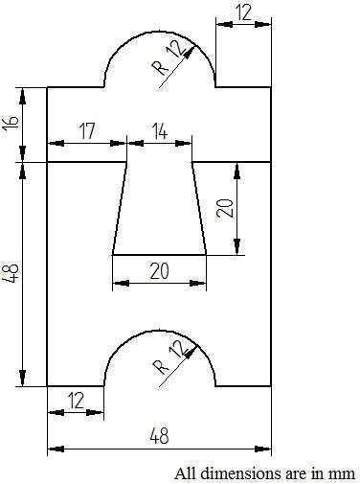
Workshop and Machine shop practice [18MEL38A/48A]
MODEL 4
[Department of Mechanical Engineering B.I.E.T., Davangere]

Slide 46
Workshop and Machine shop practice [18MEL38A/48A]
MODEL 5
AIM: To prepare the fitting model of given dimensions.
TOOL USED: Work piece (mild steel) Bench vise, try square, files, vernier at gauge, punch, hammer, divider, and hacksaw.
PROCEDURE:
Hold the given plate on a bench vise such that one edge of the plate is horizontal.
File the edge with rough and smooth files and check with try-square for flatness.
Hold the adjacent edge of the plate in horizontal position with the vise.
File the adjacent edge with rough and smooth files and check with try-square for flatness and squareness.
Apply wet chalk on any one flat side of the plate and allow it to dry for marking
Lay out the given drawing on the plate by using surface plate, angle rule, scriber, etc.
Make punch marks along the line marked on the plates using prick punch.
Cut the excess material with small allowance using hacksaw or by chisel.
Remove the material left over in the previous step by filing operation to get the desire geometry of the part.
Repeat the above procedure on the remaining parts.
RESULT:
The desired fitting model is obtained.
[Department of Mechanical Engineering B.I.E.T., Davangere]

Slide 47
Workshop and Machine shop practice [18MEL38A/48A]
MODEL 5
17
14
17
17
17
20
All dimensions are in mm
[Department of Mechanical Engineering B.I.E.T., Davangere]

Slide 48
Workshop and Machine shop practice [18MEL38A/48A]
MODEL 6
AIM: To prepare the fitting model of given dimensions.
TOOL USED: Work piece (mild steel) Bench vise, try square, files, vernier at gauge, punch, hammer, divider, and hacksaw.
PROCEDURE:
Hold the given plate on a bench vise such that one edge of the plate is horizontal.
File the edge with rough and smooth files and check with try-square for flatness.
Hold the adjacent edge of the plate in horizontal position with the vise.
File the adjacent edge with rough and smooth files and check with try-square for flatness and squareness.
Apply wet chalk on any one flat side of the plate and allow it to dry for marking
Lay out the given drawing on the plate by using surface plate, angle rule, scriber, etc.
Make punch marks along the line marked on the plates using prick punch.
Cut the excess material with small allowance using hacksaw or by chisel.
Remove the material left over in the previous step by filing operation to get the desire geometry of the part.
Repeat the above procedure on the remaining parts.
RESULT:
The desired fitting model is obtained.
[Department of Mechanical Engineering B.I.E.T., Davangere]

Slide 49
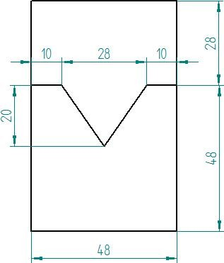
Workshop and Machine shop practice [18MEL38A/48A]
MODEL 6
All dimensions are in mm
[Department of Mechanical Engineering B.I.E.T., Davangere]

Slide 50
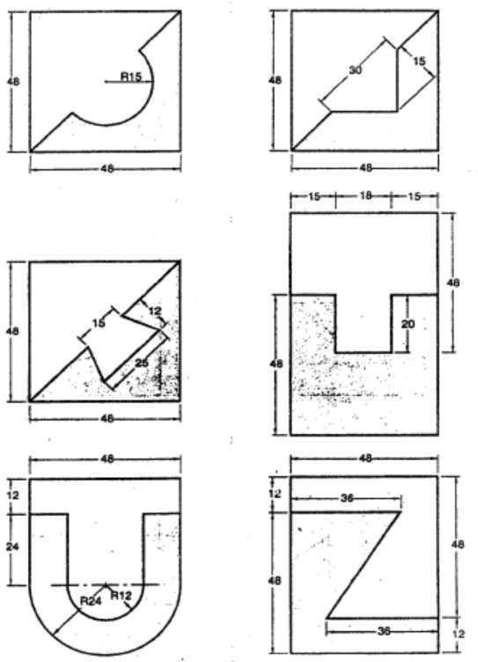
Workshop and Machine shop practice [18MEL38A/48A]
EXERCISE MODELS
Make the following fitting models from the given mild steel plates of size 50mm x 50 mm each.
[Department of Mechanical Engineering B.I.E.T., Davangere]

Slide 51
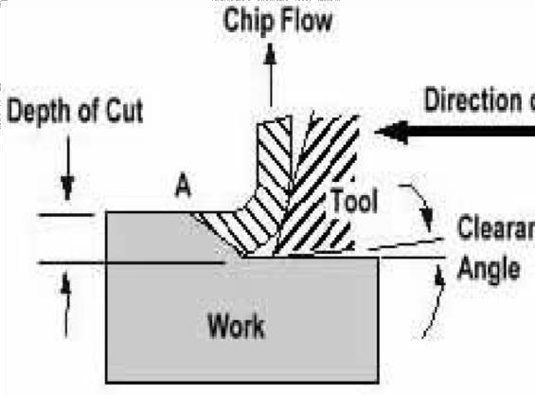
Workshop and Machine shop practice [18MEL38A/48A]
MACHINE SHOP
1. INTRODUCTION TO METAL CUTTING
BASIC METAL CUTTING THEORY
The usual conception of cutting suggests clearing the substance apart with a thin knife or wedge. When metal is cut the action is rather different and although the tool will always be wedge shaped in the cutting area and the cutting edge should always be sharp the wedge angle will be far too great for it to be considered knife shaped. Consequently a shearing action takes place when the work moves
Figure 1: Basic Metal Cutting Theory against the tool.
Figure above shows a tool being moved against a fixed work piece. When the cut is in progress the chip presses heavily on the top face of the tool and continuous shearing takes place across the shear plane AB. Although the Figure shows a tool working in the horizontal plane with the work piece stationary, the same action takes place with the work piece revolving and the tool stationary.
MACHINE TOOL:
A machine tool may be defined as a power driven machine which accomplishes the cutting or machining operations on it. The fundamental machine tools that are used for most of the machining processes are lathe, drilling, tapping, shaping, milling and grinding machines.
CUTTING TOOLS
There are basically two types of cutting tools:
Single point (e.g. turning tools).
Multiple point (e.g. milling tools).
[Department of Mechanical Engineering B.I.E.T., Davangere]

Slide 52
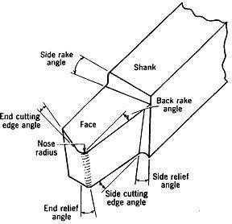
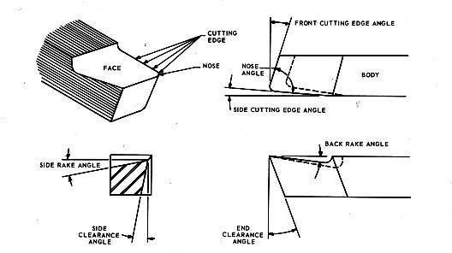
Workshop and Machine shop practice [18MEL38A/48A]
In general Single Point Cutting Tool is used which is made of H S S( high speed steel). The main alloying elements in H S S are l8-4-l (i.e.; l8% Tungsten, 4% chromium and l% vanadium, it has 0.75% carbon and l2% cobalt).Figure 2 shows the terminology of single point cutting tool.
Figure 2 Cutting Tool Terminology
The figure 2 shows a typical cutting tool and the terminology used to describe it.
[Department of Mechanical Engineering B.I.E.T., Davangere]

Slide 53
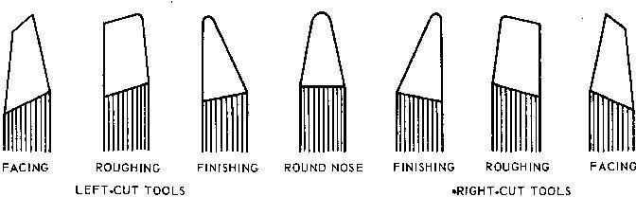
Workshop and Machine shop practice [18MEL38A/48A]
Shank: The shank is the portion of the tool bit which is not ground to form cutting edges and is rectangular in cross-section.
Face: The face of the cutting tool is that surface against which the chip slides upward. Flank: The lank of a cutting tool is that surface which face the work piece.
Heel: The heel of a single point tool is the lowest portion of the side cutting edges.
Nose: The nose of a tool is the conjunction of the side-and end-cutting edges. A nose radius increases the tool life and improves surface finish.
Base: The base of a tool is the underside of the shank.
Rake: The rake is the slope of the top away from the cutting edge. The larger the rake angle, the larger the shear angle and subsequently the cutting force and power reduce.
End cutting edge angle: It is the angle between face of the tool and a plane perpendicular to the side of the shank. It varies from 5 to l5 degrees.
The actual geometry varies with the type of work to be done. The standard cutting tool shapes are shown in figure 3.
Facing tools are ground to provide clearance with a center.
Roughing tools have a small side relief angle to leave more material to support the cutting edge during deep cuts.
Finishing tools have a more rounded nose to provide a finer finish. Round nose tools are for lighter turning. They have no back or side rake to permit cutting in either direction.
Left hand cutting tools are designed to cut best when traveling from left to right.
Aluminum is cut best by specially shaped cutting tools (not shown) that are used with the cutting edge slightly above center to reduce chatter.
[Department of Mechanical Engineering B.I.E.T., Davangere]
Figure 3 Standard Cutting Tools

Slide 54
Workshop and Machine shop practice [18MEL38A/48A]
TOOL ANGLES
There are three important angles in the construction of a cutting tool rake angle, clearance angle and plan approach angle.
Rake Angle
Rake angle is the angle between the top face of the tool and the normal to the work surface at the cutting edge. In general, the larger the rake angle, the smaller the cutting force on the tool. A large rake angle will improve cutting action, but would lead to early tool failure, since the tool wedge angle is relatively weak. A compromise must therefore be made between adequate strength and good cutting action.
Clearance Angle
Clearance angle is the angle between the flank or front face of the tool and a tangent to the work surface originating at the cutting edge. All cutting tools must have clearance to allow cutting to take place. Clearance should be kept to a minimum, as excessive clearance angle will not improve cutting efficiency and will merely weaken the tool. Typical value for front
clearance angle is 6° in external turning.
TOOL MATERIALS IN COMMON USE
The different materials used for cutting tools are:
High carbon steel 5. Cemented carbides
Alloy steels 6. Ceramics
High speed steel 7. Diamonds
Stellites 8. Abrasives
High Carbon Steel: Contains 1 - 1.4% carbon with some addition of chromium and tungsten
to improve wear resistance. The steel begins to lose its hardness at about 250° C, and is not favored for modern machining operations where high speeds and heavy cuts are usually employed.
High Speed Steel (H.S.S.): Steel, which has a hot hardness value of about 600° C, possesses good strength and shock resistant properties. It is commonly used for single point lathe cutting tools and multi point cutting tools such as drills, reamers and milling cutters.
[Department of Mechanical Engineering B.I.E.T., Davangere]

Slide 55
Workshop and Machine shop practice [18MEL38A/48A]
Cemented Carbides: An extremely hard material made from tungsten powder. Carbide tools are usually used in the form of brazed or clamped tips. High cutting speeds may be used and materials difficult to cut with HSS may be readily machined using carbide tipped tool.
LATHE
INTRODUCTION
Lathe is one of the most versatile and widely used machine tools all over the world. It is commonly known as the mother of all other machine tool. The main function of a lathe is to remove metal from a job to give it the required shape and size. The job is securely and rigidly held in the chuck or in between centers on the lathe machine and then turn it against a single point cutting tool which will remove metal from the job in the form of chips.
TYPES OF LATHE
Lathes are manufactured in a variety of types and sizes, from very small bench lathes used for precision work to huge lathes used for turning large steel shafts. But the principle ofoperation and function of all types of lathes are same. The different types of lathes are:
  Speed lathe
  Centre or Engine lathe
  Bench lathe
  Tool Room Lathe
  Capstan and Turret lathe
  Special purpose lathe
  Automatic lathe
Speed Lathe
Speed lathe is simplest of all types of lathes in construction and operation. It consists of a Bed, Headstock, Tailstock and Tool post mounted on an adjustable slide. There is no feed box, leadscrew or conventional type of carriage. The tool is mounted on the adjustable slide and is fed into the work by hand control. The speed lathe finds applications where cutting force is least such as in wood working, spinning, centering, polishing, winding etc.
Centre or Engine Lathe
The term “engine” is associated with this lathe due to the fact that in the very early days of its development it was driven by steam engine. This lathe is the important member of the lathe family and is the most widely used. Similar to the speed lathe, the engine lathe has all the basic parts, e.g., bed, headstock, and tailstock. An engine lathe is shown in Fig. 4. Unlike the speed lathe, the engine lathe can feed the cutting tool both in cross and longitudinal direction with reference to the lathe axis with the help of a carriage, feed rod and lead screw. The power may be transmitted by means of belt, electric motor or through gears.
[Department of Mechanical Engineering B.I.E.T., Davangere]

Slide 56
Workshop and Machine shop practice [18MEL38A/48A]
Bench Lathe
This is a small lathe usually mounted on a bench. It has practically all the parts of an engine lathe or speed lathe and it performs almost all the operations. This is used for small and precision work.
Tool Room Lathe
This lathe has features similar to an engine lathe but it is much more accurately built. It has a wide range of spindle speeds ranging from a very low to a quite high speed up to 2500 rpm. This lathe is mainly used for precision work on tools, dies, gauges and in machining work where accuracy is needed.
Capstan and Turret Lathe
The distinguishing feature of this type of lathe is that the tailstock of an engine lathe is replaced by a hexagonal turret, on the face of which multiple tools may be fitted and fed into the work in proper sequence. Due to this arrangement, several different types of operations can be done on a job without re-setting of work or tools, and a number of identical parts can be produced in the minimum time.
Special Purpose Lathes
These lathes are constructed for special purposes and for jobs, which cannot be accommodated or conveniently machined on a standard lathe. The wheel lathe is made for finishing the journals and turning the tread on railroad car and locomotive wheels. The gap bed lathe, in which a section of the bed adjacent to the headstock is removable, is used to swing extra-large- diameter pieces.
Automatic Lathes
These lathes are so designed that all the working and job handling movements of the complete manufacturing process for a job are done automatically. These are high speed, heavy duty, mass production lathes with complete automatic control.
PRINCIPLE FUNCTIONS OF LATHE PARTS
A simple lathe comprises of a bed made of grey cast iron on which headstock, tailstock, carriage and other components of lathe are mounted. Figure l shows the different parts of engine lathe or central lathe.
The major parts of lathe machine are given as under:
Bed
Head stock
Tailstock
Carriage
Feed mechanism
[Department of Mechanical Engineering B.I.E.T., Davangere]

Slide 57
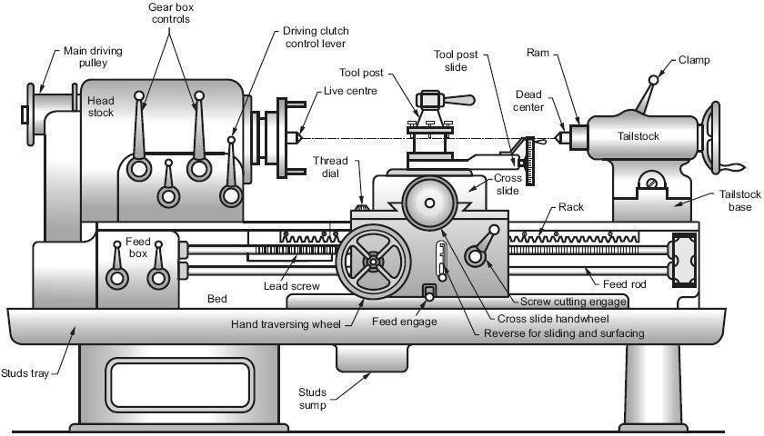
Workshop and Machine shop practice [18MEL38A/48A]
Figure 4: Different parts of engine lathe or central lathe
Bed
The bed of a lathe machine is the base on which all other parts of lathe are mounted. It is massive and rigid single piece casting made to support other active parts of lathe. On left end of the bed, headstock of lathe machine is located while on right side tailstock is located. The carriage of the machine rests over the bed and slides on it. On the top of the bed there are two sets of guideways - innerways and outerways. The innerways provide sliding surfaces for the tailstock and the outerways for the carriage. The guideways of the lathe bed may be flat and inverted V shape. Generally cast iron alloyed with nickel and chromium material is used for manufacturing of the lathe bed.
Head Stock
The main function of headstock is to transmit power to the different parts of a lathe. It comprises of the headstock casting to accommodate all the parts within it including gear train arrangement. The main spindle is adjusted in it, which possesses live centre to which the work can be attached. It supports the work and revolves with the work, fitted into the main spindle of the headstock. The cone pulley is also attached with this arrangement, which is used to get various spindle speed through electric motor. The back gear arrangement is used for obtaining a wide range of slower speeds. Some gears called change wheels are used to produce different velocity ratio required for thread cutting.
Tail Stock
Figure 5 shows the tail stock of central lathe, which is commonly used for the objective of primarily giving an outer bearing and support the circular job being turned on centers. Tail stock can be easily set or adjusted for alignment or non-alignment with respect to the spindle
[Department of Mechanical Engineering B.I.E.T., Davangere]

Slide 58
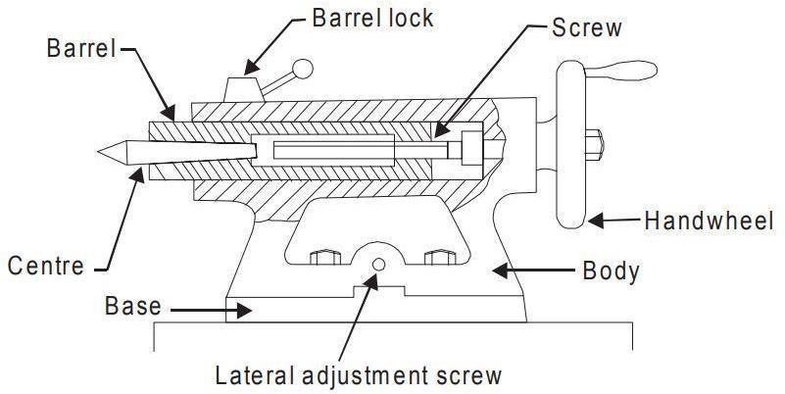
Workshop and Machine shop practice [18MEL38A/48A]
centre and carries a centre called dead centre for supporting one end of the work. Both live and dead centers have 60° conical points to fit centre holes in the circular job, the other end tapering to allow for good fitting into the spindles. The dead centre can be mounted in ball bearing so that it rotates with the job avoiding friction of the job with dead centre as it important to hold heavy jobs.
Figure 5: Tail stock of central lathe
Carriage
Carriage is mounted on the outer guide ways of lathe bed and it can move in a direction parallel to the spindle axis. It comprises of important parts such as apron, cross-slide, saddle, compound rest, and tool post. The lower part of the carriage is termed the apron in which there are gears to constitute apron mechanism for adjusting the direction of the feed using clutch mechanism and the split half nut for automatic feed. The cross-slide is basically mounted on the carriage, which generally travels at right angles to the spindle axis. On the cross-slide, a saddle is mounted in which the compound rest is adjusted which can rotate and fix to any desired angle. The compound rest slide is actuated by a screw, which rotates in a nut fixed to the saddle. The tool post is an important part of carriage, which fits in a tee-slot in the compound rest and holds the tool holder in place by the tool post screw.
Feed Mechanism
Feed mechanism is the combination of different units through which motion of headstock spindle is transmitted to the carriage of lathe machine. Following units play role in feed mechanism of a lathe machine.
End of bed gearing
Feed gear box
Lead screw and feed rod
Apron mechanism
The gearing at the end of bed transmits the rotary motion of headstock spindle to the feed gear box. Through the feed gear box the motion is further transmitted either to the feed shaft or lead
[Department of Mechanical Engineering B.I.E.T., Davangere]

Slide 59
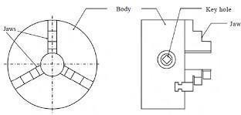
Workshop and Machine shop practice [18MEL38A/48A]
screw, depending on whether the lathe machine is being used for plain turning or screw cutting.
The feed gear box contains a number of different sizes of gears. The feed gear box provides a means to alter the rate of feed, and the ration between revolutions of the headstock spindle and the movement of carriage for thread cutting by changing the speed of rotation of the feed rod or lead screw.
The apron is fitted to the saddle. It contains gears and clutches to transmit motion from the feed rod to the carriage, and the half nut which engages with the lead screw during cutting threads.
WORK HOLDING DEVICES:
Work is held between the centres
  Live centre - head stock spindle and Dead centre - tail stock spindle.
  Driven by catch plate and carrier
Work piece held in chuck
  four jaw independent chuck
  three jaw universal self centering chuck
  magnetic chuck
  collet chuck
  Drill chuck
Work held in face plate.
Work held in mandrel
  Plain Mandrel
  Step Mandrel
  Collar Mandrel
  Screwed Mandrel
Cope Mandrel
Gang Mandrel
Expansion Mandrel
Work held in turning fixture
  Steady Rest
  Follower Rest
Figure 6: Three Jaw Universal Self Centering Chuck
[Department of Mechanical Engineering B.I.E.T., Davangere]

Slide 60
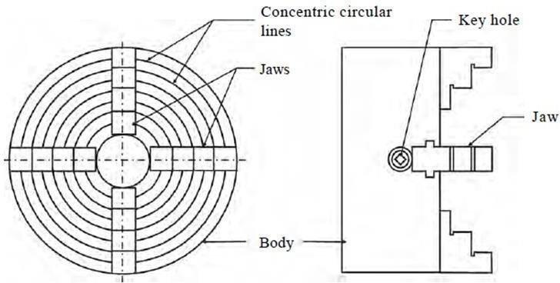

Figure 7: Four Jaw Independent Chuck
LATHE OPERATIONS:
Straight Turning Or Plain Turning
Facing
Shoulder turning
Chamfering
Knurling
Forming
Parting off (grooving)
Spinning
Eccentric turning
Drilling
Boring
Centering
Thread cutting
Taper turning
For performing the various machining operations in a lathe, the job is being supported and driven by anyone of the following methods.
Job is held and driven by chuck with the other end supported on the tail stock centre.
Job is held between centers and driven by carriers and catch plates.
Job is held on a mandrel, which is supported between centers and driven by carriers and catch plates.
Job is held and driven by a chuck or a faceplate or an angle plate

Slide 61


The above methods for holding the job can be classified under two headings namely job held between centers and job held by a chuck or any other fixture. The various important lathe operations are depicted through figure 6.
Figure 8: Various lathe operations
Taper Turning
A taper is defined as a uniform increase or decrease in diameter of a piece of work measured along its length. In a lathe machine, taper turning means to produce a conical surface by gradual reduction in diameter from a cylindrical job. The taper angle (α) for conical surface is given by;
Where,
D is diameter of the large end, d is the dia of the small end of the cylindrical job, l is the length of the taper of cylindrical job.
A taper is generally turned in a lathe by feeding the tool at an angle to the axis of rotation of the workpiece. The angle formed by the path of the tool with the axis of the workpiece should correspond to the half taper angle. A taper can be turned by anyone of the following methods:
By swiveling the compound rest,
By setting over the tailstock centre,
By a broad nose form tool,
By a taper turning attachment,
By combining longitudinal and cross feed in a special lathe and
By using numerical control lathe

Slide 62


Taper Turning by Swivelling the Compound Rest
This method uses the principle of turning taper by rotating the workpiece on the lathe axis and feeding the tool at an angle to the axis of rotation of the workpiece. The tool is mounted on the compound rest which is attached to a circular base, graduated in degrees.
Figure 9: Taper turning by swiveling compound rest
The compound rest can easily be swiveled or rotated and clamped at any desired angle as shown in Fig. 7. Once the compound rest is set at the desired half taper angle, rotation of the compound slide screw will cause the tool to be fed at that angle and generate a corresponding taper. This method is limited to turn a short but steep taper because of the limited movement of the cross-slide. The positioning or setting of the compound rest is accomplished by swiveling the rest at the half taper angle, if this is already known. If the diameter of the small and large end and length of taper are known, the half taper angle can be calculated
Thread Cutting
Figure 10: Thread Cutting

Slide 63

Figure 8 shows the setup of thread cutting on a lathe. Thread of any pitch, shape and size can be cut on a lathe using single point cutting tool. Thread cutting is operation of producing a helical groove on spindle shape such as V, square or power threads on a cylindrical surface. The job is held in between centres or in a chuck and the cutting tool is held on tool post. The cutting tool must travel a distance equal to the pitch (in mm) as the work piece completes a revolution. The definite relative rotary and linear motion between job and cutting tool is achieved by locking or engaging a carriage motion with lead screw and nut mechanism and fixing a gear ratio between head stock spindle and lead screw. To make or cut threads, the cutting tool is brought to the start of job and a small depth of cut is given to cutting tool using cross slide. The equation for thread cutting calculation is given by;
DRILLING ON A LATHE
For producing holes in jobs on lathe, the job is held in a chuck or on a face plate. The drill is held in the position of tailstock and which is brought nearer the job by moving the tailstock along the guide ways, the thus drill is fed against the rotating job as shown in Fig. 2l.l5.
Figure 11: Drilling on lathe
CUTTING PARAMETERS
Cutting speed
Cutting speed for lathe work may be defined as the rate in meters per minute at which the surface of the job moves past the cutting tool. Machining at a correct cutting speed is highly important for good tool life and efficient cutting. Too slow cutting speeds reduce productivity and increase manufacturing costs whereas too high cutting speeds result in overheating of the tool and premature failure of the cutting edge of the tool. The following factors affect the cutting speed:

Slide 64


i.
ii. iii. iv.
v.
Kind of material being cut Cutting tool material Shape of cutting tool
Rigidity of machine tool and the job piece and Type of cutting fluid being used.
Cutting speed is the speed at which metal is removed by the tool from the work.
.
Where, D is diameter of job in mm
N is speed in RPM
Feed
It is the distance the tool advances for every revolution of the workpiece. It is expressed in mm/rev.
Depth of Cut
It is perpendicular distance measured from the machined surface to the uncut surface of work. It is expressed in mm
Where,
^{D}1 is diameter of work before machining, D2 is diameter of work after machining.
Machining Time
DIFFERENT MECHANISMS:
2.7.l Apron Mechanisum:
when a spindle rotates, the LEAD screw and the feed rod will rotate through the tumbler gear.
This, Apron Mechanism provided in the carriage is connected to the LEAD Screw through the half nut engaged in the carriage, from which auto feed of the longitudinal and the cross feed mechanism is obtained.

Slide 65

Back Gear Mechanism:
Back gear arrangement is used for reducing the spindle speed, which is necessary for thread cutting and knurling.
Figure 12: Back Gear Mechanism
There is one stepped cone pulley in the lathe spindle. This pulley can freely rotate on the spindle. A pinion gear P_{l} is connected to small end of the cone pulley. P_{l} will rotate when cone pulley rotates. Bull gear G_{l} is keyed to lathe spindle such that the spindle will rotate when Gear G_{l} rotates. Speed changes can be obtained by changing the flat belt on the steps. A bull gear G_{l} may be locked or unlocked with this cone pulley by a lock pin. There are two back gears Bl ^{and B}2 on a back shaft. It is operated by means of hand lever L; back gears Bl ^{and B}2 can be engaged or disengaged with Gl ^{and P}l. For getting direct speed, back gear is not engaged. The step cone pulley is locked with the main spindle by using the lock pin. The flat belt is changed for different steps. Thus three or four ranges of speed can be obtained directly. For getting slow or indirect speeds, back gear is engaged by lever L and lock pin is disengaged. Now, power will flow from P_{l} to B_{l}. B_{l} to B₂ (same shaft), B₂ to G_{l} to spindle. As gear B_{l} is larger than P_{l}, the speed will further be reduced at Bl^{. B}l ^{and B}2 will have the same speeds. The speed will further be reduced at Gl ^{because gear G}l ^{is larger than B}2. So, the speed of spindle is reduced by engaging the back gear.
Tumbler Gear Mechanism
Tumbler gear mechanism is used to change the direction of lead screw and feed rod. By changing tumbler gear, the carriage can be moved automatically from tailstock end to

Slide 66
headstock end or moved from head stock end to tailstock end. Usually during thread cutting and automatic feed, tumbler gear is used.

Slide 67

SHAPING MACHINE
The shaper is a machine tool used primarily for:
  Producing a flat or plane surface which may be in a horizontal, a vertical or an angular plane.
  Making slots, grooves and keyways
  Producing contour of concave/convex or a combination of these
WORKING PRINCIPLE
The job is rigidly fixed on the machine table. The single point cutting tool held properly in the tool post is mounted on a reciprocating ram. The reciprocating motion of the ram is obtained by a quick return motion mechanism. As the ram reciprocates, the tool cuts the material during its forward stroke. During return, there is no cutting action and this stroke is called the idle stroke. The forward and return strokes constitute one operating cycle of the shaper.
Figure 13: Standard Shaping Machine

Slide 68

Figure 14: Shaper Tool Head
Construction: The main parts of the Shaper machine is Base, Body (Pillar, Frame, Column), Cross rail, Ram and tool head (Tool Post, Tool Slide, Clamper Box Block).
Base: The base is a heavy cast iron casting which is fixed to the shop floor. It supports the body frame and the entire load of the machine. The base absorbs and withstands vibrations and other forces which are likely to be induced during the shaping operations.
Body (Pillar, Frame, Column): It is mounted on the base and houses the drive mechanism compressing the main drives, the gear box and the quick return mechanism for the ram movement. The top of the body provides guide ways for the ram and its front provides the guide ways for the cross rail.
Cross rail: The cross rail is mounted on the front of the body frame and can be moved up and down. The vertical movement of the cross rail permits jobs of different heights to be

Slide 69
accommodated below the tool. Sliding along the cross rail is a saddle which carries the work table.
Ram and tool head: The ram is driven back and forth in its slides by the slotted link mechanism. The back and forth movement of ram is called stroke and it can be adjusted according to the length of the workpiece to be-machined.
Shapers can be classified as below;
Based on the reciprocating Mechanism
  Crank type
  Geared type
  Hydraulic type
Based on the ram travel
  Horizontal
  Vertical
  Traveling head
Based on the table design
  Standard shaper
  Universal shaper
Based on the cutting stroke
  Push cut type
  Draw cut type
SPECIFICATIONS OF A SHAPER
A shaper can be specified based on the following factors:
Maximum stroke length: It is the maximum length that the ram can travel, hence the Length of cut the tool can take. It ranges from 175 to 900 mm.
Maximum height, Length of table travel: Maximum travel of the table- in vertical direction indicates the maximum height of the workpiece that can be machined and the horizontal travel indicates the maximum width of the work-piece that can be machined.
Drive mechanism: The drive mechanism used to reciprocate the ram may be Mechanical type of hydraulic type. Hydraulic type is preferred because of its Advantages. The other parameters, which are used to specify a shaper, are cutting to return stroke ratio, belt/gear drive, power required, weight of the machine, etc.

Slide 70

DRIVE MECHANISM:
It provides the reciprocating motion to the ram, hence to the tool. In a standard shaper, the
cutting action is provided in the forward stroke of the ram and the reverse stroke is the idle/ non-cutting stroke. For proper cutting action with minimum vibrations it needs a slower forward stroke and to save machining time a faster' idle reverse stroke of the ram. A shaper drive, mechanism is always designed to serve this purpose, and this is known as Quick Return
Mechanism: This type of drive can be obtained by any of the following mechanisms
Crank and slotted link mechanism .
Whitworth quick return mechanism
Hydraulic quick return mechanism
Whitworth - quick return mechanism
Figure 15: Whitworth - quick return mechanism
The Fig. 13 shows the whirtworth – quick return mechanism. The crank OC is fixed and OQ rotates about O. The slider slides in the slotted link and generates a circle of radius CP. Link 5
connects the extension OQ provided on the opposite side of the link 1 to the ram (link 6). The rotary motion of P is taken to the ram R which reciprocates. The quick return motion mechanism is used in shapers and slotting machines. The angle covered during cutting stroke from P1 to P2 in counter clockwise direction is α or 360 -2θ. During the return stroke, the angle covered is 2θ or β.

Slide 71

Crank and Slotted Link Mechanism
In this mechanism the ram is actuated by gear drives associated with electric motor. First, the
electric motor drives the pinion gear. Next, the pinion gear drives the bull gear which rotates in opposite direction due to external gear meshing. A radial slide is provided on the bull gear. A sliding block is assembled on this slide. The block can be positioned in radial direction by rotating the stroke adjustment screw. The sliding block has a crank pin. A rocker arm is freely fitted to this crank pin. The rocker arm sliding block slides in the slot provided in the rocker arm called as slotted link. The upper end has fork which is connected to the ram block by a pin while the bottom end of the rocker arm is pivoted. When the pinion gear rotates along with the bull gear, the crank will also rotate. Due to this, the rocker arm sliding block also rotates in the same circle. Simultaneously, the sliding block slides up and down in the slot. This movement is transmitted to the ram which reciprocates. Hence, the rotary motion is converted in reciprocating motion.

Slide 72

Figure 16: Crank and slotted link mechanism
SHAPER OPERATIONS:
Generally a shaper is used to machine flat horizontal surfaces. However, a shaper can be used also to machine vertical surfaces, inclined surfaces, splines, key ways, gear teeth and irregular
contoured blanks. The operations performed in a shaper are as follows
Machining horizontal surface
Machining vertical surface
Machining inclined (angular) surface
Machining key ways
Machining splines and gear teeth

Slide 73




Apron
Apron
Tool
Work
Direct ion
of feed
Direction of feed (work)
ñlncliiniiig a Hoi'izont al Sin f:ice
irecti on if fee d tool)
hI:irliining a .4ngiil.ii’ Sui’f.ice

Slide 74


Figure 17: Shaper operations
WORK HOLDING DEVICES
Clamped in a vise
Clamped directly on the table
  Using T-bolt and strap clamp
  Using strip and stop pins
  Using a wedge strip and stop pin
Clamped on an angle plate
Clamped over a vee block
Fixture
SHAPER TOOLS CLASSIFICATIONS
Shaper tools can be classified as;
According to the shape – straight, cranked, goose necked tool.
According to the direction of cutting – left hand and right hand tool.
According to the finish required – roughing tool, finishing tool. iv. According to type of operation – down cutting, parting, squaring, side recessing tools.
v. According to the shape of cutting edge – round nose, square nose tool.

Slide 75


Figure 18: Shaper tools
CUTTING PARAMETERS
Cutting Speed
It is rate of speed at which the metal is removed by the tool. It is expressed in meter per minute.
Where, L is length of cutting storke in mm , m is ration between return time and cutting time, n is RPM of the bull gear

Slide 76
Feed
Relative movement of the tool in a direction perpendicular to the movement of ram. Expressed in mm per stroke. Feed is given at the end of the stroke.
Depth of Cut
It is the thickeness of metal removed in one cut. It is expressed in mm.
Machining Time.
Where, L is length of stroke in mm
B is width or breadth of the workpiece in mm, S is the feed expressed in mm/double strok, m is the ratio between return and cutting time. v is cutting speed in meters/min.

Slide 77
MILLING MACHINE
Milling is a machining process in which metal is removed by a rotating multiple-tooth cutter against a fixed work piece, each tooth removing a small amount of metal witheach revolution of the spindle. In this operation the cutter rotates at high speeds, and metal removal is very fast. Milling machines are employed for machining flat surfaces, contoured surfaces, external and internal teeth on gear blanks and helical surfaces.
CLASSIFICATION OF MILLING MACHINES:
  Column and knee type
    Plain or Horizontal milling Machine
    Universal milling machine
    Vertical milling machine
  Fixed bed type
    Simplex milling machine
    Duplex milling machine
    Triplex milling machine
  Planer type
  Special type.
    Rotary fable milling machine
    Drum milling machine
    Planetary milling machine.
    Profile tracer milling machine
Spindle orientation is one of the means of classifying milling machines. Horizontal milling machines have horizontal spindle and are most commonly used. Vertical milling machines have their spindle in vertical direction. Special milling machines have horizontal, vertical and angular spindles, which operate either one after the other, or all at the same time.
Column and Knee type Milling Machines:
These are so named because of two of their main structural elements, a column shaped main frame and knee shaped projection. Six principal parts of these machines are
1) The base, on which the milling machine structure is built.

Slide 78

The column, which contains the spindle and its driving mechanism.
The over arm mounted on the column, which supports the. other end of the arbor.
The knee, which is a structural member attached to the column and which moves vertically on the column. .
The saddle, which is mounted on the knee and moves horizontally.
The table mounted on the saddle, which moves at right angles to the saddle. Work is clamped on the table. The column and knee type milling machines can have manual or power control for all movements. By the use of stops & other control devices the machine can be adopted for Automatic cycles.
Figure 19: Column and Knee type Milling Machines

Slide 79

Horizontal Milling Machine:
Horizontal knee type milling machines are classified as plain or universal depending upon whether or not the table can be swiveled in a horizontal plane. The table on the universal machine can be swiveled up to 459 to the right or left, making possible angular and helical milling. These machines can also be converted into vertical type, if they have vertical spindle head. The feature of a horizontal or plain milling machine is illustrated in figure below.
Figure 20: Horizontal Milling Machine
Parts:
Base, Column, Table. Saddle (upper and lower), Knee, arbor, adjustable bearing block.
Vertical Milling Machine:
Vertical knee type milling machines have a vertical spindle. They may be either of the fixed head, sliding head, swivel head type or they may be a combination of the last two. Vertical milling machines have neither over arm nor brace. All other features are substantially the same as in the Horizontal Milling Machine. A Vertical Milling Machine is especially suitable for operations with end mills and face mills. The basic feature of a vertical milling machine is illustrated in figure below:

Slide 80

Figure 21: Vertical Milling machine
MILLING CUTTERS
Milling cutters are the rotating type cutting tools that are used in milling machines. They have multiple cutting teeth of similar shape equally spaced on the circumference of the cutter. These teeth intermittently engage with the work piece and cause cutting action upon
continuous feeding. Milling cutters may be made of High Speed Steel, cast alloys or cemented carbide tips. Generally HSS, tools are used for regular operations.
The different types of milling cutters, classified based on their constructional features and the type of operation performed, are as follows:
Plain Milling Cutters
  Straight teeth cutter
  Helical teeth cutter
Milling cutters
a)
b)
c)
3) Metal slitting Saw
Plain teeth Staggered teeth Half side teeth
Plain teeth
Staggered teeth
4) Angle Milling cutters
a) Single angle type

Slide 81

b) Double angle type
5) End Milling Cutters
a)
b)
c)
8) Formed cutters
Straight shank Taper shank
Shell end 6) Slot Milling Cutters 7) Fly cutters.
9) Tip and Reamer cutters
Figure 22: Different types of milling cutters
MILLING CUTTER NOMENCLATURE
Figure 21 shows two views of a common milling cutter with its parts and angles identified. These parts and angles in some form are common to all cutter types.

Slide 82

Figure 23: Nomenclature of Milling Cutter
The pitch refers to the angular distance between like or adjacent teeth.
The pitch is determined by the number of teeth. The tooth face is the forward facing surface of the tooth that forms the cutting edge.
The cutting edge is the angle on each tooth that performs the cutting.
The land is the narrow surface behind the cutting edge on each tooth.
The rake angle is the angle formed between the face of the tooth and the centerline of the cutter. The rake angle defines the cutting edge and provides a
path for chips that are cut from the workpiece.
The primary clearance angle is the angle of the land of each tooth measured from a line tangent to the centerline of the cutter at the cutting edge. This angle prevents each tooth from rubbing against the work piece after it makes its cut.
This angle defines the land of each tooth and provides additional clearance for passage of cutting oil and chips.
The hole diameter determines the size of the arbor necessary to mount the milling cutter.
Plain milling cutters that are more than 3/4 inch in width are usually made with spiral or helical teeth. A plain spiral-tooth milling cutter produces a better and smoother finish and requires less power to operate. A plain helical-tooth milling
•

Slide 83

cutter is especially desirable when milling an uneven surface or one with holes in it.
MILLING OPERATIONS
Milling operations can be classified as follows:
Plain milling
Face milling
Side milling
Straddle milling
Angular milling
Gang milling
Form milling
End milling
Slot milling
Saw milling Helical
milling
13. Cam milling Thread
milling
15. Gear cutting
12.
14.
8. Profile milling
INDEXING
The different methods of indexing are
Direct indexing
Plain or simple indexing
Compound indexing
Differential indexing
Angular indexing
Direct Indexing:
This consists of a index plate with an indexing arm connected directly to the work spindle without any gearing. Hence, rotation of the indexing arm is equal to the rotation of the work piece. The required number of divisions on the work is obtained directly by rotating the index arm through the index plate. Since, the method is very quick and direct it is termed as rapid or direct indexing.
When a rapid index plate with 24 holes is used, it is possible to index _he work piece into equal parts of 2, 3,4,6,8, 12 and 24. Generally the index plate is provided with different number of holes on concentric circles to make' it convenient to obtain all possible divisions. To determine the number of holes to be moved in a direct indexing, the expression is

Slide 84



n = number of holes to be moved on the index plate N = number of divisions required on the work
T = total number of holes available in one indexing circle.
Simple Indexing
Simple or plain indexing incorporates a worm gear arrangement between the index crank and the spindle. This is suitable for divisions beyond the range of direct indexing. In this, method the crank arm is mounted on a single threaded worm, which meshes with a worm gear with 40 teeth. Thus 40 turns other crank (worm) are required to rotate the spindle
(work) through one revolution. That is, one complete turn of the index crank will make the work to rotate through 1/40 of a revolution.
Spindle
Figure 24: Index plate
Figure 25: Spring loaded pin
Figure 26: Simple Indexing Mechanism

Slide 85



The expression for using plain Indexing is
Where,
n = Number of turns of index crank
N = Number of divisions required (No of teeth)
Here, the constant 40 represents the gear ratio 40: 1. For a dividing head with another gear ratio, another constant corresponding to the other Gear ratio should be used.
Figure 27: Indexing Head
Index plates
1. Brown and Sharpe type, 3 plates of 6 circles, each drilled as follows:
There are 3 standard plates with 6 sets of different index holes, they are

Slide 86


Plate 1: 15.16,17, 18, 19, 20
Plate 2: 2J, 23, 27, 29, 31, 33
Plate 3: 37,39, 41, 43. 47, 49
2. Cincinnati type, one plate drilled on both sides with circles Divided as follows
First side: 24, 25, 28, 30, 34, 37, 38, 39, 41, 42, 43 holes.
Second side: 46, 47, 49, 51, 53, 54, 57, 58, 59, 62, 66 holes.
Procedure for gear cutting
Fix the work piece (blank) in a mandrel.
Select the proper cutter & fix it on the arbor.
Switch on the power supply & select proper speed, feed, depth of cut.
As per the calculations go for indexing.
Perform the gear cutting operations.
Indexing Calculations
Where N is no. of division required.
Assume 15 teeth are to be cut.

Slide 87

Workshop and Machine shop practice [18MEL38A/48A]
Select 15 hole circle on the index plate and turn the crank for 2 complete rotation and 10th hole on the 15 hole circle.
Index plates are available in three standard with set of different index holes.
PLATE 1 | 15 | 16 | 17 | 18 | 19 | 20
PLATE 2 | 21 | 23 | 27 | 29 | 31 | 33
PLATE 3 | 37 | 39 | 41 | 43 | 47 | 49
5. GRINDING MACHINE
The grinding machine includes a power driven grinding wheel(abrasive wheel) spinning at the required speed (decided by the wheel’s diameter and manufacturer’s rating, usually by a formula) and a bed(without bed for centerless grinding machine) with a fixture to guide and hold the workpiece. The grinding head can be controlled to travel across a fixed workpiece or the workpiece can be moved while the grinding head stays in a fixed position. Very fine control of the grinding head or table’s position is possible using a vernier calibrated hand wheel, or using the features of numerical controls.
Figure 28: Bench Grinding Machine
Grinding machines remove material from the workpiece by abrasion, which can generate substantial amounts of heat; they therefore incorporate a coolant to cool the workpiece so that it does not overheat and go outside its tolerance. The coolant also benefits the machinist as the heat generated may cause burns in some cases. In very high-precision grinding machines (most
[Department of Mechanical Engineering, B.I.E.T. Davangere]
Page 78

Slide 88
cylindrical and surface grinders) the final grinding stages are usually set up so that they remove about 200nm per pass - this generates so little heat that even with no coolant, the temperature rise is negligible.
CLASSIFICATION OF GRINDING WHEEL
Rough Grinders
  Floor stand grinders
  Bench grinders
  Portable girnders
  Abrasive belt grinders
  Swing frame grinders
Precision Grinders
  Cylindrical grinders
    Centre type plain grinders
    Centre type universal grinders
    Centreless grinders
  Internal grinders
    Chucking type grinders
    Planetary type grinders
  Surface grinders
    Reciprocating table – horizontal spindle
    Rotary table – horizontal spindle
    Reciporcating table – vertical spindle
    Rotary table – vertical spindle
  Tool and cutter grinder
  Special grinders

Slide 89


Figure 29: Cylindrical Grindin Machine
Figure 30: Centreless grinding mechanism
GRINDING WHEELS
A grinding wheel is a wheel composed of an abrasive compound and used for various grinding (abrasive cutting) and abrasive machining operations. Such wheels are used in grinding machines.

Slide 90

Figure 31: working principle of Grinding Wheel
The wheels are generally made from a composite material consisting of coarse-particle aggregate pressed and bonded together by a cementing matrix (called the bond in grinding wheel terminology) to form a solid, circular shape. Various profiles and cross sections are available depending on the intended usage for the wheel. They may also be made from a solid steel or aluminium disc with particles bonded to the surface. Today most grinding wheels are artificial composites made with artificial aggregates, but the history of grinding wheels began with natural composite stones, such as those used for millstones.

Slide 91

MODEL: 1
All dimensions are in mm

Slide 92
MODEL 1
Aim: To prepare the model according to the given sketch Tools Required:
Single point cutting tool Venier caliper
Chuck key
Spanner Steel rule
Operations :
Facing Countersinking Turning
Procedure:
Check the dimensions of the raw material supplied according to the drawing
Face the end of the job and drill a counter sink
Turn the job according to the outside dimensions as per the sketch

Slide 93

MODEL 2:
All dimensions are in mm
Calculation:
Taper turning by swiveling the compound rest method Tan α = D-d/2l
D = bigger dia of the taper
d = smaller dia of the job l = length of the taper

Slide 94
MODEL 2:
Aim : To prepare the model according to the given sketch
Tools Required:
Single point cutting tool Venier caliper
Chuck key Spanner Steel rule
Operations
Facing Turning Taper turning Knurling
Countersinking Chamfering
Procedure:
Check the dimensions of the raw material supplied according to the drawing
Face the end of the job and drill a counter sink
Turn the job according to the outside dimensions as per the sketch
Do the marking according to the sketch
Turn the shoulder turning as per sketch
Do the different operations like concave, convex, straight knurling, diamond knurling, chamfering, and taper turning according to the sketch

Slide 95

MODEL 3
All dimensions are in mm

Slide 96
MODEL 3:
Aim : To prepare the model according to the given sketch Tools required :
Single point cutting tool
Vernier caliper Shoulder cutting tool Chuck key
Spanner Steel rule
Operations:
Facing Turning Chamfering Countersinking
Shoulder cutting Thread cutting
Procedure:
Check the dimensions of the raw material supplied according to the drawing
Face the end of the job and drill a counter sink
Turn the job according to the outside dimensions as per the sketch
Do the marking according to the sketch
Turn the shoulder turning as per sketch
Do the different operations thread cutting

Slide 97

MODEL 4
All dimensions are in mm
Spur gear Calculation: |  | Helical gear calculation
Blank diameter = m(z+2) Tooth depth = 2.25 × m |  | Blank diameter = m(z/cos + 2), Helix angle β =17° Tooth depth = 2.25 ×m
Indexing simple indexing = 40/N | N = no. of teeth | Indexing simple indexing = 40/Z, Z= no. teeth
Selection of cutter |  | selection of gears (gears availability 28, 28,36, 44,48, 56,
64, 72, 86, 86, 100
Cutter no. | No. of teeth cut
No. 1 | 135 to rack
No. 2 | 55 to 134 teeth
No. 3 | 35 to 54 teeth
No. 4 | 26 to 34 teeth
No. 5 | 21 to 25 teeth
No. 6 | 17 to 20 teeth
No. 7 | 14 to 16 teeth
No. 8 | 12 to 13 teeth

Slide 98
MODEL 4
Aim : To prepare the model according to the given sketch
Tools required :
Single point cutting tool Vernier caliper Shoulder cutting tool Chuck key
Spanner Steel rule
Operations:
Facing Turning Chamfering Countersinking
Shoulder cutting Thread cutting
Procedure:
Check the dimensions of the raw material supplied according to the drawing
Face the end of the job and drill a counter sink
Turn the job according to the outside dimensions as per the sketch
Do the marking according to the sketch
Turn the shoulder turning as per sketch
Do the different operations thread cutting

Slide 99
MISCELLANEOUS VIVA QUESTIONS
FITTING
What is meant by bench work in fitting shop?
Explain line measurement and end measurement with examples.
What is a steel rule?
4 Name the principal parts of a micrometer.
How are measurements read on a micrometer?
What is meant by least count of an instrument? How do you find the least count of the given vernier caliper?
Explain the principle of the vernier caliper. How are measurements read on a vernier caliper?
What is a rule depth gauge?
What is a caliper and what are its uses?
What is squaring?
What is a combination bevel?
What is a bevel protractor?
What is screw pitch gauge?
What are the uses of feeler gauge and plate gauge?
What is a surface plate and what is its use?
Page 90

Slide 100
Name the materials used in the manufacture of surface prate.
What are angle plates?
What are uses of V-block?
What is the use of center punch?
What is the difference between a prick punch and a center punch?
What are the uses of dividers?
What is a trammel?
What is a scriber?
What is a surface gauge? State its uses.
Name the tools used in marking.
What is a universal surface gauge?
What are the uses of a vernier height gauge?
What are the uses of vises?
Name the different vises used in fitting shop.
How do you specify the size of the bench vise?

Slide 101
What is the proper position of the vise?
What is a C-clamp?
What are the uses of hammer?
Name various forms of peen hammers. Of what material are the heads of ball peen hammers usually made?
How is the size of the hammer specified?
Where and how should the hammer handle be grasped? Why?
What are the uses of soft hammers?
What is a chisel?
What is a flat cold chisel?
Name the various cold chisels and state their uses.
Name the material on which cold chisels are made.
What is a hack saw blade?
What kind of a chisel is used for chipping a keyway?
What materials are hack saw blade determined?
arts of twist drill and the material out of which it is made.

Slide 102
45. How is the length of a hacksaw blade determined?
What is meant by set of the saw?
What is meant by an all hard blade and flexible blade?
Does a hacksaw blade cut on the return stroke?
When using a hacksaw, which stroke is the cutting stroke?
Which way should the saw blade to be placed in the frame?
What are the effects of operating a hacksaw too rapidly?
What is a file? Name the various parts of a file
How are files classified?
How is the length of file measured?
What is meant by the safe edge on a file and when is sit advisable to use it?
List the different grades of files.
Name the different types of cut on files.
Explain the various methods of filing.
Name and explain the various types of files.
What materials are files usually made of?
What do you understand by bastard, second cut, and smooth files?
What is a scraper?
Name the principal p

Slide 103
65. What is a tap?
66. What is a reamer?
57. Name the three hand taps.
Name the material that can be used to make taps.
Name the hand tools to cut internal and externalthreads.
What is the difference between pitch and lead ofthread?
What is a die? What tool is used to drive a die?
How are split dies adjusted?
MACHINE SHOP
Define a machine tool
What is the function of a lathe?
Write a neat sketch of a single point lathe tool and name all its parts
Explain with a neat diagram the principal parts of a engine lathe.
Explain the specification of a lathe?
What are the provisions made on a lathe to obtain different speeds?
Explain the principle of taper turning with necessary sketches.
Explain the swiveling of tool post method of taper turning.
Describe the taper turning by the method of offsetting the tailstock.

Slide 104
I0 Name the various machining operations that can be conducted on a lathe.
Explain the principle of thread cutting with necessary sketches.
Explain the process of drilling?
Mention the different types of drilling machines.
Briefly differentiate between the pillar drilling machine and universal drilling Machine
Differentiate between:
  Portable drilling machine and Sensitive drilling machine
  Multiple spindle drilling machine and Radial drilling machine
16. What is a milling? Explain.
What is the difference between milling, drilling and turning?
Sketch a horizontal or vertical type milling machines and explain their parts 19.
Differentiate between:
  Climb Milling and Conventional Milling
  Conventional Milling and Gang Milling
Explain the different operations commonly performed on a milling machine.
What is grinding? Explain.
What are different types of abrasives and their desired properties?

Slide 105
23. Explain the different types of bonding of grinding wheels and the material used. 4. 24.With a neat sketch explains the principle of metal removal in a cylindrical grinder.
With neat sketches explain the principle of operation of (a) surface grinding and (b) Centre less grinding.
Name the different methods of grinding and explain them briefly.
What are the main two types of or abrasive materials? Give examples.
Explain the process of lapping. Compare the same with grinding process.
Explain the process of honing.
Differentiate between lapping and honing?

