Slide 1
Code Generation

Slide 2
Introduction
The final phase of our compiler model is code generator.
It takes input from the intermediate representation(IR) with supplementary information in symbol table of the source program and produces as output an equivalent target program.

Slide 3
Issues in the Design of a Code Generator
Details depend on
  Target language
  Operating System
But following issues are inherent in all code generation problems
  Memory management
  Instruction Selection
  Register allocation and
  Evaluation order

Slide 4
Issues in the Design of a Code Generator
Input to the code generator.
Target program.
Memory management.
Instruction selection.
Register allocation.
Choice of evaluation order.
Approaches to code generation.

Slide 5
Input to the Code Generator
We assume, front end has
  Scanned, parsed and translate the source program into a reasonably detailed intermediate representations
  Intermediate representations may be
    Postfix notations - linear
    Three address representations
    Stack machine code
    Syntax tree
    DAG
    Here focus will be on three address code, tree and dags
  Type checking, type conversion and obvious semantic errors have already been detected
  Symbol table is able to provide run-time address of the data objects
  So the code generation phase can proceed on the assumption that its input is free of error.
Graphical

Slide 6
Target Programs
The output of the code generator is the target program.
Target program may be
  Absolute machine language
    It can be placed in a fixed location of memory and immediately executed
    Small program can be compiled and executed. (advantages)
  Re-locatable machine language
    Subprograms to be compiled separately.
    A set of re-locatable object modules can be linked together and loaded for execution by a linker.
  Assembly language
    Easier, symbolic instructions.

Slide 7
Memory management
  Mapping names in the source program to addresses of data objects in run time memory is done by front end & code generator.
  If a machine code is being generated, labels in three address statements have to be converted to addresses of instructions.

Slide 8
Instruction Selection
The nature of the instruction set of the target machine determines the difficulty of the instruction selection.
Uniformity and completeness of the instruction set are important
non- uniformity on different data type requires special case handling.
Instruction speeds is also important
We can design a code skeleton for each type of three address statements
  Say, x = y + z
  Mov y, R0 // R0=y
  Add z, R0 //R0=R0+z
  Mov R0, x //x=R0
Statement by statement code generation often produces poor code

Slide 9
Instruction Selection
a = b + c
d = a + e
MOV b, R0
ADD c, R0
MOV R0, a
MOV a, R0
ADD e, R0
MOV R0, d
MOV R0, a
If a is subsequently used
MOV a, R0
This statement is redundant

Slide 10
Instruction Selection
The quality of the generated code is determined by its speed and size.
Cost difference between the different implementations may be significant.
  Say a = a + 1
    Mov a, R0
    Add #1, R0
    Mov R0, a
  If the target machine has increment instruction (INC), we can write
    inc a // more efficient implementation

Slide 11
Register Allocation
Instructions involving register operands are usually shorter and faster than those involving operands in memory.
Efficient utilization of register is particularly important in code generation.
The use of register is subdivided into two sub problems
  During register allocation, we select the set of variables that will reside in register at a point in the program.
  During a subsequent register assignment phase, we pick the specific register that a variable will reside in.
Finding an optimal assignment of registers to variables is difficult
Certain machine requires register pairs: M x , y

Slide 12
Register Allocation
The multiplication instruction is of the form
M x, y
where x, is the multiplicand, is the even register of an even/odd register pair.
The multiplicand value is taken from the odd register pair. The multiplier y is a single register. The product occupies the entire even/odd register pair.

Slide 13
Register Allocation
The division instruction is of the form
D x, y
the 64-bit dividend occupies an even-odd register pair whose even register is x; y represents the divisor.
After division, the even register holds the remainder and the odd register the quotient.

Slide 14
Register Allocation
t=a+b
t=t*c
T=t/d
t=a+b
t=t+c
T=t/d
L R0, a
A R0, b
A R0, c
SRDA R0, 32
D R0, d
ST R1, t
L R1, a
A R1, b
M R0, c
D R0, d
ST R1, t
(shift right double arithmetic)

Slide 15
Choice of evaluation order
The order in which computations are performed can affect the efficiency of the target code.
When instructions are independent, their evaluation order can be changed

Slide 16
Choice of evaluation order
MOV a,R0
ADD b,R0
MOV R0,t1
MOV c,R1
ADD d,R1
MOV e,R0
MUL R1,R0
MOV t1,R1
SUB R0,R1
MOV R1,t4
t1:=a+b
t2:=c+d
t3:=e*t2
t4:=t1-t3
a+b-(c+d)*e
reorder
MOV c,R0
ADD d,R0
MOV e,R1
MUL R0,R1
MOV a,R0
ADD b,R0
SUB R1,R0
MOV R0,t4
t2:=c+d
t3:=e*t2
t1:=a+b
t4:=t1-t3

Slide 17
Approaches to code generator
Criterion for a code generator is to produce correct code.
Given the premium on correctness, designing a code generator so it can be easily implemented, tested, and maintained is an important design goal.

Slide 18
Target machine
Implementing code generation requires thorough understanding of the target machine architecture and its instruction set
Our (hypothetical) machine:
  Byte-addressable (word = 4 bytes).
  Has n general purpose registers R0, R1, …, Rn-1.
  Two-address instructions of the form
  op source, destination
  Op – op-code.
  Source, destination – data fields.

Slide 19
The Target Machine: Op-codes
Op-codes (op), for example.
  MOV (move content of source to destination).
  ADD (add content of source to destination).
  SUB (subtract content of source from destination).
There are also other ops.

Slide 20
The Target Machine: Address modes
Addressing mode: Different ways in which location of an operand can be specified in the instruction.
Mode | Form | Address | Added Cost
Absolute | M | M | 1
Register | R | R | 0
Indexed | c(R) | c+contents(R) | 1
Indirect register | *R | contents(R) | 0
Indirect indexed | *c(R) | contents(c+contents(R)) | 1
Literal | #c | N/A | 1
This cost corresponds to the length (in words) of the instruction

Slide 21
Costs associated with the addressing modes
We often associate a cost with compiling and running a program.
Depending on what aspect of a program we are interested in optimizing, some common cost measures are
  The length of compilation time and the size,
  Running time and power consumption of the target program.

Slide 22
Costs associated with the addressing modes
Cost of an instruction = 1 + cost of operands
Cost of register operand = 0
Cost involving memory and constants = 1
Cost of a program = sum of instruction costs.

Slide 23
Costs associated with the addressing modes
Instruction Operation Cost
MOV R0,R1 Store content(R0) into register R1 1
MOV R0,M Store content(R0) into memory location M 2
MOV M,R0 Store content(M) into register R0 2
MOV 4(R0),M Store contents(4+contents(R0)) into M 3
MOV *4(R0),M Store contents(contents(4+contents(R0))) into M 3
MOV #1,R0 Store 1 into R0 2
ADD 4(R0),*12(R1) Add contents(4+contents(R0))
to value at location contents(12+contents(R1)) 3

Slide 24
Instruction Costs
For the form mov R0, c(R1) needs two words to store the instruction, one for instruction itself and its immediate words for storing c.
To generate code for a= b+c,
MOV b, R0
ADD c, R0
MOV R0, a
Cost is 6
Assuming R0, R1 and R2 contain the addresses of a, b and c respectively
MOV *R1, *R0
ADD *R2, R0
Cost is 2
SUB 4(R0), *12(R1) – Cost is 3

Slide 25
Run Time Storage Management
The information needed during an execution of a procedure is kept in a block of storage called activation record.
The information stored are return address, local variables, temporaries, return values etc.
2 standard storage allocation strategies namely
  Static allocation
  Stack allocation

Slide 26
Run Time Storage Management
In static allocation the position of an activation record in memory is fixed at compile time.
In stack allocation a new activation record is pushed onto the stack for each execution of the procedure. The record is popped when the activation ends.

Slide 27
Run Time Storage Management
An activation record for a procedure has fields to hold parameters, results, machine-status information, local data, temporaries and the like. Since run-time allocation and de-allocation of activation records occurs as part of the procedure call and return sequences, we focus on the following three-address statements:
call
return
halt
action, a placeholder for other statements

Slide 28

Static allocation
A call statement, needs a move instruction to save the return address and GOTO transfers control to the target code for the called procedure.
  MOV instruction saves return address.
  GOTO transfers control to the target code for the called procedure.
  callee.static_area is constant referring to the address of activation record
  calle.code_area is the first instruction for the called procedure.
  #here+20 in the mov instruction is return address.
  Cost of 2 instructions is 5.
Return by the instruction GOTO *callee.static_area.

Slide 29
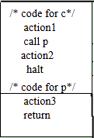
Three address code

Slide 30
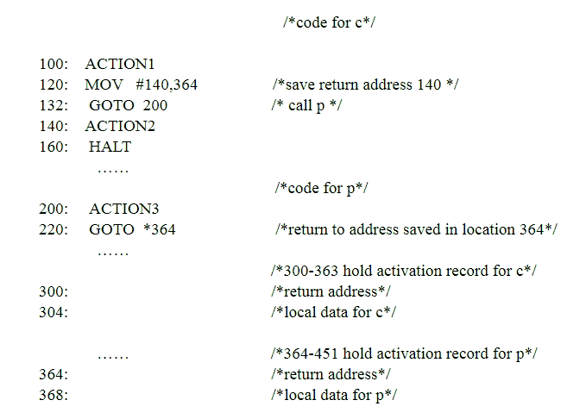
Target code

Slide 31
Stack Allocation
Static allocation can become stack allocation by using relative addresses for storage in activation records. The position of the record for an activation of a procedure is not known until run time.
In stack allocation, this position is usually stored in a register, so words in the activation record can be accessed as offsets from the value in this register
When a procedure call occurs, the calling procedure increments SP and transfers control to the called procedure.
After control returns to the caller, it decrements SP, thereby de-allocating the activation record of the called procedure.

Slide 32
Stack Allocation
The code for the 1st procedure initializes the stack by setting SP to the start of the stack area in memory.
MOV #stackstart, SP /*initialize the stack*/
code for the first procedure
HALT /*terminate execution*/
A procedure call sequence increments SP, saves the return address, and transfers control to the called procedure:
ADD #caller.recordsize, SP
MOV #here+16, *SP /* save return address*/
GOTO callee.code_area
The attribute caller.recordsize represents the size of an activation record, so the ADD instruction leaves SP pointing to the beginning of the next activation record.

Slide 33
Stack Allocation
The source #here+16 in the MOV instruction is the address of the instruction following the GOTO; it is saved in the address pointed to by SP.
The return sequence consists of two parts. The called procedure transfers control to the return address using
GOTO *0(SP) /*return to caller*/
  The reason for using *0(SP) in the GOTO instruction is that we need two levels of indirection: 0(SP) is the address of the first word in the activation record and *0(SP) is the return address saved there.
  The second part of the return sequence is in the caller, which decrements SP, thereby restoring SP to its previous value. That is, after the subtraction SP points to the beginning of the activation record of the caller:
SUB #caller.recordsize, SP

Slide 34
Stack Allocation
The following program is a condensation of the three-address code for the Pascal program for reading and sorting integers. Procedure q is recursive, so more than one activation of q can be alive at the same time.

Slide 35
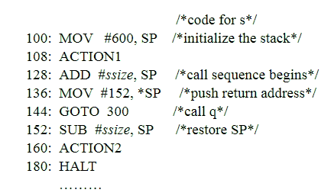
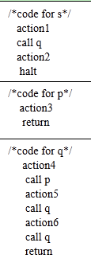

Slide 36
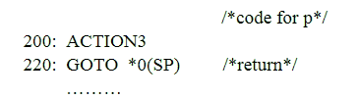

Slide 37
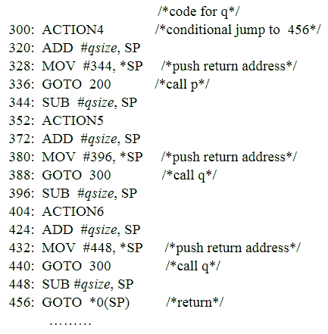
600: /*stack starts here*/

Slide 38
Stack Allocation
We assume that ACTION4 contains a conditional jump to the address 456 of the return sequence from q; otherwise, the recursive procedure q is condemned to call itself forever.
If ssize, psize, and qsize are 20,40, and 60, respectively, then SP is initialized to 600, the starting address of the stack, by the first instruction at address 100. SP holds 620 just before control transfers from s to q, because ssize is 20. Subsequently, when q calls p, the instruction at address 320 increments SP to 680, where the activation record for p begins; SP reverts to 620 after control returns to q. If the next two recursive calls of q return immediately, the maximum value of SP during this execution is 680. However, the last stack location used is 739, since the activation record for q starting at location 680 extends for 60 bytes.

Slide 39
Run time addresses for names
The storage allocation strategy and the layout of local data in an activation record for a procedure determine how the storage for names is accessed.
If we assume that a name in a three-address statement is really a pointer to a symbol-table entry for the name; it makes the compiler more portable, since the front end need not be changed even if the compiler is moved to a different machine where a different run-time organization is needed.

Slide 40
Run time addresses for names
Names must be replaced by code to access storage locations. We thus consider some elaborations of the simple three-address statement x := 0.
After the declarations in a procedure are processed, suppose the symbol-table entry for x contains a relative address 12 for x.
First consider the case in which x is in a statically allocated area beginning at address static. Then the actual run-time address for x is static+12.

Slide 41
Run time addresses for names
The assignment x := 0 then translates into
    static[12] := 0
If the static area starts at address 100, the target code for this statement is
    MOV #0, 112
Suppose x is local to an active procedure whose display pointer is in register R3. Then we may translate the copy x := 0 into the three-address statements
  t1 := 12+R3
  *t1 := 0
in which t1 contains the address of x. This sequence can be implemented by the single machine instruction
MOV #0, 12 (R3)
The value in R3 cannot be determined at compile time.

Slide 42
The End

