Slide 1

Recurrent Problem
Amartya Kundu Durjoy
Lecturer, CSE, UGV

Slide 2
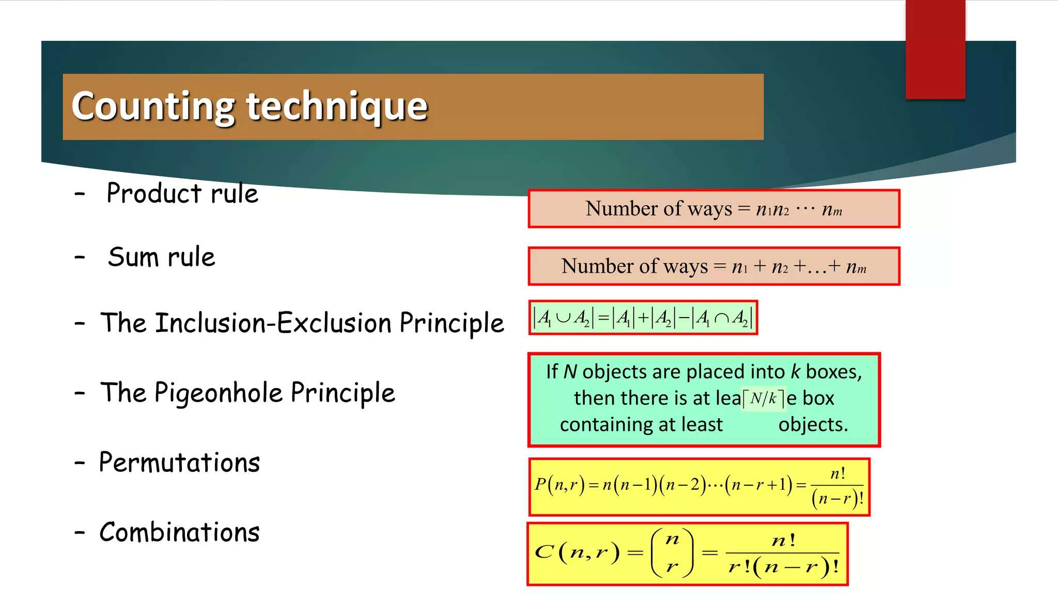

Slide 3
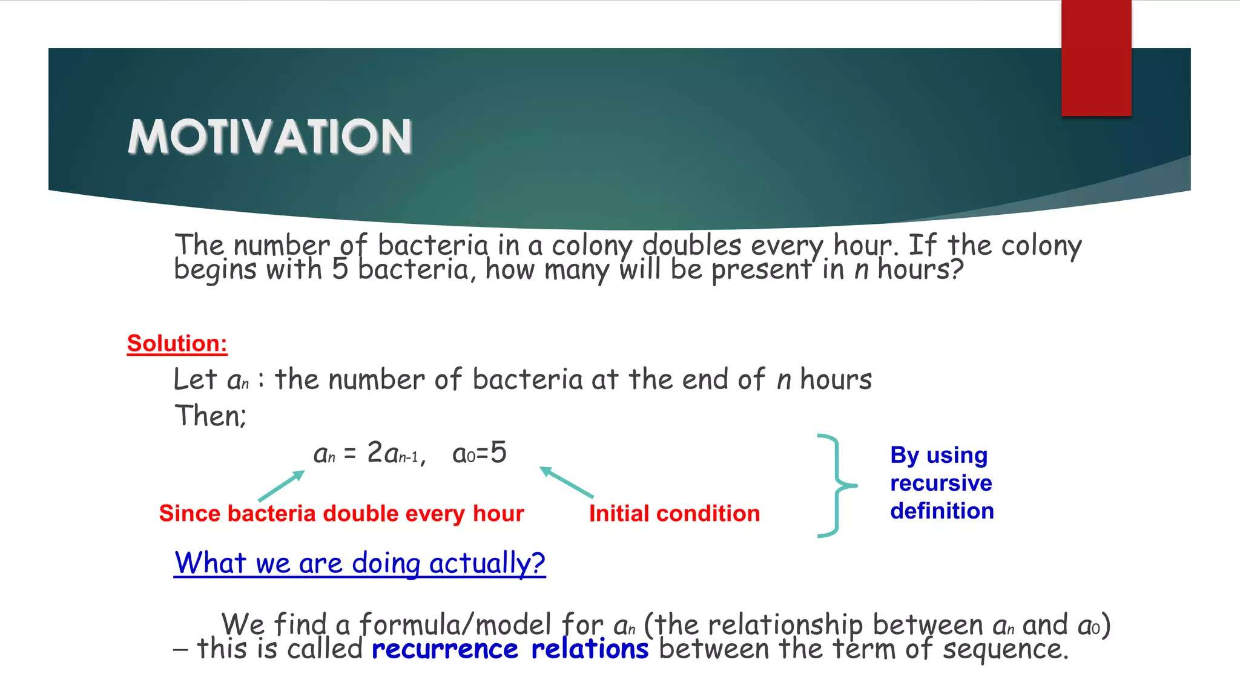

Slide 4
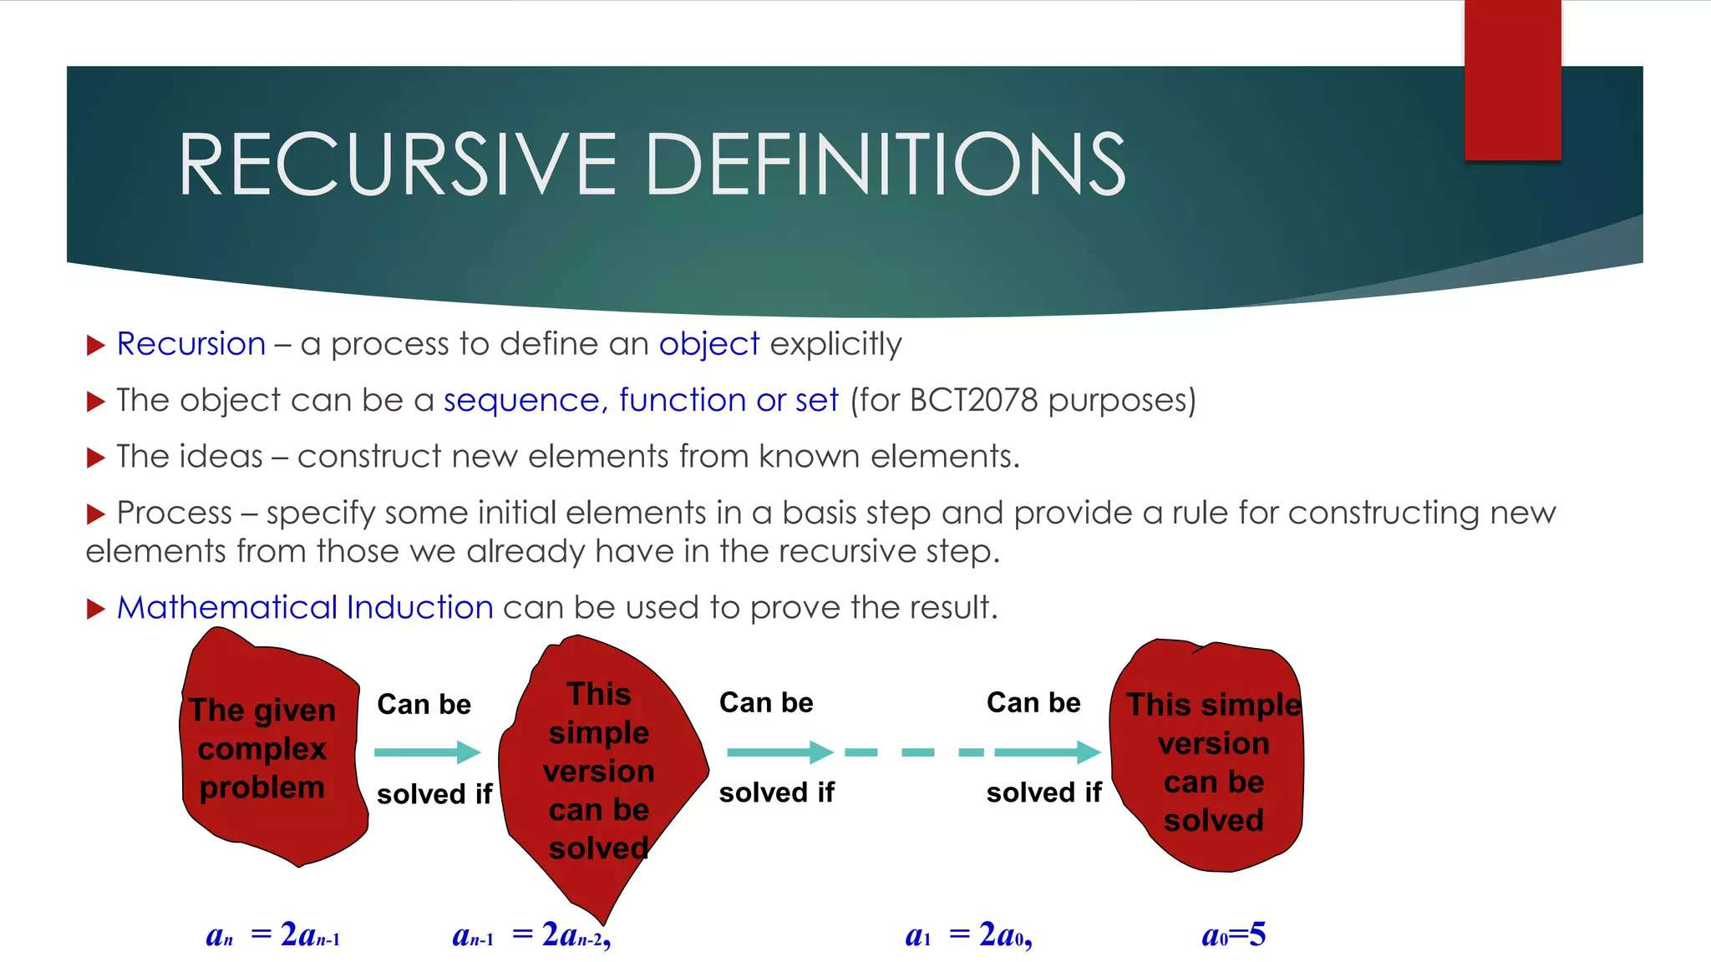

Slide 5
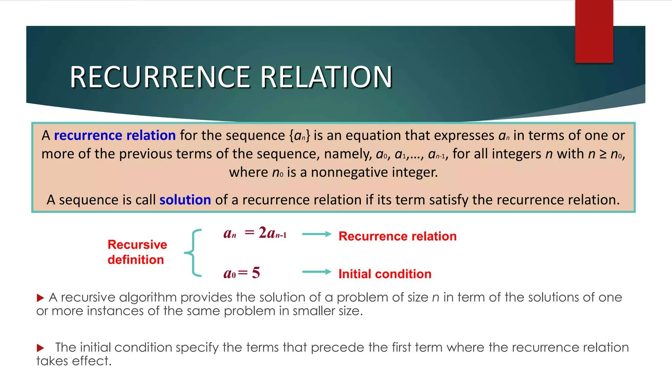

Slide 6
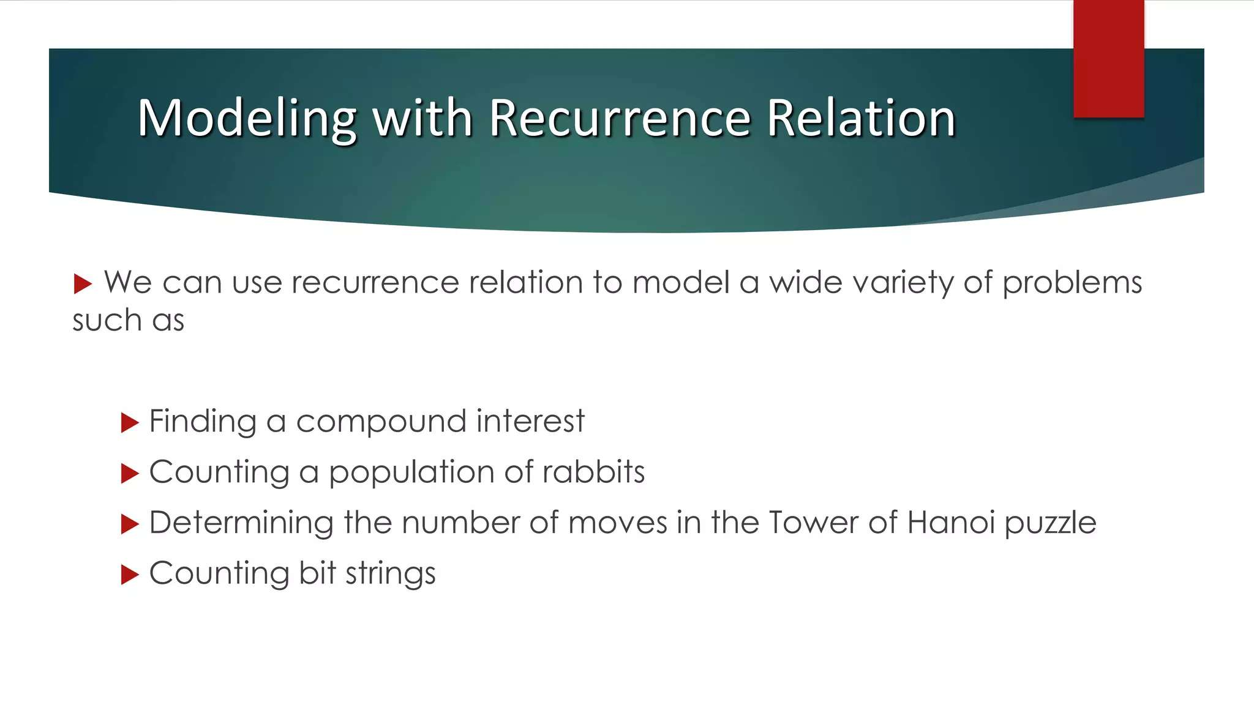

Slide 7
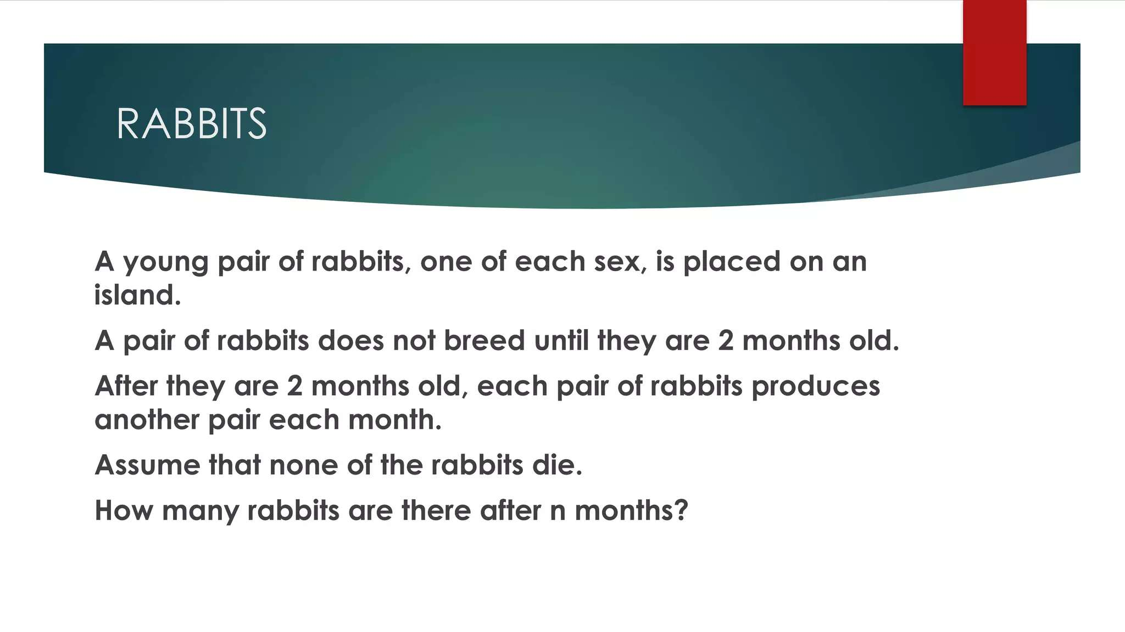

Slide 8
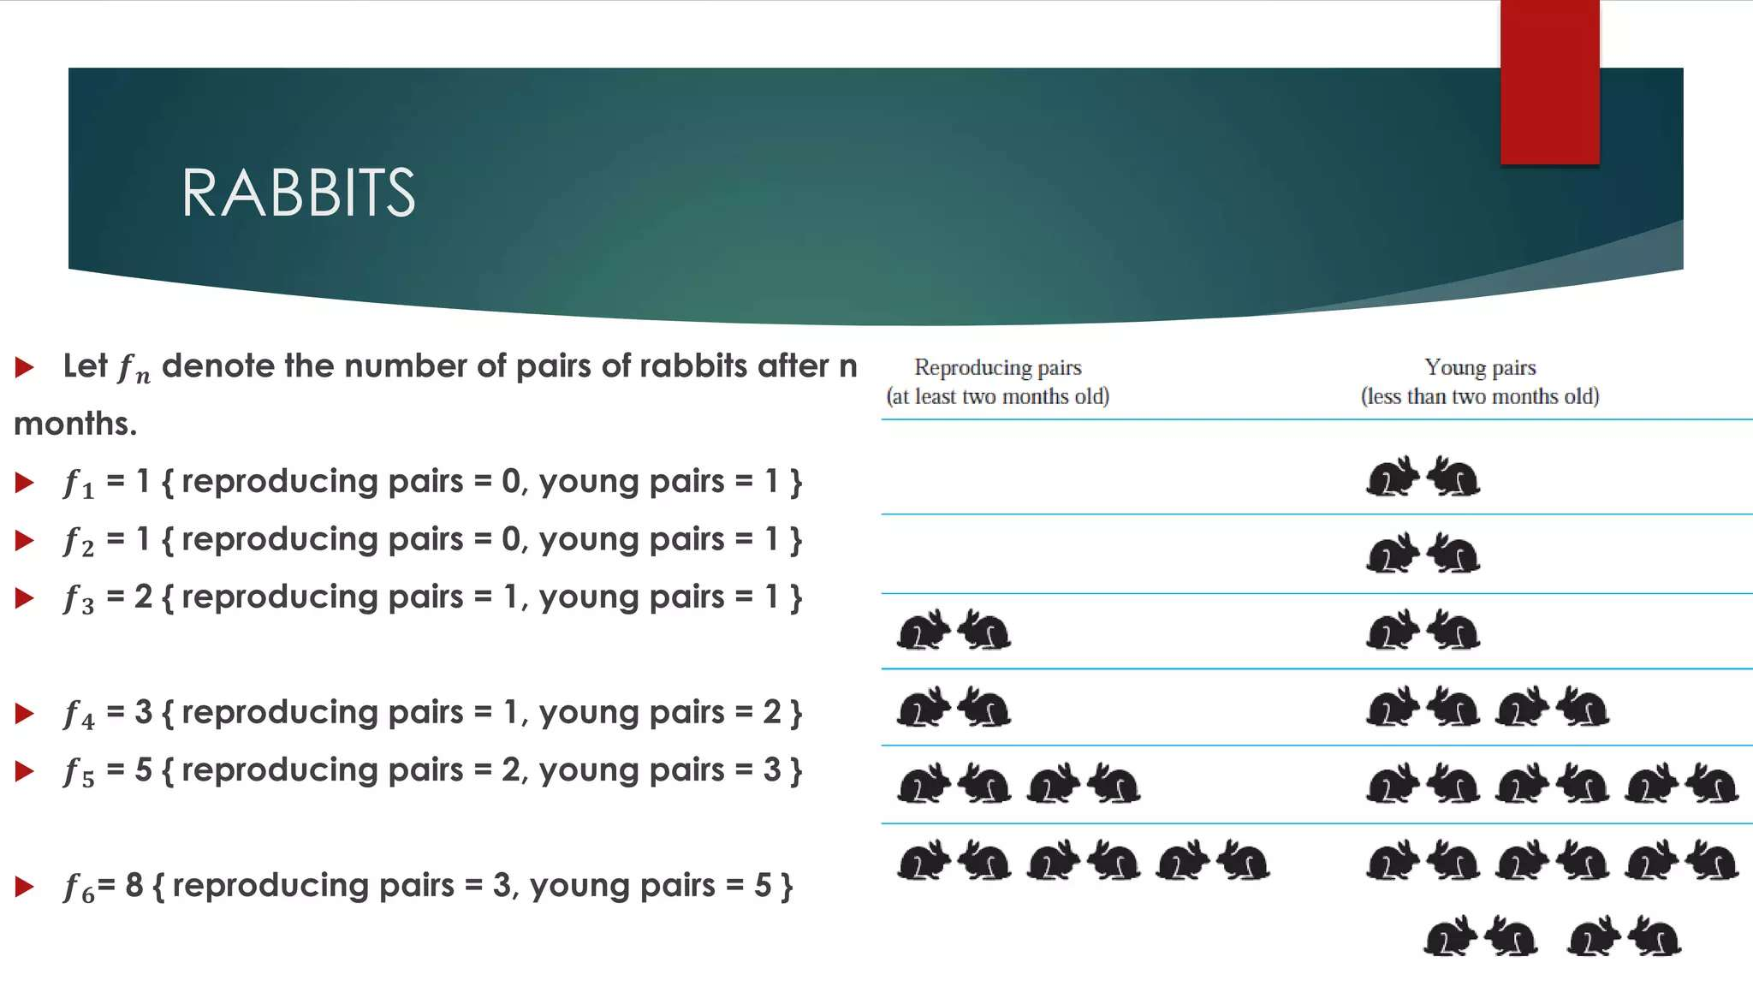

Slide 9
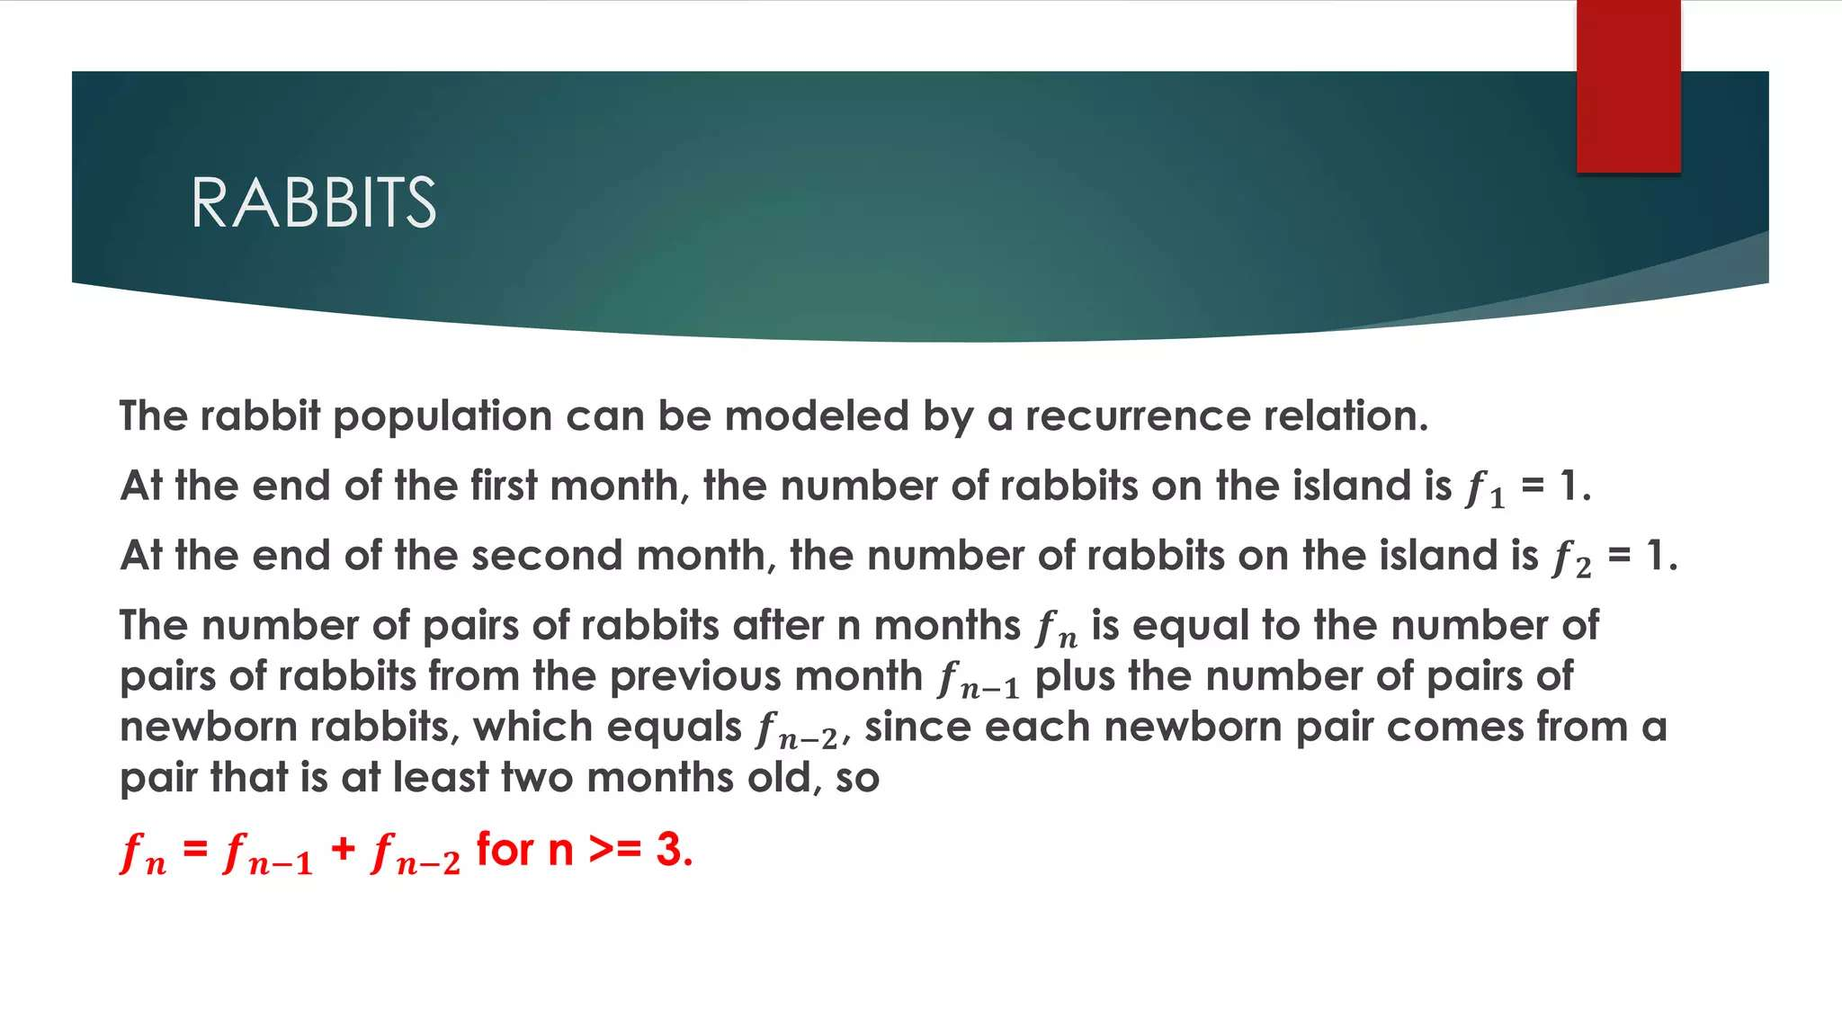

Slide 10
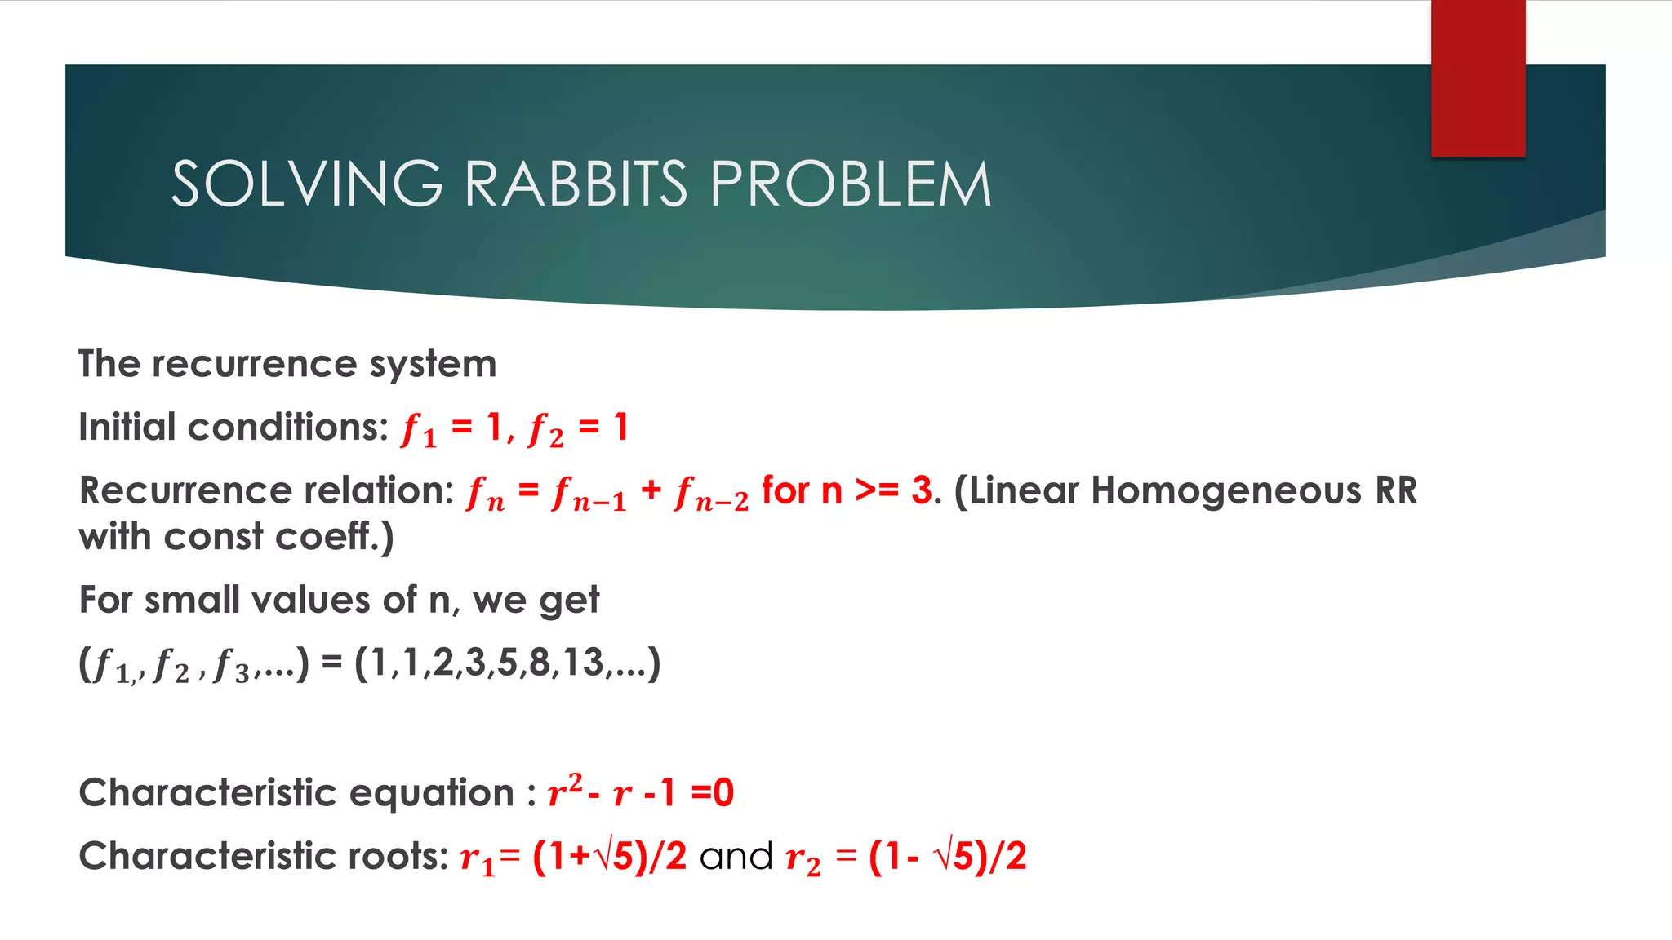

Slide 11
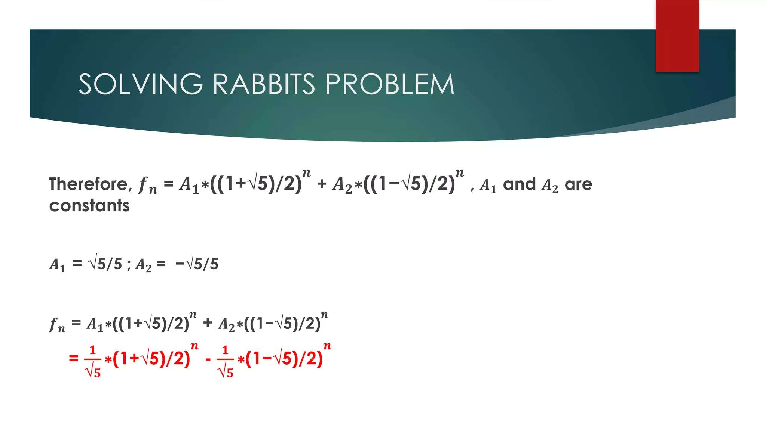

Slide 12
The Tower of Hanoi Problem
Invented by the French mathematician Edouard Lucas in 1883.
Given a tower of n disks, initially stacked in decreasing size on one of three pegs.
The objective is
▪ Transfer the entire tower to one of the other pegs.
▪ Move only one disk at a time.
▪ Never move a larger one onto a smaller

Slide 13
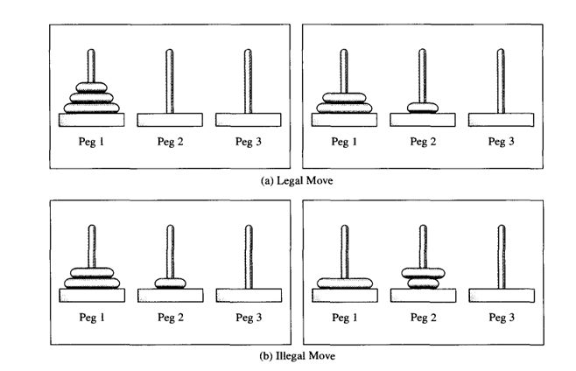

Slide 14
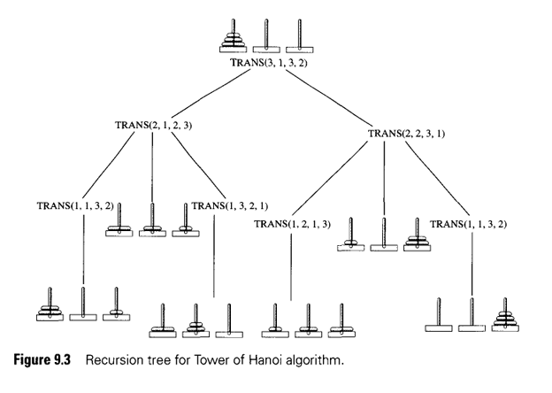
It is instructive to follow the steps of the procedure for an initial configuration involving three disks. The steps in this recursive procedure are shown in Figure 9.3 using a tree. The actual computation order can be found by an inorder traversal of the tree .

Slide 15

The equation that gives the number of disk moves needed for the algorithm presented is
The expression for T(n) is called a first-order recurrence relation, because the value of T at any value n > 1 is given in terms of the value of T at a value smaller by 1-that is, by n - 1. The value of T at 1 is called an initial value. A function of n that gives the values of the recurrence is called a solution of the recurrence relation.

Slide 16
Tower of Hanoi : No. of Moves, Tn
• for 1 disk it takes 1 move to transfer 1 disk from BEG to END;
• for 2 disks, it will take 3 moves: 2 $T_{n−1}$ + 1 = 2(1) + 1 = 3
• for 2 disks, it will take 3 moves: 2 𝑇_(𝑛−1) + 1 = 2(1) + 1 = 3
• for 3 disks, it will take 7 moves: 2$T_{n−1}$ + 1 = 2(3) + 1 = 7
• for 3 disks, it will take 7 moves: 2𝑇_(𝑛−1) + 1 = 2(3) + 1 = 7
• for 4 disks, it will take 15 moves: 2$T_{n−1}$ + 1 = 2(7) + 1 = 15
• for 4 disks, it will take 15 moves: 2𝑇_(𝑛−1) + 1 = 2(7) + 1 = 15
• for 5 disks, it will take 31 moves: 2$T_{n−1}$ + 1 = 2(15) + 1 = 31
• for 5 disks, it will take 31 moves: 2𝑇_(𝑛−1) + 1 = 2(15) + 1 = 31
• for 6 disks... ?

Slide 17
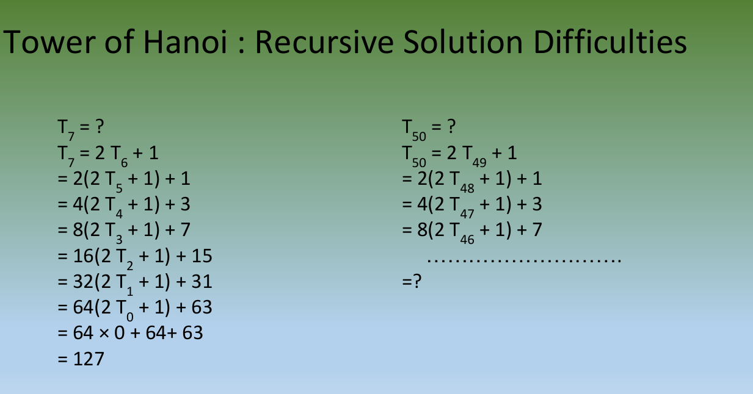

Slide 18
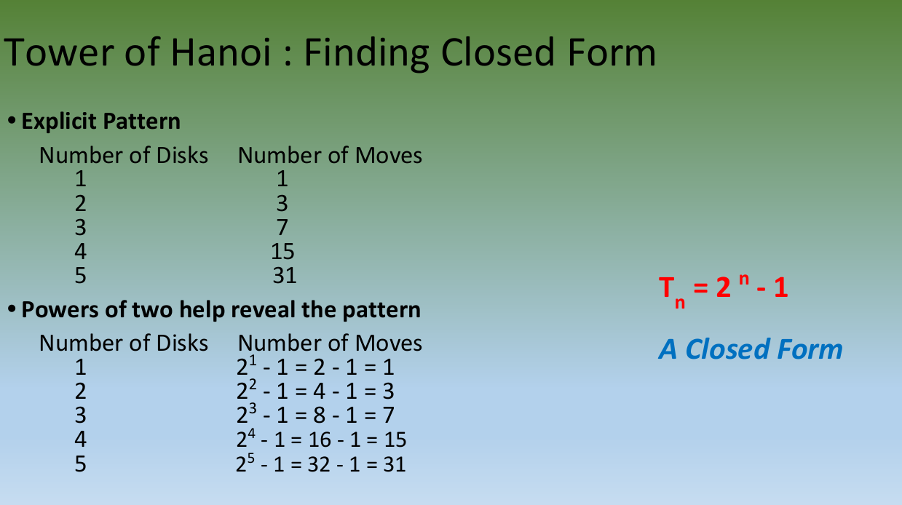

Slide 19
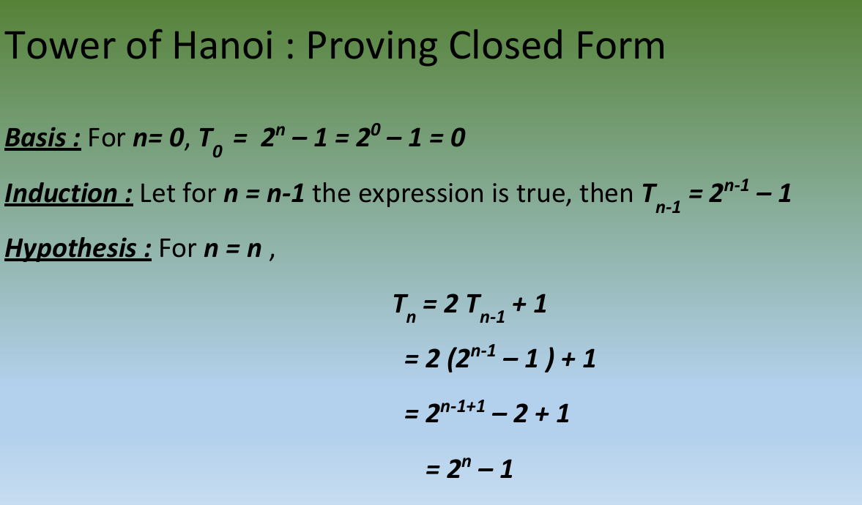

Slide 20
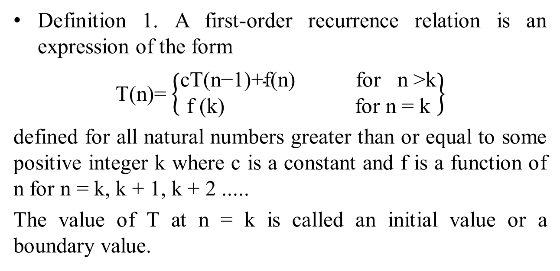
First-Order Recurrence Relations
Definition 1. A first-order recurrence relation is an expression of the form
T(n)= $\left\{\begin{aligned}\text{cT}\text{(}\text{n}\text{−1)+}\text{f}\text{(}\text{n}\text{) } \text{for} \text{n}\text{ >}\text{k} \\ \text{f}\text{ (}\text{k}\text{) } \text{for} \text{n}\text{ = }\text{k}\end{aligned}\right\}$
defined for all natural numbers greater than or equal to some positive integer k where c is a constant and f is a function of n for n = k, k + 1, k + 2 .....
The value of T at n = k is called an initial value or a boundary value.

Slide 21
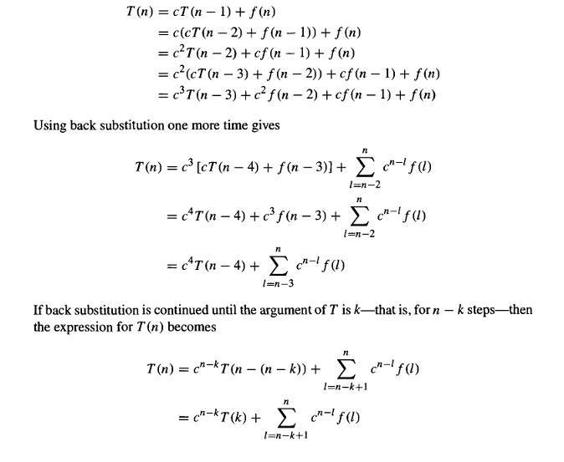
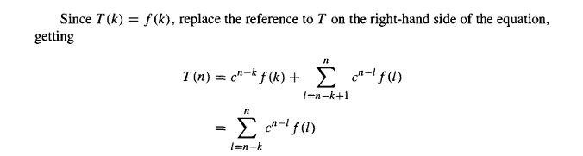
Solving First-Order Recurrences Using Back Substitution

Slide 22
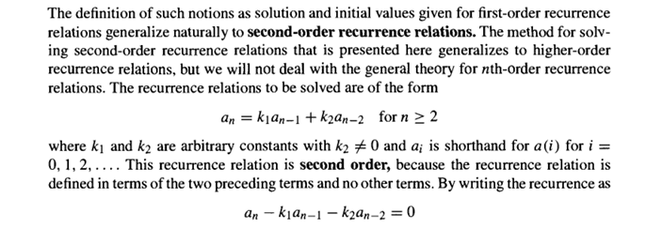
Second Order-Recurrence Relations

Slide 23
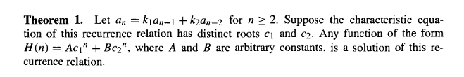

Slide 24
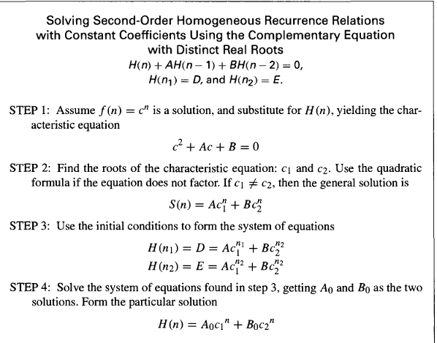

Slide 25
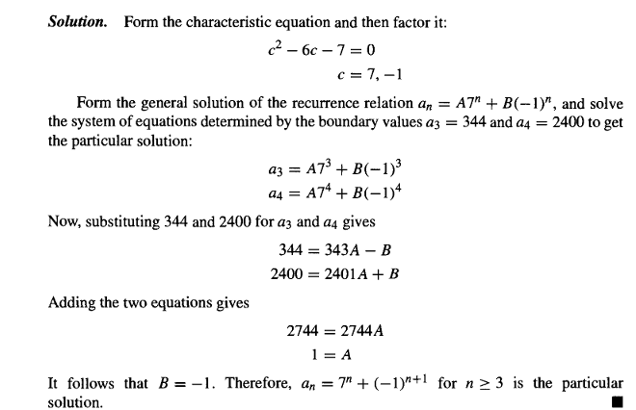
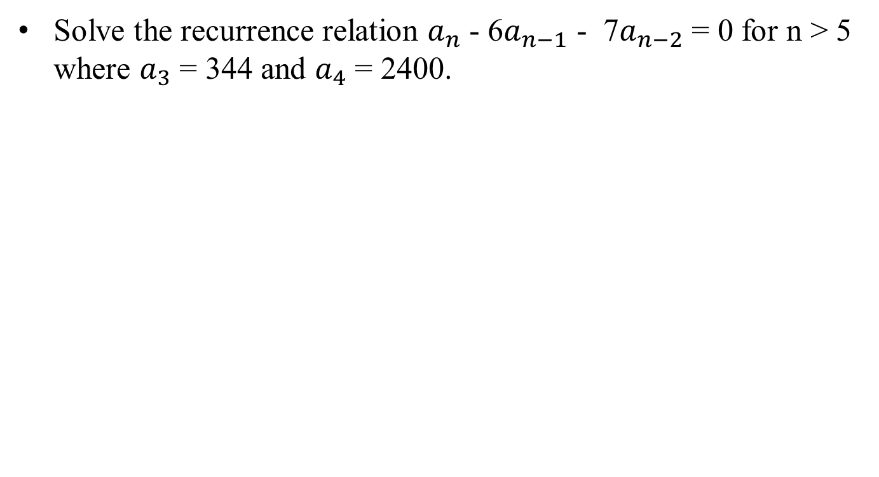
Example-1
Solve the recurrence relation $a_{n}$ - 6$a_{n−1}$ - 7$a_{n−2}$ = 0 for n > 5 where $a_{3}$ = 344 and $a_{4}$ = 2400.

Slide 26
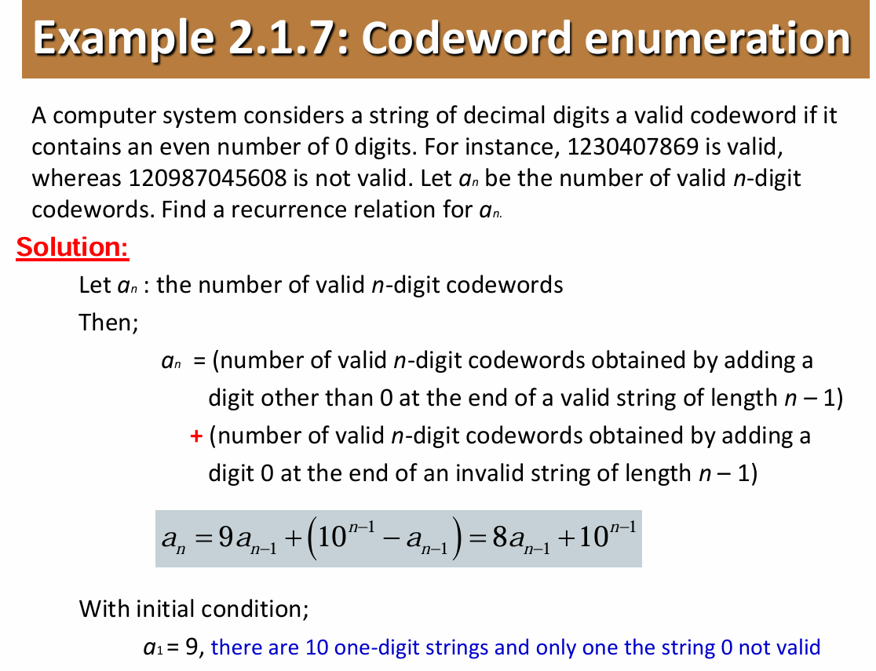

Slide 27
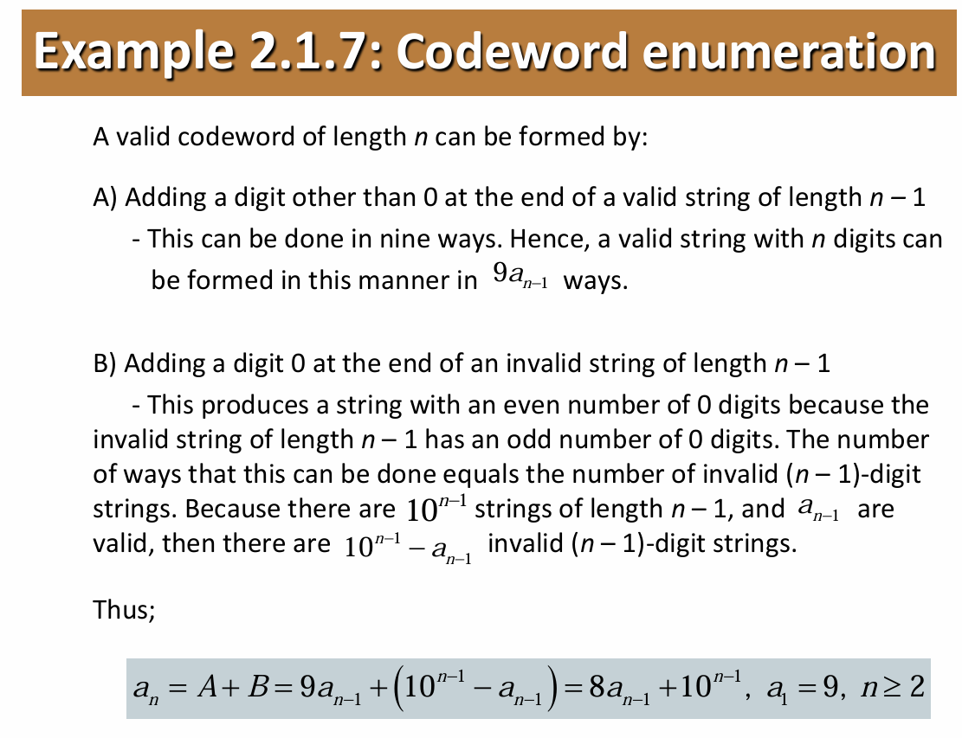

Slide 28
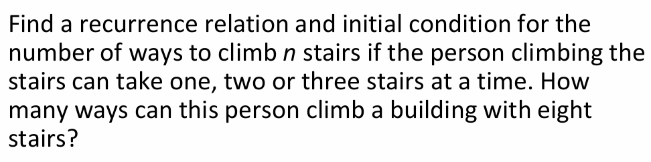
Practice

Slide 29


