Slide 1



Counting
Amartya Kundu Durjoy
Lecturer, CSE, UGV
z

Slide 2
Motivation
Combinatorics is the study of collections of objects. Specifically, counting objects, arrangement, derangement, etc. along with their mathematical properties
Counting objects is important to analyze algorithms and compute discrete probabilities
Originally, combinatorics was motivated by gambling:
counting configurations is essential to elementary probability
  A simple example: How many arrangements are there of a deck of 52 cards?
In addition, combinatorics can be used as a proof technique
  A combinatorial proof is a proof method that uses counting arguments to prove a statement

Slide 3
Product Rule
If two events are not mutually exclusive (that, is we do them separately), then we apply the product rule
Theorem: Product Rule
Suppose a procedure can be accomplished with two disjoint subtasks. If there are
  n₁ ways of doing the first task and
  n₂ ways of doing the second task,
then there are n₁.n₂ ways of doing the overall procedure

Slide 4
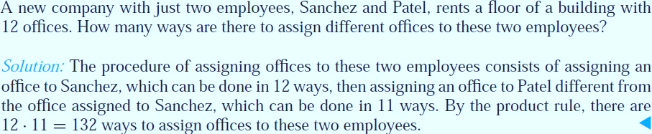
Product Rule

Slide 5
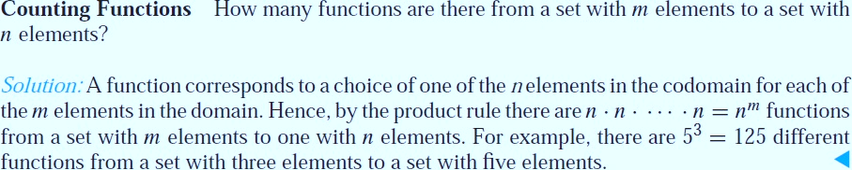
Product Rule

Slide 6
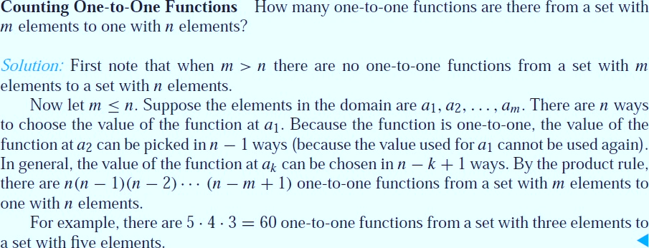
Product Rule

Slide 7
Sum Rule (1)
If two events are mutually exclusive, that is, they cannot be done at the same time, then we must apply the sum rule
Theorem: Sum Rule. If
  an event e₁ can be done in n₁ ways,
  an event e₂ can be done in n₂ ways, and
  e₁ and e₂ are mutually exclusive
then the number of ways of both events occurring is n₁+ n₂

Slide 8
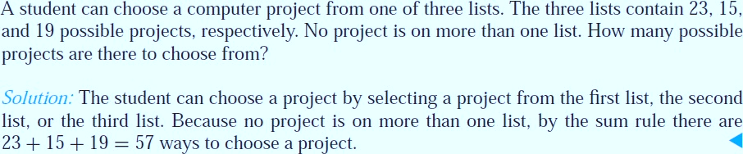
Sum Rule (1)

Slide 9

Sum Rule (2)
There is a natural generalization to any sequence of m tasks; namely the number of ways m mutually events can occur
n₁ + n₂ + … + n_{m-1} + n_{m}
We can give another formulation in terms of sets. Let A₁, A₂, …, A_{m} be pairwise disjoint sets. Then
| A₁ $∪$ A₂ $∪$ … $∪$ A_{m} | = |A₁| $∪$ |A₂| $∪$ … $∪$ |A_{m}|
(In fact, this is a special case of the general Principal of Inclusion-Exclusion (PIE))

Slide 10
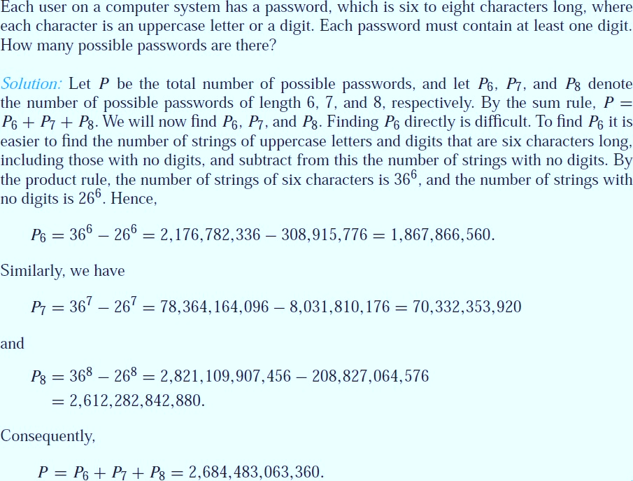
More Complex Counting Problems

Slide 11
The Subtraction Rule (Inclusion– Exclusion for Two Sets)
Suppose that a task can be done in one of two ways, but some of the ways to do it are common to both ways.
In this situation, we cannot use the sum rule to count the number of ways to do the task.
If we add the number of ways to do the tasks in these two ways, we get an overcount of the total number of ways to do it, because the ways to do the task that are common to the two ways are counted twice.

Slide 12
The Subtraction Rule (Inclusion– Exclusion for Two Sets)
To correctly count the number of ways to do the two tasks, we must subtract the number of ways that are counted twice.
This leads us to an important counting rule THE SUBTRACTION RULE or principle of inclusion–exclusion

Slide 13
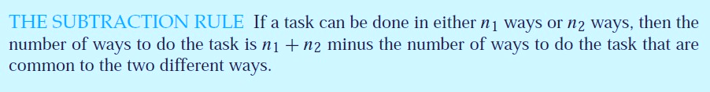

The Subtraction Rule

Slide 14

The Subtraction Rule
How many bit strings of length eight either start with a 1 bit or end with the two bits 00?
We can construct a bit string of length eight that begins with a 1 in 2⁷
= 128 ways
Similarly, we can construct a bit string of length eight ending with the
two bits 00, in 2⁶ = 64 ways.
Some of the ways to construct a bit string of length eight starting with a 1 are the same as the ways to construct a bit string of length eight that ends with the two bits 00 ,in 2⁵ = 32 ways.
So, the solution is = 128 + 64 – 32 = 160

Slide 15

Solving Counting Problems Using Tree Diagrams
A tree consists of a root, a number of branches leaving the root, and possible additional branches leaving the endpoints of other branches.
To use trees in counting, we use a branch to represent each possible choice.
We represent the possible outcomes by the leaves, which are the endpoints of branches not having other branches starting at them.

Slide 16
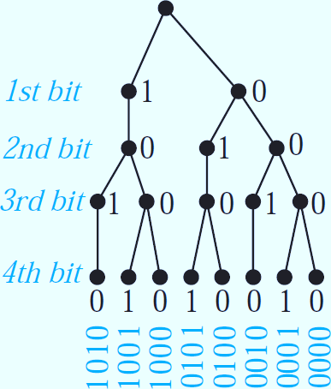
Solving Counting Problems Using Tree Diagrams
How many bit strings of length four do not have two consecutive 1s?
Answer : 8

Slide 17

Permutations and Combinations
Many counting problems can be solved by finding the number of ways to arrange a specified number of distinct elements of a set of a particular size, where the order of these elements matters. Permutations
Many other counting problems can be solved by finding the number of ways to select a particular number of elements from a set of a particular size, where the order of the elements selected does not matter. Combinations

Slide 18
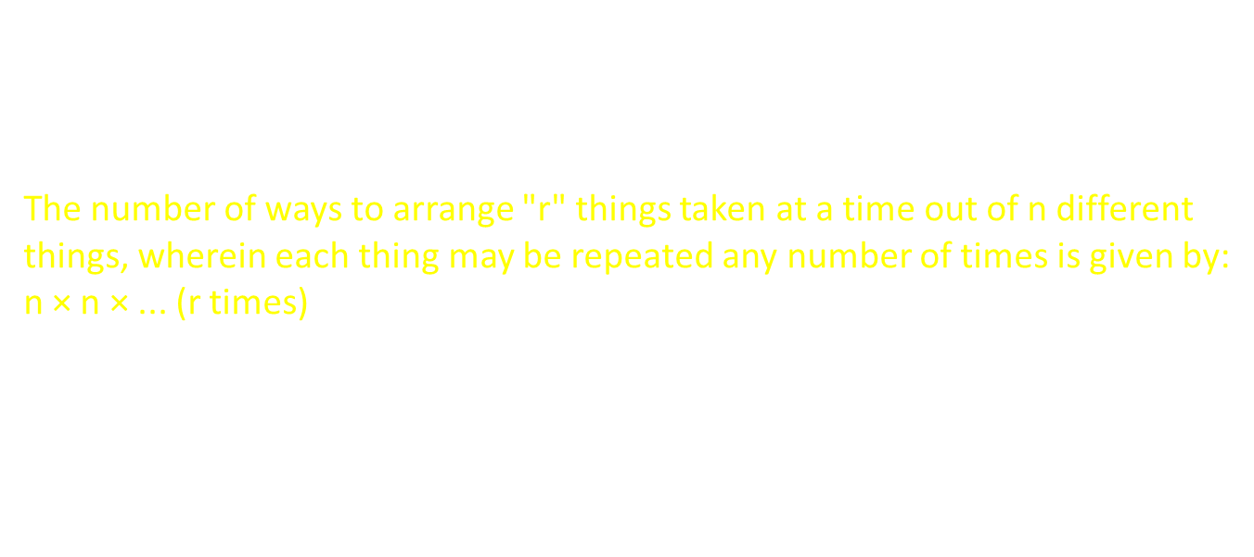
What is Permutation Formula?
The formula for permutation for n objects taken r at a time is given by:
${n_{p}}_{r}$= $\frac{\text{n}\text{!}}{\text{(}\text{n}\text{−}\text{r}\text{)! }}$ ${n_{p}}_{n}$= n!
The number of ways to arrange "r" things taken at a time out of n different things, wherein each thing may be repeated any number of times is given by:
n × n × ... (r times) $→n^{r}$

Slide 19
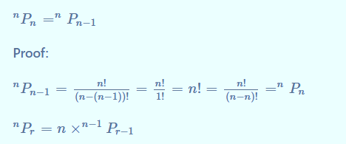

Slide 20

Permutations Formula WITHOUT Repetition
Permutations without repetition: Each time you have to create a new permutation in this situation, one item gets taken out of the list. Simply put, as you proceed, the number of possible permutations decreases.
The number of permutations without repetitions is:
${n_{p}}_{r}$= $\frac{\text{n}\text{!}}{\text{(}\text{n}\text{−}\text{r}\text{)! }}$

Slide 21
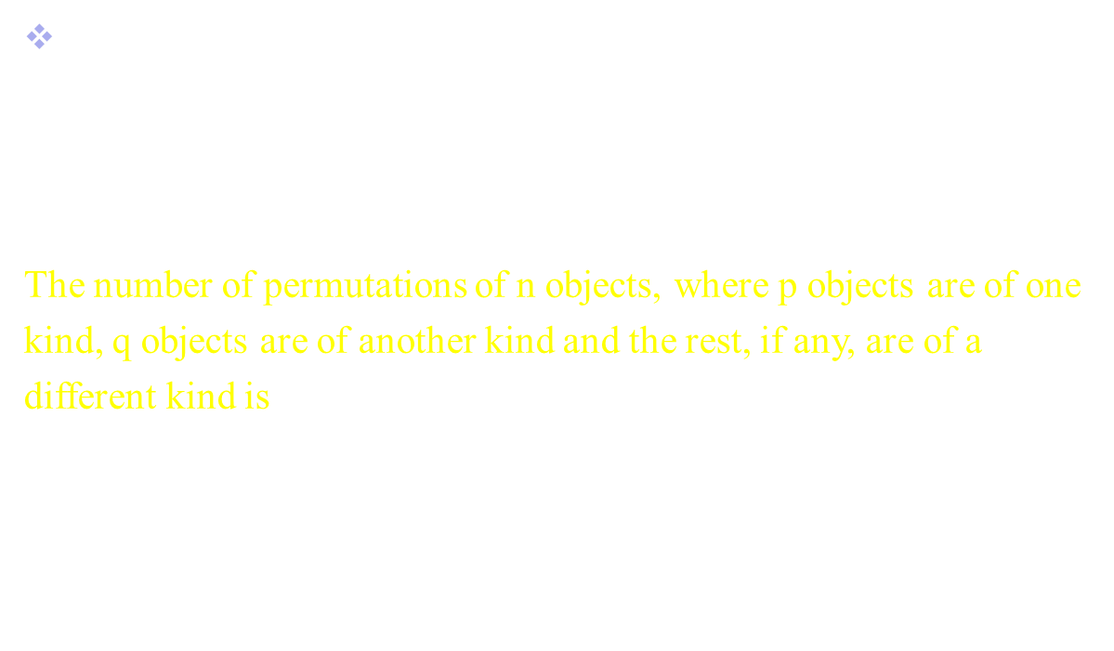
Permutations Formula WITH Repetition
Permutations with repetition: You can combine various objects in different ways by repeating the process. The data can be used more than once because there are no limitations on how often it can appear.
The number of permutations of n objects, where p objects are of one kind, q objects are of another kind and the rest, if any, are of a different kind is
$$\frac{{n_{p}}_{r}}{\text{p}\text{!} \text{q}\text{!}}$$

Slide 22
Example-1
A student has 5 different books. In how many ways can they arrange 3 of them on a shelf?
This is a permutation without repetition:
P(5,3) = 5!/(5−3)!​ = 5!​/2! = 120​/2 = 60​
How many 4-digit numbers can be formed using the digits 1, 2, 3, 4, 5 if no digit is repeated?
P(5,4) = 5!/1! ​= 120​
How many distinct permutations can be made from the word “BALLOON”
7!/ 2!×2! ​= 5040/4 ​= 1260​

Slide 23
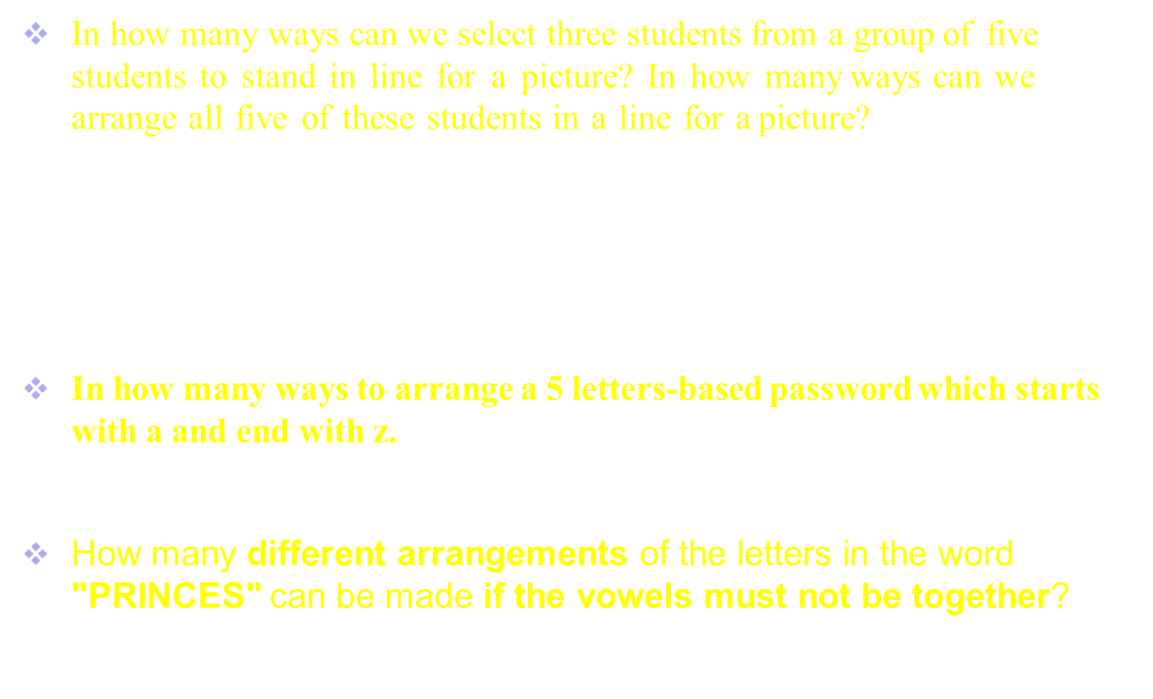
Example-2
In how many ways can we select three students from a group of five students to stand in line for a picture? In how many ways can we arrange all five of these students in a line for a picture?
By the product rule, there are 5 · 4 · 3 = 60 ways to select three students from a group of five students.
By the product rule, there are 5 · 4 · 3 · 2 · 1 = 120 ways to arrange all five students
In how many ways to arrange a 5 letters-based password which starts with a and end with z.
$${26}^{3}$$
How many different arrangements of the letters in the word "PRINCES" can be made if the vowels must not be together?
7!−1440=3600

Slide 24
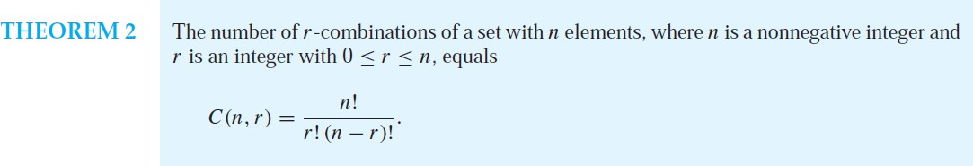
Combinations

Slide 25
Combinations

Slide 26
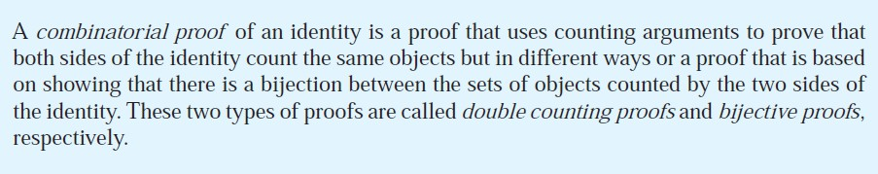
Combinatorial Proof

Slide 27
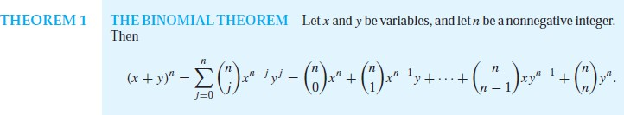
Binomial Coefficients and Identities
A binomial expression is simply the sum of two terms, such as x + y. (The terms can be products of constants and variables, but that does not concern us here.)

Slide 28
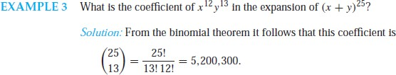
Binomial Coefficients and Identities

Slide 29
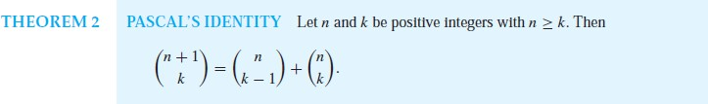
Binomial Coefficients and Identities

Slide 30
Combinations with Repetition

Slide 31
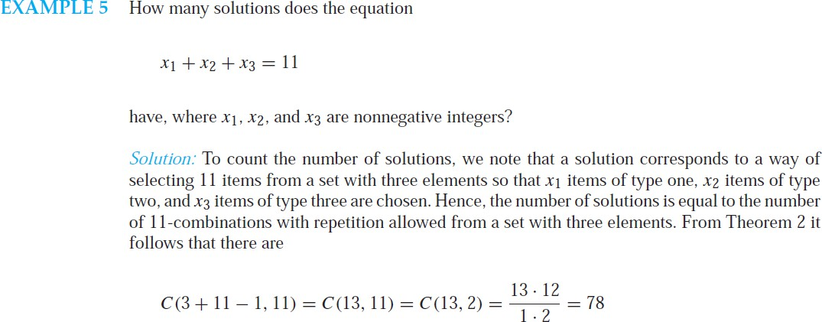
Combinations with Repetition

Slide 32
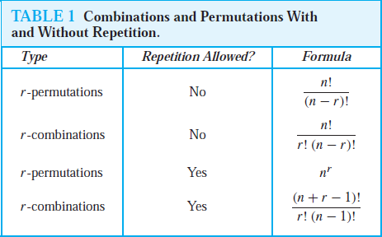
Generalized Permutations and Combinations

Slide 33
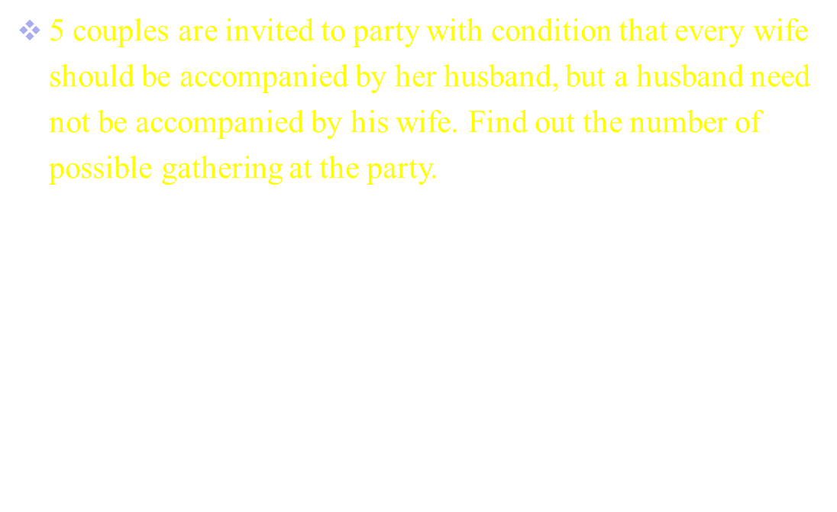
5 couples are invited to party with condition that every wife should be accompanied by her husband, but a husband need not be accompanied by his wife. Find out the number of possible gathering at the party.
$$3^{5}$$

Slide 34
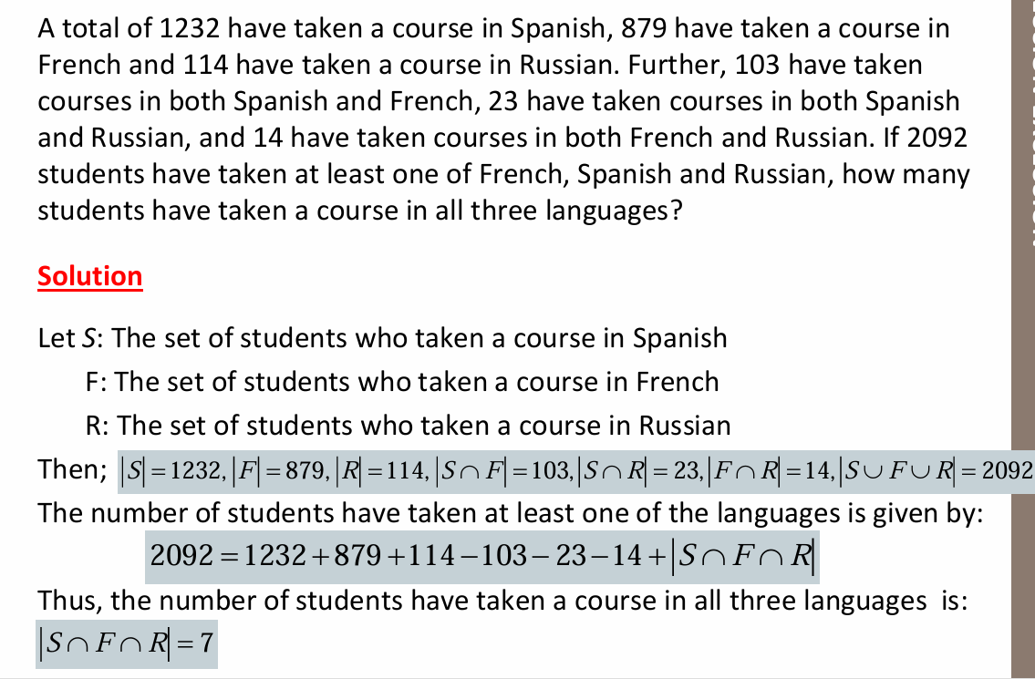

Slide 35
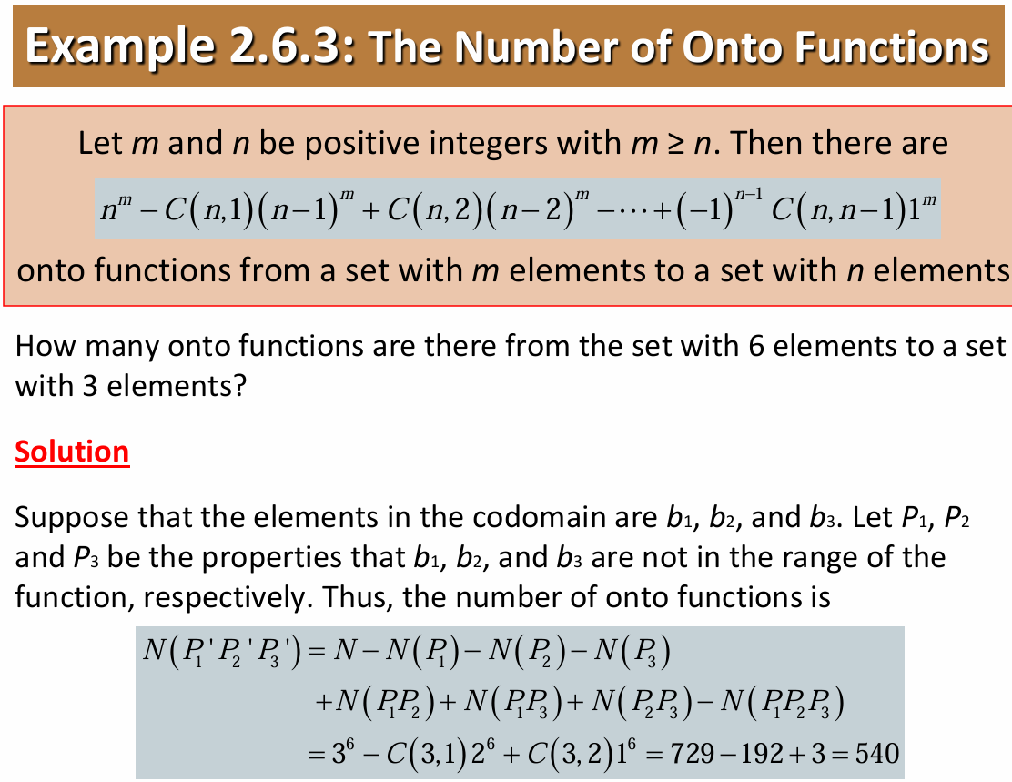

Slide 36
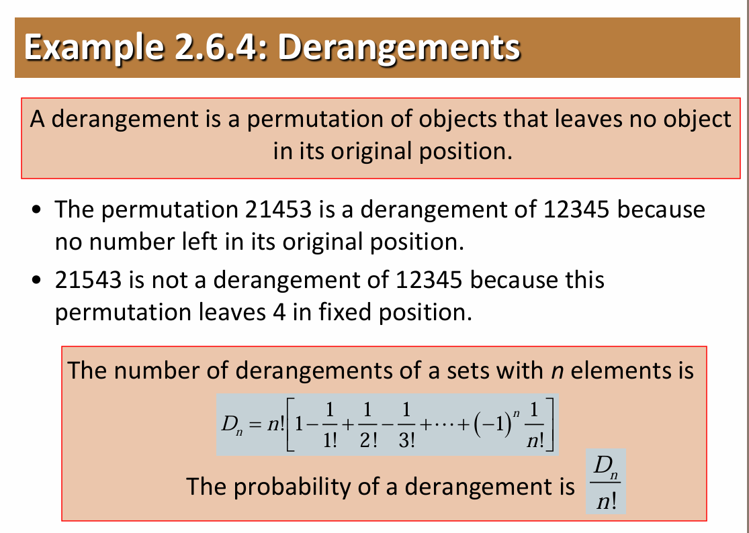

Slide 37

The End
z

