Slide 1
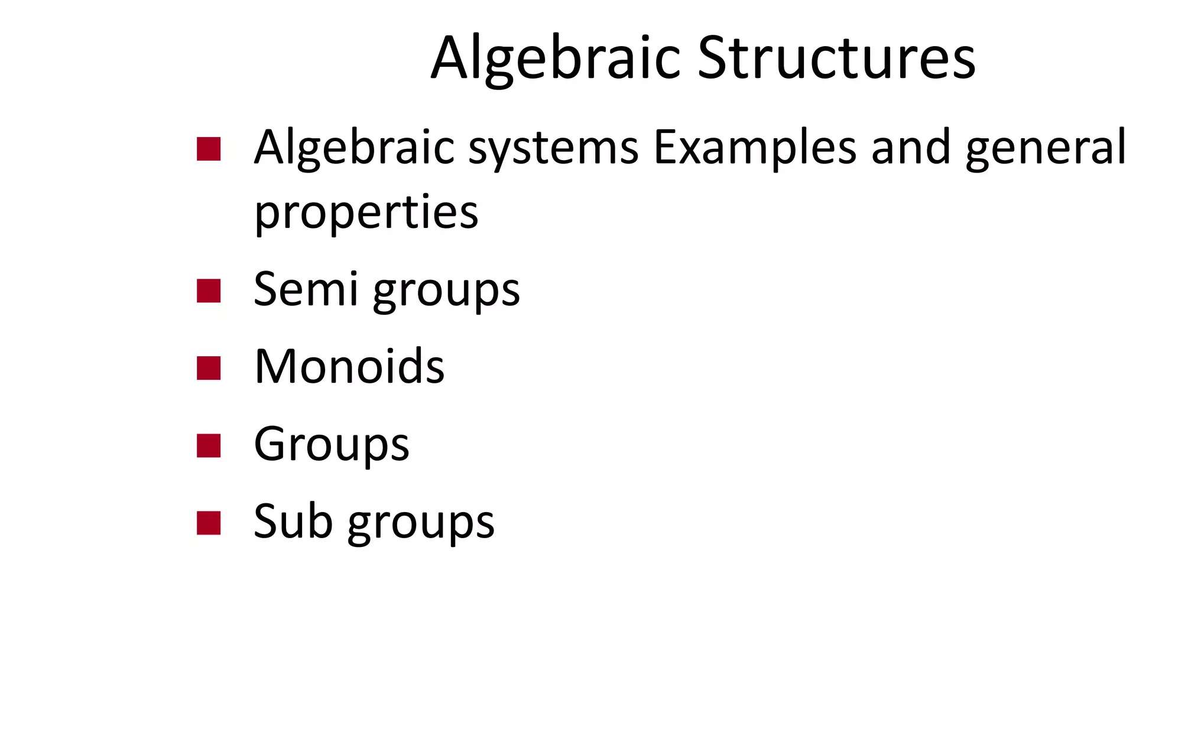

Slide 2
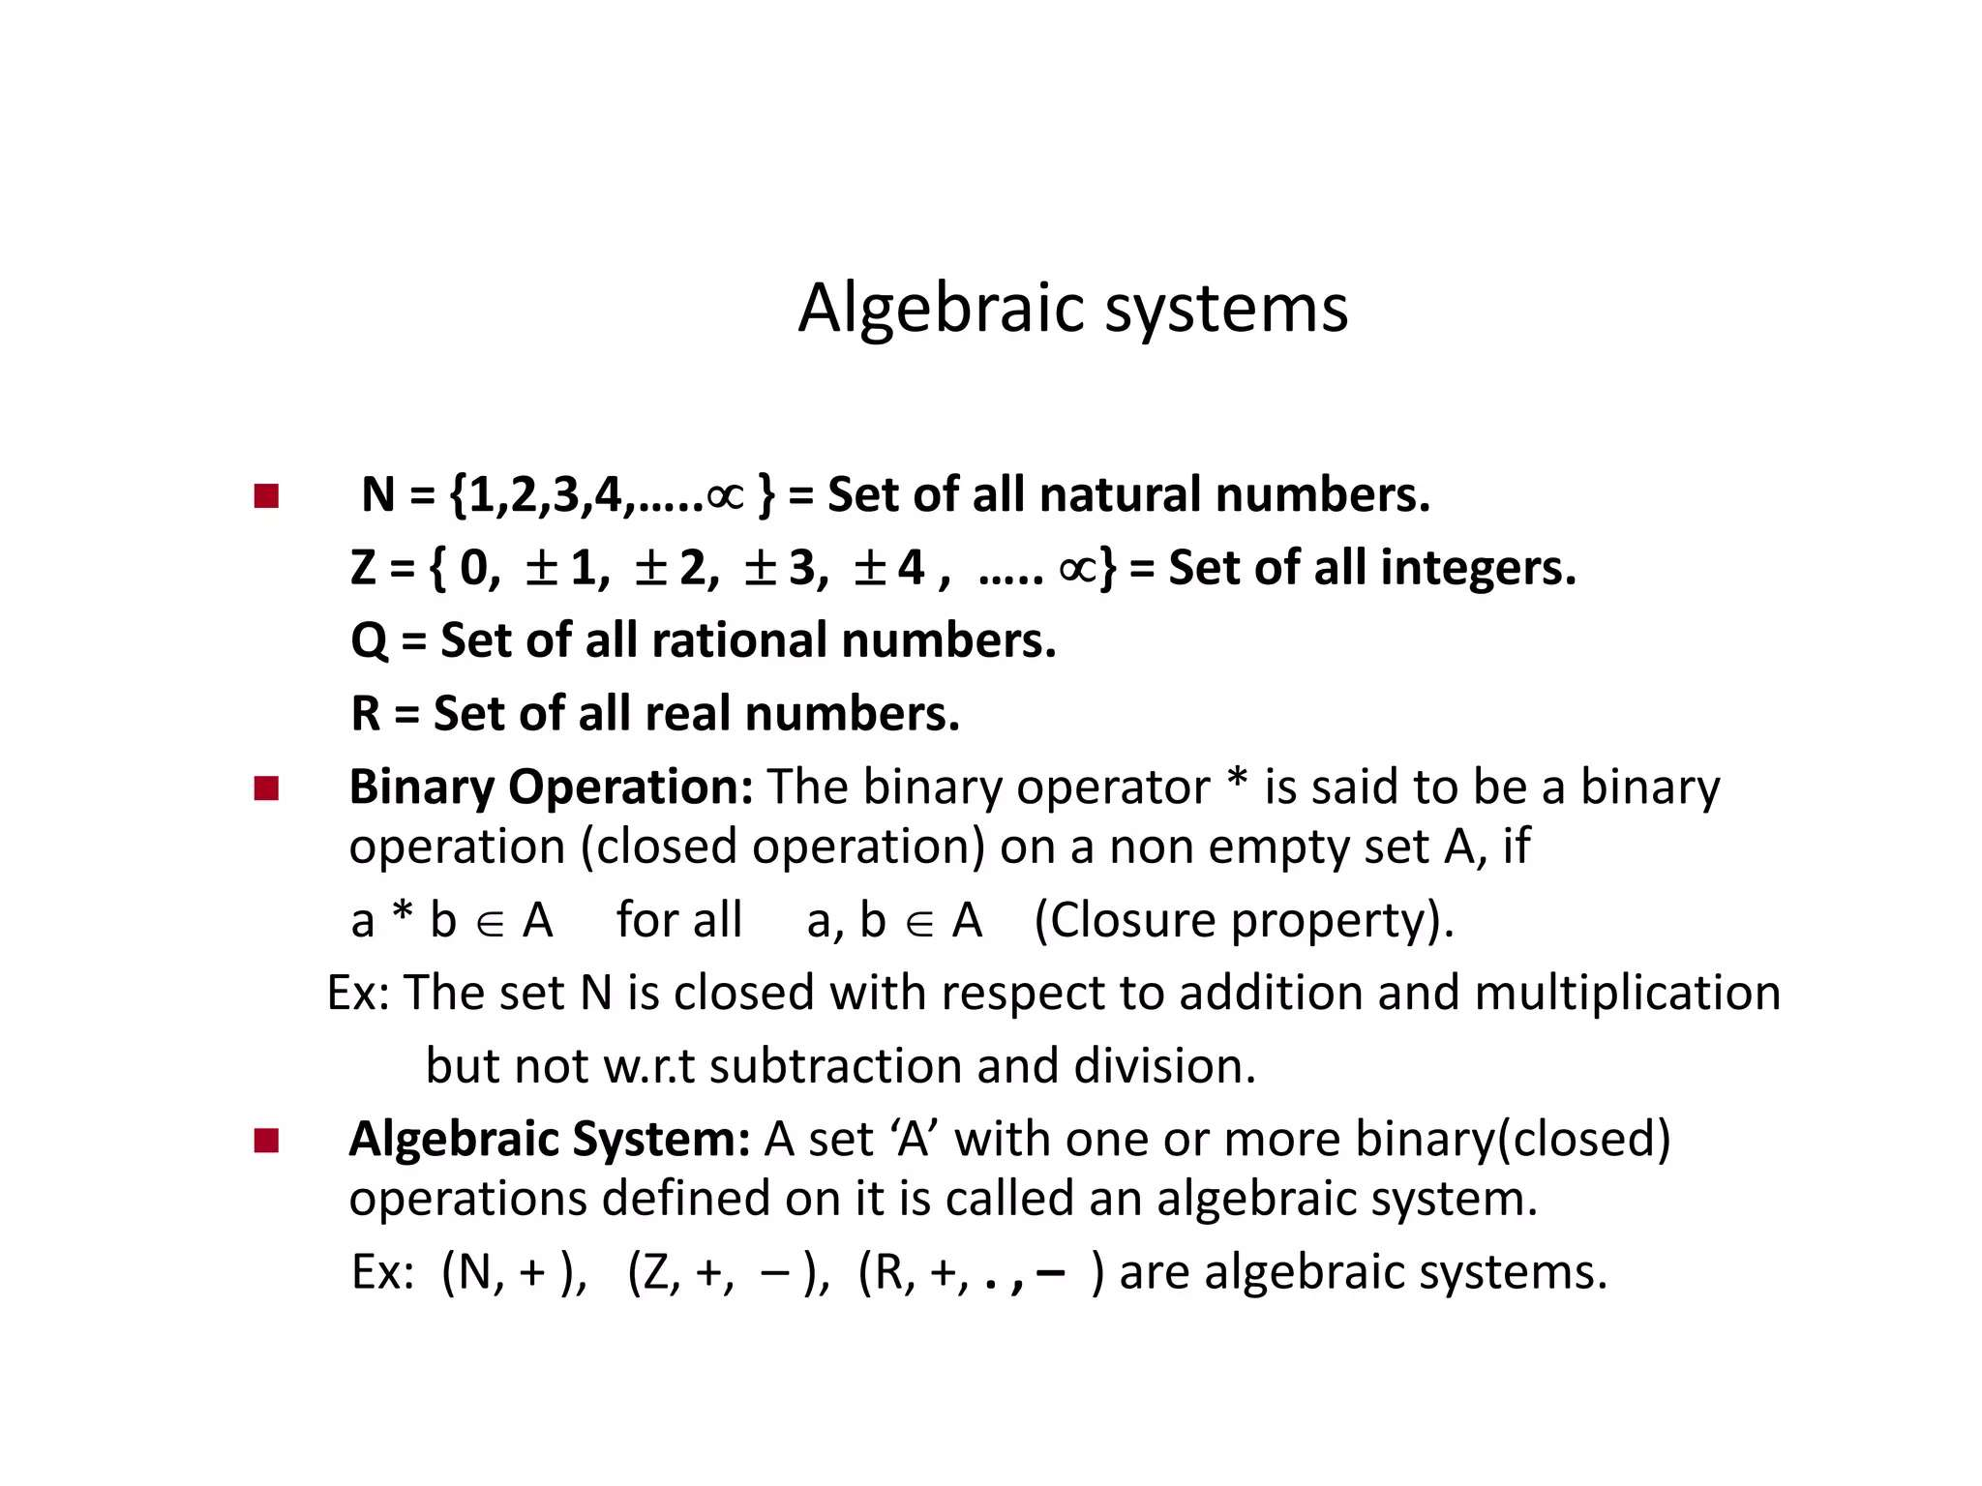
[Z⁺, -] is not an algebraic system

Slide 3
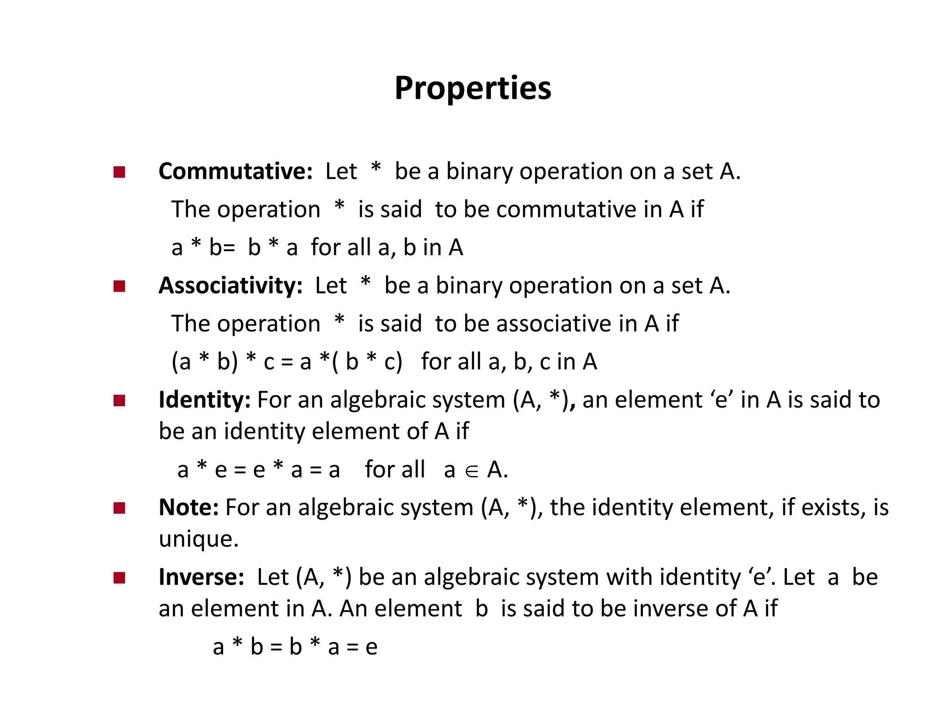

Slide 4
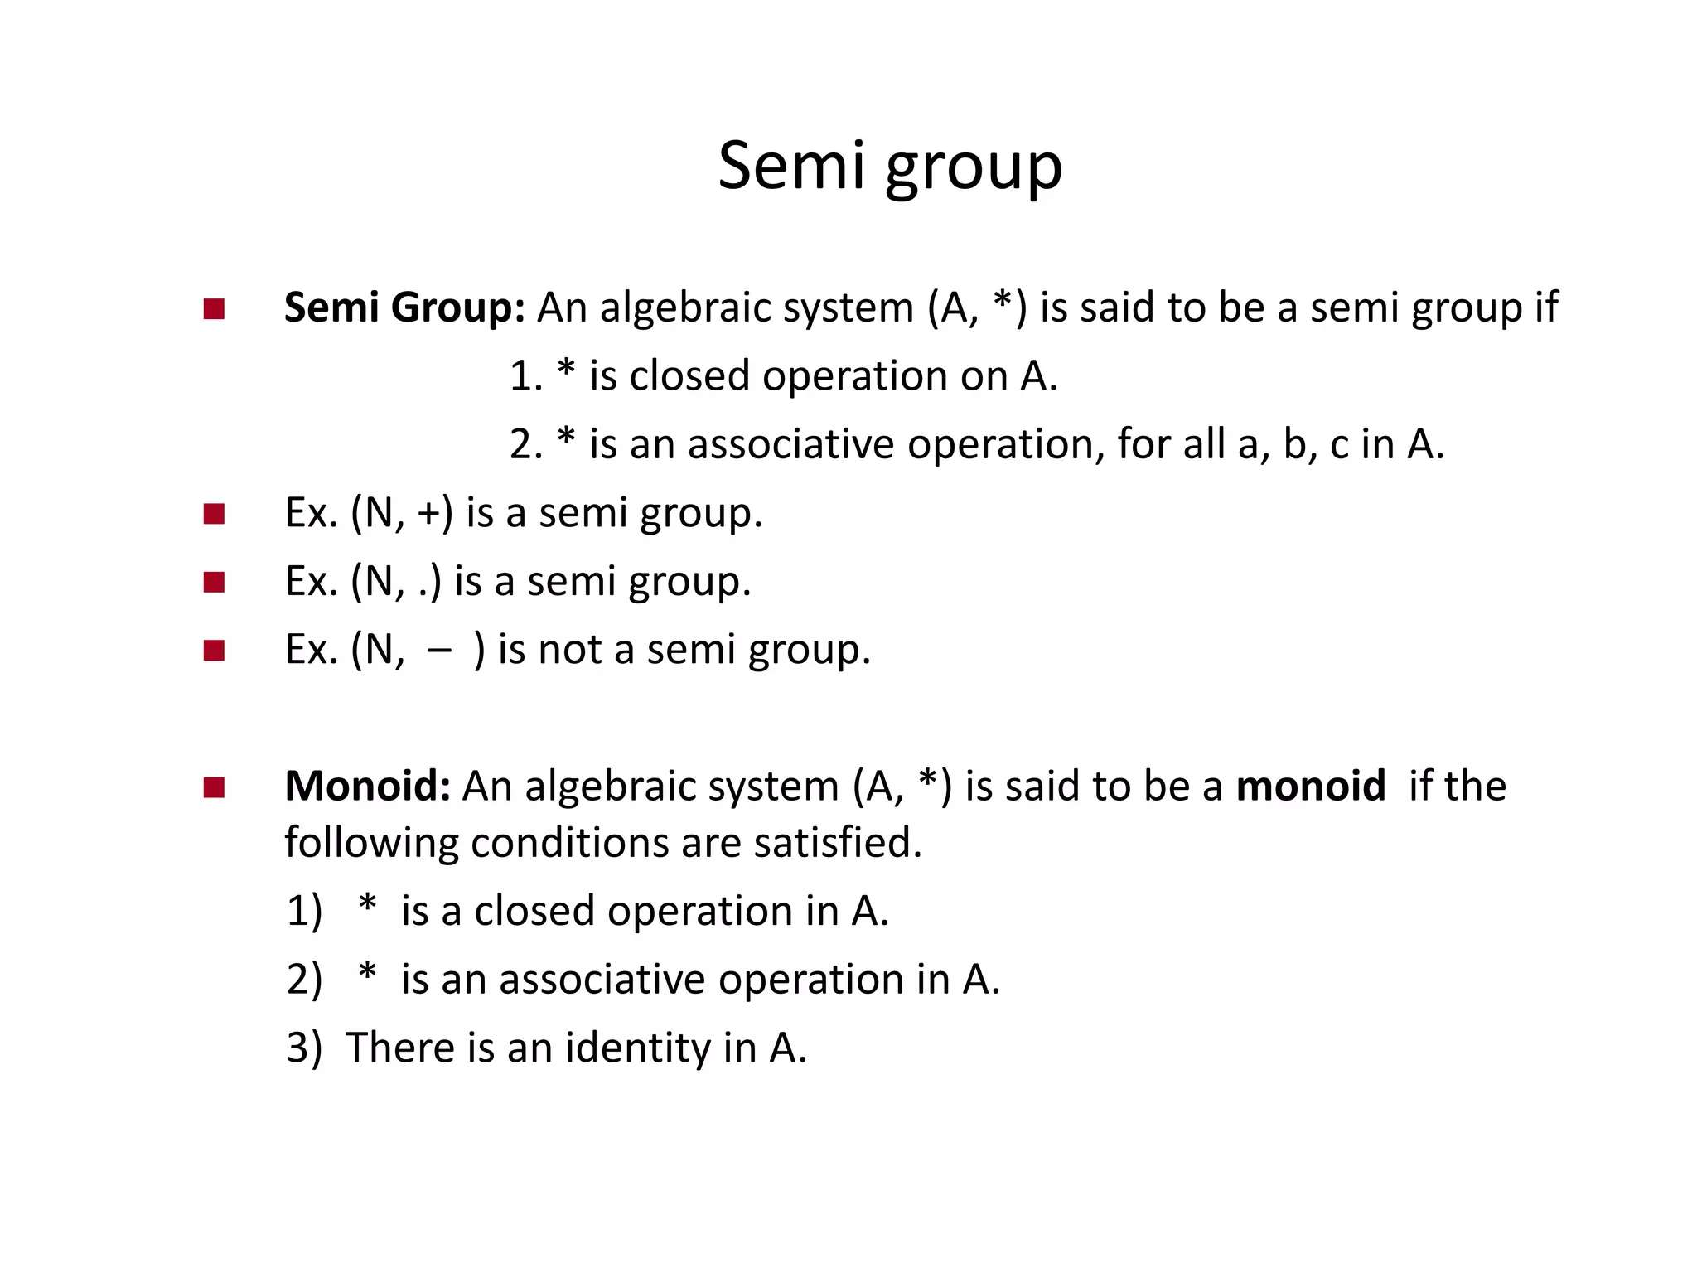

Slide 5
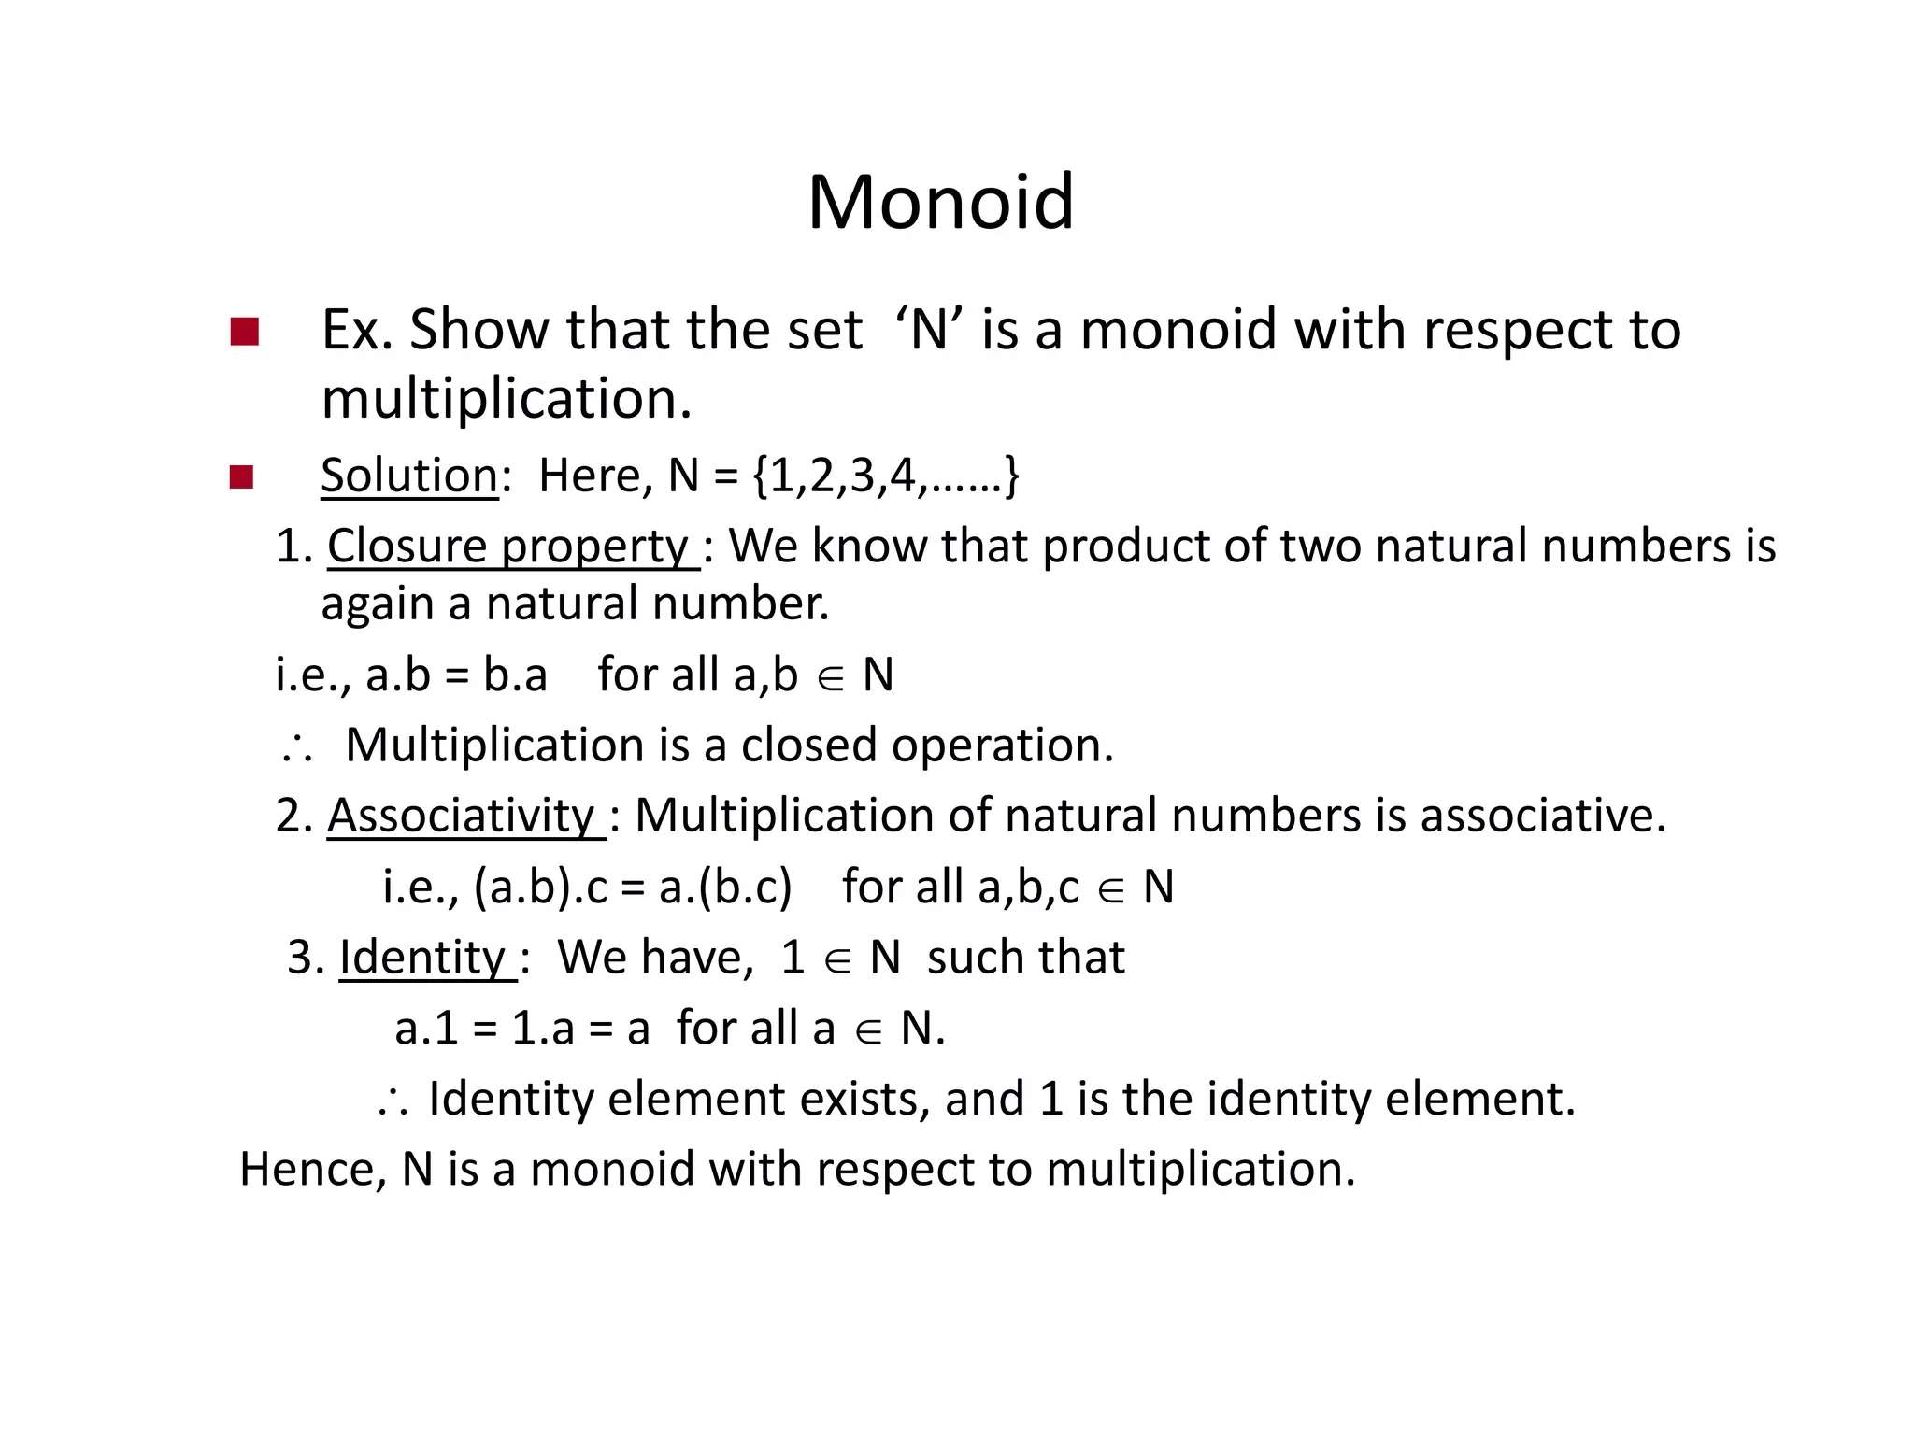

Slide 6
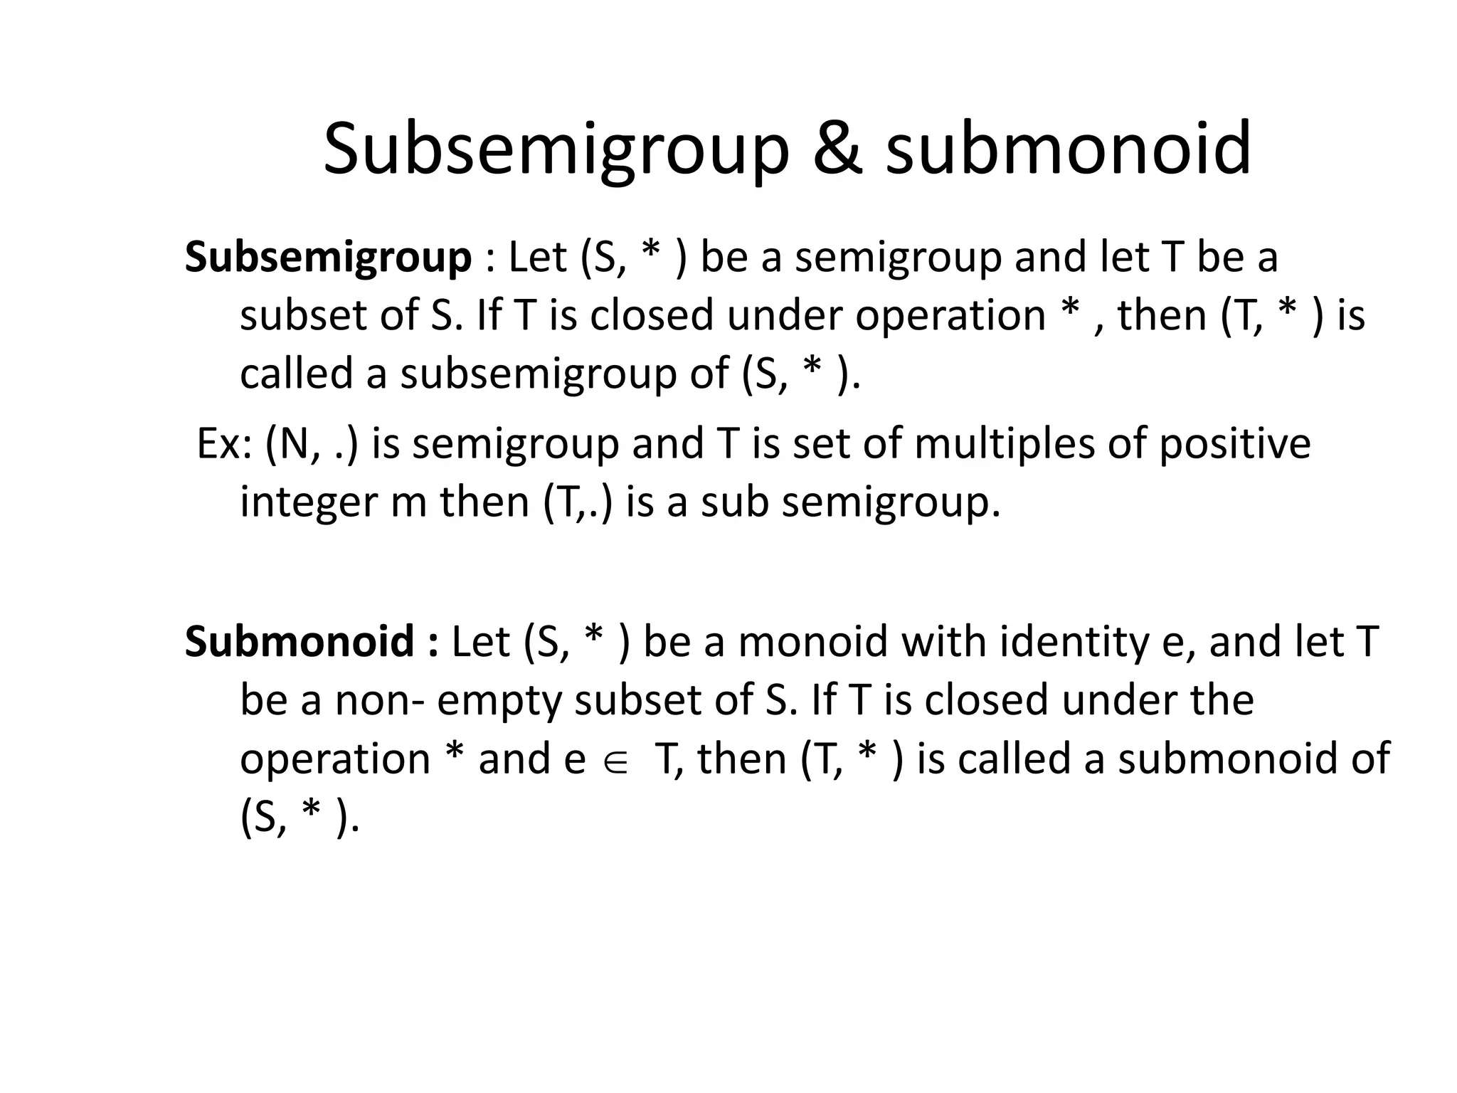

Slide 7
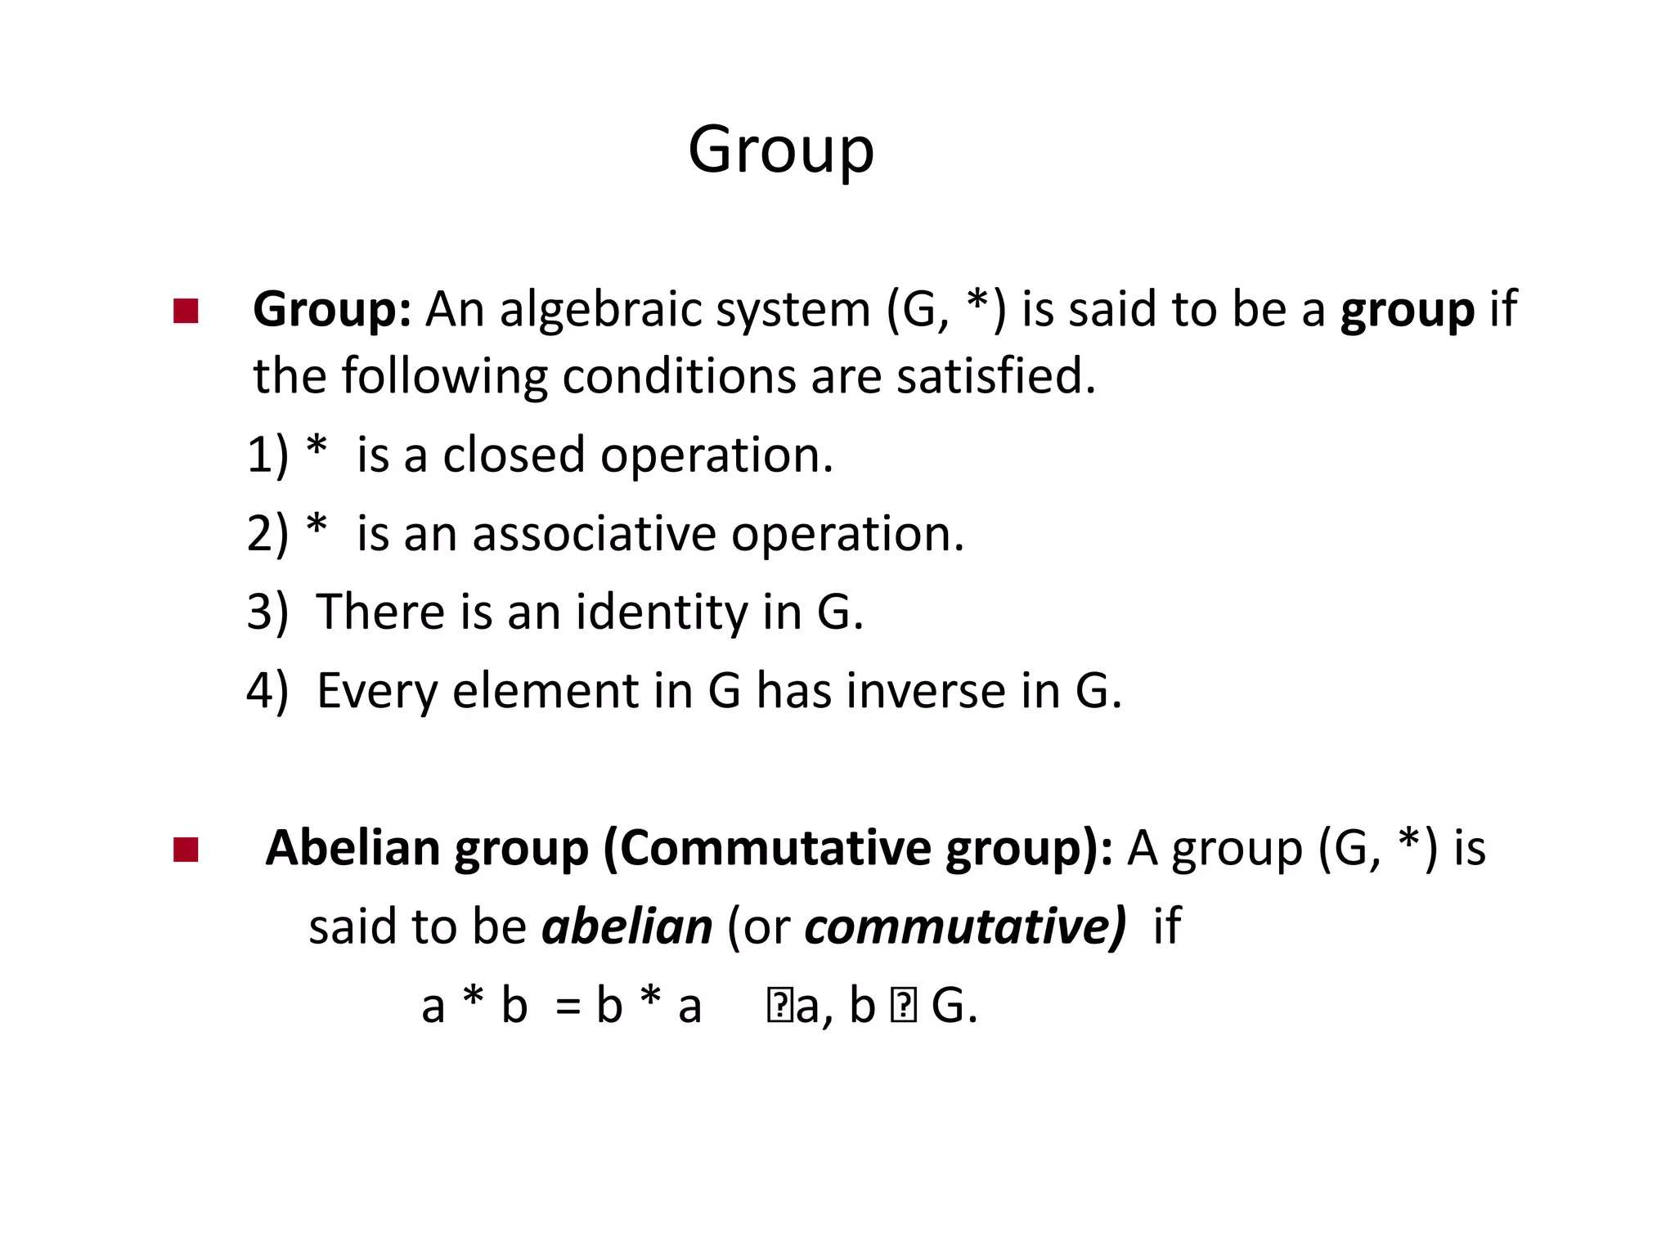

Slide 8
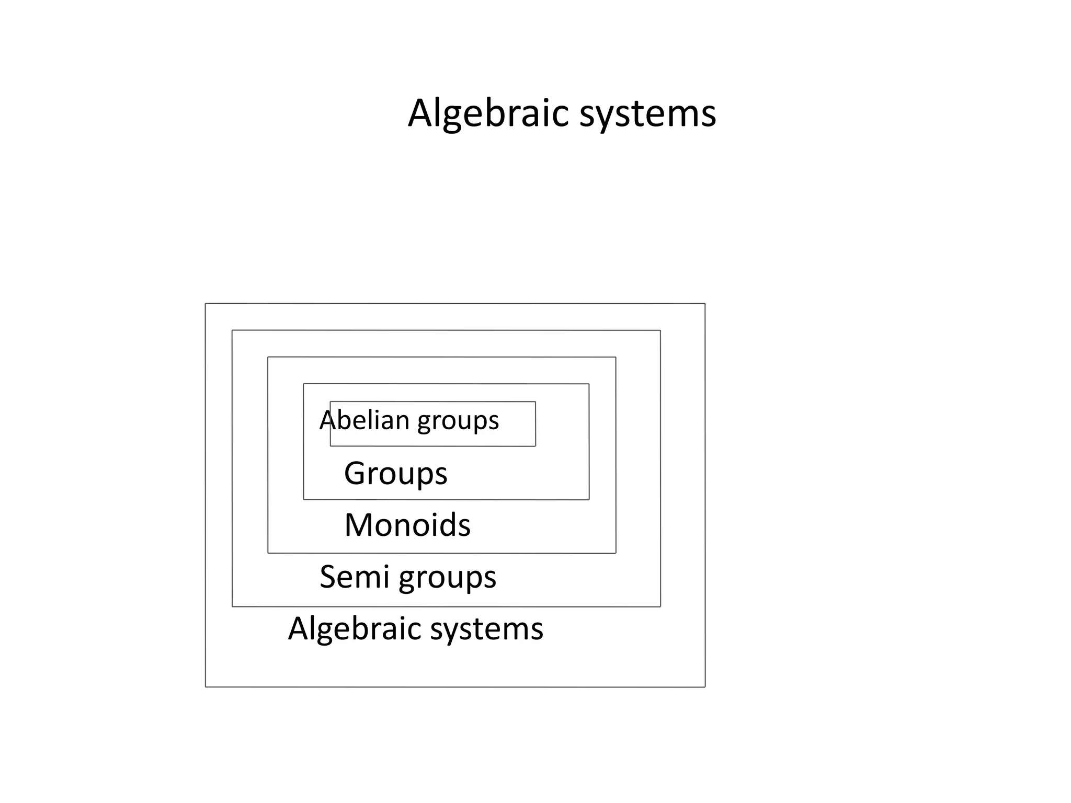

Slide 9
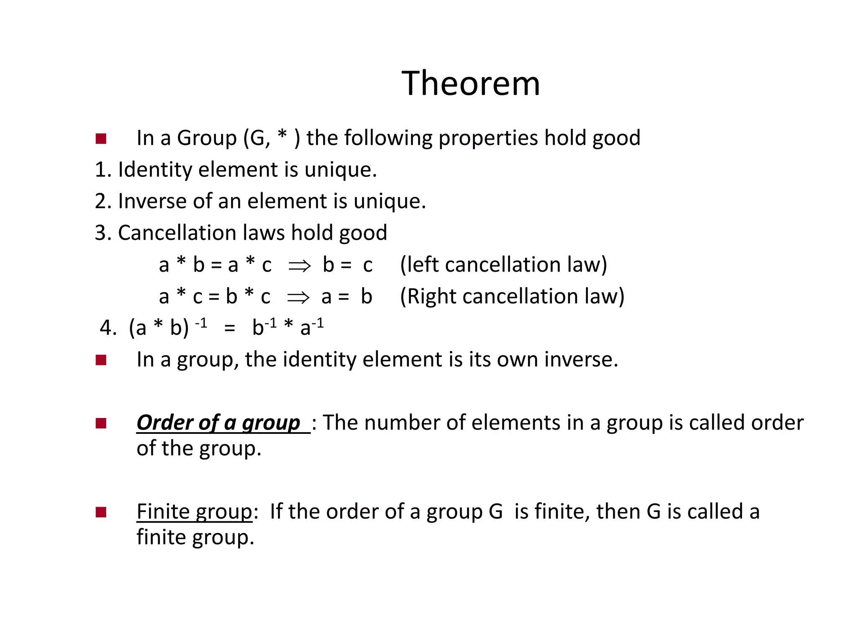

Slide 10
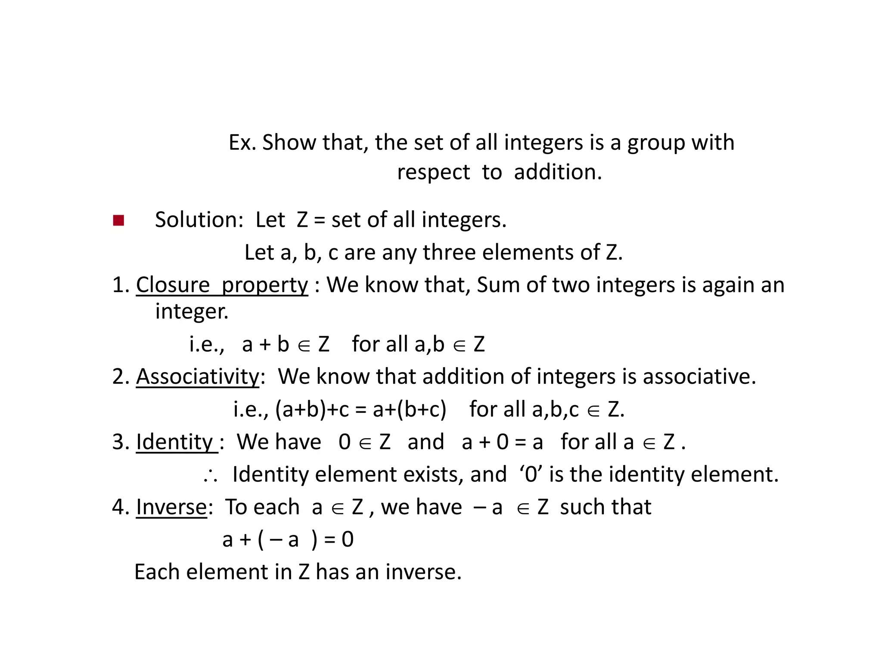

Slide 11
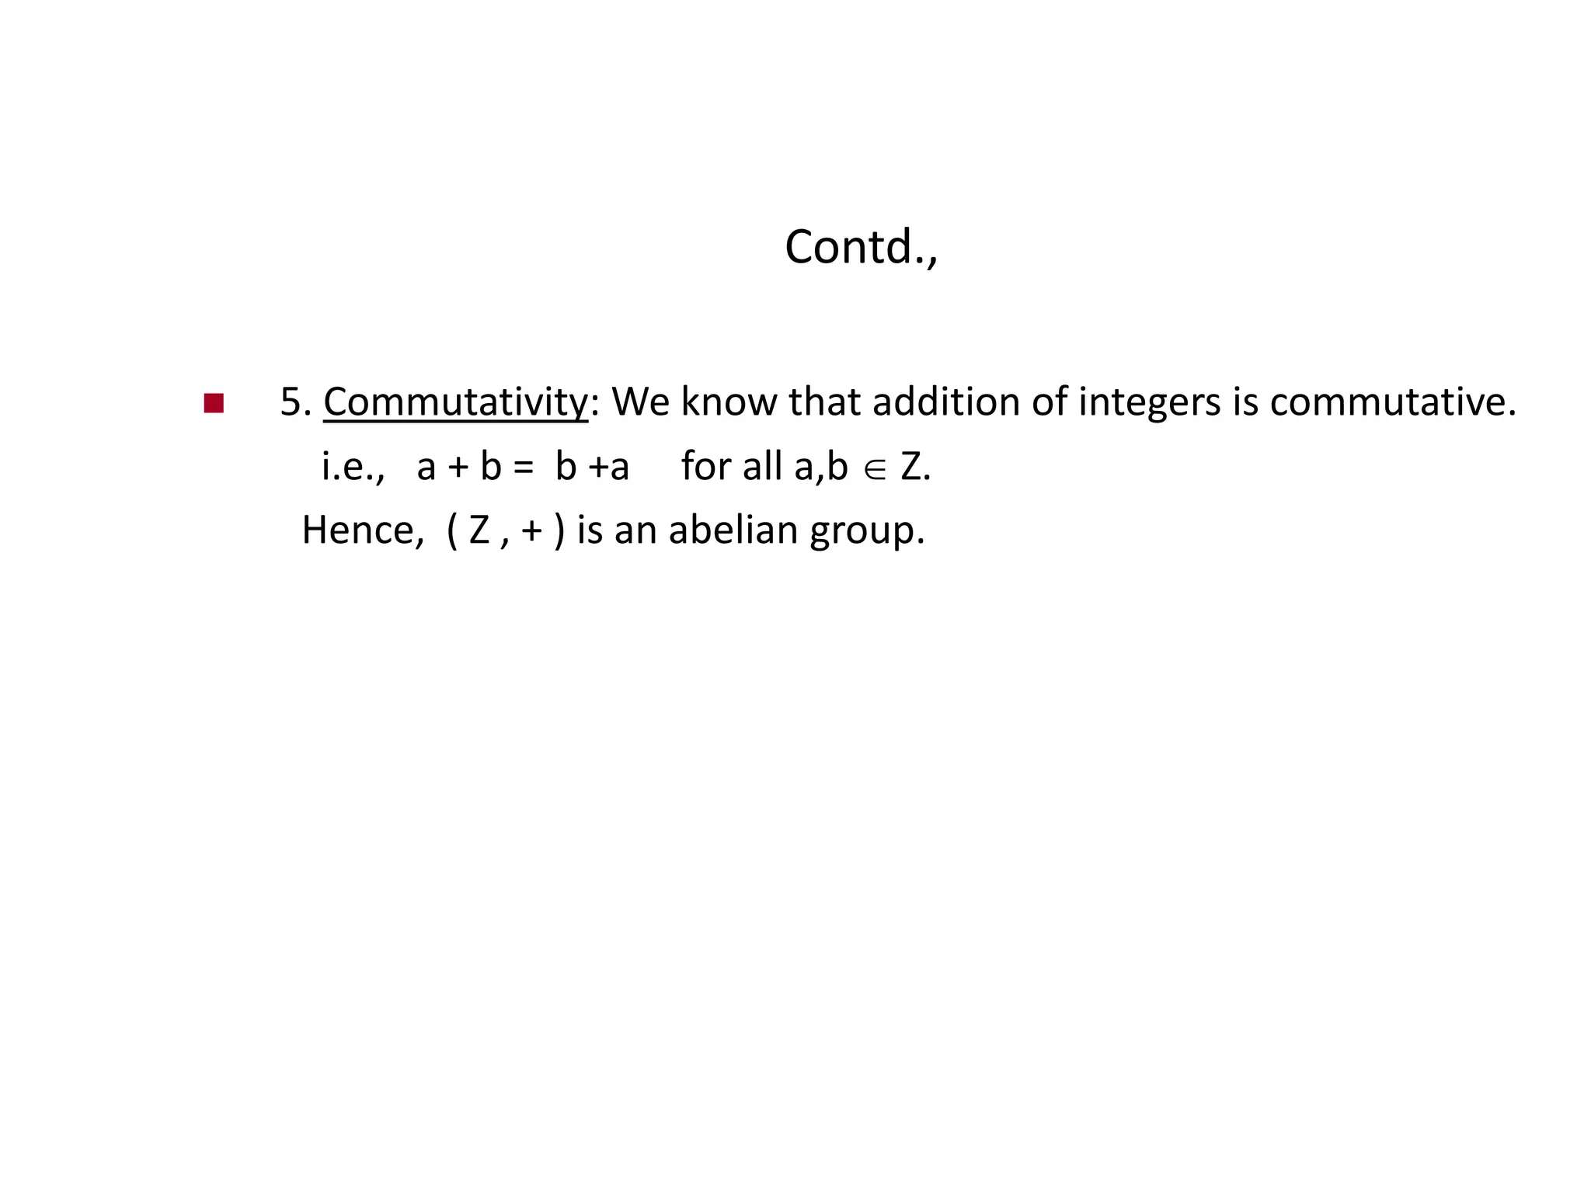

Slide 12
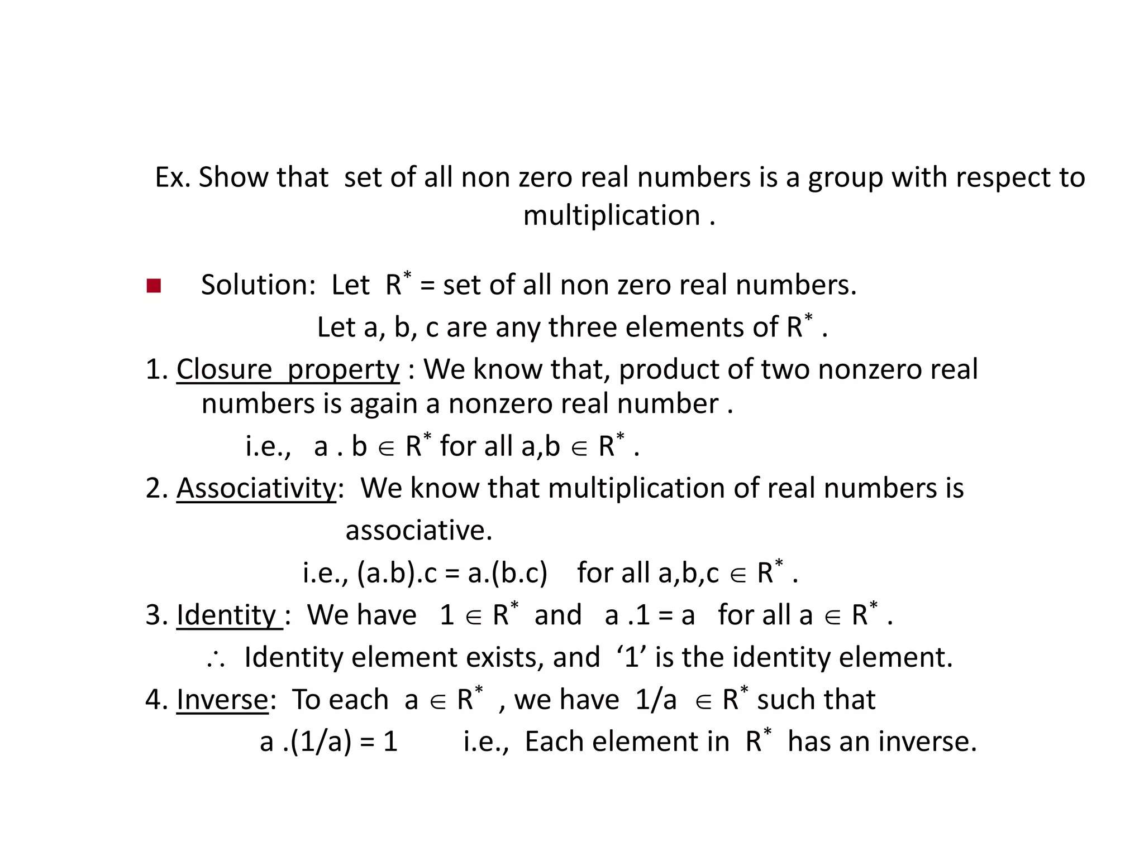

Slide 13
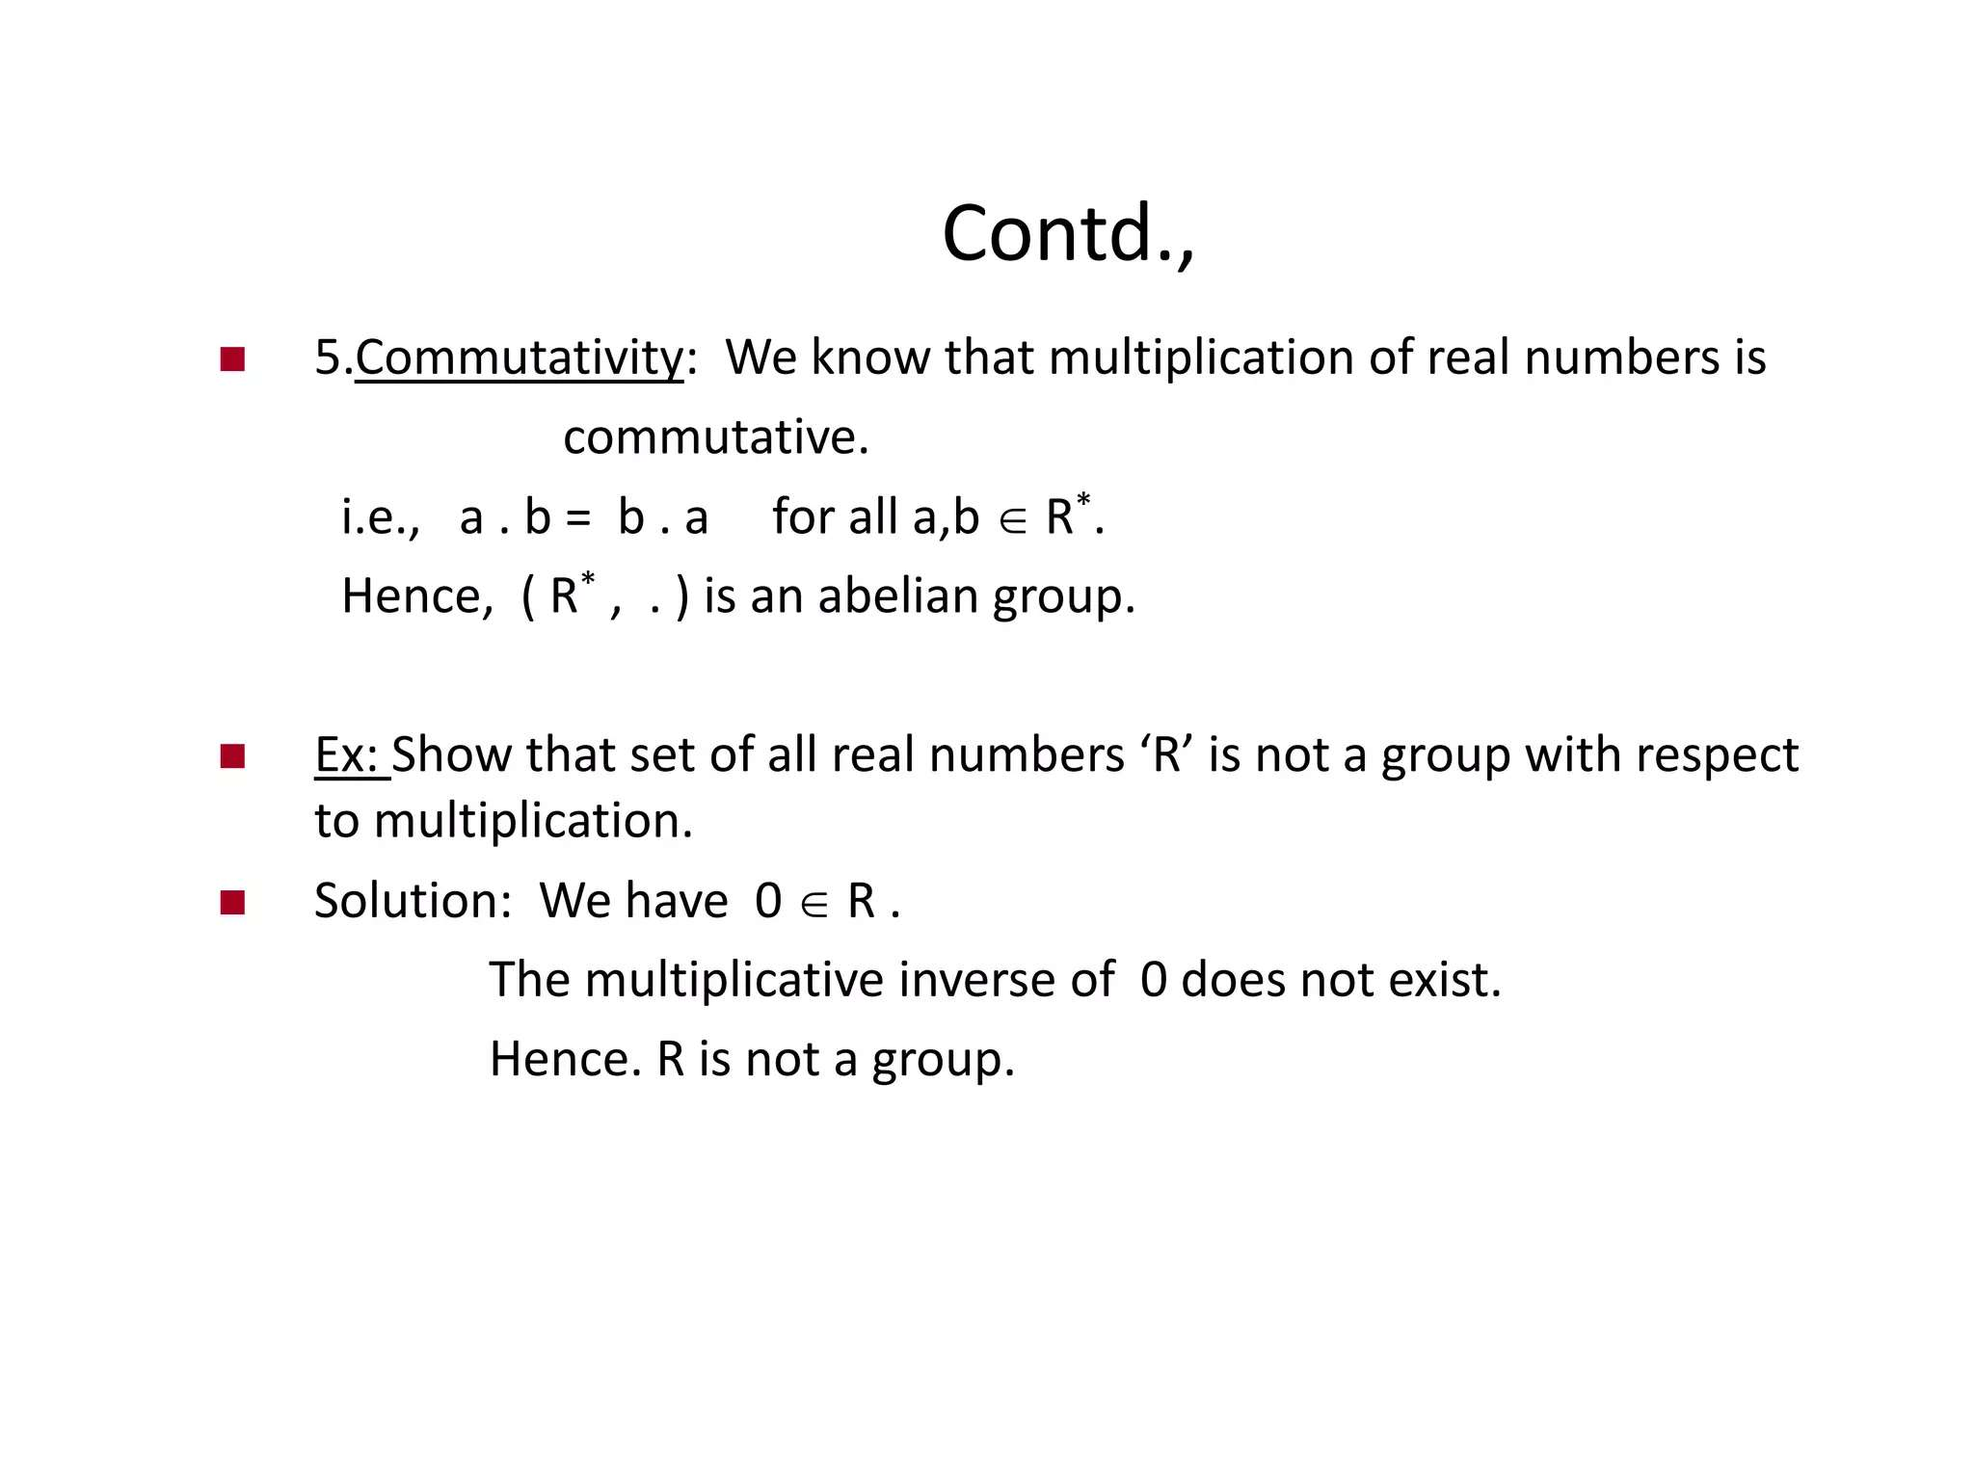

Slide 14
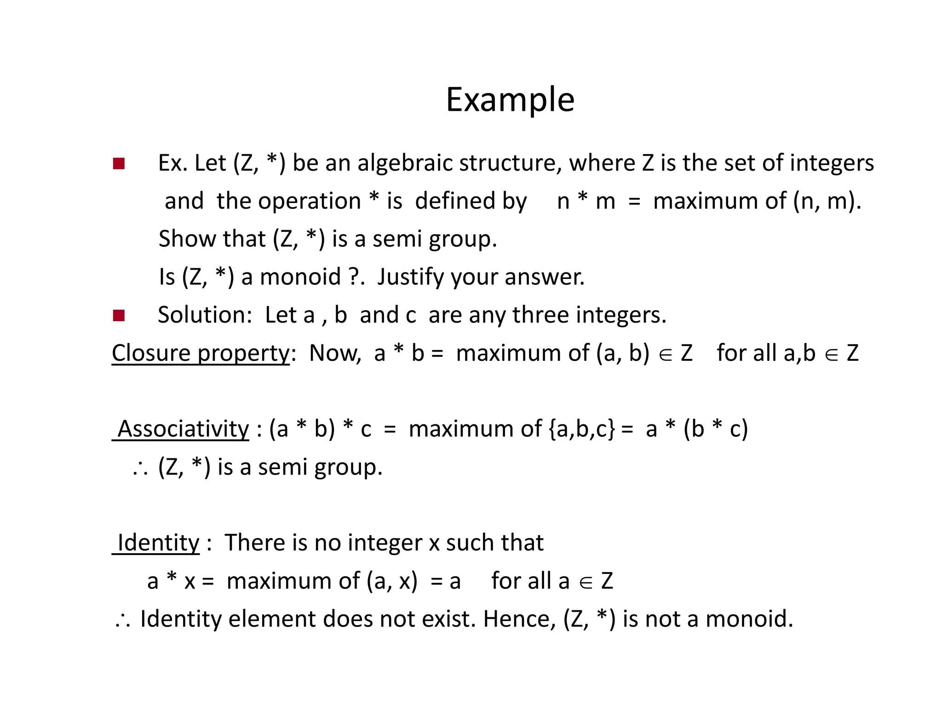

Slide 15
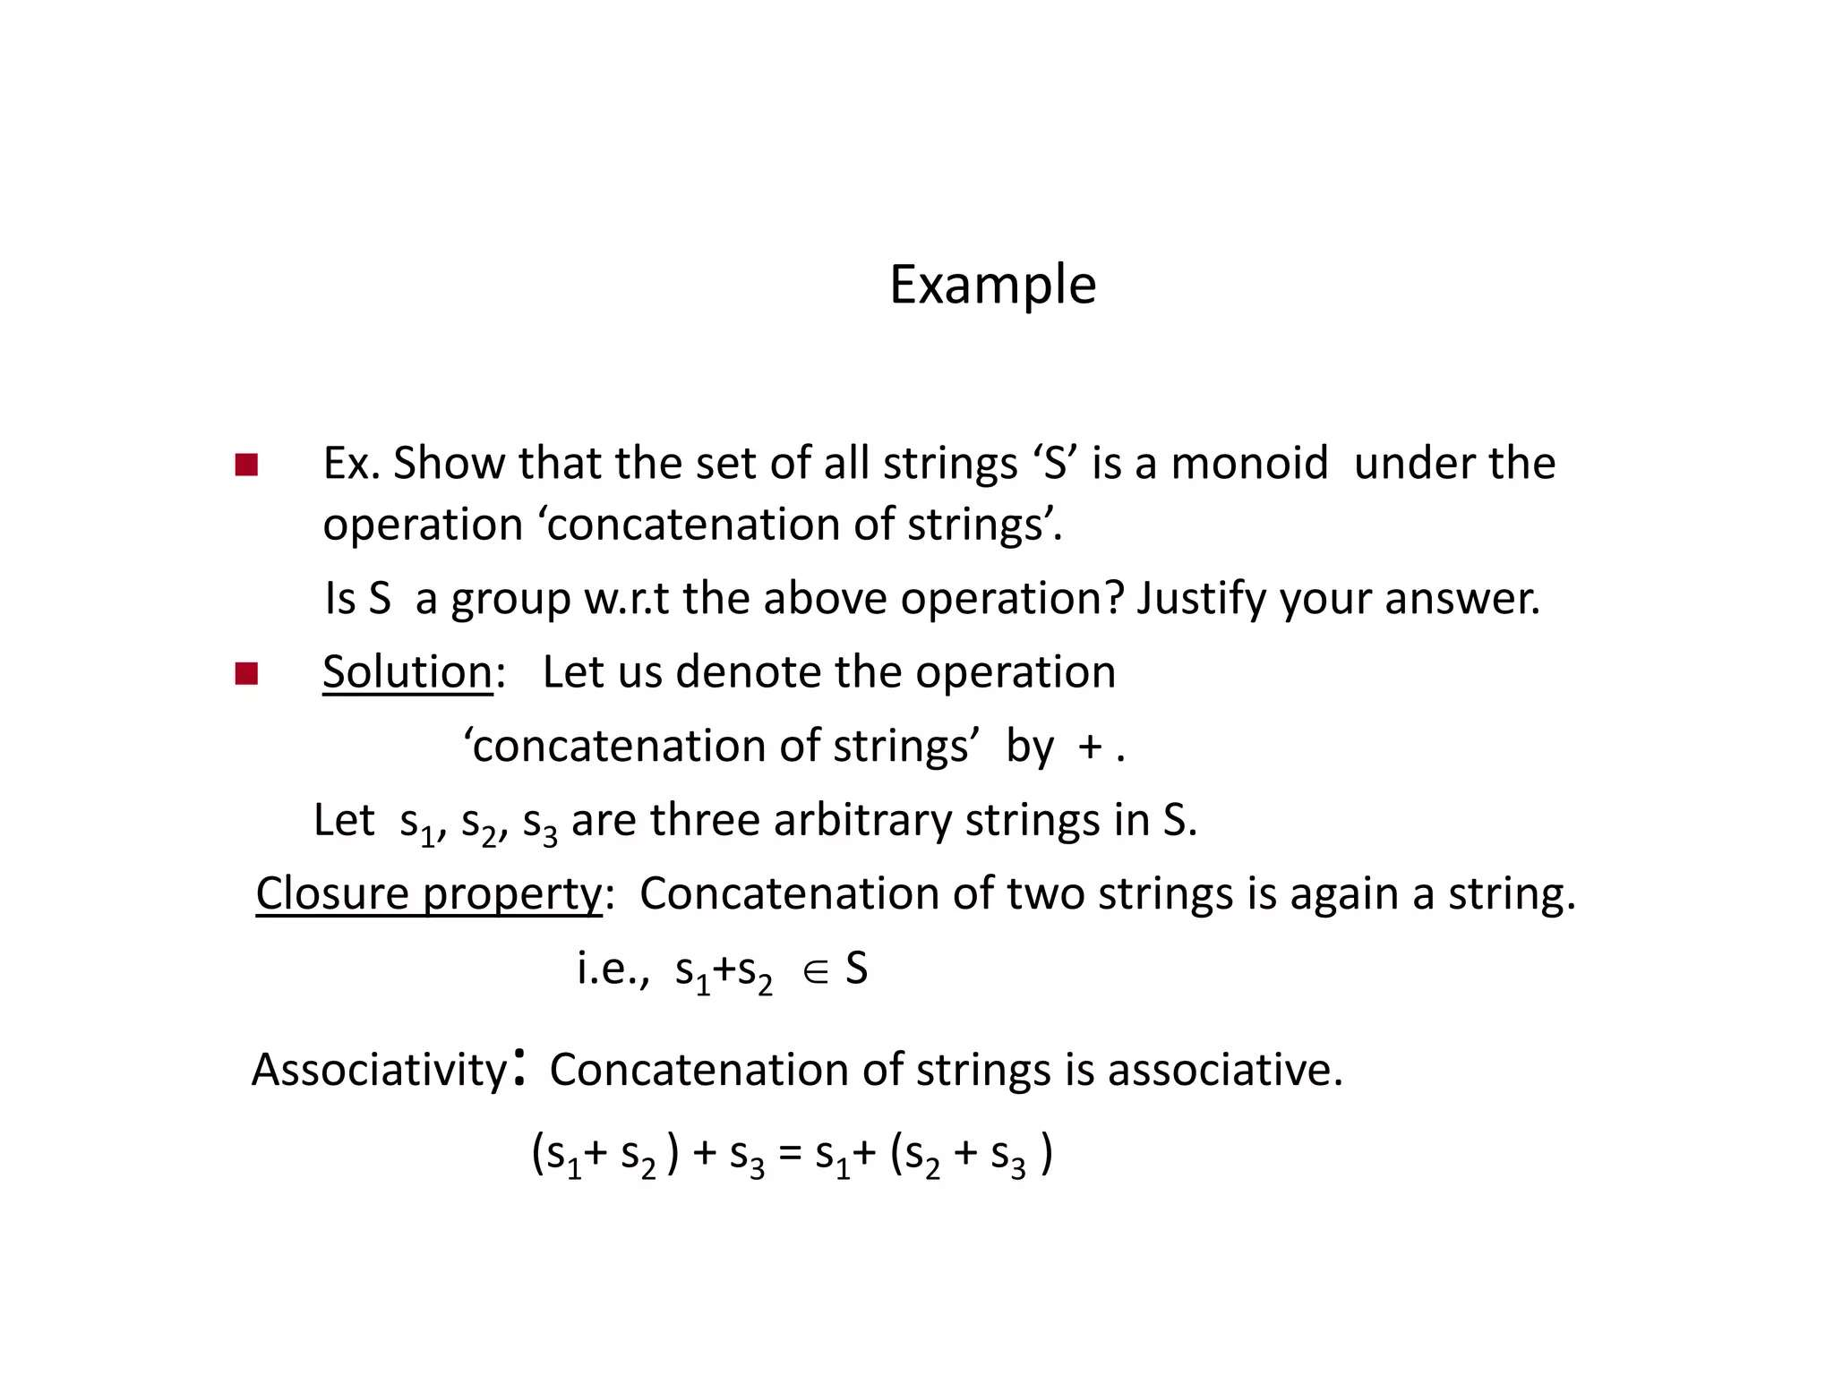

Slide 16
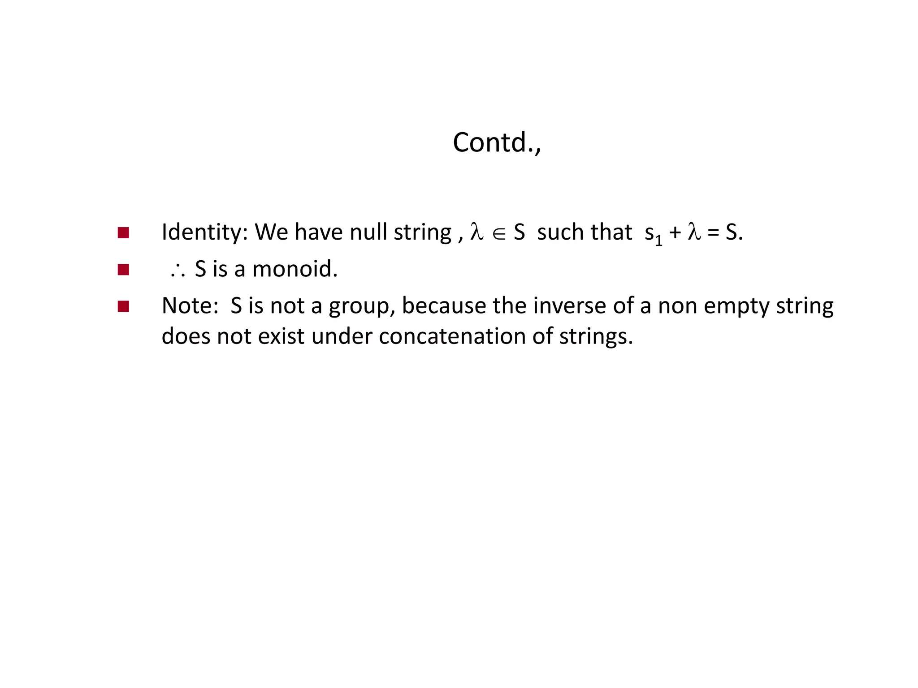

Slide 17
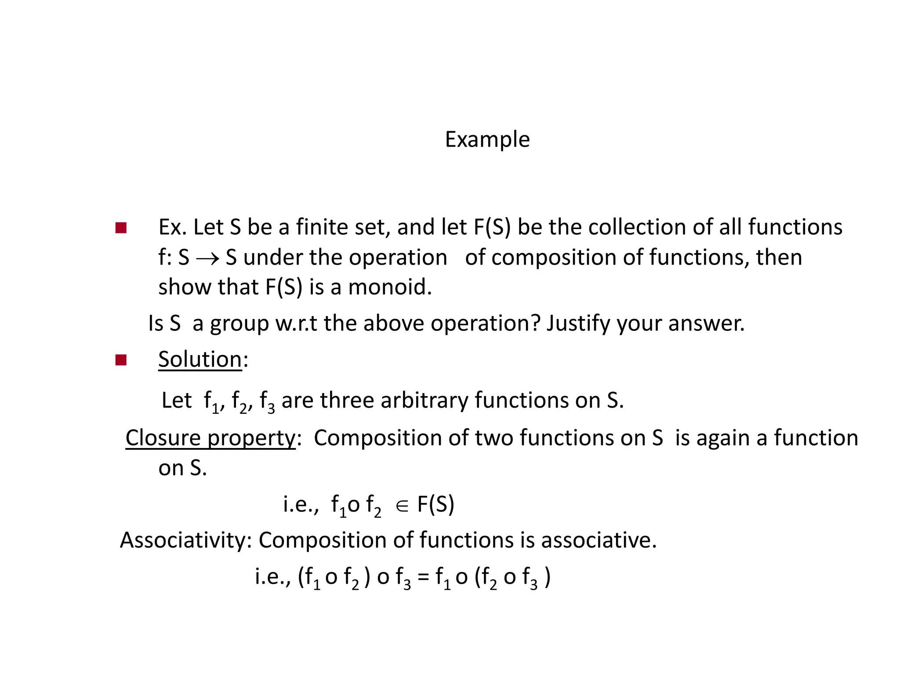

Slide 18
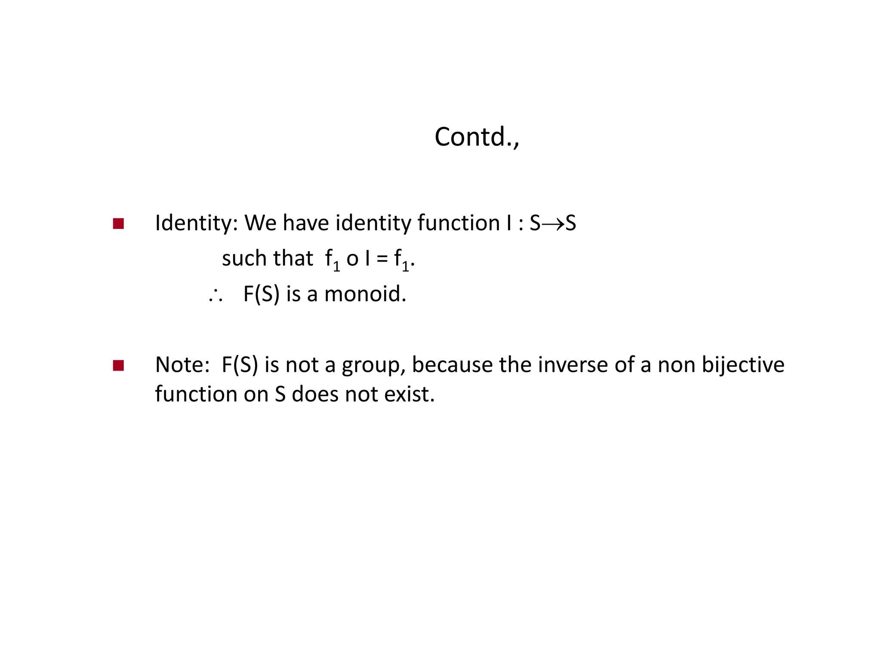

Slide 19
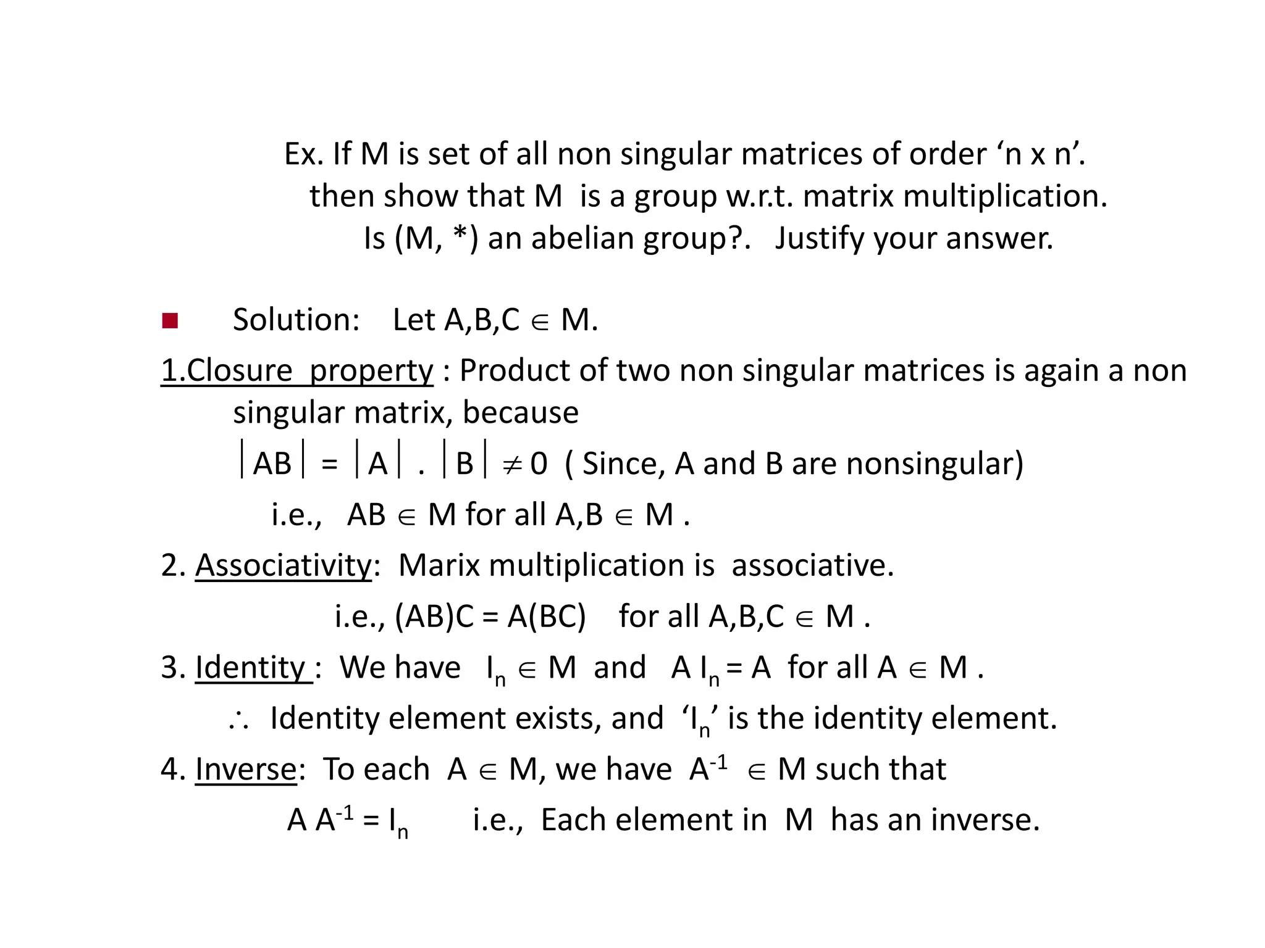

Slide 20
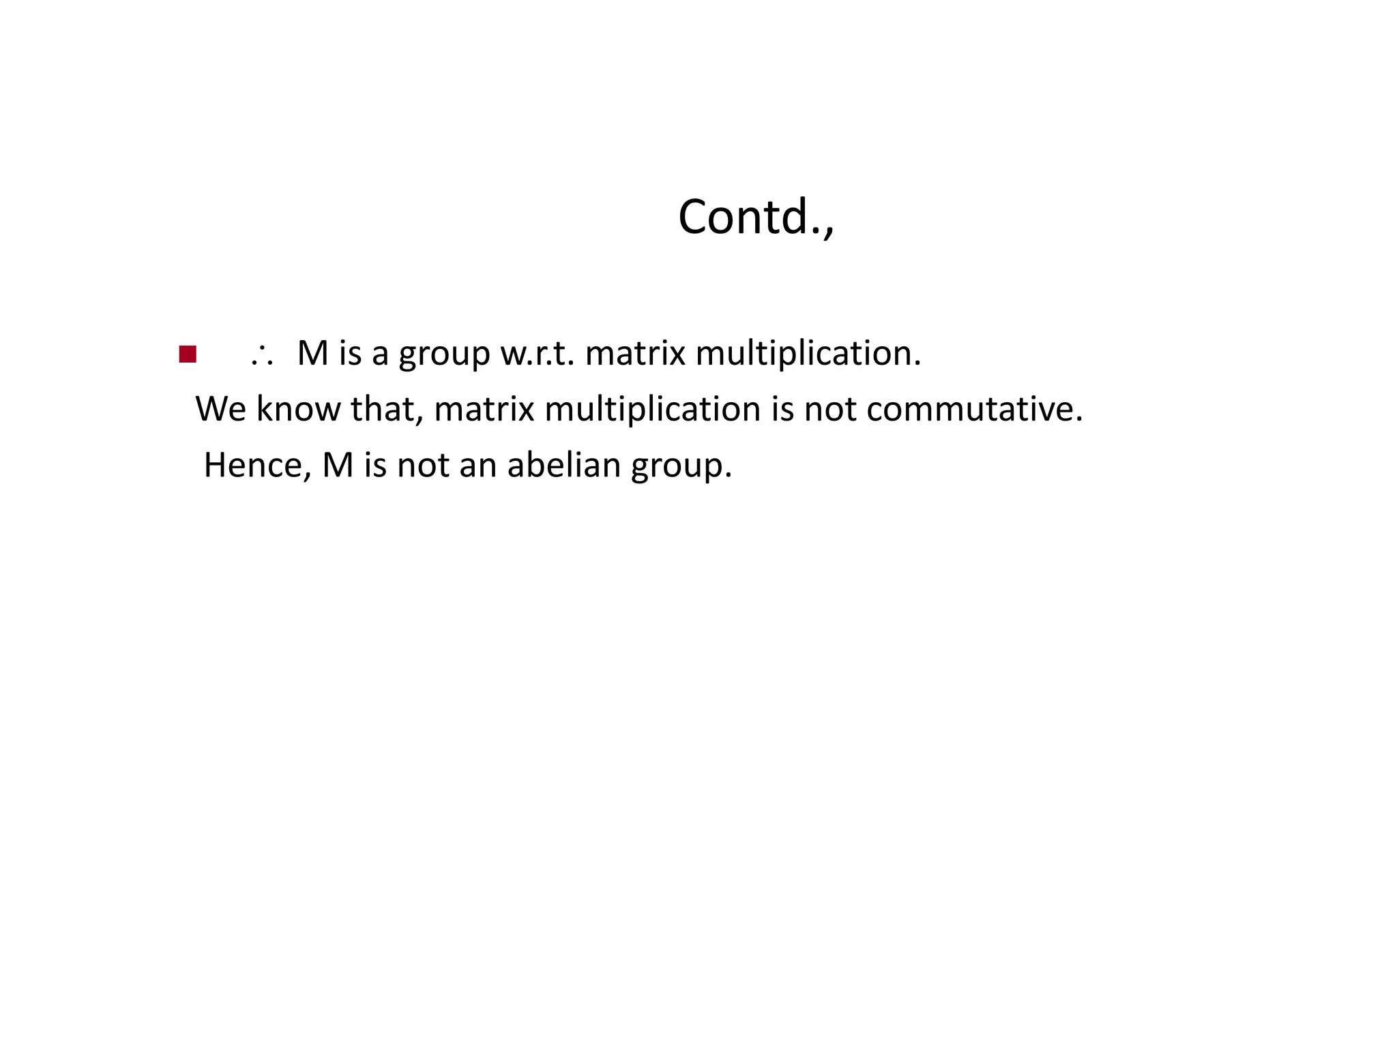

Slide 21
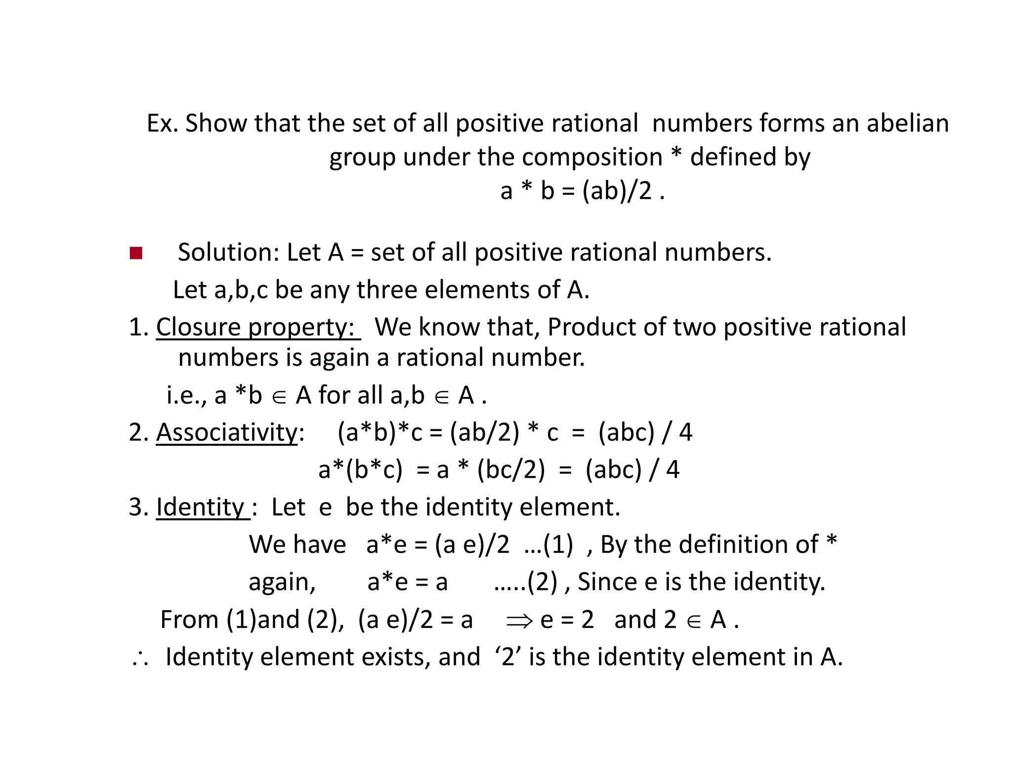

Slide 22
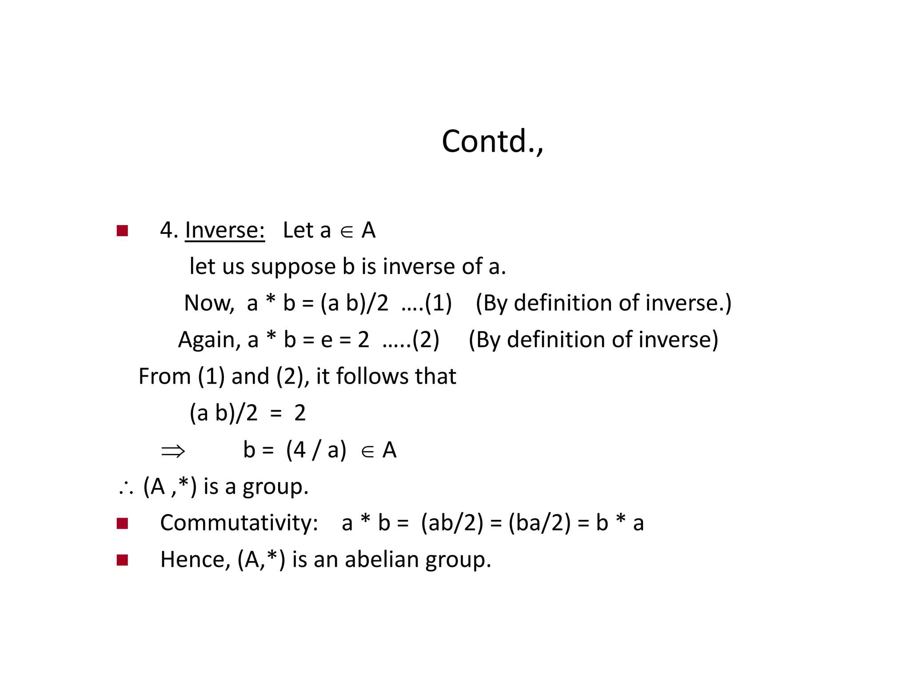

Slide 23
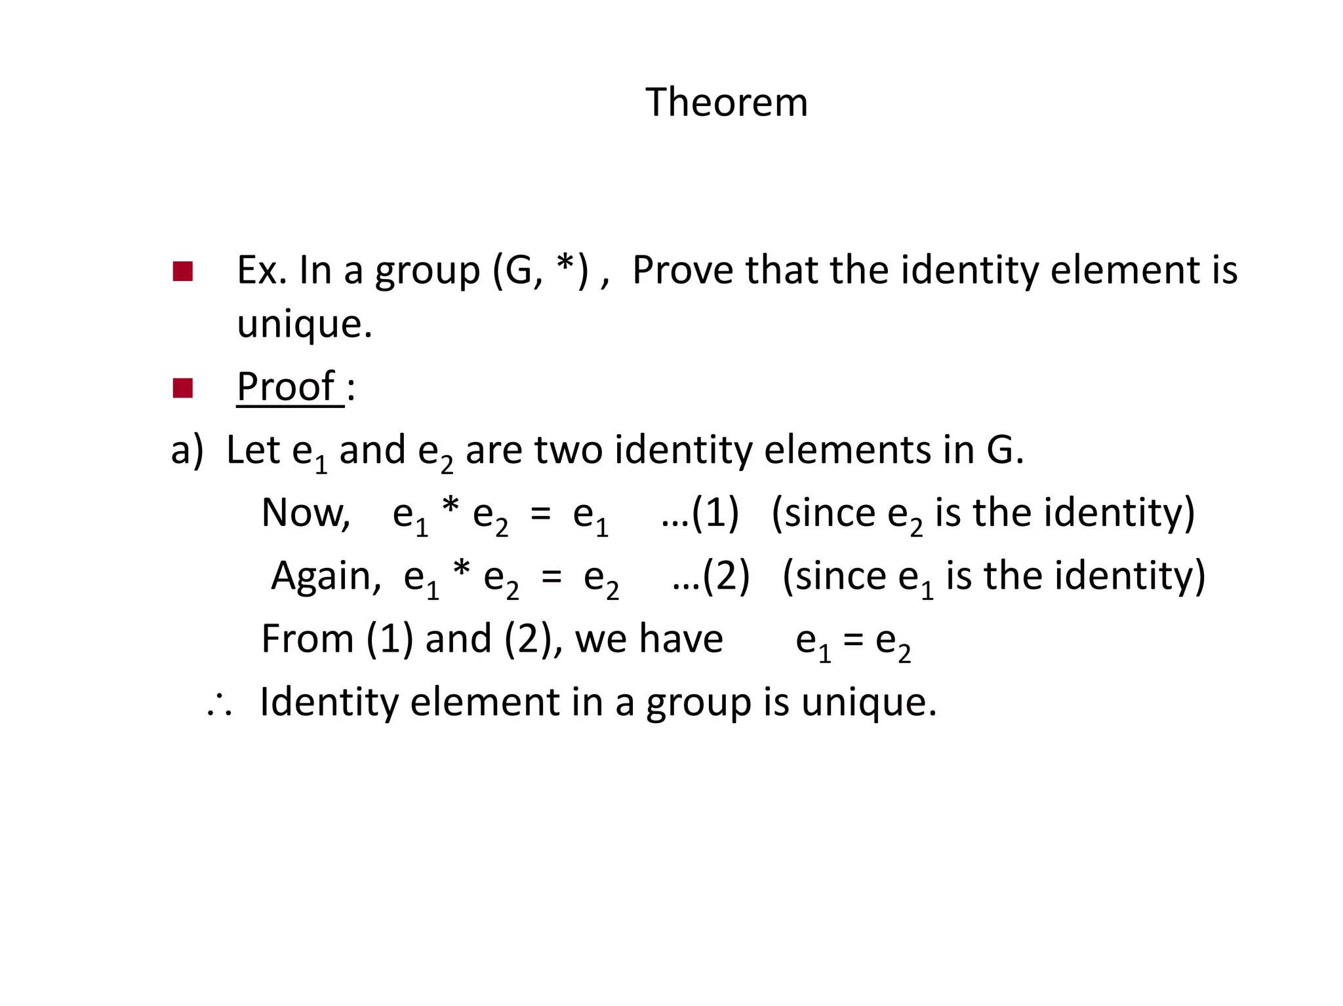

Slide 24
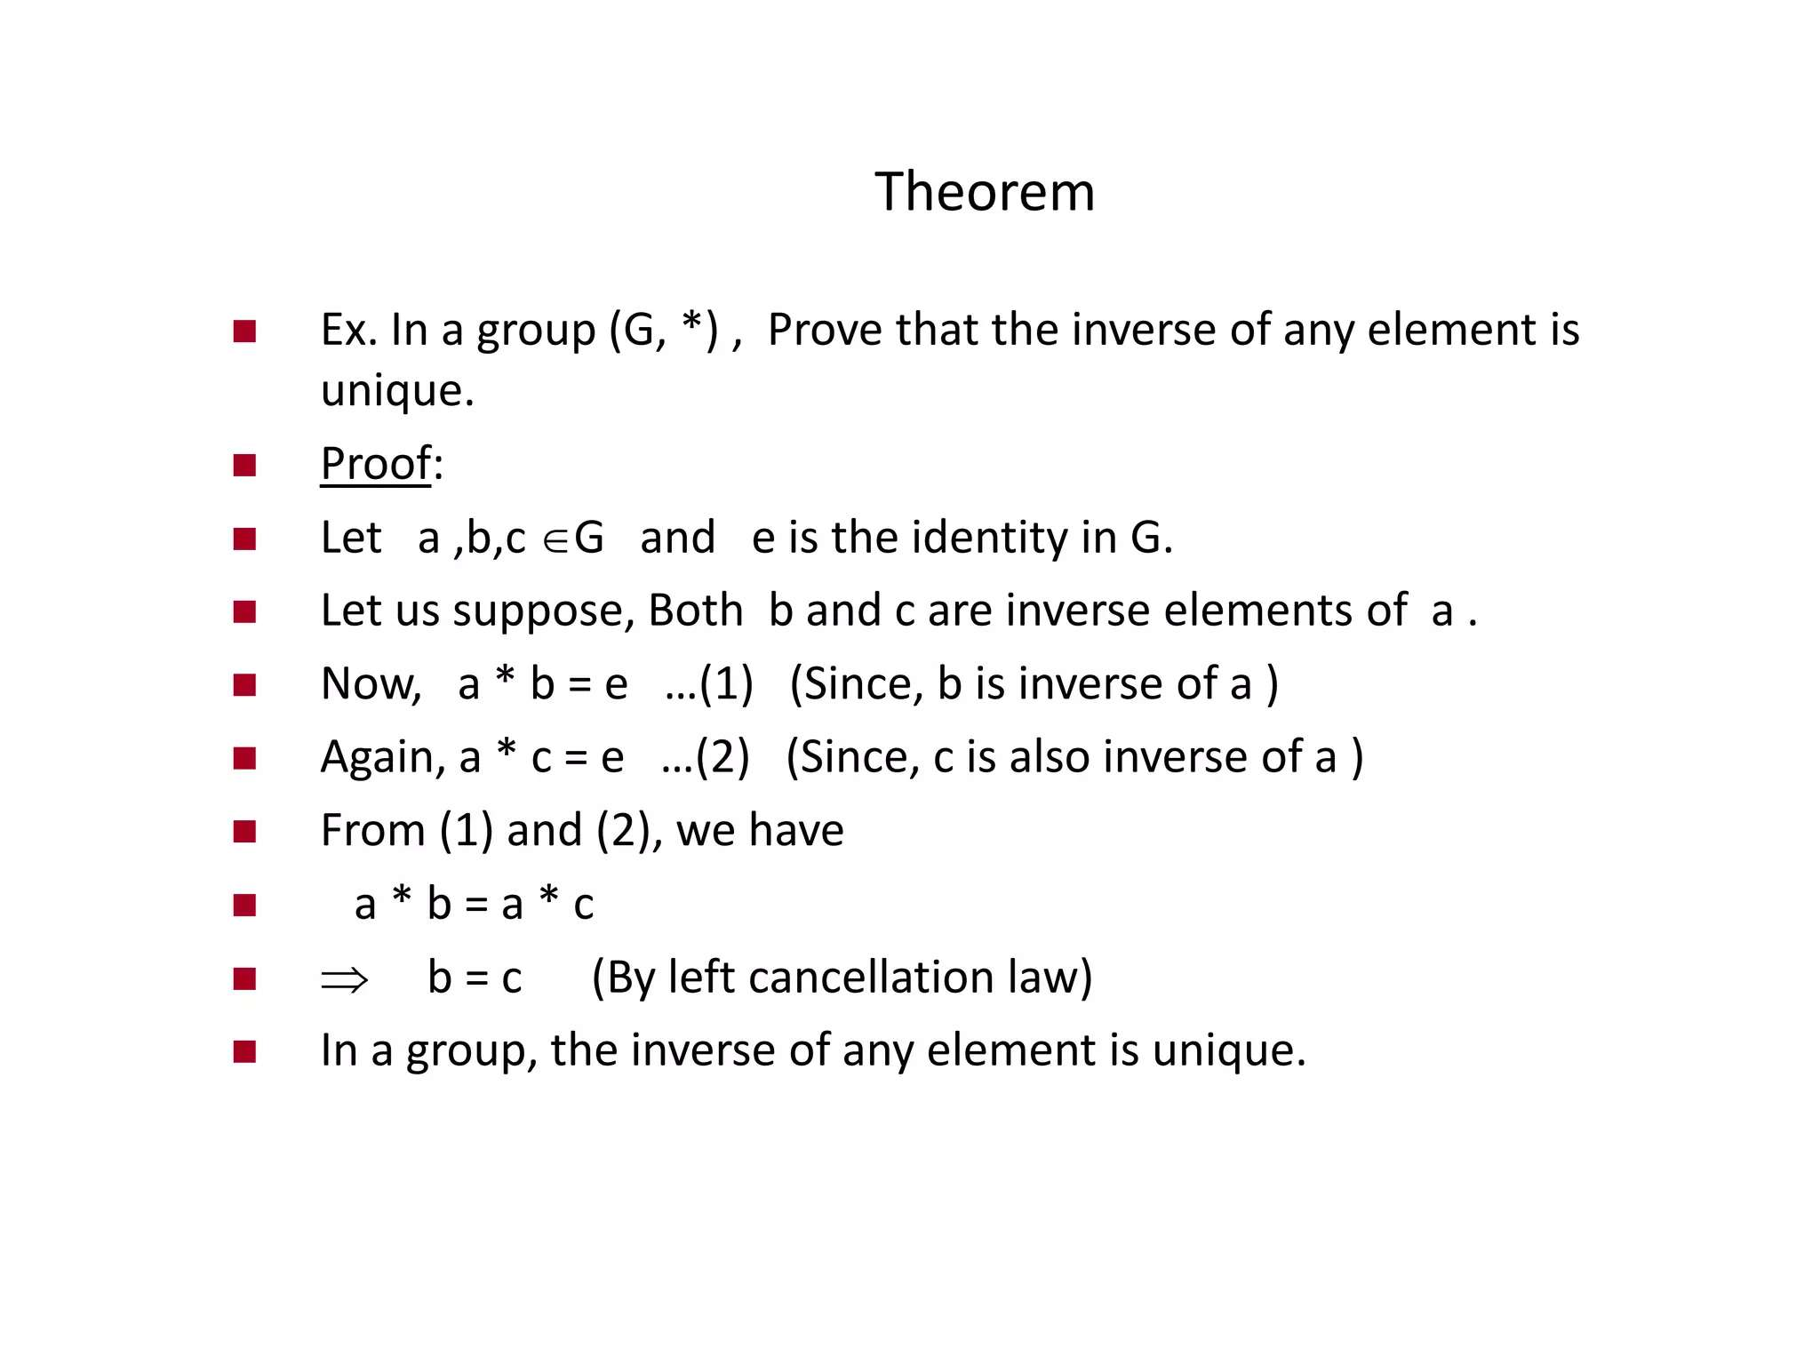

Slide 25
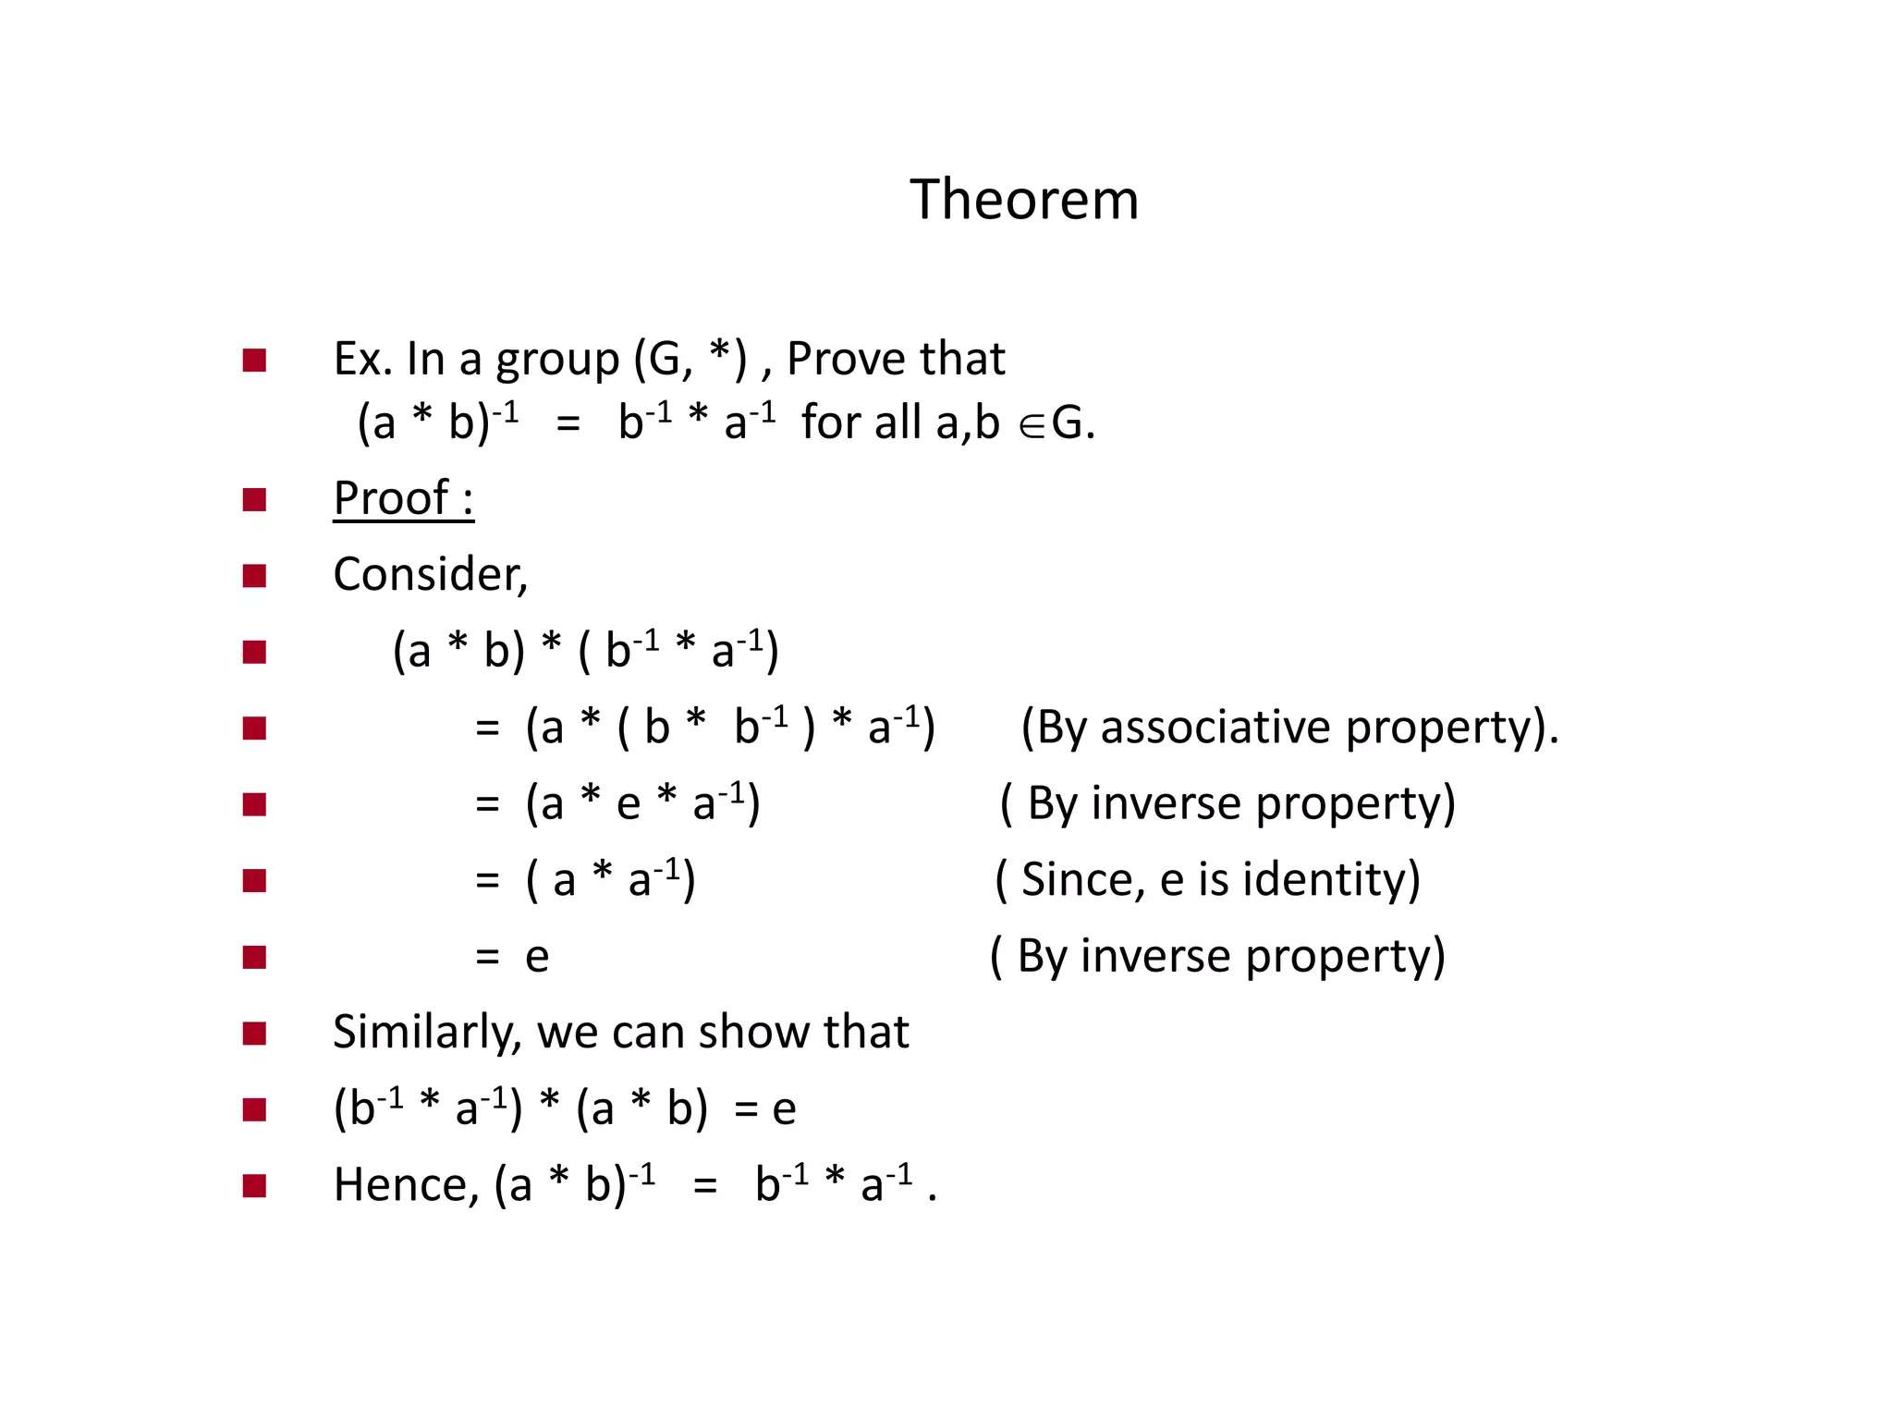

Slide 26
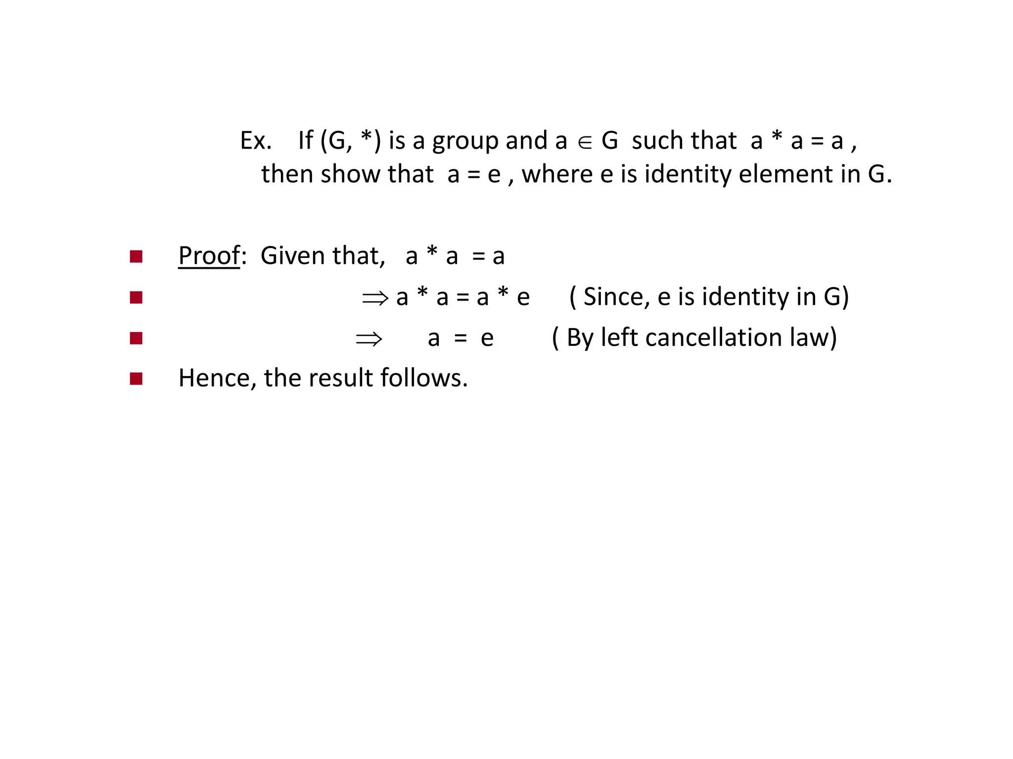

Slide 27
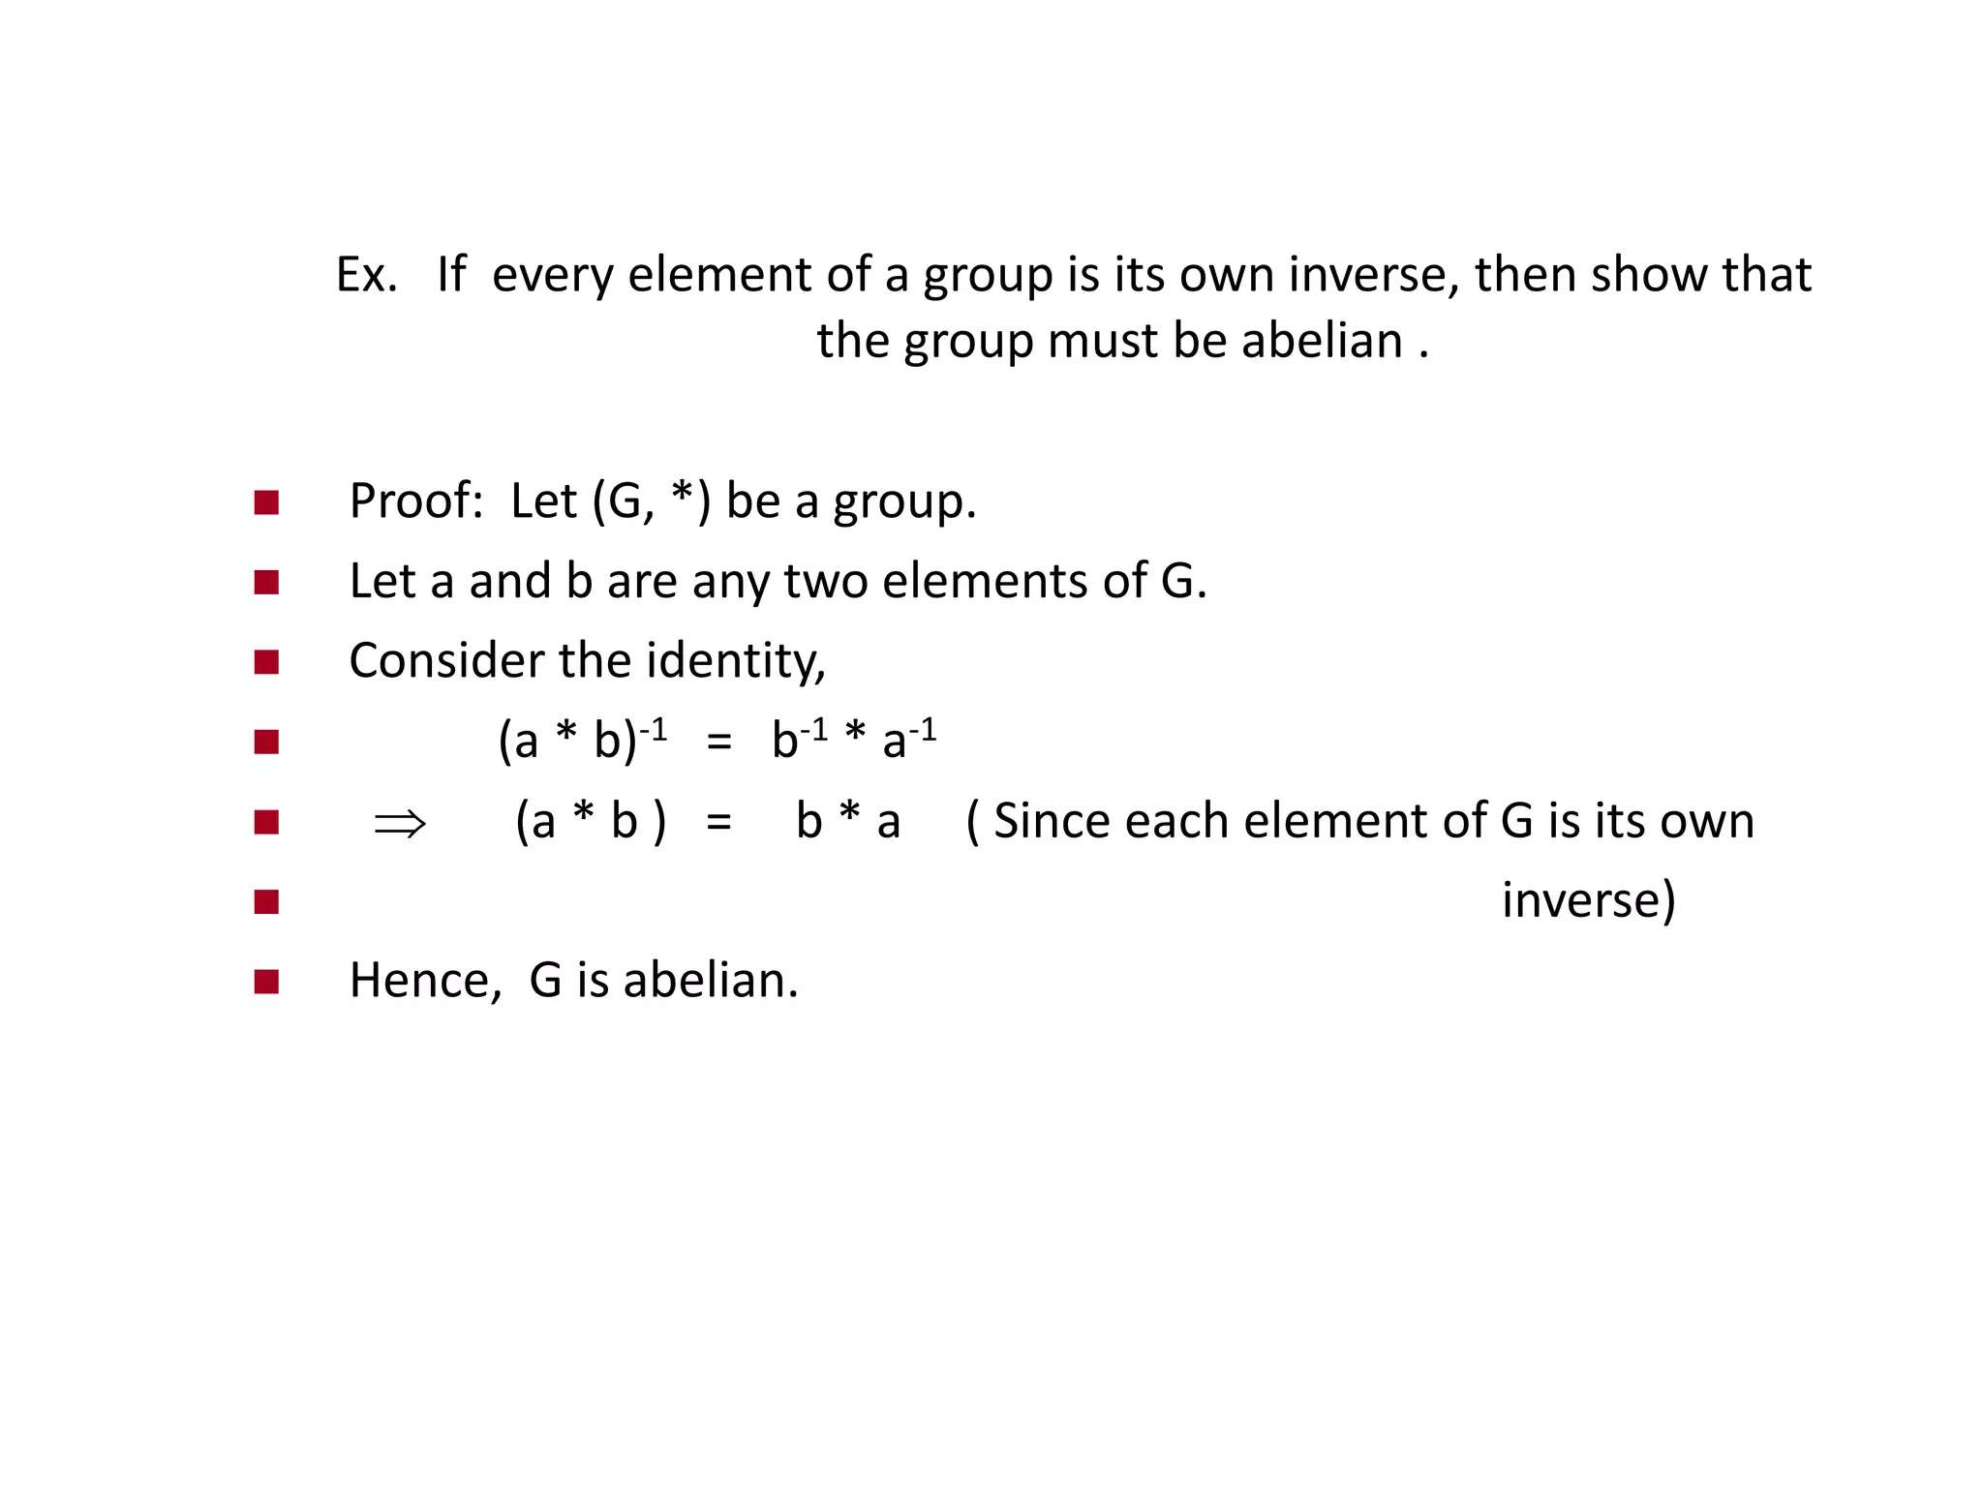

Slide 28
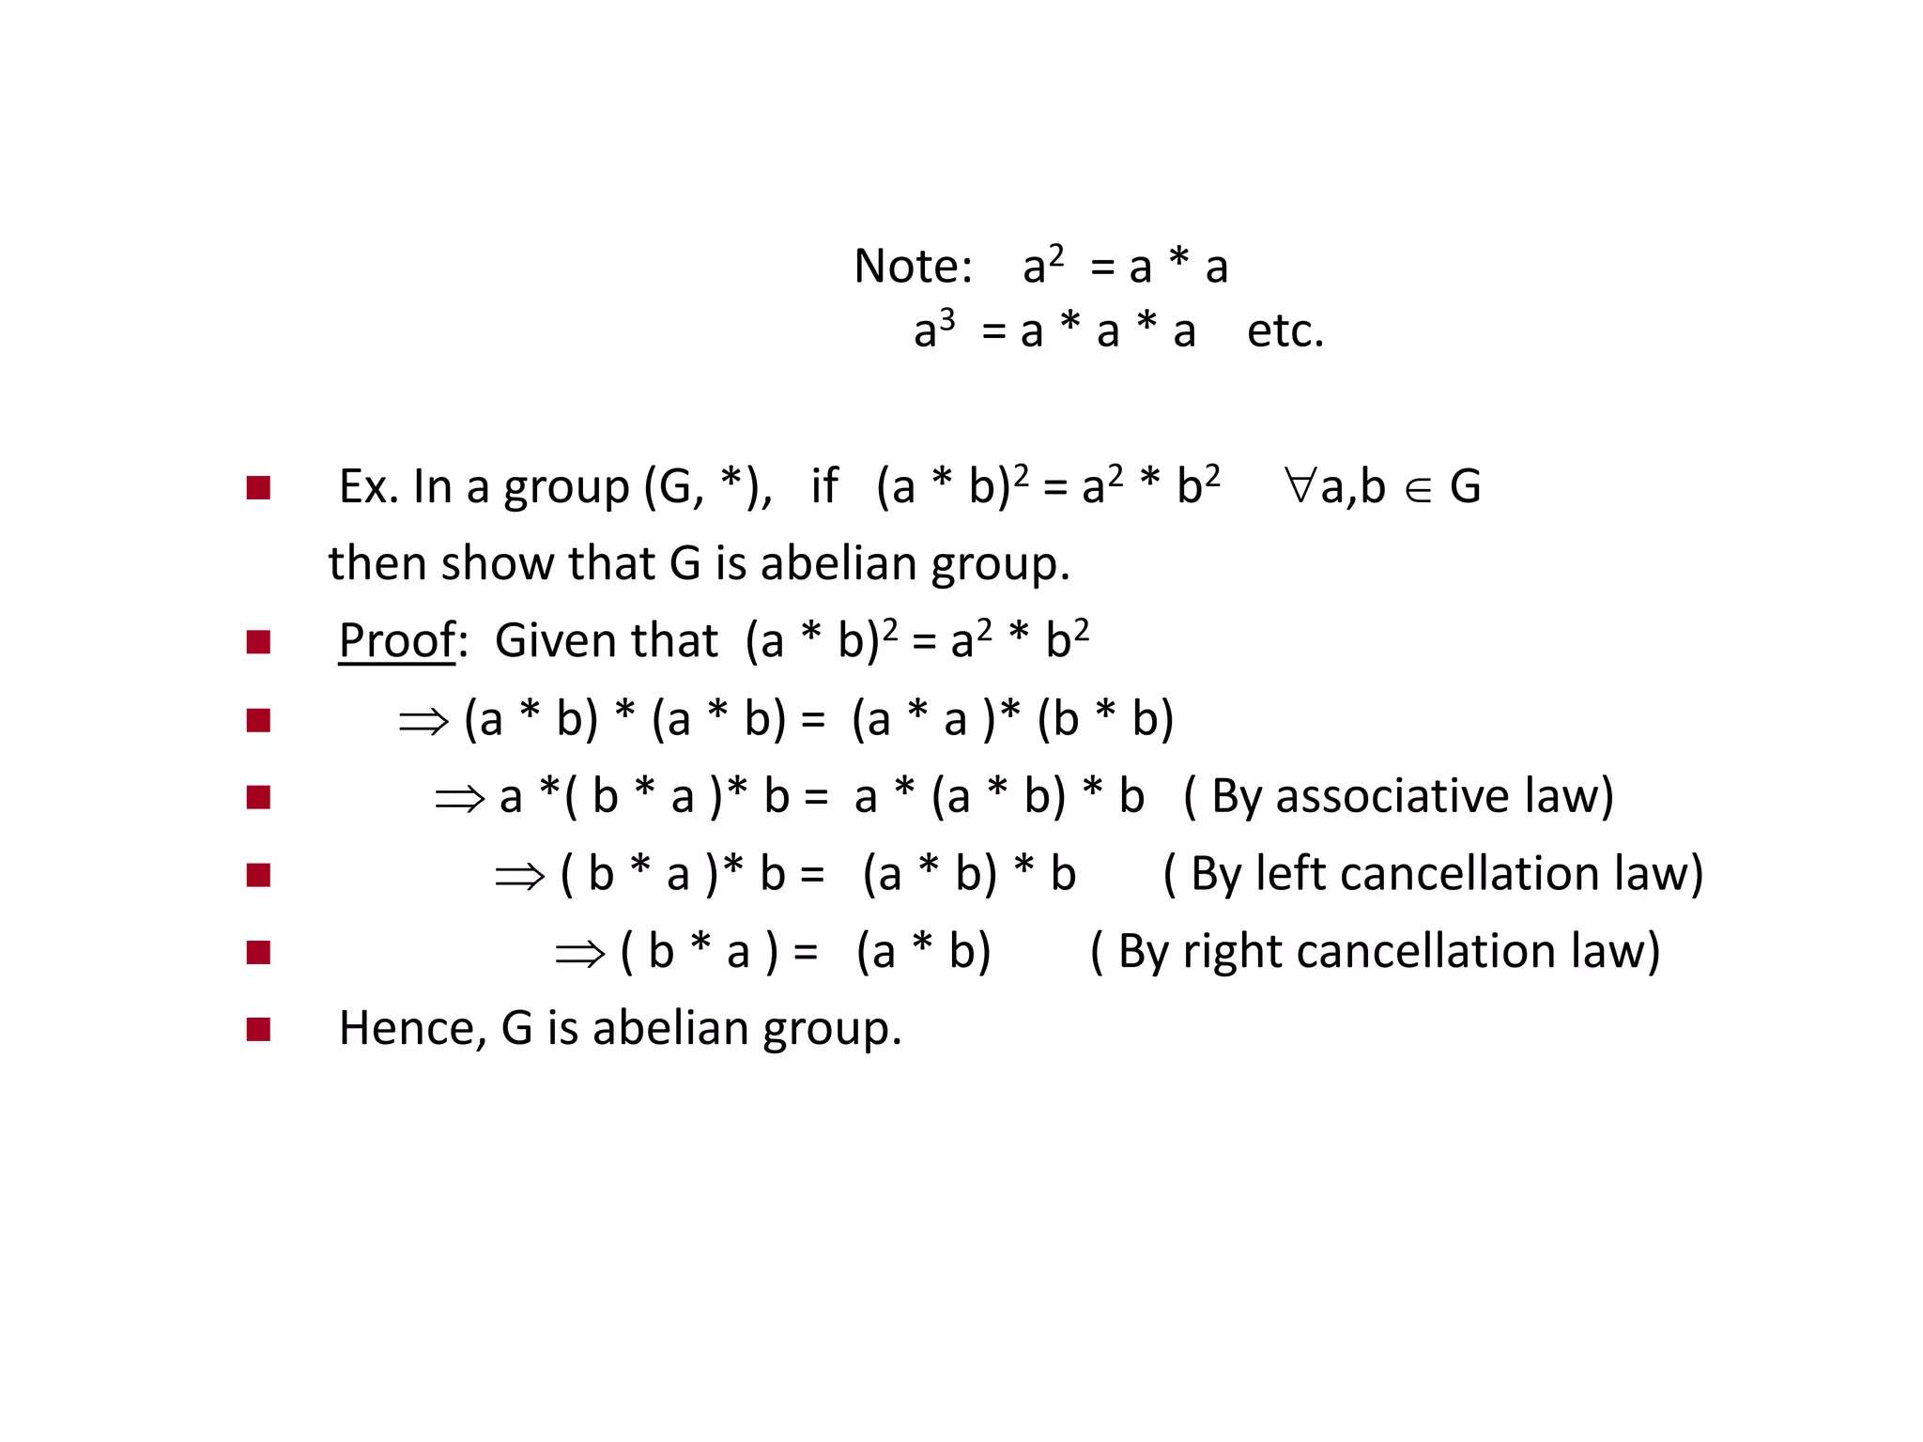

Slide 29
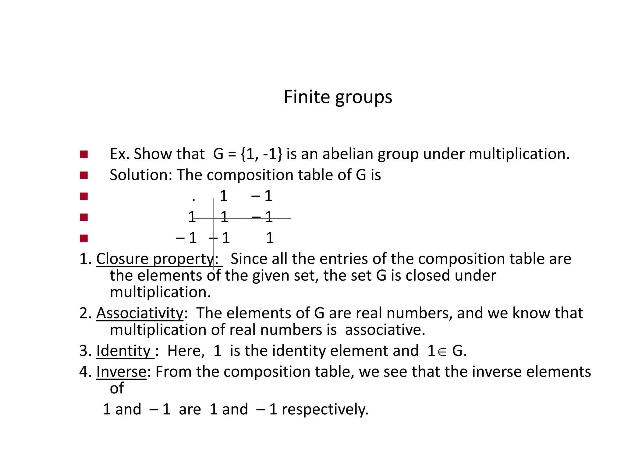

Slide 30
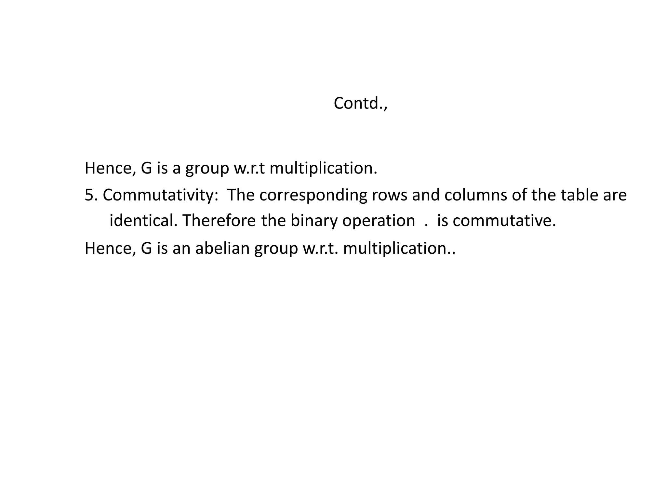

Slide 31
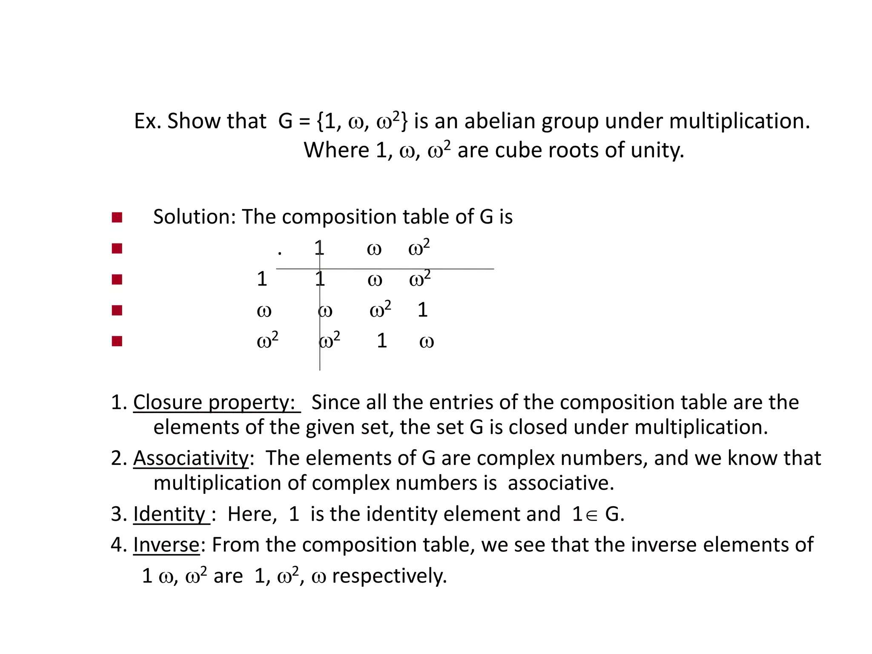

Slide 32
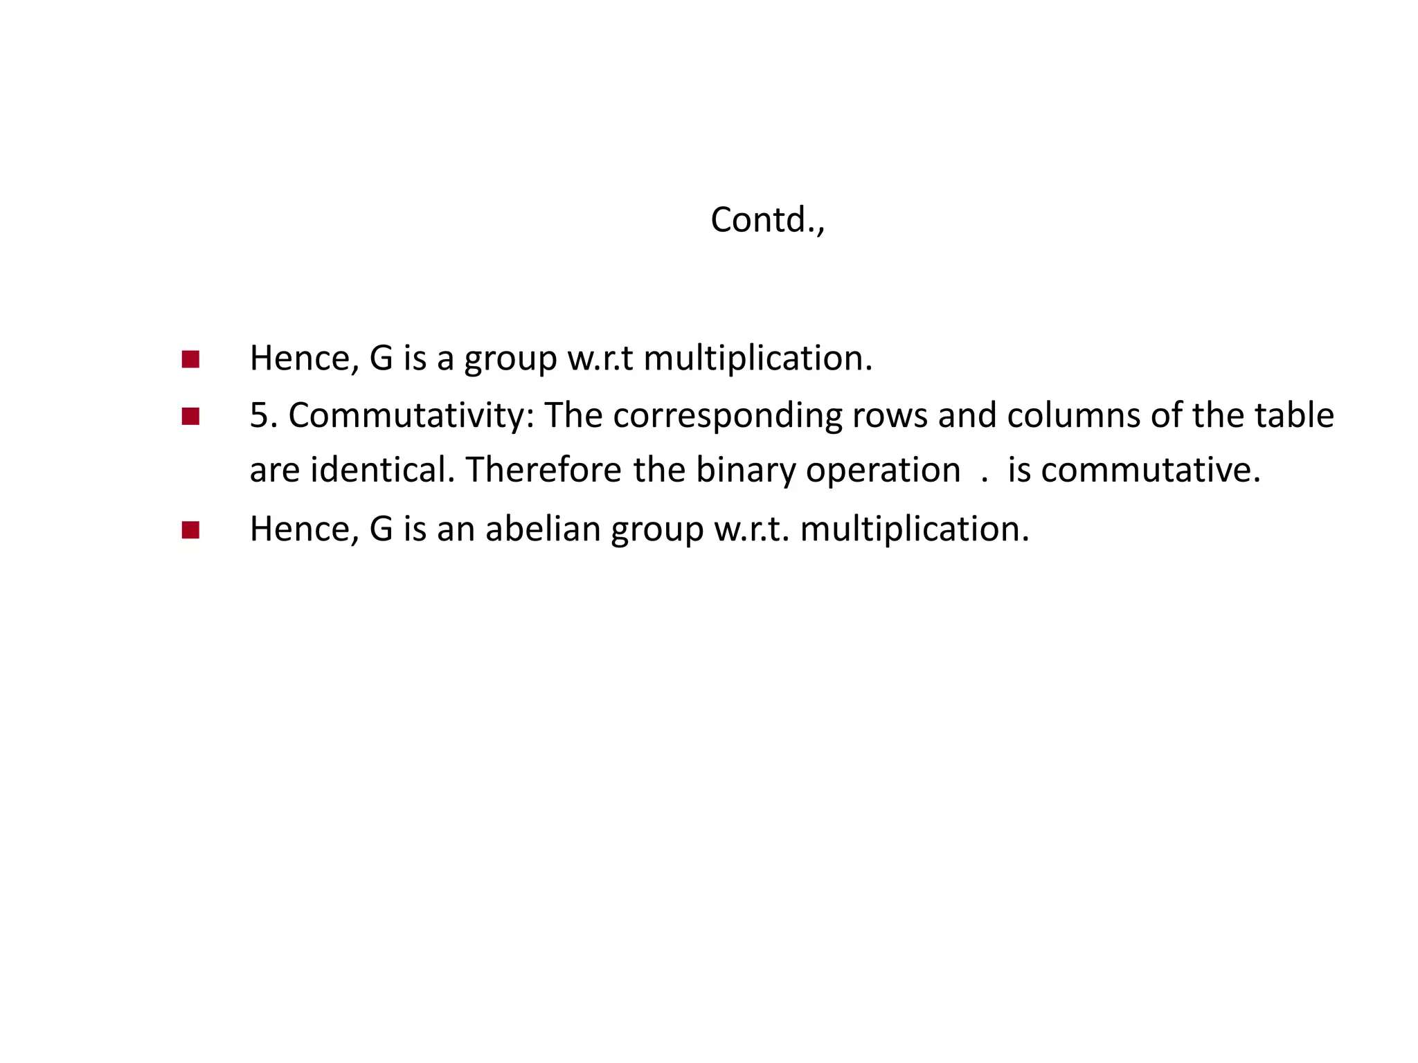

Slide 33
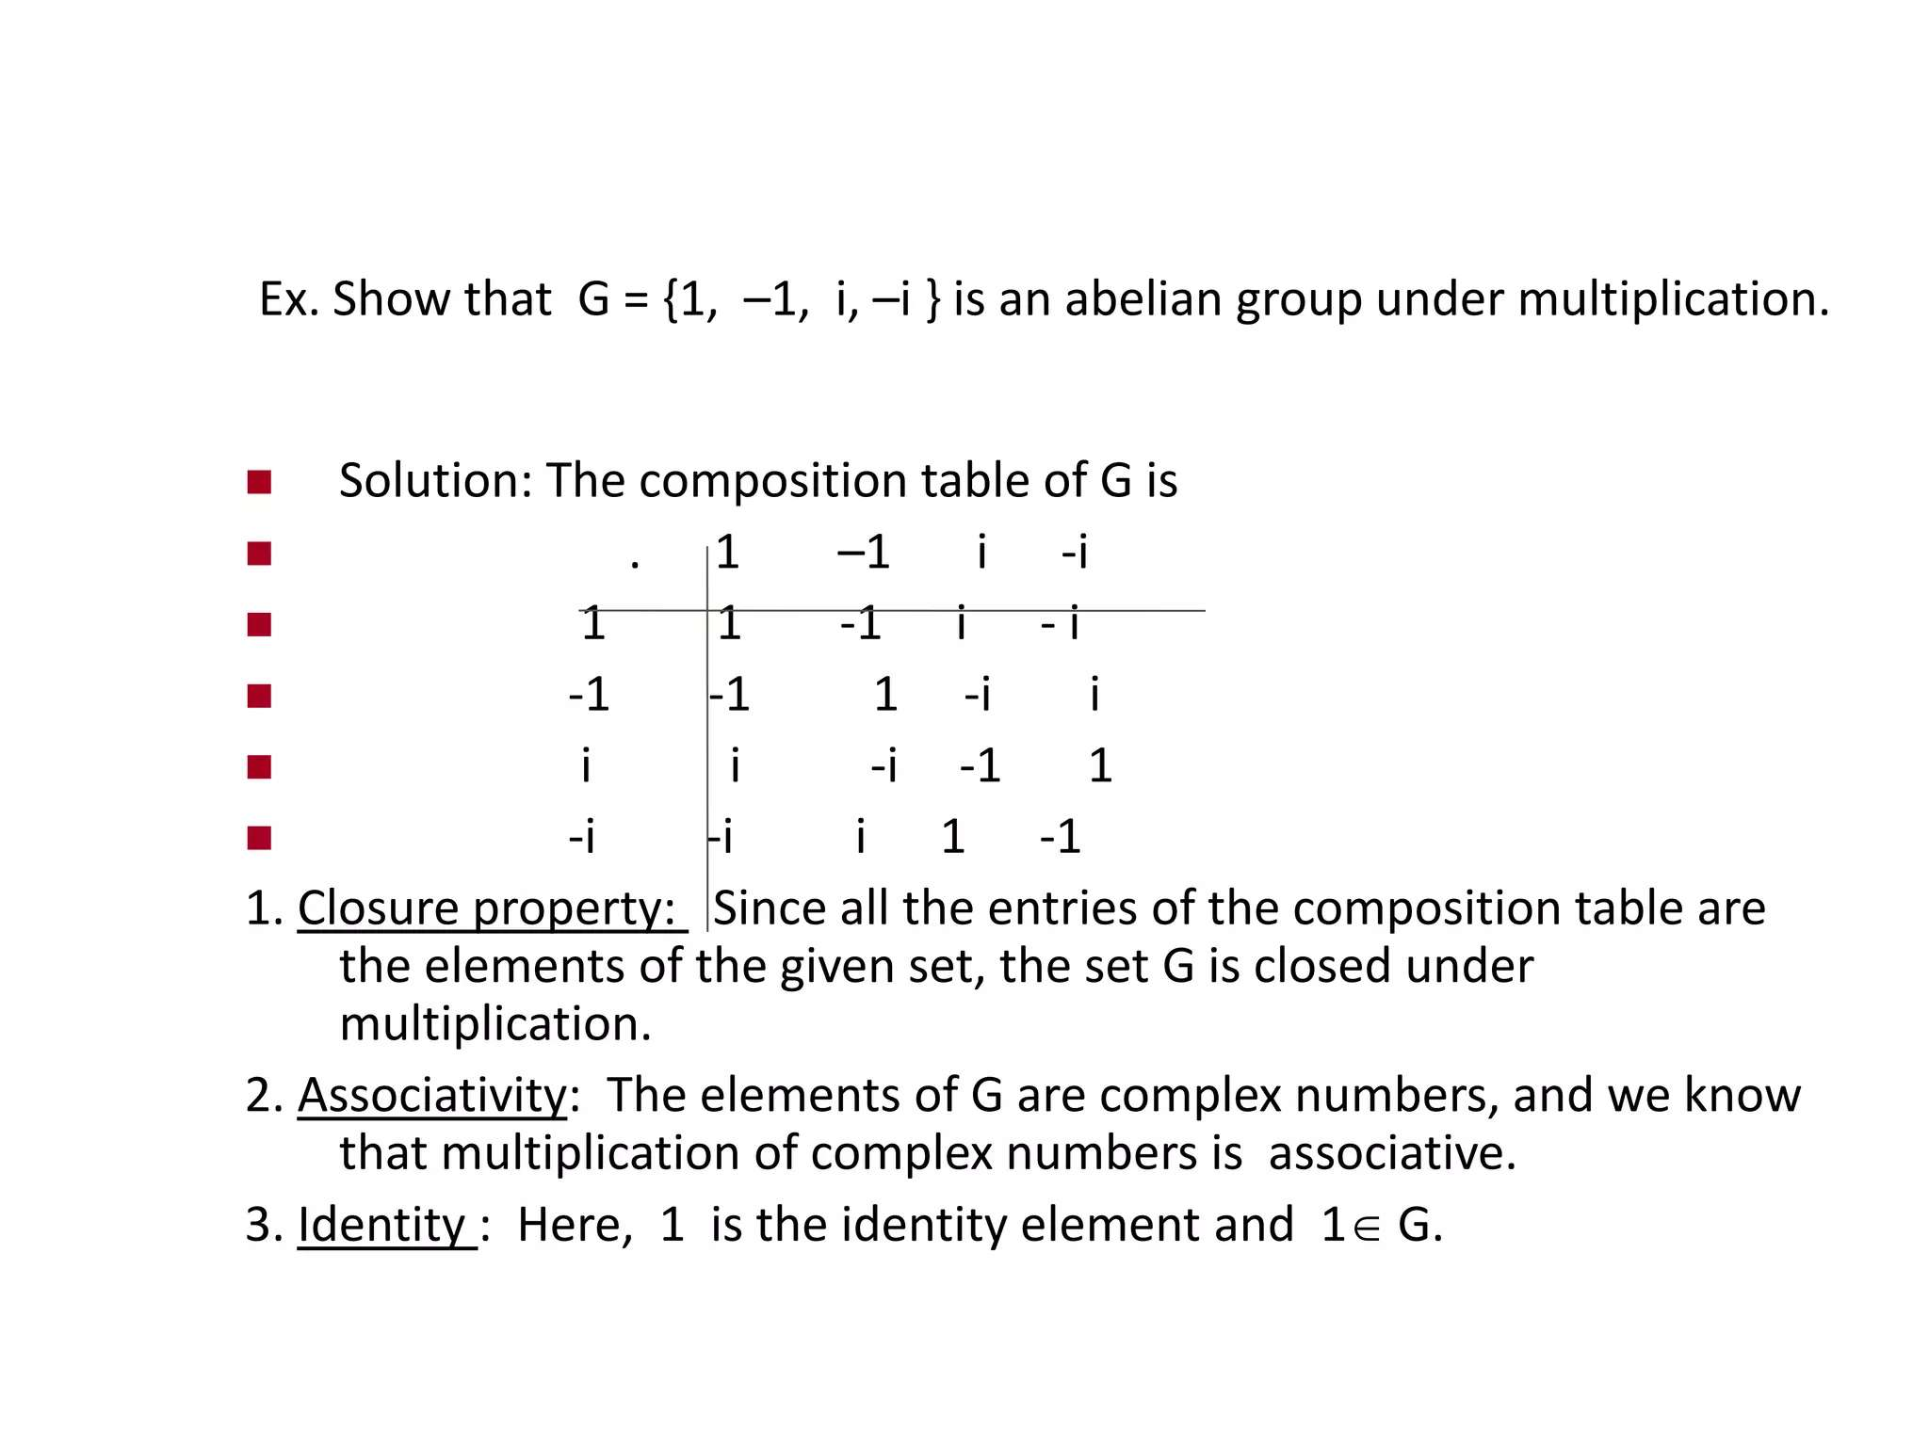

Slide 34
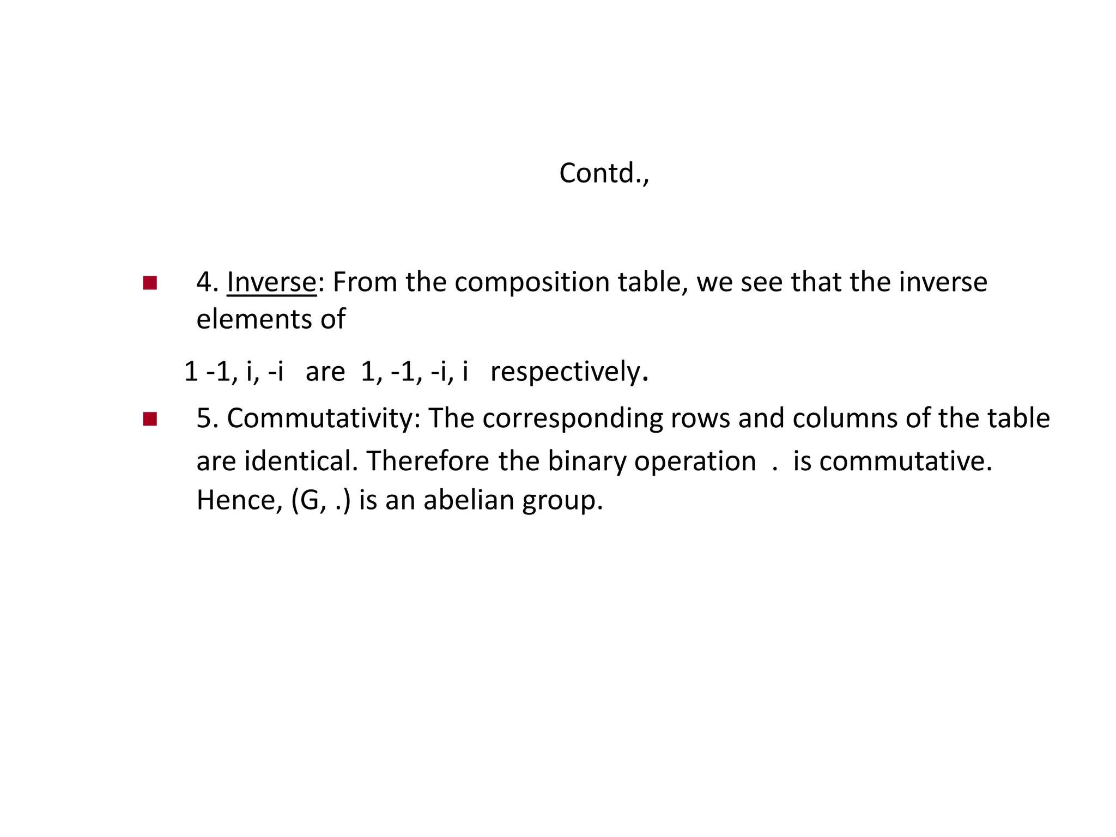

Slide 35
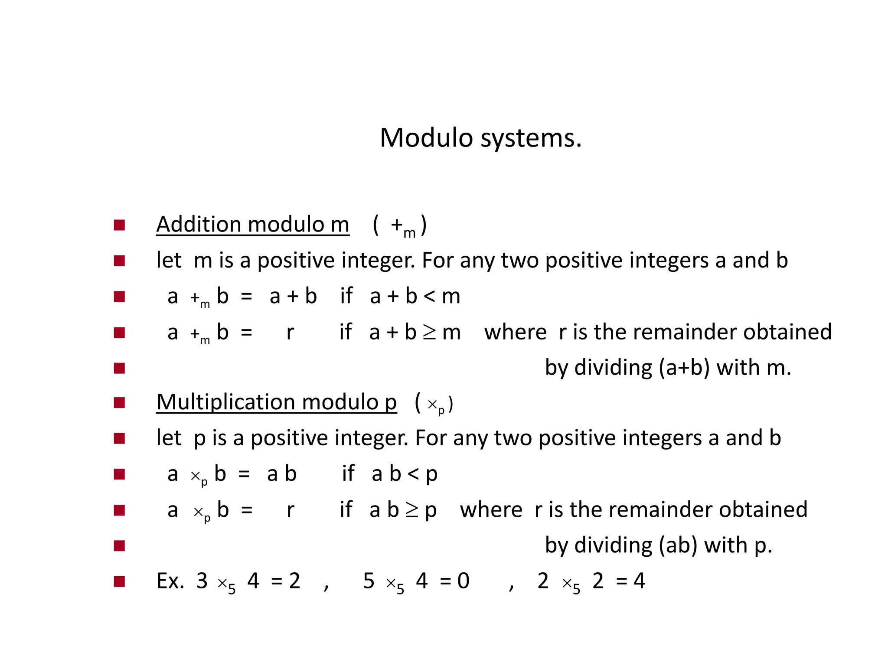

Slide 36
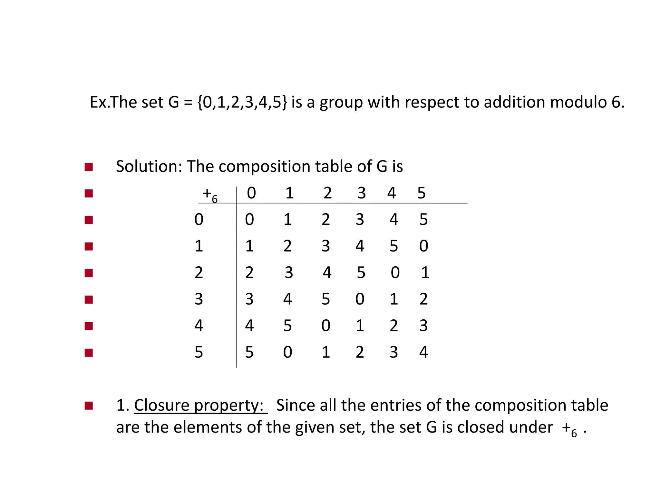

Slide 37
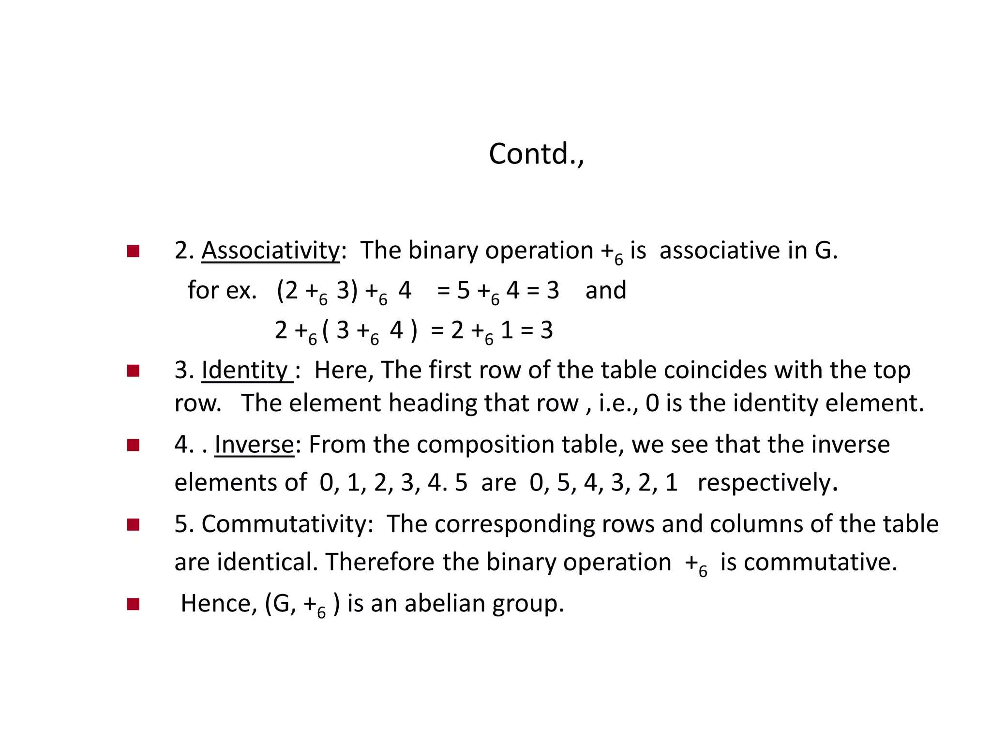

Slide 38
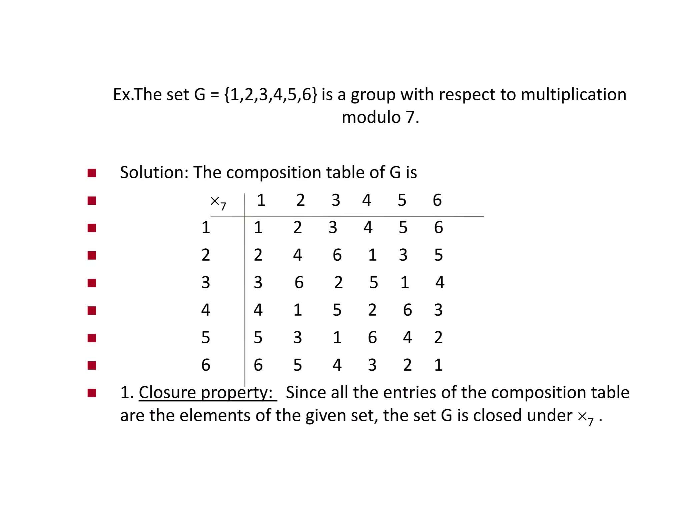

Slide 39
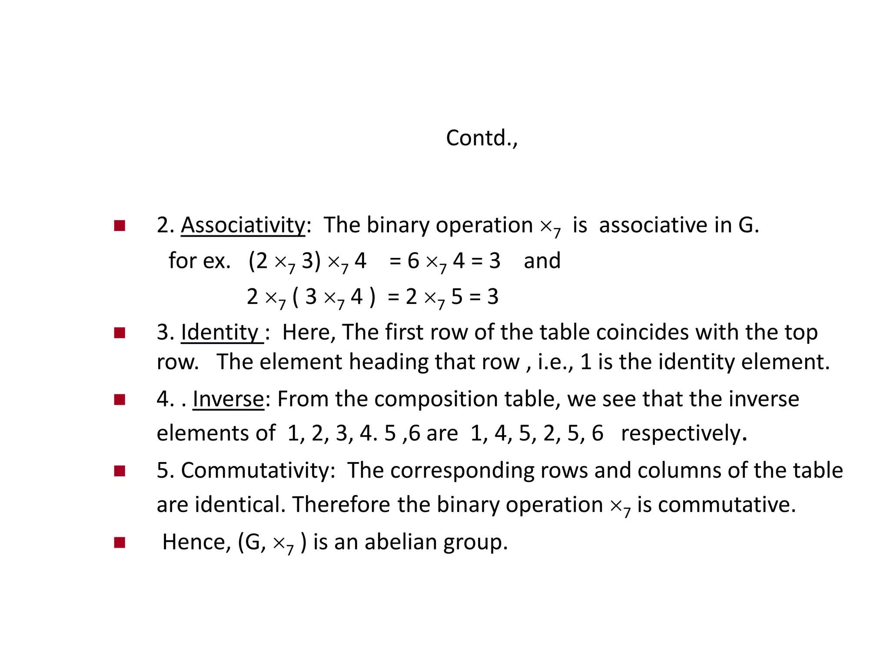

Slide 40
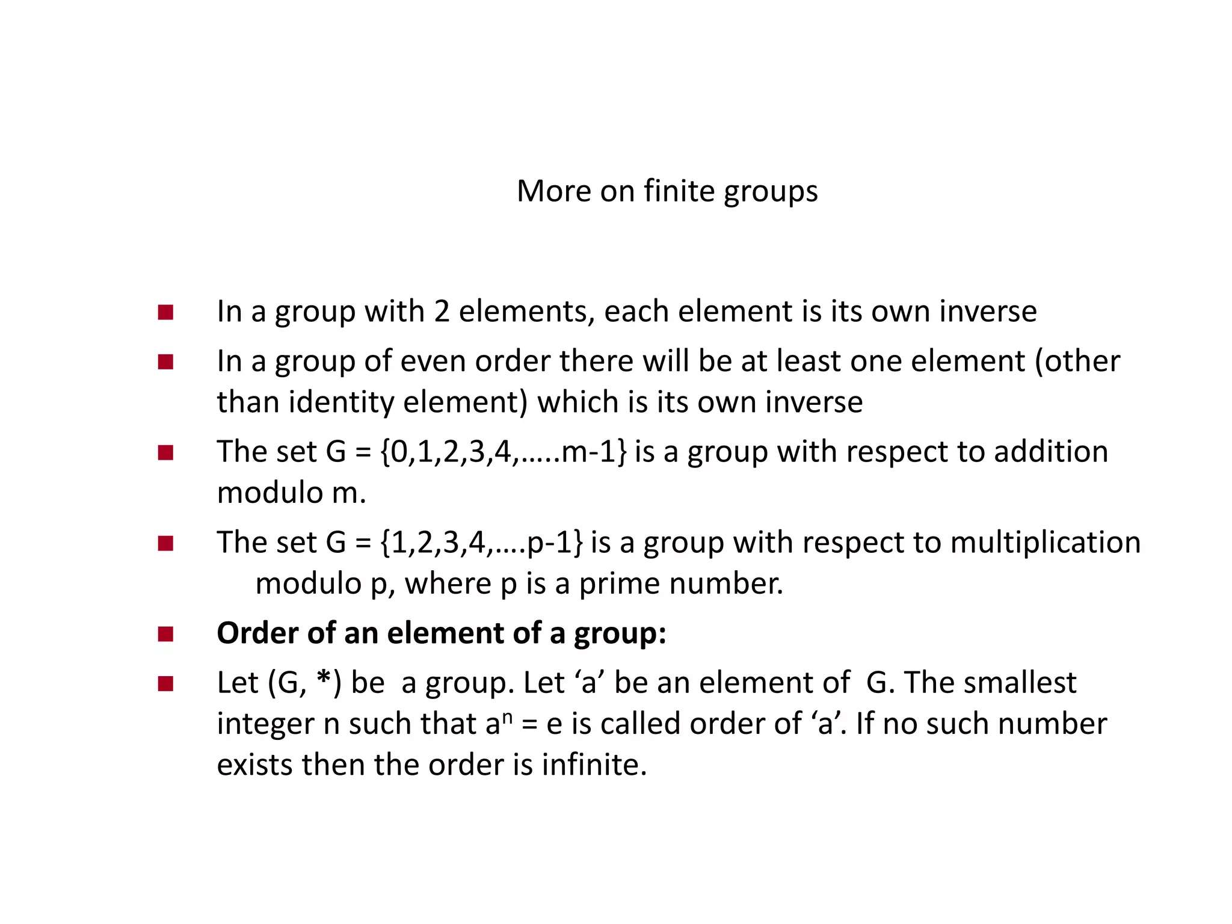

Slide 41
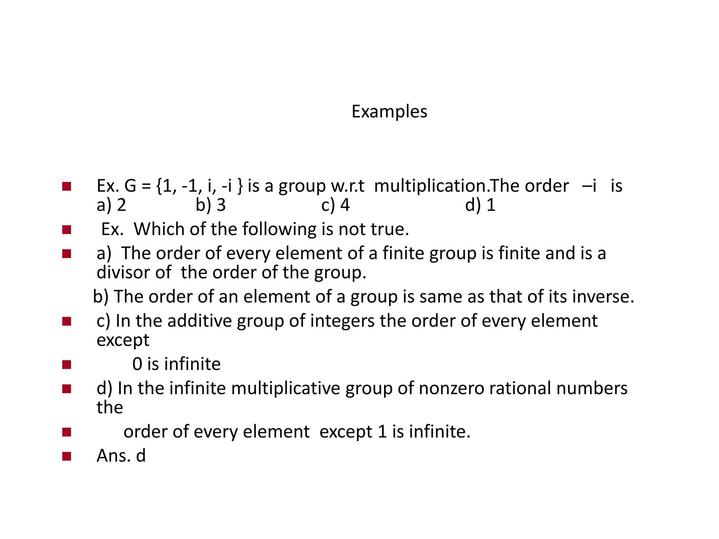

Slide 42
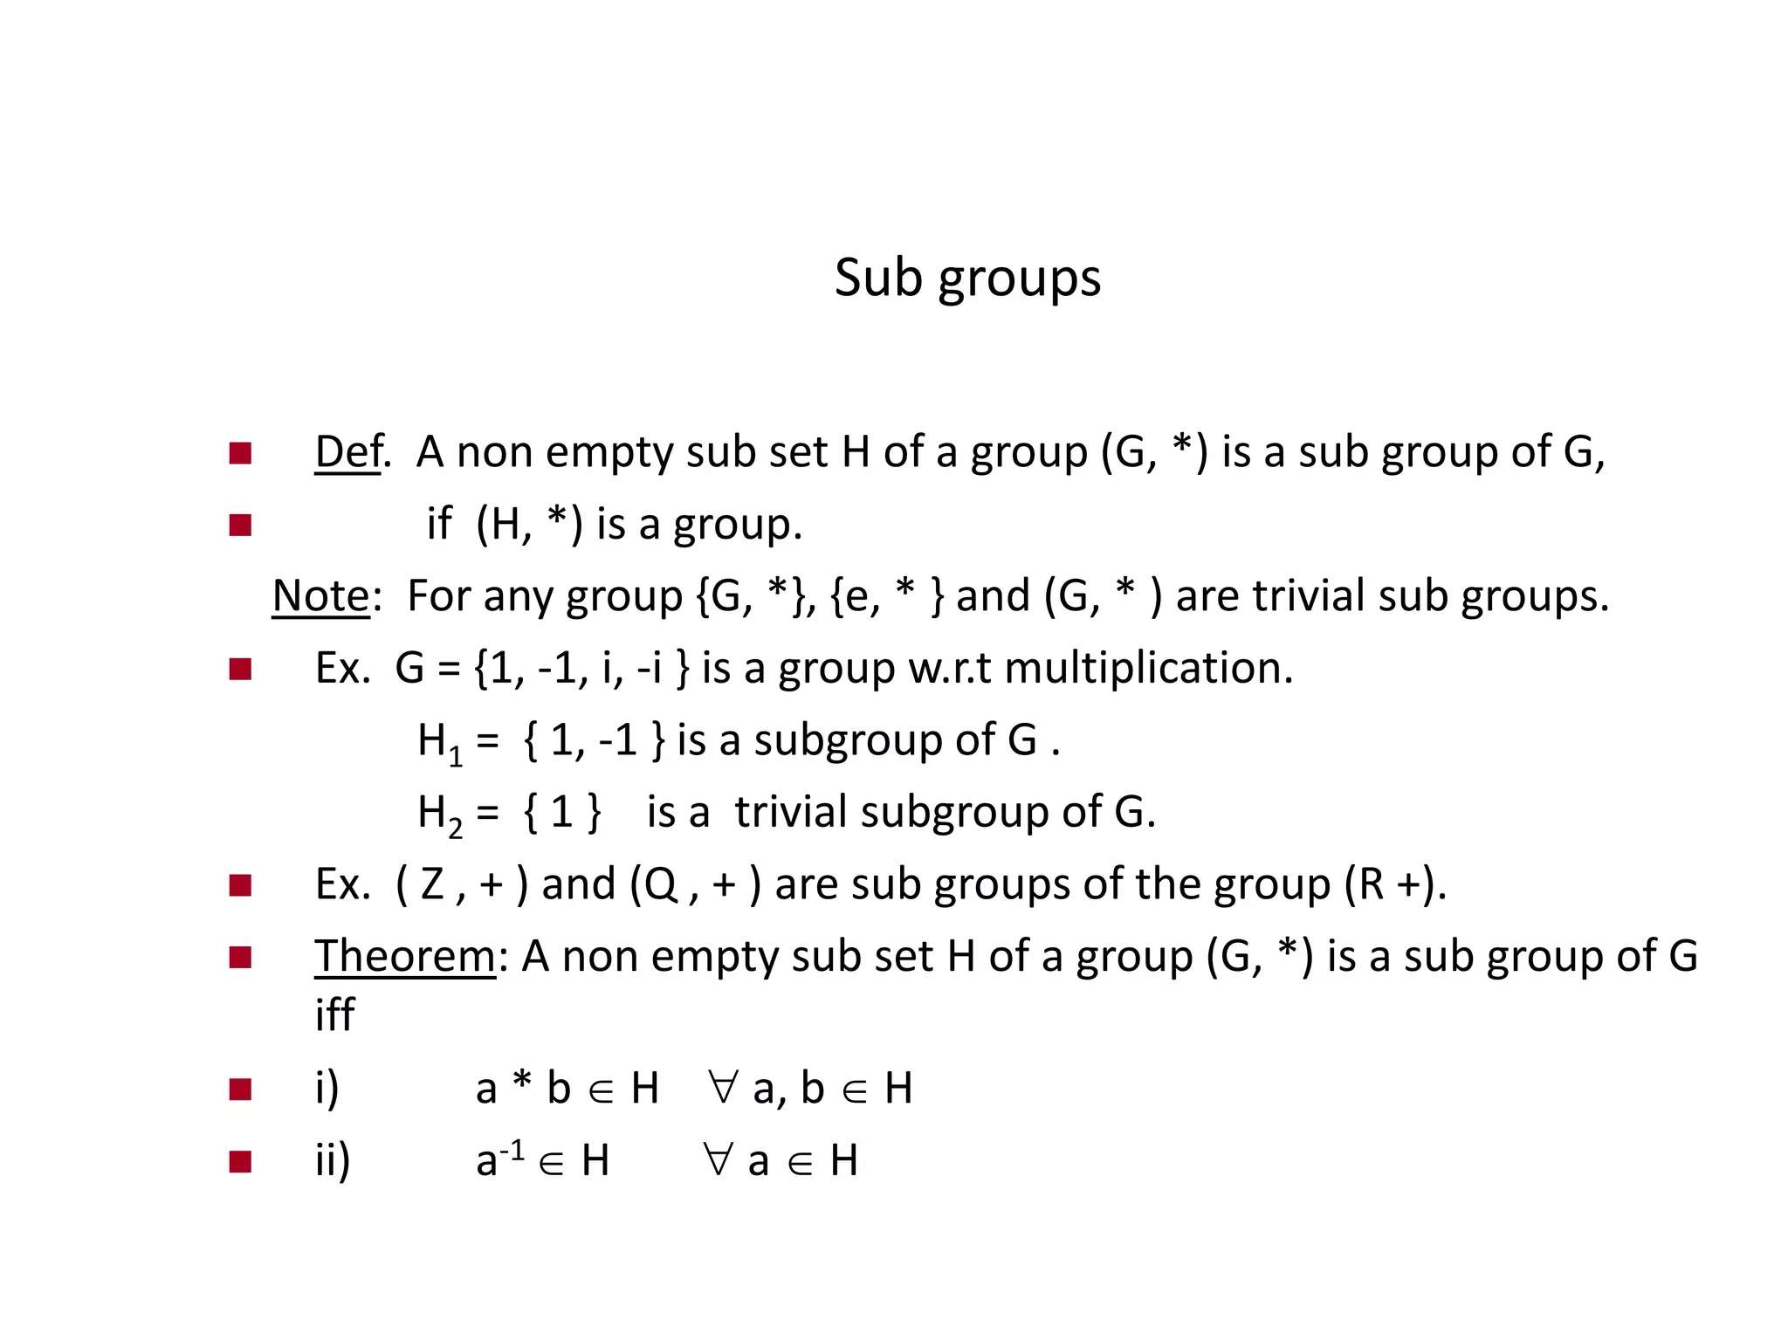

Slide 43
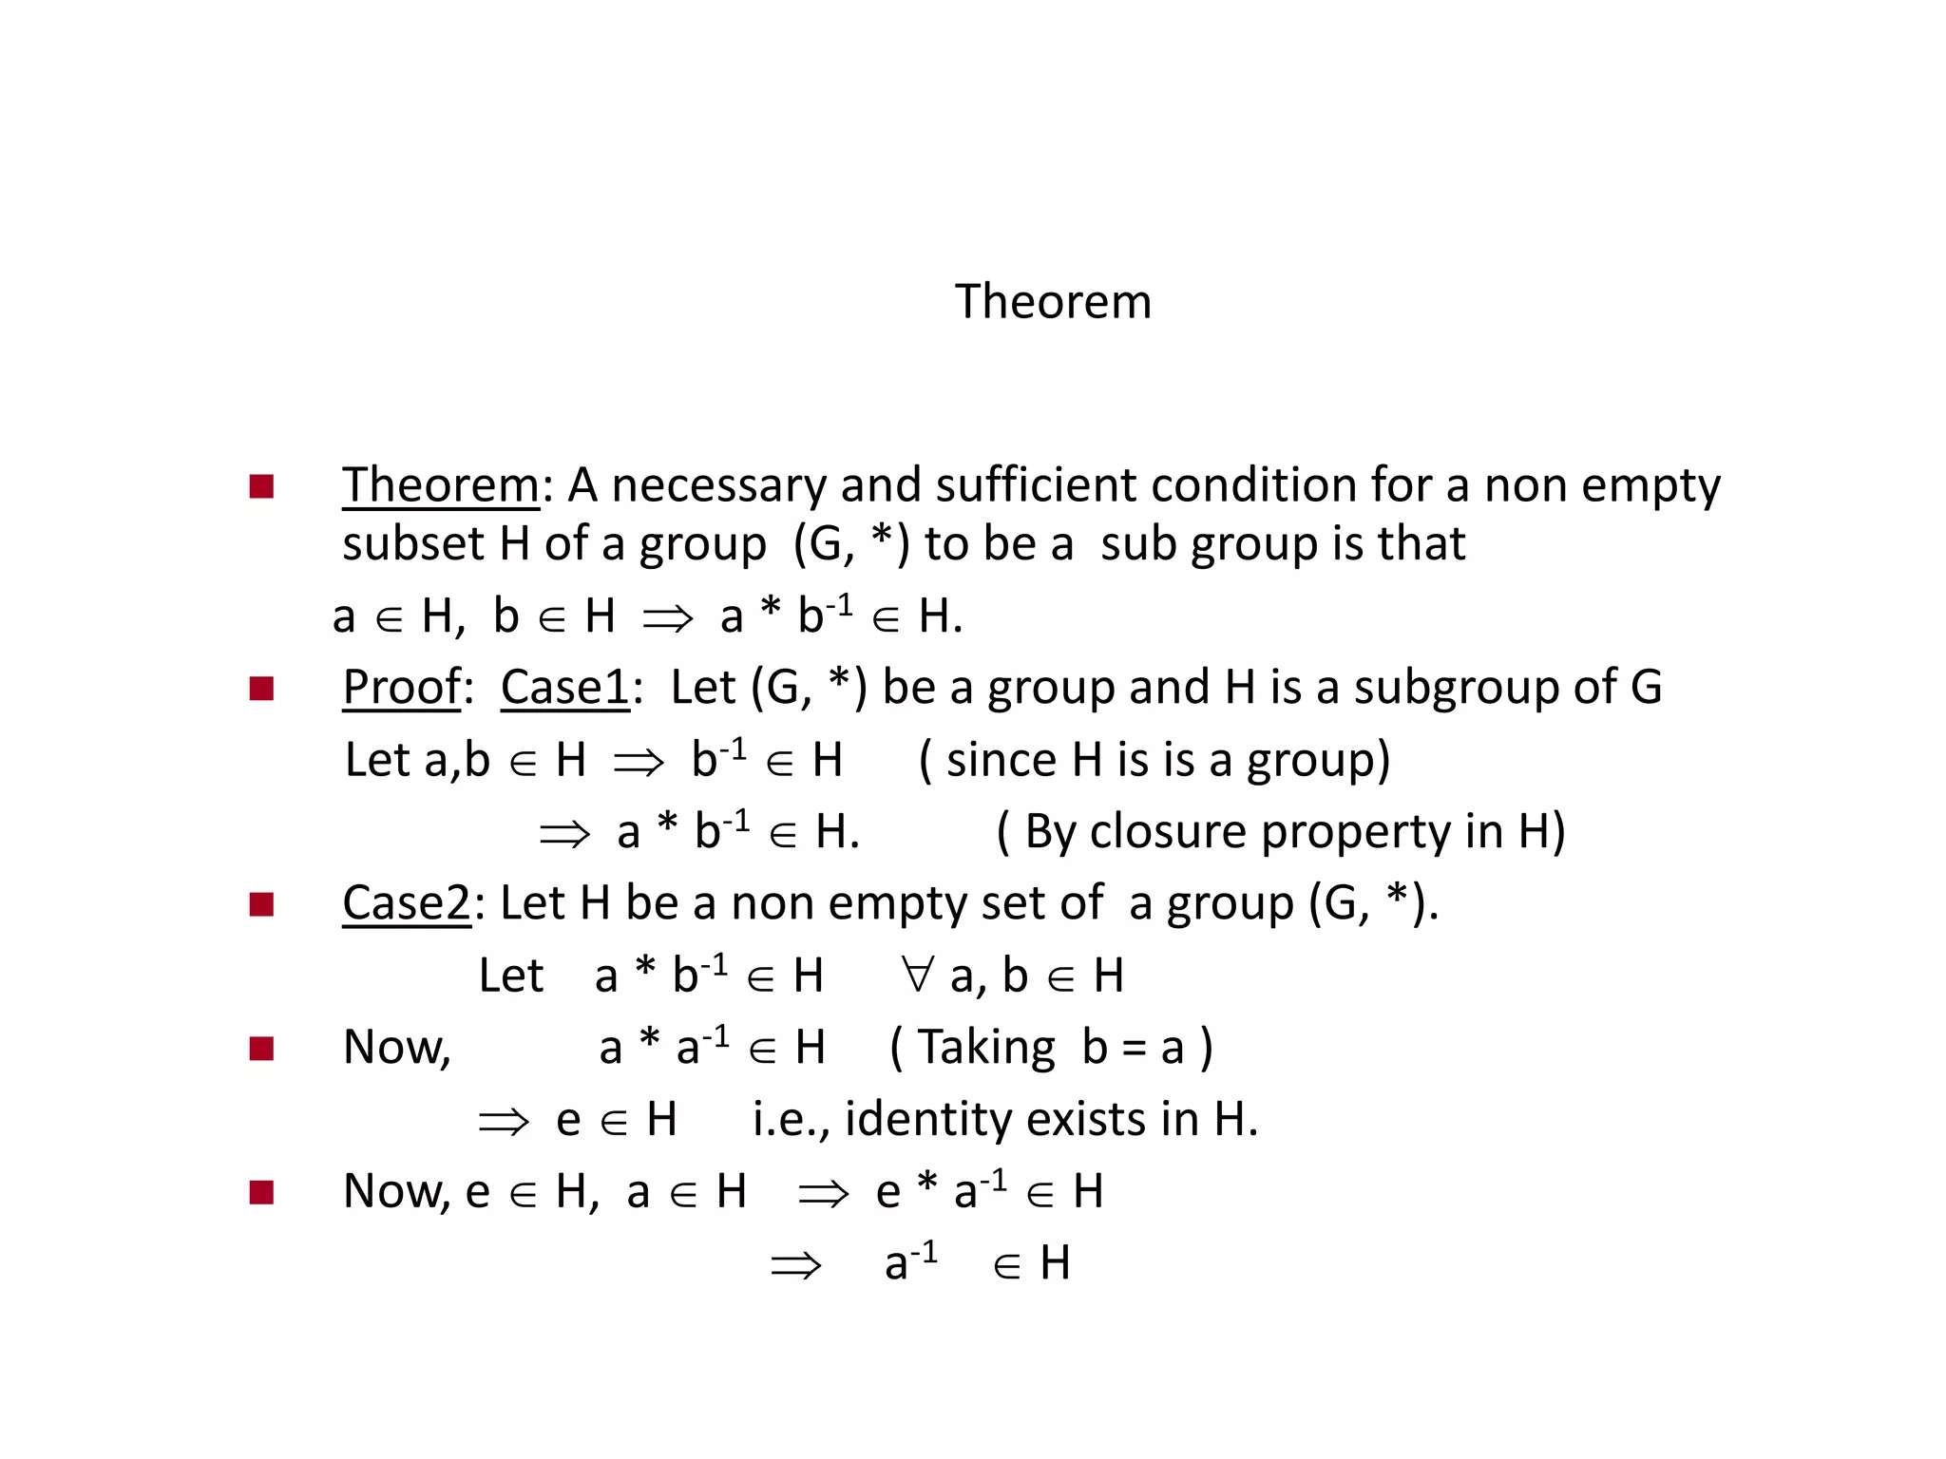

Slide 44
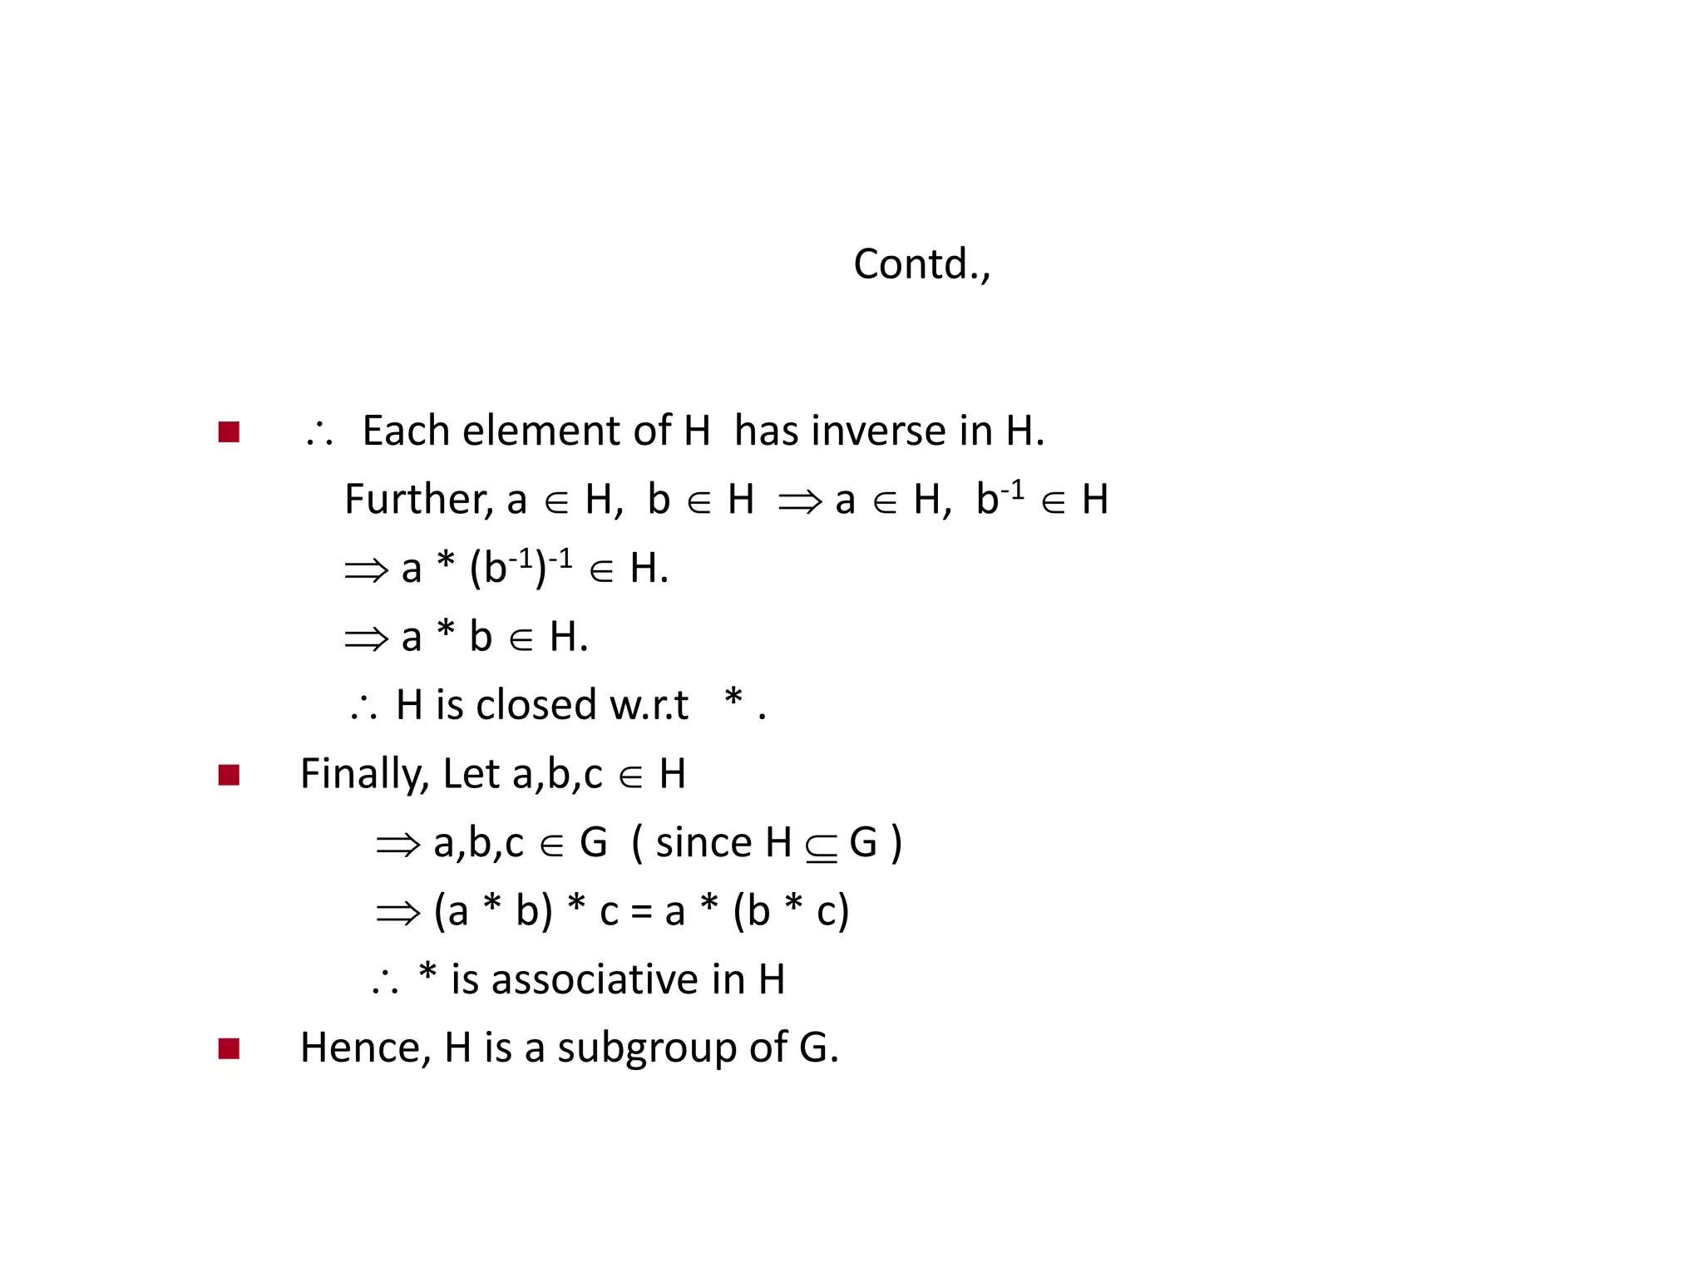

Slide 45
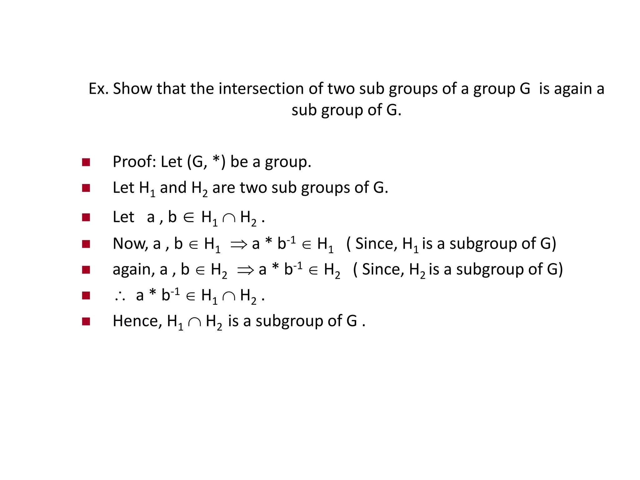

Slide 46
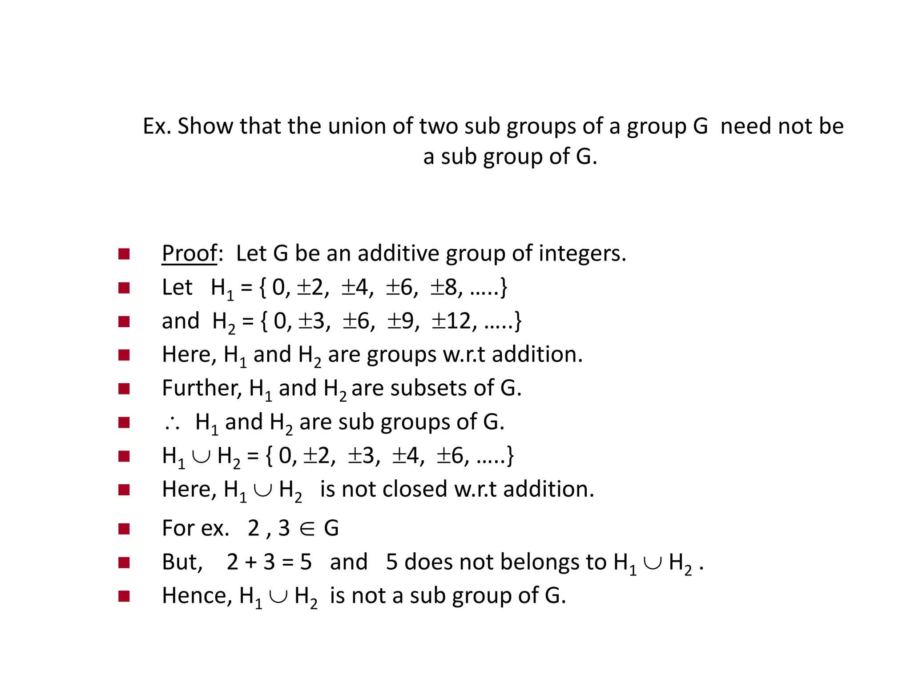

Slide 47
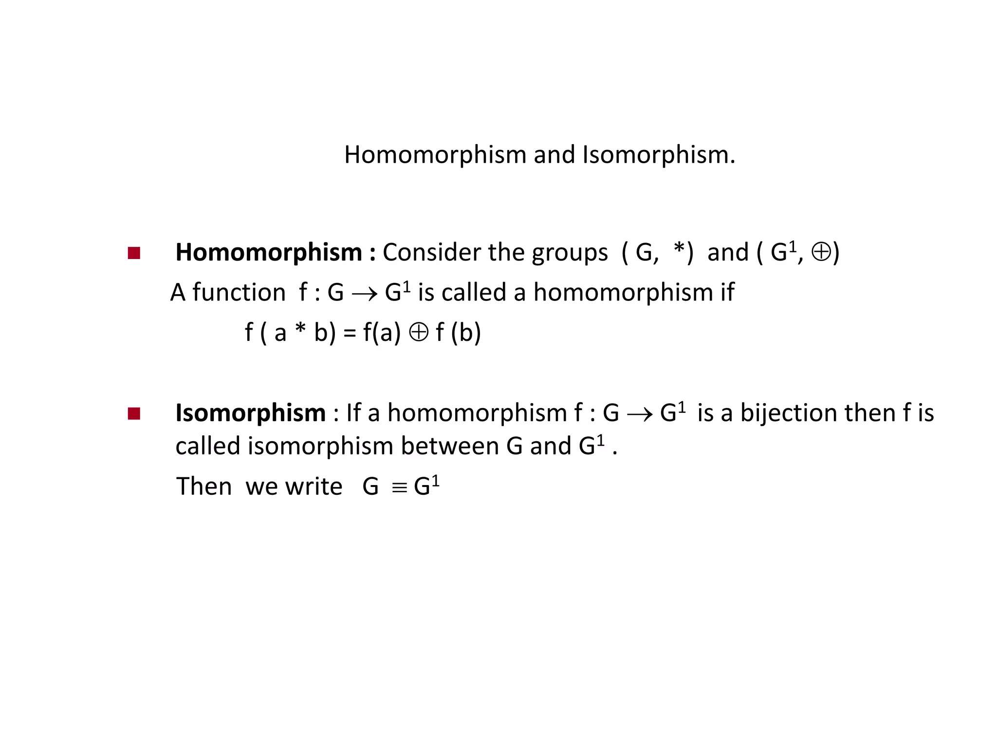

Slide 48
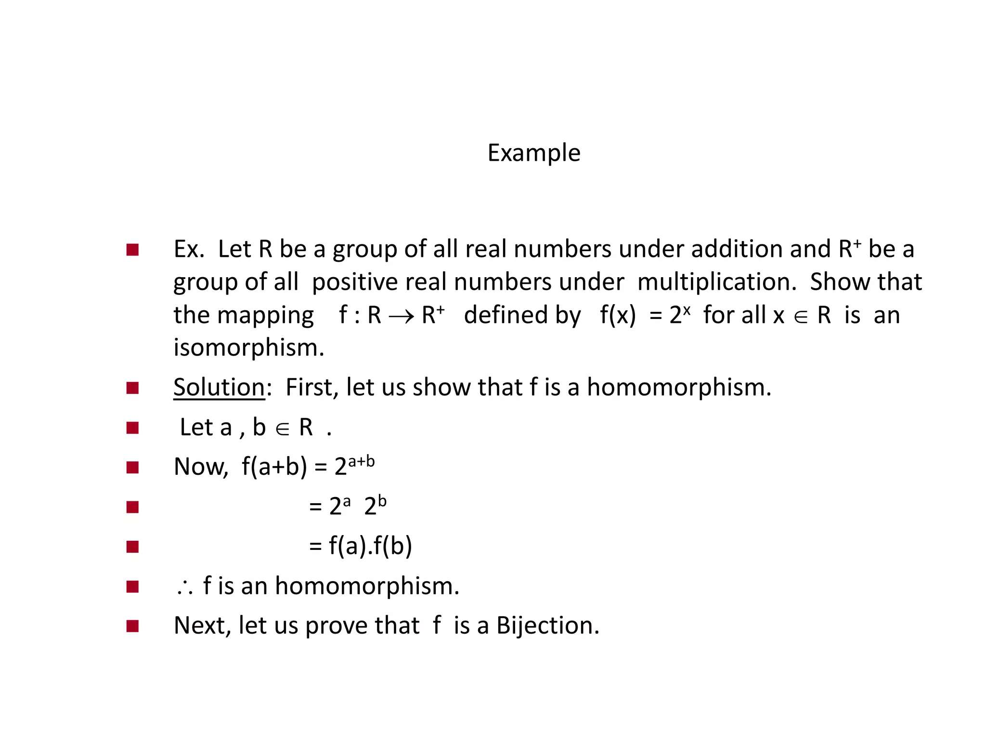

Slide 49
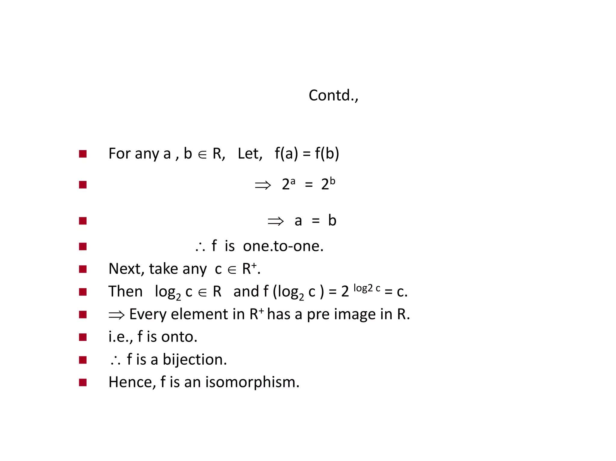

Slide 50
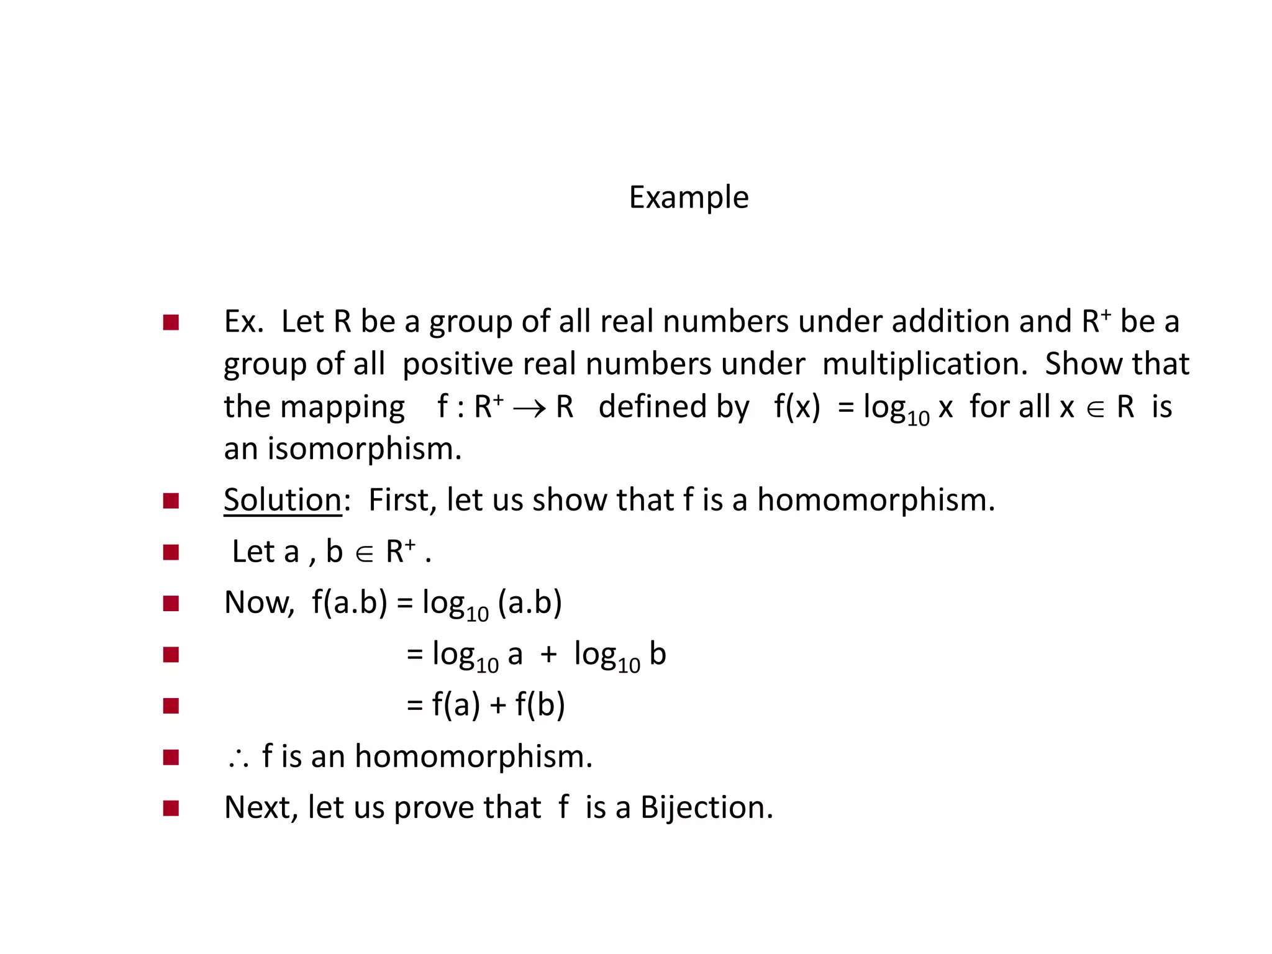

Slide 51


Slide 52


Slide 53


Slide 54


Slide 55


Slide 56
Homomorphism of Semigroups
Definition 3: Let [S;@] and [T;∙] are two algebraic system with a binary operation. A function ϕ from S to T is called a homomorphism from [S;*] to [T;∙] if
ϕ(a @ b) =ϕ(a) ∙ ϕ(b) for a , b S.

Slide 57




Homomorphism of Semigroups
Z_{m =} Integer modulo m
[Z₄ ,+] | 0 | 1 | 2 | 3 |  | [Z₁₀ ,×] | 1 | 3 | 7 | 9
0 | 0 | 1 | 2 | 3 |  | 1 | 1 | 3 | 7 | 9
1 | 1 | 2 | 3 | 0 |  | 3 | 3 | 9 | 1 | 7
2 | 2 | 3 | 0 | 1 |  | 7 | 7 | 1 | 9 | 3
3 | 3 | 0 | 1 | 2 |  | 9 | 9 | 7 | 3 | 1

Slide 58

Homomorphism of Semigroups
Z_{m =} Integer modulo m
[Z₄ ,+] | 0 | 1 | 2 | 3 |  | [Z₁₀ ,×] | 1 | 3 | 7 | 9
0 | 0 | 1 | 2 | 3 |  | 1 | 1 | 3 | 7 | 9
1 | 1 | 2 | 3 | 0 |  | 3 | 3 | 9 | 1 | 7
2 | 2 | 3 | 0 | 1 |  | 7 | 7 | 1 | 9 | 3
3 | 3 | 0 | 1 | 2 |  | 9 | 9 | 7 | 3 | 1

Slide 59


Isomorphism of Semigroups
Definition 4: Let ϕ be a homomorphism from [S;*] to [T;∙]. ϕ is called an isomorphism if ϕ is also one- to-one correspondence (one-to-one+onto).
We say that two algebraic systems [S;*] and [T;∙]
are isomorphism, if there exists an function. Denoted by
[S;*] [T;∙](S T)
Given example is also an isomorphism
isomorphic

Slide 60

Example
◼

Slide 61

Example
◼

Slide 62

Theorem

Slide 63
Morphism of Monoids
Definition 3: Let [S;@] and [T;∙] are two monoids with identities e , e’. A function ϕ from S to T is called a morphism from [S;
*] to [T;∙] if
ϕ(a @ b) = ϕ(a) ∙ ϕ(b) for a , b S and ϕ(e) = e’

Slide 64

Morphism of Monoids

Slide 65

Morphism of Monoids

Slide 66

Permutation Group
◼

Slide 67

Permutation Group
◼

Slide 68
Rings
A ring (R,+, ·) is a set R, together with two binary operations + and · on R satisfying the following axioms. For any elements a, b, c ∈ R,
  (a + b) + c = a + (b + c). (associativity of addition)
  a + b = b + a. (commutativity of addition)
  there exists 0 ∈ R, called the zero, such that a + 0 = a. (existence of an additive identity)

Slide 69
Rings
A ring (R,+, ·) is a set R, together with two binary operations + and · on R satisfying the following axioms. For any elements a, b, c ∈ R,
  there exists (−a) ∈ R such that a + (−a) = 0.(existence of an additive inverse)
  (a · b) · c = a · (b · c). (associativity of multiplication)

Slide 70
Rings
(vi) there exists 1 ∈ R such that
1· a = a · 1 = a. (existence of multiplicative identity)
(vii)
a · (b + c) = a · b + a · c
and (b + c)· a = b · a + c · a.(distributivity)
Axioms (i)–(iv) are equivalent to saying that (R,+) is an abelian group.
The ring (R,+, ·) is called a commutative ring if, in addition,
(viii) a · b = b · a for all a, b ∈ R. (commutativity of multiplication)
38

Slide 71

Rings
◼

Slide 72
Integral Domain
A commutative ring R is an integral domain if R has no zero divisors, i.e if ab = 0 implies a = 0 and b = 0.

Slide 73

Example
Prove that if x2 = 1 in an integral domain D, then x = −1 or x = 1

Slide 74

Field
◼

Slide 75


Slide 76


Slide 77

Let G be an abelian group and let n be a fixed positive integer. Show that the function f : G → G defined by f (a) = an is a homomorphism.
=>
f is a homomorphism, i.e., for all a,b∈
f(ab)=f(a)f(b)
f(ab)=f(a)f(b)⇒f is a group homomorphism

Slide 78


