Slide 1

Mathematical Induction
Amartya Kundu Durjoy
Lecturer, CSE, UGV

Slide 2
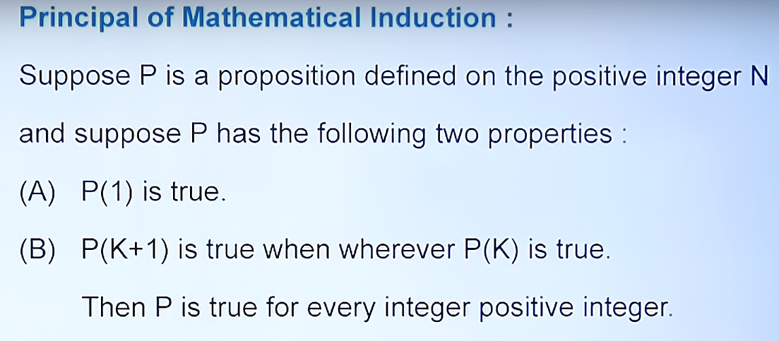
Principle of mathematical Induction

Slide 3
To complete the inductive step of a proof using the principle of mathematical induction, we assume that P(k)is true for an arbitrary positive integer k and show that under this assumption, P(k+1) must also be true. The assumption that P(k) is true is called the inductive hypothesis.
In the inductive step, we show that ∀k(P(k) → P(k+ 1)) is true, where again, the domain is the set of positive integers.
Expressed as a rule of inference, this proof technique can be stated as
(P(1) ∧∀k(P(k)→ P(k+1))) →∀nP(n)
when the domain is the set of positive integers.

Slide 4
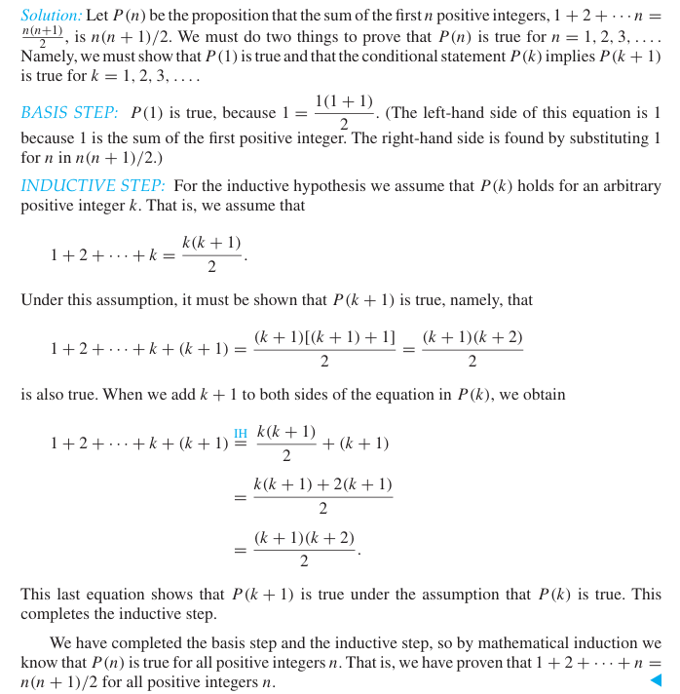
Example-1
Answer
Show that if n is a positive integer, then
1 +2+···+n= n(n+1)/ 2 .

Slide 5
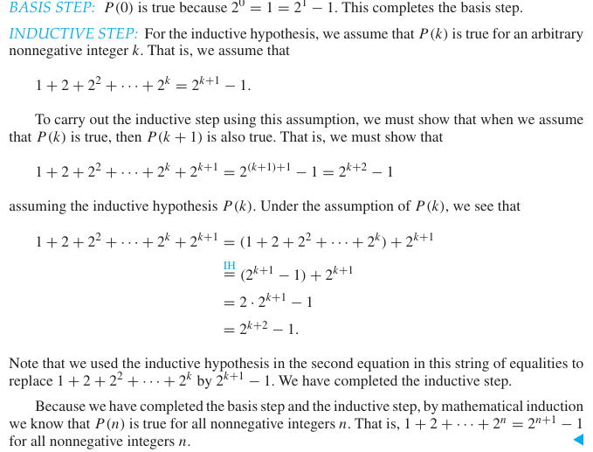
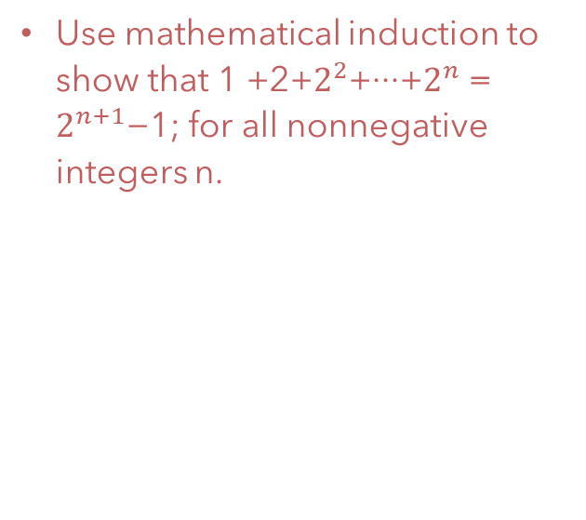
Example-2
Answer:
Use mathematical induction to show that 1 +2+$2^{2}$+···+$2^{n}$ = $2^{n+1}$−1; for all nonnegative integers n.

Slide 6
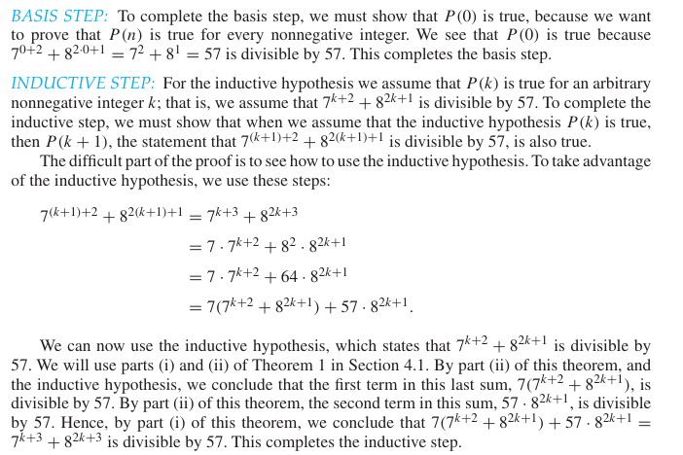
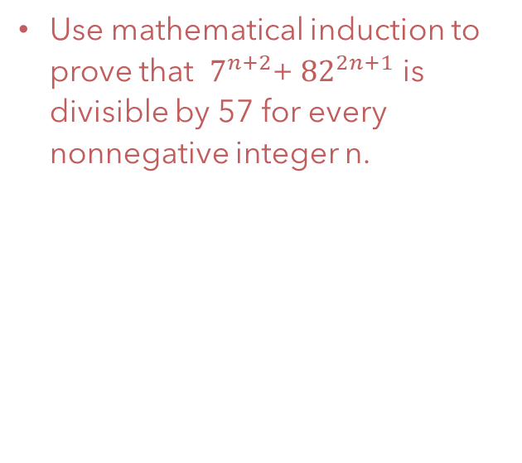
Example-3
Answer:
Use mathematical induction to prove that $7^{n+2}$+ ${82}^{2n+1}$ is divisible by 57 for every nonnegative integer n.

Slide 7
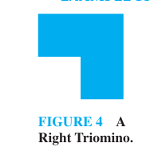
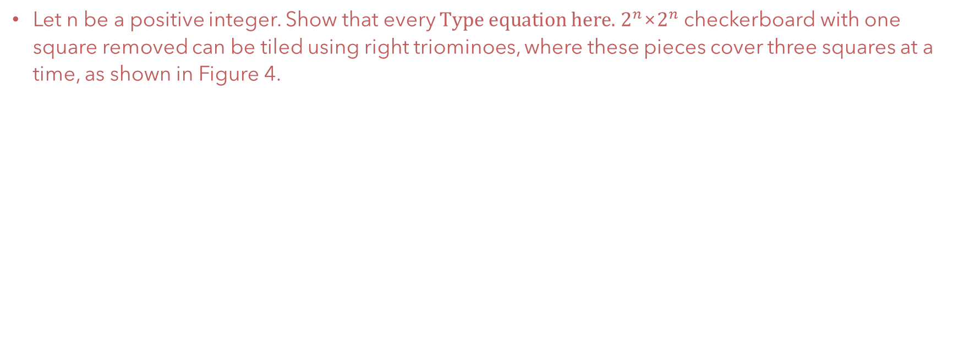
Example-4
Let n be a positive integer. Show that every $2^{n}$×$2^{n}$ checkerboard with one square removed can be tiled using right triominoes, where these pieces cover three squares at a time, as shown in Figure 4.

Slide 8
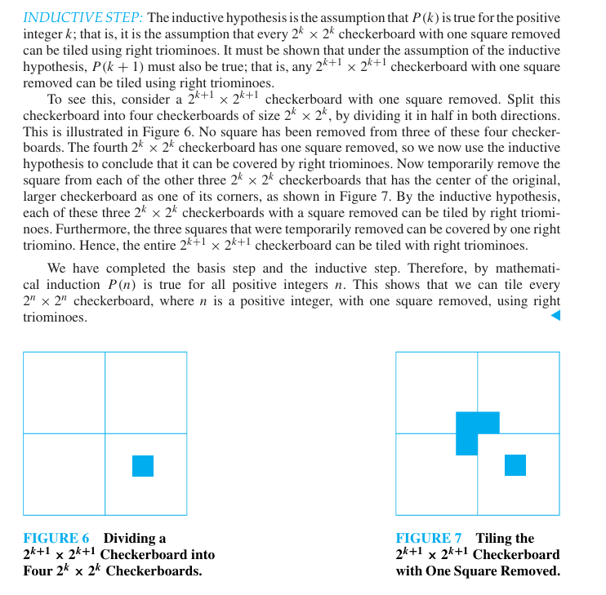

Answer:

Slide 9
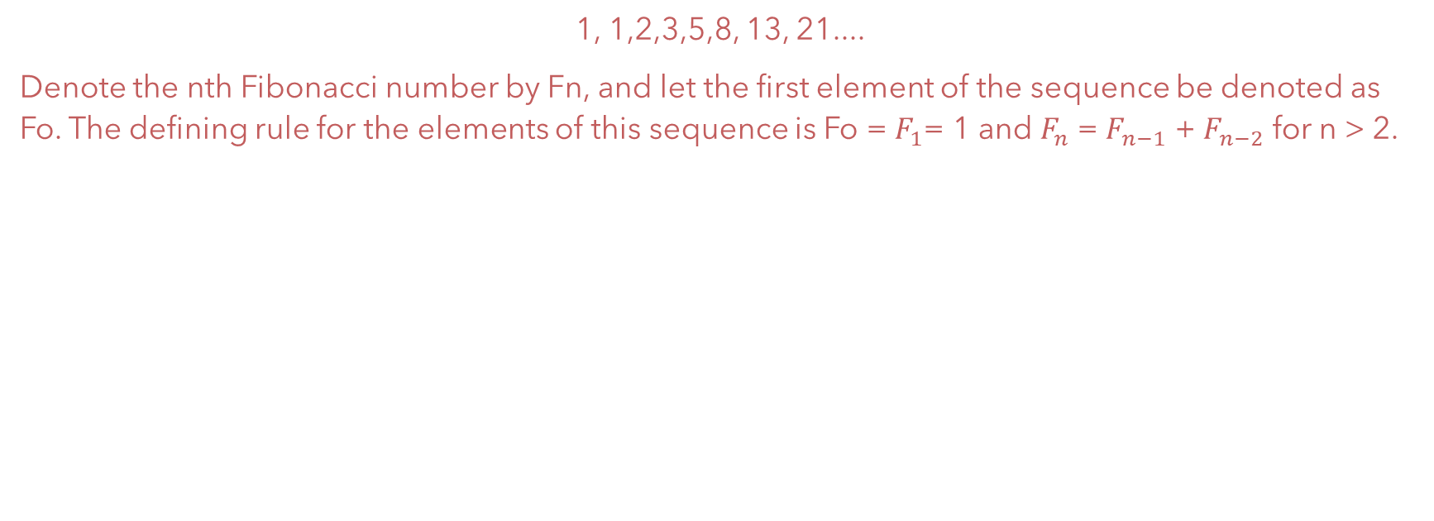
Fibonacci Numbers
1, 1,2,3,5,8, 13, 21....
Denote the nth Fibonacci number by Fn, and let the first element of the sequence be denoted as Fo. The defining rule for the elements of this sequence is Fo = $F_{1}$= 1 and $F_{n}$ = $F_{n−1}$ + $F_{n−2}$ for n > 2.

Slide 10
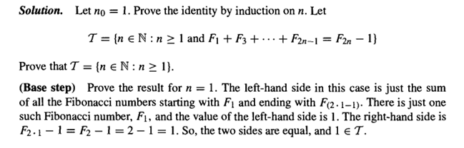
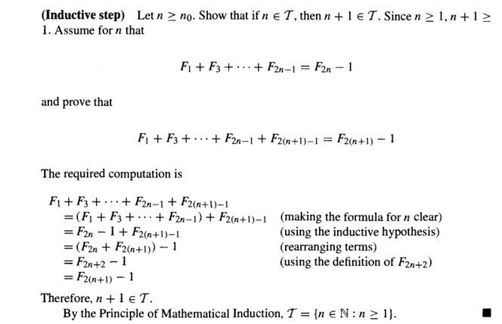
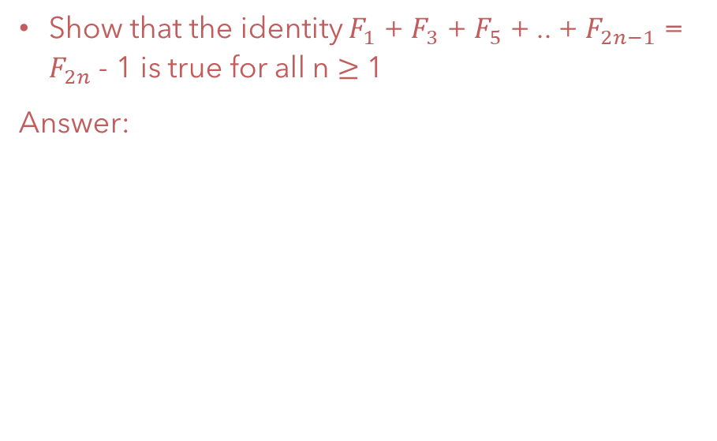
Prove by Induction
Show that the identity $F_{1}$ + $F_{3}$ + $F_{5}$ + .. + $F_{2n−1}$ = $F_{2n}$ - 1 is true for all n $≥$ 1
Answer:

Slide 11
Thank you

