Slide 1
Introduction to
Databases with SQL
Relating

Slide 2


Slide 3
sqlite3 FILENAME

Slide 4
.tables

Slide 5
Relational Databases

Slide 6
authors
books
name
title
Eva Baltasar
Boulder
Han Kang
The White Book
Gauz
Standing Heavy
Olga Tokarczuk
Flights

Slide 7
name
title
Eva Baltasar
Boulder
Han Kang
The White Book
Gauz
Standing Heavy
Olga Tokarczuk
Flights

Slide 8
name
title
Eva Baltasar
Boulder
Han Kang
The White Book
Gauz
Standing Heavy
Olga Tokarczuk
Flights
Olga Tokarczuk
The Books of Jacob

Slide 9
authors
books
name
title
Eva Baltasar
Boulder
Han Kang
The White Book
Gauz
Standing Heavy
Olga Tokarczuk
Flights

Slide 10
book
author

Slide 11
books
author

Slide 12
books
authors

Slide 13
One-to-one One-to-many Many-to-many

Slide 14
Entity Relationship Diagrams

Slide 15
ER Diagrams

Slide 16
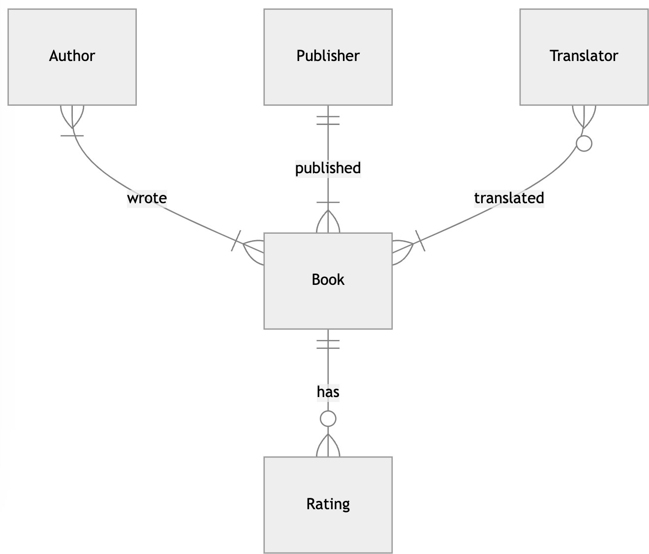

Slide 17
Zero
One
Many

Slide 18
Book
Author

Slide 19
Book
Author

Slide 20
Book
Author

Slide 22
Keys

Slide 23
The Birthday Party
The Birthday Party
Wendy Dranfield | Paperback
The Birthday Party
Laurent Mauvignier | Hardcover

Slide 24
The Birthday Party by Laurent Mauvignier
The Birthday Party
Laurent Mauvignier | Hardcover
The Birthday Party
Laurent Mauvignier | Paperback

Slide 25
The | Birthday | Party | by | Laurent | Mauvignier
in | paperback
The Birthday Party
Laurent Mauvignier | Paperback | 1st edition
The Birthday Party
Laurent Mauvignier | Paperback | 2nd edition

Slide 26
ISBN

Slide 27
978-1-80427-022-6

Slide 28
Primary Key

Slide 29
books
isbn
title
9788439736967
Boulder
9780525573067
The White Book
9781529414431
Standing Heavy
9781910695432
Flights

Slide 30
Foreign Key

Slide 31
ratings
isbn | rating
9788439736967 | 4
9788439736967 | 3
9788439736967 | 5
9780525573067 | 2
9780525573067 | 3
9781529414431 | 4
9781910695432 | 5
9781910695432 | 4
books
isbn
title
9788439736967
Boulder
9780525573067 The White Book
9781529414431
Standing Heavy
9781910695432
Flights

Slide 32
One-to-many

Slide 33
ratings
isbn | rating
9788439736967 | 4
9788439736967 | 3
9788439736967 | 5
9780525573067 | 2
9780525573067 | 3
9781529414431 | 4
9781910695432 | 5
9781910695432 | 4
books
isbn
title
9788439736967
Boulder
9780525573067 The White Book
9781529414431
Standing Heavy
9781910695432
Flights

Slide 34
978-1-80427-022-6

Slide 35
9781804270226

Slide 36
1

Slide 37
ratings
isbn | rating
9788439736967 | 4
9788439736967 | 3
9788439736967 | 5
9780525573067 | 2
9780525573067 | 3
9781529414431 | 4
9781910695432 | 5
9781910695432 | 4
books
isbn
title
9788439736967
Boulder
9780525573067 The White Book
9781529414431
Standing Heavy
9781910695432
Flights

Slide 38
ratings
book_id | rating
1 | 4
1 | 3
1 | 5
74 | 2
74 | 3
4 | 4
78 | 5
78 | 4
books
id | isbn | title
1 | 9788439736967 | Boulder
74 | 9780525573067 | The White Book
4 | 9781529414431 | Standing Heavy
78 | 9781910695432 | Flights

Slide 39
Many-to-many

Slide 40
books
authors
authored
id | name |  |  | author_id | book_id |  |  |  | id | isbn | title
23 | Eva Baltasar |  |  | 23 | 1 |  |  |  | 1 | ... | Boulder
31 | Han Kang |  |  | 31 | 74 |  |  |  | 74 | ... | The White Book
27 | Gauz |  |  | 27 | 4 |  |  |  | 4 | ... | Standing Heavy
58 | Olga Tokarczuk |  |  | 58 | 78 |  |  |  | 78 | ... | Flights

Slide 41
Break

Slide 42
Subqueries

Slide 43
One-to-many

Slide 44
books
publisher_id
title
5
Minor Detail
5
Paradais
33
Love in the New …
…
…

Slide 45
publishers
books
id
publisher
publisher_id
title
5
Fitzcarraldo Editions
5
Minor Detail
22
Seagull Books
5
Paradais
33 Yale University Press
33
Love in the New …
…
…
…
…

Slide 46
publishers
books
id
publisher
publisher_id
title
5
Fitzcarraldo Editions
5
Minor Detail
22
Seagull Books
5
Paradais
33 Yale University Press
33
Love in the New …
…
…
…
…

Slide 47
publishers
books
id
publisher
publisher_id
title
5
Fitzcarraldo Editions
5
Minor Detail
22
Seagull Books
5
Paradais
33 Yale University Press
33
Love in the New …
…
…
…
…

Slide 48
SELECT "id" FROM "publishers"
WHERE "publisher" = 'Fitzcarraldo Editions';

Slide 49
SELECT "title" FROM "books" WHERE "publisher_id" = 5;

Slide 50
SELECT "title" FROM "books" WHERE "publisher_id" = (
SELECT "id" FROM "publishers"
WHERE "publisher" = 'Fitzcarraldo Editions'
);

Slide 51
Many-to-many

Slide 52
books
authors
authored
id | name |  | author_id | book_id |  | id | isbn | title
23 | Eva Baltasar |  | 23 | 1 |  | 1 | ... | Boulder
31 | Han Kang |  | 31 | 74 |  | 74 | ... | The White Book
27 | Gauz |  | 27 | 4 |  | 4 | ... | Standing Heavy
58 | Olga Tokarczuk |  | 58 | 78 |  | 78 | ... | Flights

Slide 53
books
authors
authored
id | name |  | author_id | book_id |  |  | id | isbn | title
23 | Eva Baltasar |  | 23 | 1 |  |  | 1 | ... | Boulder
31 | Han Kang |  | 31 | 74 |  |  | 74 | ... | The White Book
27 | Gauz |  | 27 | 4 |  |  | 4 | ... | Standing Heavy
58 | Olga Tokarczuk |  | 58 | 78 |  |  | 78 | ... | Flights

Slide 54
books
authors
authored
id | name |  | author_id | book_id |  |  |  | id | isbn | title
23 | Eva Baltasar |  | 23 | 1 |  |  |  | 1 | ... | Boulder
31 | Han Kang |  | 31 | 74 |  |  |  | 74 | ... | The White Book
27 | Gauz |  | 27 | 4 |  |  |  | 4 | ... | Standing Heavy
58 | Olga Tokarczuk |  | 58 | 78 |  |  |  | 78 | ... | Flights

Slide 55
books
authors
authored
id | name |  |  | author_id | book_id |  |  |  | id | isbn | title
23 | Eva Baltasar |  |  | 23 | 1 |  |  |  | 1 | ... | Boulder
31 | Han Kang |  |  | 31 | 74 |  |  |  | 74 | ... | The White Book
27 | Gauz |  |  | 27 | 4 |  |  |  | 4 | ... | Standing Heavy
58 | Olga Tokarczuk |  |  | 58 | 78 |  |  |  | 78 | ... | Flights

Slide 56
books
authors
authored
id | name |  |  | author_id | book_id |  |  |  | id | isbn | title
23 | Eva Baltasar |  |  | 23 | 1 |  |  |  | 1 | ... | Boulder
31 | Han Kang |  |  | 31 | 74 |  |  |  | 74 | ... | The White Book
27 | Gauz |  |  | 27 | 4 |  |  |  | 4 | ... | Standing Heavy
58 | Olga Tokarczuk |  |  | 58 | 78 |  |  |  | 78 | ... | Flights

Slide 57
SELECT "id" FROM "books" WHERE "title" = 'Flights';

Slide 58
SELECT "author_id" FROM "authored" WHERE "book_id" = (
SELECT "id" FROM "books" WHERE "title" = 'Flights'
);

Slide 59
SELECT "name" FROM "authors" WHERE "id" = (
SELECT "author_id" FROM "authored" WHERE "book_id" = (
SELECT "id" FROM "books" WHERE "title" = 'Flights'
)
);

Slide 60
IN

Slide 61
books
authors
authored
id | name |  | author_id | book_id |  | id | isbn | title
23 | Eva Baltasar |  | 23 | 1 |  | 1 | ... | Boulder
31 | Han Kang |  | 31 | 74 |  | 74 | ... | The White Book
27 | Gauz |  | 27 | 4 |  | 4 | ... | Standing Heavy
58 | Olga Tokarczuk |  | 58 | 78 |  | 78 | ... | Flights

Slide 62
books
authors
authored
id | name |  | author_id | book_id |  | id | isbn | title
23 | Eva Baltasar |  | 23 | 1 |  | 1 | ... | Boulder
31 | Han Kang |  | 31 | 74 |  | 74 | ... | The White Book
27 | Gauz |  | 27 | 4 |  | 4 | ... | Standing Heavy
58 | Olga Tokarczuk |  | 58 | 78 |  | 78 | ... | Flights

Slide 63
books
authors
authored
id | name |  |  | author_id | book_id |  | id | isbn | title
23 | Eva Baltasar |  |  | 23 | 1 |  | 1 | ... | Boulder
31 | Han Kang |  |  | 31 | 74 |  | 74 | ... | The White Book
27 | Gauz |  |  | 27 | 4 |  | 4 | ... | Standing Heavy
58 | Olga Tokarczuk |  |  | 58 | 78 |  | 78 | ... | Flights

Slide 64
books
authors
authored
id | name |  |  | author_id | book_id |  |  | id | isbn | title
23 | Eva Baltasar |  |  | 23 | 1 |  |  | 1 | ... | Boulder
31 | Han Kang |  |  | 31 | 74 |  |  | 74 | ... | The White Book
27 | Gauz |  |  | 27 | 4 |  |  | 4 | ... | Standing Heavy
58 | Olga Tokarczuk |  |  | 58 | 78 |  |  | 78 | ... | Flights

Slide 65
books
authors
authored
id | name |  |  | author_id | book_id |  |  |  | id | isbn | title
23 | Eva Baltasar |  |  | 23 | 1 |  |  |  | 1 | ... | Boulder
31 | Han Kang |  |  | 31 | 74 |  |  |  | 74 | ... | The White Book
27 | Gauz |  |  | 27 | 4 |  |  |  | 4 | ... | Standing Heavy
58 | Olga Tokarczuk |  |  | 58 | 78 |  |  |  | 78 | ... | Flights

Slide 66
Joins

Slide 67
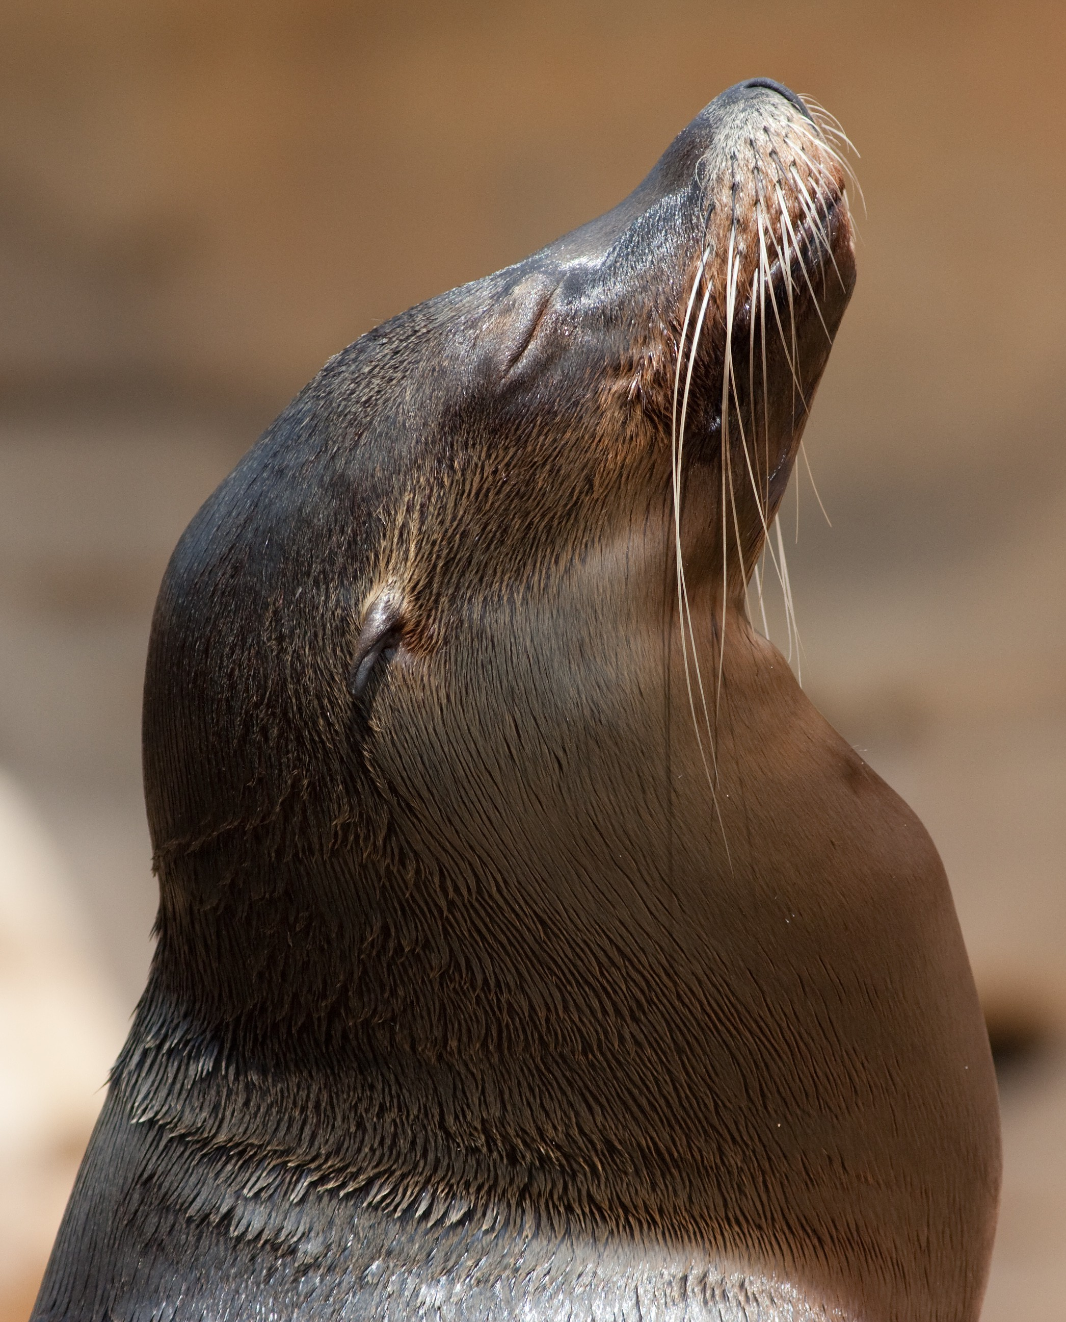

Slide 68
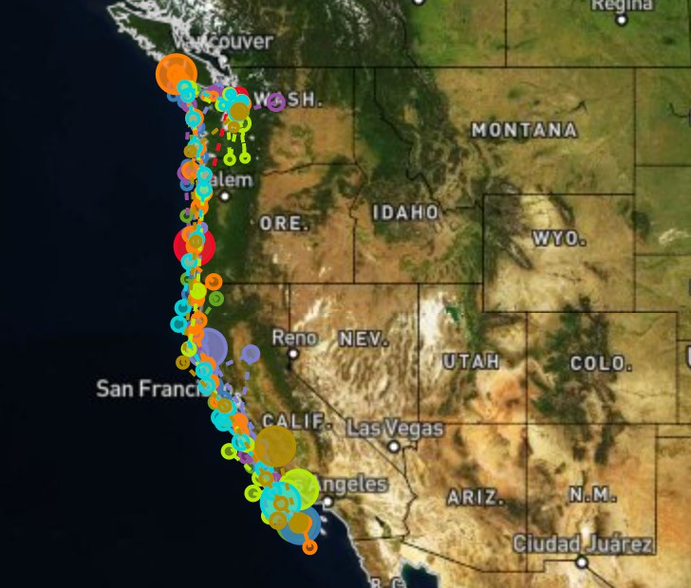

Slide 69
migrations
sea lions
id name
10484 Ayah
11728 Spot
11729 Tiger
11732 Mabel
11734 Rick
11790 Jolee
id | distance | days
10484 | 1000 | 107
11728 | 1531 | 56
11729 | 1370 | 37
11732 | 1622 | 62
11734 | 1491 | 58
11735 | 2723 | 82
11736 | 1571 | 52
11737 | 1957 | 92

Slide 70
migrations
sea lions
 | id | distance | days
 | 10484 | 1000 | 107
 | 11728 | 1531 | 56
 | 11729 | 1370 | 37
 | 11732 | 1622 | 62
 | 11734 | 1491 | 58
 | 11735 | 2723 | 82
 | 11736 | 1571 | 52
 | 11737 | 1957 | 92
id
name
10484
Ayah
11728
Spot
11729
Tiger
11732
Mabel
11734
Rick
11790
Jolee

Slide 71
sea lions JOIN migrations
 | id | name | id | distance | days
 | 10484 | Ayah | 10484 | 1000 | 107
 | 11728 | Spot | 11728 | 1531 | 56
 | 11729 | Tiger | 11729 | 1370 | 37
 | 11732 | Mabel | 11732 | 1622 | 62
 | 11734 | Rick | 11734 | 1491 | 58

Slide 72
JOIN

Slide 73
INNER JOIN

Slide 74
id | name
10484 | Ayah
11728 | Spot
11790 | Jolee
id | distance
10484 | 1000
11728 | 1531
11735 | 2723

Slide 75
id | name | id | distance
10484 | Ayah | 10484 | 1000
11728 | Spot | 11728 | 1531
11790 | Jolee | 11735 | 2723

Slide 76
id | name | id | distance
10484 | Ayah | 10484 | 1000
11728 | Spot | 11728 | 1531

Slide 77
LEFT JOIN RIGHT JOIN FULL JOIN

Slide 78
LEFT OUTER JOIN RIGHT OUTER JOIN FULL OUTER JOIN

Slide 79
LEFT OUTER JOIN

Slide 80
id | name
10484 | Ayah
11728 | Spot
11790 | Jolee
id | distance
10484 | 1000
11728 | 1531
11735 | 2723

Slide 81
id | name | id | distance
10484 | Ayah | 10484 | 1000
11728 | Spot | 11728 | 1531
11790 | Jolee
 |  | 11735 | 2723

Slide 82
id | name | id | distance
10484 | Ayah | 10484 | 1000
11728 | Spot | 11728 | 1531
11790 | Jolee | NULL | NULL
NULL | NULL | 11735 | 2723

Slide 83
id | name | id | distance
10484 | Ayah | 10484 | 1000
11728 | Spot | 11728 | 1531
11790 | Jolee | NULL | NULL

Slide 84
RIGHT OUTER JOIN

Slide 85
id | name
10484 | Ayah
11728 | Spot
11790 | Jolee
id | distance
10484 | 1000
11728 | 1531
11735 | 2723

Slide 86
id | name | id | distance
10484 | Ayah | 10484 | 1000
11728 | Spot | 11728 | 1531
11790 | Jolee
 |  | 11735 | 2723

Slide 87
id | name | id | distance
10484 | Ayah | 10484 | 1000
11728 | Spot | 11728 | 1531
11790 | Jolee | NULL | NULL
NULL | NULL | 11735 | 2723

Slide 88
id | name | id | distance
10484 | Ayah | 10484 | 1000
11728 | Spot | 11728 | 1531
NULL | NULL | 11735 | 2723

Slide 89
FULL JOIN

Slide 90
id | name
10484 | Ayah
11728 | Spot
11790 | Jolee
id | distance
10484 | 1000
11728 | 1531
11735 | 2723

Slide 91
id | name | id | distance
10484 | Ayah | 10484 | 1000
11728 | Spot | 11728 | 1531
11790 | Jolee
 |  | 11735 | 2723

Slide 92
id | name | id | distance
10484 | Ayah | 10484 | 1000
11728 | Spot | 11728 | 1531
11790 | Jolee | NULL | NULL
NULL | NULL | 11735 | 2723

Slide 93
NATURAL JOIN

Slide 94
Break

Slide 95
Sets

Slide 96


Translators
Authors

Slide 97

Translators
Authors

Slide 98

Translators
Authors

Slide 99

Translators
Authors

Slide 100
Authors
Translators
Authors INTERSECT Translators

Slide 101

Translators
Authors

Slide 102
Authors
Translators
Authors UNION Translators

Slide 103

Translators
Authors

Slide 104
Authors
Translators
Authors EXCEPT Translators

Slide 105

Translators
Authors

Slide 106
Authors
Translators
Translators EXCEPT Authors

Slide 107

Translators
Authors

Slide 108
Groups

Slide 109
book_id | rating
1 | 4
1 | 3
1 | 4
2 | 2
2 | 3

Slide 110
book_id | rating
1 | 4
1 | 3
1 | 4
2 | 2
2 | 3

Slide 111
book_id
rating
1
43
2
32

Slide 112
book_id
average rating
1
3.67
2
2.5

Slide 113
GROUP BY

Slide 114
HAVING

Slide 115
Introduction to
Databases with SQL
Relating

